Slide 1


Notes:
Good afternoon! (Introduce myself)
Welcome to our 2024 mentorship kick-off! Before we started, we’d like to give you some updates from WofA National. To start this, let me introduce fellow board member, Ashley Batson.

Slide 2
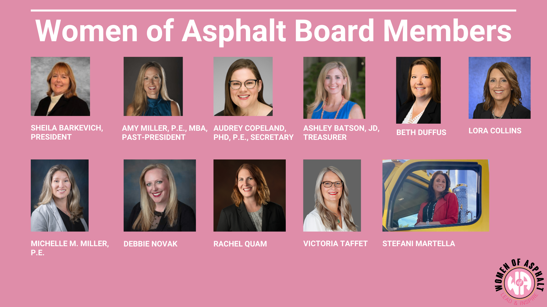

Slide 3


Slide 4
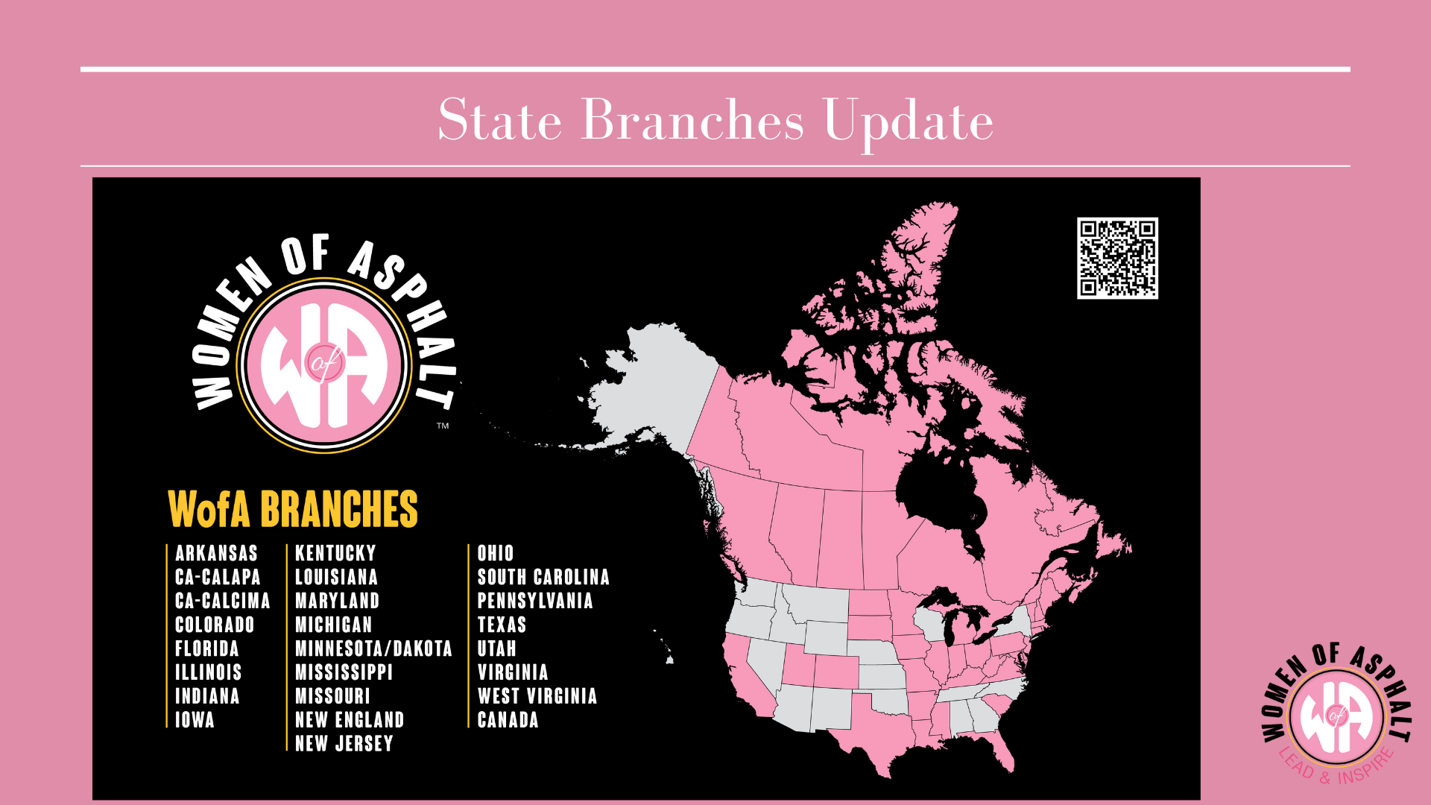

Slide 5

Notes:
WofA goals include: AWARENESS - Increasing awareness of opportunities in the industry. KNOWLEDGE - Elevating knowledge through education and resources. COMMUNITY - Providing platforms to create supportive relationships and growth.
With these goals in mind, we are proud that this program’s reach has extended so far!
A lot of hard work goes into the matching process, and I would like to thank everyone on our mentorship committee for all their hard work and time spent doing this.
It is the responsibility of the Mentor to reach out to the Mentee first. If this has not happened yet, please feel free to email your mentor to request a meeting.

Slide 6

Notes:
Here are some of the benefits of the mentorship program. (read slide)

Slide 7
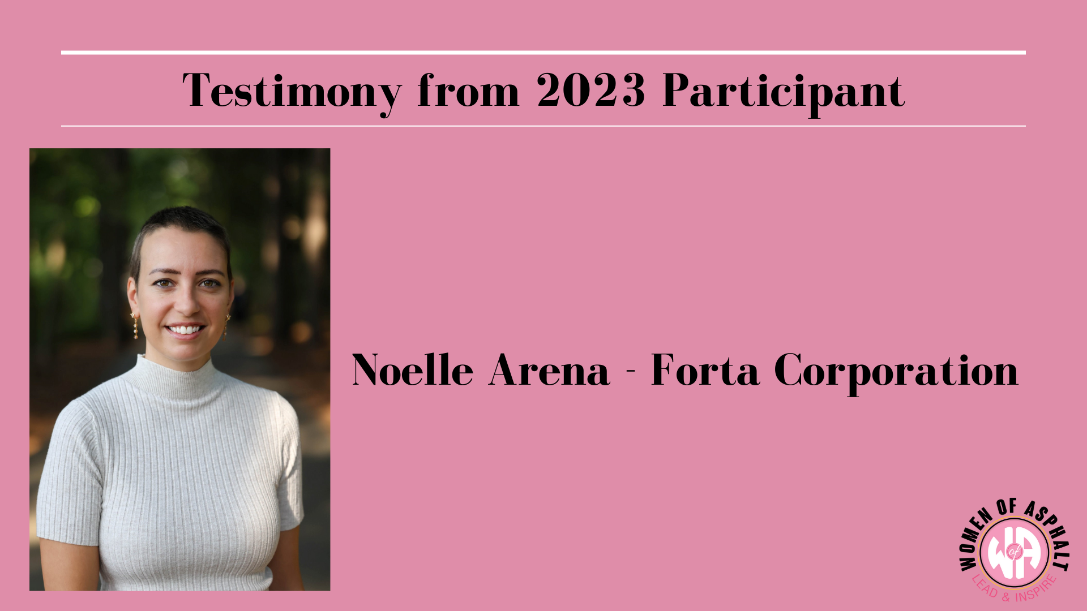


Notes:
Noelle Arena is the NC/SC Sales Representative for Forta Corp. She works with owners, engineers, and producers to provide asphalt reinforcement solutions that contribute to long-lasting and sustainable pavements. She is also very proud to serve as the Chair for the Women of Asphalt SC Branch. She has been in the industry for 2 years. She started with Pacific GeoSource which was acquired by Forta in July 2023.

Slide 8
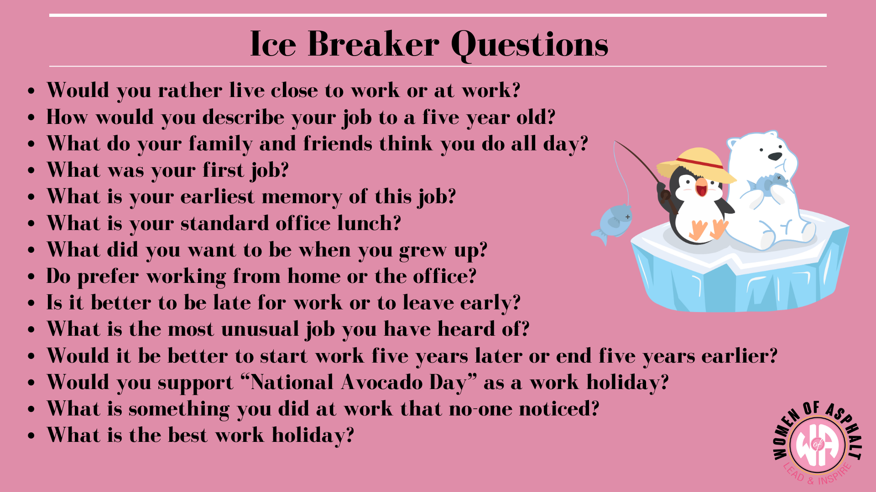
Notes:
Not all of us are extroverts and starting conversations may be difficult. Here are some questions you can use to get the ball rolling. Once you get started and get to know each other better, hopefully you’ll both be more at ease and conversation will no longer be difficult but something you look forward to!

Slide 9

Notes:
We wanted to do something a little different this year and make the kick-off more interactive. If you have a phone, you can use the QR code to join our trivia. Elle Meitl ran this at our MAPA conference last month and everyone seemed to enjoy it. Hope you do too!

Slide 10
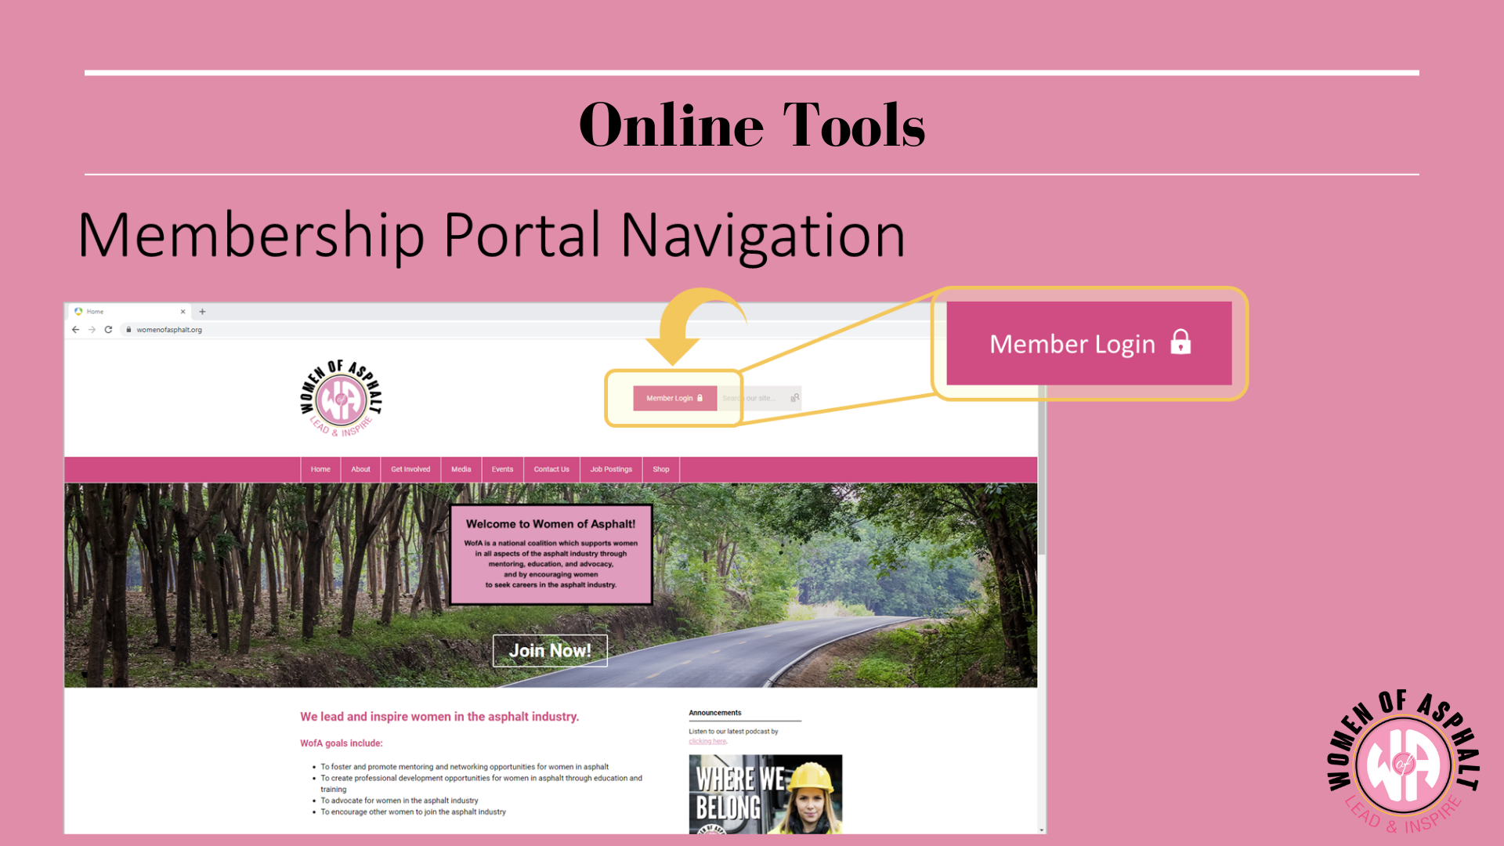
Notes:
Now that we’ve gone over how to get started and tips for easing into conversation, we want to make you aware of the online resources available to you. As a member of WofA, you have a number of valuable tools at your disposal online. This slide and the next, guide you to them.

Slide 11
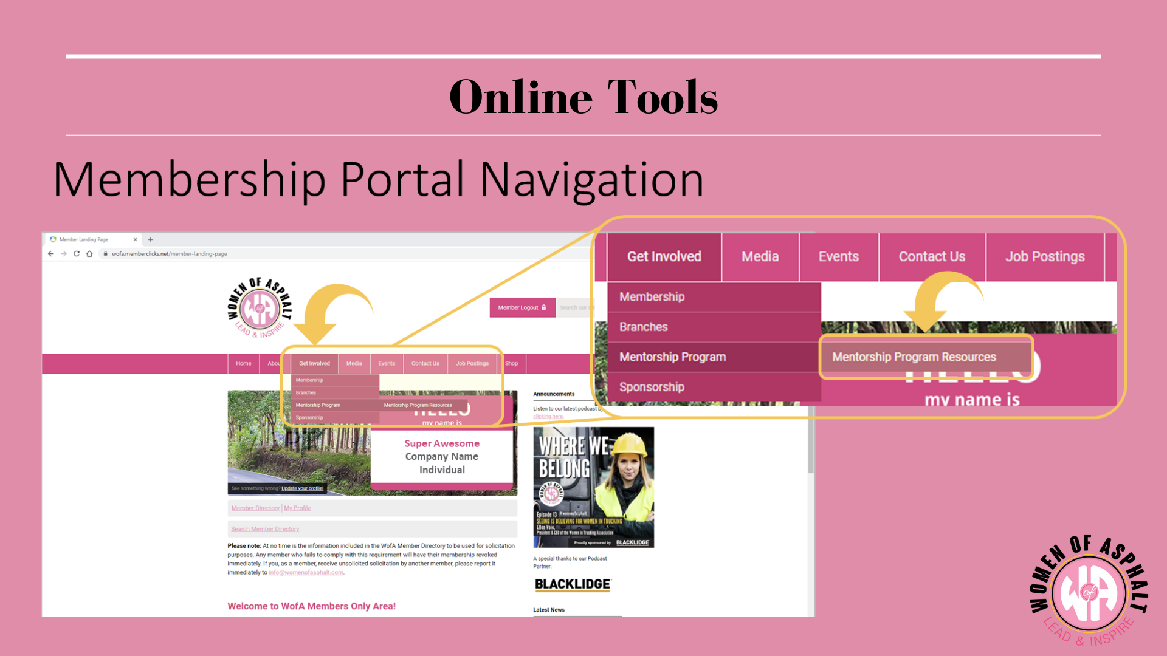
Notes:
Please take advantage of them. Most, if not all, of your questions can be answered on here. But we are also here for you, should you need anything further.

Slide 12

Notes:
Again, it is the responsibility of the Mentor to reach out to the Mentee first. If this has not yet happened, please feel free to email your mentor to request a meeting.
If you are not successful in connecting with your mentor or mentee, or if any issues arise, please feel free to reach out to us for help. The contact information is provided above and will also be noted on our website in the same section as the mentorship tools.

