Slide 1

WELCOME

Slide 2
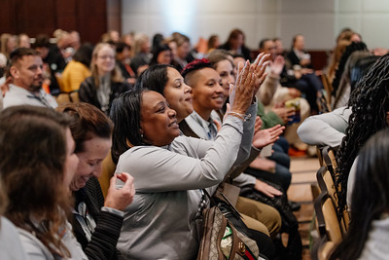
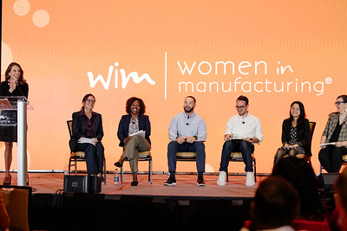
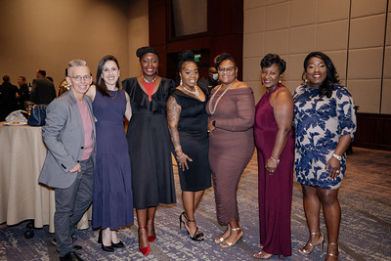
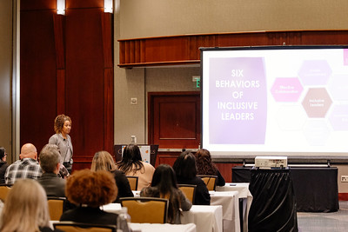
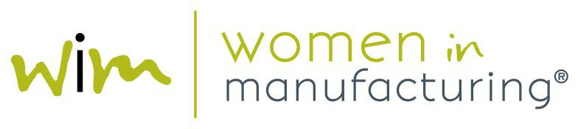
AGENDA
MEMBERSHIP OVERVIEW
WEBSITE TOUR
BREAKOUT ROOMS
5 WAYS – 30 DAYS

Slide 3
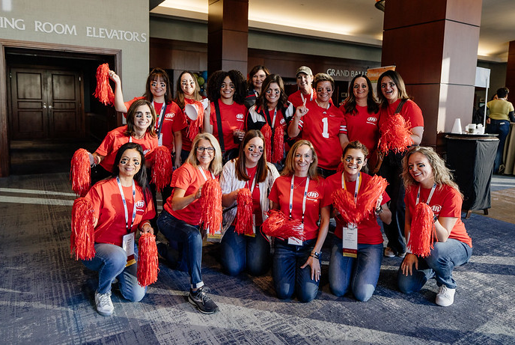
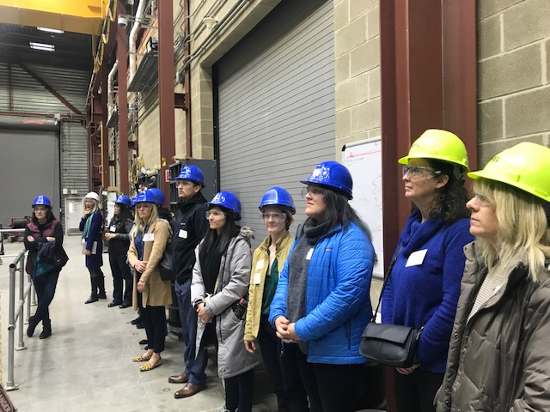
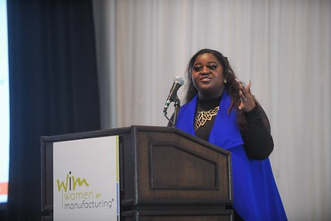
WHO WE ARE
OUR MEMBERS
EVENTS & CONFERENCES
LOCAL CONNECTIONS
RECRUITMENT & CAREER RESOURCES
WiM EDUCATION FOUNDATION
Notes:
WiM is the only national organization dedicated to providing year-round support to women who have chosen a career in the manufacturing industry.
2010: Formed as Women in Metalforming, held first SUMMIT.
2011: Changed name to Women in Manufacturing.
2015: Official 501c6 status.
2016: Established the WiM Education Foundation, 501c3 arm of WiM that powers our leadership development programs.
Led by 20-person Board of Directors and a staff of twelve.
WiM’s mission is to support, promote and inspire women who have chosen a career in the manufacturing industry.
Support women in the industry as they work to advance in their careers and deliver companies effective and powerful resources to recruit, retain and advance their female workforce.
Promote the great accomplishments of women in the industry and highlight modern manufacturing innovations.
Inspire current and future women in manufacturing careers.
Today I’ll cover how you as a member can take advantage of all the benefits available through our organization and provide you with actionable next steps to make the most of your experience in the WiM community!

Slide 4
OUR MEMBERS
31,000+
INDIVIDUAL MEMBERS
500+
CORPORATE MEMBERS
WELCOME TO OUR NEWEST CORPORATE MEMBERS!
Novo Nordisk Inc.
Wausau Tile
Industrial Motor Service
Action Industries
Teamforce AI
USG Corporation
R.A Jones
Owens Corning
BrightOrg Services
GOJO Industries, Inc.
Notes:
As a member of WiM, you are now part of a network of more than 31,000 women in manufacturing globally! WiM and our allies in manufacturing. Our membership ranks span all levels and industries within manufacturing, including: Aerospace, Automotive or Transportation, Agriculture, Food and Beverage, Chemicals or Pharmaceuticals – which happen to be the top 5 industries represented amongst WiM’s individual and corporate member companies.

Slide 5
MEMBER BENEFITS
FOR COMPANIES:
FOR INDIVIDUALS:
Ability to enroll an unlimited number of individuals in your company membership.
Special recognition in our WiM Weekly e-newsletter.
One free registration to both the Summer Leadership Conference and Winter Leadership Conference.
Logo and link on WiM’s website.
Discounted registration for 501(c)(3)-powered programming (i.e. Leadership Institute, Management Development Program, etc.).
First right-of-refusal to sponsor WiM national events and programs.
1-10 free job posting credits on WiM's job board, WiMWorks, based on membership tier.
Discounted registration to WiM national and local events and programs.
Free monthly webinars via the Virtual Learning Series
Access to our Virtual Learning Library with over 100+ hours of content available.
A professional profile on the only directory of women in manufacturing.
Discounts to post or seek job opportunities on WiMWorks, our WiM-powered job board.
Ability to use the “Proud Member of WiM” logo.
Affinity partnership discounts and savings.

Slide 6
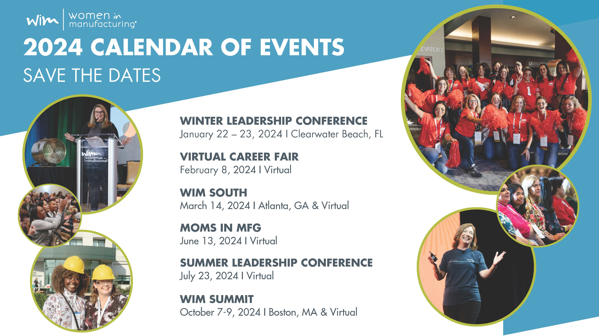
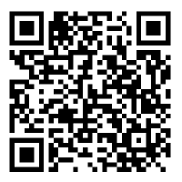
EVENTS & CONFERENCES
SCAN FOR ALL EVENTS
2025
Virtual Career Fair
February 6, 2025 | Virtual
Winter Leadership Conference
February 17-18, 2025 | Clearwater Beach, FL
Men as Allies
February 19-20, 2025 | Clearwater Beach, FL
WiM West
March 10, 2025 | Seattle, WA
Moms in MFG
May 8, 2025 | Virtual
WiM SUMMIT
October 12-14, 2025 | Chicago, IL & Virtual
Notes:
LINK - MOMS LinkedIn Group: https://www.linkedin.com/groups/14348629/
WLC:
Twice annually, WiM hosts seasonal Leadership Conferences for our Corporate members and their employees. Typically taking place in the Summer and Winter, these events bring together our corporate member community together to discuss how their companies are maximizing their member benefits and creating inclusive working environments for women. Each corporate member can send one company representative to both the Summer and Winter Leadership Conferences for free and additional attendees can be registered for a fee.
MEN AS ALLIES:
Men as Allies Conference will serve as a thought-provoking platform for participants to discuss the crucial role of men as allies in the manufacturing industry. Experts in the field will present evidence-based arguments and real-world examples to demonstrate the advantages of diversity, equity, and inclusion in manufacturing. Attendees will learn and discuss strategies and best practices to actively support and champion women in the manufacturing industry, thereby contributing to the creation of lasting change within their organizations.
WEST:
WiM West is a regional conference for manufacturing professionals who are navigating the way through their careers—whether it be in production, the C-Suite, or anywhere in between. WiM Regional Conferences offer attendees industry content from regional thought leaders and manufacturers, as well as opportunities to interact and engage, network with peers in their region. Registration for WiM West will open soon and our team is actively seeking sponsors and speakers for this event. Contact meetings@womeninmfg.org to learn more!
MOMS:
Many members of the WiM community play this dual role in life – manufacturing professional and mom or caregiver. This is why we launched our first-ever event dedicated to working moms and caregivers in manufacturing in August 2021. Our most recent Moms in MFG conference took place on June 13 and attracted more than 700 virtual participants. The agenda included education tracks for both caregivers and employers and popular sessions included Creating & Leveraging ERGs to Support Moms in Manufacturing and Empowering Mothers Through Pregnancy & Beyond. The next Moms in MFG conference will be scheduled soon for 2025, but WiM invites all moms and caregivers in MFG to stay connected and share resources and support year-round in our LinkedIn community.
SUMMIT:
2,000+ Attendees – LARGEST SUMMIT EVER!
60+ Breakout Sessions
5 Keynotes - Sam Rapoport, Senior Director of Diversity, Equity, and Inclusion, National Football League (NFL)
20 Plant Tours
50+ Exhibitors at the first-ever WiM Expo
Group rates for Corporate member companies.
October 12-14, 2025 in Chicago, IL

Slide 7

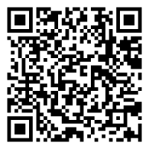
CLICK OR SCAN TO LEARN MORE
February 12, 2025 | Monterrey, Mexico
  Hosted by AFL and Donaldson
  Registration OPEN NOW!
UPCOMING
EVENTS
Notes:
WEBSITE - https://www.womeninmanufacturing.org/international-womens-network
INTEREST FORM - https://womeninmfg.wufoo.com/forms/x16zt9z60zyeeah/
First IWN event held March 3, 2023 was held with support from John Deere at their facility in Germany. Since then, the WiM team have traveled to Tokyo, Montenegro Brazil, Barcelona, and Canada to co-host events with corporate members in those regions, with the primary goal of uniting women in the manufacturing industry abroad. These events typically consist of an agenda of speakers from regional manufacturing companies, a tour of the host facility, and conclude with a networking reception.
Our next international WiM event will be in Monterrey, Mexico on February 10, 2025, for a co-sponsored tour and networking event with AFL and Donaldson. Registration is now open!
To register for these events, visit the IWN page of our website and if you would like to be kept informed about future IWN events or potentially host one with your company, you can complete the interest form linked on our website on the International Women’s Network page.

Slide 8
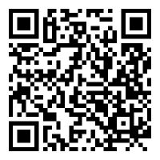
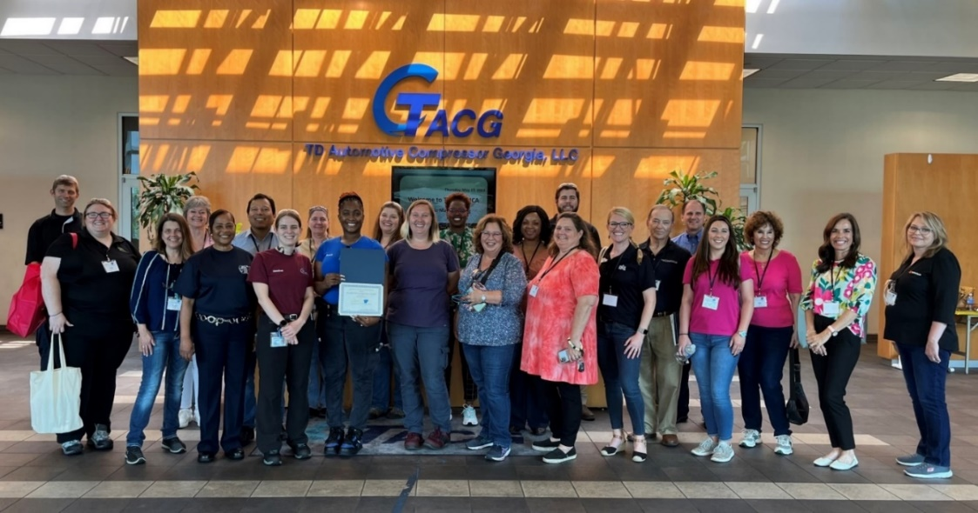
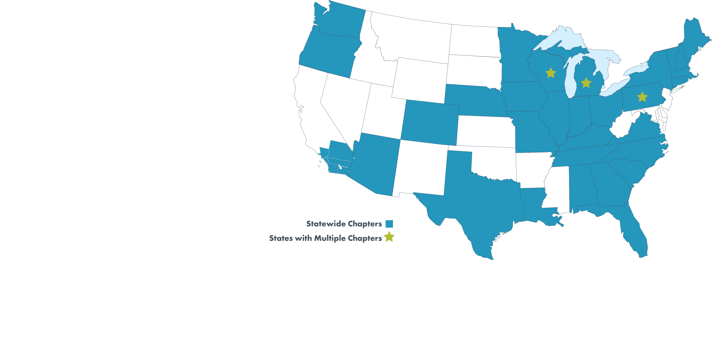
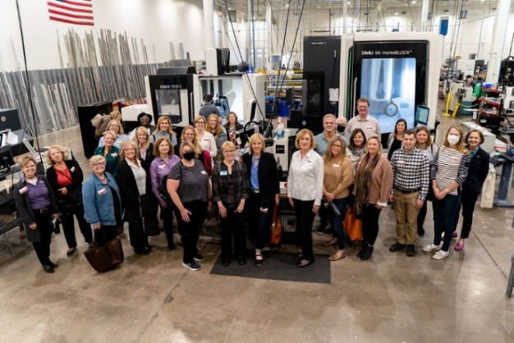
LOCAL CONNECTIONS
CLICK OR SCAN TO FIND A CHAPTER
34 WiM CHAPTERS
320+ VOLUNTEER MEMBERS
375+ EVENTS ANNUALLY
Notes:
CHAPTERS: https://www.womeninmanufacturing.org/chapters/wim-chapters
CH EVENTS: https://www.womeninmanufacturing.org/events/chapter-events
In the U.S., WiM Chapters fulfill our mission to support, promote and inspire women in manufacturing on the local level. Current members are eligible to events from ANY chapter at a discount and sometimes for free. Member can also volunteer to join our rapidly growing ranks of 320+ volunteer chapter leaders, who plan events and connect members with opportunities to network and learn locally. Most of our chapters recruit new leaders on an ongoing basis, so there is always an opportunity to lead with WiM. Members can connect with their chapter directly via the leadership page for each chapter or via the Chapter Directory on our website, where members can reach out to the primary contact for each chapter.

Slide 9
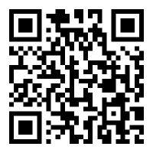
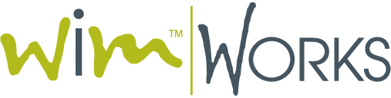
RECRUITMENT RESOURCES
CLICK OR SCAN TO VISIT WiM WORKS
EMPLOYER BENEFITS
Access highly qualified professional candidates.
Generate high return on recruitment advertisement spending.
Easy-to-use job posting and resume searching capabilities.
Access to job board networks for broader job distributions to qualified candidates.
Applicant tracking and management capabilities.
Internal messaging system automatically stores messages sent from the job seeker in the candidates’ file.
User friendly template system to reuse job postings, pre-screen filters and automatic letters and notifications.
To learn more about your company’s free posting, contact: membership@womeninmfg.org
Notes:
https://www.womeninmanufacturing.org/careers/wim-career-center
Advancing the careers of women in manufacturing is central to the mission of WiM. Our WiM Works career center and job board supports this aspect of our mission by connecting qualified candidates from the WiM community with manufacturing jobs from our network of corporate member companies. Depending on membership tier, each Corporate member company receives a number free posting to the WiM Works job board each year. Contact membership@womeninmfg.org to learn how many free postings your company has currently. Posting a job to WiM Works providers to job poster with access to applicant tracking, an internal messaging system that automatically stores messages sent from the job seeker in the candidates’ file, and resources like templates for job postings, pre-screen filters and automatic letters and notifications to candidates.

Slide 10
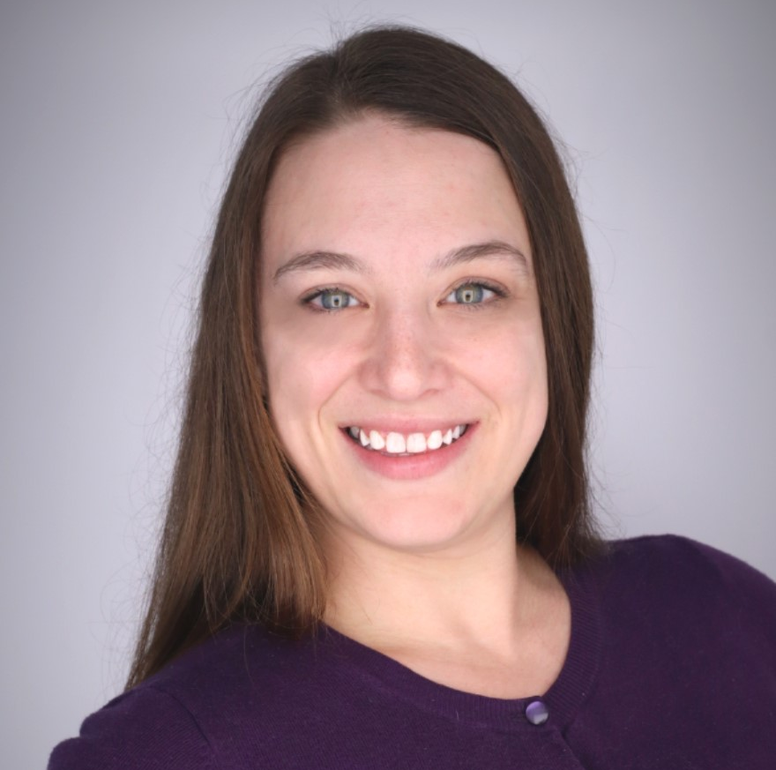


Welcome!
Alana Lesnansky
Program Coordinator
WiM Education Foundation
alesnansky@womeninmfg.org
Notes:
Hi everyone! My name is Alana Lesnansky and I am the Program Coordinator for the WiM Education Foundation, or WiM EF. Thank you so much for having me join you today to tell you a little more about what we are doing over at the Education Foundation.

Slide 11
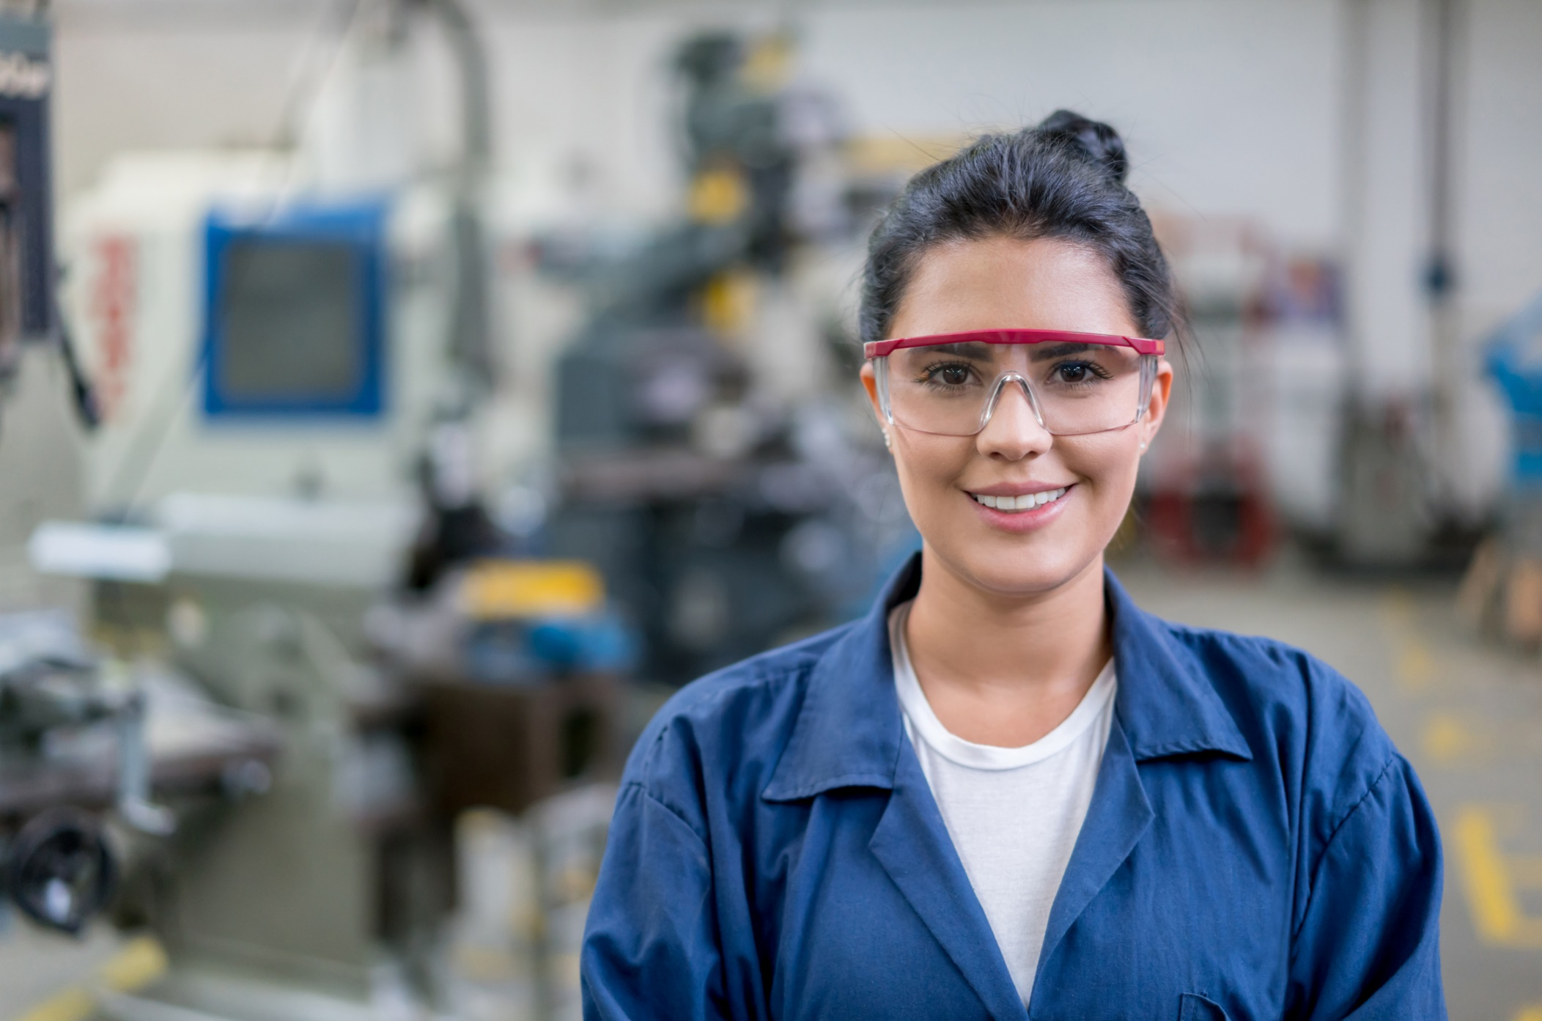

About WiM Education Foundation
  The WiM Education Foundation is WiM’s nonprofit (501c3) partner
  WiMEF provides women with valuable connections, access to career pathways, and best-in-class programming at all stages of their manufacturing careers
  Programming includes a monthly speaker series, three cohort-based leadership development programs, and a bi-annual virtual career fair
  Each year, more than 350 women graduate from WiMEF leadership development programs, 600 participate in the career fair, and 5,000 join our speaker series
Notes:
The WiMEF is the 501c3 nonprofit partner to WiM that was founded in 2016 to provide women with valuable connections, access to career pathways, and best-in-class programming at all stages of their manufacturing careers
We have a variety of programming that includes a monthly speaker series, three cohort-based leadership development programs, and a bi-annual virtual career fair. I will be getting into more detail on each of these programs in the following slides.
Each year, more than 350 women graduate from WiMEF leadership development programs, 600 participate in the career fair, and 5,000 join our speaker series. We are so proud to announce that we just reached a huge milestone in 2024 - more than 1,000 women have now participated in WiMEF leadership development programs, and we look forward to continuing to grow that number.

Slide 12
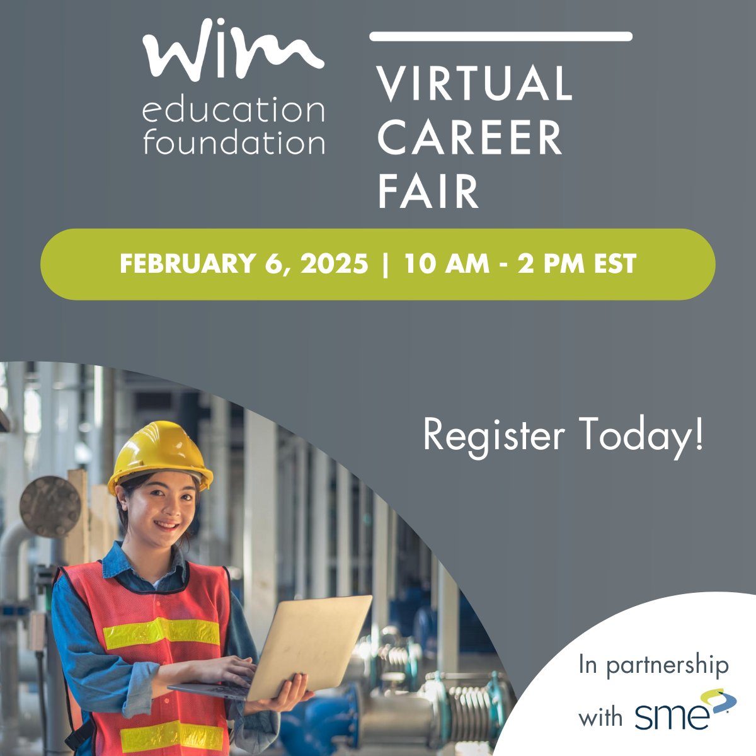
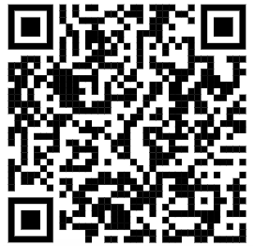
Virtual Career Fair
Bi-annual virtual career fair to connect job seeking women with national and regional manufacturing companies who are hiring today.
45 Employers
300+ Job Seekers
Production, operations, engineering, sales, marketing, HR, maintenance supervisor, controller, inventory control, quality technician, talent acquisition, etc.
Notes:
We are so excited to be hosting the Virtual Career Fair in partnership with SME on February 6th 2025. This program is the WiMEFs one and only recruiting event, and provides a streamlined and cost-effective process for employers and job seekers to connect one-on-one from across the country in a convenient, virtual platform. Employers have the opportunity to preview candidate resumes and information, schedule chats and conduct interviews, all while highlighting their company's culture, location and workplace benefits with a customizable booth and spot light add ons. Job seekers are able to browse through the virtual booths, showcase their resumes and engage with recruiters from top manufacturing companies for free from the convenience of their own device.
The career fair takes place February 6th from 10am-2pm eastern time; but we keep the employer booths and job lists open for 24 hours after the event to give additional time for connections. So if you, your company, or someone you know is interested, please scan the QR code below to learn more. I’ll also drop 3 links in the chat: 1 for the webpage where you can learn more information, 1 for the employer registration reminder, and one for the job seeker registration. Now for our education programs…

Slide 13
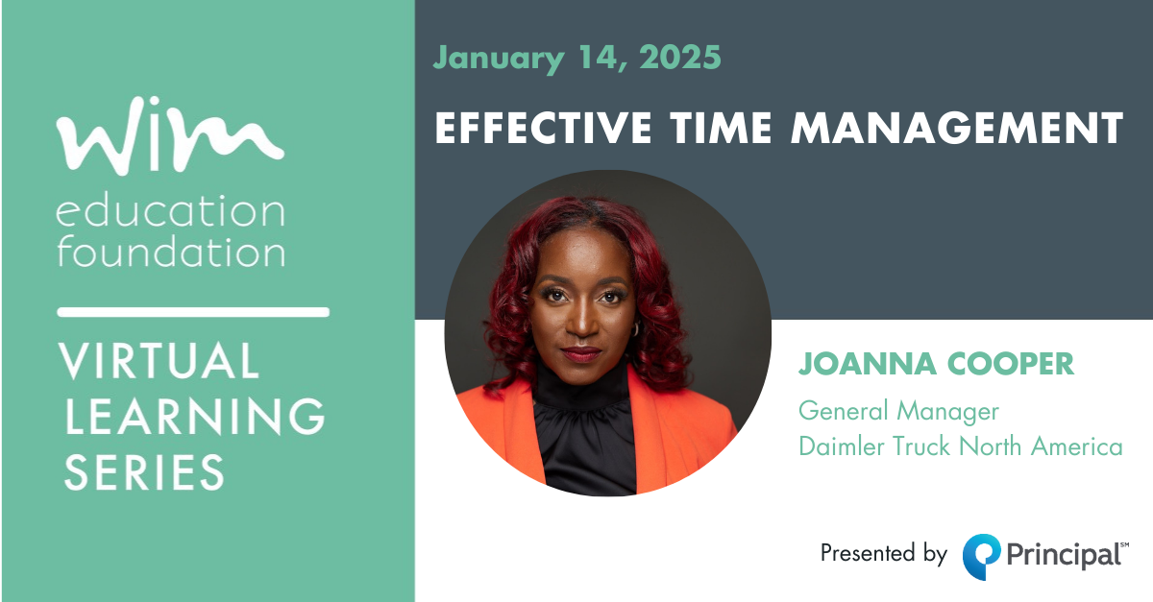

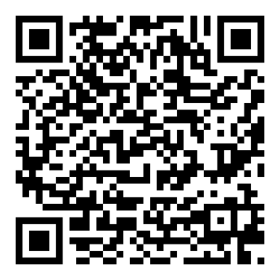
Virtual Learning
Live, monthly webinar exploring industry-related subjects relevant for women who work in manufacturing
Action-oriented and solution-driven objectives presented by diverse knowledge experts
Second Tuesday of each month 11:00 am ET
FREE to WiM members
Recordings are saved in the Virtual Learning Library and available to WiM members at any time
Notes:
We will start with our monthly webinars. The Virtual Learning Series consists of monthly webinars about various industry-related subjects relevant for women who work in manufacturing. They take place live on the second Tuesday of each month at 11 AM EST. Topics are geared towards cultivating leadership skills, and a carefully selected knowledge expert hosts each webinar. Each webinar includes action-oriented and solution-driven objectives to help participants succeed in the manufacturing sector.
Virtual Learning Series webinars are a free WiM-member benefit, made possible through the generosity of PrincipalSM. WiM members are encouraged to register for each learning opportunity (even if you can’t attend live), as all registrants receive a recording of the presentation immediately following each webinar. All webinars are recorded and archived in the Virtual Learning Library where they are available to WiM members at any time. These are just some examples of our past presentations.
Our January VLS yesterday was focused on Effective Time Management, and can now be found in the Virtual Library. Join us in February to hear Lori Highby chat about AI in manufacturing.

Slide 14
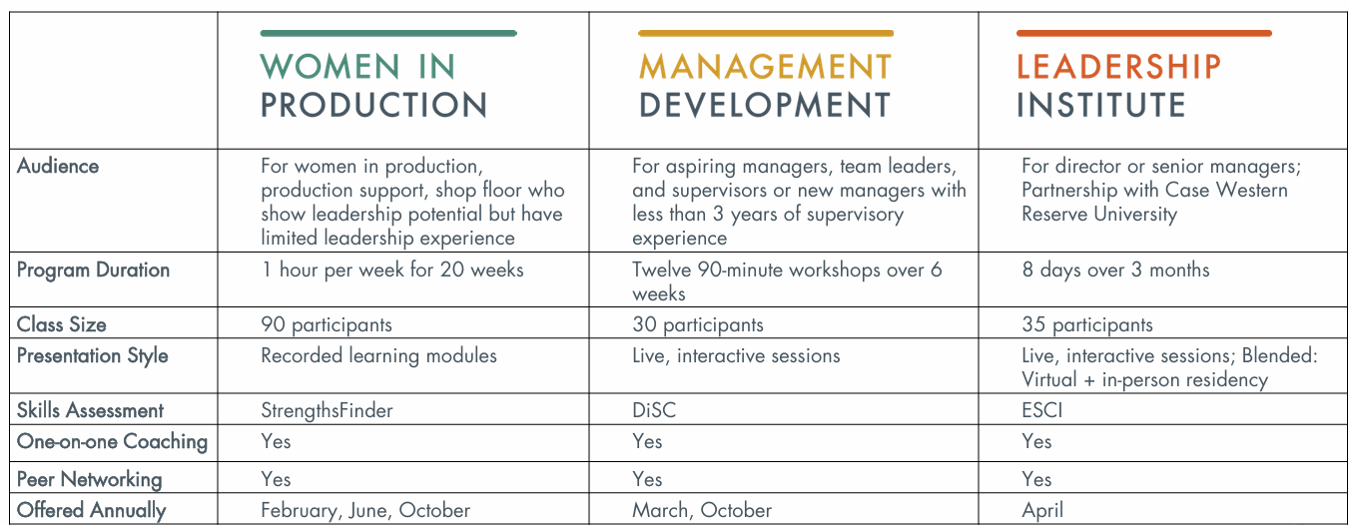
Educational Programs
Notes:
We also have three different cohort based educational programs. Each program consists of four components: coursework, a skills assessment like DiSC or Strengthsfinders, one-on-one coaching, and peer networking. The programs are specifically designed to support women at various stages throughout their manufacturing careers.
The Women in Production program is a 20-week course designed to support the professional development of production, production support, and shop floor employees. This program is best suited for newer team members or team leaders and/or those who are identified as having leadership potential but limited leadership experience. This is a 100% online program, where participants can learn at their own pace, with a roughly 60-minute time commitment per week. The coursework includes 13 modules based on 28 core competencies that manufacturers look for in their leaders including problem solving, communication skills, negotiation, time management, leadership fundamentals, customer service, emotional intelligence, safety orientation, networking and more. In addition to the online course, the program includes a StrengthsFinder assessment, one-on-one coaching and peer networking, culminating in a graduation ceremony where participants receive a certificate of completion. The next cohort begins in February and then again in June. We are excited to announce that the Women in Production Program is getting a Glow Up! Starting with our February cohort we will have all new presentations. I’ll drop a link to the WiP webpage where you can learn more information. Enrollment is now open for the February cohort, and is selling quickly.
The Management Development Program is geared towards new and aspiring supervisors, managers and team leaders with up to three years of experience. This course is100% virtual, but these are live, interactive sessions (as opposed to the mainly asynchronous approach that EWiP takes). Each 90-minute workshop is led by an expert facilitator and encourages active participation, idea sharing and peer interaction. The program supports two cohorts each year, limited to 30 participants each. This limited cohort size fosters a close-knit community of peers, providing a valuable network for ongoing support and career growth in the manufacturing industry even after the program concludes. Our next cohort will be spring of 2025, with registration open now. I will drop a link to the webpage in the chat.
And last but certainly not least, we have our Leadership Institute for Women in STEM and Manufacturing. This program is designed in partnership with Case Western Reserve University’s Weatherhead school of Management. It is designed for emerging and experienced leaders who have 3+ years of experience and one or more direct or indirect reports, like those who
Perform in a director or senior manager position
Head a functional effort (e.g., finance, operations, information technology, etc.) or business department
Lead a professional services firm, nonprofit organization, or government agency
Are shifting from a purely technical role to one that's supervisory, or are preparing for a senior leadership position
As part of a leadership cohort, participants learn from world-class professors and coaches, build strong relationships with individuals in similar career functions, and develop core skills that create a lasting impact on you and your company. The comprehensive curriculum includes topics ranging from negotiations, influence, and effective communication to managing multiple levels of strategy. The course also includes individualized executive coaching, 360-degree assessments and peer coaching, as well as an Emotional Social Competency Inventory (ESCI) assessment. The next cohort will begin in January of 2025 and registration is now open on our website (I’ll put a link in the chat).
I’ll also drop a link to our Education Programs reminder list where you can sign up for reminders for any of the specific programs and cohorts, or if you’d like to be reminded for all programs.

Slide 15

NAVIGATING THE WiM WEBSITE & MEMBER COMPASS

Slide 16
BREAKOUT ROOMS

Slide 17
BREAKOUT ROOMS
20 MINUTES TO CONNECT WITH FELLOW MEMBERS
Individual Introductions
  Each person shares:
    Name
    Geographic Location
    Current Employer & Role
    One fun (or boring!) fact about your job or life outside of work.
Group Chat Topics
    Tell the group a bit about your current role and what you enjoy most about it…
    What is your favorite thing about manufacturing?
    What is one personal or professional goal you hope to achieve with your WiM membership?
Notes:
Individual Introductions
Each person shares:
Name
Geographic Location
Current Employer & Role
One fun (or boring!) fact about your job or life outside of work.
Group Chat Topics
Tell the group a bit about your current role and what you enjoy most about it…
What is your favorite thing about manufacturing?
What other groups or organizations are you involved in that support your career?

Slide 18
WELCOME BACK!

Slide 19
5 WAYS
TO MAKE THE MOST OF YOUR MEMBERSHIP IN THE NEXT
30 DAYS

Slide 20
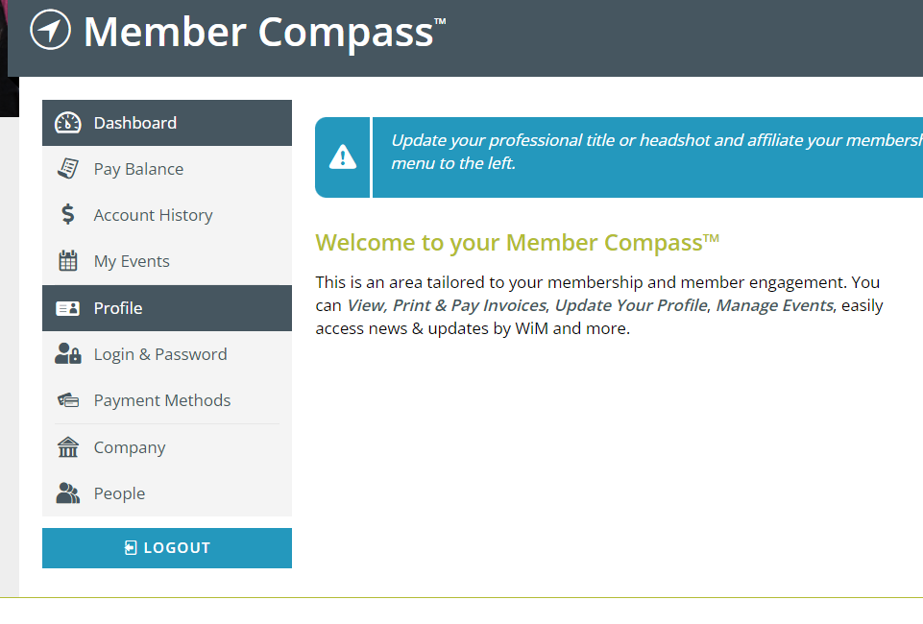
#1 COMPLETE YOUR MEMBER PROFILE

Slide 21
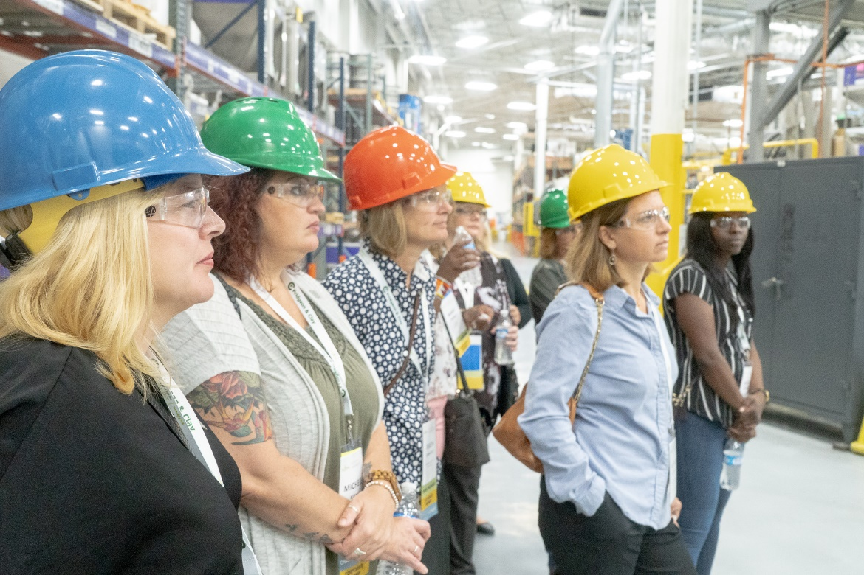
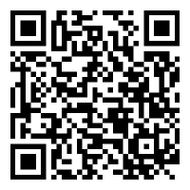
#2 REGISTER FOR A WiM CHAPTER EVENT
CLICK OR SCAN FOR ALL CHAPTER EVENTS
Notes:
https://www.womeninmanufacturing.org/events/

Slide 22
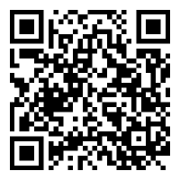

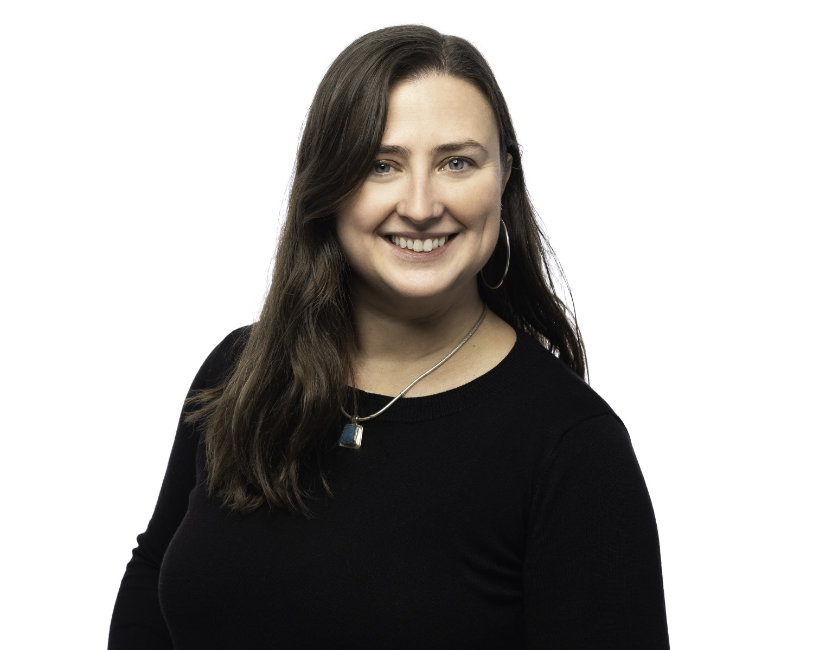
#3 REGISTER FOR A VLS WEBINAR
CLICK OR SCAN TO REGISTER
Tuesday, February 11, 2025
  AI in Manufacturing: Balancing Innovation and Human Expertise
Presented by Lori Highby
Notes:
Let's explore how Artificial Intelligence (AI) is revolutionizing the manufacturing sector while emphasizing the irreplaceable value of human insight and durable skills. Participants will gain practical insights into leveraging AI tools for increased efficiency, productivity, and smarter decision-making in daily operations. At the same time, we’ll discuss the boundaries of AI, highlighting the critical thinking, emotional intelligence, and problem-solving skills that remain uniquely human.

Slide 23
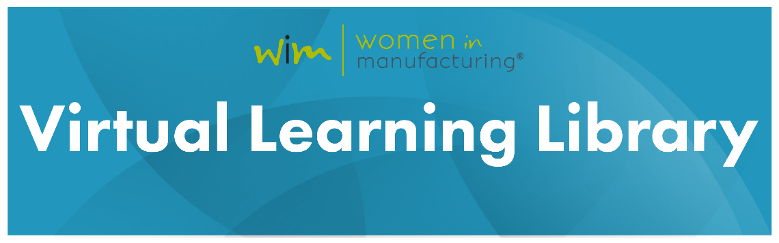
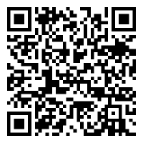
#4 WATCH A VLS WEBINAR ON-DEMAND
CLICK OR SCAN TO VIEW THE LIBRARY
Effective Time Management
Presented by Joanna Cooper
Bridging the Multigenerational Gap
Presented by Jenna Armato

Slide 24

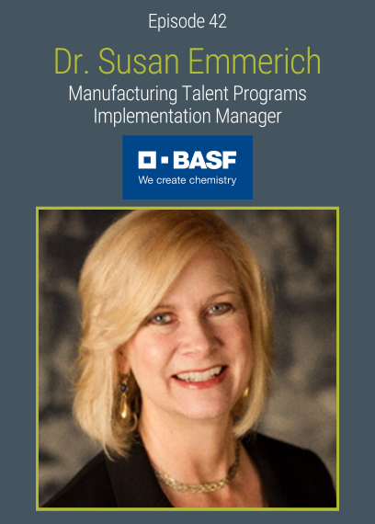
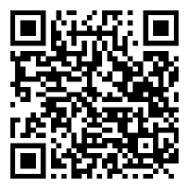
#5 LISTEN TO THE HEAR HER STORY PODCAST
CLICK OR SCAN TO LISTEN & SUBSCRIBE

Slide 25
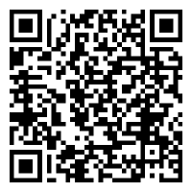
UPCOMING SESSIONS
February 12 @ 2:00 – 3:00 PM ET
Notes:
https://www.womeninmanufacturing.org/events/wim-member-town-halls

Slide 26
CONTACT WiM
Questions about MEMBERSHIP or RECRUITMENT RESOURCES?
Contact membership@womeninmfg.org
Questions about NATIONAL EVENTS & CONFERENCES?
Contact meetings@womeninmfg.org
Questions about the WiMEF or LEADERSHIP PROGRAMS?
Contact alesnansky@womeninmfg.org
Questions about CHAPTERS & CHAPTER EVENTS?
Contact chapters@womeninmfg.org
Questions about INTERNATIONAL WOMENS NETWORK?
Contact jkopf@womeninmfg.org
Notes:
https://www.linkedin.com/company/women-in-manufacturing/

Slide 27
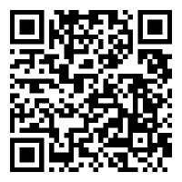
THANK YOU!
YOUR FEEDBACK IS IMPORTANT -
TAKE OUR SURVEY!
CLICK OR SCAN TO TAKE SURVEY
Notes:
https://womeninmfg.wufoo.com/forms/x2bx5qp12141u5/

