Slide 1
Moms in Manufacturing
August 11, 2022

Slide 2
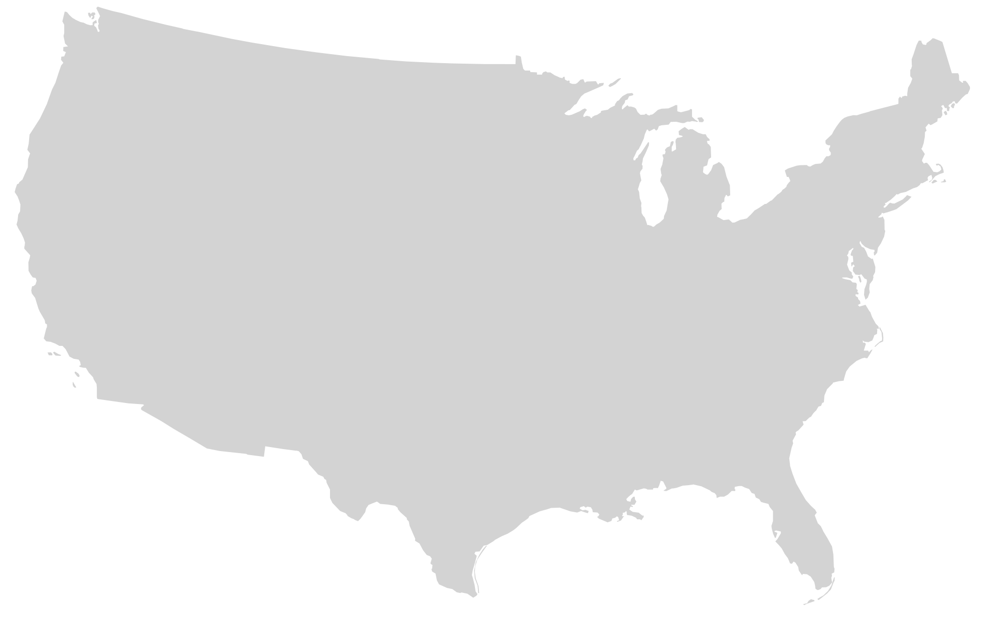
Welcome
Who are you caring for?
(Select all that apply)
Where are you calling in from?
0 – 5
Year Old
6 – 10
Year Old
11 – 16
Year Old
16 – 20
Year Old
20+
Year Old
Annotate Me!
To annotate, select View Option from the top of the Zoom window, and then choose Annotate.

Slide 3
My Journey as a Mom
Briana Martin
Deloitte Senior Manager, Workforce Transformation
Houston, TX
Became a mom in 2019 - Annie (3)
Benefited from generous parental leave + supportive leaders and co-workers
I focus exclusively on industrial products clients, including heavy machinery and aerospace
Travel is back: I am on the road 1 – 4 days a week
My “superpower” as a mom is stain fighting!
Notes:
In addition to parental leave and a strong support network, I also had lots of role models and visible examples of other moms in consulting who were “making it work”
Much of my focus is on helping manufacturing clients with addressing the implications of the current talent gap in manufacturing, as well as how to upskill and retain their current workforce

Slide 4
Zoom in |Moms in Manufacturing Today
Women represent a vast talent pool
55%
Women surveyed have seen positive change in the industry's attitude toward female employees
59%
of the associate’s, bachelor's, master’s, and doctorate’s degrees are held by women in the total US labor force
Manufacturers continue to work to create an inclusive environment for women
1 in 3
women surveyed agreed that their company had an active recruitment program for women
47%
30%
Is manufacturing capturing its share?
Overall manufacturing
Overall US workforce
50%
Women surveyed feel women are sufficiently represented in their company’s leadership team
Top 5 Benefits Offered at Manufacturing Organizations
Top 5 Benefits Desired at Manufacturing Organizations
A number of manufacturing sub-sectors have experienced notable growth in adding women over the past decade
Women are 1.8 times more likely to leave the industry
Health Insurance
Performance Reviews
Educational Opportunities
Employee Assistance Programs
Remote Work
Health Insurance
Flexible Schedules
Educational Opportunities
Remote Work
Performance Reviews
1.5x
1.6x
Industrial and miscellaneous chemicals
Ship and boat building
Benefits often fall short of employee expectations
1.5x
Top Desired Benefits:
Aluminum production and processing
Some sectors have made substantial progress in increasing the number of women
93%
of women surveyed
73%
of women surveyed
86%
of men surveyed
55%
of men surveyed
On-Site Childcare
Transportation Allowance
Source: Deloitte Analysis of BLS data
Notes:
Women are underrepresented in manufacturing, and while many are not content with the current recruitment, retainment, or development efforts of their companies, it’s not all bad news, in fact, data suggests that the situation that has been improving, but slowly
Manufacturers remain unable to capture their fair share of the labor market: Women, for instance, represent 30% of the manufacturing workforce whereas they represent 47% of the overall workforce. Similarly, workers under 35 represent 30% of the manufacturing workforce, but 45% of the overall workforce (Deloitte, 2022)
Workers in the sector are seeking flexibility across racial & ethnic demographics and especially in women. Women are almost twice as likely to leave the industry as men, citing lack of flexibility and visible career pathways.
Further compounded by the ongoing impacts of the pandemic: working mothers are being disproportionately impacted by this new reality. The consequences: more than 2.3 million women have left the workforce since March 2020. Moreover, a quarter of women still in the workforce are considering leaving their jobs or reducing their hours. (National Law Center)

Slide 5
Does this reflect your experience?
What changes have you seen?
Annotate Me!
To annotate, select View Option from the top of the Zoom window, and then choose Annotate.

Slide 6
Zoom out Supporting Moms in Manufacturing in the Future
Flexibility and work-life balance are table stakes
Work-life balance
Formal mentorship and sponsorship is critical
Priorities when choosing where to work
Flexible schedules
63% of surveyed women agreed formal mentorship and sponsorship programs are among the top retention programs
62% of surveyed women agreed that they have support of at least one sponsor to advance their career goals
58% of surveyed women agreed that they see a future in their current company due to attention to their personal development
Attractive income and benefits
Source: Deloitte’s study: 2021 Manufacturing Talent Study
63% women find formal mentorship and sponsorship programs impactful in retaining employees, however only 31% manufacturers offer it in their talent programs
69% women find visibility of key leaders who serve as role models for employees are impactful in retaining, however only 28% manufacturers offer it in their talent programs
Share of women who believe these programs are most impactful at retaining employees
Share of manufacturers who offer these programs
Source: Deloitte’s study: 2021 Manufacturing Talent Study
Notes:
Programs like formal mentorship or sponsorships and visibility of key leaders who can serve as role models are likely to have impact on retaining women professionals
The current experience of mom’s in manufacturing: less effective mentorship and imposter syndrome to insufficient parental leave and company support, this lack of representation leads to myriad issues that women manufacturers, and women employees at large, face in male-dominated workplaces

Slide 7
What opportunities do you see?
What are moms in your organization asking for?
Annotate Me!
To annotate, select View Option from the top of the Zoom window, and then choose Annotate.

Slide 8
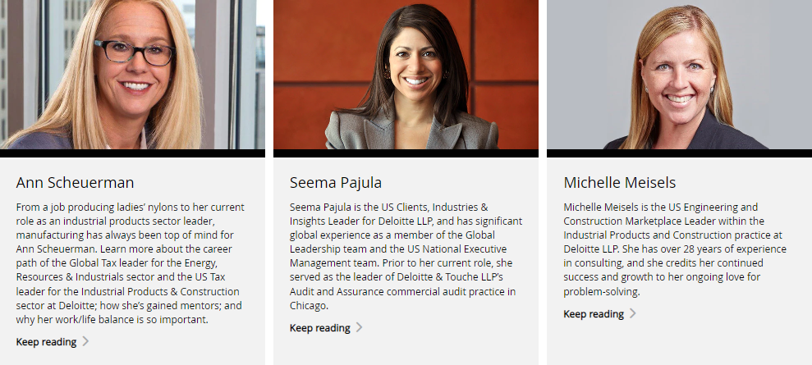
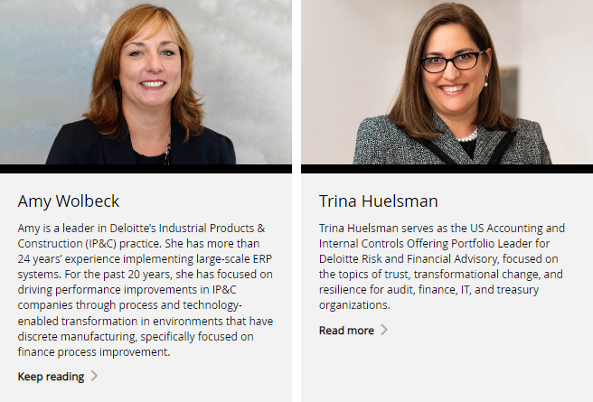
Celebrating women in manufacturing
Powerful women. Powerful stories.
Notes:
This series showcases the different stories of women within energy and manufacturing. By highlighting their stories, our campaign highlights the numerous opportunities for women within these industries. This unique collection of profiles help facilitates meaningful conversations and foster greater connections throughout these industries.
The IP&C Women at Deloitte campaign worked to better understand the stories and experiences of women in IP&C. And how did we accomplish that? We asked them. Through Deloitte’s partnership with Women in Manufacturing (WiM) we are able to document the experience of powerful women in manufacturing and energy.

Slide 9
CONTACT
Briana Martin
brianamartin@deloitte.com

