Slide 1
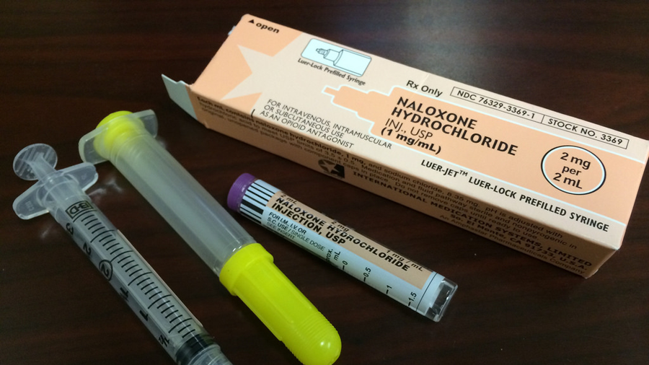

Telecommunicator Narcan administration instructions for Wisconsin dispatchers
Courtesy Wisconsin EMS Association
Made possible by Grant OD2A
2021

Slide 2
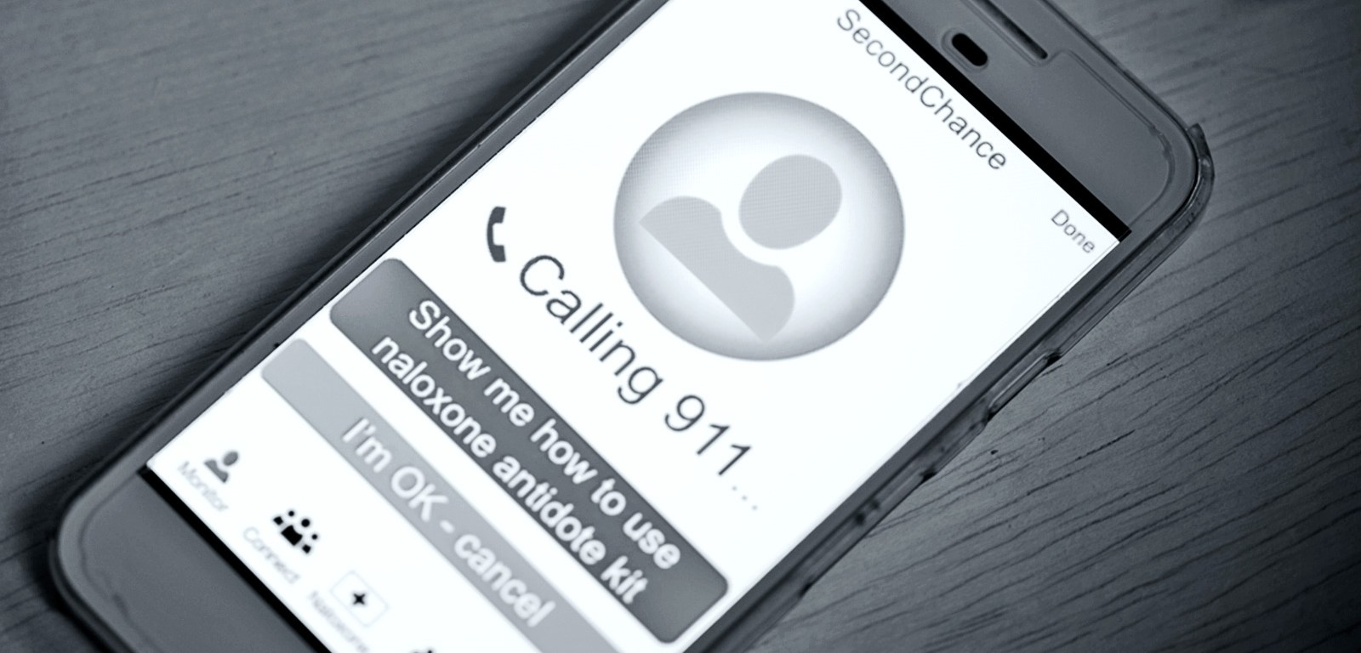
WISCONSIN IS TAKING ACTION THROUGH THE FEDERAL OD2a GRANT SUPPORTING THIS TRAINING!
Overdose Data to Action is a 3-year cooperative agreement that began in September 2019 and focuses on the complex and changing nature of the drug overdose epidemic and highlights the need for an interdisciplinary, comprehensive, and cohesive public health approach.

Slide 3

OUR GOAL
Coordinating with public safety and community-based partners to rapidly identify overdose threats, reverse overdoses, link people to effective treatment, and reduce harms associated with illicit opioids

Slide 4

IMPORTANT DISCLAIMER
Please note that this training is offered to provide dispatchers in Wisconsin with important basic information about Opioid Overdose and does contain suggestions for protocol language and workflow process.
If your agency already has a protocol in place for use; please continue to utilize that protocol. If you do not already have a protocol for opioid overdose or instructions on the administration of naloxone (Narcan) and would like to use the protocol shared here, please consult with your agency’s Medical Control/Director for guidance and approval. Thank you!
Th

Slide 5

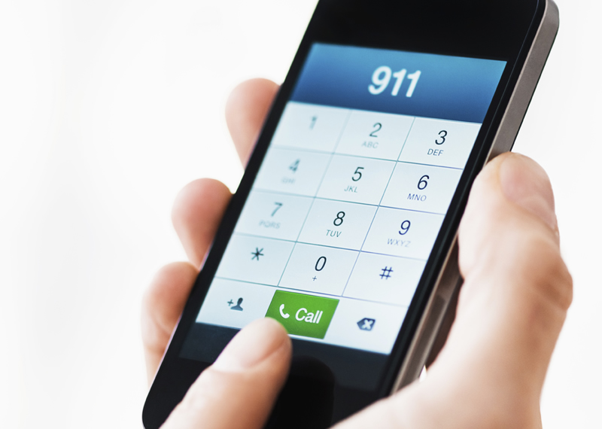
Please take a few minutes to respond to some demographic questions before you begin the training! Click orange link below!
https://forms.office.com/Pages/ResponsePage.aspx?id=DQSIkWdsW0yxEjajBLZtrQAAAAAAAAAAAAO__Z9t1dhUREwyT0dCMEFJN1hDWFRUTUpKSEtHSVIyNS4u

Slide 6
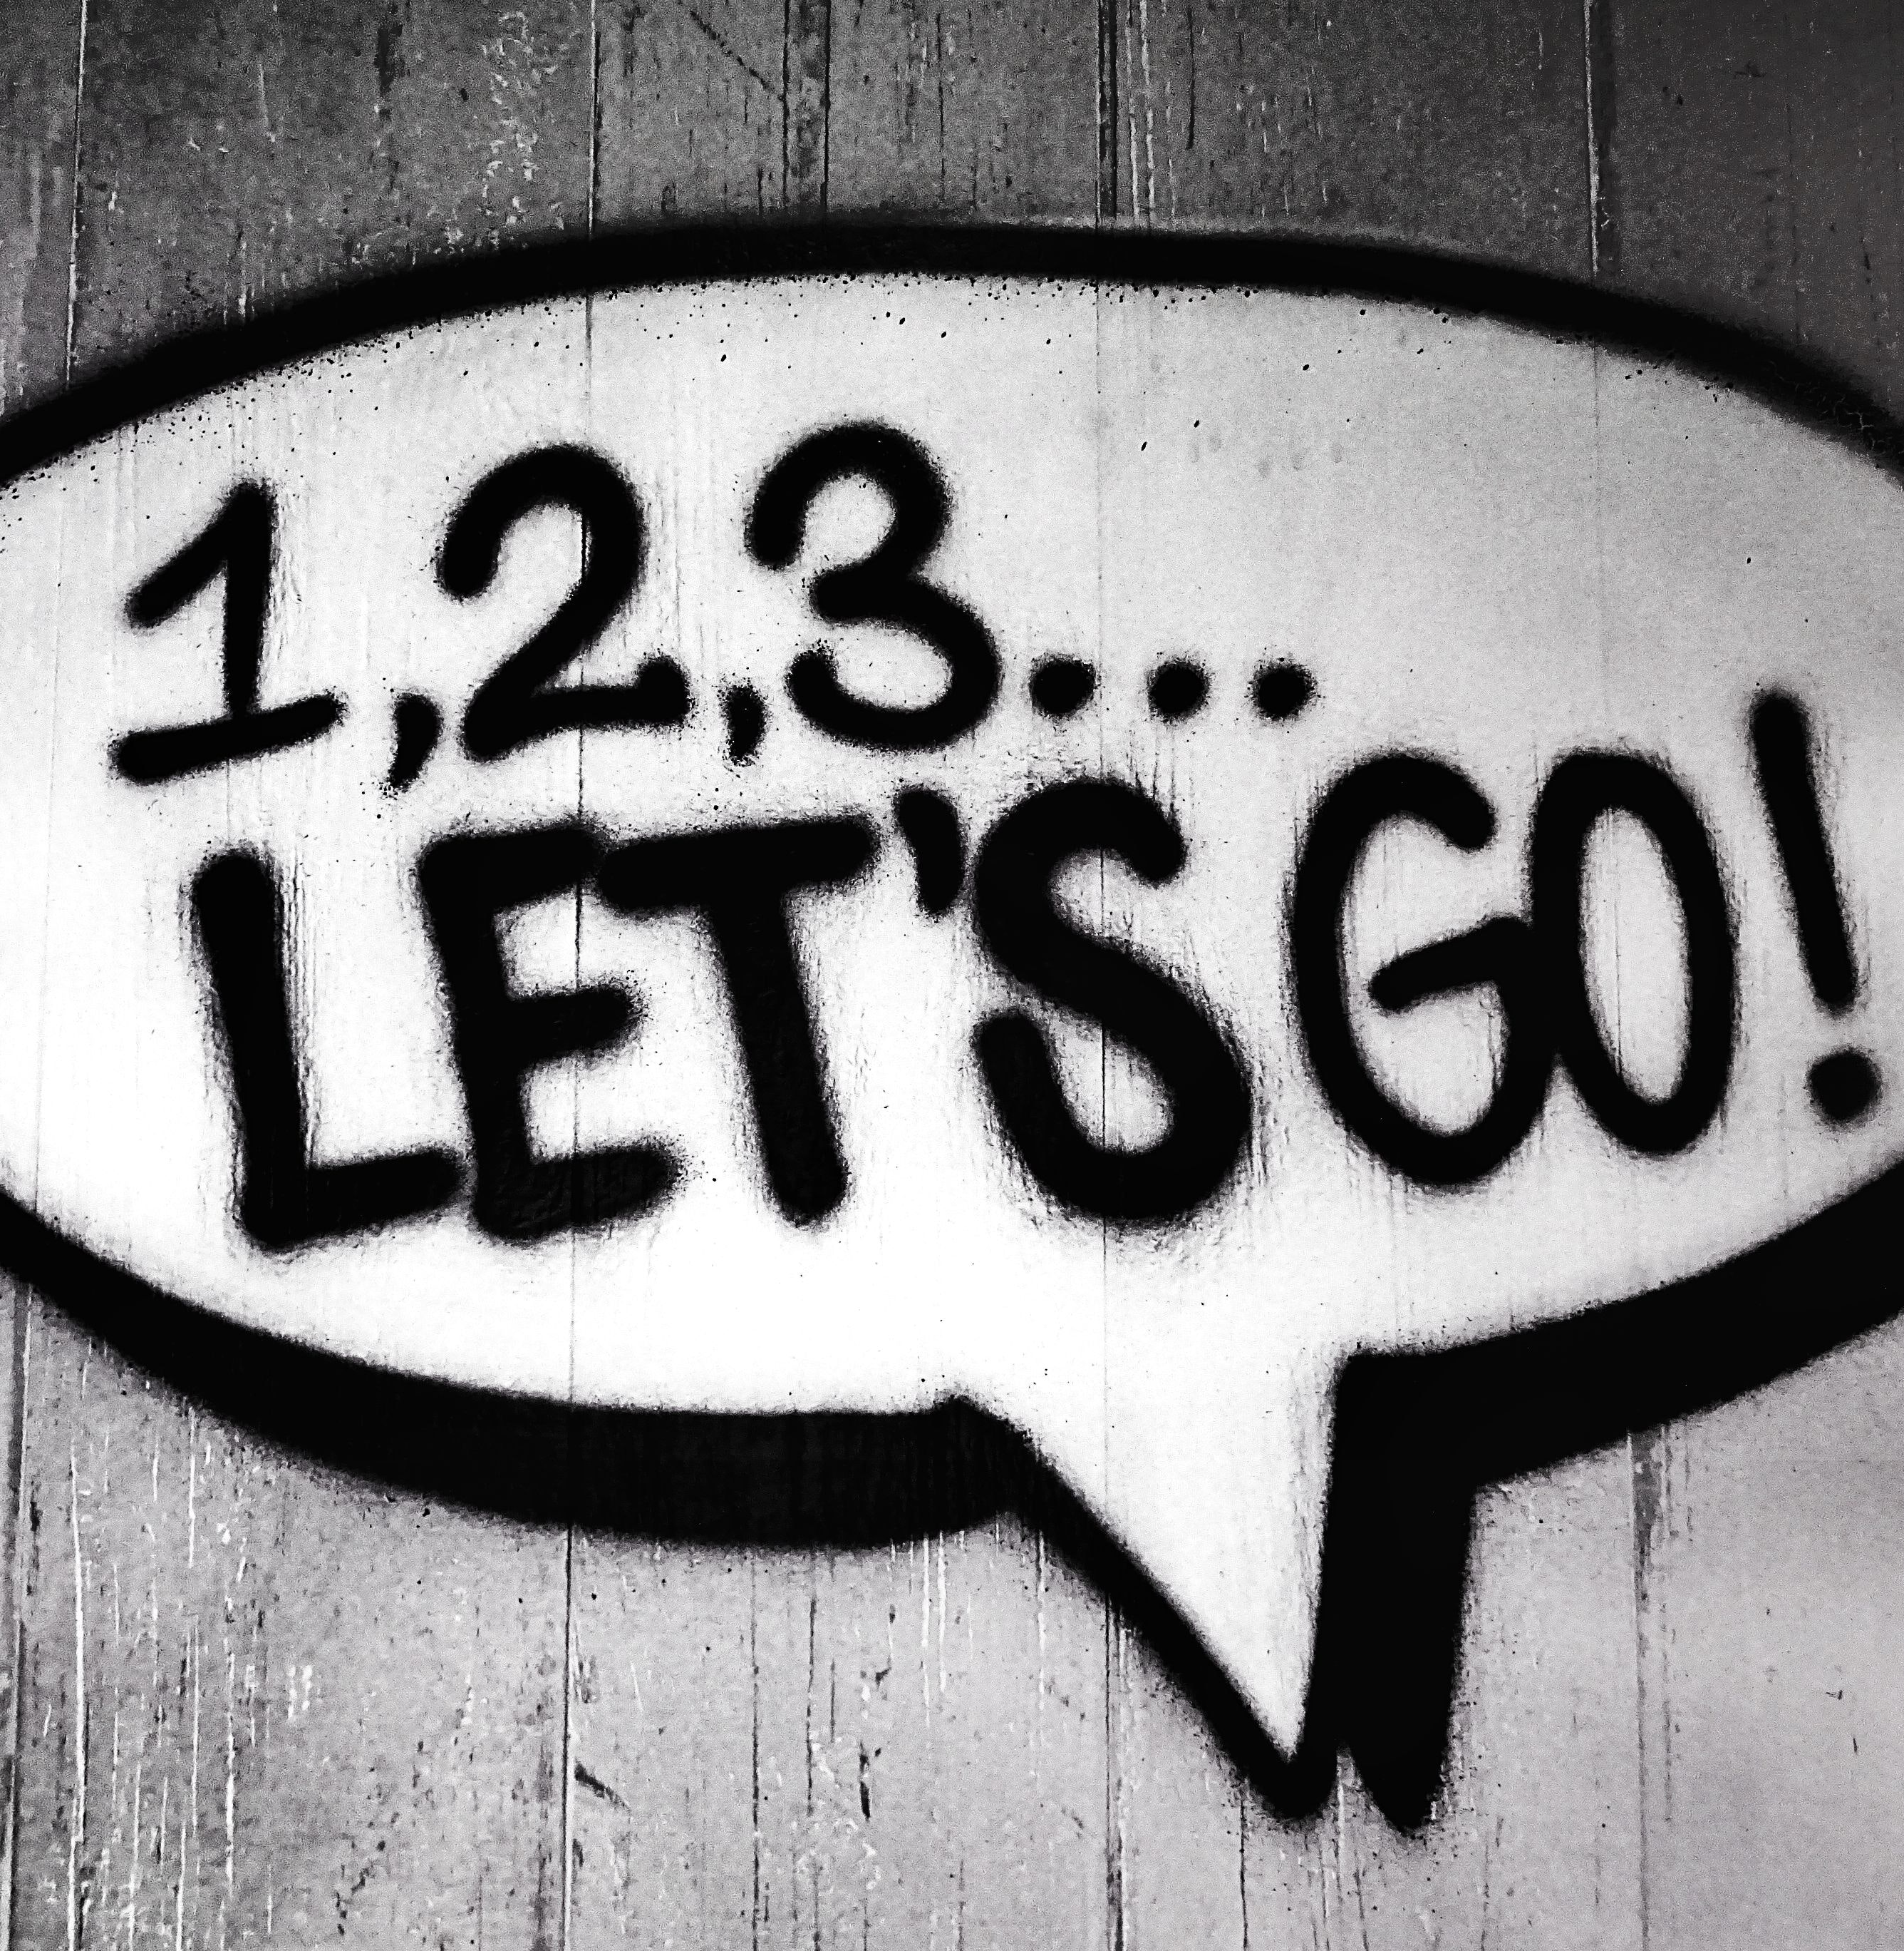
THANKS for your responses!
LET’S BEGIN!!!

Slide 7

OPIOIDS IN WISCONSIN
According to the Wisconsin department of health services website, there are three waves of the opioid epidemic
The first wave began in 1999. That’s when deaths involving opioids began to rise following an increase in the prescribing of opioids for the treatment of pain.
The second wave began in 2010. That’s when deaths involving heroin began to rise. More people began to use heroin around this time because it was cheaper and more accessible than prescription opioids.
The third wave began in 2014. That’s when deaths involving synthetic opioids like fentanyl began to rise. This increase has been linked to fentanyl illegally manufactured and mixed with other drugs like heroin.

Slide 8

ADDICTION IN WISCONSIN

Slide 9

What causes the opioid problem?

Slide 10


Slide 11

What is an opioid overdose?

Slide 12
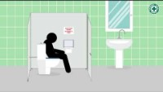
SPOTTING AN OVERDOSE

Slide 13
Why Narcan???
Opiates can cause breathing to slow or stop
Narcan (aka naloxone)
  Reasonably Safe medication
  Can reverse OD caused by opioids - prescription pain meds or heroin
  Blocks effects of opioids on brain
  Helps OD victim breathe again
  Expect it to restore breathing within two to eight minutes

Slide 14

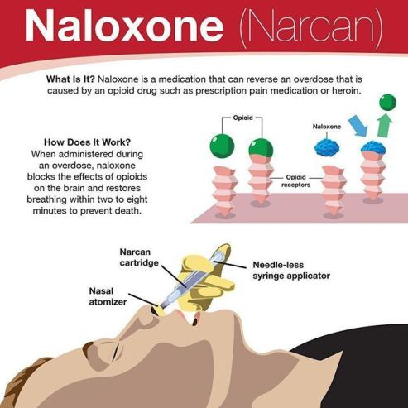
How NALOXONE WORKS IN THE BODY

Slide 15

4 Ways to get Narcan in wisconsin
Talk to your doctor and ask for a prescription.
1
Ask a pharmacist how to get naloxone.
2
Find a nearby pharmacy that dispenses naloxone. Wisconsin has more than 300 pharmacies who can fill
3
Find an agency near you participating in Wisconsin's NARCAN® Direct Program.
4

Slide 16
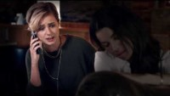

Slide 17
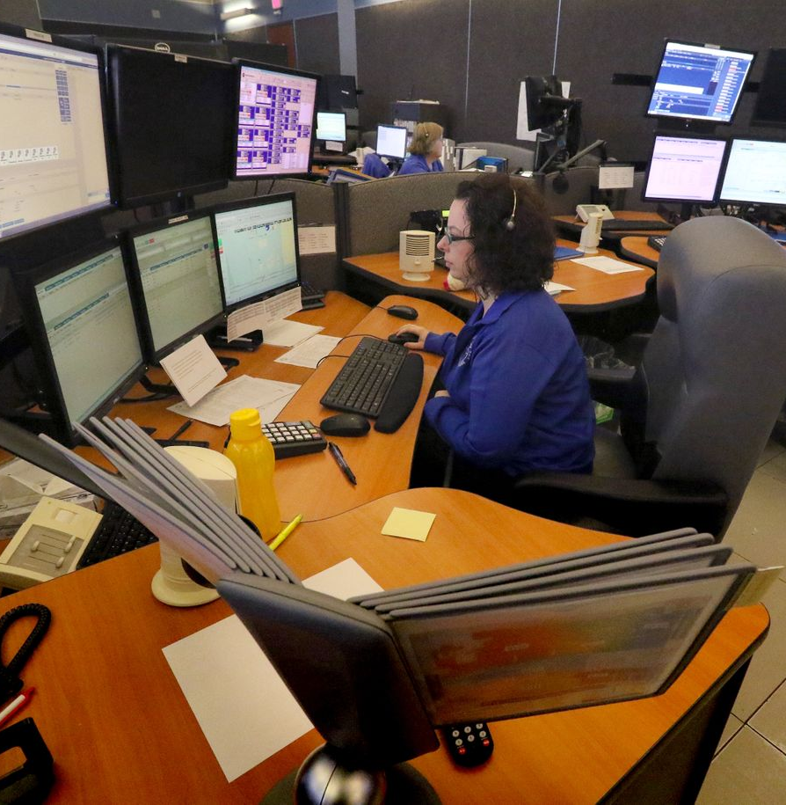
9-1-1 Dispatchers!
You are truly the ‘first’ first responders!
Be prepared to give instructions on how to help bystanders assist overdose victims!

Slide 18
Things to know about narcan:
Narcan does NOT reverse OD’s caused by non-opioid drugs, such as: cocaine, benzodiazepines (e.g., Xanax, Klonopin and Valium), methamphetamines, or alcohol.
Narcan administered to a person dependent on opioids may produce Withdrawal symptoms.
Acute withdrawal, can be uncomfortable,
and in very rare circumstances life-threatening.

Slide 19
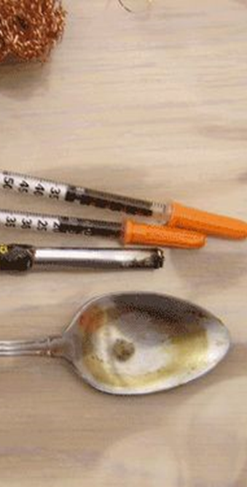
Needles:
DISPATCHERS SHOULD Warn callers
To be aware of any exposed needles
To Be aware of other contaminated
paraphernalia that people may come in contact with
That EMS can safely dispose of needles for them
  ** Do NOT advise anyone to recap a needle. **

Slide 20
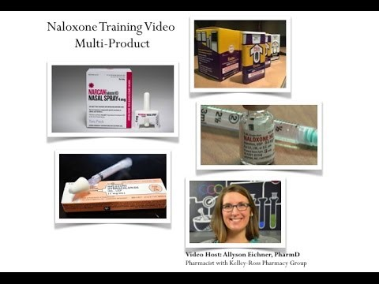
4 WAYS TO ADMINISTER NARCAN
(CLICK ON VIDEO)

Slide 21
Things to know about Narcan:
Narcan effect lasts: ~30 min
With some long-lasting opioids, Narcan may wear off before the opioids, causing the person to lose consciousness again and “overdose” again
Pregnancy - Animal studies have shown an adverse effect on the fetus and there are no adequate and well-controlled studies in humans, but potential benefits may warrant use of the drug in pregnant women despite potential risks.

Slide 22
Narcan administration in dispatch
Symptoms given on a 911 call may include:
  Hx of drug use, heroin, narcotics
  Unconscious (rapid loss of consciousness)
  Not alert (condition worsening)
  Respiratory arrest (not breathing or agonal)
Narcan administration indicated when:
  narcotic OD is suspected
  Pt is not alert or unconscious
  Pt has ineffective, uncertain, agonal , or absent breathing

Slide 23
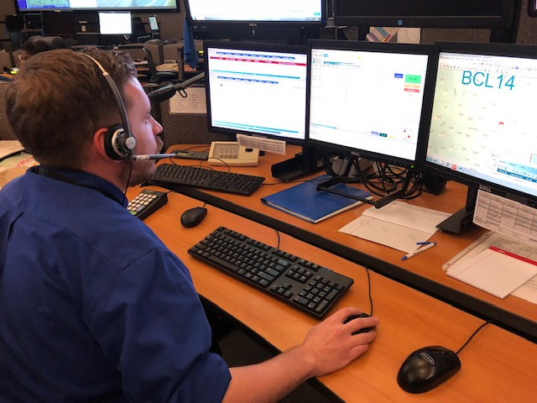
NARCAN ADMINISTRATION INSTRUCTIONS
(FOLLOW INTERNAL PROTOCOLS/DIRECTIVES)
IAED
APCO
POWERPHONE
STATE OFFERED AS ADD ON TO T-CPR AS SHOWN IN FOLLOWING SLIDES
HOME GROWN/APPROVED PROTOCOL

Slide 24


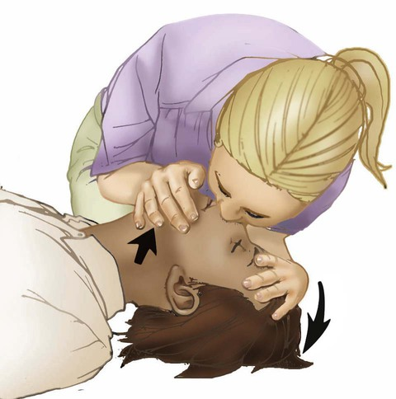
The caller may not recognize this as an overdose. In those cases, CPR NEEDS TO BE INITIATED if the patient is pulseless and non-breathing.
If you know or find out it may be an overdose situation, be sure to ventilate first (if possible), and do CPR. If a SECOND person is there who can get the Narcan to the patient, it can be administered. But NEVER delay CPR efforts to go look for Narcan.

Slide 25
TELECOMMUNICATOR NARCAN ADMINISTRATION INSTRUCTIONS
T-NAI Telecommunicator-Assisted Bystander Naloxone Administration Instruction (Caller advises that an Opioid Overdose is Suspected)
Get the phone NEXT to the person – PUT YOUR PHONE ON SPEAKER SO YOU CAN HAVE YOUR HANDS FREE TO HELP HIM/HER.
Listen carefully.
Check him/her for responsiveness. (Shake/Shout/Sternal Rub)
If available, QUICKLY GET or SEND someone to get AED and/or NALOXONE (Narcan rescue device)
Check for breathing vs no breathing or gasping
If unresponsive and no breathing/gasping/unsure, BEGIN CPR UNTIL NARCAN device is ready.

Slide 26
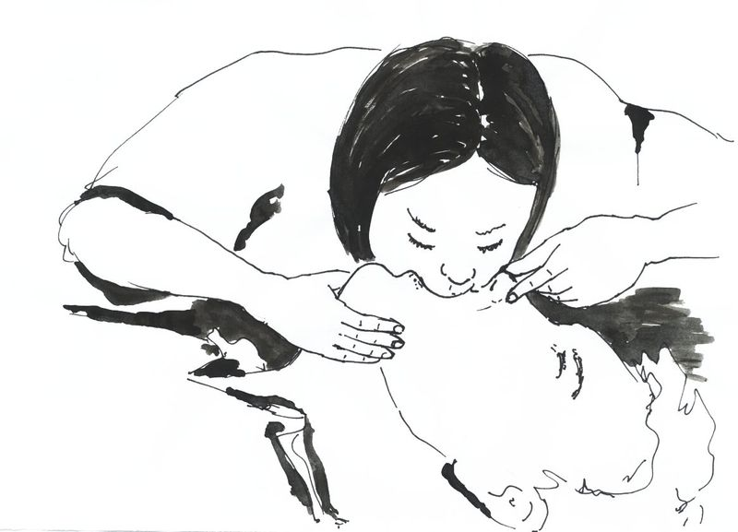
IT IS CRITICAL TO BEGIN VENTILATIONS!!!!!
DISPATCHERS….DO NOT DELAY HAVING THE BYSTANDER BEGIN VENTILATIONS TO GO LOOK FOR NARCAN!!!!
These patients NEED AIR!!

Slide 27
NARCAN DELIVERY INSTRUCTIONS CONTINUED
AT ANY POINT THAT NARCAN DEVICE IS AT PATIENT’S SIDE, provide the following instruction:
Intranasal Spray Instruction
  Take Narcan® Nasal Spray out of box.
  Peel back tab with the circle to open the Narcan® Nasal Spray. IMPORTANT: Do not remove Narcan® until ready to use and do NOT test the device.
  Hold the Narcan® Nasal Spray with your thumb on the bottom of the plunger and your first and middle fingers on either side of the nozzle.
  Tilt the person’s head back and provide support under the neck with your hand.
  Gently insert the tip of the nozzle into one nostril, until your fingers on either side of the nozzle are against the bottom of the person’s nose.
  Press the plunger firmly to give the dose of Narcan® Nasal Spray. Remove the Narcan® Nasal Spray from the nostril after giving the dose.
  If the person is still not conscious and not breathing, move to step 5 below.

Slide 28
NARCAN ADMINISTRATION INSTRUCTIONS CONTINUED
Intramuscular Nalaxone (Evzio)
  Pull the auto injector from the outer case. DO NOT go to next step until ready to use.
  Firmly pull off the RED SAFETY guard. DO NOT touch the black base – this is where the needle comes out.
  Place the black end of the auto injector against his/her outer thigh; through clothing if necessary.
  PRESS FIRMLY and hold in place for 5 seconds, then pull out.
  Put USED device back in protective outer case and give to responders as the used device to be properly disposed of.
5. Evaluate / Monitor for Changes. Does he/she move purposefully, breathe regularly, moan, or otherwise respond?
IF YES: Continue to assess responsiveness and breathing until help arrives.

Slide 29
NARCAN ADMINISTRATION INSTRUCTIONS CONTINUED
IF NO: (Go to Step 6 / CPR and AED if available, followed by 2nd dose of Narcan if available)
6. Make sure he/she is flat on the floor on her/his back.
7. PINCH the nose closed.
6. With your OTHER hand, LIFT the CHIN so the head BENDS BACK.
7. COMPLETELY COVER their mouth with your mouth.
8. GIVE 2 breaths.
***If they don’t want to give breaths continue with compression only***
9. MAKE SURE the HEEL of your hand is on the CENTER of their chest, RIGHT BETWEEN the
NIPPLES PUMP the CHEST 30 times as hard and as fast as you can.
10. PINCH the NOSE and LIFT the CHIN so the head BENDS BACK.
11. Give 2 MORE breaths
12. KEEP DOING THIS. REMEMBER, PUMP the CHEST as hard and fast as you can 30 times, then 2
breaths
13. Keep doing it until help takes over. I‘ll stay on the line.

Slide 30
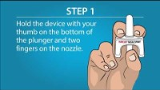
HOW IS NARCAN ADMINISTERED?

Slide 31
What to expect after administering narcan
Each victim will react differently!!!!!
  will wake up confused and disoriented
  May be combative - rescuer should use extreme caution
  May be very irritated that your caller/rescuer just took away their ‘high’
  may not listen to caller or to officers/EMS as they arrive

Slide 32
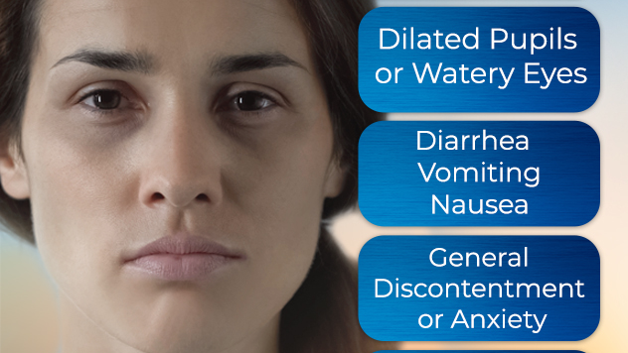

Slide 33
Signs of withdrawal
Muscle aches
Excessive sweating
Anxiety
Agitation
Insomnia
Tearing of the eyes
Runny nose
Rapid pulse (high heart rate)
Combative behavior
Seizures
Abdominal Cramps
Diarrhea

Slide 34

https://forms.office.com/Pages/ResponsePage.aspx?id=DQSIkWdsW0yxEjajBLZtrQAAAAAAAAAAAAO__Z9t1dhUQUxEMjhUUlExRlpEVUdHQTRMMVNJRlAwSi4u
CLICK THE LINK BELOW TO TAKE THE QUIZ

Slide 35

Thank you DISPatchers for taking the time to learn more about how to help someone suffering from an opioid overdose! More info below!
https://www.dhs.wisconsin.gov/aoda/drug-overdose-deaths.htm
https://doseofrealitywi.gov/
https://hope.wi.gov/Pages/Home.aspx
https://iaedjournal.org/when-you-need-it-most/
https://wjactv.com/news/local/saving-lives-dispatchers-trained-on-narcan-administration

