Slide 1
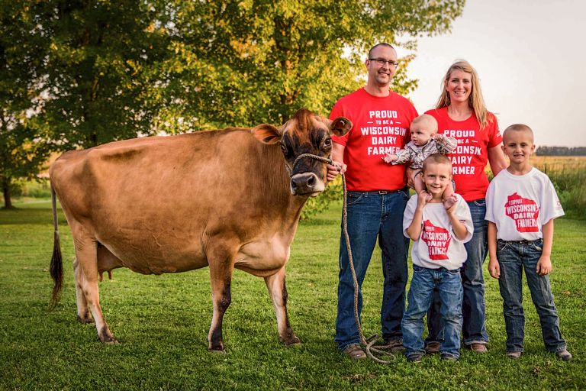
The Non-Profit Promoter for Wisconsin Dairy Funded by Wisconsin Dairy Farmers
1

Slide 2
Our Support of Wisconsin Dairy
About 1 days' worth of milk leaves the US each week, bound for dairy deficit countries.
90% of Wisconsin milk is used to produce cheese and 90% of that cheese is shipped outside of Wisconsin
Wisconsin ranks #1 in Specialty Cheese Exports and as the Most Awarded Cheese in the World, well-positioned to take advantage of growing export opportunities.
17%
Notes:
Connection and partnership is key

Slide 3
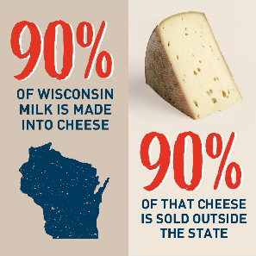
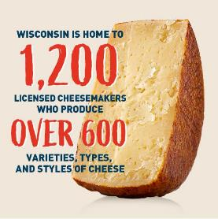

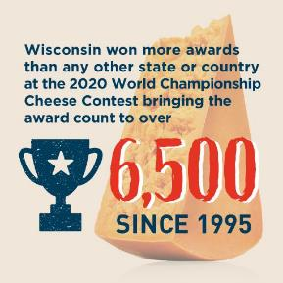
Wisconsin is The State of Cheese
Wisconsin cheese is all about the quality. We are the only state that requires a license to make cheese.
Look for the Proudly Wisconsin Cheese badge on menus and packages nationwide.
The tradition of cheesemaking excellence in Wisconsin began more than 175 years ago – before we were even a state.
The best cheese in the world is made in Wisconsin.
3
Notes:
90% of milk is made into Cheese; and 90% sold out of state
Cheesemaking heritage that dates back before Wisconsin was a state; we’re about quality – we have the only Master Cheesemaker program outside of Europe and Wisconsin is the only state that requires a license; Master program is an extensive program that requires years of effort to call yourself a master
We’ve won more awards than any other state or country

Slide 4
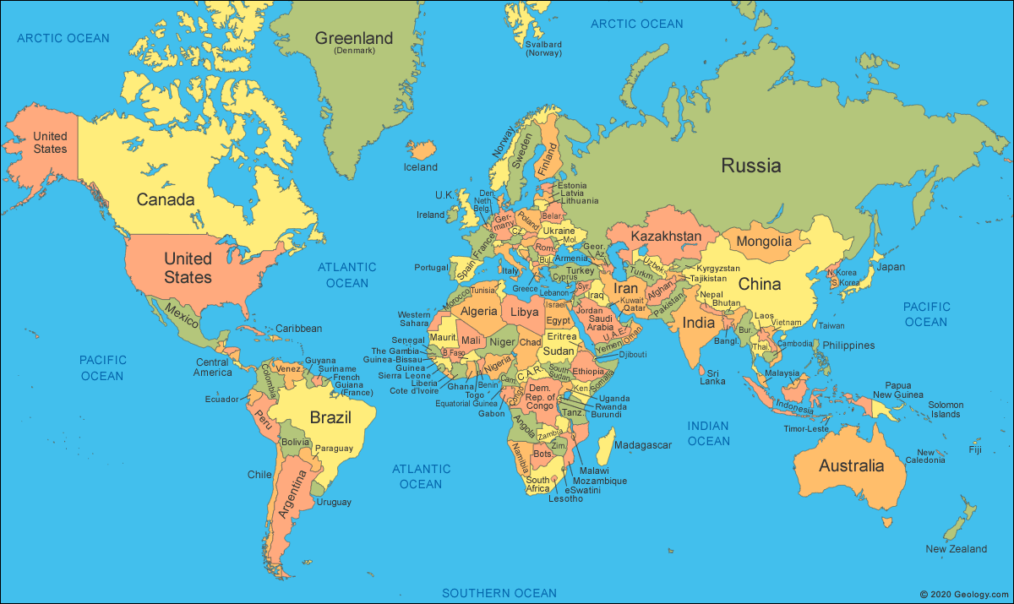
Working with industry partners, our global focus
WI Cheese sold in 140 countries
4

Slide 5

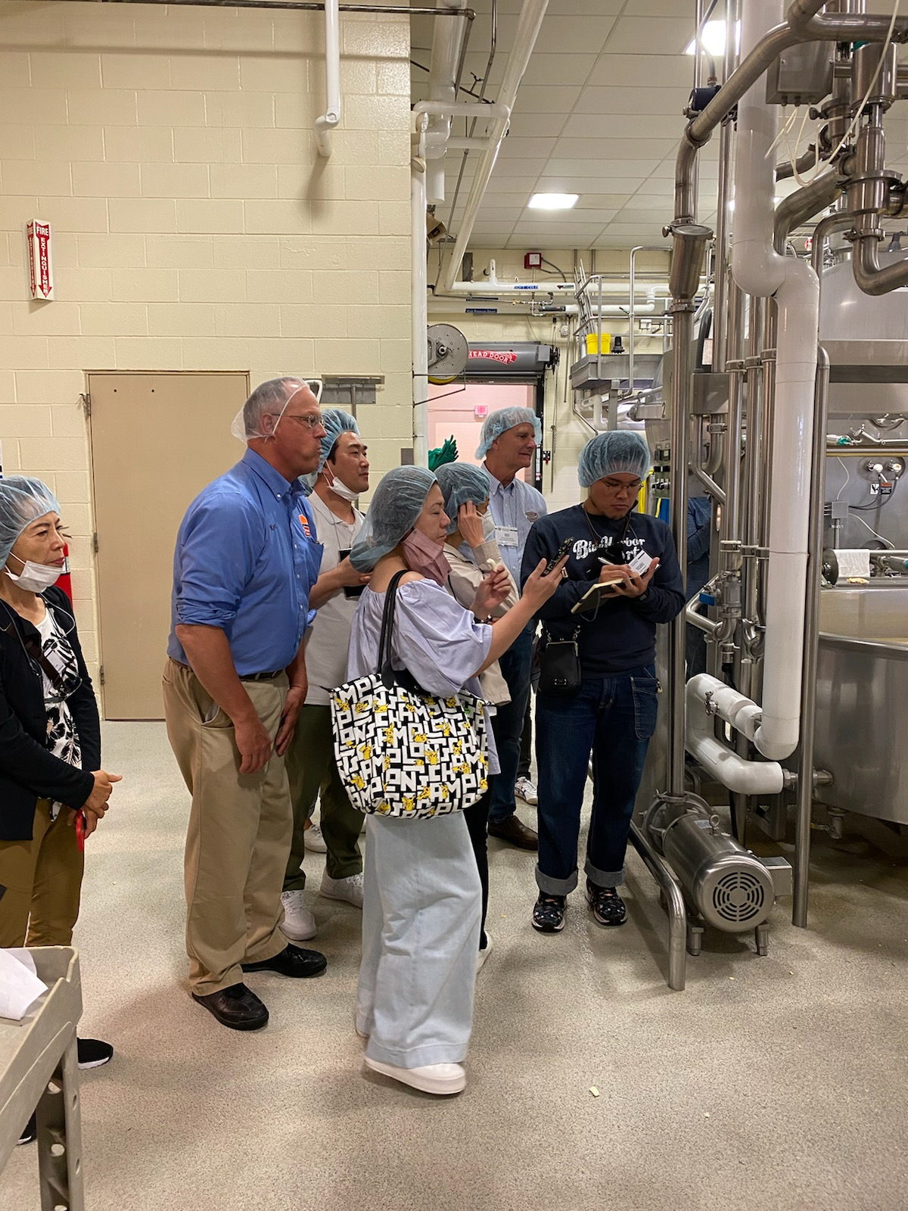
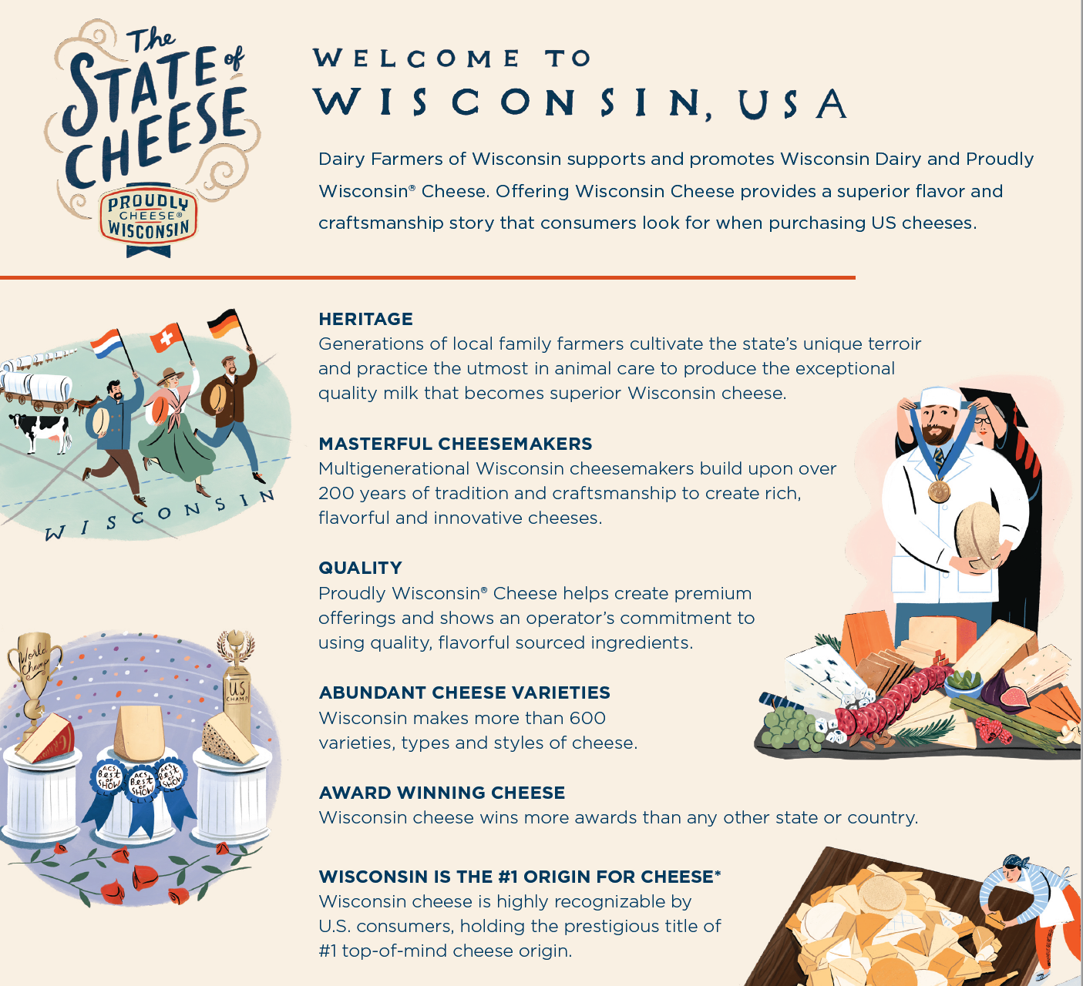
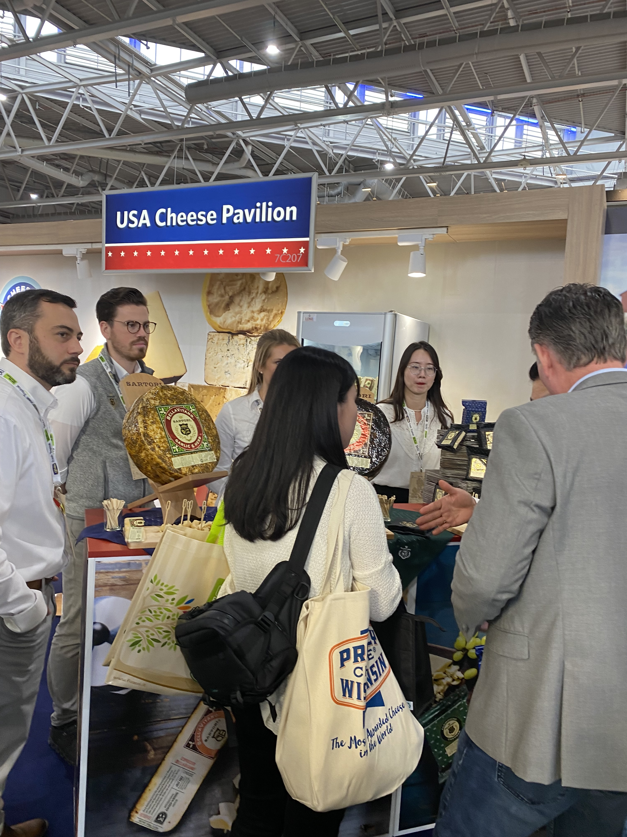
FY’23 Activations
SIAL Americas, Buyer Missions, FHA
5

Slide 6
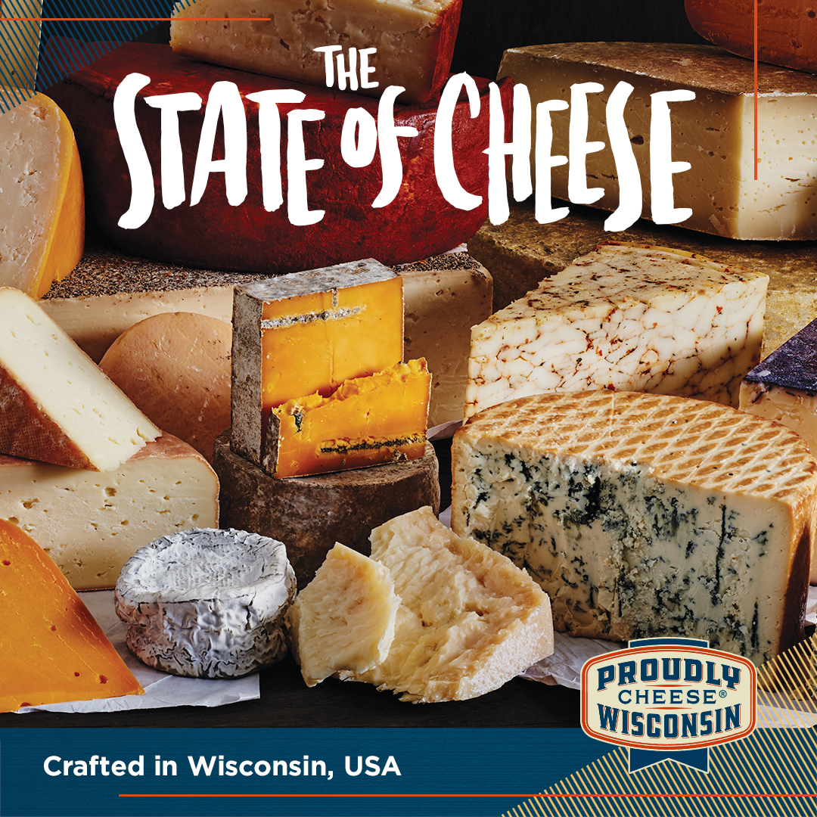


Partnership Opportunities with Proudly Wisconsin Cheese Digital & In-store Promotions

Slide 7

Notes:
Specialty cheese …
Top ten fastest growing cheeses at foodservice
Outpacing total food & beverage growth and driving total cheese growth at retail
On trend – natural, protein-rich whole food in innovative flavors and blends
Delivers compelling stories and food experiences

