Slide 1
Food Export – Midwest Programs and Services
WCMA Export Expansion Workshop
November 2022

Slide 2

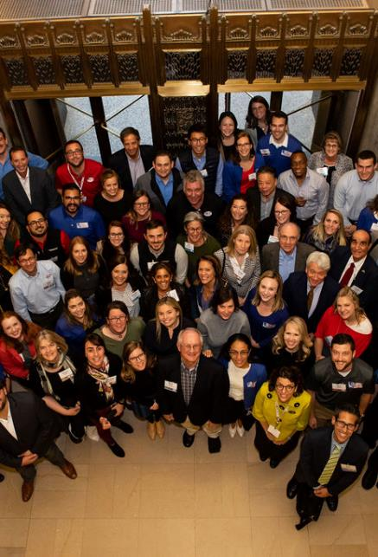
Who is Food Export?
Private, non-profit international trade organization – State Regional Trade Group
Members are State Agricultural Promotion Agencies
Work with producers in the Midwest
Often work with small and medium-sized producers
Focus on products that are value-added, consumer-oriented
Members promote services to the companies within their state
Governed by a Board of Directors consisting of Secretaries, Directors or Commissioners of Agriculture from member states

Slide 3
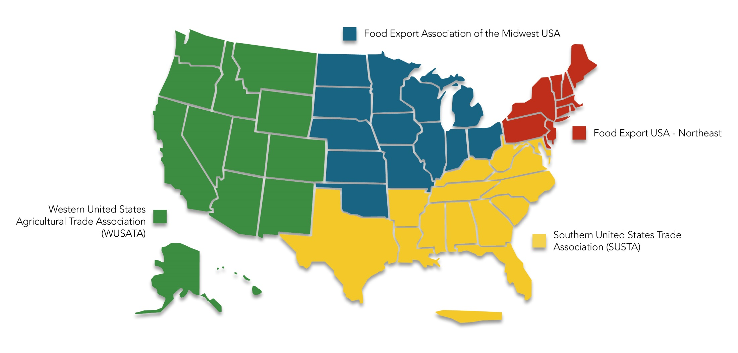
State Regional Trade Groups

Slide 4
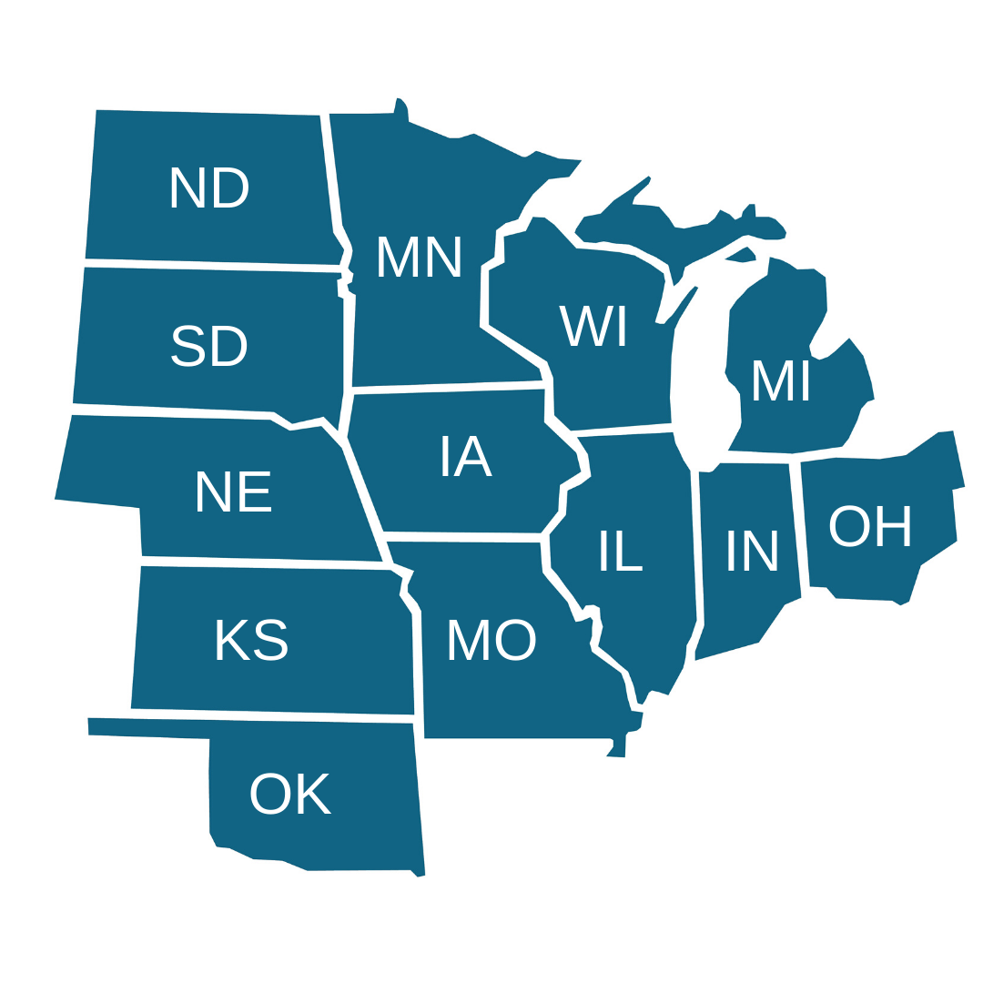
Food Export-Midwest Members
Illinois Department of Agriculture
Indiana State Department of Agriculture
Iowa Economic Development Authority
Kansas Department of Agriculture
Michigan Department of Agriculture and Rural Development
Minnesota Department of Agriculture
Missouri Department of Agriculture
Nebraska Department of Agriculture
North Dakota Department of Agriculture
Ohio Department of Development
Oklahoma Department of Agriculture, Food and Forestry
South Dakota Department of Agriculture
Wisconsin Department of Agriculture, Trade and Consumer Protection

Slide 5
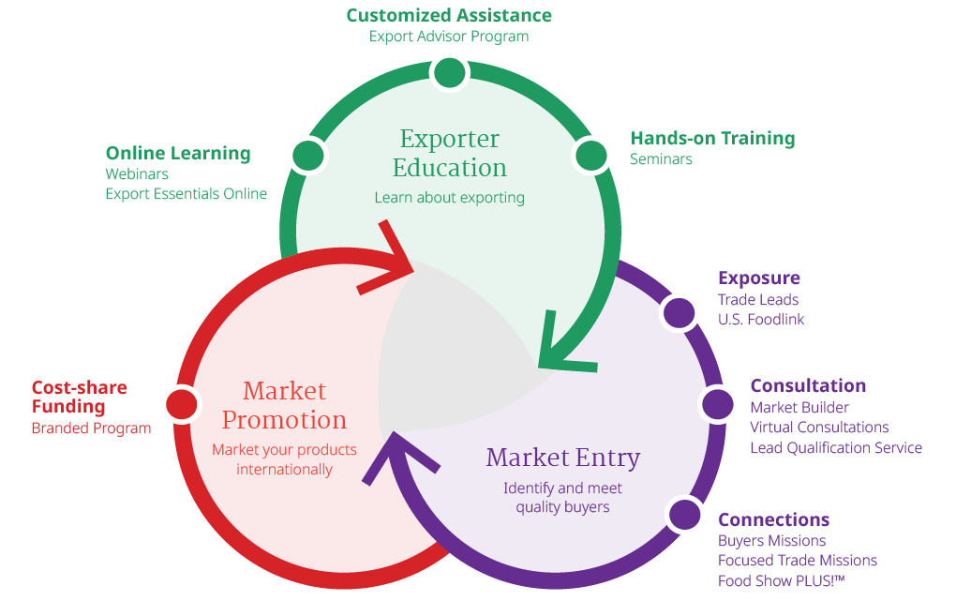
How We Help

Slide 6

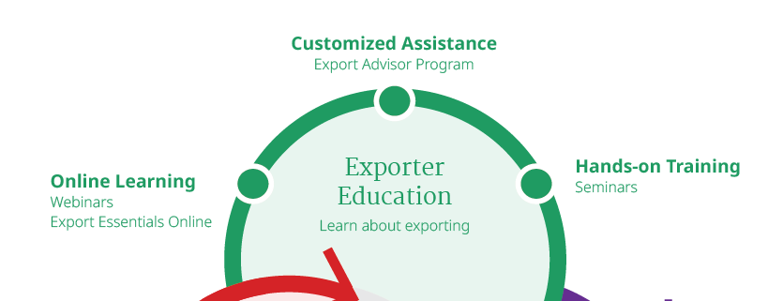
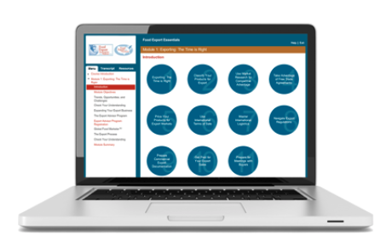
Webinars
Export Essentials Online
Export Advisor Program
Seminars

Slide 7
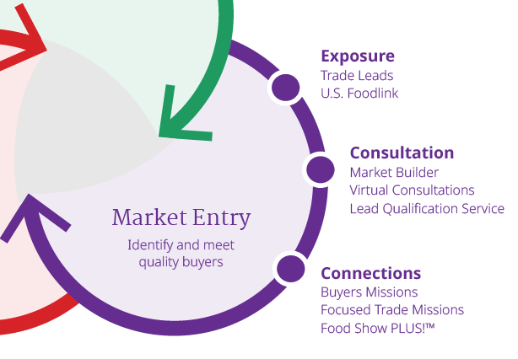


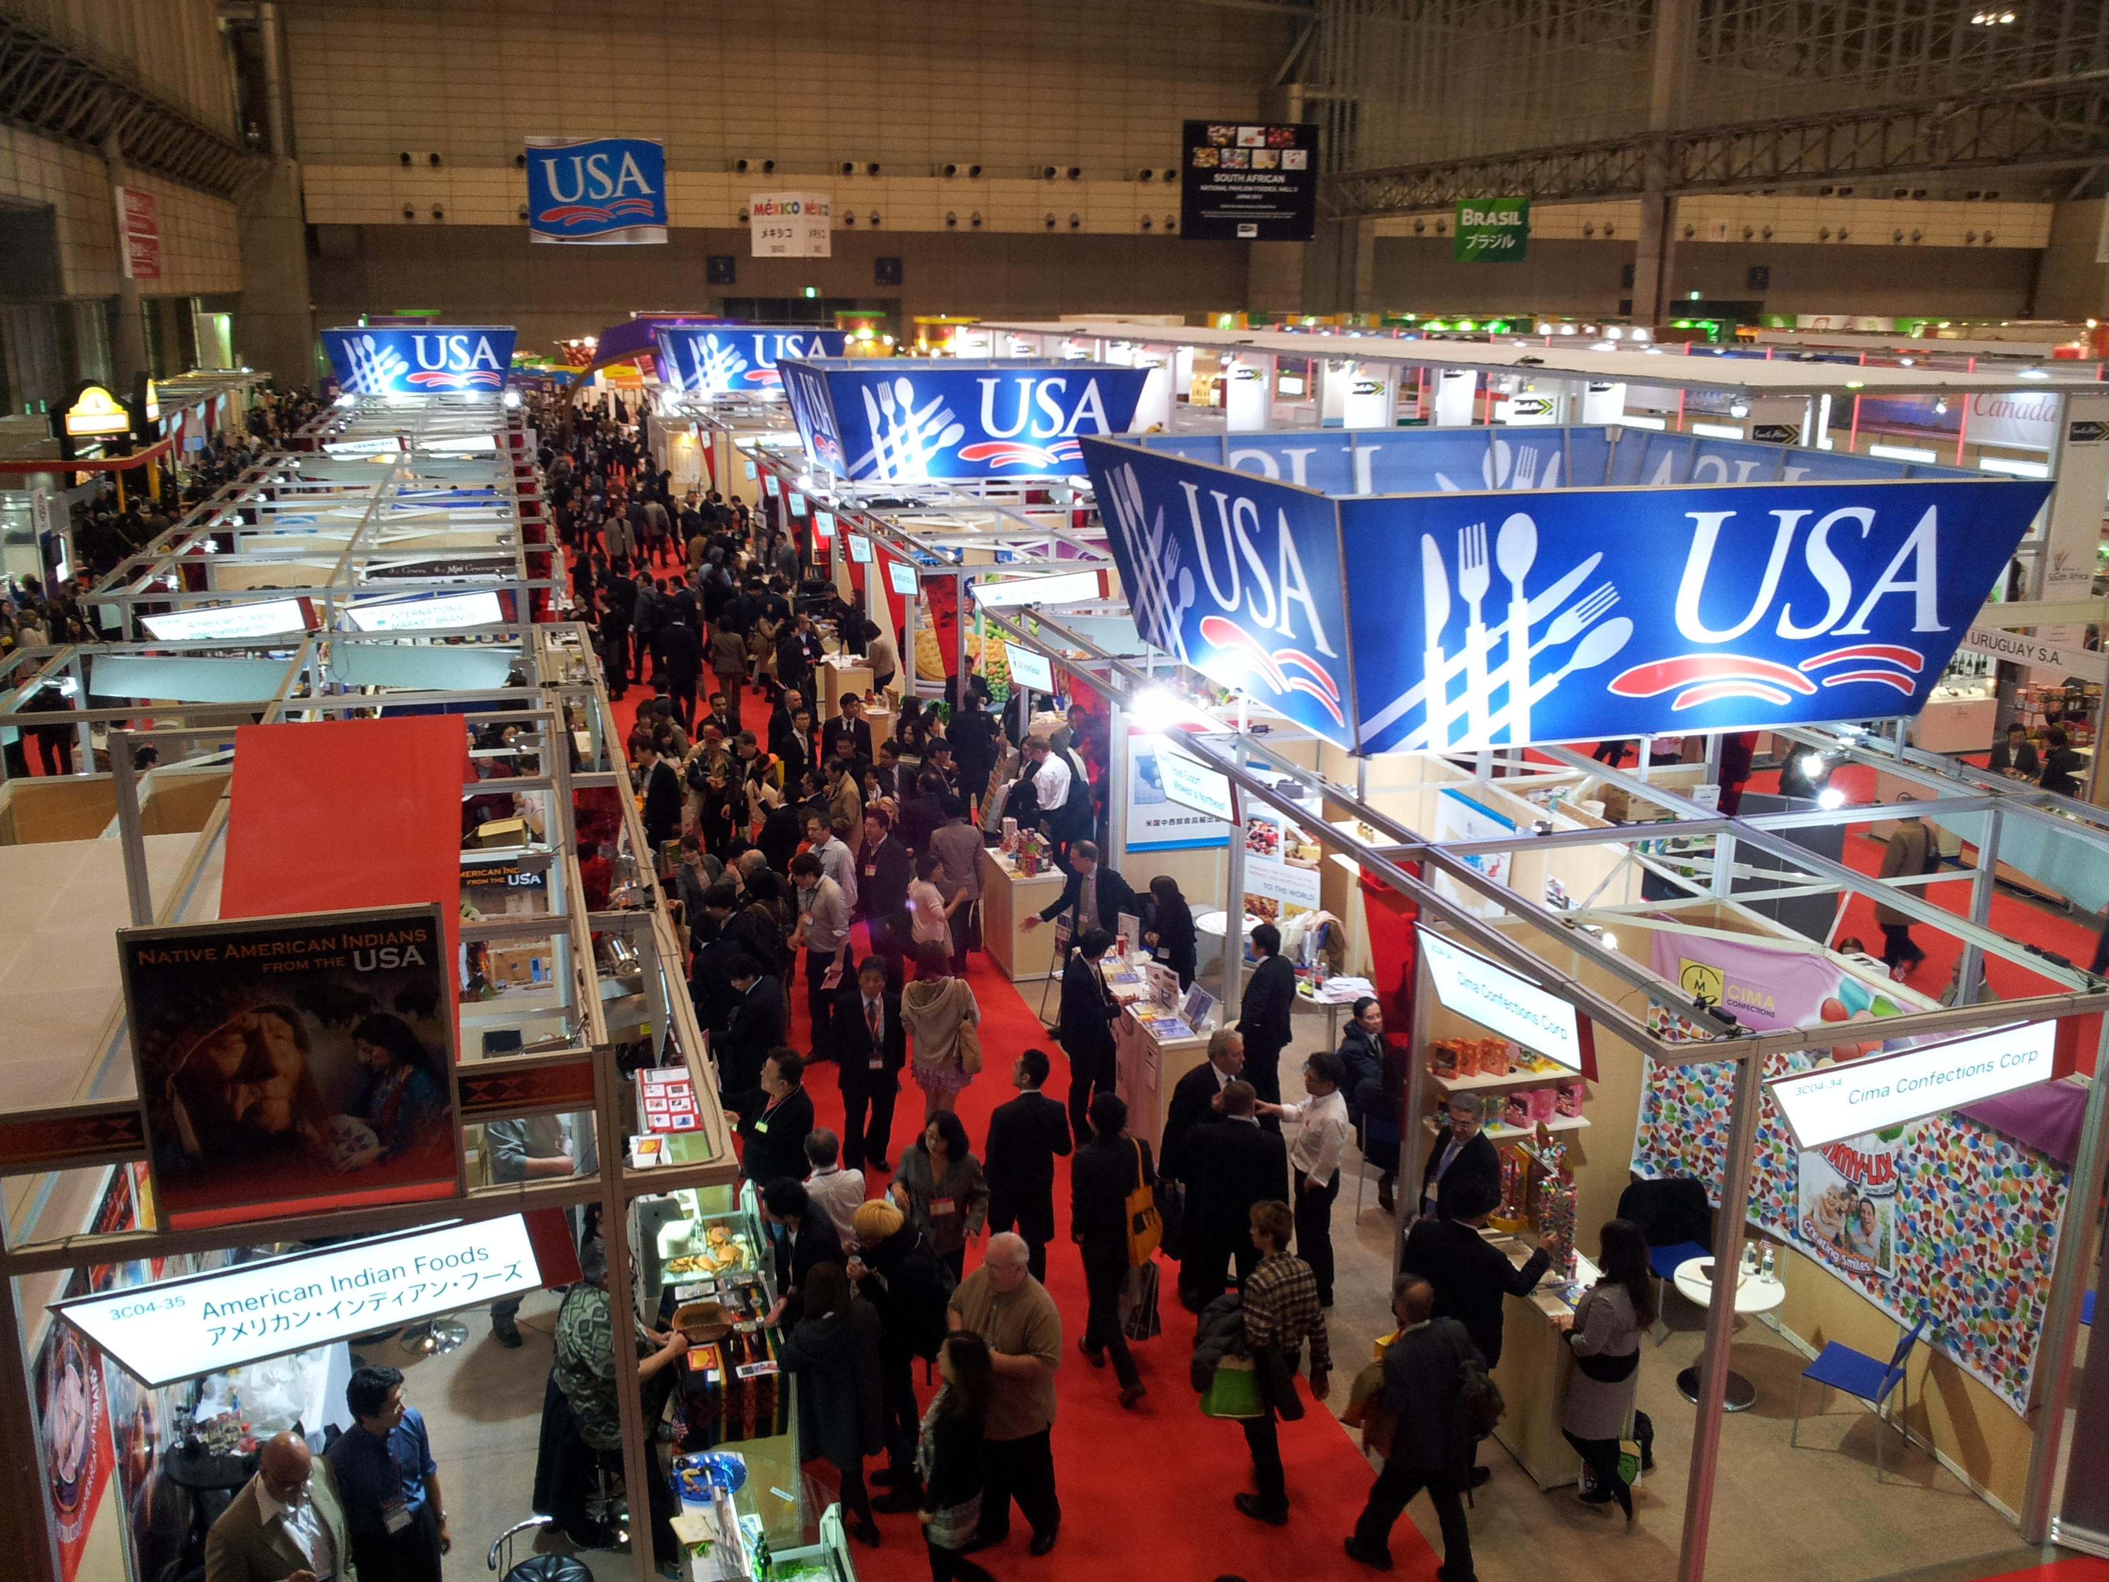
Buyers Missions
Focused Trade Missions
Food Show PLUS!™
Market Builder
Lead Qualification
Virtual Consultations
Trade Leads
U.S. Foodlink

Slide 8
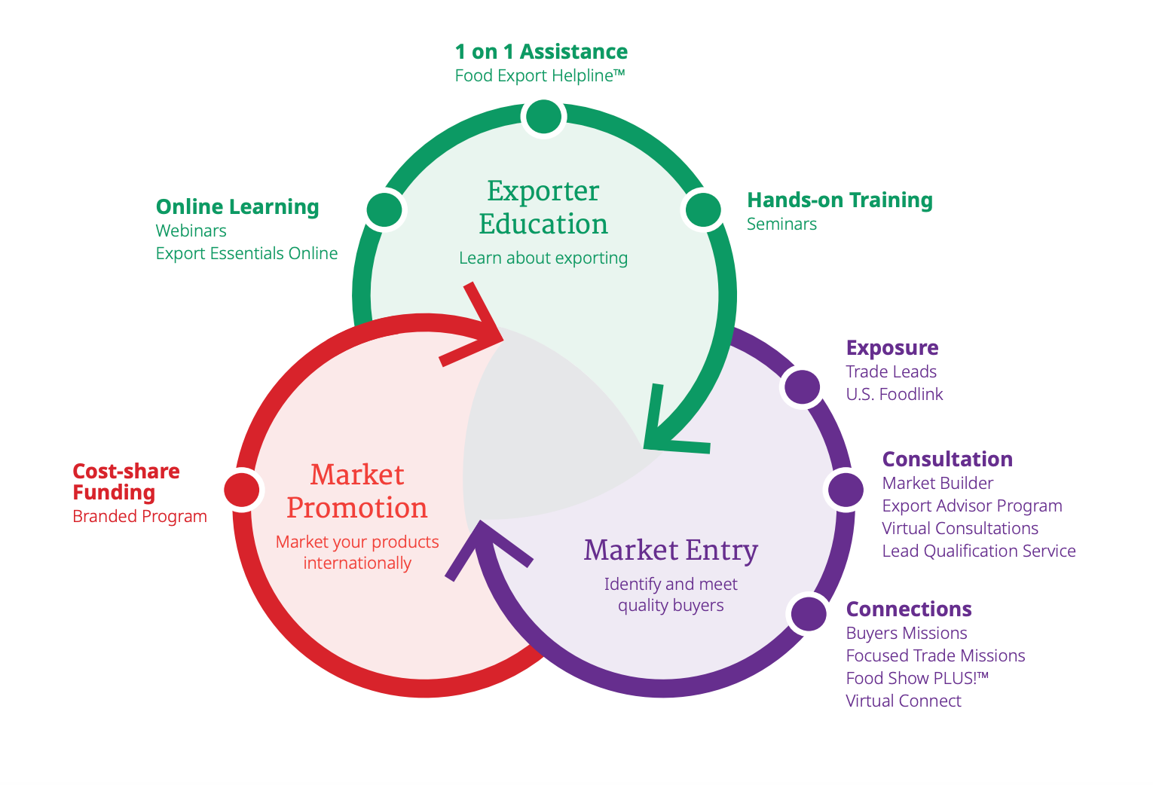

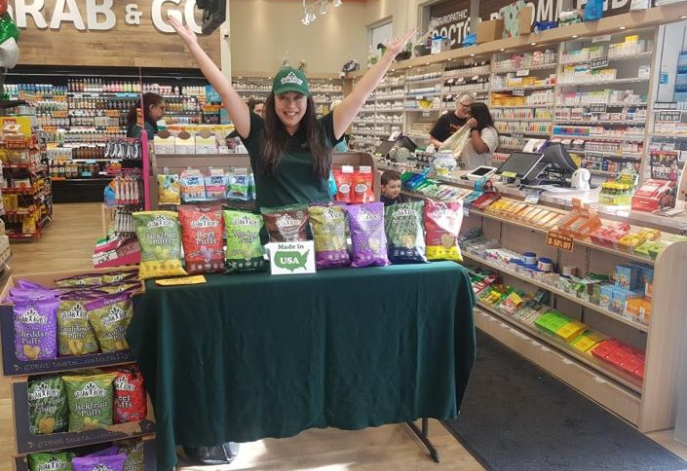
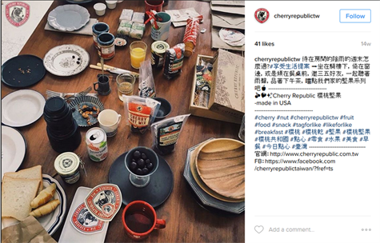
Branded Program
50% reimbursement on international marketing expenses
Annual application process
Can receive up to $300,000 in reimbursement annually
Companies must be small businesses and promoting 50% USA ag products

Slide 9
What are Eligible Expenses?
Freight for sample shipments
Foreign-compliant packaging & labeling
International tradeshows
Travel for international trade shows/trade missions
Certain U.S. trade shows
Websites and social media
Digital/printed marketing collateral
Advertisements
Public relations and seminars
In-store promotions and sampling
Food service promotions
Marketing expenses incurred by importer
Notes:
Many of you have used the Branded Program for trade show and travel reimbursement. We’ll go over that, but I want to highlight some other ways to use the program.
Key Messages:
Through the Branded Program, companies can receive reimbursement for a wide variety of promotional expenses, including:
- developing and placing advertisements in publications
- conducting public relations activities
- running promotions and product demonstrations
- exhibiting at international tradeshows - including some travel costs
- exhibiting at some domestic trade shows - excluding travel costs
- shipping samples and trade show materials to overseas markets
- making modifications to packaging and labeling to meet a country’s requirements
Today I want to highlight three expense categories we see from soy-related suppliers: exhibiting at tradeshows, travel for shows and trade missions, and other marketing expenses incurred by importers.

Slide 10
Thank You
Stay up to date by following us on Social Media
Visit us online at
www.foodexport.org

