Slide 1
Center for Dairy Research
WCMA Export Expansion Workshop

Slide 2

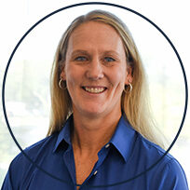

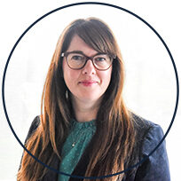
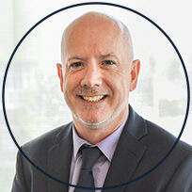
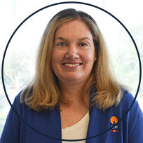


Center for Dairy Research - Founded 1986
World recognized scientific dairy research center
40 staff; CDR is a separate unit and works with multiple departments on campus
Staff with significant industry experience, as well as the resources of a world class university
Budget of ~$5.0M; mainly dairy farmer/industry funded
We turn knowledge and expertise into the dairy industry’s success by bridging cutting edge research with practical education and outreach
Support over 100 dairy companies per year with research projects, training and product development activities
Dr. John Lucey
Director
Tracy Hanke Administrative Director
Andrea Miller
Sr. Management Team
Administration Group
Dean Sommer
Sr Management
Team
Tom Guerin
Sr Management Team
Tina Chorlton
Center Administrator
Donna Christen
Financial Specialist Sr
Dr. Mark Johnson
Assistant Director

Slide 3
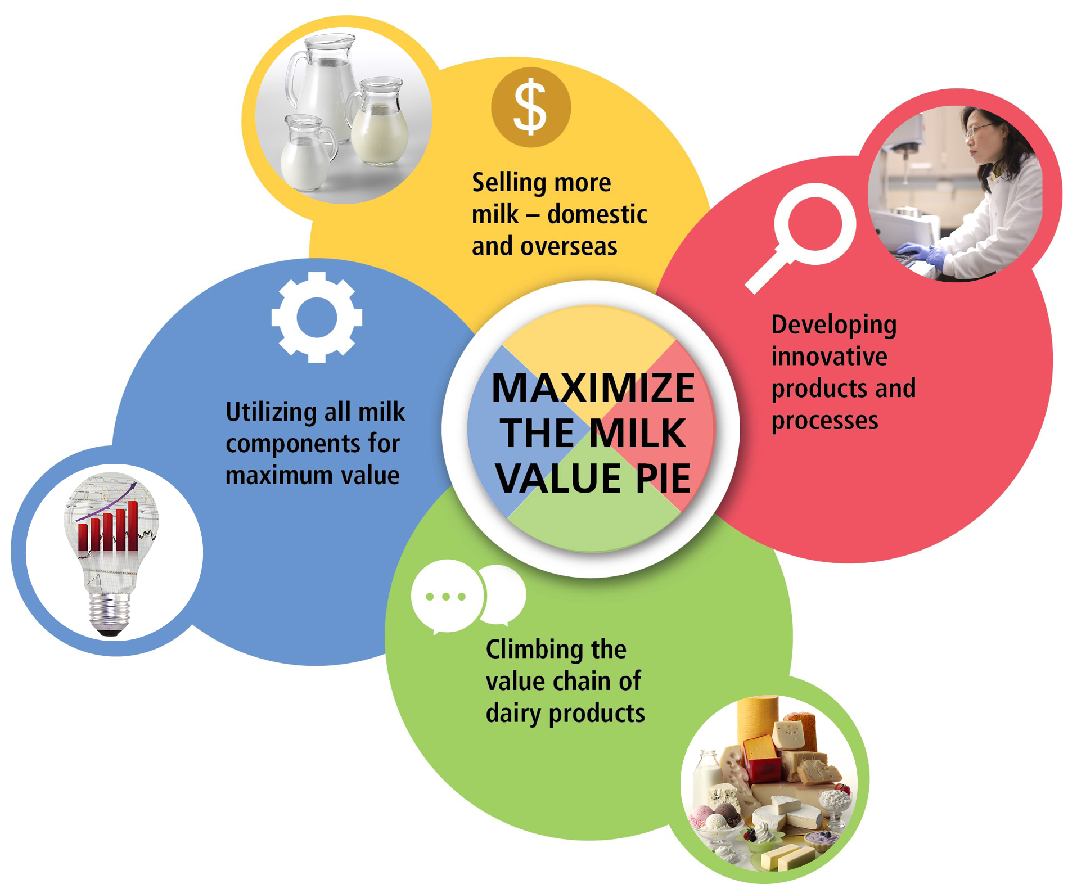
UW-CDR Mission
Support U.S. Dairy Farmers and Dairy Processors by

Slide 4










Center for Dairy Research
Scientific Depth
Practical Expertise
Pilot Plant Capabilities
Analytical & Sensory Support
Grant Opportunities
Product Development
Process Development
Scale-up Support
Troubleshooting
Research
Cheese
Dairy Powders
Beverages
Butter
Fermented Products

Slide 5

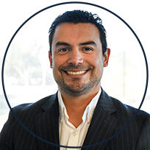
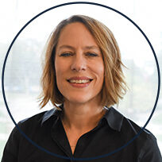

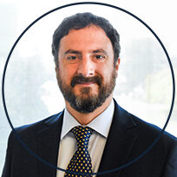
Research Group
Research Projects:
Industry or sponsored competitive projects
Basic studies often involving graduate students
Provide support to applied projects done by cheese applications group
Facilities/Expertise
Provide expertise/resources for non-routine testing of dairy products, e.g. sensory, rheology, microstructure, protein profiles, etc.
Develop new techniques for the analysis/characterization of milk/
dairy products
Technical outreach
Teach technical short courses and workshops
Dr. Mark Johnson
Assistant Director
Rani Govindasamy-Lucey
Senior Scientist
Rodrigo Ibáñez Alfaro
Associate Scientist
Kristen Houck
Research Specialist
Brandon Prochaska
Sensory Coordinator
Miguel Perez
Cheese Scientist

Slide 6

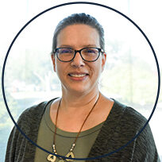
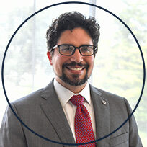

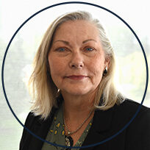

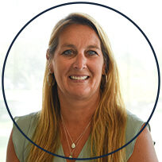

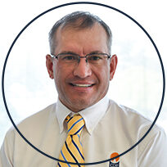
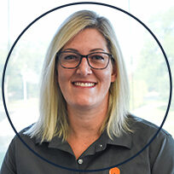

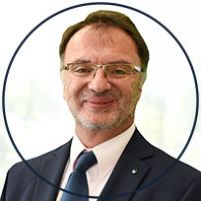
Cheese Industry and Applications
Cheese applications development
Cheesemaking trials
Tailor make cheese for a specific end use
Outline manufacturing protocol for specialty cheeses
Technical service
Address technical questions
Support plant scale-up for new cheeses
On-site visits and trouble shooting
Technical outreach
Provide technical short courses and workshops
Develop technical reviews and fact sheets
Support Wisconsin Master Cheesemaker® Program
John Jaeggi
Coordinator
Gina Mode
Assistant Coordinator
Dean Sommer
Luis Jimenez Maroto
Assistant Coordinator
Joey Jaeggi
Research Cheesemaker
Rebecca Hohlstein
Assistant Coordinator
Ben Ullerup-Mathers
Research
Cheesemaker
Amy Bostley
Research Specialist
David Niemiec
Cheesemaker
Ben Smith
Cheesemaker
Jeremy Johnson
Research Cheesemaker
Melissa Houfe
Research Cheesemaker
Andy Johnson
Assistant Coordinator
Juan Romero
Assistant Coordinator

Slide 7

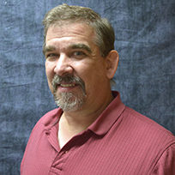
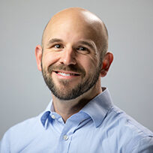
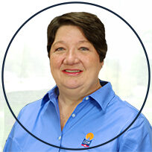
Dairy Products and Processing Group
Dairy Ingredients
Dairy ingredient applications development
Functionality testing of dairy ingredients
Develop formulations using dairy ingredients (non-cheese)
Prototype Development
Dairy processing
Work with processors and manufacturers on milk/whey processing
Separation technology of milk/whey components
Pilot plant trials: Fractionation & Concentration
Technical outreach and utilization
Dairy ingredient processing and utilization short courses
Tom Guerin
Research Program Manager
Dairy Ingredients Coordinator
Mike Molitor
Pilot Plant Project Manager
Jim Cropp
Instrumentation Technologist
Susan Larson
Research Specialist
Daniel Wilbanks
Research Specialist
Dean Sommer
Cheese & Food Technologist
Mellisa Houfe
Instrumentation Technologist

Slide 8
CDR Addition
Cheese
  Production spaces for natural, processed, and specialty cheese
  Ripening rooms for specialty cheese
Fractionated milk proteins
  e.g. purified proteins with membrane filtration)
Dried dairy ingredients
  MPC, WPC, etc.
Cultured products
  Yogurt, Greek yogurt
Beverages
  UHT aseptic, juices containing dairy proteins)

Slide 9
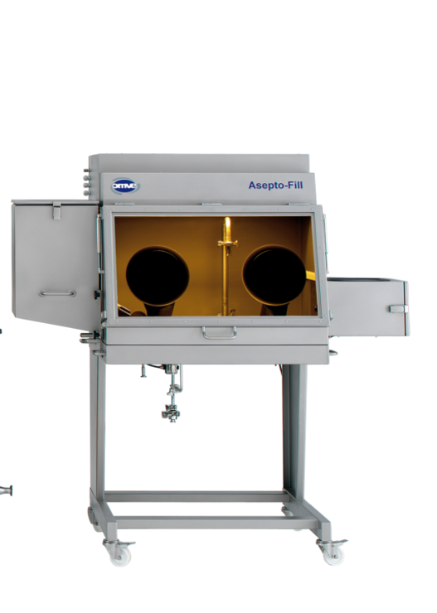
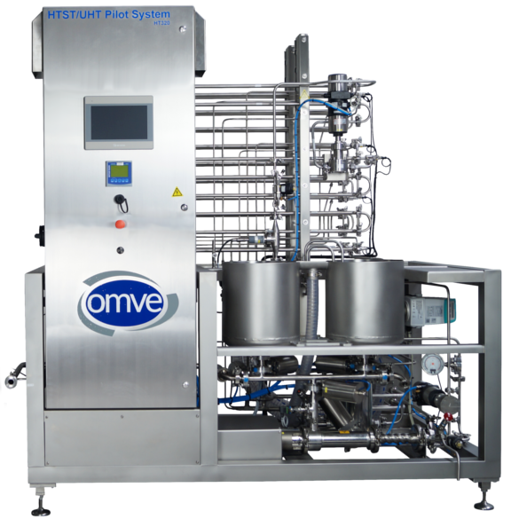
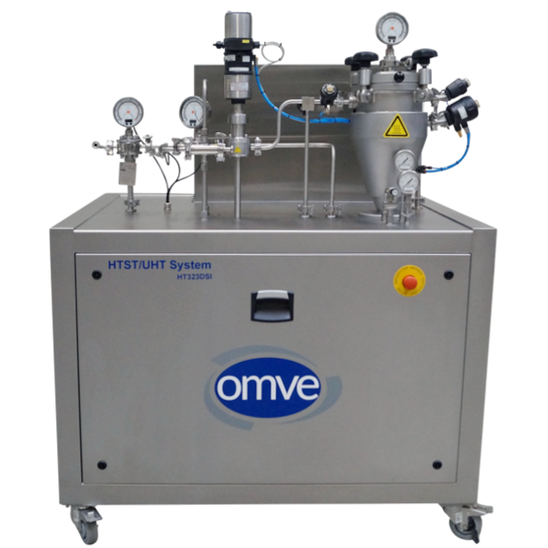
Aseptic/UHT Beverage Innovation Facility
Direct & Indirect heating Aseptic homogenizer Surge tank Bag in box filler Packaging/bottles
Example of the flexible, modular system for processing and aseptic packaging of beverages
Notes:
Modular: add features/components as needed
Scalable: design and controls facilitate scaling up to full-size commercial beverage plant
Flexibility: different types of beverages can be produced for retail/consumer testing
New technologies: can be evaluated on this system

Slide 10
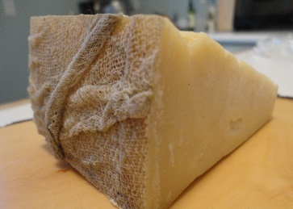
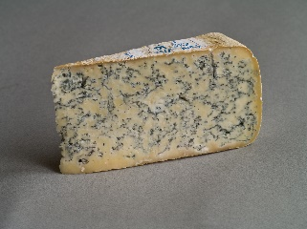
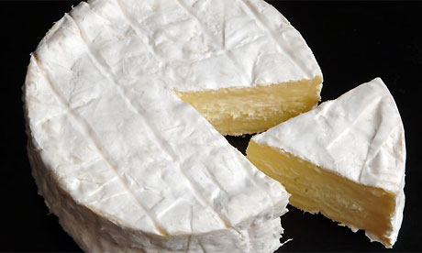
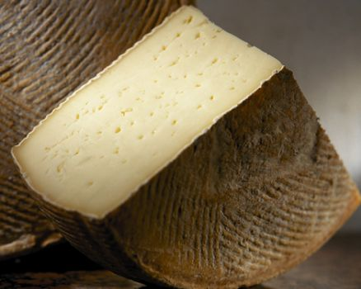
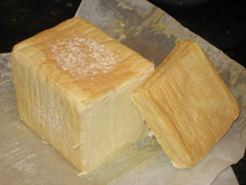
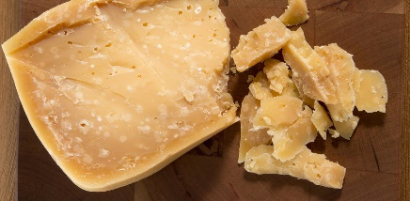
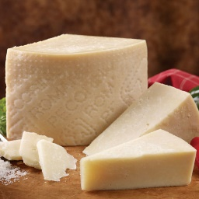
9 Specialty Cheese Ripening Rooms
Natural (bloomy) rind – e.g., bandaged Cheddar (2)
Blue mold
White mold
Smeared – e.g., Alp style (longer aging)
Smeared – e.g., Limburger (shorter aging) (2)
Aged rind cheese – e.g., Gouda
Drying room – e.g., Romano

Slide 11
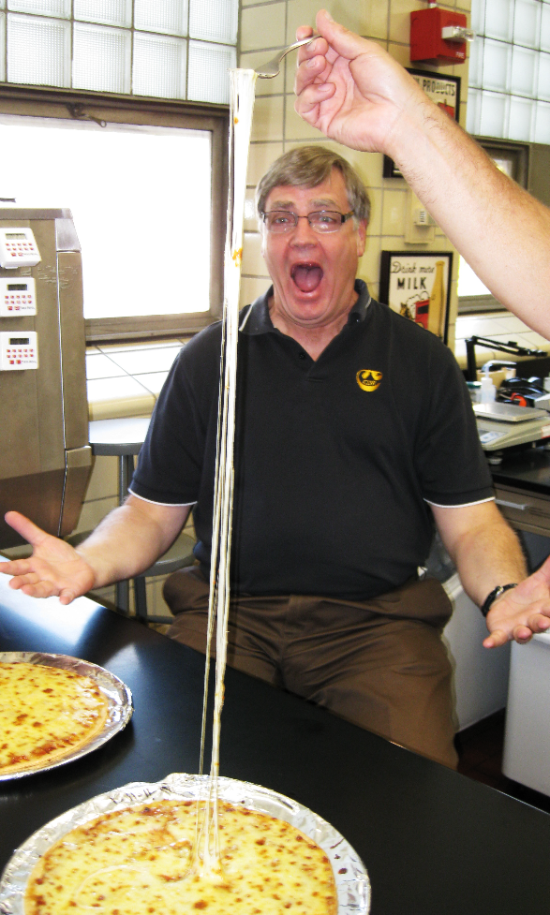
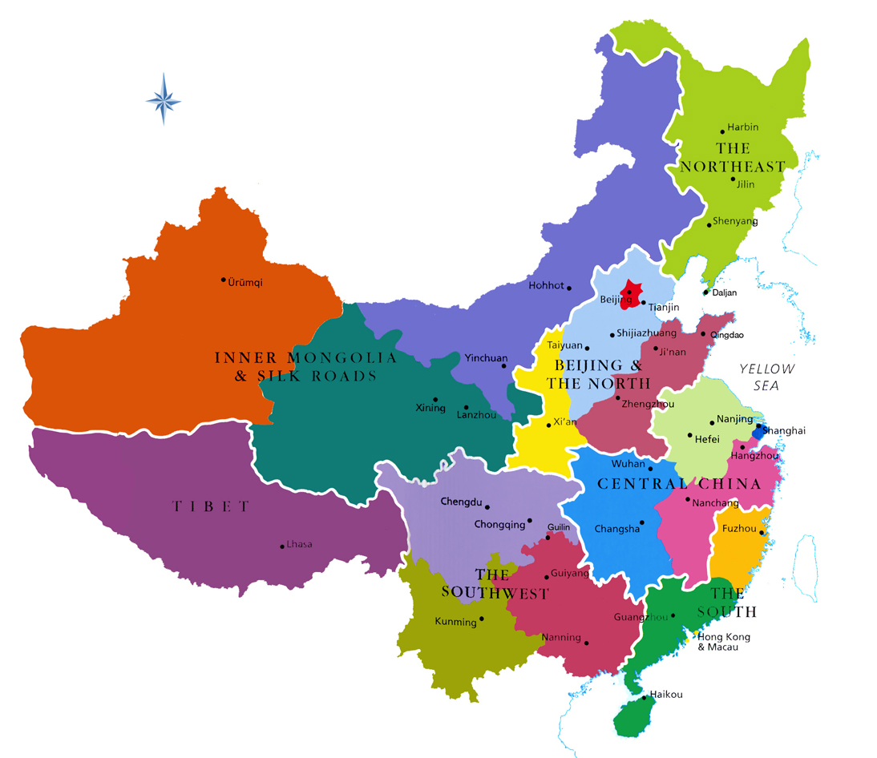
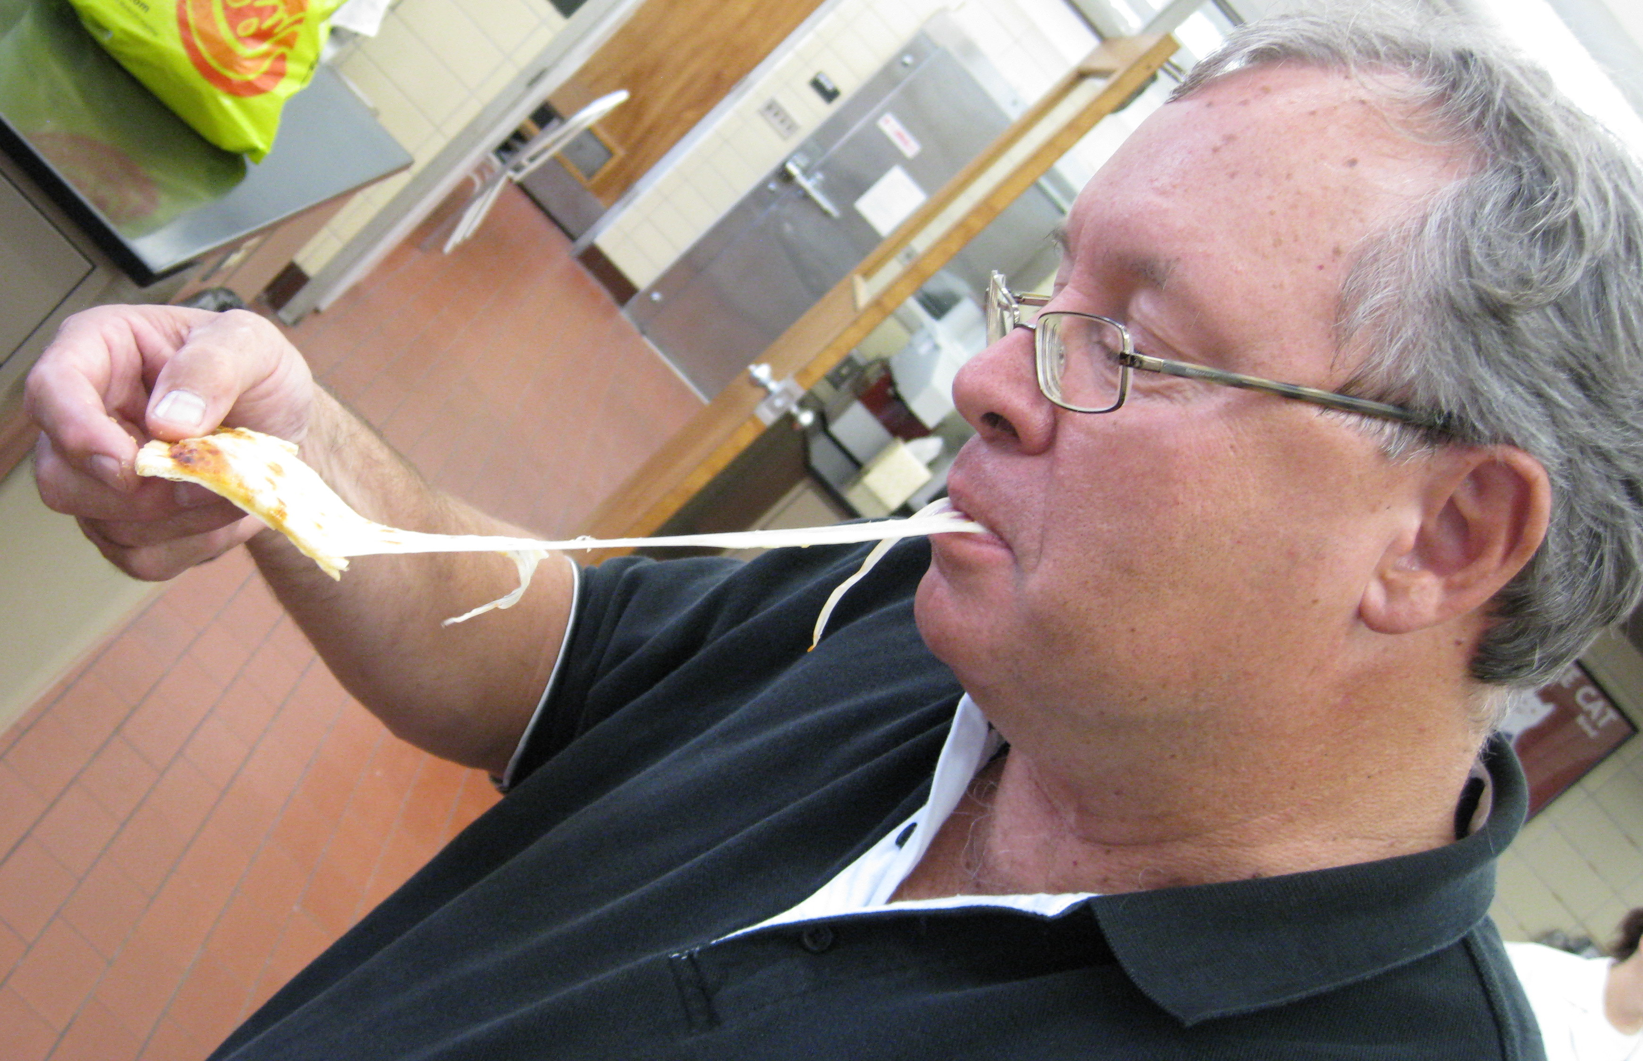
Mozzarella in China
Mark Johnson’s excursion to China…

Slide 12
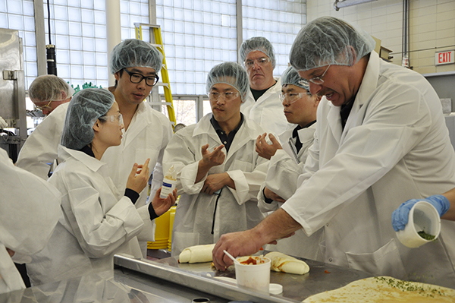
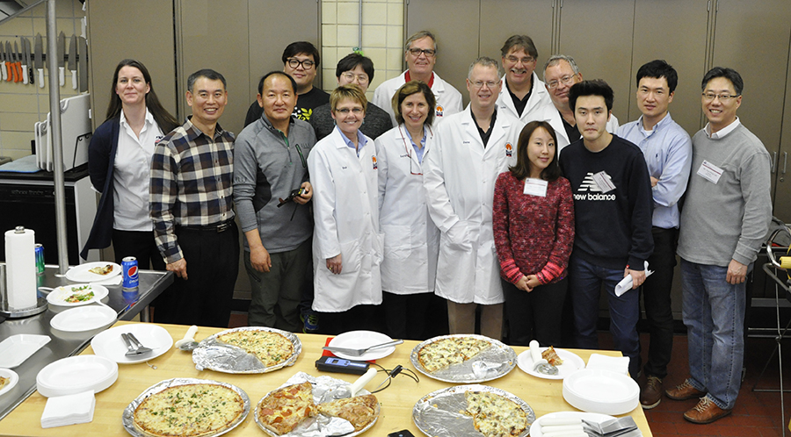
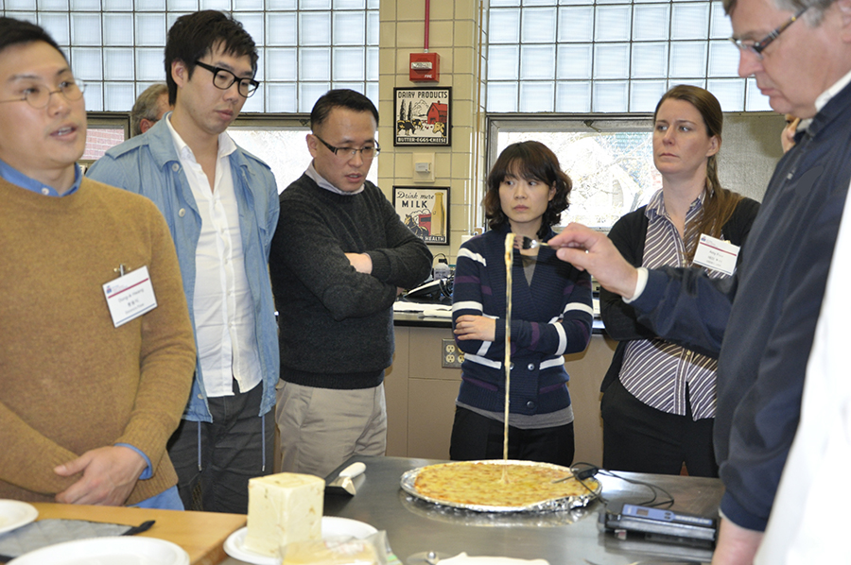
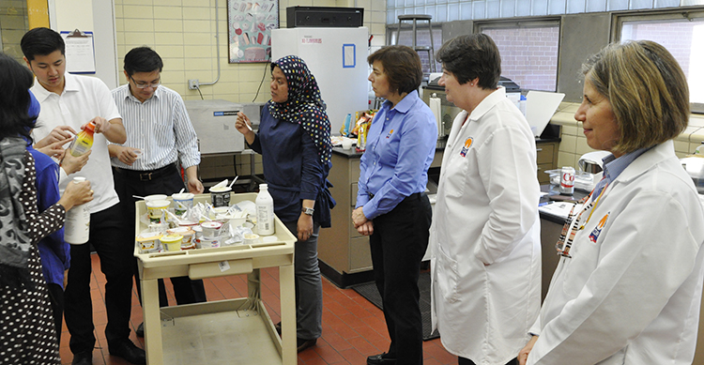
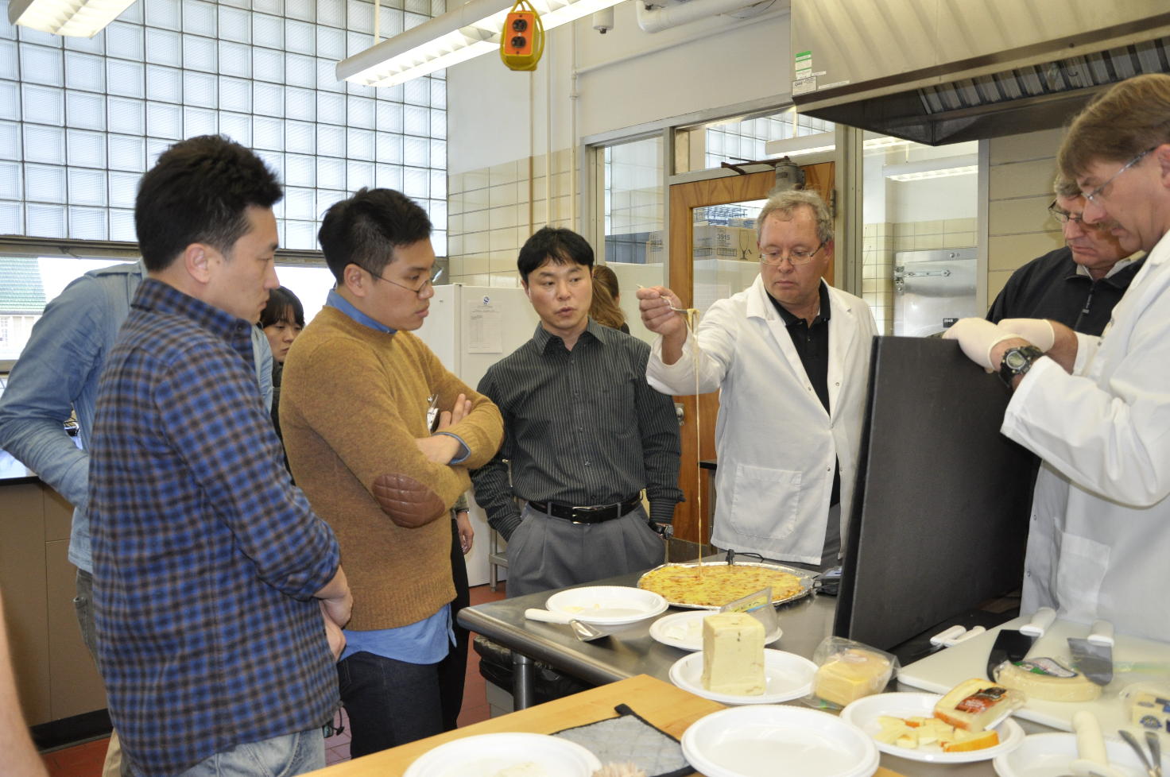
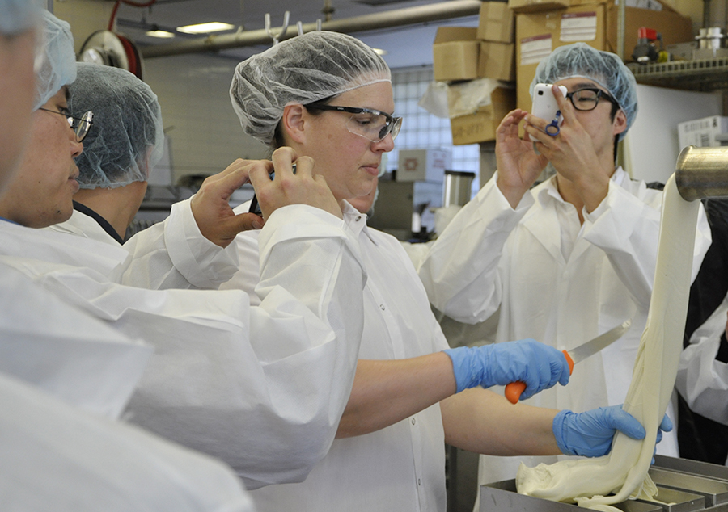
Host USDEC/DATCP
Foreign Trade Missions

Slide 13
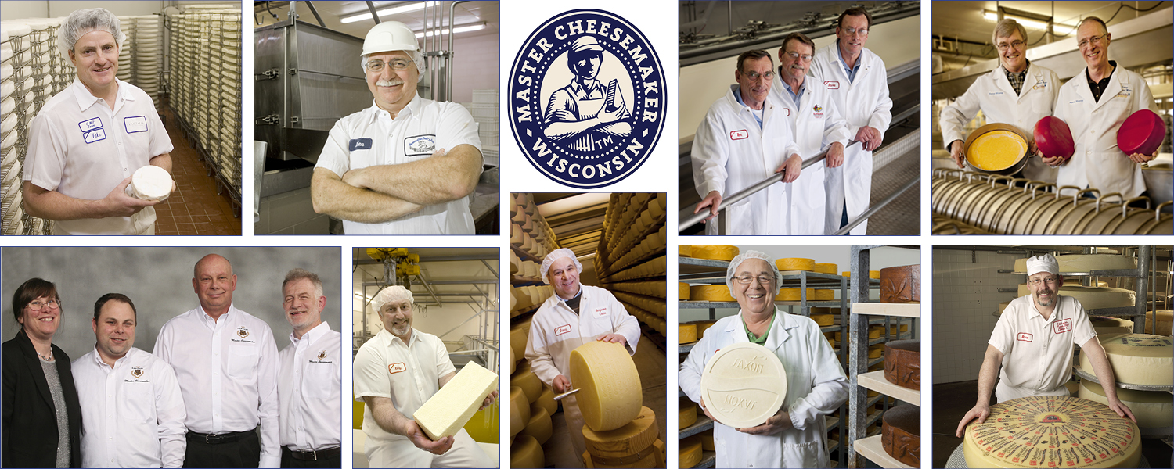
Wisconsin Master Cheesemaker Program
The Wisconsin Master Cheesemaker Program began in 1994.

Slide 14
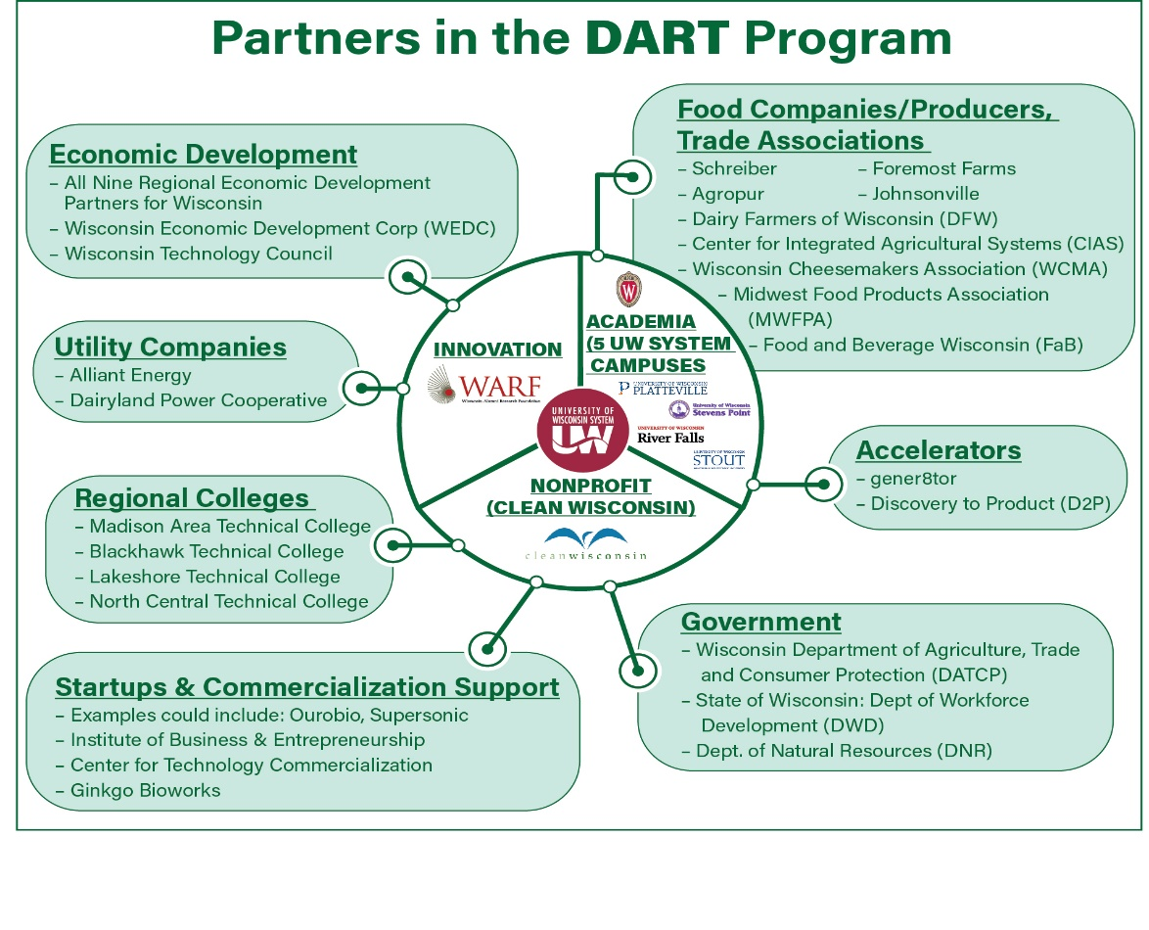
NSF OPPORTUNITY: Decarbonize Agricultural Residues by bio-Transformation
Type 1 Grant: $1M – 2years
Type 2 Grant: $160 M – 10 years
DART: Type 1 Grant submitted
Conversion of Agricultural residues (e.g. dairy) into value added products.

