Slide 1
Food Export – Midwest Branded Program Overview
WCMA Export Expansion Workshop
November 2022

Slide 2
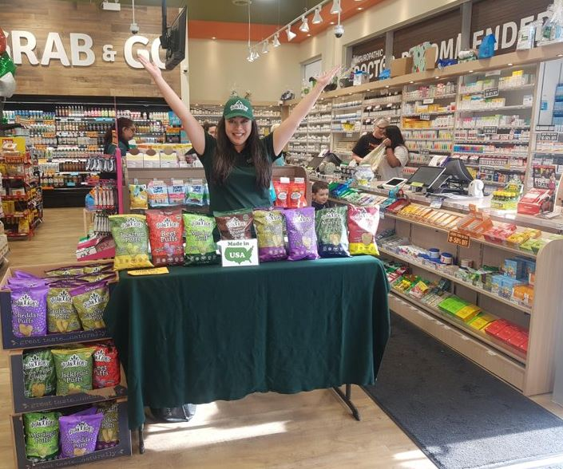
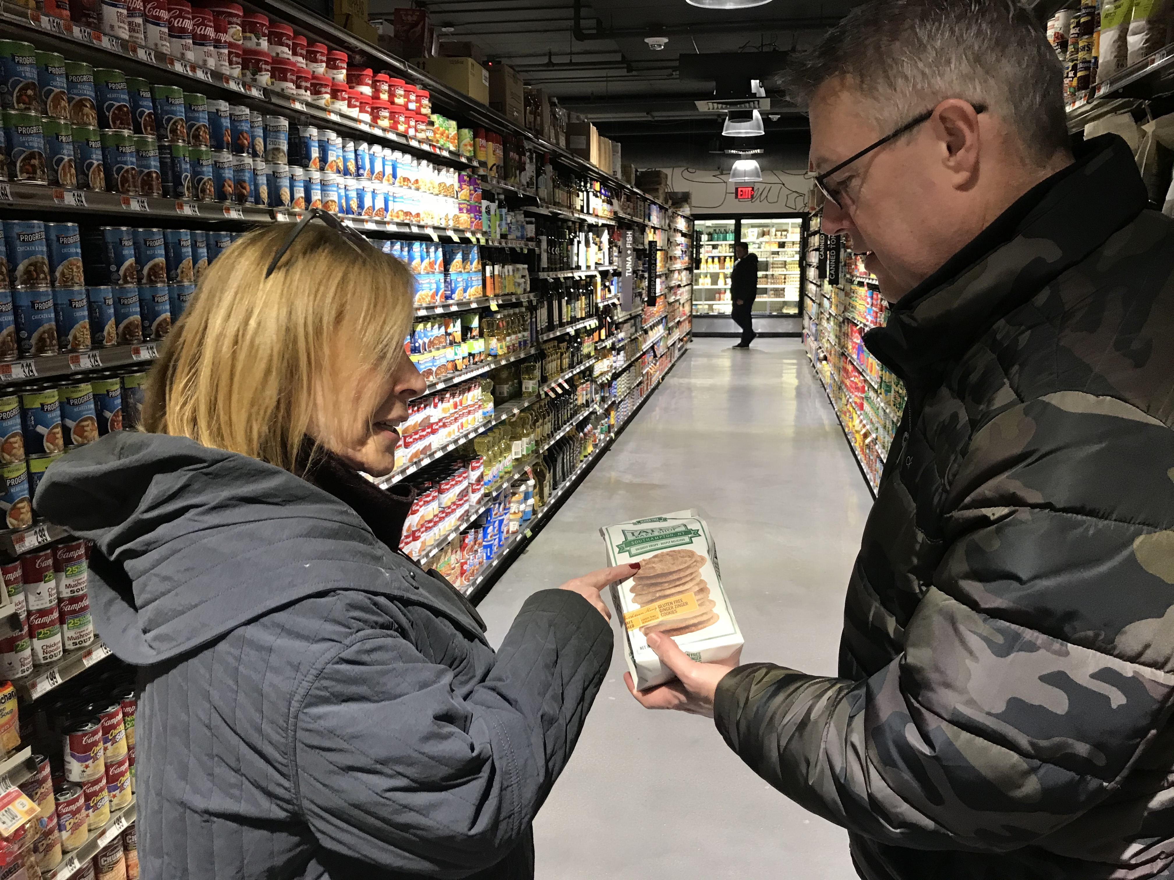
Market Promotion
Branded Program
We reimburse 50% of export marketing expenses.
All activities approved in advance.
Company incurs all expenses up front.
We assist products that have at least 50% of
U.S. agricultural origin.

Slide 3
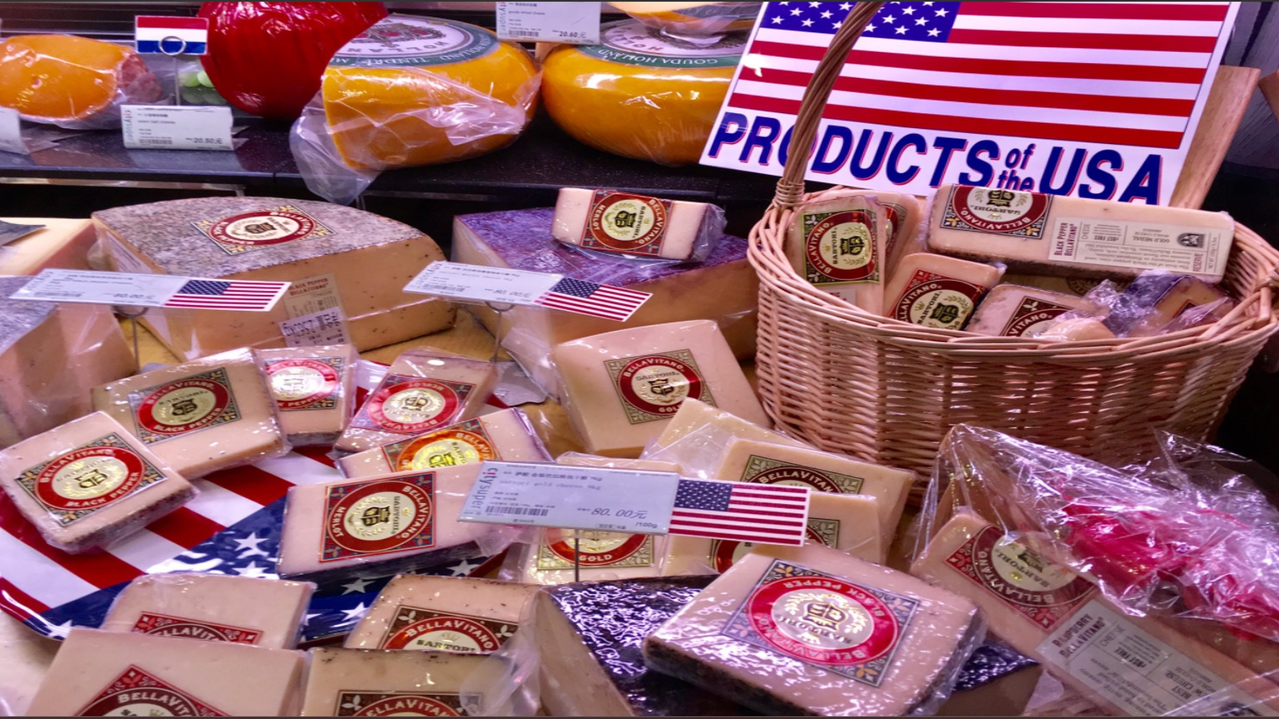
Branded Program – Details
Up to $300,000 in reimbursement annually
Products must have at least 50% U.S. agricultural content
U.S. Supplier = Small or Medium Size
Activities approved in advance
Claim for reimbursement afterwards
Must promote U.S. origin of product
  Made in …
  Product of …
  Grown in …
  U.S., USA, America or State name can be used
Notes:
There are some requirements to apply for the branded program. Suppliers are the ones that apply and have to pay a 6% application fee. Suppliers incur all expenses for approved activities up front and will be reimbursed after showing proof of payment and activity. In order to qualify for the branded program, the supplier’s products must have a minimum of 50% US agricultural origin.

Slide 4
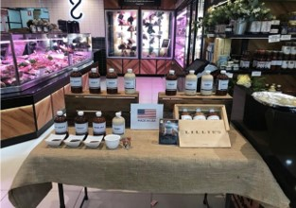
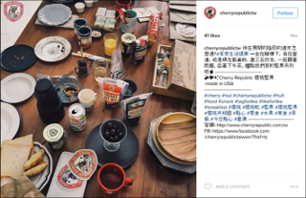
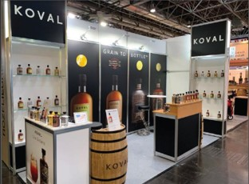
Eligible Expenses
Advertisements and publications
Websites and social media
Public relations and seminars
Promotions and demonstrations
International tradeshows (including limited travel costs)
Certain trade shows held in the U.S.
Foreign-compliant packaging and labeling
Freight for sample shipments
International Travel Costs

Slide 5
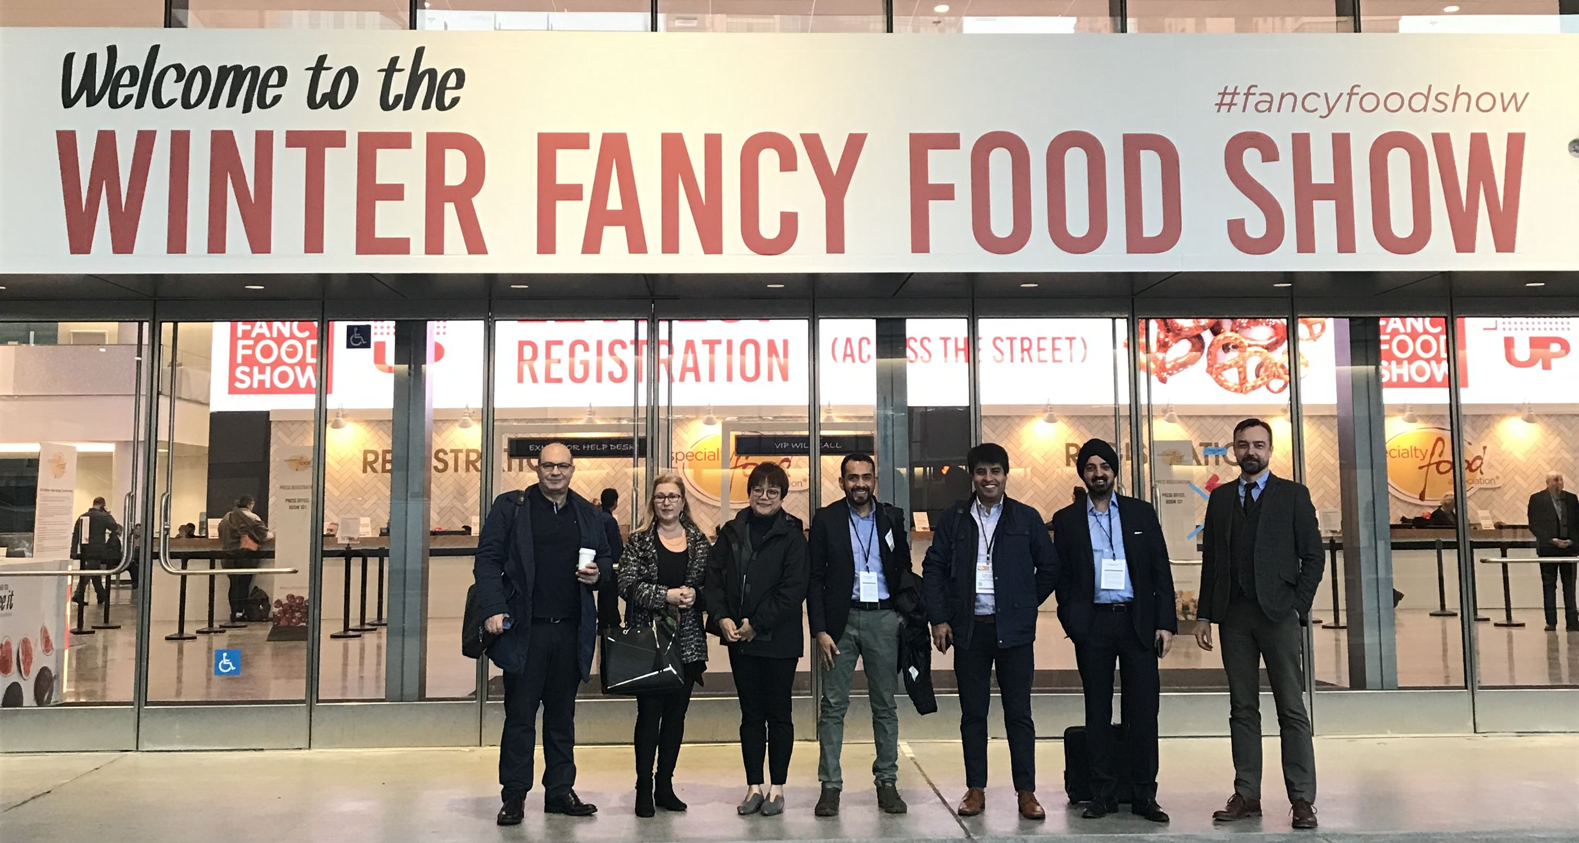
Eligible Activities
Various Tradeshow Expenses – including certain U.S. tradeshows
General Promotional Activities
Promotional/Giveaway items
Product Demonstrations/Merchandising
Social Media Campaigns
Website Development
Public Relations
Packaging and Label Modifications
Freight for sample shipments
And more!

Slide 6
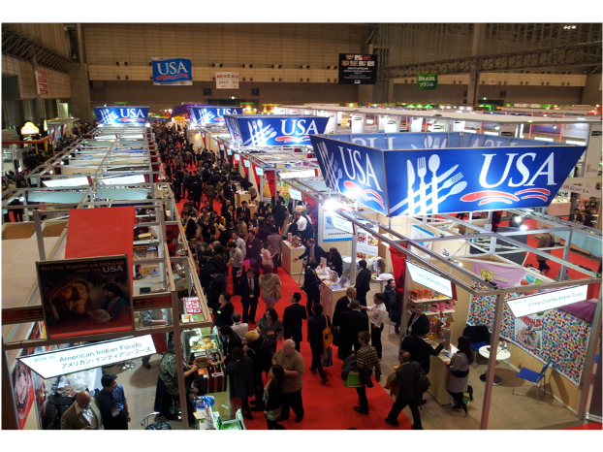
International Trade Shows
Virtual or In-Person
Eligible Expenses
Exhibition Fee
Product Showcases
Rented Furniture
Electrical
Freight To/From Show
Booth Buildout, Banners, Signage
POS Materials
Uniforms
Part-Time Contractors
Giveaway Items

Slide 7
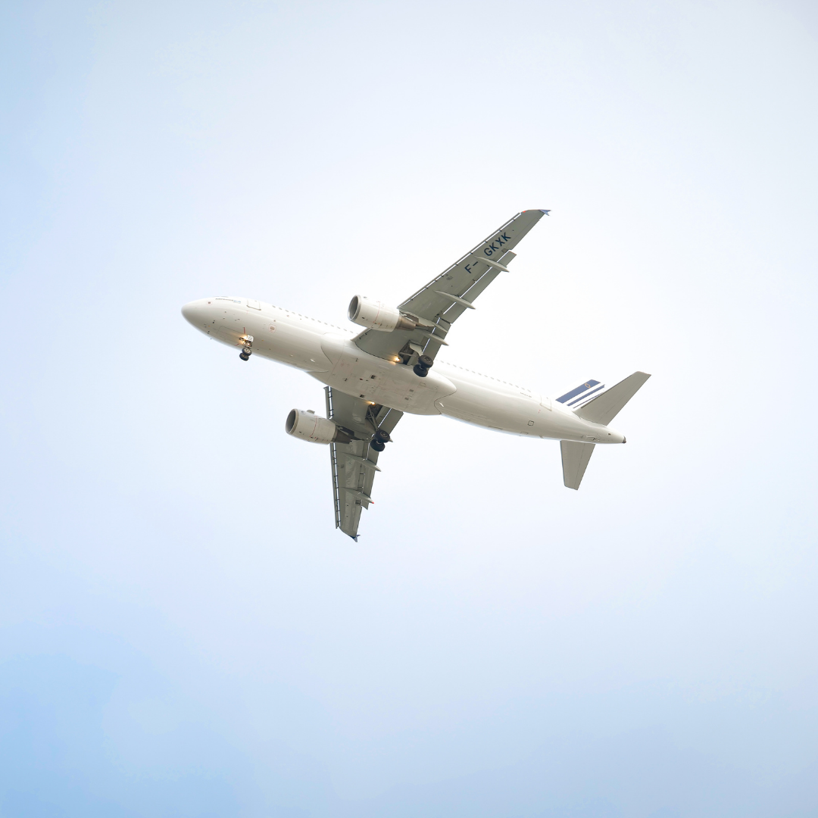
Travel Reimbursement
International shows or trade missions only – outside the US
Must exhibit at the show
Up to 2 travelers
Round-trip coach airfare on
US or EU carrier
Federal per diem rate for hotel and meals

Slide 8
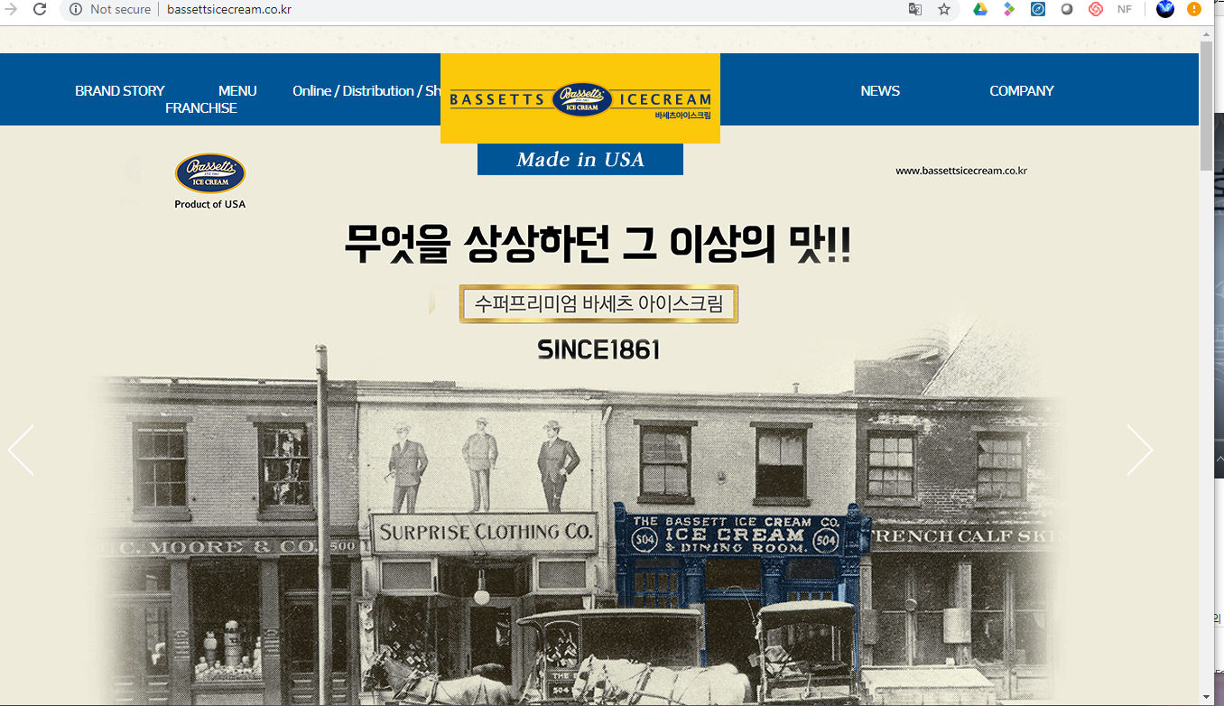
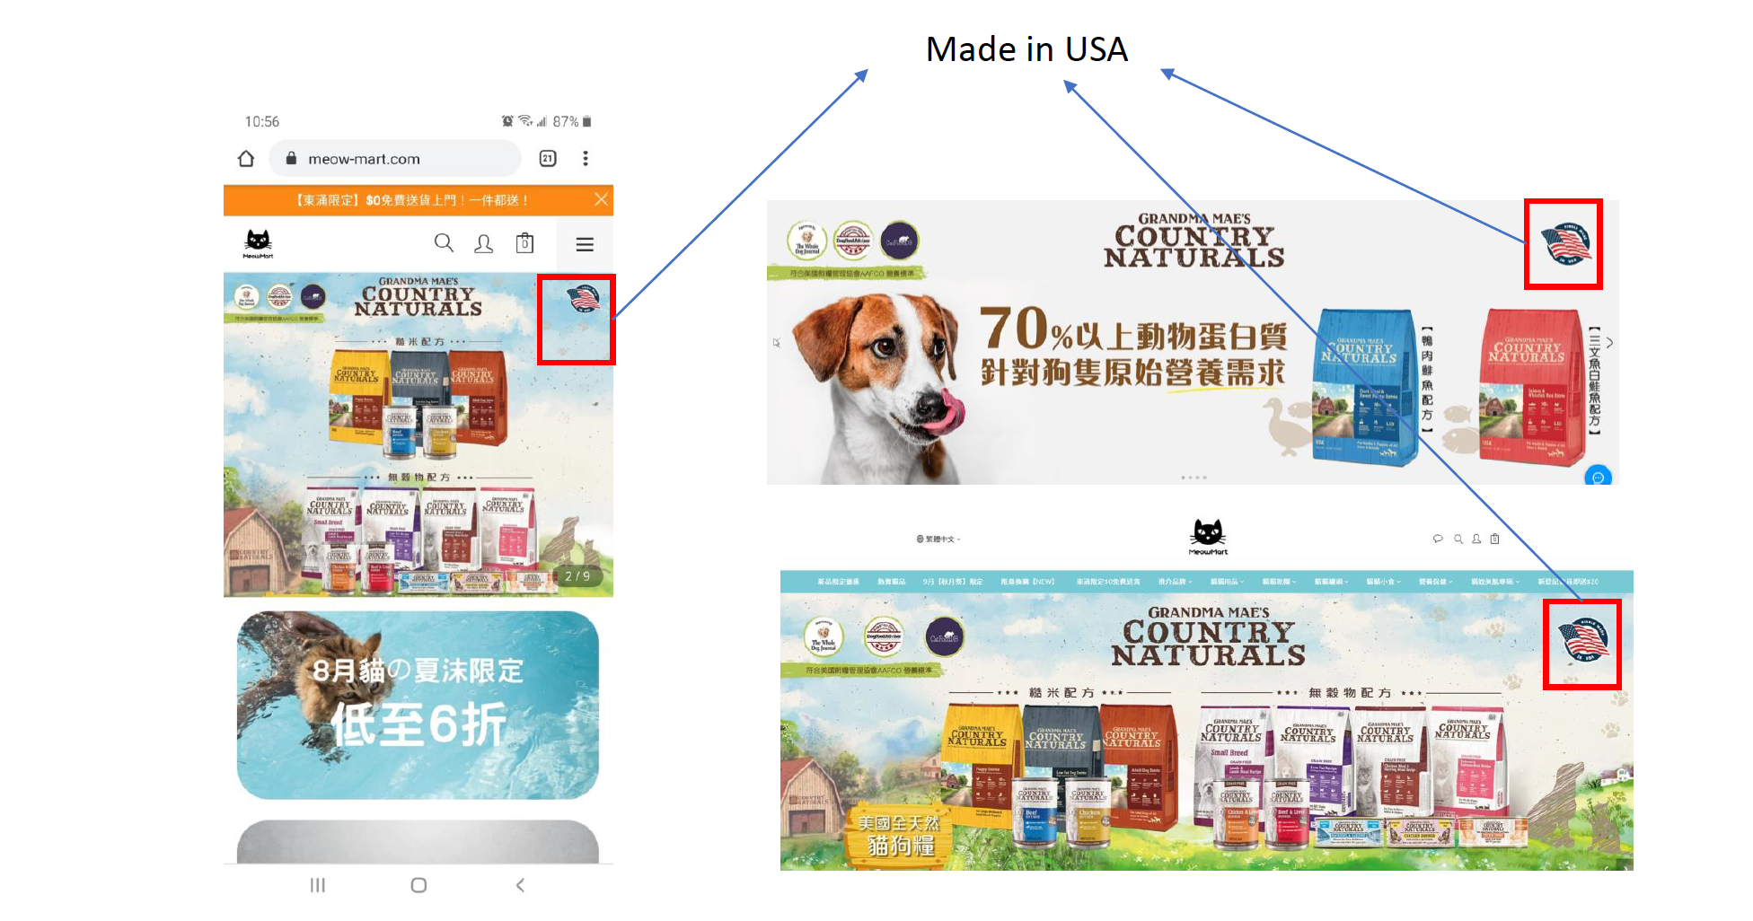
International Website Development
Web Banners for Hong Kong
Website for South Korea

Slide 9
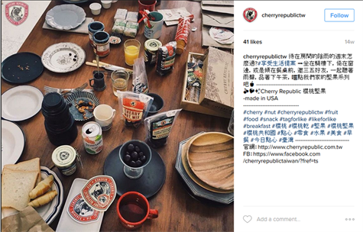
Social Media
Web & Social
Eligible Costs Include:
SEO and other online advertisements
Website Development, Updating, and Servicing
Social Media Management
Content Development

Slide 10

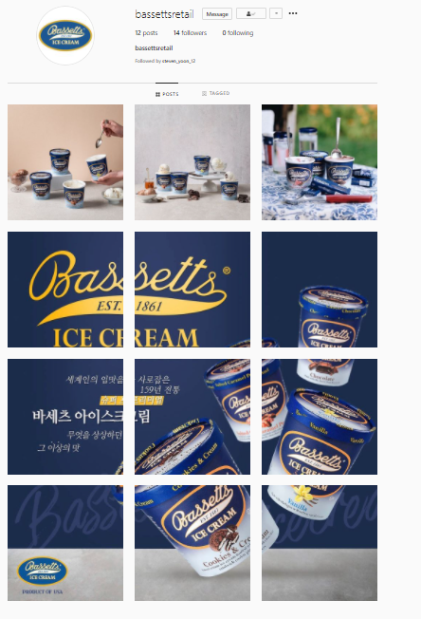
Instagram Influencer Post

Slide 11
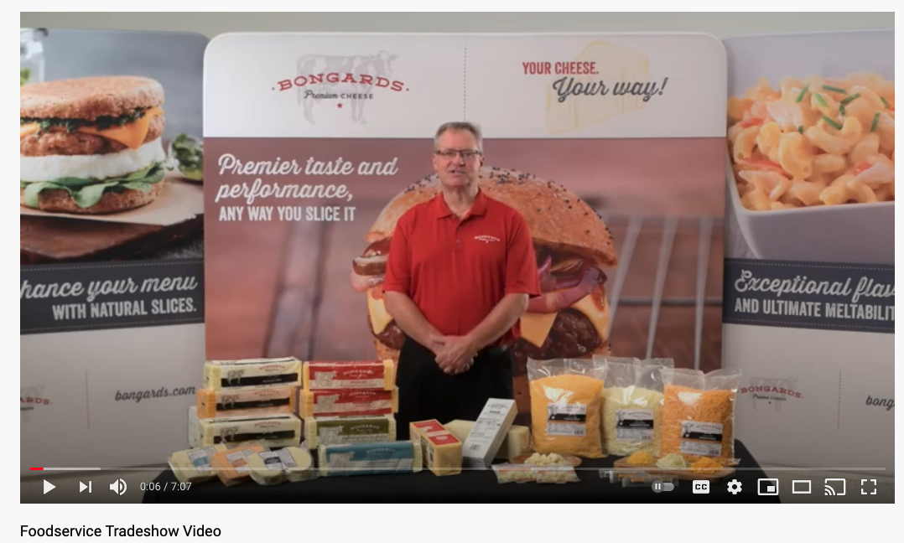
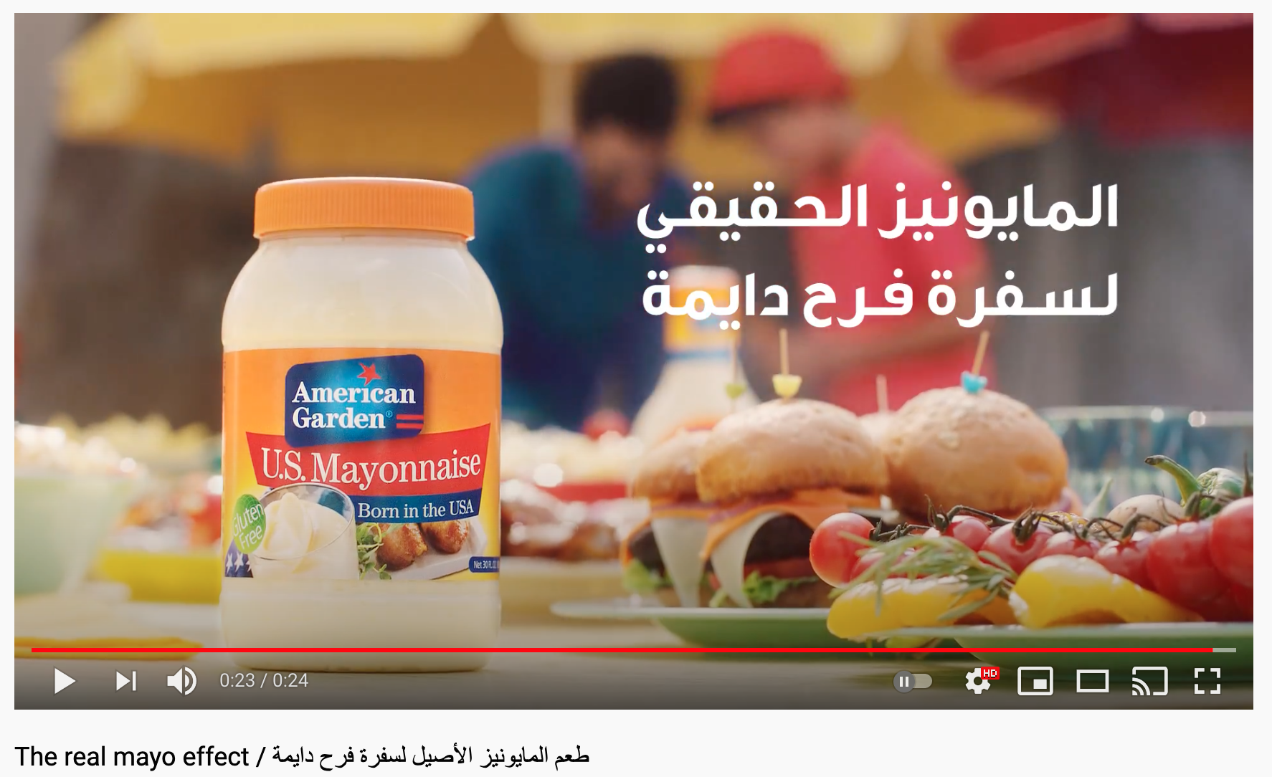
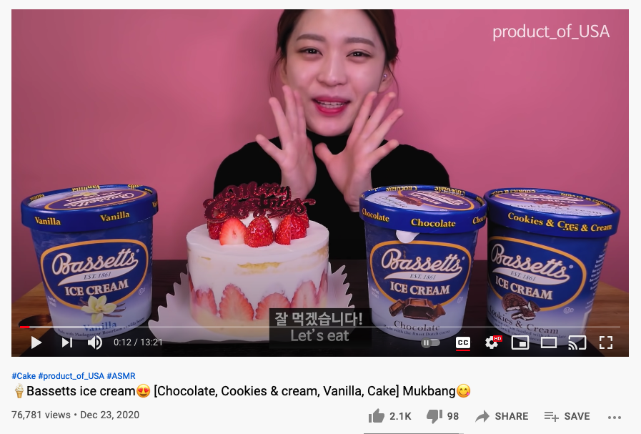
Videos
Commercial in Arabic for U.S. Mayonnaise for the U.A.E. & Saudi Arabia
Video that walks viewer through supplier’s entire food service product line
Product placement in a South Korean ASMR Mukbang YouTube Video
Mukbang is a type of video that features a person eating a large quantity of food in one sitting.

Slide 12
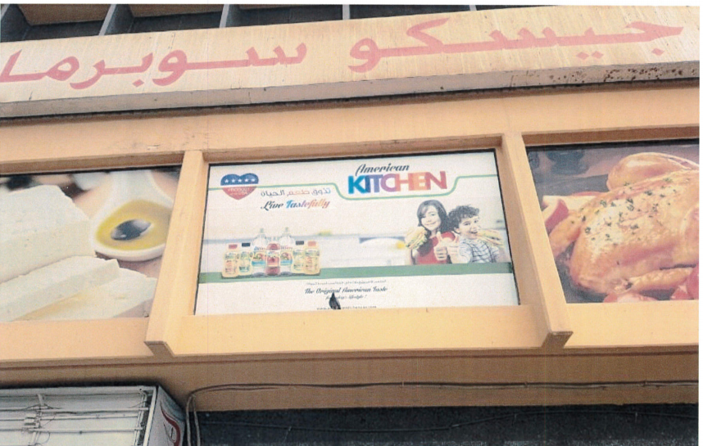
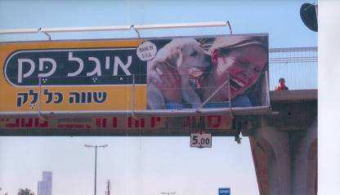
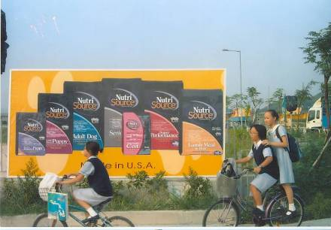
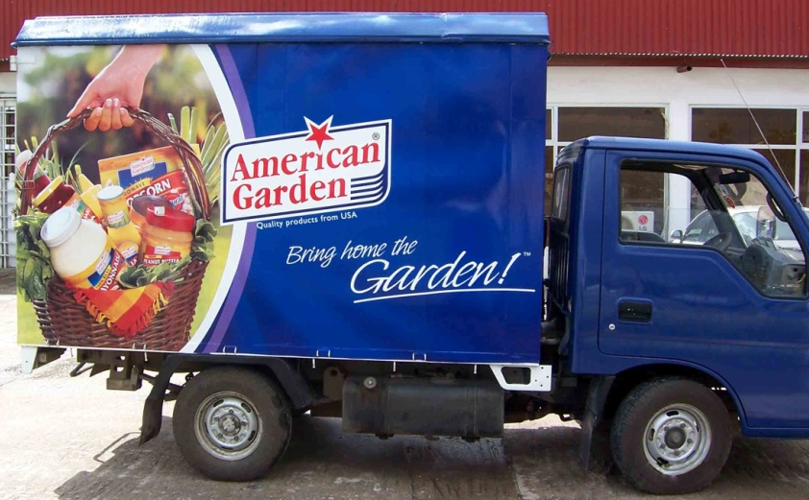
Large Format Advertising

Slide 13

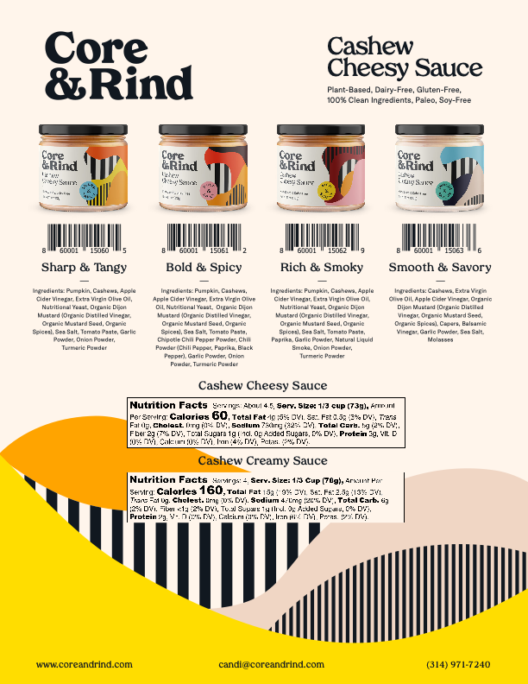
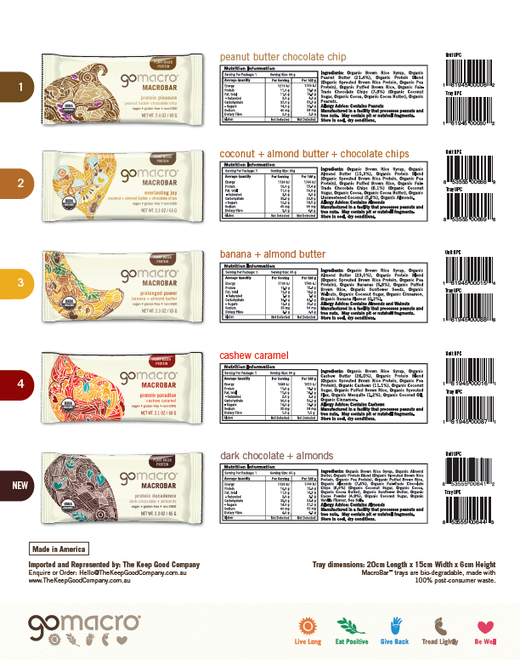
Point of Sale Materials

Slide 14
Promotions and Demonstrations
In-store and food service
promotions
End-of-aisle displays
Temporary displays
Giveaways
Shipment of samples
Posters, banners, shelf talkers
Demos to the trade and consumers

Slide 15

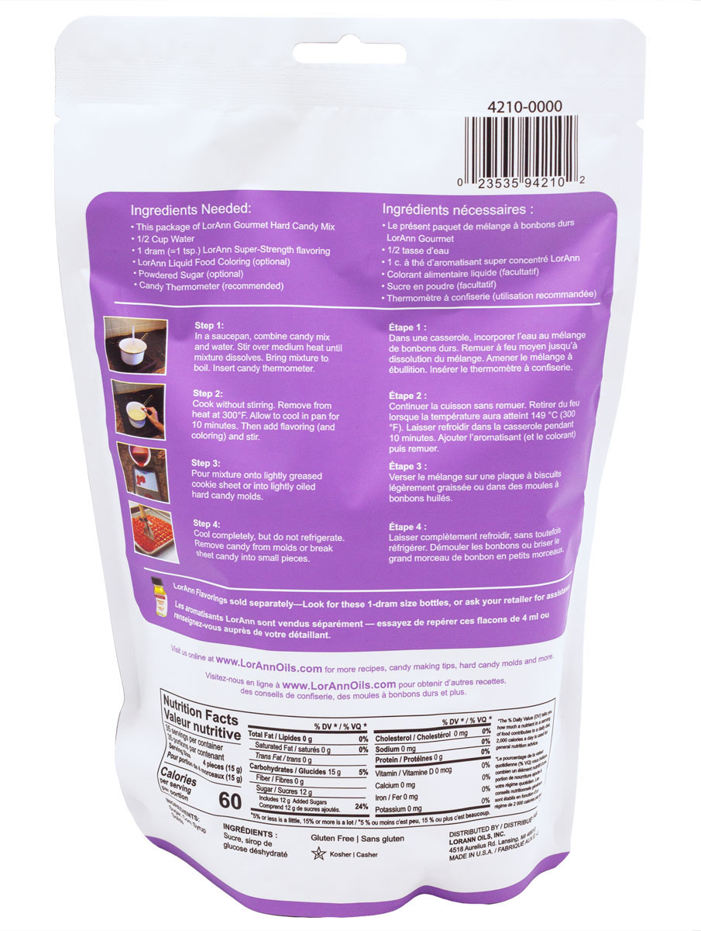
Foreign-Compliant Packaging & Labeling
Eligibility requirements when REQUIRED by importing country
Eligible expenses include
  Design costs
  Translation costs
  Production/printing costs
  Labor to attach stickers

Slide 16
Application
Application Steps
Pre-qualify​
Complete the application​
Submit application​
Submit application fee
Maximum request is $300,000 ($350,000 for cooperatives)​
Minimum request is $2,500​
First-time applicants:​
  With exporting experience, initial maximum request is $50,000​
  Without exporting experience, initial maximum request is $25,000​
$250 application fee (non-refundable) ​
6% administrative fee (non-refundable, based on approved allocation)
Note: Maximum/Minimum requests are based on the reimbursement amount.

Slide 17

Apply Annually, Apply Early
2023 Key Dates
What’s Due? | When?
2023 Branded Program Year Opened | August 1, 2022
Submit Branded Application | ASAP/Before incurring eligible expenses
Conclude Activities & Make Payments | December 31, 2023
Claims Submission Deadline | February 28, 2024

Slide 18
Thank You
Stay up to date by following us on Social Media
Visit us online at
www.foodexport.org

