Slide 1
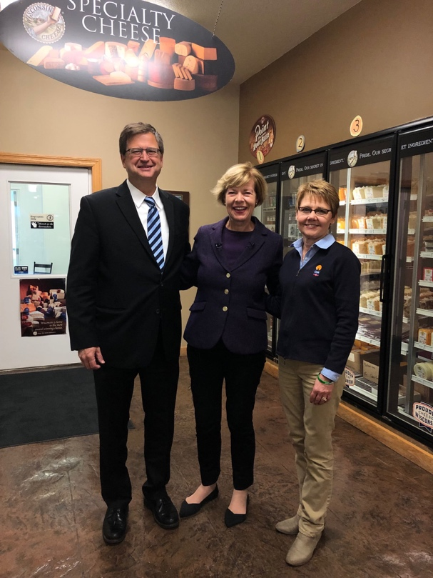
Dairy Business Innovation Initiative
2018 Farm Bill authorized Senator Tammy
Baldwin’s Dairy Business Innovation
Initiatives
Competitive application process led USDA to select CDR/WCMA, Tennessee, and
Vermont to lead DBII programs
California was added in 2022
Potential funding of up to $20 million allowed per year through Fiscal Year 2023 contingent on Congressional budgets

Slide 2

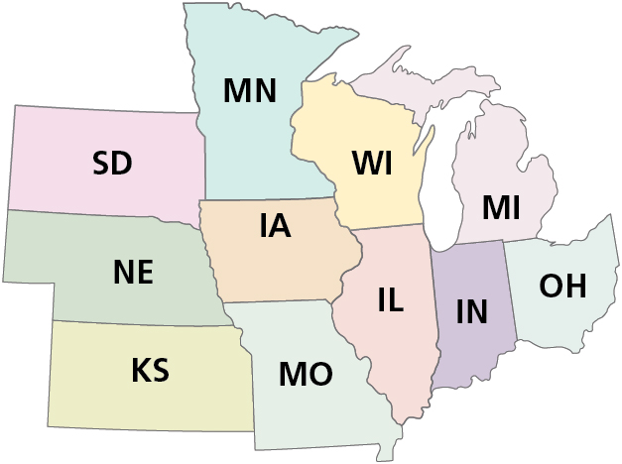


35% of U.S. milk production
50% of dairy farms
(2021 data)

Slide 3






DBIA: Programs
Grants
Technical Assistance
BUSINESS BUILDER
INDUSTRY IMPACT
Access to resources
Product development opportunities
Notes:
AMS/USDA REGULATIONS: A minimum of 50% of awarded funds must go toward direct grants.
DBIA Grant programs are set up to help:
As many Farmers & Small/Medium Processors as possible
Effect as much change as possible

Slide 4
DBIA: Grants
Dairy Business Builder Program
Dairy Industry Impact Program
$3,752,000
81 awards
FALL 2020 $230,000 (13 GRANTS UP TO $20,000)
SPRING 2021 $1,200,000 (25 GRANTS UP TO $50,000)
FALL 2021 $645,000 (4 GRANTS UP TO $250,000)
WINTER 2021 $1,700,000 (38 GRANTS UP TO $50,000)
SUMMER 2022 TBD (GRANTS UP TO $250,000)
FALL 2022 TBD (GRANTS UP TO $100,000)

Slide 5
DBIA Grant Application Eligibility
Grant applicants must:
Operate or endeavor to operate a dairy farm or dairy manufacturing or processing facility in one of the 11 states.
Use the grant funds to support a business location in one of these states.
Use the grant funds for a dairy-related purpose. For example, a dairy farmer who wants to expand into the beef business would not be eligible for this grant program.
All applications must meet one of the DBIA goals:
Dairy farm diversification through dairy product development, specialization packaging and/or marketing
Creation of value-added products that contain a dairy ingredient
Enhancement of the value of a dairy commodity or by-product through product development or alternate use
Creation or expansion of a program for exporting dairy products

Slide 6
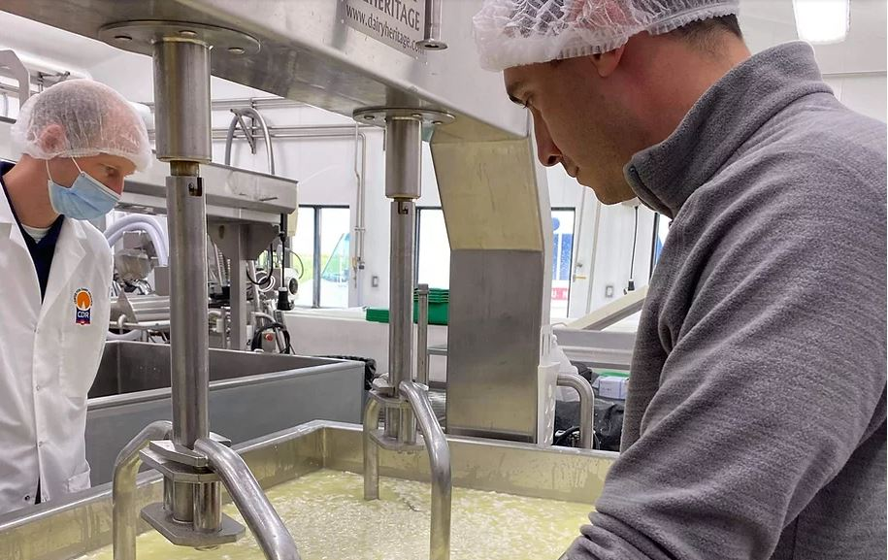
DBIA: Technical Assistance
Access to CDR pilot plant
Product development assistance
E-library resources
Business Opportunities

Slide 7



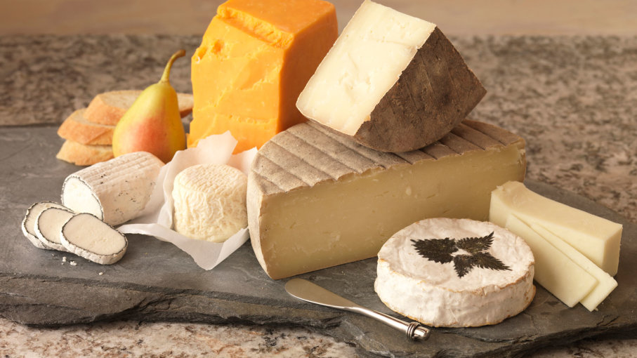



DBIA: Export and Import Displacement Updates
Cheese & Cheese Product Launches
Asia Pacific & Middle East
2017 – 2021 YTD
# Cheese Product Launches
Total # Launches
by Cheese Category
by Company
by Claims
Top Claims by Region
Retail Market ($ & Vol) for Cheese
Notes:
China, Japan, Singapore, S. Korea, Saudi Arabia, UAE

Slide 8
How to Contact DBIA with Questions
Contact DBIA staff f you have questions prior to formally submitting your application.
Confirmation emails will be sent on a daily basis after submission.
Questions/Additional Information: Emily Slatter, DBIA Program Coordinator eslatter@cdr.wisc.edu 608-301-7751

