Slide 1
International Market Access Grant
Notes:
Through the Global Business Development Program we offer:
The INTERNATIONAL MARKET ACCESS GRANT (IMAG) - Wisconsin companies can be reimbursed for specific short-term expenses associated with a targeted export project that will help to grow their presence in their identified international market(s). Builds off trade venture

Slide 2
Allowable Expenses
Trade Shows
Marketing & Promotion
Consulting Services
Export Education
Transportation
and Lodging
registration, booth construction, one-time shipping, interpreters, non-WEDC trade missions
website development, translation of marketing materials, IP registration, product certification
WEDC trade reps, US Commercial Service, website designer, partner search or market research
cultural competency, best business practices in foreign markets, export compliance, foreign language
match only—not reimbursable
Notes:
Extremely flexible
Highlight trade reps

Slide 3
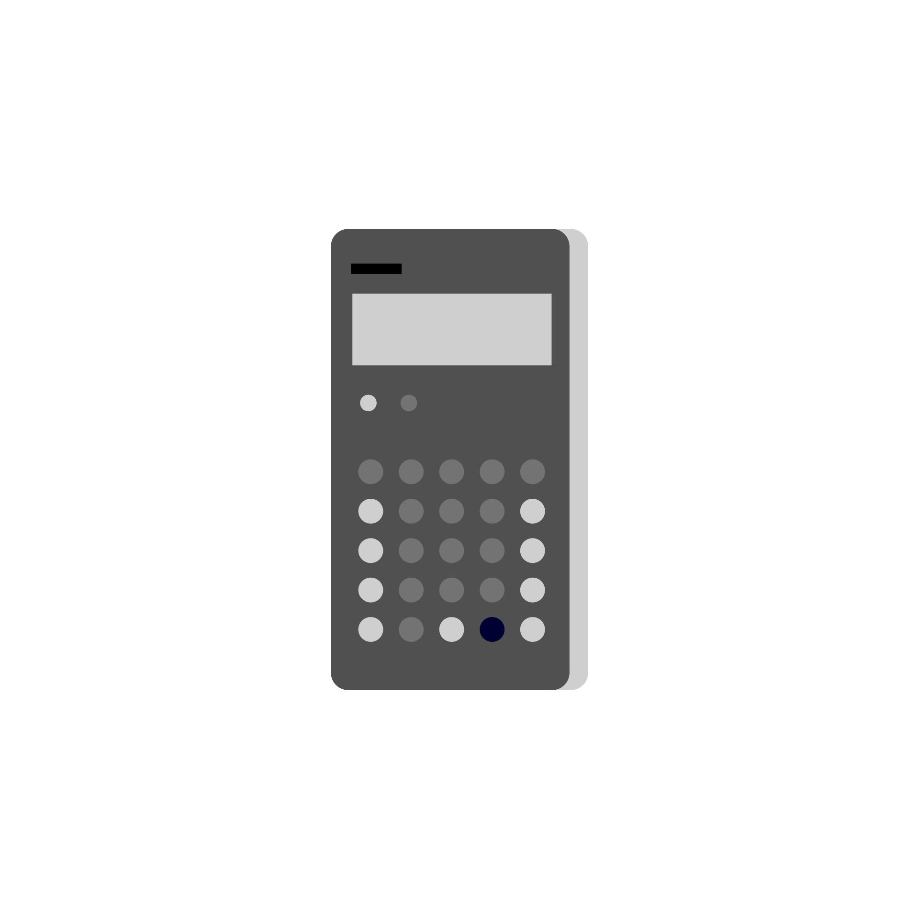
Budgeting & Reimbursement
Tiered support
Up to $10,000 for eligible applicants
Up to $25,000 for ExporTech Graduates
30% match required
All expenses must be invoiced and paid within project window
Retain invoices for each expense
WEDC will analyze all invoices to approve a disbursement
Notes:
The grant is a reimbursement grant, meaning you will initially pay for the projects out of your own budget. Once you’ve paid for an expense, you can submit a reimbursement request to us. We will analyze all the invoices you send and determine a reimbursement amount. Expenses incurred or paid before the application is formally accepted cannot be reimbursement. All expenses must be invoiced and fully paid off by your project end date.

Slide 4
Application Process
PORTAL
Get Network Wisconsin access from Katie Ujdak
Complete application in Network Wisconsin portal
Wait 6-8 weeks for preliminary decision
If accepted, begin underwriting and contracting
TIMELINE
Application window is open now
Application window closes April 1, 2023
Projects begin upon acceptance
Projects end as late as December 31, 2023
APPLICATION
Identify specific countries
Illustrate targeted strategy supported by research/experience
Be specific about uses of funding
Notes:
Tips for a great application:
You must identify specific countries in your application! We no longer accept regions or extensive lists. We recommend no more than 5 countries.
You must show a cohesive strategy for these markets.
Be specific, both about markets and uses of funding
Demonstrate a targeted export strategy based on research and/or evidence
Thoroughly justify the expenditure as an opportunity for growth.

Slide 5
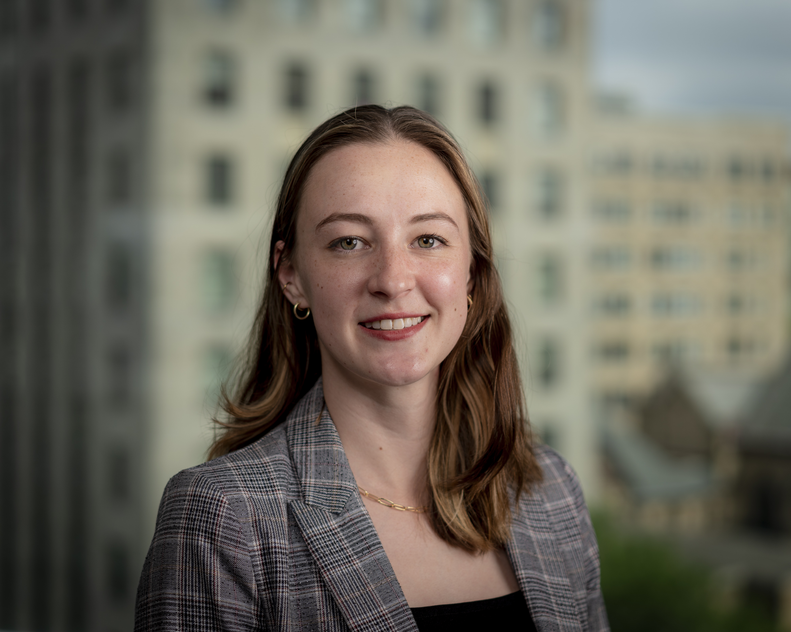
Contact
KATIE UJDAK
Global Trade & Investment Grants Specialist
katie.ujdak@wedc.org
608.210.6773
Email me to get access to Network Wisconsin and start your application today!

