Slide 1
Current Trends in Cheese Sales
June 13, 2023

Slide 2
USDA 2022 Dairy Product Report: Highlights
Insights & Outlook: Hispanic-Style Cheeses
Insights & Outlook: Parmesan
Q&A
Agenda

Slide 3


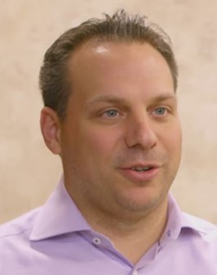
John Umhoefer
Wisconsin Cheese Makers Association
Paul Scharfman
Specialty Cheese Company
Bob Greco
Cheese Merchants

Slide 4
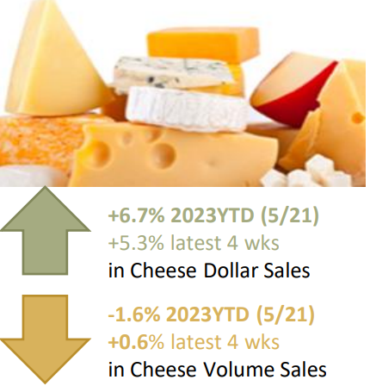
Retail Cheese Volumes are Down 1.6% through May 21 in 2023.
But…
Up 0.6% in the Four Weeks ending May 21
IRI Retail Sales Data courtesy of DMI

Slide 5
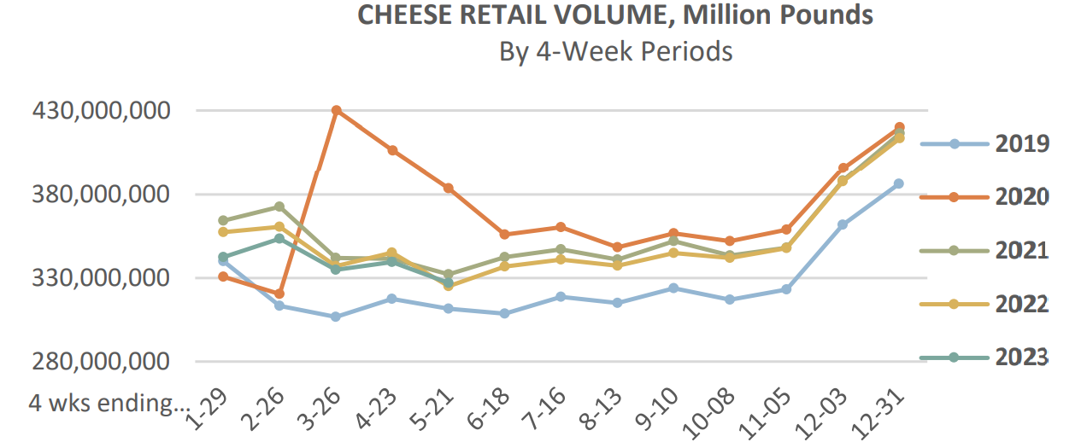
Cheese Sales aligned in 2021, 2022, 2023
IRI Retail Sales Data courtesy of DMI

Slide 6
Top Performing Cheese Styles
Top Retail Volume Sales Products in the 52 weeks ending May 21, 2023
IRI Retail Sales Data courtesy of DMI

Slide 7
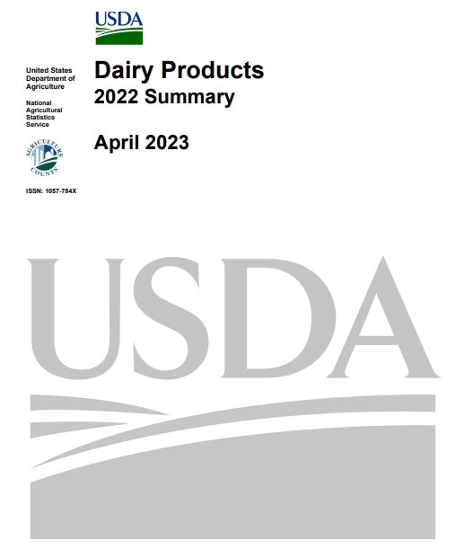
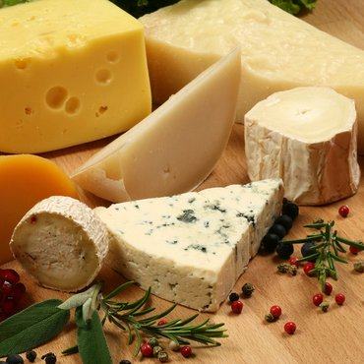
Dairy’s Annual Census

Slide 8
70% Growth since 2000!

Slide 11

Texas Will Leapfrog into Fifth or Sixth Place within Years

Slide 12
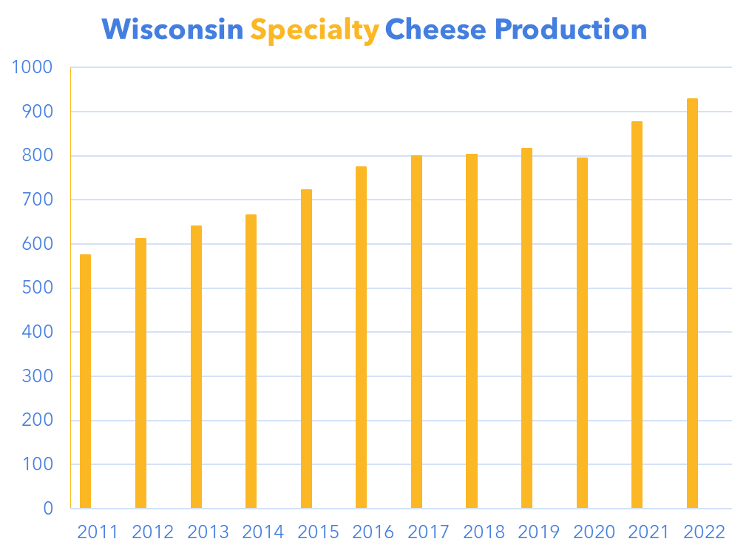
61% Growth since 2011!
A COVID Recovery for Wisconsin Specialty Cheese
Million Pounds

Slide 13
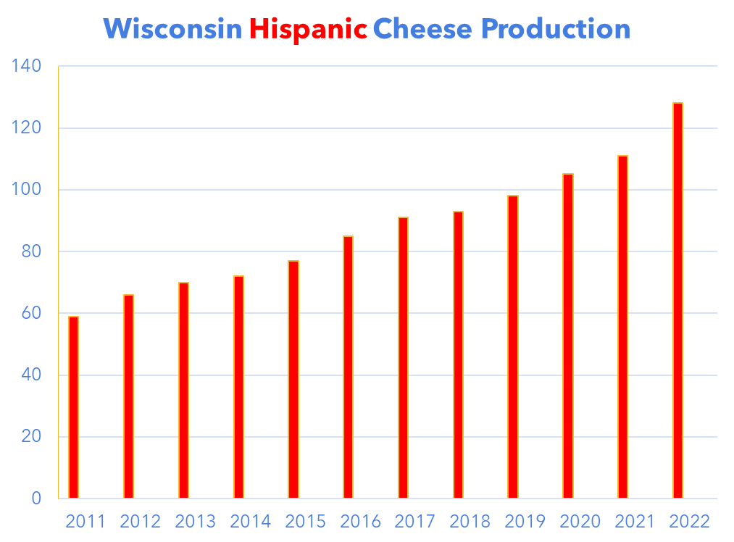
117% Growth since 2011!
High Speed Growth for Wisconsin Hispanic Cheese
Million Pounds

Slide 14
72% Growth since 2011!
U.S. Hispanic Production Approaches 400 Million Pounds
Million Pounds

Slide 16
104% Growth since 2011!
Wisconsin has Doubled Parmesan Production in the Last Decade
Million Pounds

Slide 17
71% Growth since 2011!
A COVID Lift For Parmesan Sales
Million Pounds

Slide 18
Million Pounds

Slide 19
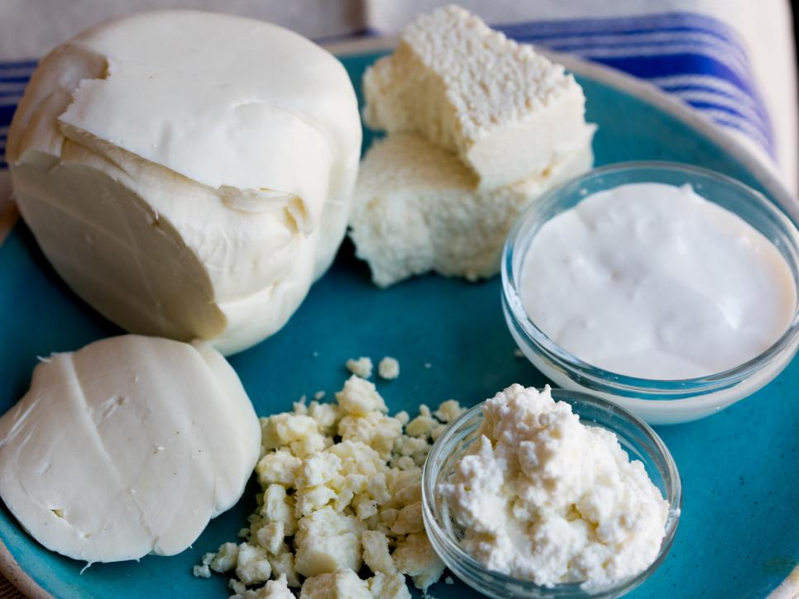
Hispanic Cheese
Why growth and what’s ahead?

Slide 20

What’s been driving growth?
I. Hispanic cuisine is becoming mainstream
  More restaurants have it on their menu
  More Anglo’s like it
  “Is Hispanic the new Italian”?

Slide 21
What else is driving growth?
II. More retail points of distribution
  Most retailers need to attract Hispanic shoppers
  More Anglo’s want to make Hispanic cuisine at home

Slide 22
And…. Immigration
III. Data is poor but….
1. Seems that more Hispanic people are entering U.S. than leaving it
2. Central American economies are driving people out
  A. price of beans has doubled in past 18 months. Other staple foods as well.
  B. vicious cycle:
    people leave so
    labor short so
    Harvesting/processing costs increase so
    prices up so
    more people leave.

Slide 23
What’s the outlook?
I. More restaurants will offer more dishes with “Mexican” flair.
  1. Likely continued growth in Anglo’s eating “Mexican”
  2. Mexican has become American, just like Pizza or Spaghetti and Meatballs

Slide 24
Outlook continued…
II. More Hispanic items at more retailers
  1. Category growth has cemented the need for Hispanic cheese at retail
  2. likely increase in items
  3. Value-added Hispanic growing – shreds, snack-size, flavors

Slide 25
What’s ahead for Immigration?
III. LOL
  1. Likely NOT going to expel immigrants already in U.S.
  2. Likely those people are not going to want to go back to messy economies
  3. Growth or flat? Anyone’s guess

Slide 26
Thank you

Slide 27
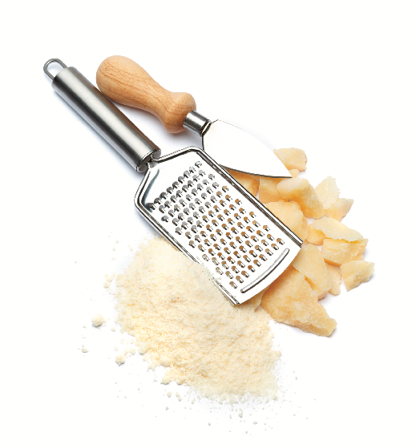

Insights & Outlook on Parmesan
June 13, 2023
PRESENTED BY
Bob Greco, President & CEO
PRESENTED TO

Slide 28


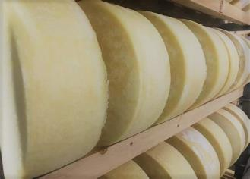
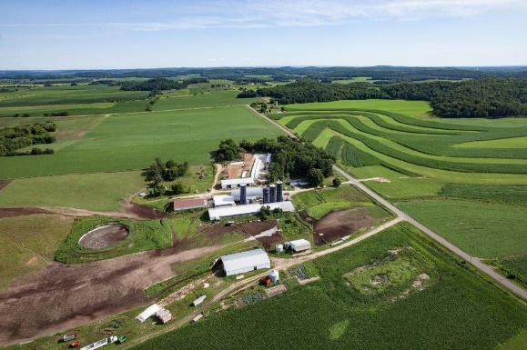

AGENDA
Cheese Merchants Intro
US Parmesan Production, 10-Year Trajectory (2013 – 22)
US Foodservice Industry Sales
US Parmesan Sales - Retail
Addendum
Eau Galle Cheese- Durand, WI

Slide 29
Bob Greco, President & CEO
Bob’s entire professional career (25 years) has been with Cheese Merchants, and he has held a variety of positions leading up to his current role as President & CEO
Hard Italian cheese processors: grated, shredded & shaved
Cheese Merchants has 3 facilities in Northwestern IL, which includes an aging facility in West Chicago
We’re a vertically integrated company with 2 Wisconsin make facilities in Eau Galle and Dairy State

Slide 30
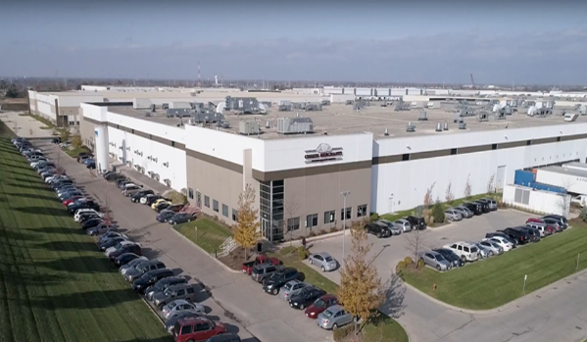


Cheese Merchants Intro
Cheese Merchants was founded 25 years ago by Pasquale Greco as a hard Italian cheese converter
It’s a privately held, family-run business, led by Bob Greco (President & CEO)
Processes for every type of category in hard Italian (FS, Retail, and Food Ingredient)
Private labels for some of the largest FS Broadline Distributors and Retailers
CM is a top supplier for many of the largest Broadline & Specialty Foodservice Distributors, 60+ Major Retailers, and Fortune 500 Food Manufacturers
The Cheese Merchants family of companies and brands encompasses 7 facilities, 1MM+ square feet, 25+ production lines, and a combined 250+ years of history

Slide 31





Cheese Merchants Family Portfolio
Vertically integrated cheese provider specializing in hard Italian cheese that is grated, shredded, shaved, dehydrated or wedged. A family of cheese experts with a dedication to quality & customer service.
Dairy State Cheese Company is the first step in Cheese Merchants Vertical integration journey. Raw milk → Production → Conversion → Finished Goods.
Selfish Cow is a Plant-Based & Dairy Free brand of distinguished quality with a wide range of super cheesy pull and meltiness. It’s unbeLEAFably good!
Eau Galle Cheese (since 1945) is led by Master Cheesemaker, Steve Bechel. This US Championship Medal winner crafts artisanal cheese wheels in Parmesan, Romano, & Asiago.
Toscana Cheese has been manufacturing award-winning FRESH mozzarella cheeses since 1993.
Selfish Cow brand acquired Oct 2020
Eau Galle Cheese acquired May 2021
Toscana Cheese acquired June 2022
Wisconsin Dairy State Cheese acquired Jan. 2023

Slide 32
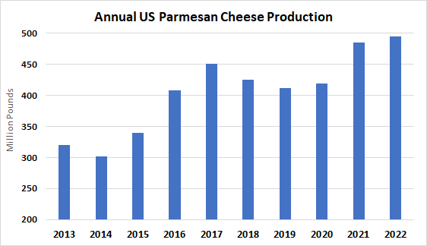
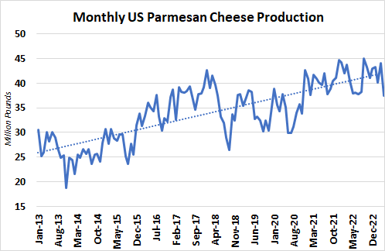
US Parmesan Cheese Production Statistics
2022 Domestic Parmesan production UP 20% versus 2020
(+82 million pounds)
Compound annual growth rate (CAGR) from 2013-2022: +5%
Over the past 10 years, US Parmesan cheese production has increased by 55%, with manufacturers making nearly 175 million pounds more in 2022 versus 2013.
Source: USDA

Slide 33
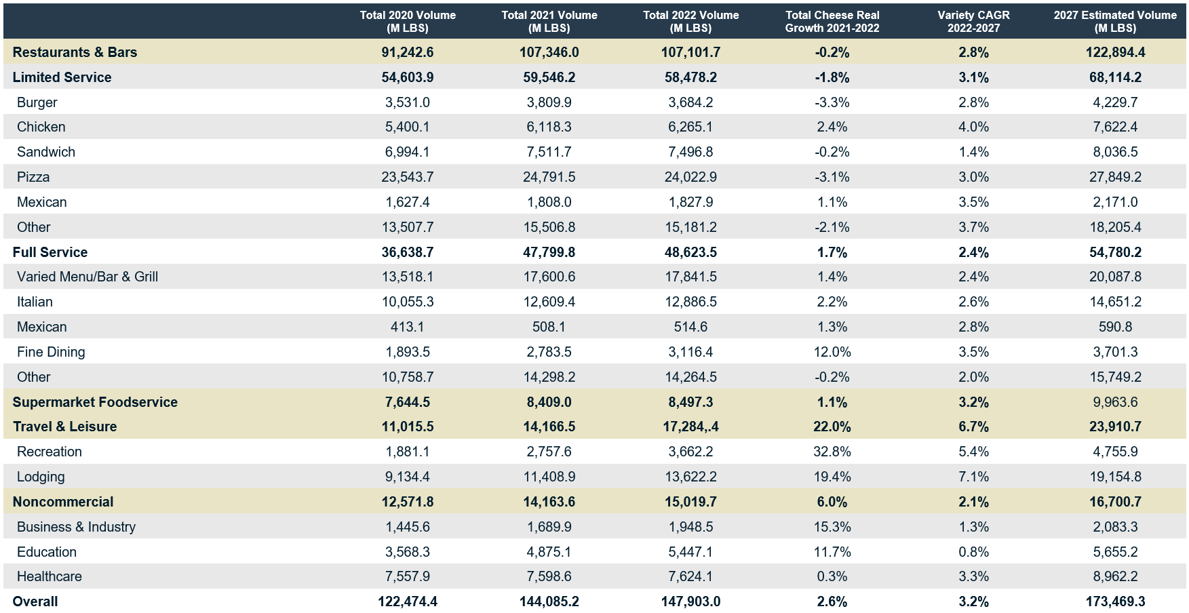
Parmesan Market Metrics: 2022 Foodservice
Source: Technomic

Slide 34
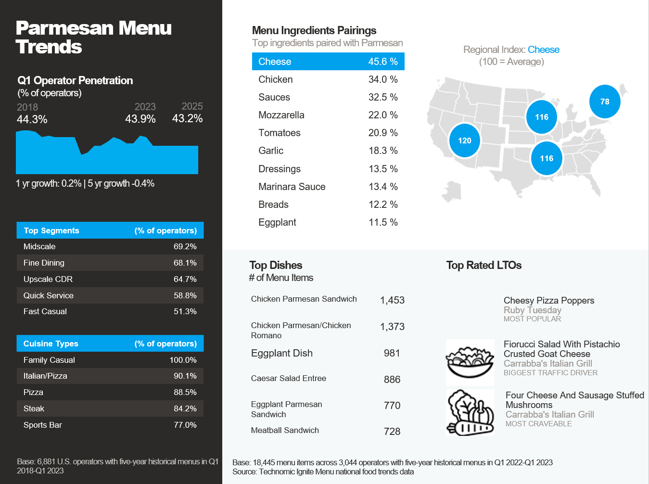
Parmesan Menu Penetration & Trends
Source: Technomic, June 2023.

Slide 35
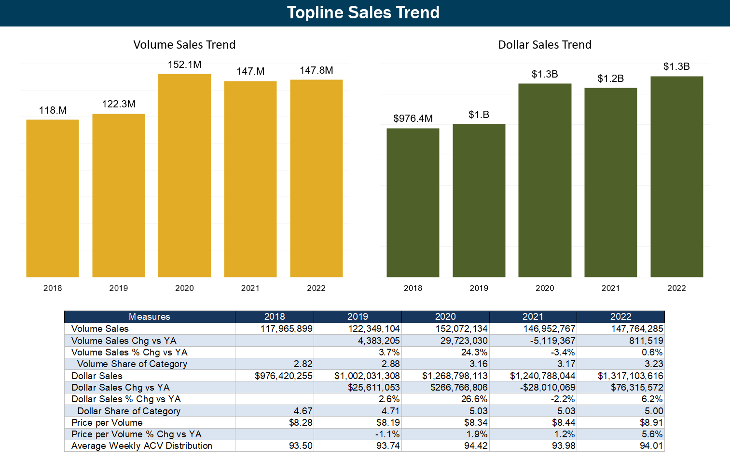
Retail Natural Parmesan Sales by Top Forms (2018 - 2022)
Geography: Total U.S. Multi-Outlet+Convenience
Source: Dairy Farmers of Wisconsin Cheese Sales Database

Slide 36
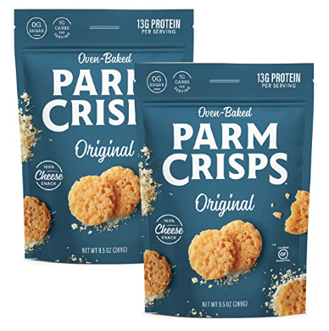
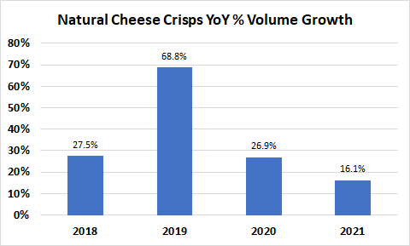
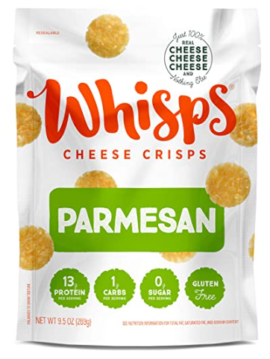
US Natural Cheese Crisps
Source: Dairy Management Inc.

Slide 38
Can you give some examples of retailers that have grown their Hispanic cheese offerings in response to consumer demand?

Slide 39
How does the growth in parmesan compare to other hard Italian styles?

Slide 40
Which Hispanic styles seem to be showing the most growth? Least?

Slide 42
Save the date for our next webinar, focused on...
Dairy Sustainability
Tuesday, July 11
1:00 p.m. (CT)
Registration opening soon!
WisCheeseMakers.org/Events

