Slide 1


Slide 2


Welcome Chapter Leaders!
WAI Chapter Leader Workshop

Slide 3
Today’s Agenda
Chapter Updates
Chapter Communication
Chapter & Member Opportunities
Chapter Resources & Tools
Break
Guest Speaker – Dr. Janette McMurtrie
Networking Event

Slide 4
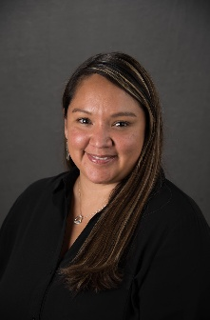
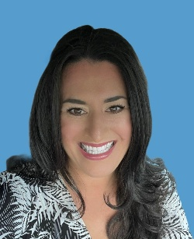

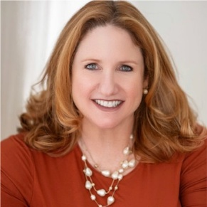

Meet your WAI Chapter & Membership Team!
Summer Cole
Manager, Chapter Relations
scole@wai.org
Christine Gainsley
Member Services & Events Specialist
cgainsley@wai.org
Olivia Lisbon Stancil
Member Relations Coordinator
ostancil@wai.org
Molly Martin
Director, Member Engagement
mmartin@wai.org

Slide 5

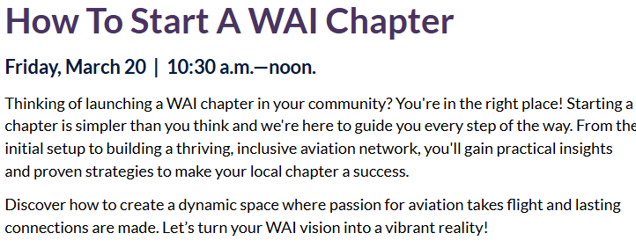
2026 Chapter Events at Conference
Room: Texas D
Room: Grapevine A

Slide 6


2026 Chapter Events at Conference
Please vote for your favorite chapter logo by Friday at 5pm.
Room: Grapevine C

Slide 7
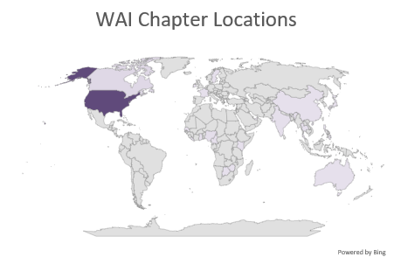
WAI Chapter Stats!
Chapter Count
Official Chapter - US |  | 74
Official Collegiate Chapter - US |  | 35
Official Collegiate Chapter - International |  | 2
Official Chapter - International |  | 16
Provisional Chapter - US |  | 15
Provisional Collegiate Chapter - US |  | 14
Provisional Collegiate Chapter - International |  | 3
Provisional Chapter - International |  | 15
Total Chapters |  | 174
Number of Countries | 26

Slide 8
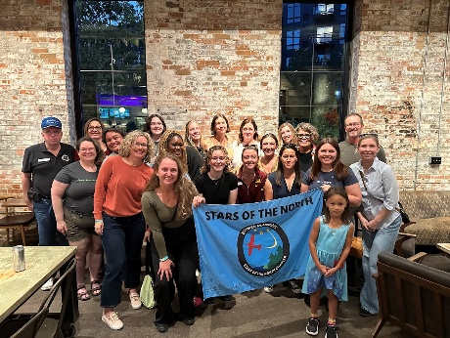

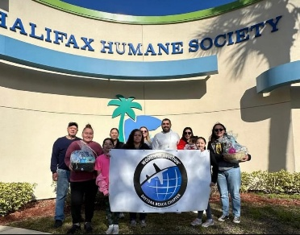
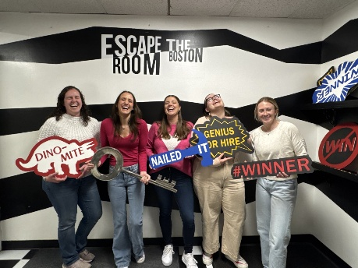
Membership Snapshot
More than 20,000 active members
51% Individual Members
9.5% International Members (Outside the U.S.)
45% Student Members (College and University students)
Over 5,000 Junior Members (18 years old and younger)
Over 300 Corporate Members (Organizations/Corporations)
85% women; 15% men

Slide 9
CHAPTER
UPDATES

Slide 10

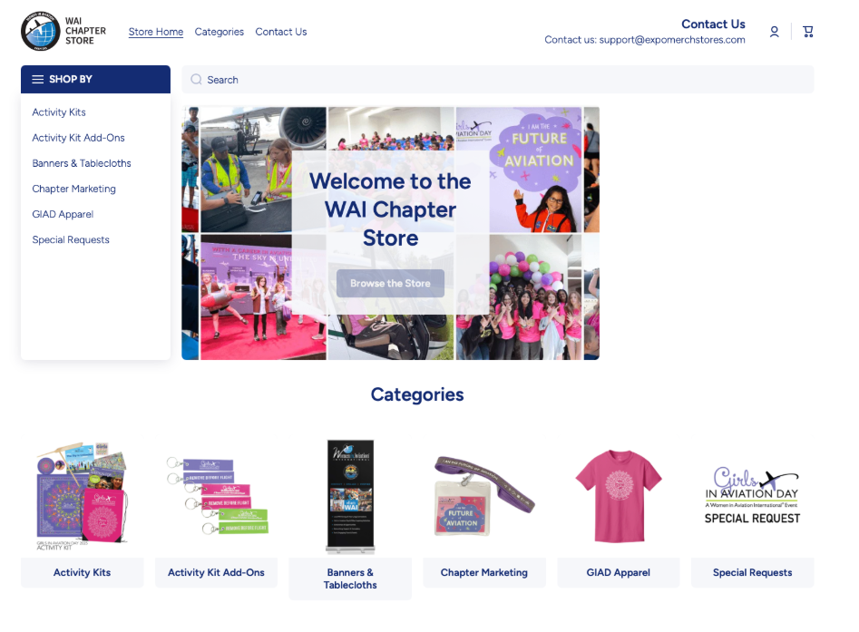
Chapter Store
www.waichapterstore.org
New Store!
New Look!
New Products!

Slide 11
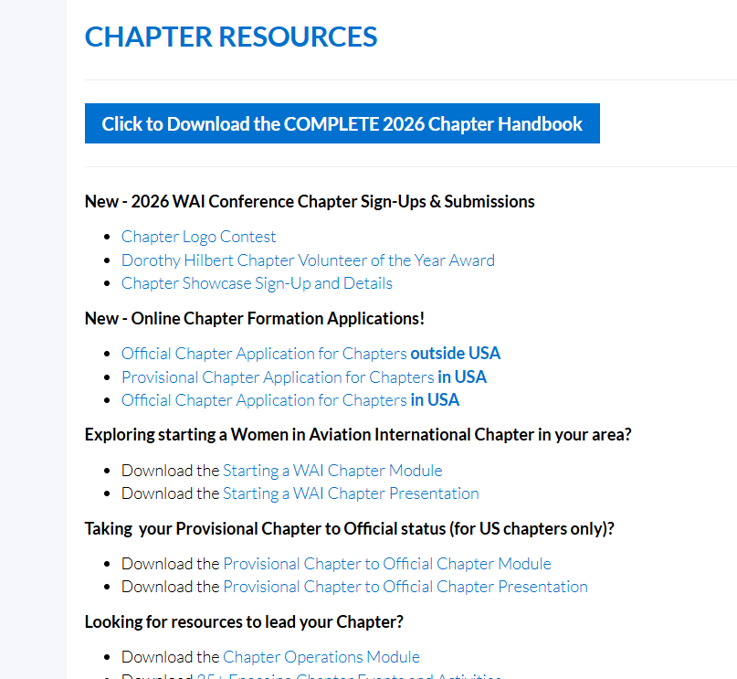
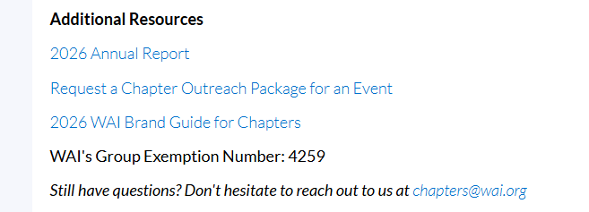
Chapter Resources

Slide 12
CHAPTER
COMMUNICATIONS

Slide 13
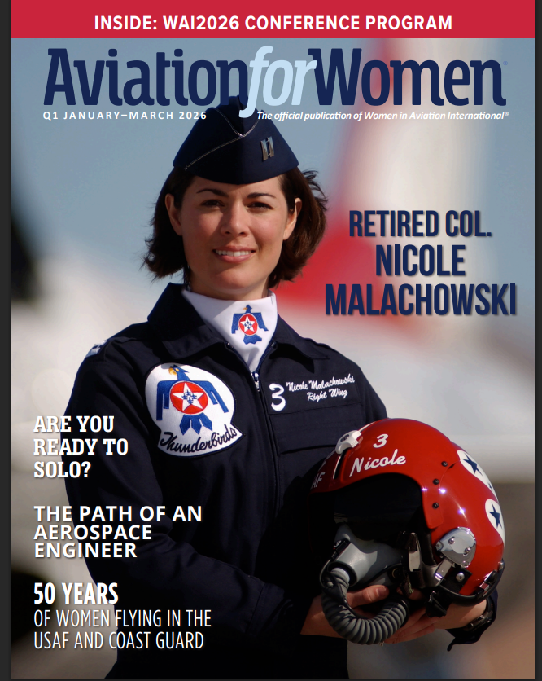
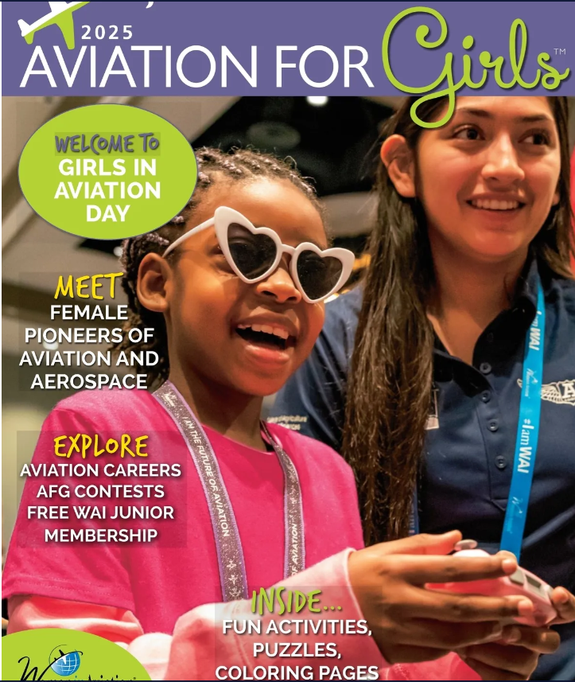
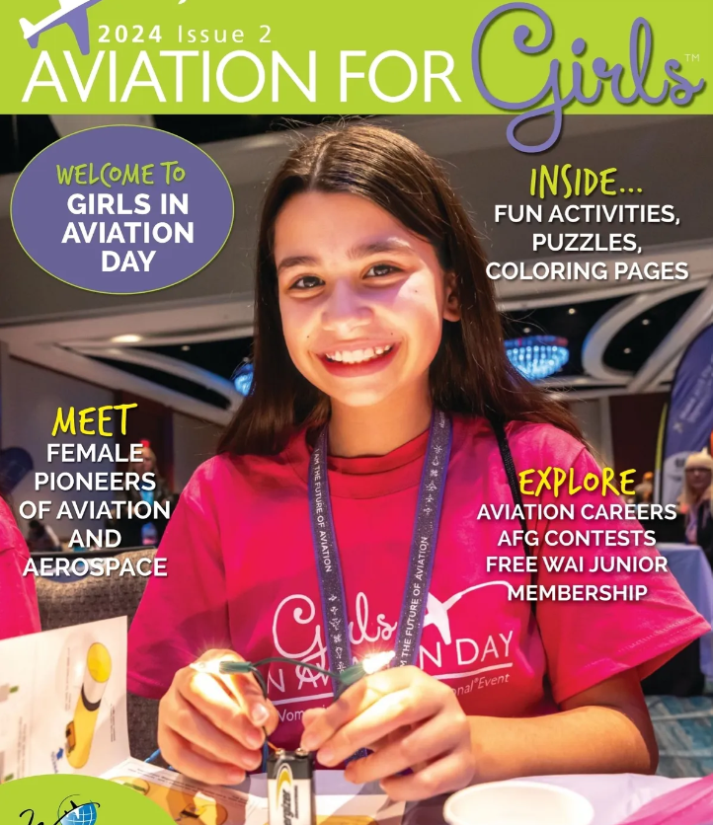

Aviation for Women Magazine
Aviation for Girls Magazine

Slide 14
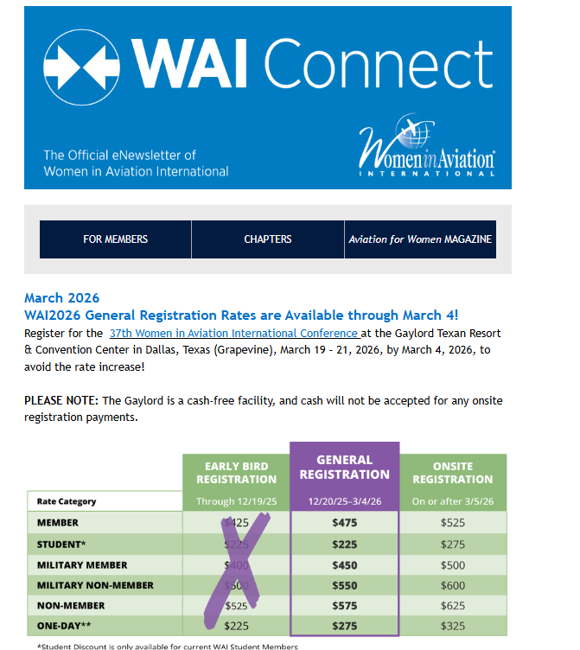
WAI Connect e-Newsletter
12x a year e-Newsletter
Published 1st of each month
Mobile, friendly format
Chapter activities, member news
Advertising
Job Postings
Are you getting this?
If not,
  We don’t have your correct email and/or check your spam folder!

Slide 15
Important Reminders!
Emails are sent to the contact you provided on your member profile​
If your email account doesn’t accept bulk messaging, you must make Summer Cole and Women in Aviation International trusted senders or you will not get communications​
You MUST be listed as a Chapter Officer to receive Chapter Operations emails​
Send any and all chapter officer updates to chapters@wai.org

Slide 16
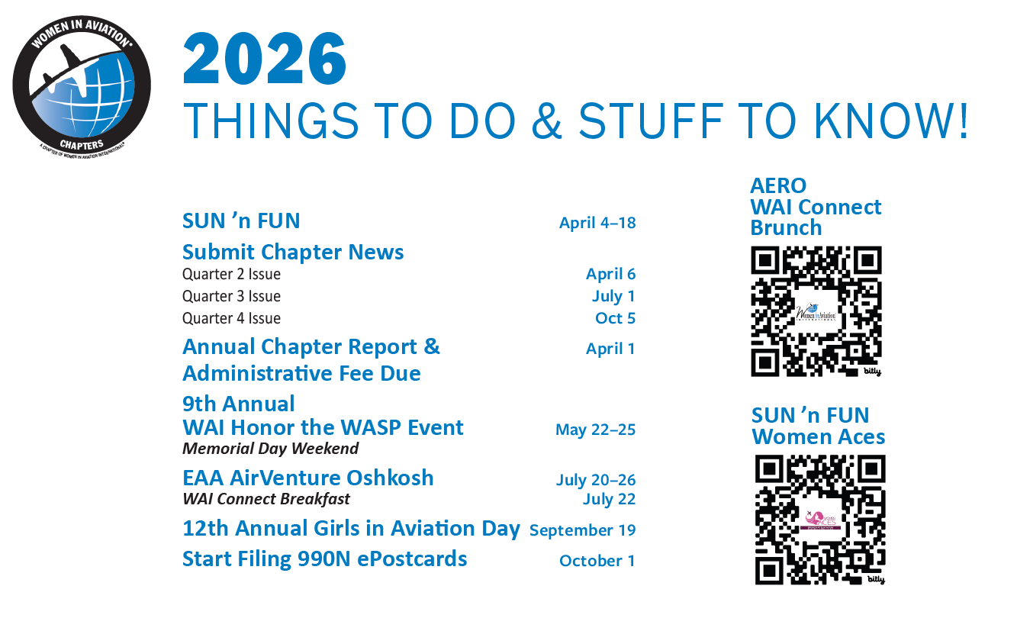

Slide 17
CHAPTER & MEMBER OPPORTUNITIES

Slide 18
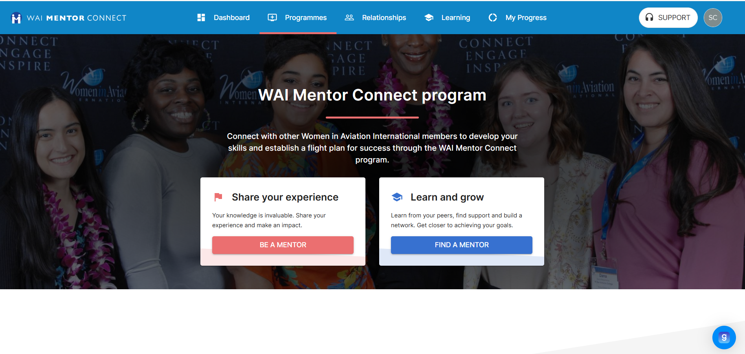
www.wai.org/mentor-connect

Slide 19
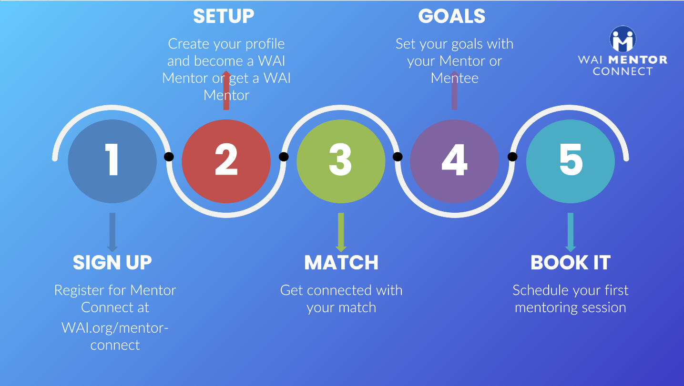

Slide 20
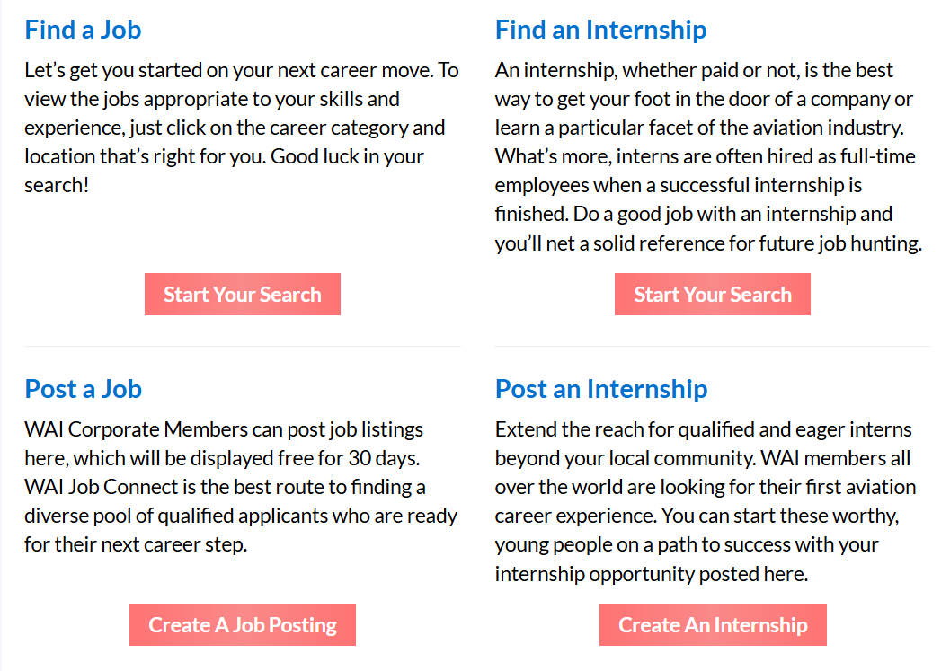

www.wai.org/jobs-connect

Slide 21
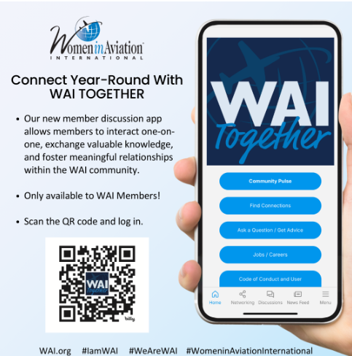


Slide 22

www.wai.org/scholarships
WAI2027 Scholarships will open in July 2026.

Slide 23
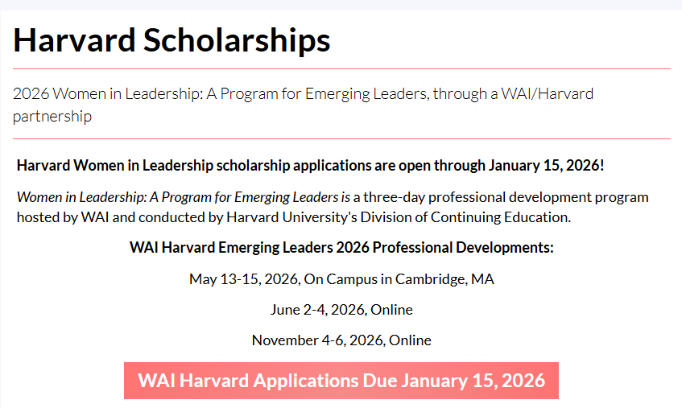
Women in Leadership: A Program for Emerging Leaders
www.wai.org/harvard-scholarships

Slide 24

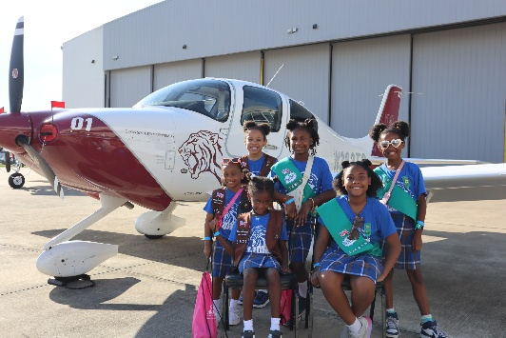
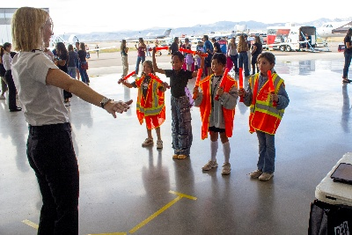


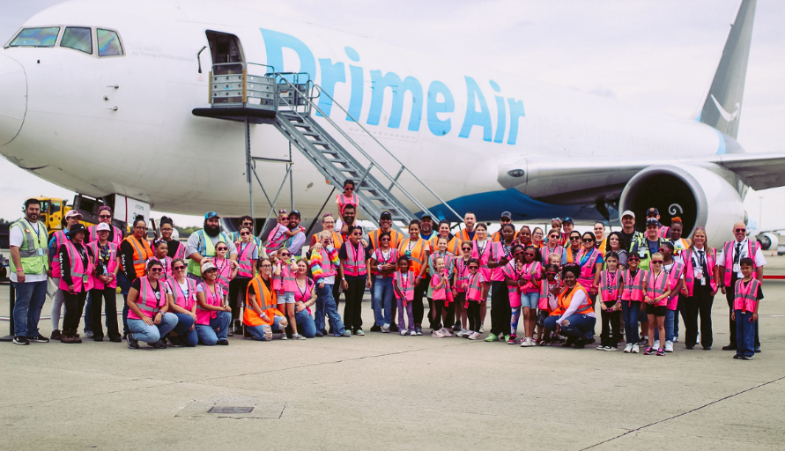
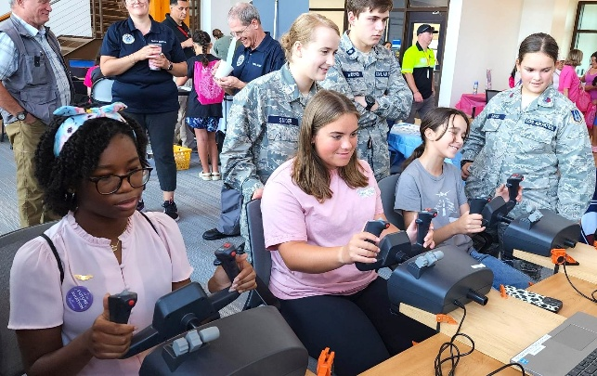
Girls in Aviation Day 2025
200 total GIAD events took place in 33 countries!
GIAD 2026 is on September 19, 2026!

Slide 25
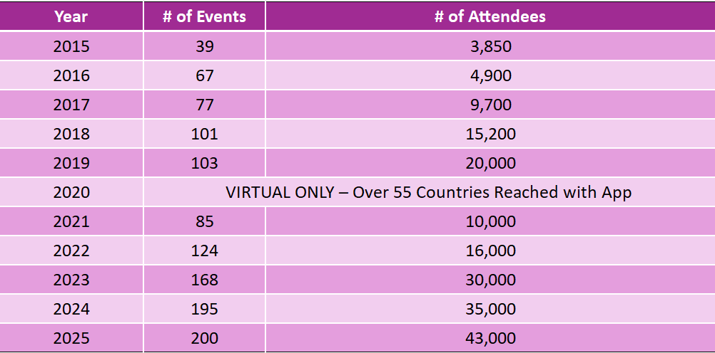

Slide 26
CHAPTER RESOURCES & TOOLS

Slide 27
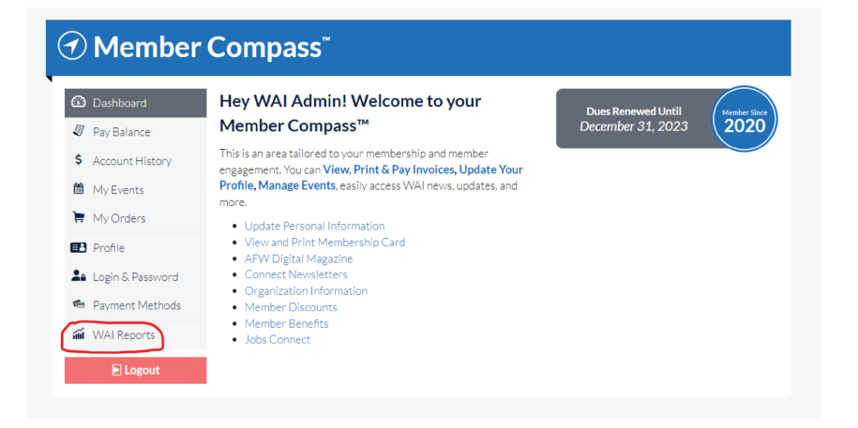
Download Your Chapter Roster!
1. Log in to your WAI Account and click on your name at the top of the page to enter your Member Compass.​
2. Once on your Member Compass, you will see a menu on the left-hand side. Click on “WAI Reports”. ​
3. Here you will see your chapter’s name. Click on this to download your updated Chapter Roster.​
4. Save this download in your preferred format.​

Slide 28
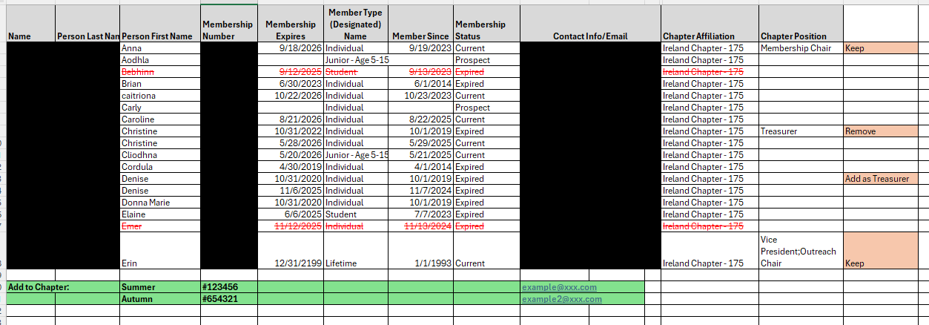
Update Your Chapter Roster!
Green Highlight at Bottom: Additions to chapter roster
Orange Highlight at Last Column: Officer changers
Red Strikethrough: Remove from chapter roster
Email updated chapter roster changes to chapters@wai.org
Page 23 of Chapter Handbook

Slide 29
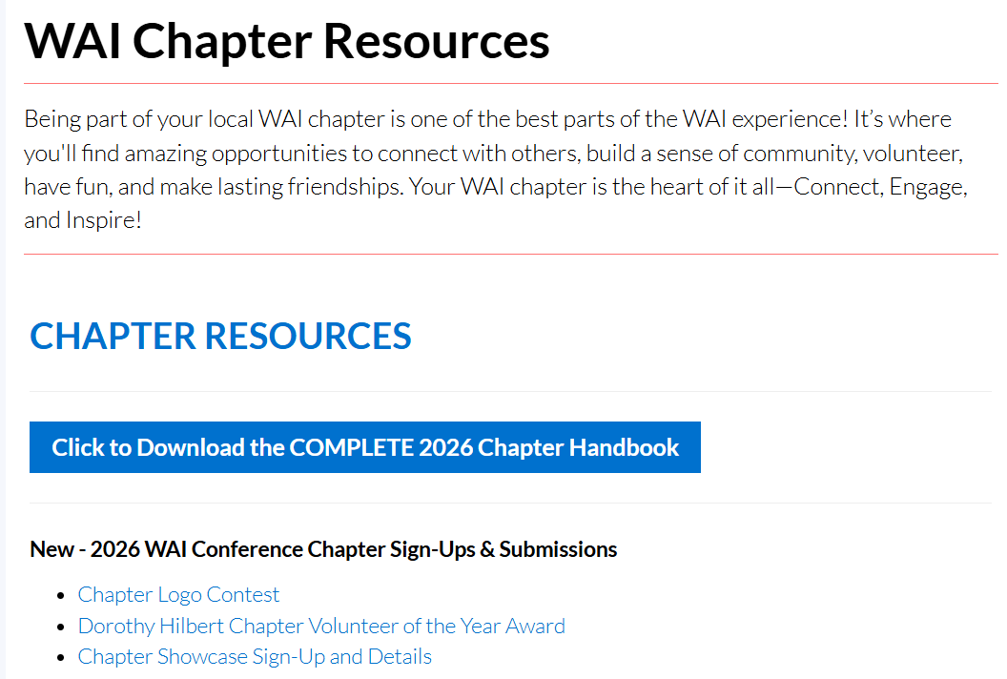
wai.org/chapter-resources

Slide 30
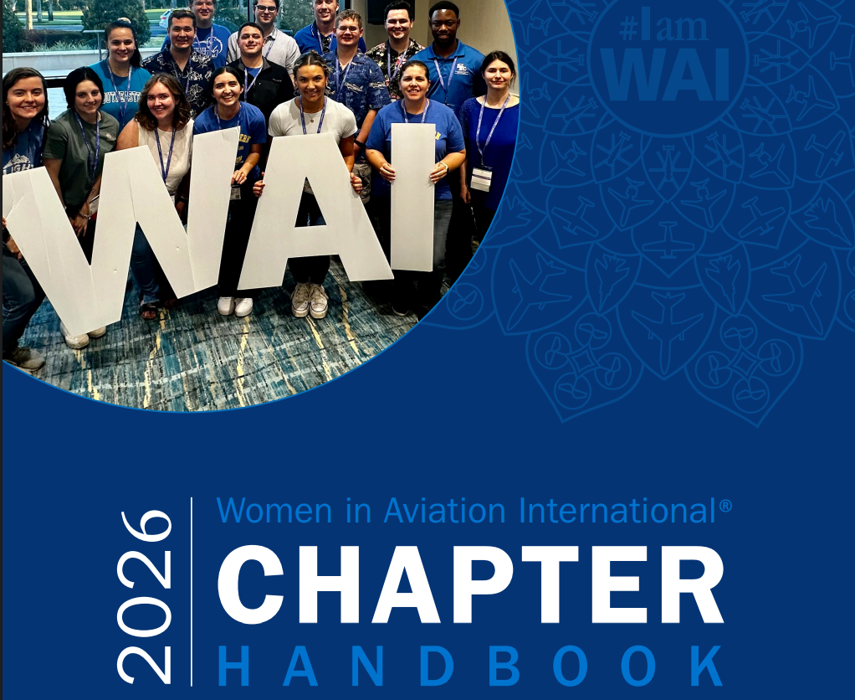

Slide 31
Chapter Compliance Requirements
Submit Chapter Annual Report by April 1
Pay Chapter Annual Administrative Fee by April 1
  All applicable rebates from previous year will be applied on March 1.
  If there is a balance still remaining, all invoices will be sent to chapters on March 2.
  All rebate balances over $250 will be capped on March 5.
  Chapters have until April 1 to make dues payment (pay amount due directly from the invoice that is e-mailed).
US Chapters:
1. File your chapter’s 990 e-card by February 15.

Slide 32
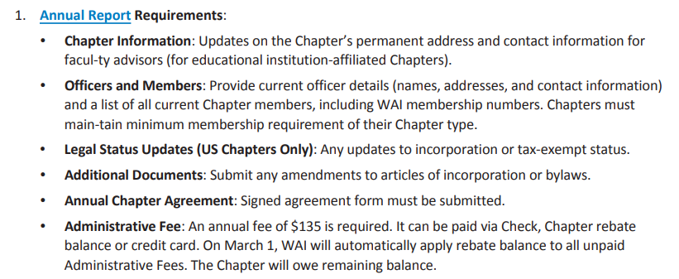
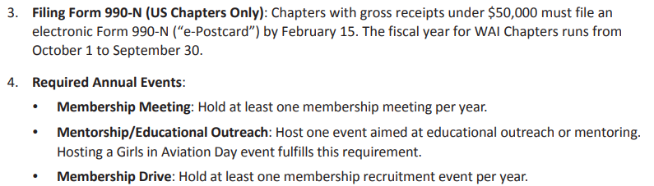
Ongoing Chapter Management
Submission Deadline: The report must be submitted no later than April 1 to maintain the Chapter’s official status.
Page 19 of Chapter Handbook

Slide 33



WAI Chapter Logo Guidelines
Standard Logo Design
WAI provides to all chapters
Custom Logo Design
Chapters can create a custom logo, but must include the outer ring and trademark; All custom logos MUST be approved by WAI by sending to chapters@wai.org
The WAI Brand Guide can be found on the Chapter Resources page
Page 33 of Chapter Handbook

Slide 34
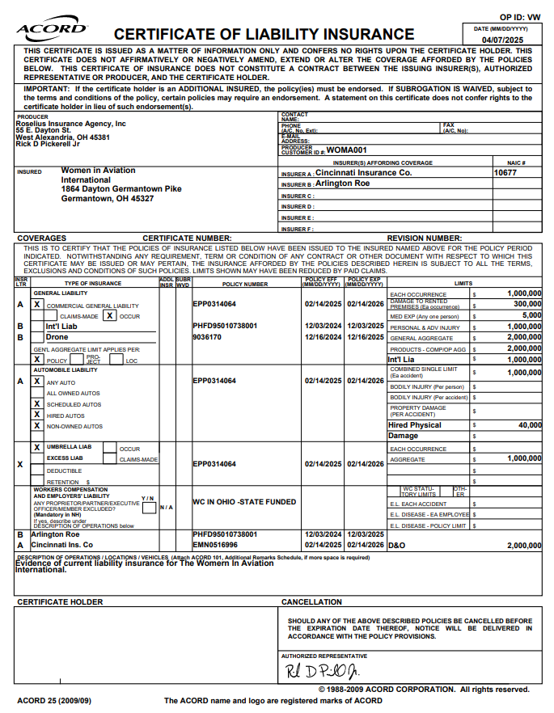
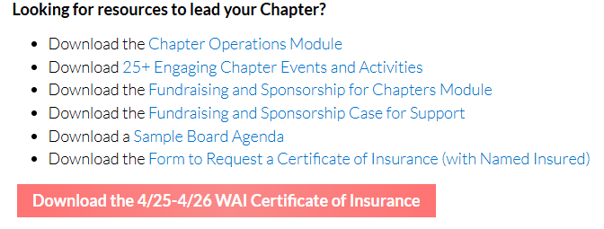
Certificate of Insurance
WAI maintains an insurance policy that provides insurance for all WAI chapters.
A customized certificate can be requested by filling out the form and sending to scole@wai.org.
A blanket certificate is available on the Chapter Resources page
Page 46 of Chapter Handbook

Slide 35
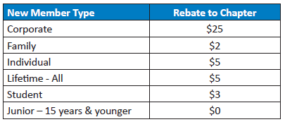
Chapter Rebate Program
Chapters earn rebates throughout the year for any new members that join WAI.
Chapters can use rebate funds to:
Pay the annual chapter admin fee
Apply to cover costs to attend the annual WAI Conference
Purchase WAI merchandise
Chapters will be notified of their rebate amounts in January and July each year.
Page 49 of Chapter Handbook

Slide 36
Chapter Continuity Tool
Maintaining accurate chapter documents and information is critical for supporting the chapter’s continued success and ensuring a smooth transition from one board to the next.
This includes (but is not limited to):
Banking Information
Corporate & Tax Information
Login
Organizational Calendar
Project & Event Log
Officers & Leadership
Committees
It is important to keep information up-to-date at all times!
Make sure designated board members have access to the designated information.
The file should be password-protected and/or saved in private folder with limited access.
Sample continuity tool can be found here!

Slide 37
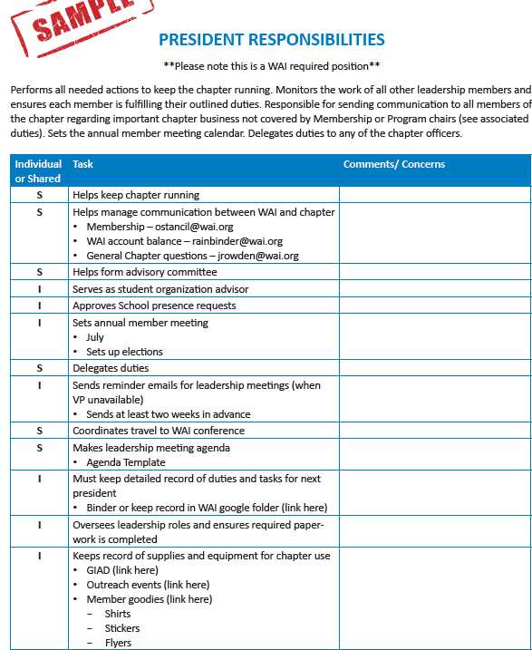
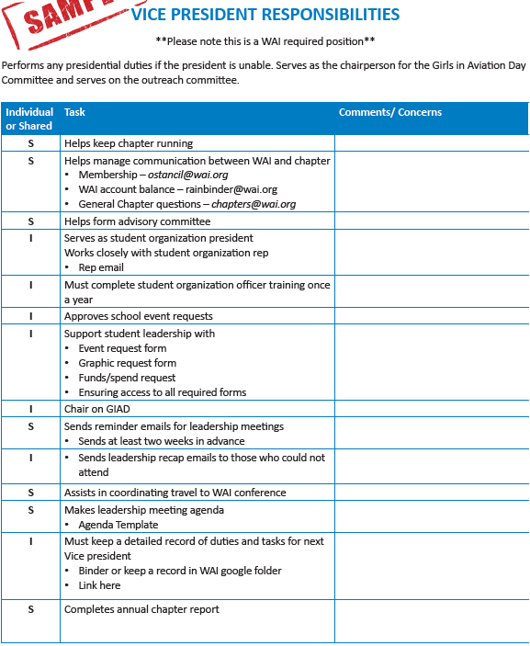
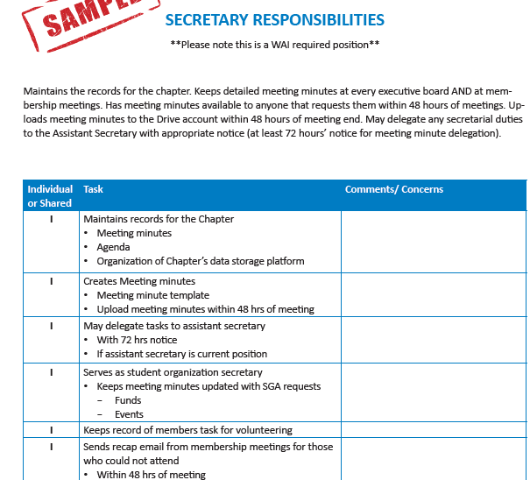
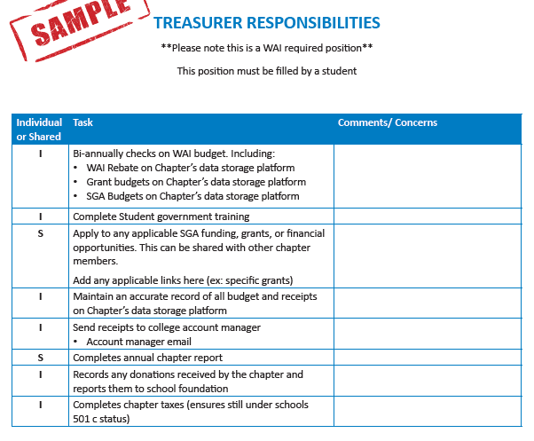
Chapter Continuity Tool - continued
Part of the continuity tool includes maintain chapter board/officer roles and responsibilities.
President
Vice-President
Secretary
Treasurer
These samples (along with other officer positions) can be found online here!

Slide 38
Plans for 2026!
Enhancements and new resources for chapters!
Chapter In A Box
Quarterly Webinars
Condensed Chapter Leader Handbook
An easier way to read/navigate the chapter resources page

Slide 39
ANY QUESTIONS?

Slide 40
Break Time!
Up Next After the Break…
Dr. Janette McMurtrie

Slide 41

Thank you! You are all amazing and I appreciate what you do so much!

