Slide 1


Slide 2


Welcome WAI Members!
Plan & Host an outstanding GIAD event!

Slide 3
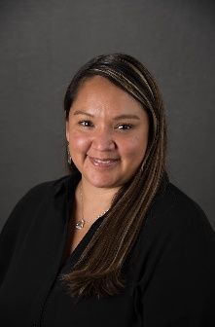
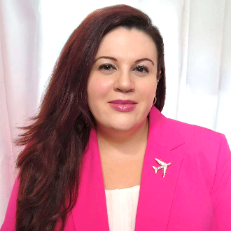


Your Presenters Today
Summer Cole
Manager, Chapter Relations
scole@wai.org
Annie Stikeleather
Manager, Education Programs
astikeleather@wai.org
WAI North Texas Chapter

Slide 4
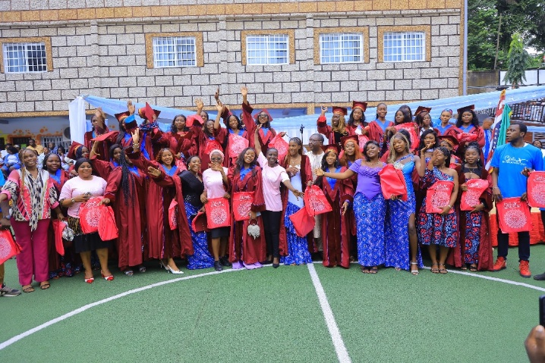
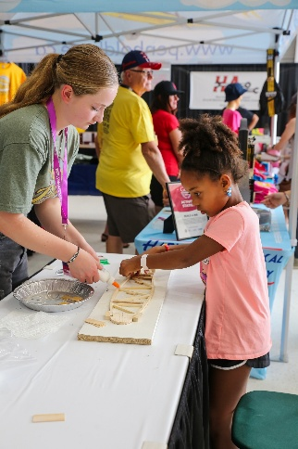
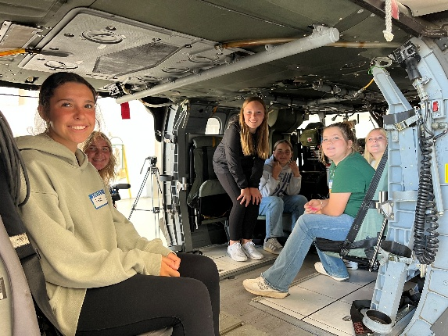
Why Girls in Aviation Day?
Girls in Aviation Day was started in 2014 by Women in Aviation International to inspire young girls to explore careers in aviation and aerospace.

Slide 5

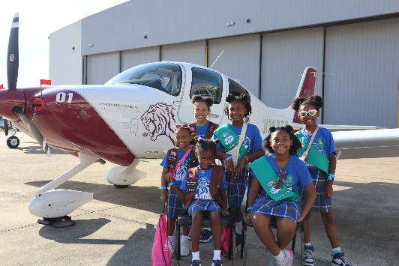
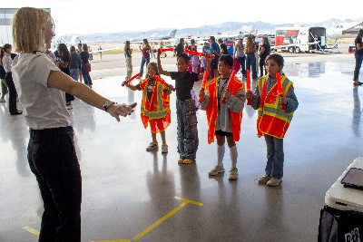

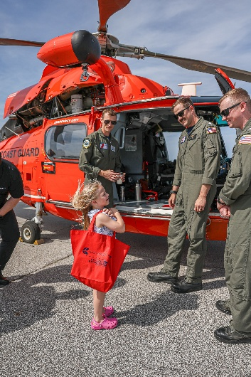
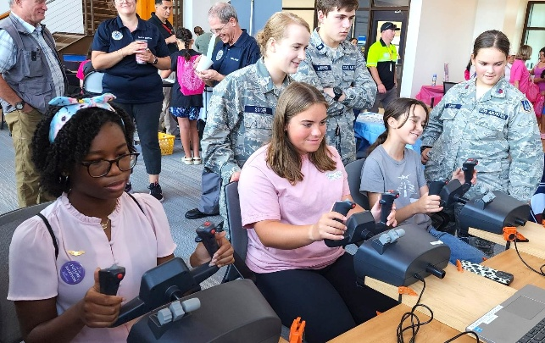
Girls in Aviation Day 2025
200 total GIAD events took place in 33 countries!
GIAD 2026 is on September 19, 2026!
In 2025, GIAD saw 200 in-person events hosted by Chapters and corporate members across the globe, reaching over 42,000 attendees. Thousands more engaged through the Girls in Aviation App.
ONLY WAI Chapters and corporate members are authorized to hold in-person GIAD events.
www.wai.org/giad

Slide 6
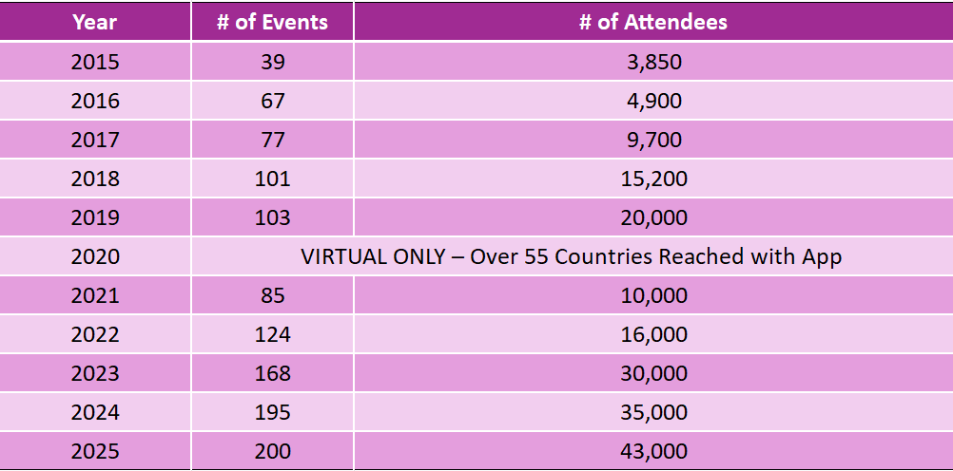

Slide 7




GIAD Event Resources

Slide 8
ANY QUESTIONS?
www.wai.org/giad
Contact giad@wai.org

Slide 9

Up Next…
WAI North Texas Chapter

Slide 10
Casey Coker – President
Janette McMurtrie – Vice President
Grace Fuller – Outreach
Jodi Airhart – Webmaster (GIAD Volunteer Lead)

Slide 11


Dallas
Average Attendance:
2,000 attendees
200 volunteers

Slide 12
MEETINGS & ORGANIZATION
Board Roles Involved
Outreach
Fundraising
Social Media
Educations & Careers
Webmaster
Membership
GIAD Specific Roles
GIAD Planning Lead – Vice President
Attendee Registration
Teen Zone Lead
Career Panel Moderator
Graphic Design
Activities
Volunteer Coordinator
Facilities
Exhibitors
Static Display/Ramp
Food Coordinator
Media
Meetings | Timeframe
Planning/Kickoff | March/April
Monthly | Until July
Biweekly | August
Weekly | September
  Activities
  Volunteers
  Registration
  Logistics/Facilities
  Marketing
  Schedule
  Action Items
  Due dates
Strong GIAD leader to manage all other leads
Continuous communication and task delegation
Directing meetings and following up to ensure tasks are completed
Share updates in GIAD Lead group chat
Manage files in shared GIAD Cloud Drive

Slide 13
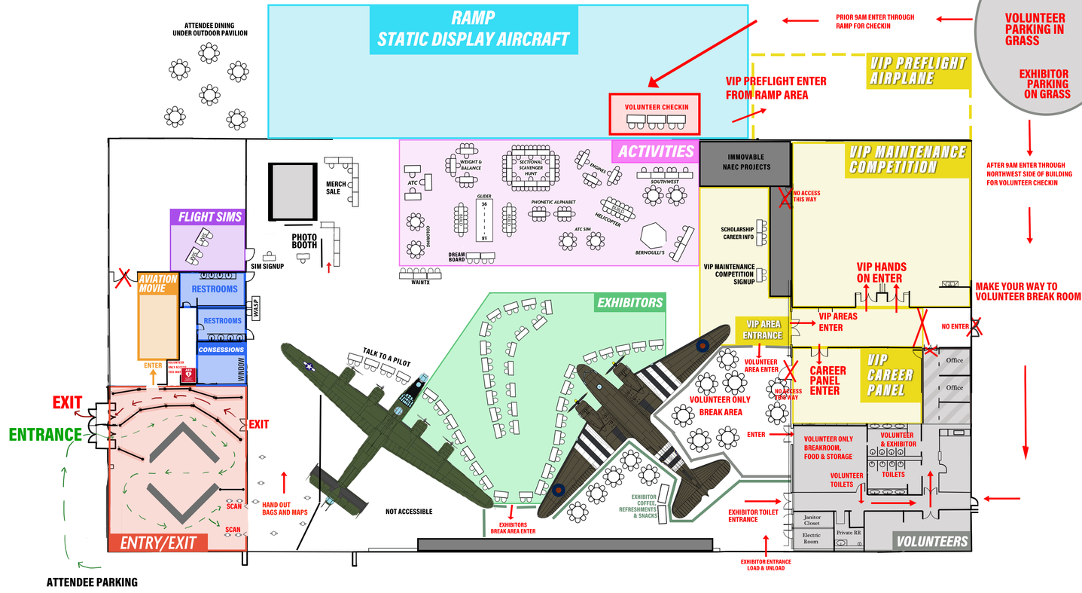
FACILITIES
Strong leader with at least 3 key volunteers
Pay for a porter for bathroom/trash if hosting a larger event
Handheld radios for communication between leaders
Security/police presence, ideally female
Prepare for the unexpected: extra power cords, duct tape, tools, etc.
Less is more when it comes to planning

Slide 14
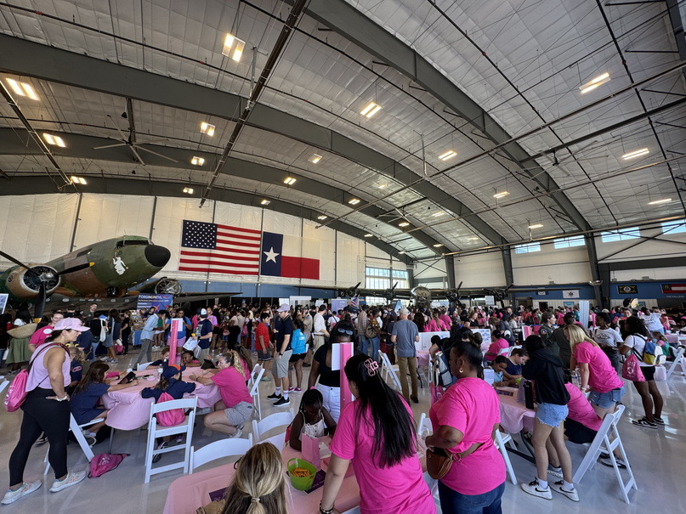
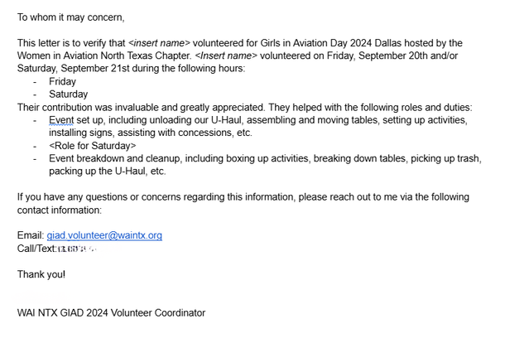
VOLUNTEER MANAGEMENT
NAME | PHONE | EMAIL | AVAILABILITY | START TIME | END TIME | LUNCH | ACTIVITY | SHIRT SIZE
GIAD
ROCKSTAR
Strong leader with at least 3 key volunteers
Set up volunteers for success by communicating expectations/instructions in advanced
About 1 volunteer for every 10 attendees
Scheduled lunch break rotation

Slide 15

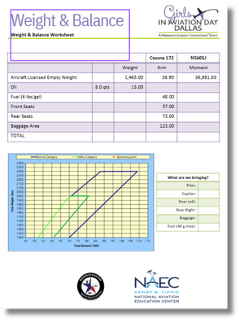

ACTIVITIES
Creative with strong organizational skills
Inventory and update activity instructions and supplies
Plan for the unexpected with extra materials
Train volunteers on the activity as needed
Activity
Chairs
FAA
Approval
What is the cause of the problem?
# Tables
How To’s
Inventory
Volunteers
Surveys
Budget
Notes
Sponsors
Software
Location
Power
Signs
Who is involved in the problem?

Slide 16


FUNDRAISING
Sponsor
Levels
Cash/Gift in Kind
Invoice Date
Logo Received
Status
Payment Method
Tax Receipt
Contact Name
Phone/Email
Address
Thank You Sent
Strong communication and organizational skills
Reach out to previous and prospective sponsors
Work with Chapter board to adhere to promises made
Tracking and manage funds from sponsors
Encourage corporate memberships

Slide 17


OUTREACH
NAME | PHONE | EMAIL | ORGANIZATION | NOTES
Strong communication and organizational skills
Reach out to schools and organizations such as YMCA, Girl Scouts, etc.
Manage contact list
Distribute flyers regarding the event
Talk to exhibitors to find more POCs

Slide 18
Q&A TIME!

Slide 19


Learn more about our GIAD here:
THANK YOU!

