Slide 1


Slide 2


Welcome WAI Members!
Student & Collegiate Chapter Leader Workshop

Slide 3
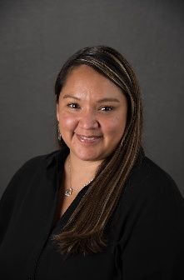

Who is your Chapter Contact at WAI?
Interested in starting a WAI Student Chapter at your school/university? Reach out to our Manager of Chapter Relations to learn more and share your interest!
Summer Cole
Manager of Chapter Relations
scole@wai.org

Slide 4
What makes WAI unique?
Women in Aviation International is made up of ladies and gentlemen from all backgrounds of all age groups within aviation and aerospace working toward common goals. Our Purpose is to:
Foster, promote and engage in aviation education, particularly as it relates to women in aviation.
Cultivate, foster and promote interest and understanding among the public in the accomplishments and contributions of women to the aviation industry.
Promote, encourage and facilitate membership in WAI and Chapter.
Support and promote the mission, vision, goals and objectives of WAI.

Slide 5
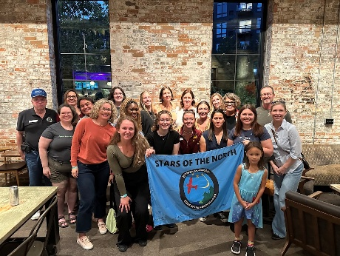



Membership Snapshot
More than 20,000 active members
51% Individual Members
9.5% International Members (Outside the U.S.)
45% Student Members (College and University students)
Over 5,000 Junior Members (18 years old and younger)
Over 300 Corporate Members (Organizations/Corporations)
85% women; 15% men

Slide 6
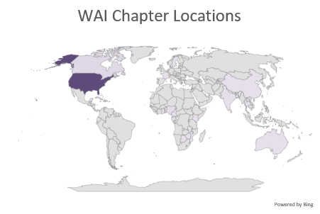
WAI Chapter Stats!
Chapter Count
Official Chapter - US |  | 74
Official Collegiate Chapter - US |  | 35
Official Collegiate Chapter - International |  | 2
Official Chapter - International |  | 16
Provisional Chapter - US |  | 15
Provisional Collegiate Chapter - US |  | 14
Provisional Collegiate Chapter - International |  | 3
Provisional Chapter - International |  | 15
Total Chapters |  | 174
Number of Countries | 26

Slide 7
Steps to Start a Student Chapter

Slide 8
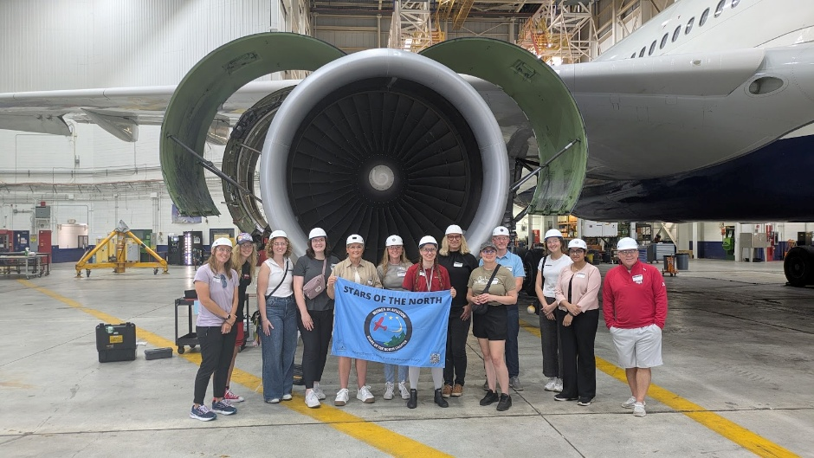
You’re Ready to Start a Student Chapter of Women in Aviation International: What Should You Know
All Chapter members and officers must also be members of the Women in Aviation International organization. Members can join or renew easily at www.wai.org/membership-information
Student Chapters must have and maintain a minimum number of active WAI members.
  Student/Collegiate Chapters: minimum of 6 members and an advisor from the school or institution who is also an active member of WAI.

Slide 9
You’re Ready to Start a Student Chapter of Women in Aviation International: What Should You Know
All Chapters must have and maintain officers in the following positions:​
  President​
  Vice President​
  Secretary​
  Treasurer
  Advisor
All Chapters must agree to the WAI Official Chapter Agreement

Slide 10
You’re Ready to Start a Student Chapter of Women in Aviation International: What Should You Know
Faculty/Staff Advisor: Student Chapters must have an advisor who is a member of the school’s faculty or staff.
  The advisor helps maintain continuity as the Chapter’s Board of Directors turns over through the school years and as membership changes.
  Having an excited advisor is important to the success of your chapter.
  Keep your advisor informed of what’s going on with your chapter, how he or she can help you and your board hit your goals for the year, and any important information exchanged during the board meetings.
Ensure that the School/College/University’s student organization information is on your Application, along with performing a regular check to ensure that your Faculty Advisor’s information is up to date with Women in Aviation International.

Slide 11
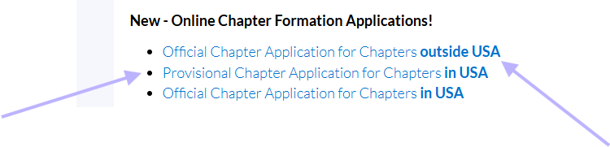
Are you in or outside the US?
US Student Chapters
Non-US Student Chapters
US Student Chapters have to go through the Provisional chapter status application first before they can apply as an Official Student chapter.
Non-US Student Chapters DO NOT have to go through the Provisional chapter status and can apply for Official Student chapter status right away.

Slide 12
WAI Chapter Formation Steps for Student Chapters in the US

Slide 13
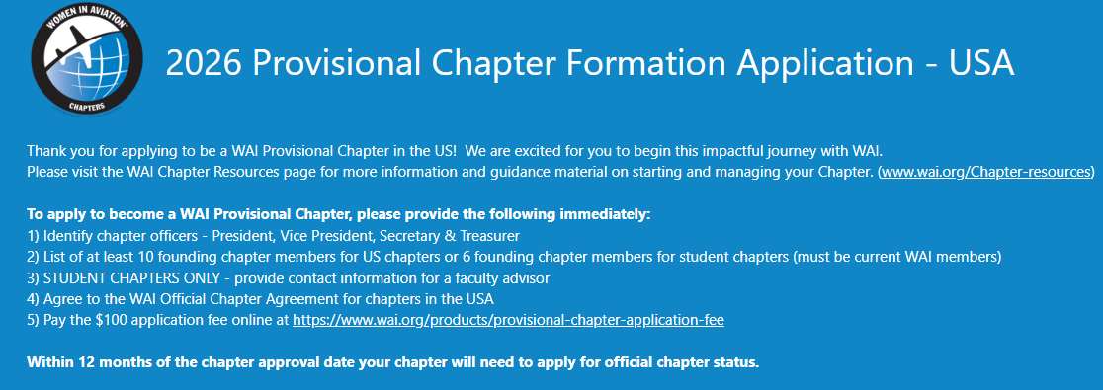
www.wai.org/chapter-resources

Slide 14
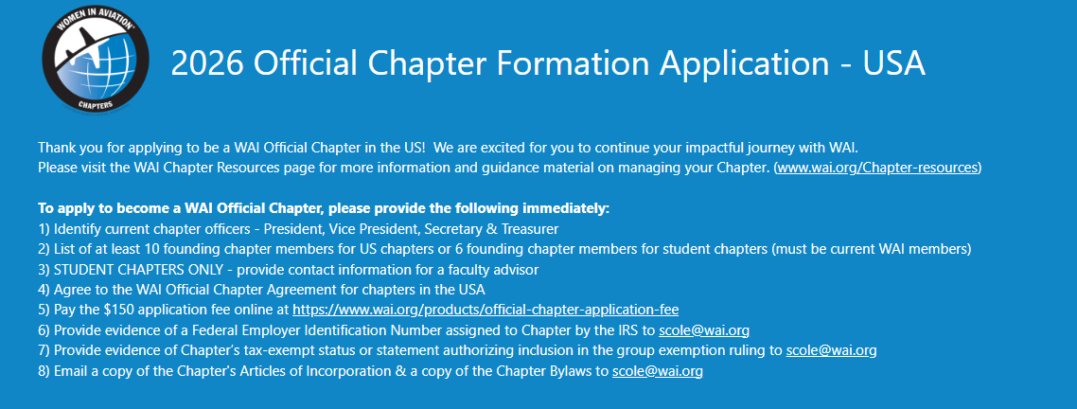
www.wai.org/chapter-resources

Slide 15
WAI Chapter Formation Steps for Chapters outside the US

Slide 16
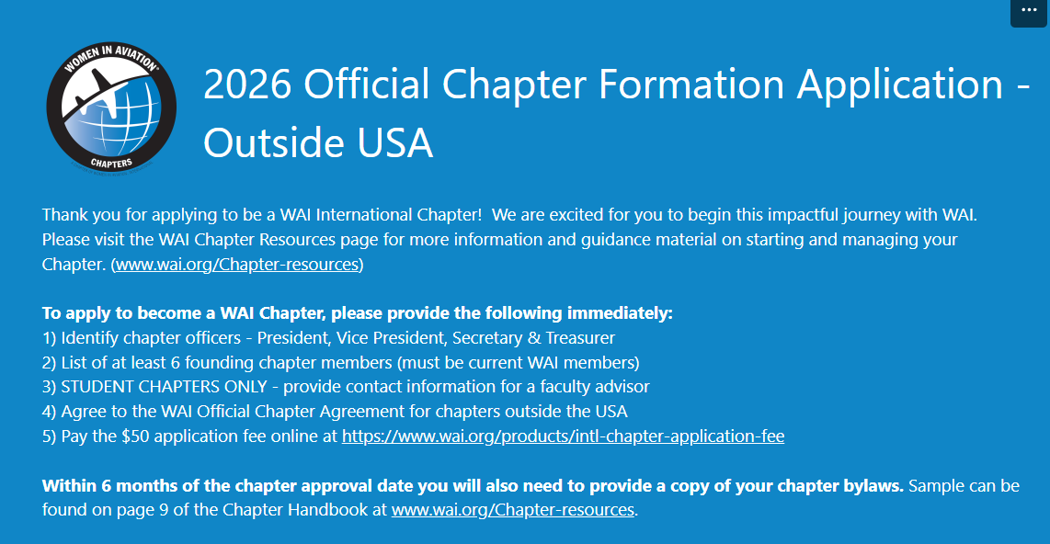
www.wai.org/chapter-resources

Slide 17

Important!
WAI does not require International chapters to register locally. However, it is up to the chapter to determine what is required locally in their country and make sure those requirements are met.
Submit your bylaws within 6 months!

Slide 18
Helpful Tips

Slide 19
Important
Make sure the chapter is in line with the School’s requirements.
Ensure that you are getting the School’s recognition as a student organization on campus.
Ensure you have visibility as a student organization on campus.
Use resources available to you as a student organization!

Slide 20

Recruiting Members on Campus
You have to give them the WHY.
Why should I join ANOTHER student organization?
Why is this organization more important than all the others who are talking to me?
Why do I want to juggle student life, a job, classes, volunteering, and extracurriculars? What’s in it for me?

Slide 21
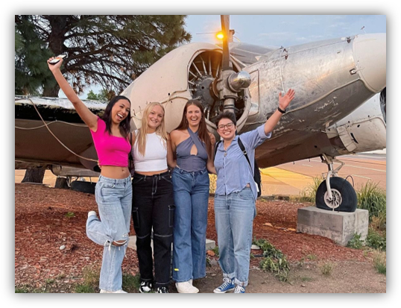
Freshman Outreach
Start early! Let new students know WAI is an available resource ASAP.
Drop by student orientations or a class the new students are attending. Have you considered recruiting OUTSIDE of the traditional aviation program?
Highlight what makes WAI and the chapter different from other organizations on campus.
Make joining a clear and easy process! New students are already overwhelmed.

Slide 22
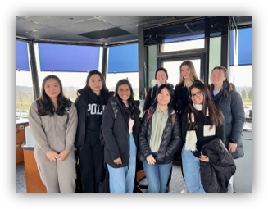
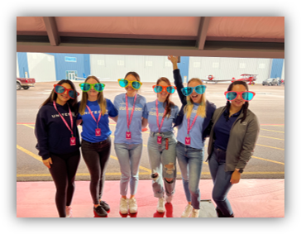
Recruiting Members on Campus
Ideas for Recruiting:
  Involvement with incoming Freshmen
  Address the ladies AND gentlemen membership ratio on campus
  Community outreach and volunteerism events
  Activities on campus, study groups, etc.
  Utilize the WAI Mentorship program and the lifetime benefits of creating these relationships
  Whatever you do, make it FUN! Chapter BBQs, day trips, potluck dinners, pizza socials, movie nights, etc.

Slide 23

Unique Challenge: Succession Planning
Student Chapters Experience Constant Change
Why should I become an officer?
How do you find individuals invested in WAI, not looking for something to add to their resume?
How do you hold your elections?
What are the terms of your officers?
How do you dismiss officers if it becomes necessary?
What do you use to guide your chapter?

Slide 24
Chapter Tools & Resources

Slide 25
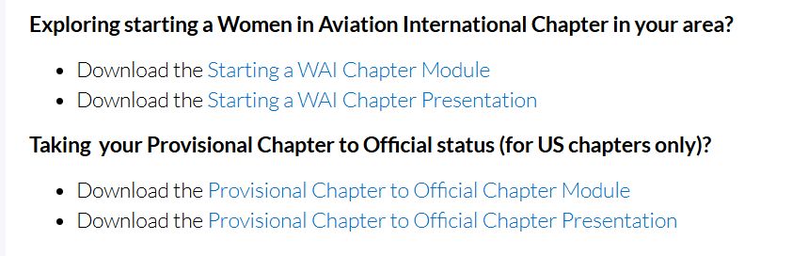
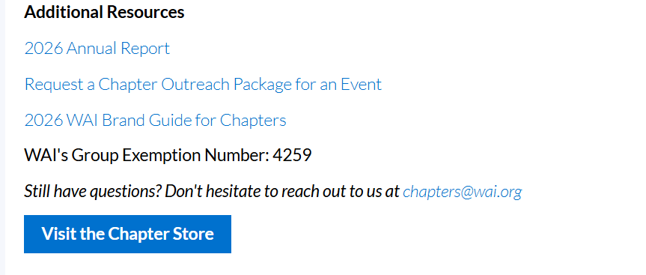
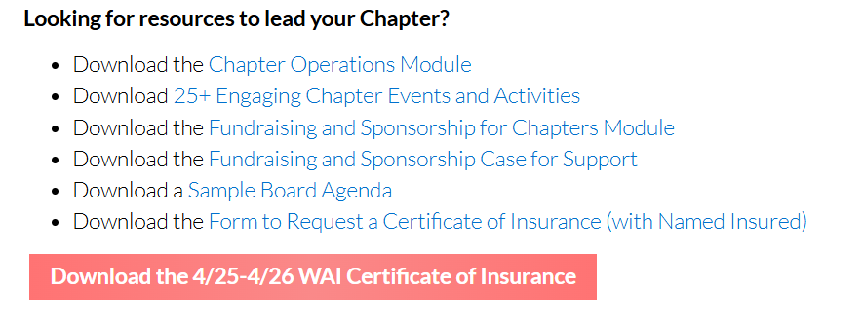
https://www.wai.org/chapter-resources

Slide 26
Chapter Continuity Tool
Maintaining accurate chapter documents and information is critical for supporting the chapter’s continued success and ensuring a smooth transition from one board to the next.
This includes (but is not limited to):
Banking Information
Corporate & Tax Information
Login
Organizational Calendar
Project & Event Log
Officers & Leadership
Committees
It is important to keep information up-to-date at all times!
Make sure designated board members have access to the designated information.
The file should be password-protected and/or saved in private folder with limited access.
Sample continuity tool can be found here!

Slide 27
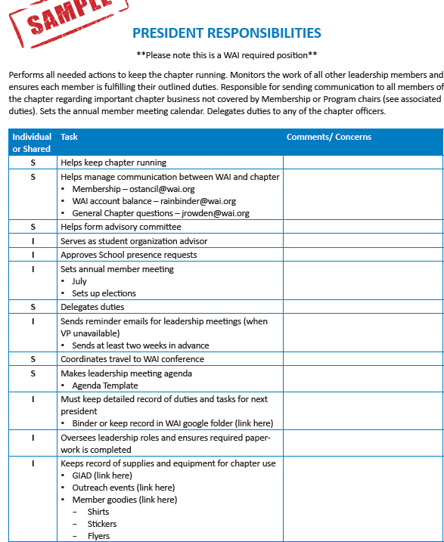
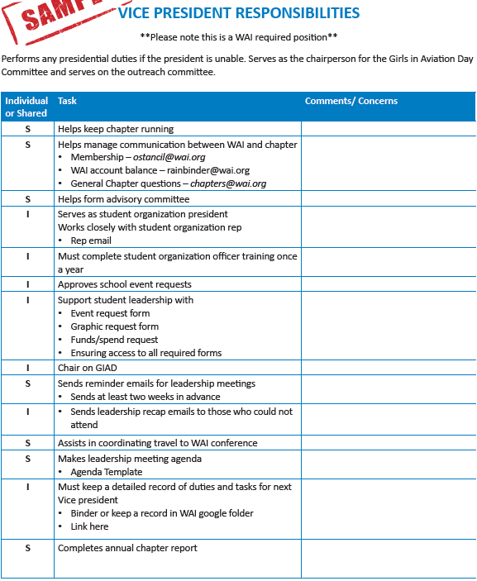
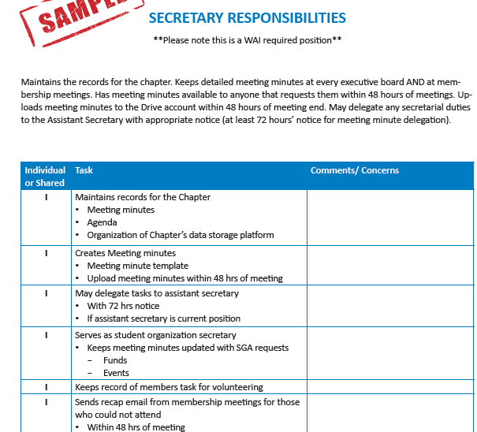
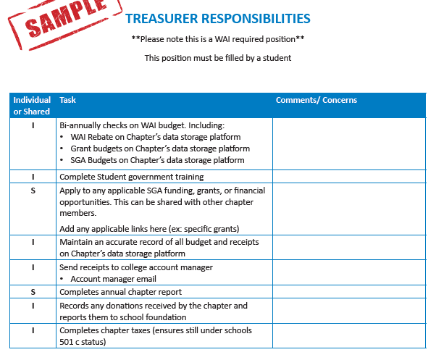
Chapter Continuity Tool - continued
Part of the continuity tool includes maintain chapter board/officer roles and responsibilities.
President
Vice-President
Secretary
Treasurer
These samples (along with other officer positions) can be found online here!

Slide 28

Important Note:
Create a generic e-mail address contact for your chapter such as abcunivwai@gmail.com rather than using someone’s personal school email address.
This ensures a continuous point of contact with the chapter.
Without this in place, leadership graduates, people forget to update their rosters, and the rest of the world is like…

Slide 29

Financials: EVERY SCHOOL IS DIFFERENT!
First: For tax exemption, are you under the school’s tax exemption or under the WAI ruling?
*If your student chapter falls under the school’s non-profit group ruling, you must provide a letter to WAI from the school confirming this arrangement. The letter can be found in the Chapter Handbook to provide to the appropriate school official to place on school letterhead, personalize, sign, and send to Summer at scole@wai.org.
This determines how you handle your financials.
  Is your money in a school fund/account?
  How do you have access to cash?
  Where do you get money if needed?
  How do you account for your funds?
WAI Tax Exempt Form on page 27 of Chapter Leader Handbook

Slide 30
There Are Three Things You Have To Do Annually!
If you’re under the WAI tax exempt group ruling, file your 990N and send a copy to Summer! Filing window is Oct. 1-Feb.15 every year.
You need to monitor your chapter lists in your Member Compass. Update your membership roster and ensure that your officers are current.
3) Submit your Annual Report and annual administrative chapter dues by 4/1.
Deadline to remember is April 1!

Slide 31
Any Questions???

Slide 32
Up Next…
WAI OU Sooners Chapter!

Slide 33



WAI Sooner Chapter
The University of Oklahoma

Slide 34

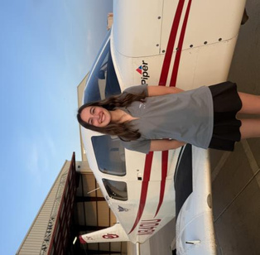
About Us
Casey Cox
President
OU Flight Instructor
Natalie Smith
Vice President
OU Flight Instructor

Slide 35
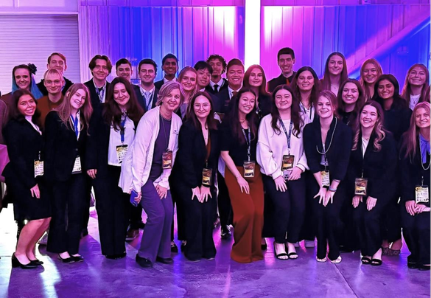
Our Chapter
WAI Sooner Chapter
75 Members
Meetings Monthly

Slide 36
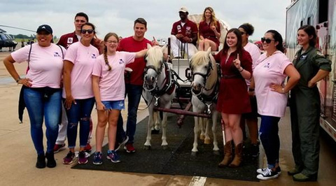
How We Got Started
Initial steps taken
Resources used when starting
2019 Girls in Aviation Day

Slide 37
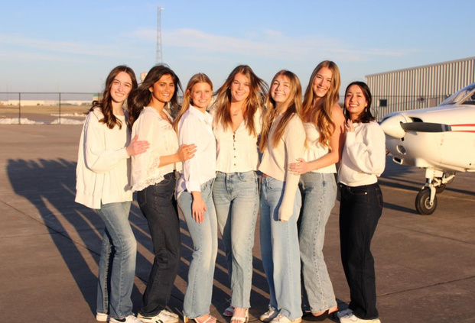
Chapter Structure and Leadership
President
Vice President
VP of Communications
VP of Events
VP of Finance
VP of Marketing

Slide 38
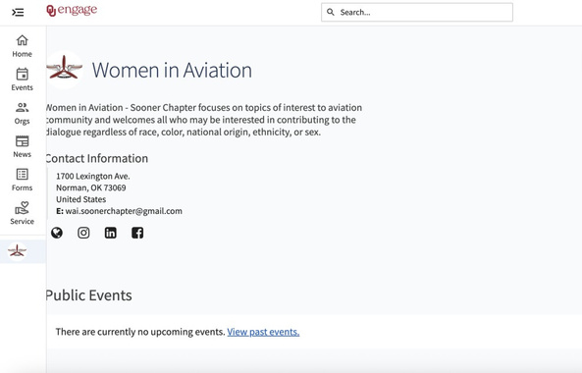
Working with our University
OU Engage
Funding and Meeting Space
Promotion through School of Aviation and AGS College

Slide 39
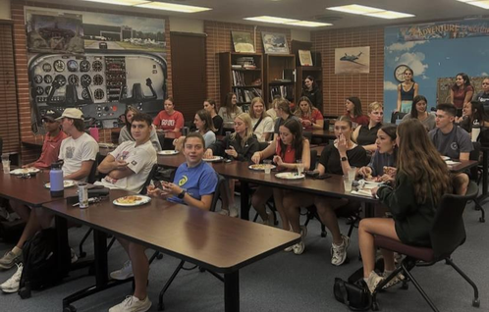
Growing Membership
Fun events
FOOD!!
Social Media
Finding a good time for meetings

Slide 40
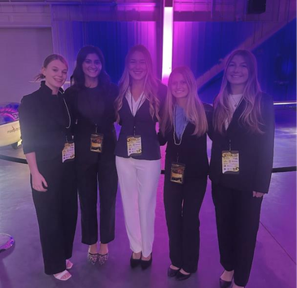
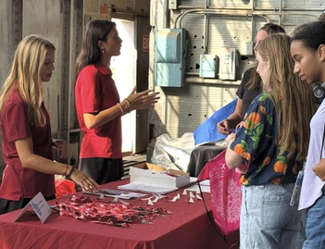
Events: Professional Development
Networking events
  Girls in Aviation, Airport Events
Guest speakers at meetings
Oklahoma WAI Lunch-in

Slide 41
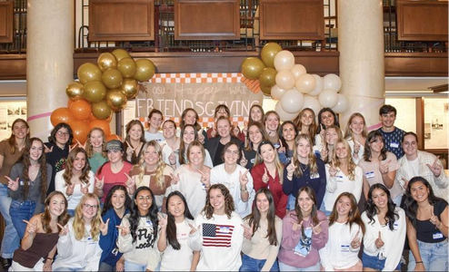
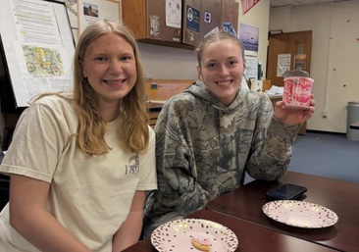
Events: Community and Social
Events with other organizations
Social Events
  Cookie Decorating, Movie Nights
Study Night

Slide 42
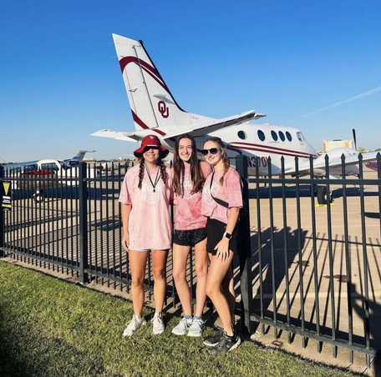
The Wins
Benefits to Members
Professional Connections
Community/Friends

Slide 43

The Challenges
Finding times to meet
Budget Constraints
Leadership Transitions

Slide 44
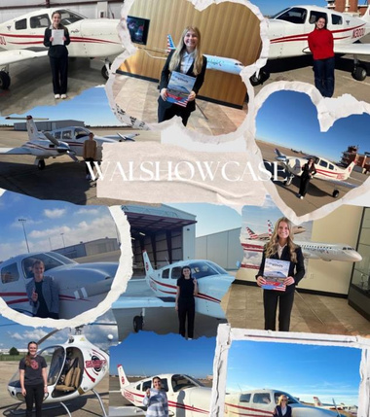
Keys to Success
Don't be afraid to reach out to mentors for help
Opportunities for networking
If budget allows, offer food at meetings

Slide 45

Thank You!
@oklahomawai wai.soonerchapter@gmail.com

Slide 46
Any Questions???

