Slide 1
JEOPARDY JEOPARDY JEOPARDY JEOPARDY JEOPARDY JEOPARDY JEOPARDY JEOPARDY JEOPARDY JEOPARDY JEOPARDY JEOPARDY JEOPARDY JEOPARDY JEOPARDY JEOPARDY JEOPARDY JEOPARDY JEOPARDY
JEOPARDY JEOPARDY JEOPARDY JEOPARDY JEOPARDY JEOPARDY JEOPARDY JEOPARDY JEOPARDY JEOPARDY JEOPARDY JEOPARDY JEOPARDY JEOPARDY JEOPARDY JEOPARDY JEOPARDY JEOPARDY JEOPARDY
Notes:
Family Feud Template
Introduction Slide – Family Feud!

Slide 2
HERE ARE TODAY’S CATEGORIES
Notes:
Family Feud Template
Introduction Slide – Family Feud!

Slide 3
The Mythical North

Slide 4
Solving the South’s Problems

Slide 5
Whose regulation is it anyway?

Slide 6
Peripheral Vision

Slide 7
Water Warriors

Slide 8
The Mythical North
Solving the South’s Problems
Those regulation is it anyway?
Peripheral Vision
Water Warriors
$200
$200
$200
$200
$200
$400
$400
$400
$400
$400
$600
$600
$600
$600
$600
$800
$800
$800
$800
$800
$1000
$1000
$1000
$1000
$1000
FINAL JEOPARDY

Slide 9
Northern California conserved this percentage of water in 2018.

Slide 10
What is 25%.

Slide 11
The number of adjudicated groundwater basins in Northern California.

Slide 12
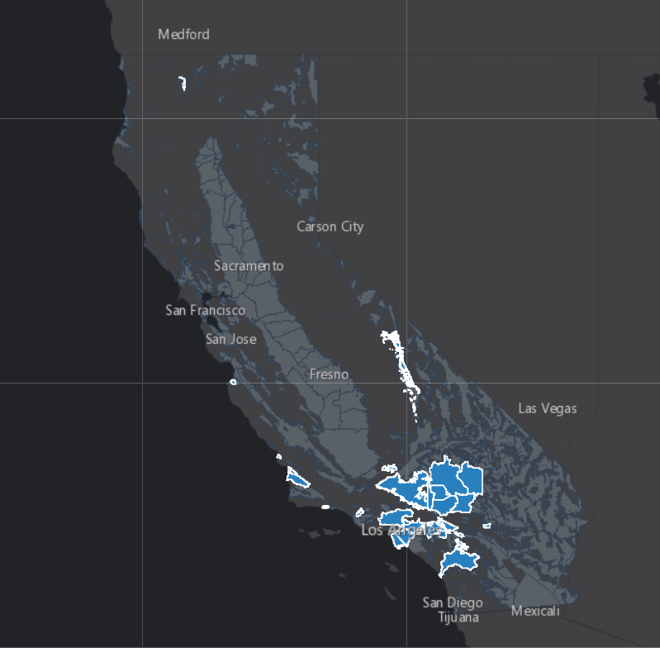
What is the one?
Adjudicated Basins

Slide 13
Over 50% imported water is served to this area.

Slide 14
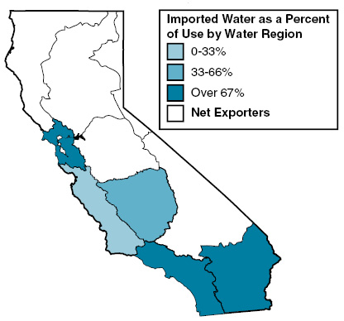
What is the Bay Area?

Slide 15
In 2008 this fish resulted in cutting back 1/3 of state water supplies from the bay delta.

Slide 16
What is the Delta Smelt?

Slide 17
This will be the first potable reuse project in Northern California.

Slide 18
What is Monterey One Water?

Slide 19
This is the largest planned potable reuse project in the world.

Slide 20
What is the MWD-LACSD Regional Recycled Water Project (150 MGD)?

Slide 21
This was the first permit to inject 100% recycled water for indirect potable reuse.

Slide 22
What is West Basin Municipal Water District West Coast Barrier Injection?

Slide 23
This is the largest desalination plant in North America.

Slide 24
What is Carlsbad-Poseidon 50 MGD Ocean Desal Facility (50 MGD)?

Slide 25
This nick-name was given to the Southern California resident who managed to use 11.8 million gallons of water in a single year.

Slide 26
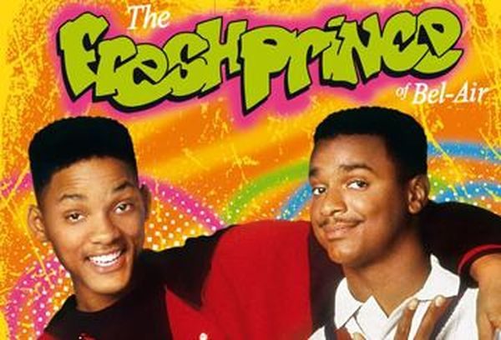
Who is the Wet Prince of Bel Air?

Slide 27
This is the largest potable reuse facility in the world.

Slide 28
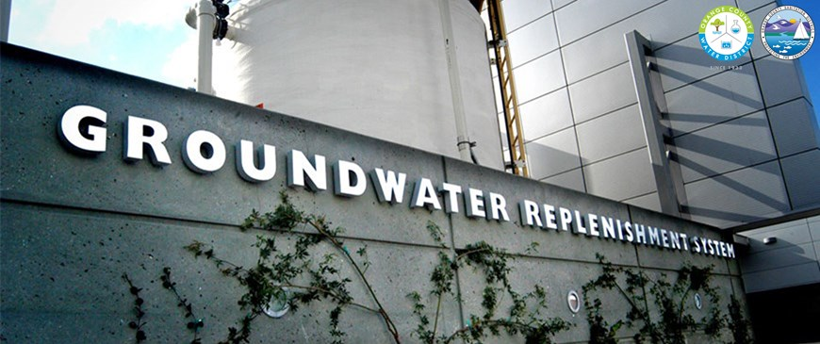
What is the OCWD Groundwater Replenishment System?

Slide 29
These major laws transformed environmental regulations in the 1970s.

Slide 30
What is the decade of the Environmental Revolution – ESA, NEPA, CEQA, CWA?

Slide 31
The date of Governor Brown's declaration of 25% mandatory water use.

Slide 32
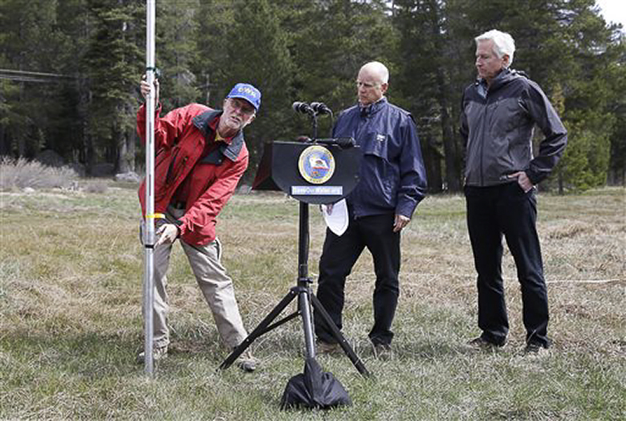
When is April 1, 2015?

Slide 33
This is the first permitted reservoir water augmentation facility in CA.

Slide 34
What is Pure Water San Diego?

Slide 35
This is the estimated cost to comply with MS4 requirements in Los Angeles County.

Slide 36
What is $22B?

Slide 37
Imported water TDS levels can get a surface reservoir on this list of impaired water bodies.

Slide 38
What is the 303(d) list?

Slide 39
This controversial project aims to provide reliable imported water.

Slide 40
What is WaterFix?

Slide 41
This independent state agency is one of the last approvals for WaterFix.

Slide 42
What is the Delta Stewardship Council?

Slide 43
In 2016, MWD purchased this deliciously named delta island.

Slide 44
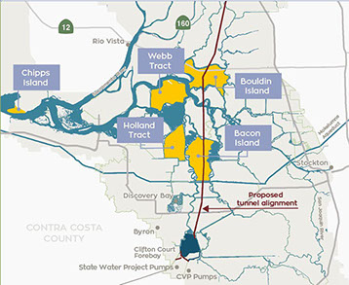
What is Bacon Island?

Slide 45
This judge ruled on the decision to cut water deliveries by 33% due to the Delta Smelt.

Slide 46
Who is Judge Oliver Wanger?

Slide 47
63% of California voted no on a 1982 Ballot measure for this water facility.

Slide 48
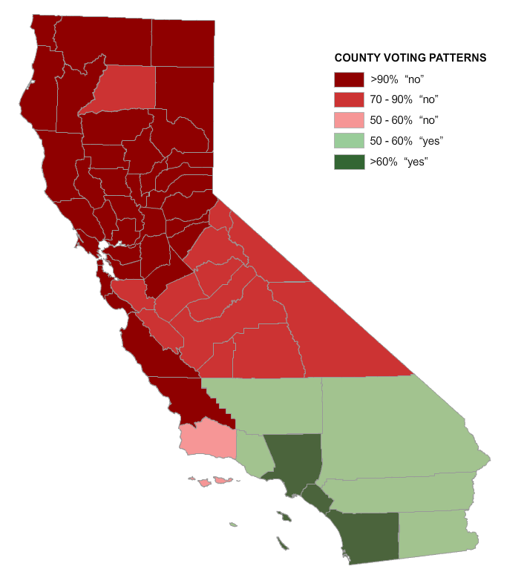
What is the Peripheral Canal?

Slide 49
He was the self-taught civil engineer that was responsible for the first two imported water aqueducts of the 20th century.

Slide 50
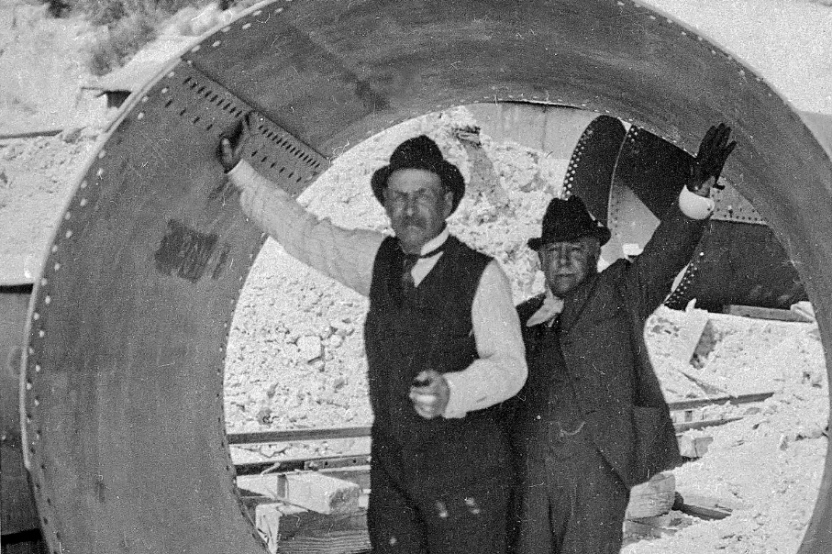
Who was William Mulholland?

Slide 51
The famous quote “Whiskey is for drinking, water is for fighting over.” is attributed to this American writer.

Slide 52
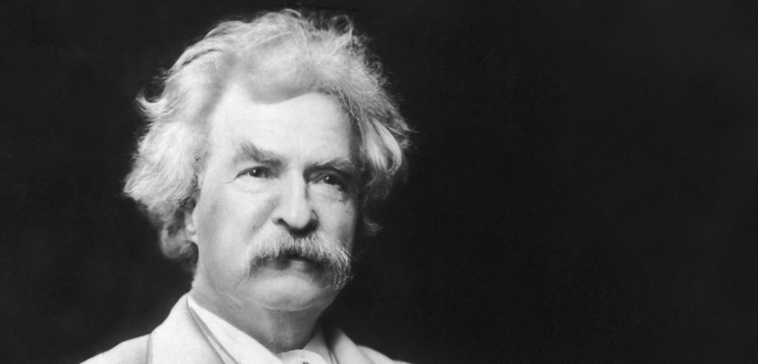
Who is Mark Twain?

Slide 53
This Greek mathematician developed a method to determine the volume of an irregular object by using water.

Slide 54
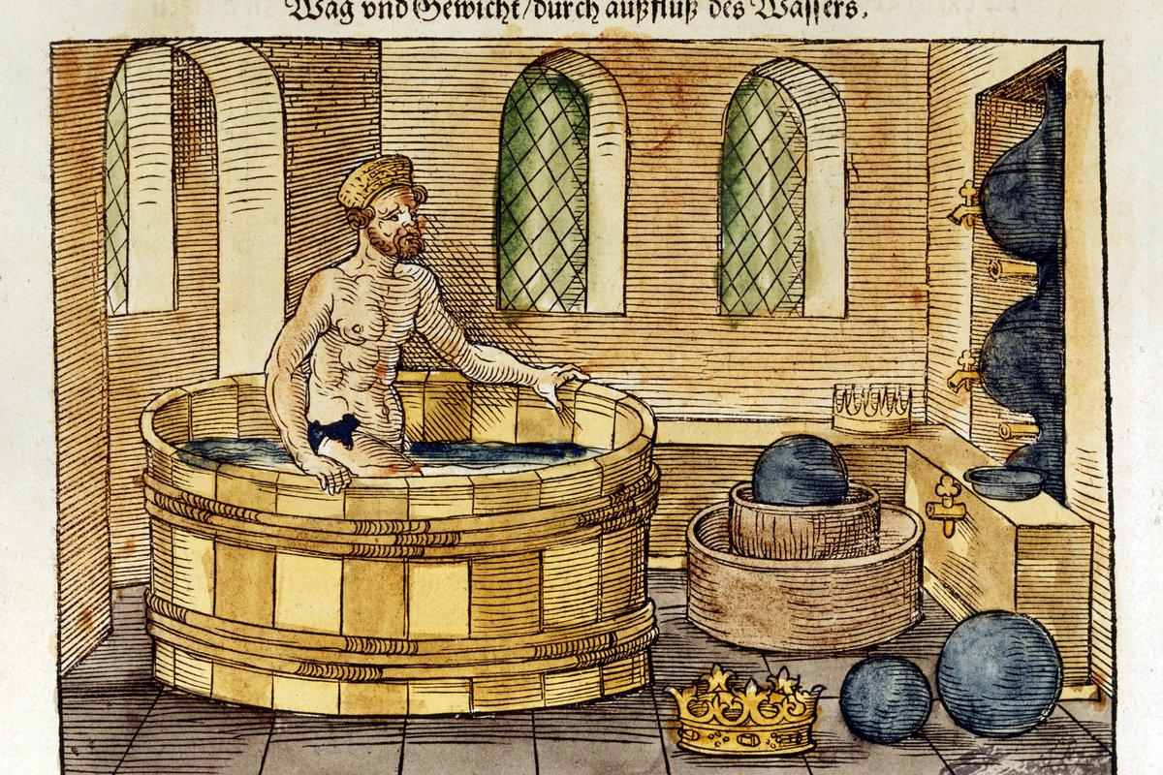
Who is Archimedes?

Slide 55
This environmentalist was the author of Cadillac Desert.

Slide 56
Who is Mark Reisner?

Slide 57
This General Manager was first to spend millions on “cash for grass” and said “we can’t conserve our way out of a massive drought on the Colorado River”.

Slide 58
Who is Pat Mulroy?

Slide 60
What accounts for ¼ of the water use in your home?
Start Timer
GO TO
ANSWER
(question)

Slide 61
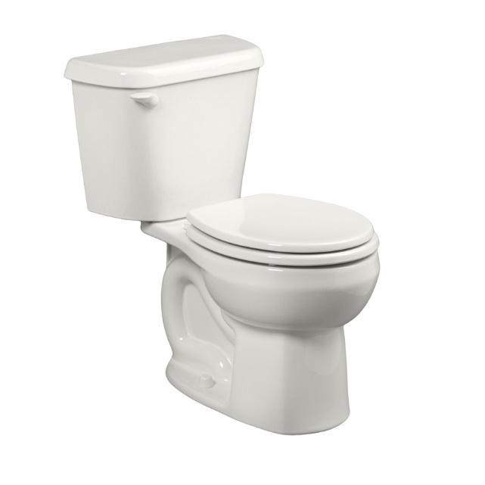
Toilet

