Slide 1
The Unintended Consequences of Water Conservation
…that you’ve probably never considered…

Slide 2
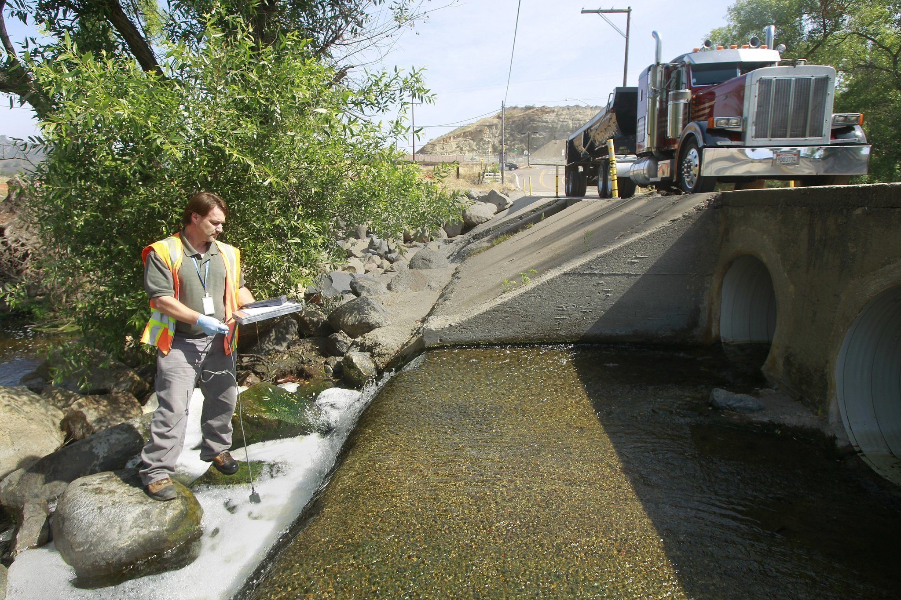
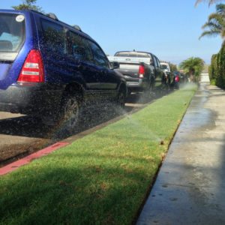
The intended consequences…
But what about…

Slide 3
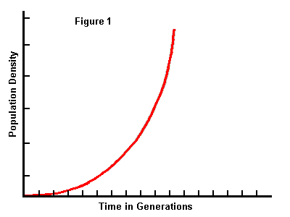
Population Impacts…
This Photo by Unknown Author is licensed under CC BY-NC-ND

Slide 4
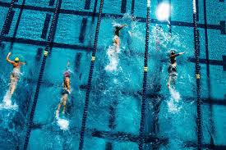
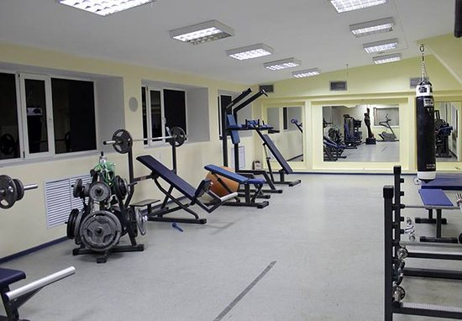
New Year’s Gym Membership resolutions will have new value

Slide 5
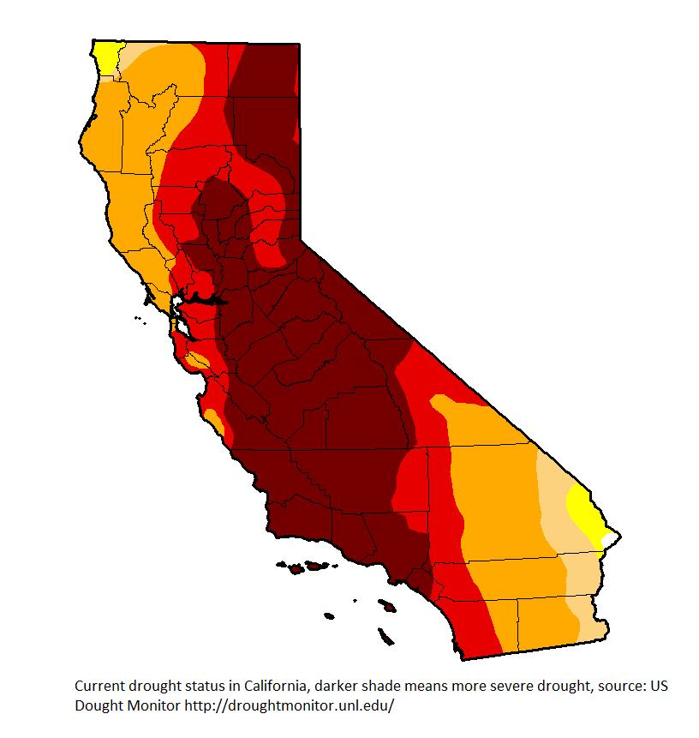
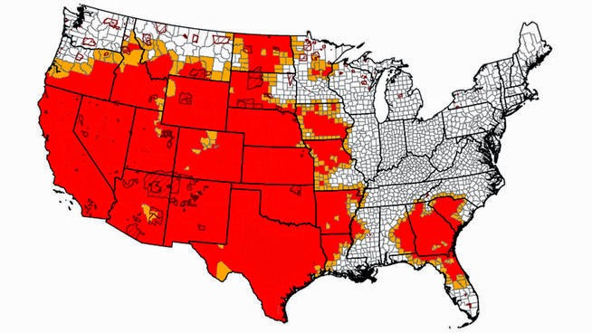
Redrawing political colors?
Blue
Blue
Blue
Blue
This Photo by Unknown Author is licensed under CC BY-SA-NC

Slide 6
No more endangered species…oh wait
Rare sighting of the endangered yellow sharp-toothed quint fin swallow-tailed salmon at mouth of San Francisco Bay

Slide 7
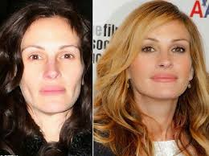
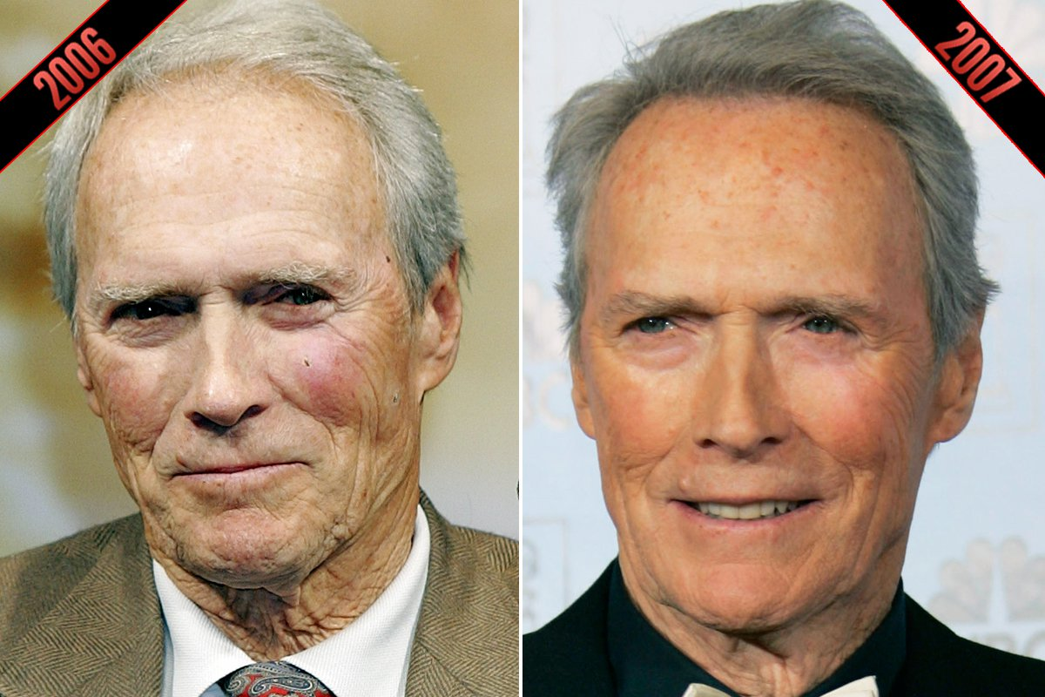
Plastic Surgeons in Hollywood will get a boost…

Slide 8
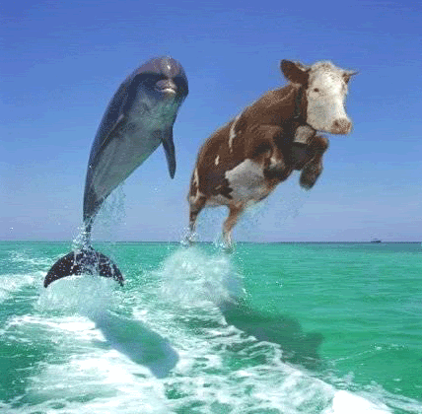
Little known relationships will be threatened

Slide 9
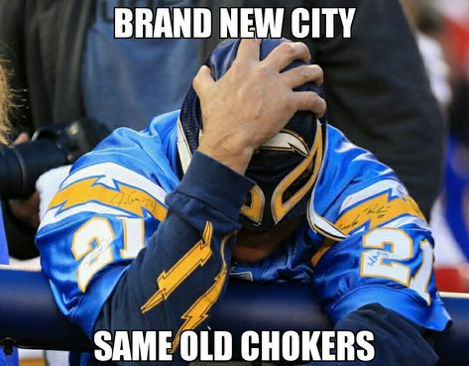
Sports will be affected

Slide 10
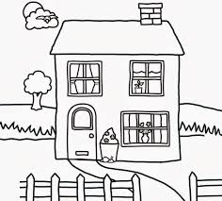
Crayola Stock Boom

Slide 11
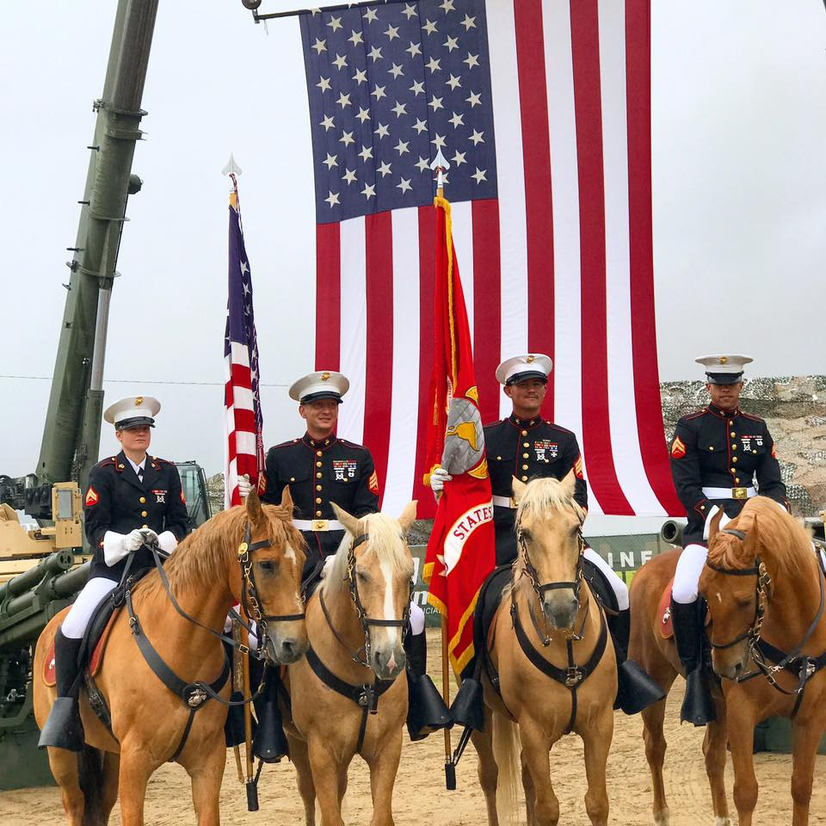
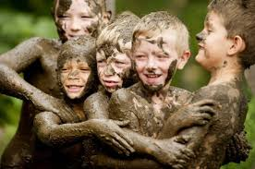
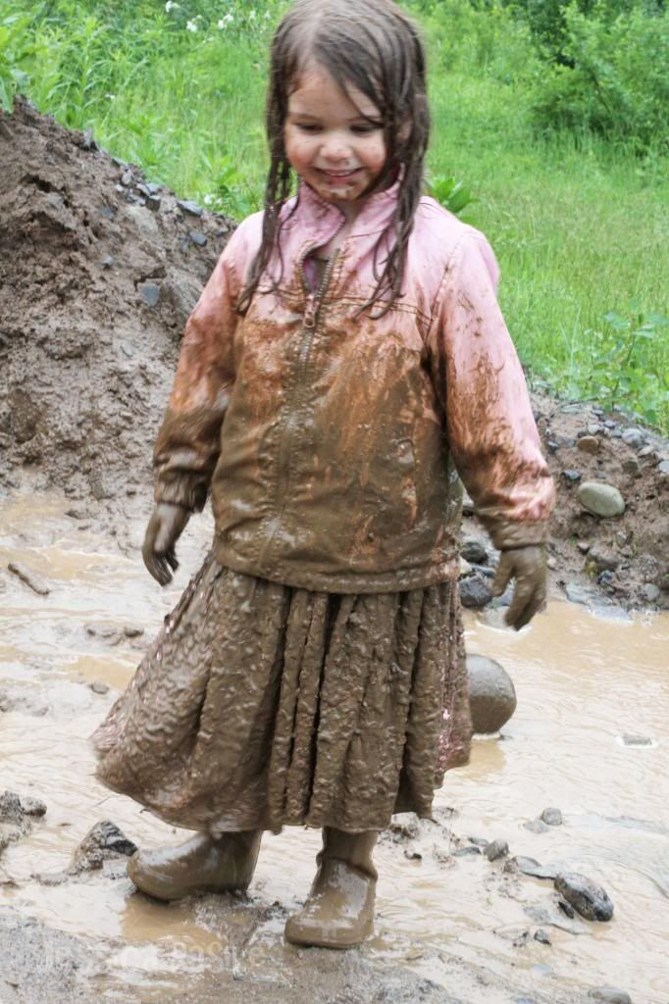
Big gains in the kid happiness index!

