Slide 1

Is a gallon conserved a gallon saved? The impacts of (uninformed) conservation on effluent generation and quality
Kurt A. Schwabe
Professor of Environmental Economics and Policy, School of Public Policy
University of California – Riverside
Adjunct Fellow, Water Policy Center, Public Policy Institute of California
Adjunct Professor, Center for Food and Resources, University of Adelaide
Dr. Mehdi Nemati
Assistant Cooperative Extension Specialist
Water Resource Economics and Policy
School of Public Policy
University of California-Riverside
Presented at the Urban Water Institute’s Spring Conference, Palm Springs, CA
February 27th, 2019
Notes:
E30/S1: “And the Rains Came

Slide 2
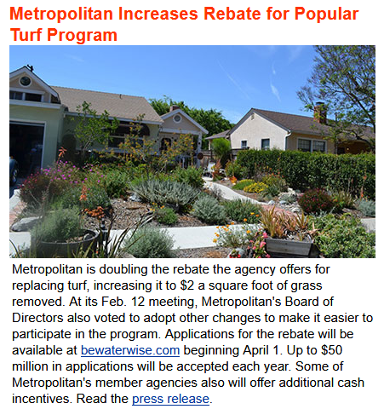
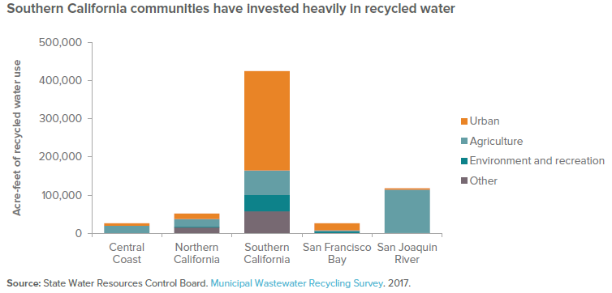
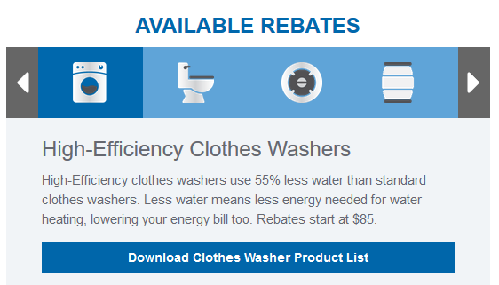
California’s Engaged Heavily in Conservation, Efficiency, & Reuse Investments, Legislation, and Policies
BC WaterNews 2/24/19
PPIC (2018)
Examples: State Policies
SB606 / AB1668 (legislative actions)
Conservation Mandate (executive action)
Notes:
96 over all; 34 for this research

Slide 3
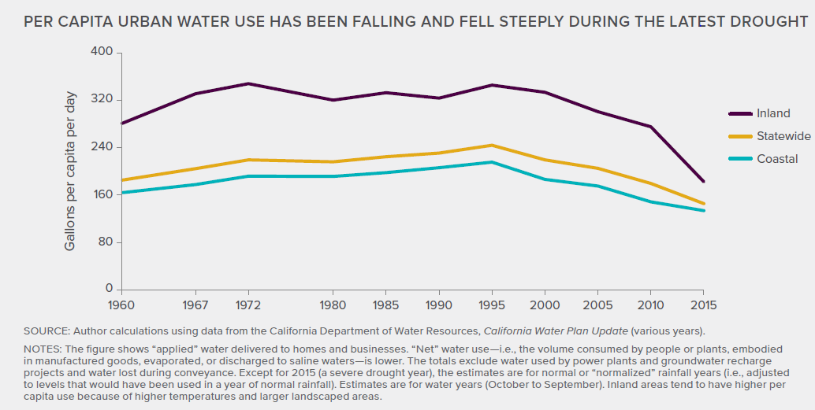
Reducing Demand (per capita):Effects of Water Use Efficiency / Conservation (PPIC 2017)
1995-2010: 27% reduction in per capita water use (244 down to 178 gpcd)
2013-2105: 25% reduction in per capita water use (173 down to 130 gpcd)

Slide 4
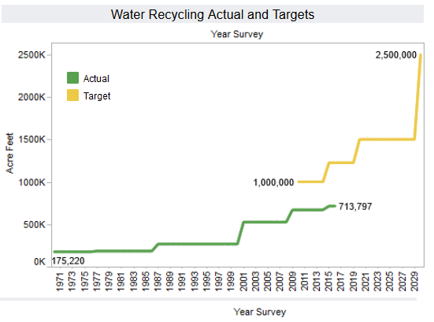
Augmenting Supply:
Recycled Use in CA/U.S
Increased by > 300% since 1970
  Urban reuse (w/o IPR)~36%
  Agricultural reuse ~ 31%
Significant efforts/expectations to increase reuse/recycling
Trends observed throughout U.S.
PPIC (2019)
SWRCB (2017)
Tran, Schwabe, and Jassby (2016)

Slide 5
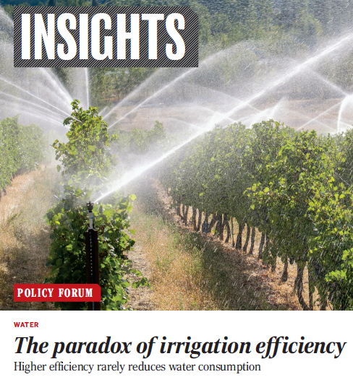
Irrigation efficiency and irrigated agriculture: A “Paradox”?
=> Govts spend $billions on subsidizing advanced irrigation technologies to “save” water
=> Provides water savings (private benefits) at farm scale
=> Rarely delivers public good benefits of increased water availability at basin-scale
Why? Overlook nonconsumptive water => losses at farm-scale often recovered & reused at basin or watershed scale
Two (among many) helpful “Fixes”
Acknowledge rebound effects
Implement a robust water accounting and measurement system
Science (2018)
Ward and Pulido-Velazquez (2008);
Qureshi, Schwabe, Connor, Kirby (2010)
Grafton et al. (2018)
Notes:
Rio Grande
Australia’s Murray Darling

Slide 6
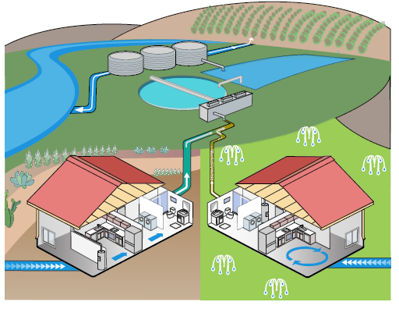
Is there a similar “paradox” in municipal water policy/management?
Question 1: Are supposedly efficient actions in one area of the “water portfolio” leading to inefficiencies in another area of the water portfolio?
Question 2: What is the magnitude of the inefficiency on the system?
Question 3: How has policy exacerbated or mitigated such a system inefficiency?
Question 4: What can be done to operate the system more efficiency?

Slide 7
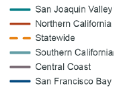
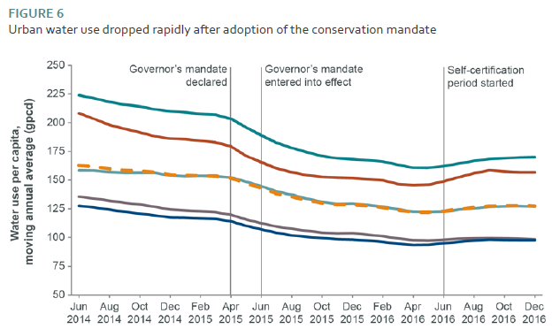
Are there unintended consequences from water conservation on recycling/reuse of wastewater?
__________
Mitchell et al. (2017)
Notes:
June 2015 to Feb 2016: statewide savings ~ 23.9%
June 2016 to Dec. 2016: statewide savings ~ 19.5%

Slide 8
Are there unintended consequences from water conservation on recycling/reuse of wastewater?
__________
Mitchell et al. (2017)
________________
(Tran et al. 2017)
Notes:
June 2015 to Feb 2016: statewide savings ~ 23.9%
June 2016 to Dec. 2016: statewide savings ~ 19.5%

Slide 9
Estimating Impact of Conservation Policies on WWTP Effluent Quality and Flow (Schwabe, Nemati, Amin, Tran, and Jassby)
Estimate two equations:
Monthly effluent as a function of:
  monthly water deliveries to single family residential accounts
  Conservation policy
    Voluntary request period: June-2014 to May-2015
    Conservation mandate period: June-2015 to May-2016
    Self-certification period: June-2016 to May-2017
  Plant-level fixed factors
  Season
Monthly TDS as a function of:
  monthly effluent
  Conservation policy
  Plant-level fixed factors
  Season
Data: 34 WWTPs in SoCal over 48 months (January 2013-December, 2017)
Regression (Statistical) Model: Fixed Effects OLS
Notes:
96 over all; 34 for this research
1600 observations

Slide 10
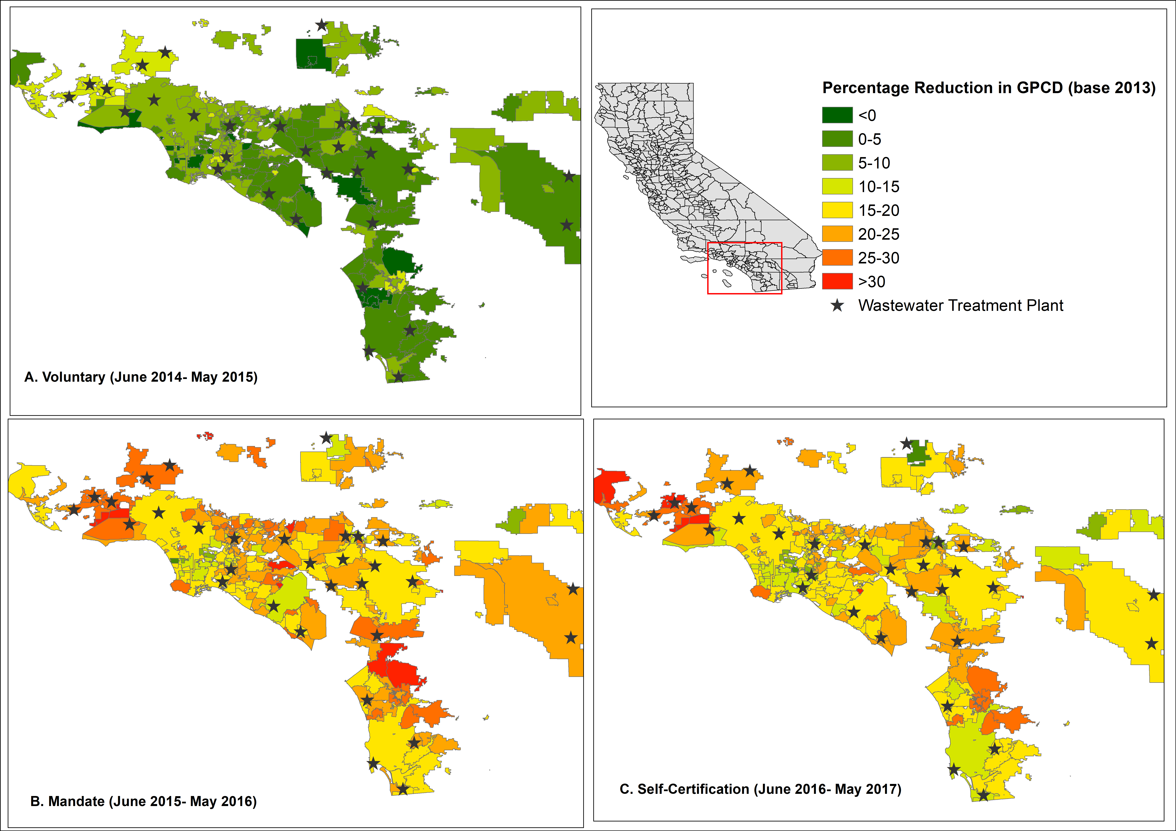
WWTPs (34) Location & Corresponding Water Agency Flow Reductions

Slide 11
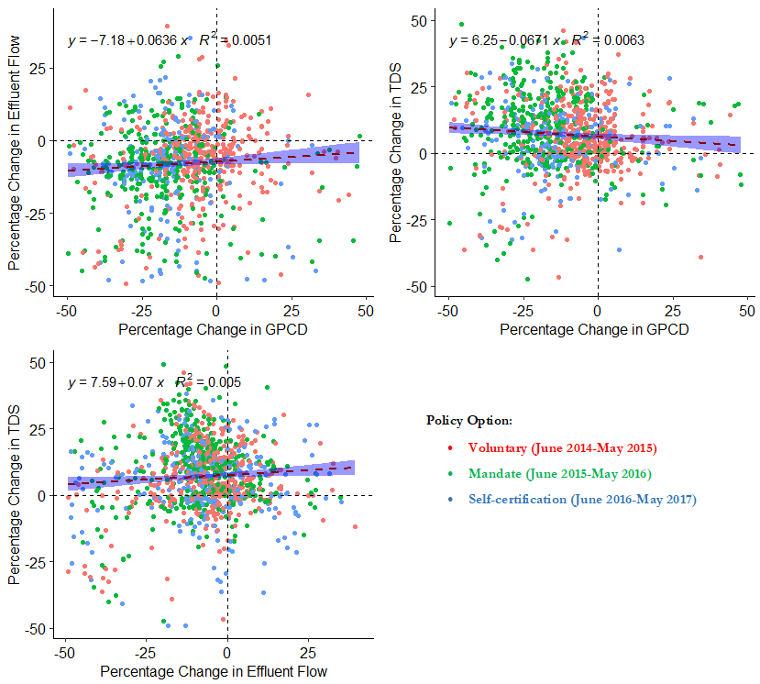
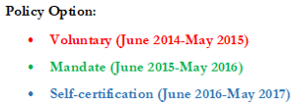
Monthly Relationship between Effluent Flows, GPCD, and TDS*
_____________
* Relative to 2013

Slide 12
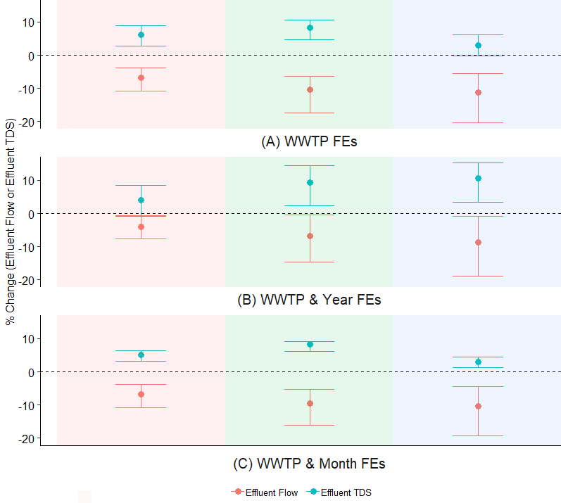
Estimated Impacts of Conservation Policy on Effluent Flow and TDS
Voluntary
(June 2014-May 2015)
Mandate
(June 2015-May 2016)
Self-certification
(June 2016-May 2017)
Conservation policies lead to:
(-) impact on effluent flows
  Voluntary request
    least impact
  Conservation Mandate:
    ~ 9% reduction
    4% to 16% range
(+) impact on TDS
  Conservation mandate:
    Likely largest effect
    ~ 8.7% increase
    4.4% to 11.4% range
Notes:
Effluent flow: Average point estimate: -8.27%; average upper limit: -3.45%; and average lower limit: -15.11%
Effluent TDS: Average point estimate: 6.45%; average upper limit: 9.33%; and average lower limit: 2.51%

Slide 13
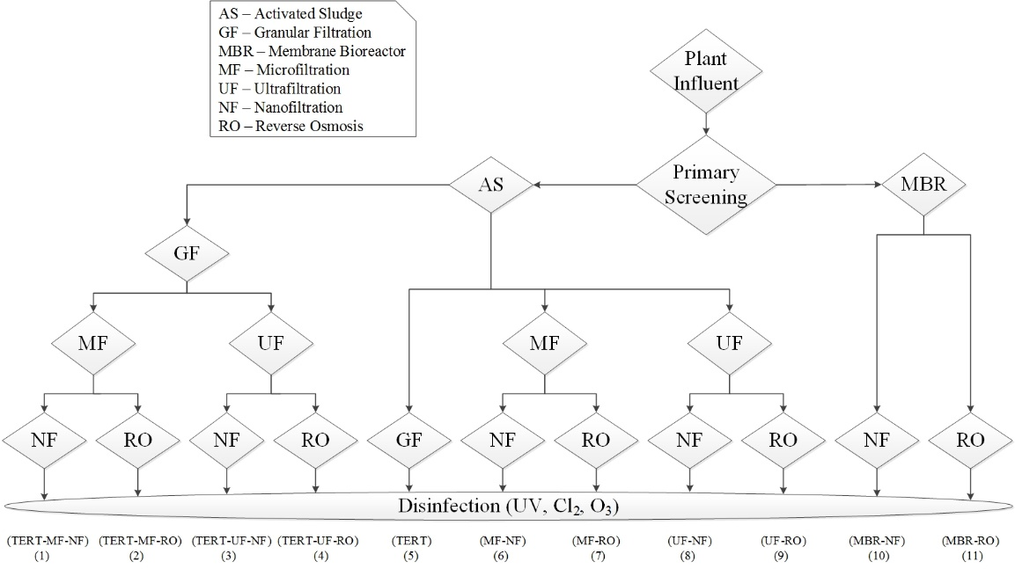
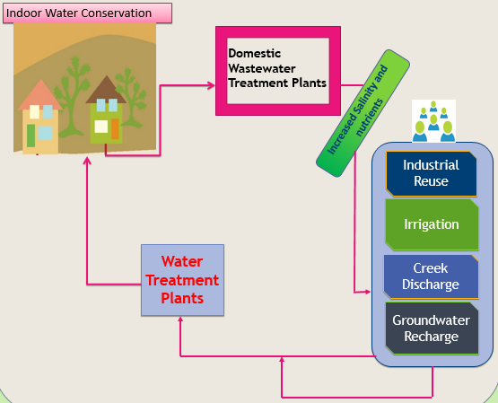
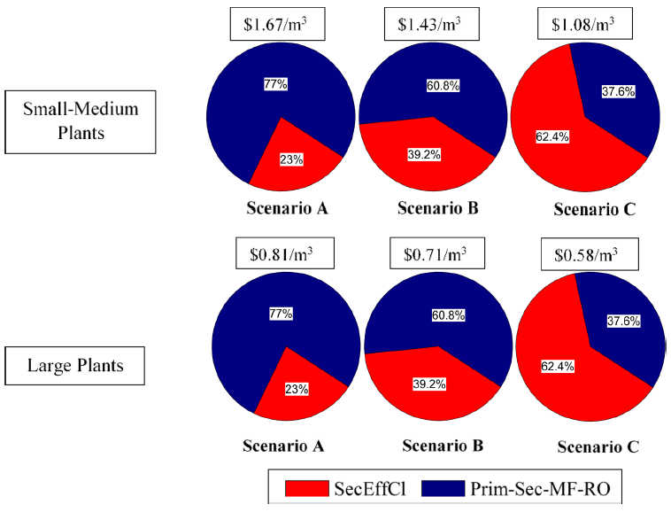
Cost-Effective Treatment to Mitigate Poorer Quality Influent During Drought: Regional Water Reuse Decision Support Model-RWRM (Tran, Schwabe, & Jassby 2016; 2017)
Notes:
-To those of you who don’t know what RWRM is, it is a Regional Water Reuse Decision-Support Model (RWRM) using GAMS software to evaluate the cost-effective irrigation solutions using the blending technique from different wastewater effluents within a treatment train. The RWRM uses constrained linear programming methods to identify wastewater treatment trains optimized to deliver treated wastewater with specific water quality properties.

Slide 14
Summary
Recycling/reuse, conservation, and increasing water use are integral parts of California’s water portfolio to address water scarcity and drought
Evidence suggests that conservation efforts and the drought – including the state mandate –impacted wastewater treatment effluent flow and quality
“unintended” conservation efforts may
  increase wastewater treatment costs
  reduce recycling opportunities
  impair surface water flows and qualities (especially in areas with effluent dominated streams)
Policy makers need to recognize the potential dependence of recycling on conservation, particular indoor water conservation

