Slide 1
Adapting to a New Era:
Declining Flow and Deteriorating Water Quality
A Santa Clara Valley Water District Perspective
Bhavani Yerrapotu, P.E.
Deputy Operating Officer
Treated Water Operations and Maintenance Division

Slide 2
Outline
Drought Impacts on Source Water Quality
Treatment Adjustments to Maintain Reliable Drinking Water Supply and Best Quality
Outcomes and Responses
Impacts to Purified Water Programs

Slide 3
Santa Clara Valley Water District Overview
Water resources management agency providing Silicon Valley
  Safe and clean water
  Flood protection
  Groundwater management
Santa Clara County water wholesaler serving
  15 cities
  39 miles of large-diameter distribution mains
  7 treated water retailers
  3 drinking water treatment plants (220 MGD)
  1 advanced purification center (8 MGD)
Two primary treatment plant sources
  Sacramento-San Joaquin Delta
  San Luis Reservoir
Sacramento
San Joaquin Delta
San Luis Reservoir
Source: valleywater.org

Slide 4
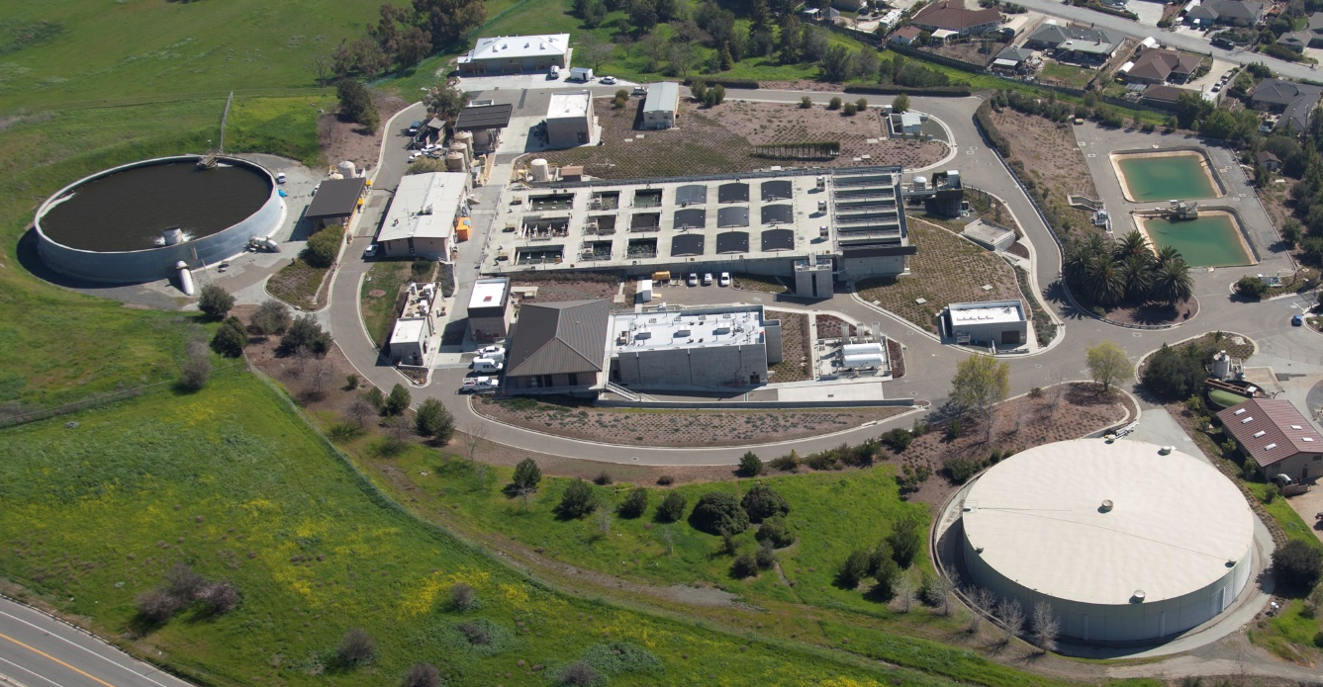
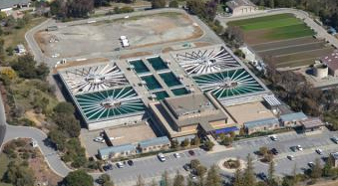

Water Treatment Plants Overview
Santa Teresa and Penitencia
  Conventional surface water treatment plants
  Settled water ozonation as primary disinfectant
  Receive different source waters
Rinconada
  Upflow clarifiers
  Free chlorine primary disinfectant
  No ozonation yet, coming soon
  Receive blend of both sources
Notes:
A treatment plant overview to better understand the upcoming data
Santa Teresa and Penitencia
They are conventional water treatment plants (Coagulation, flocculation, sedimentation, and filtration)
Both have settled water ozonation as primary disinfectant.
The plants typically receive water from different sources (PWTP – Delta, STWTP – San Luis)
Rinconada
Uses upflow clarifiers, followed by filtration
Does not have ozone, uses free chlorine as primary disinfectant
Will have raw water ozone in 2020 as part of a complete plant improvement.
Can receive a blend of the waters received by the other two plants

Slide 5
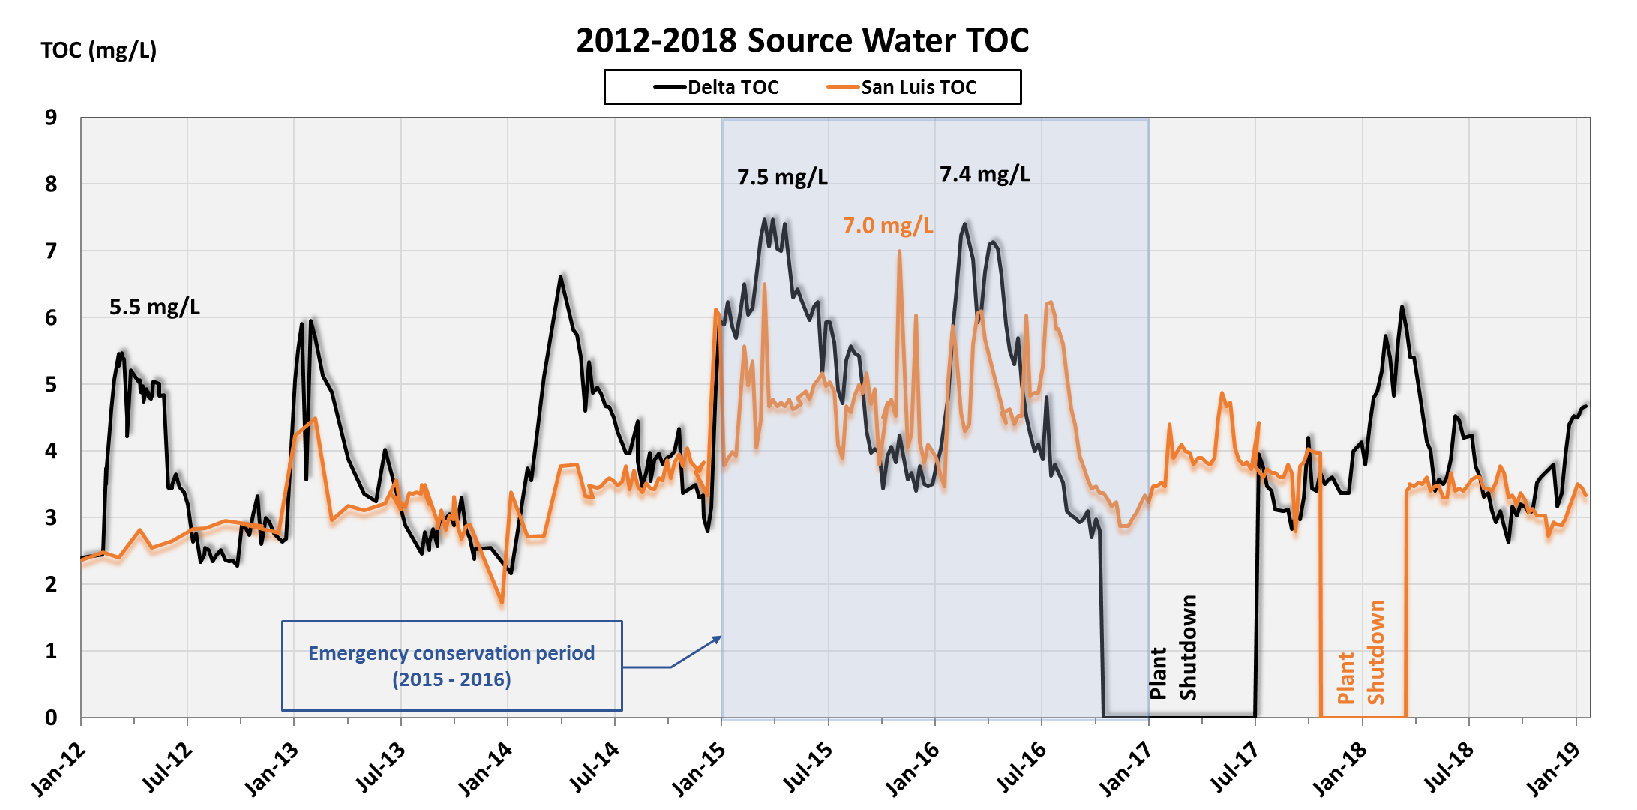
Drought Source Water Quality Impacts - TOC
Notes:
Our treatment plants typically receive water from the Delta and San Luis Reservoir
The Delta shows seasonal TOC trends, San Luis does not
Lower water volumes flowing through the Delta and San Luis resulted in historic TOC highs seen at the plants
The seasonal maximum TOC in the Delta increased from 5.5 mg/L in 2012 to 7.5 mg/L in 2015 and 7.4 mg/L in 2016.
In San Luis, TOC rose steadily during the drought, peaking at 7.0 mg/L in 2015.
Graph updated to 01/23/2019

Slide 6
Adaptation Strategies – Penitencia and Santa Teresa
Settled water ozonation
Lowered clearwell level to reduce detention
Lowered finished chlorine residual target
TTHMs under MCL and internal goal (64 µg/L)
Notes:
Increased TOC impacts were minimized at PWTP and STWTP with operational changes to keep concentrations below both the 80 ug/L MCL and our internal action level of 80% of MCL (64ug/L)
Plants have settled water ozone for primary disinfection
Lowered finished chlorine residual target
Lowered clearwell level to reduce detention time

Slide 7
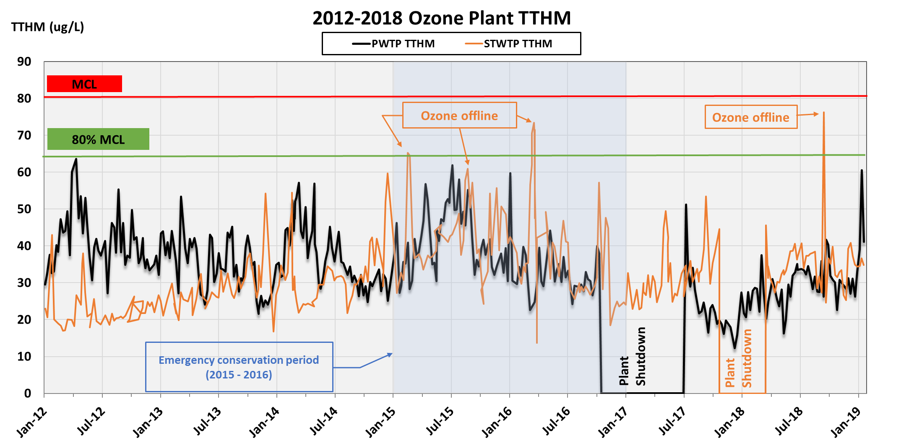
Adaptation Strategies – Penitencia and Santa Teresa
Notes:
Penitencia and Santa Teresa are the settled water ozone plants.
Graph updated to 01/23/2019

Slide 8
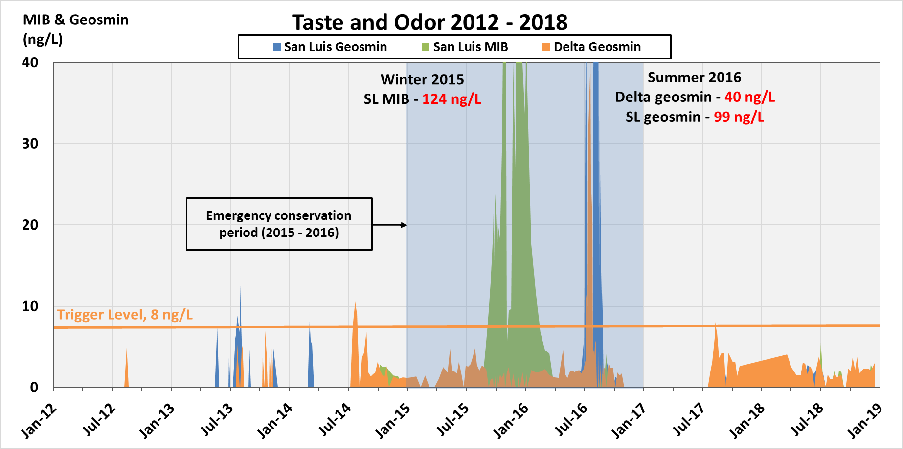
Drought Source Water Quality Impacts (T & O)
Notes:
Both the Delta and San Luis Reservoir experienced historical taste and odor highs during the drought
Warmer weather and reduced flows increased algal growth
Summer 2016 highs partly due to San Luis Reservoir intake pulling surface water
Source water levels were well above our internal trigger level of 8 ng/L.
Achieved 75%+ compound removal in finished water. During T&O episodes, the highest finished concentration was MIB at 10 ng/L
Blended San Luis with local reservoir to reduce incoming T&O concentration to more manageable levels
Used high settled water ozone dose (>2.0 mg/L)
And hydrogen peroxide (ozone + peroxide = peroxone)

Slide 9
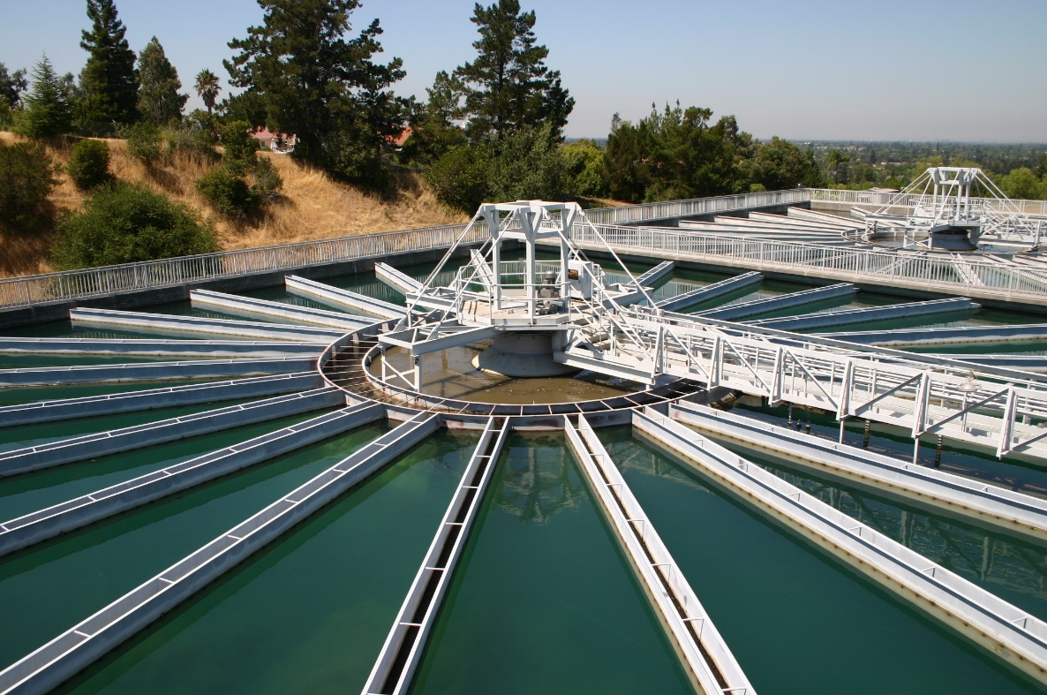
Adaptation Strategies - Rinconada WTP
Different Treatment Process
  Receives a blend of both Delta and San Luis waters
  Four (4) upflow clarifiers
  No ozone, free chlorine primary disinfectant
Taste and Odor adjustments
  Vary source blends
  Powder activated carbon (PAC)
THM mitigation
  Increased PAC dose through clarifiers to help remove TOC
  Moved chlorine injection point
  Coagulant change
  Established minimum flows in distribution system
Notes:
Rinconada varies from the other two treatment plants
Can receive a blend of Delta and San Luis source waters
Upflow clarifiers instead of conventional coagulation, flocculation, and sedimentation.
No ozone treatment, uses free chlorine for primary disinfectant which creates an issue with T&O and THMs.
Taste and odor adjustments
Can vary the source blend to receive water with manageable taste and odor concentrations
PAC onsite to help with T&O removal
THM mitigation
Increased PAC dose to help with TOC removal
Initially injected chlorine in the clarifiers. Moved downstream, with a low dose just prior to filters and a boost post filtration.
Switched from aluminum sulfate to ferric chloride for a period in 2016. (more discussion later)
Established minimum flows to help improve lower distribution system contact time for those retailers at the end of the pipeline. (more discussion later)

Slide 10
Coagulant Change - Rinconada WTP
Benefits and impacts
Aluminum Sulfate
to
Ferric Chloride
Increased TOC removal
Increased Chemical Costs
Increased sludge production
Maintain THMs below internal goal (64 ug/L)
Notes:
Similar to other two plants, RWTP was battling historically high TOC in the raw water during 2015 and 2016.
Switched coagulant from aluminum sulfate to ferric chloride in March 2016 to address high TOC.
Ferric will help increase TOC removal and consequently achieve lower treated water TTHMs
There are costs associated with a switch to ferric, namely increased chemical costs and sludge production

Slide 11
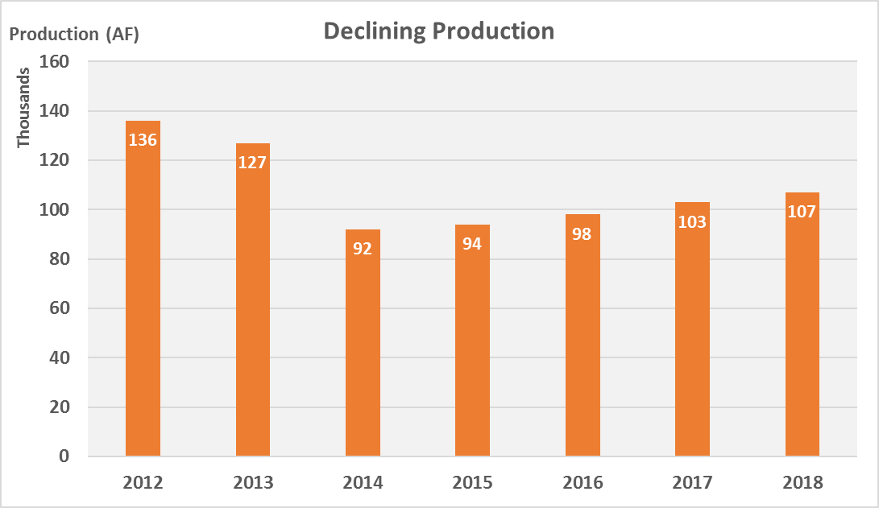
Minimum Flow in Distribution Pipeline - Rinconada WTP
Notes:
Our total production declined during the drought.
Retailers were required to conserve, leading to some closing turnouts for an extended period.
This lead to longer water age in our pipeline.

Slide 12
Minimum Flow in Distribution Pipeline - Rinconada WTP
Declining production
Declining Production
Longer detention times
Increased THM formation
Establish minimum flows
Minimum flows established with our retailers
  Ensure fresh water in the pipelines
  Reduce THM formation in the pipelines
Notes:
Additional THMs will be formed in the distribution pipeline due to the residual chlorine continuing to react with organics in the water.
The longer the contact time, the more THMs formed.
Retailers closing their turnouts, resulted in longer detention times, i.e contact time increased leading to more THMs formed in the pipeline.
To help retailers comply with TTHM standards, the District worked with them and agreed on a minimum continuous flow at their TOs.
This ensured fresh water in the pipeline and less THMs formed while still meeting the reduced water demand.

Slide 13
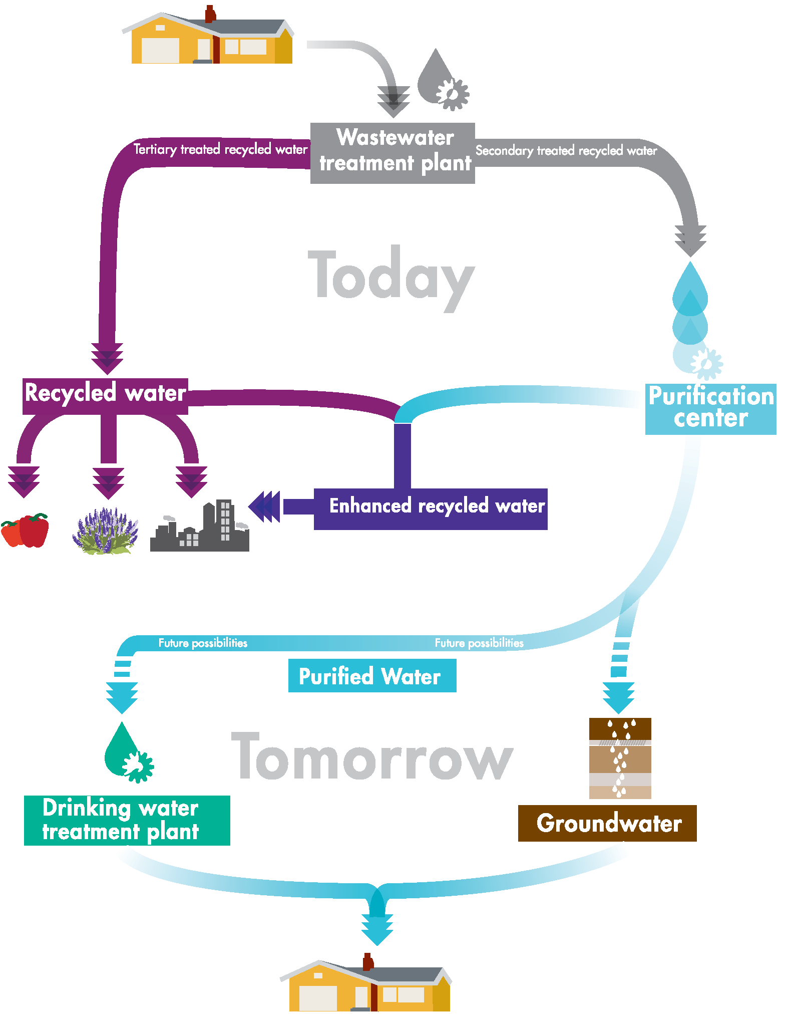
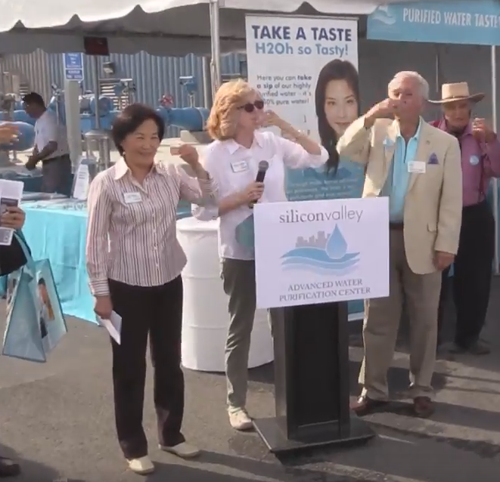
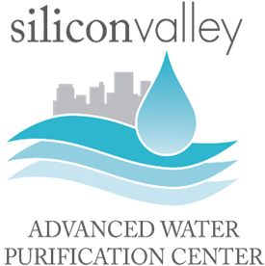
Purified Water Program to Diversify Water Supply
  Demonstrate technology at Silicon Valley Advanced Water Purification Center
  Conduct potable reuse studies
  Collaboration with recycled water producers
  Engage the public
  Select & build project
Notes:
The District has been looking into alternative sources to supplement its water supply for future drought and increased demand.
In addition to Indirect Portable Reuse (IPR) to reduce drinking water demand, also looking into Direct Portable Reuse (DPR), for a drought proof drinking water supply. (pic on the right)
The district has successfully built and operated a demonstration plant for the above mentioned purposes. The treated water has met all the existing drinking water standards and our directors are enjoying it (illustration on the left).

Slide 14
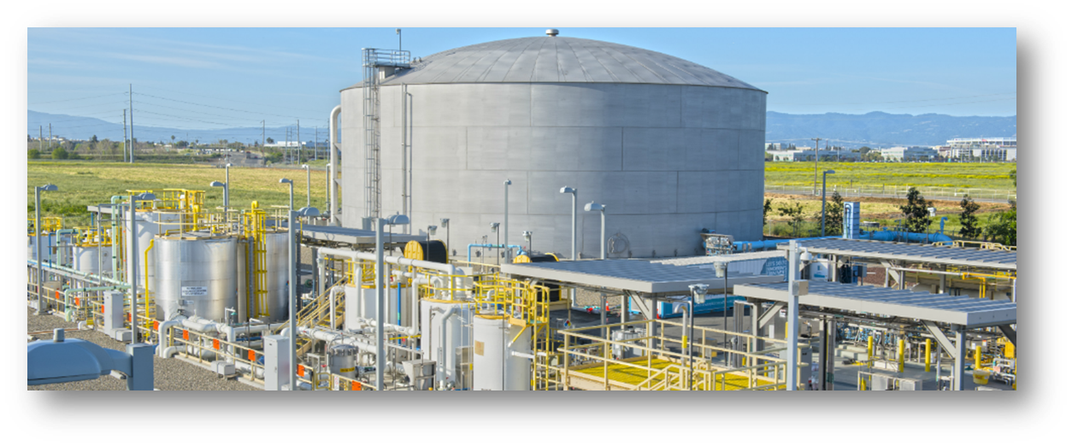
Impacts to Purified Water Programs
Planning and Development Challenges:
  Competing demands on waste water effluent (i.e. recycled water, purified water, environmental flows).
  Uncertainty related to the amount of water POTWs can commit to the program.
  Sizing of the program over a long-term horizon becomes challenging.

Slide 15
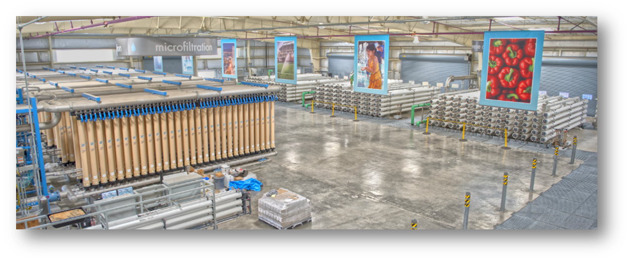
Impacts to Purified Water Programs
Higher treatment costs and more complex technologies:
  As POTWs receive declining flows, secondary or tertiary effluent water quality can degrade.
    Higher level of treatment needed to achieve purified water program goals.

Slide 16
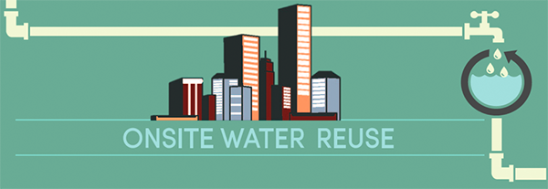
Impact of Onsite Reuse
The advent /popularity of on-site reuse can further aggravate existing trends:
  Less flow
  Waste products discharged into the sewer system
  Stressing POTW treatment processes
  Increased concentrations of organics and solids.
Potential competing interests for low interest loans and grant funding
  Onsite reuse/ decentralized projects vs centralized projects.

Slide 17
Major Takeaways
  Increase configurability when planning long-term process improvements
      Not just variable chemical doses
      Design for multiple chemicals with various injection locations
  Design to a higher percentile for increased reliability
      Peak factor multipliers may not cover future variability
  Challenges for establishing a purified water program
      In the face of reduced production, wastewater plants can’t commit flow source.
      Competing demands for wastewater reuse
      Impact of onsite reuse

