Slide 1
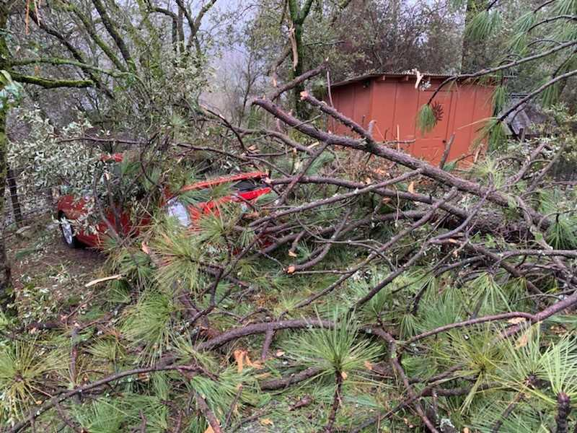

Slide 2
State Water Project
34 storage facilities, reservoirs and lakes
20 pumping plants
4 pumping-generating plants
5 hydroelectric power plants
701 miles of open canals and pipelines
Construction Began in the 1960s

Slide 3
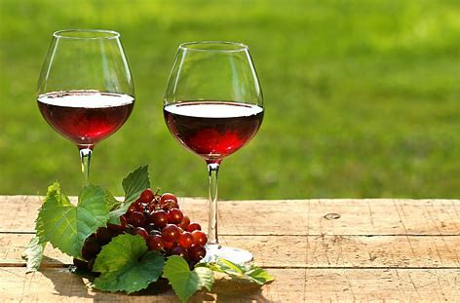
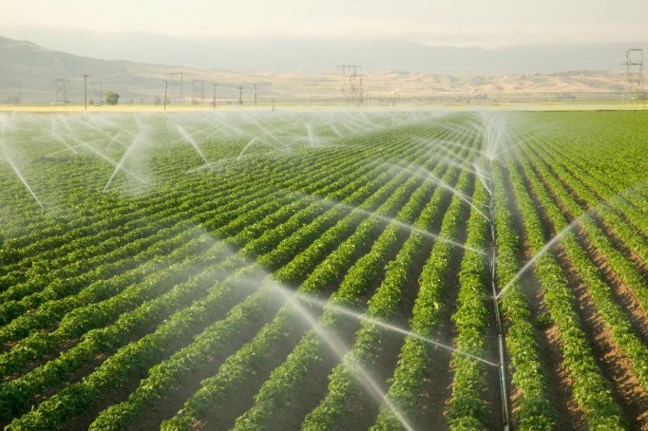
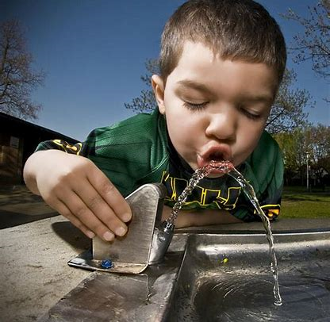
Water Delivery
26 million people
750,000 ac of farmland
Silicon Valley
San Joaquin Valley
Southern California
Inland Empire
Entire Coastal area
High Desert
Napa, Solano, Yuba City

Slide 4
Improving use of science and flexibility in regulatory actions
=
Improving environmental conditions
=
Improving water supply reliability

Slide 5
Vision for Decision-Making under new Bay-Delta Water Quality Control Plan
Co-Equal Goals
Develop and Test Revised Hypotheses
What did we learn?
Develop and Test Revised Hypotheses
Water and $
What did we learn?
Decision support science
Develop and Test Initial Hypotheses
Water and $
Decision support science
Initial Projects/Actions
Time

