Slide 2
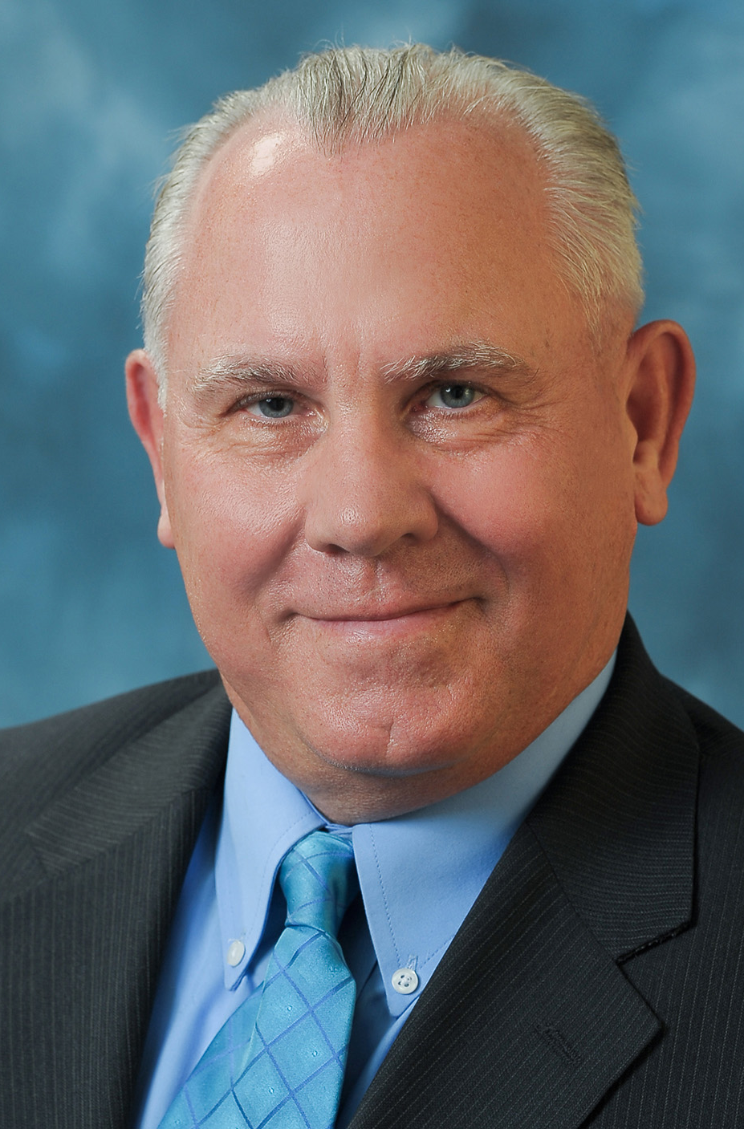
1:00 p.m. Opening Remarks & Introduction Greg Quist, Chairman, Urban Water Institute
Urban Water Institute
26th Annual Water Conference: August 14-16, 2019

Slide 3
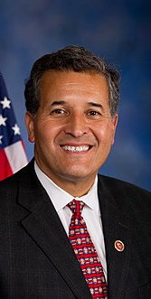
1:15 p.m. Welcome to San Diego! Congressman Juan Vargas California’s 51st District Urban Water Institute’s 26th Annual Water Conference: August 14-16, 2019

Slide 4
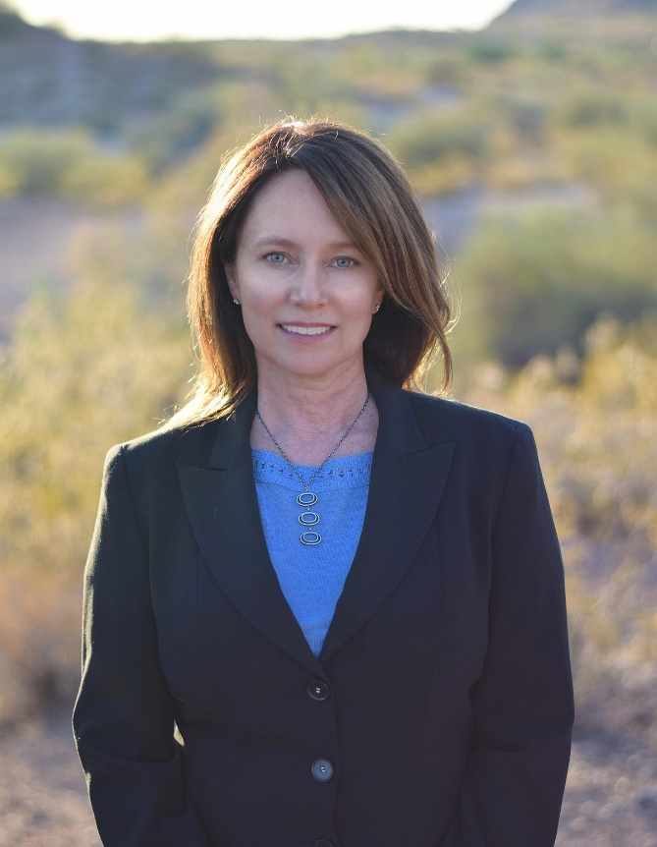
1:30 p.m. – USBR Update for California
Water Decision Makers
Brenda Burman
Commissioner,
U.S. Bureau of Reclamation

Slide 5
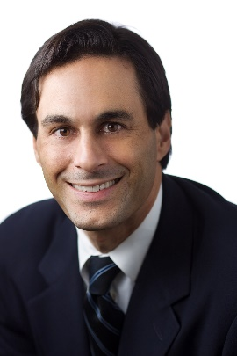
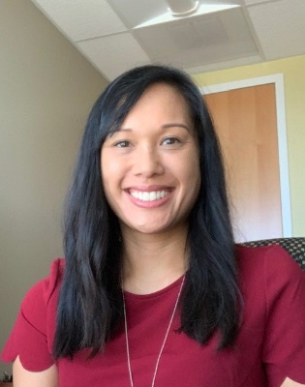
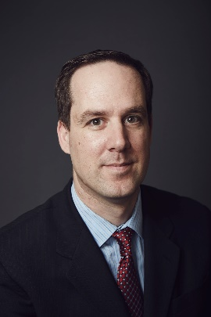
2:30 p.m. – Getting Stuck with the Teflon Contaminant – How PFAS will Affect Water Agencies
Per-and polyfluoroalkyl substances (PFAS) are a large group of human-made substances used in a wide variety of products since the 1940s including non-stick products, stain and water-repellent products and fire-fighting foams. They are widespread in the environment, and according to the State Water Resources Control Board (State Board), PFAS were found in the blood of nearly every person tested in several national surveys. While PFAS as a class and individually are currently unregulated contaminants, increased regulatory scrutiny is already here. This panel will provide: general background on PFAS; an update on regulatory initiatives, including ongoing State Board investigations and development of drinking water standards; toxicology of PFAS; and, the anticipated impact of PFAS on water and recycled water systems.
Moderator: Greg Newmark
Attorney,
Meyers Nave
Annalisa Kihara
Water Board Regulator,
PE
Jason Dadakis
Executive Director of Water Quality & Technical Resources,
Orange County
Water District
Dr. Lisa Corey
Senior Toxicologist,
INTERTOX

Slide 6
Thank You To Our Networking Break Sponsor HDR, Inc.
3:15 p.m.
Urban Water Institute’s 26th Annual Water Conference August 14-16, 2019

Slide 7
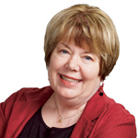
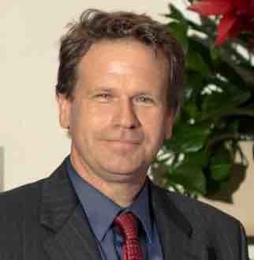
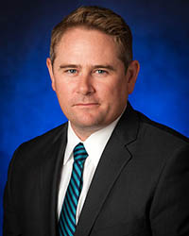
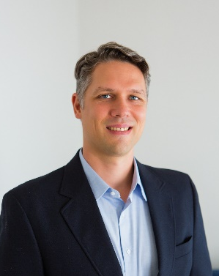
3:30 p.m. – Water Managers Dilemma – Caught in the Political Vortex of Climate Change
We know about the prisoner’s dilemma where two people who appear to be rational may not cooperate even if it is in their best interests to do so. Are we creating a water managers version as we learn more about the impacts of climate change over the next 50 years?
Moderator: Ane Deister
Executive Director,
Urban Water Institute
Alex Tardy
Scientist,
National Oceanic and Atmospheric Administration
Dan Denham
Assistant General Manager,
San Diego County Water Authority
Erik Ekdahl
Deputy Director Division Water Rights, State Water Resources Control Board

Slide 8
Please Join Us For Our Welcome Reception at the Fresco Lounge Bayside at 5:00 p.m. Sponsored By Water Replenishment District of Southern California

