Slide 1
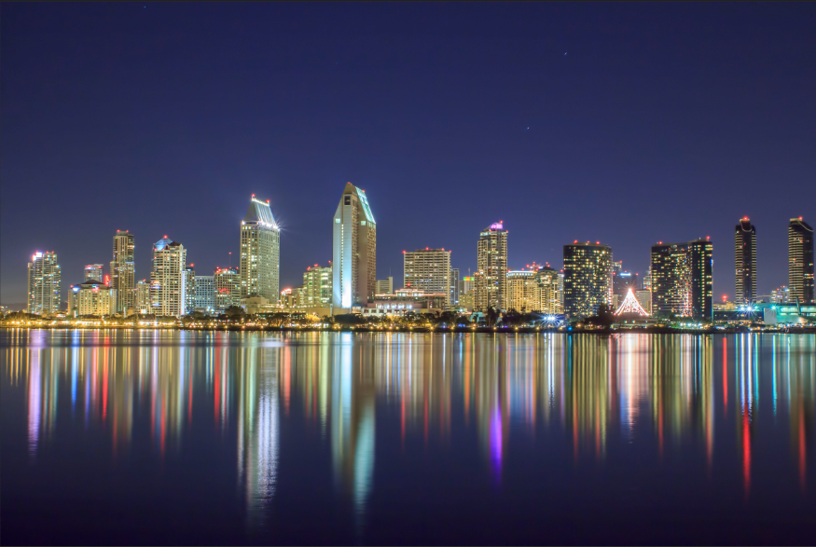
UWI 2023
ANNUAL CONFERENCE
Every Drop, Not Everywhere, and Not All At Once
August 23-25 | San Diego, CA

Slide 2
AWWA’s View of the Water Industry
---Its Evolution and Future---
David LaFrance
Chief Executive Officer
American Water Works Association

Slide 3
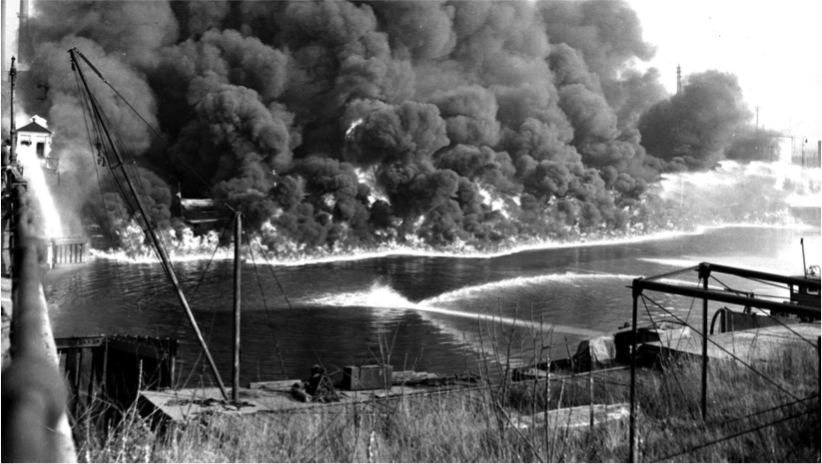
Looking Back

Slide 4
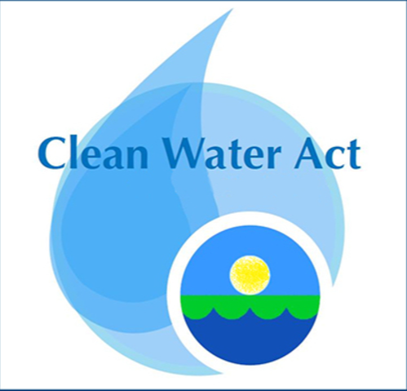
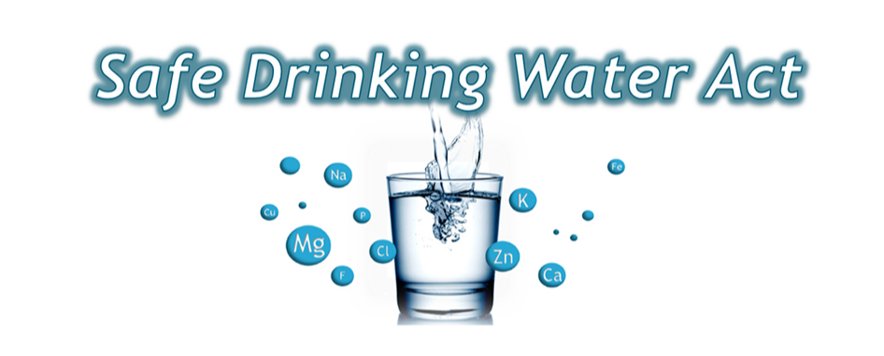
The Environment, Society & Water
1969
1970
1970
1972
1974
Earth Day Created
US EPA created
Clean Water Act Passed
Safe Drinking Water Act Passed
Cuyahoga River Fire
Notes:
Cuyahoga River fire:
Series of fires (13 total) in the polluted Cuyahoga River in Cleveland, Ohio during the mid-20th century.
Result of industrial waste and pollution: accumulation of oil, debris, & chemicals caused flammability and periodic fires.
Notable fire on June 22, 1969, gained national attention and sparked U.S. environmental movement.
Catalyst for change:
Prompted efforts to restore the river and improve water quality.
Led to the formation of the EPA and passage of the Clean Water Act.

Slide 5
Today
Insights to key water issues
Identify and track water trends
Raise awareness of emerging issues

Slide 6
State of the Water Industry (2004 – 2023) In your opinion, what is the current overall state of the water industry? How sound will the overall water industry be 5 years from now? (1 = not sound at all, 7 = very sound)

Slide 8
Top 15 Water Sector Challenges (2023)
1. Renewal & replacement of aging water infrastructure
2. Long-term drinking water supply availability (#3 in 2022)
3. Financing for capital improvements (#2 in 2022)
4. Public understanding of the value of water resources (#8 in 22)
5. Watershed/source water protection (#7 in 2022)
6. Aging workforce/anticipated retirements (#4 in 2022)
7. Public understanding of the value of water systems/services (#5 in 2022)
8. Emergency preparedness (#6 in 2022)
9. Groundwater management and overuse
Compliance with current regulations
11. Water conservation/efficiency (#16 in 2022)
12. Talent attraction and retention (#11 in 2022)
13. Cybersecurity issues (#10 in 2022)
14. Drought or periodic water shortages (#13 in 2022)
15. Compliance with future regulations

Slide 9
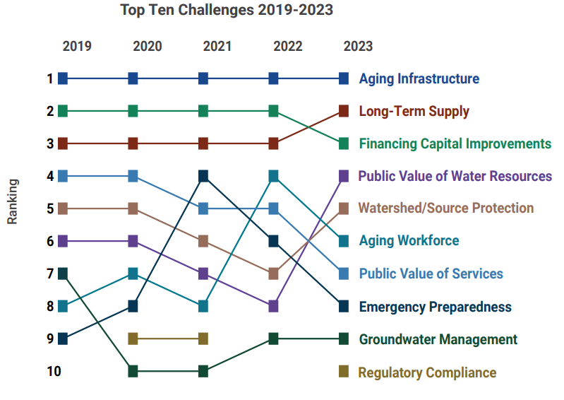
Water Sector Challenges: Trends over Time (2019-2023)

Slide 10
The Future
Social and Demographics
Sustainability
Technology
Economics
Governance

Slide 12
What will 2050 Look Like?

Slide 13
5 Think Tanks
124 Experts
47 Total Recommendations
What are the Game Changers?

Slide 14
Game Changers
Sustainability: Maximize reuse and conservation
Tech: Incorporate in-home treatment technology
Governance: Regionalize utilities
Social/Demo: Meet affordability challenges
Econ: Advance a circular water economy

Slide 17
Discussion
David LaFrance, CEO
American Water Works Association
Email: dlafrance@awwa.org
Download the Water 2050 Reports

