Slide 1
What are you planning for the next 30 years?
August 24, 2023
Discussion facilitated by Paul Brown & Jennifer Persike

Slide 2
What are you planning for the next 30 months?
August 24, 2023
Discussion facilitated by Paul Brown & Jennifer Persike

Slide 3
The Big Question
“What does leadership look like in a world where rational policies and management decisions are harder and harder to make – in the context of a future that is increasingly uncertain, and change is occurring at and evermore rapid pace?”
, 2016

Slide 4
Unprecedented Challenges
“We are confronted with the convergence of two forces which will require a level of leadership and innovation unprecedented in our history – one is the deep uncertainty of climate change, and the other is the extreme complexity of our radical transition to one-water-solutions.”

Slide 5
Debate Versus Dialogue
Debate
Assumes there is a right answer, and you have it
Combative: participants attempt to prove the other side wrong
About winning
Listening to find flaws and make counterarguments
Critiquing other side’s position
Defending one's own views against those of others
Dialogue
Assumes people have pieces of the answer and create a solution together
Collaborative: participants work together toward common understanding
About exploring common ground
Listening to understand find meaning and agreement
Reexamining all positions
Admitting that others' thinking can help improve on one's own
Source: Daniel Yankelovich, The Magic of Dialogue: Transforming Conflict into Cooperation, 1999

Slide 6
Topics to Explore
Leadership Attributes
Workforce Diversity, Equity, Inclusion
Succession Planning

Slide 7
Leadership

Slide 8
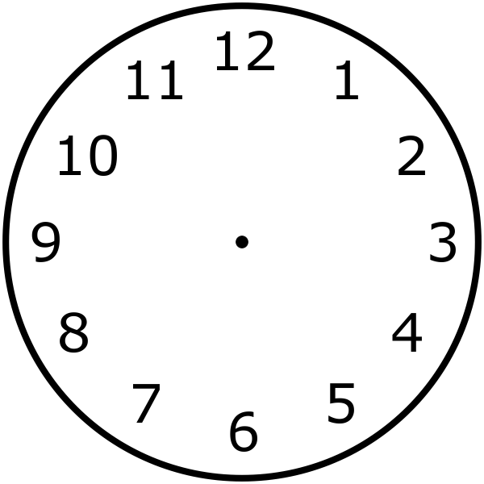
Attributes of Leadership #1 – VISIONING – LOOK FORWARD
72% of workers (88% of managers) want leader who is forward-looking
McKinsey worldwide survey (10,000+ responses)
Only 3% of typical leader’s time is spent on visioning

Slide 9
Attributes of Leadership #2 – BUILDING THE BEST TEAM
Building a strong, agile team and a healthy culture increases:
Performance
Decision-making
Employee satisfaction and retention.
Creates positive impact on the organization.
Source: Harvard University

Slide 10
Attributes of Leadership RETURN ON INVESTMENT
Benefits
Implements vision and values
Boosts morale
Promotes trust and confidence among employees
Ensures effective communication
Motivates employees
Provides resources
Barriers
Lack of time to teach or coach
Lack of accountability
Lack of skills
Lack of interest
Lack of information and infrastructure

Slide 11
Leadership
Discussion

Slide 12
Diversity, Equity, Inclusion

Slide 13
Diversity, Equity, Inclusion CALIFORNIA – MOST DIVERSE STATE in us
Resident population of California in 2021, by race and ethnicity [add data both #s and percentages]

Slide 14
Diversity, Equity, Inclusion Challenges for Future Recruitment
Aging workforce and continued retirements
Competition for workers – must expand pipeline
Lack of commitment to workforce diversity and inclusion
Minimal external industry awareness
Industry does not reflect its customers / communities
McKinsey 2020 Report: Organizations that do not have a diverse workforce will lag in innovation, creativity and will be less competitive.

Slide 15
Diversity, Equity, Inclusion RETURN ON INVESTMENT
Benefits
Expands innovation
Increases perspectives
Improves problem solving
Increases successful recruitment and retention
Improves workplace culture and productivity
Barriers
Commitment from top leaders
Action plan: goals and metrics
Inadequate training
Investment
Cultural resistance

Slide 16
Diversity, Equity, Inclusion
Discussion

Slide 17
Succession Planning
No buy-in from leadership
No buy-in from leadership

Slide 18
Succession Planning
While 86% of leaders believe leadership succession planning is of utmost importance, only 14% believe organization does it well.
Only 35% of organizations have a formalized succession planning process.
Deloitte survey (200 public & private companies)

Slide 19
Succession Planning
Ongoing Priority
?
Trends in Water Industry
Long-term GMs retiring out
Next in line, shorter tenure
Who is next?
* Loss of institutional knowledge
5-10 Years
30 Years

Slide 20
Succession Planning Benefits Clear, Why the Struggle to Implement?
Benefits
Steady pipeline of leaders
Greater engagement and retention of top talent
Stronger organizational
A ‘future-proofed’ workforce better prepared to thrive in dynamic conditions
Greater organizational stability and resilience
Barriers
Long-term discipline in short-term world
Succession planning can be destabilizing and threatening
Not clear who is accountable for implementation
Good data not available or ignored, leading to subjective decisions
No clear process for succession planning

Slide 21
Succession Planning
No buy-in from leadership
No buy-in from leadership
Discussion

Slide 22
Questions

Slide 23
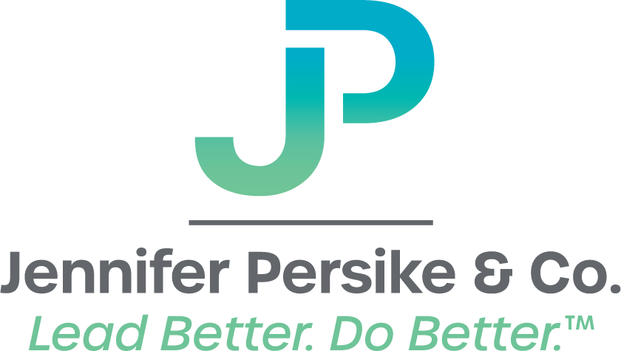
Contacts
Paul Brown
President,
Paul Redvers Brown. Inc.
https://www.urbanh2oplanner.com
Jennifer Persike
Founder & President,
Jennifer Persike & Company
www.jenniferpersike.com

Slide 24
OTHER BACKGROUND IF NEEDED

Slide 25
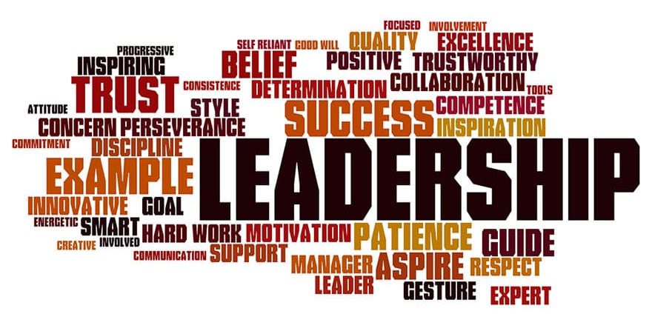
Attributes of Leadership WHAT ELSE?
Walk the Talk
Encourage Risk-Taking and Innovation
Integrity and Accountability
Act Decisively
Ineffective leadership can cost more than just morale.
According to Gallup research , 24 percent of employees are actively disengaged as a result of poor management, leading to teams that are less productive, less profitable, and more likely to cause turnover.
Turnover adds up quick: translating into nearly two times the annual salary of every employee who quits.
Notes:
Employee turnover cost is calculated by taking your vacant position coverage cost plus cost to fill the vacant position plus onboarding & orientation costs plus the productivity ramp up cost multiplied by the number of employees lost in that position in a given year multiplied by 12 to give you your annual rate.

Slide 26
Succession Planning Lessons from the Series
No clear plan
Confusion among among the ranks
Potential successors not ready / tested

