Slide 1
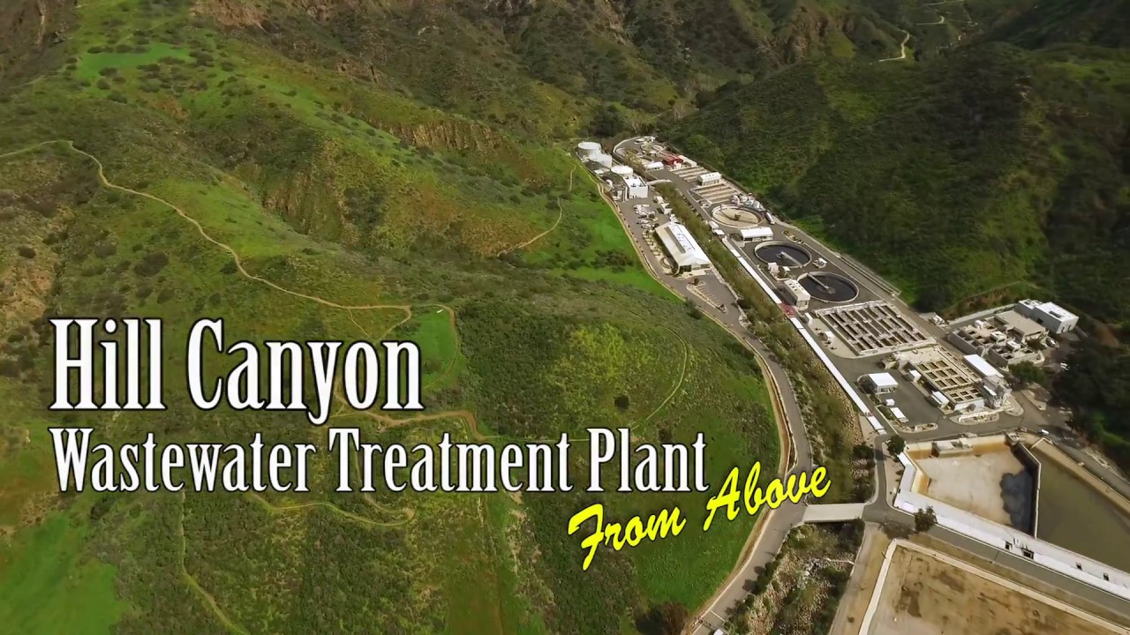
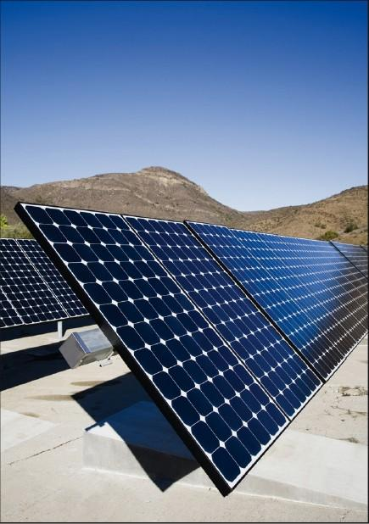
Urban Water Institute
Spring Water Conference
Sen. Fran Pavley, Environmental Policy Director
USC Schwarzenegger Institute

Slide 2

Climate Changes
Climate Change
Impacts on California
Temperature
Increase
Health
Air Quality - Respiratory Illness
Weather-related Mortality
Infectious and Tropical Diseases
Precipitation
Patterns and Extremes
Sea Level Rise
Agriculture
Crop Yields
Irrigation Demands
Forests
Forest Composition
Geographic Range of Forests
Forest Health and Productivity
Water Resources
Water Supply
Water Quality
Competition for Water
Coastal Areas
Erosion of Beaches
Inundation of Coastal Wetlands
Additional Costs to Protect
Coastal Communities
Species and Natural Areas
Loss of Habitat and Species
Union of Concerned Scientists
Notes:
This is a fairly classic slide on climate impacts. As you see on the top left, climate change means temperatures increase, which causes temperatures to warm but not uniformly across the planet. This causes precipitation patterns to change, with more extreme conditions, both wet and dry, and warming oceans and melting glaciers, especially in Antarctica and Greenland, cause sea level rise.
The Union of Concerned Scientists did a highly influential study in 2000 that showed how these changes would impact California.
In California, we found that warming temperatures impact health due to heat waves, and they also exacerbate poor air quality and also cause diseases to migrate. As predicted we’re seeing more tropical diseases and insect species that carry some diseases in more northern latitudes. Warming and changing precipitation impacts crop yields and increases water demand. Forest species die off and change, and are more susceptible to extreme wildfire as plant matter dries out, as we have seen in California. Water supplies are strained by changing precipitaiton, sea level rises and extreme storm erode beaches and cause coastal communities to flood, and species both migrate and die because of loss of habitat.
These things are serious business, but when scientists say that crop yields will be reduced or water supply will be impacted or fires will impact forest health and productivity I don’t think it really expresses what it is that’s going to happen in a way that gives a true flavor of what we are experiencing, and the very words tend to abstraction. So I’m going to talk about just three impacts of a warming world and talk about things that are either starting to happen or are already well underway right now in California. In 2000, UCS produced the report pictured here, which was one of the first detailed compilations of what climate change would look like for our state, and the impacts predicted have been borne out with pretty much as predicted.

Slide 3
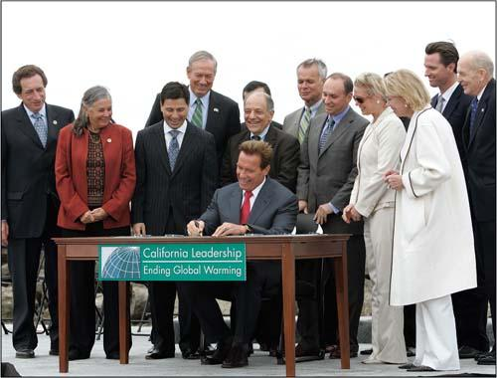
Global Warming Solutions Act (2006)
California’s Landmark Policy
Climate pollution
reduction targets by 2020
Multi-sector approach:
  Vehicles
  Fuels
  Renewable energy standards
  Appliances
  Buildings
  Land use planning
  Cap-and-trade
Putting a cap on emissions and rolling back to 1990 levels
by 2020 created a market for investment and innovation
Notes:
Slide 6

Slide 4
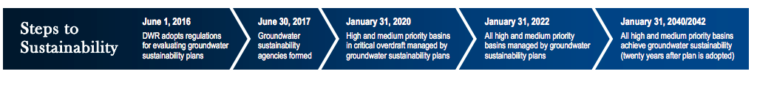
The Sustainable Groundwater Management Act (SGMA)
Package of three bills (AB 1739, SB 1168, and SB 1319) that provides local agencies with a framework for managing groundwater basins in a sustainable manner.
The SGMA:
  Respects regional differences and provides for a tailored approach to planning
  Establishes minimum standards for sustainable groundwater management
  Improves coordination between land use and groundwater planning
  Provides state technical assistance
  Creates a mechanism for state intervention if, and only if, a local agency is not managing its groundwater sustainably
  Protects water rights
Notes:
https://water.ca.gov/-/media/DWR-Website/Web-Pages/Programs/Groundwater-Management/Sustainable-Groundwater-Management/Files/SGMA-Interagency-Brochure---English-Version.pdf?la=en&hash=8719B8A9E23032EE4341793FCDDDD82448EBFCC4

Slide 5

Water-Energy Nexus, CA SB 1425
The Water-Energy Nexus (WEN) Registry is a voluntary state-wide GHG reporting program initiative of the CalEPA.
The WEN Registry helps better understand the emissions associated with each process in the water management cycle.
May 2019 – Water-Energy Nexus Registry Program Launch

Slide 6
LA County Sustainability Plan (2019)
Water is imported regularly from areas outside LA County to provide to residents.
Water imports create 4x more GHG emissions per acre-foot of supplied water than utilizing groundwater and more than 13x as high as stormwater.
While recycled water emissions are twice as high as groundwater, they are still less than half of imported GHG emissions.

Slide 7
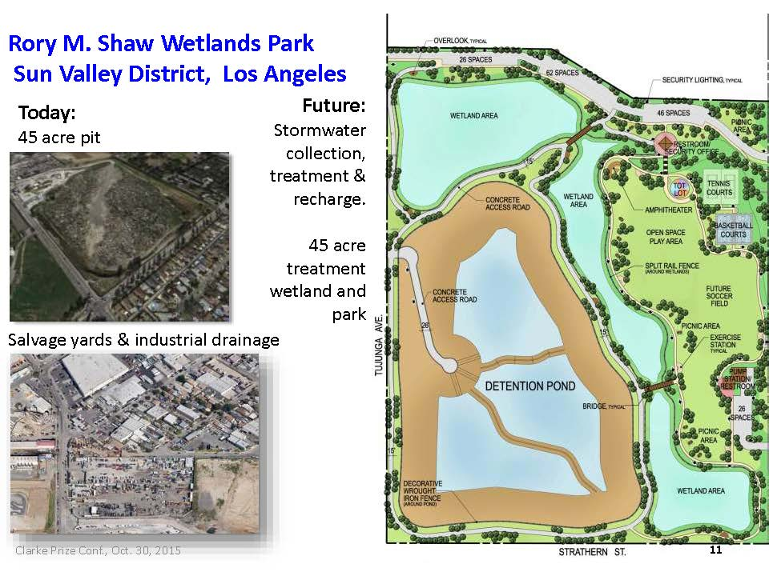

Slide 8
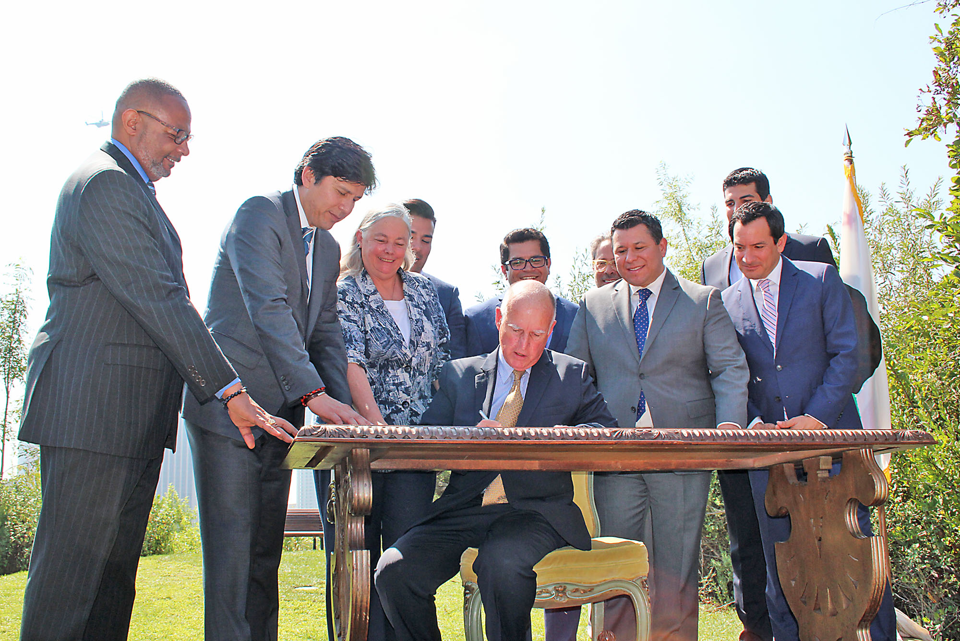
California has a 40% GHG
Reduction Target by 2030
Executive Order B-30-15:
Brown Administration’s 2030 greenhouse gas reduction goals.
SB 32 codifies this 2030 economy-wide greenhouse gas reduction target.
AB 197 institutionalizes a policy of equity, transparency, and accountability in future programs.
Los Angeles, September 2016
Businesses and Markets Need Certainty
Notes:
Slide 9

Slide 9
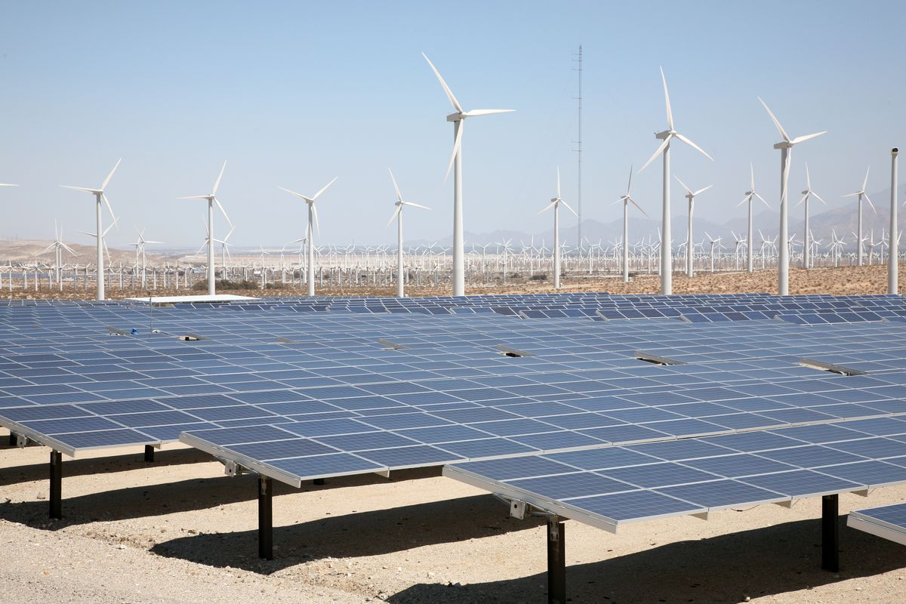
SB 100 (de León)
California has set a goal to reach 100% clean energy by 2045.
Sustainable water management should:
  Include the use of renewable energy.
  Incorporate renewable energy into storm-water capture, treatment and recharge projects.

Slide 10
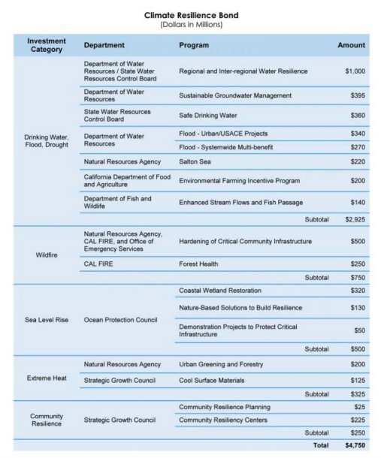
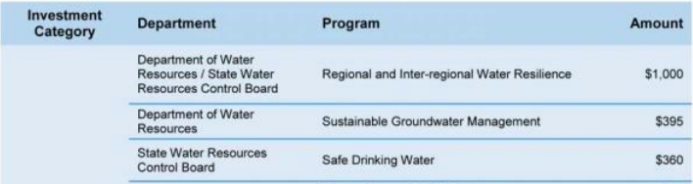

Slide 11
What Else Should We Be Doing?
Develop strategies to adapt to the increased volatility of snowpack, sea level rise, extreme weather events, and longer periods of drought.
Mitigate climate impacts by accelerating the decarbonization of water delivery and treatment.
Implement local water reuse policies and projects.
Invest in renewable energy (i.e. solar and storage) to increase resiliency in managing both water quality and water supply.
Reduce use of fossil fuels in your fleets, buildings and water delivery and treatment operations.
Consider participating in local Climate Resiliency Centers in High Fire Risk(power shut off) communities.
Provide EV charging infrastructure for employees, visitors and customers.
Join the Climate Registry’s voluntary program to measure and manage the carbon embedded in the delivery, treatment and heating of water.

Slide 12
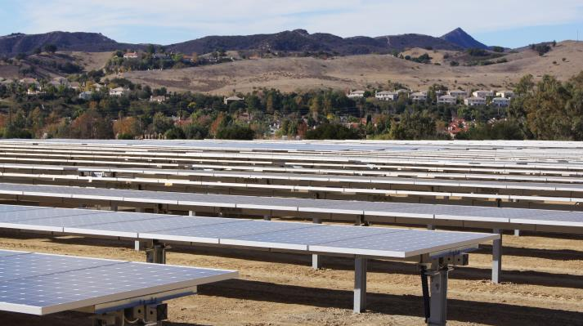
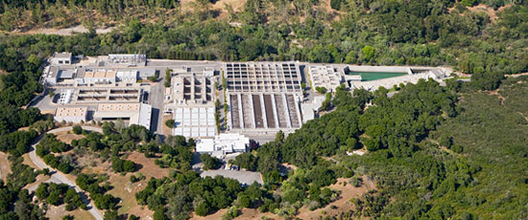
Tapia Reclamation Plan by the Las Virgenes Municipal Water District

