Slide 1
Drought Preparedness - San Diego Style
Urban Water Institute Conference
September 9, 2021
Sandy Kerl
General Manager

Slide 2
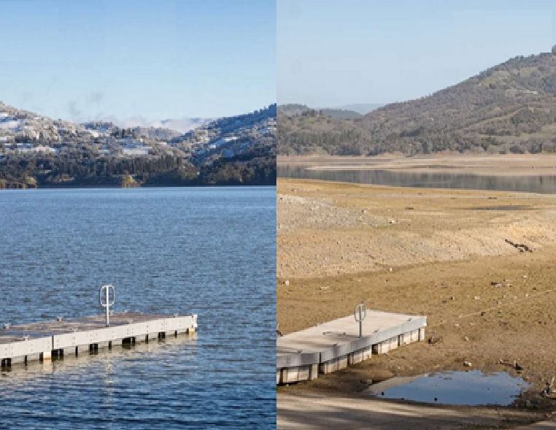
Background
Recent Drought News
November 2020 - Governor Newsom directed state agencies to prepare for possible dry conditions in 2021
Northern California experienced below average rainfall/snowpack and warm weather in late 2020 and early 2021
Reduced local water supplies
Reduced SWP supplies
Governor signed 3 drought emergency proclamations and an Executive Order seeking voluntary 15% reduction in water use
February 2019
January 2021
Lake Mendocino
Source: Sonoma County

Slide 3
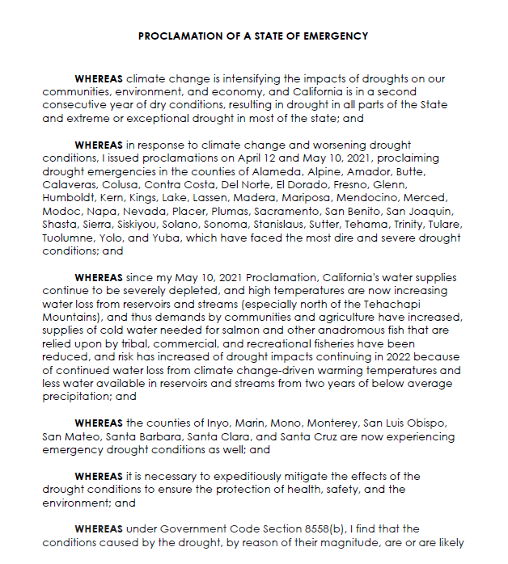
2021 Drought Emergency Proclamations
What Are Drought Proclamations?
Direct state agencies to
Take actions to preserve critical water supplies
Mitigate effects of drought
Ensure protection of health, safety, and environment
Proclaim drought emergency in 50 of 58 counties
April 21 – 2 counties
May 10 – 39 counties
July 8 – 9 counties
Excludes counties in Southern California

Slide 4
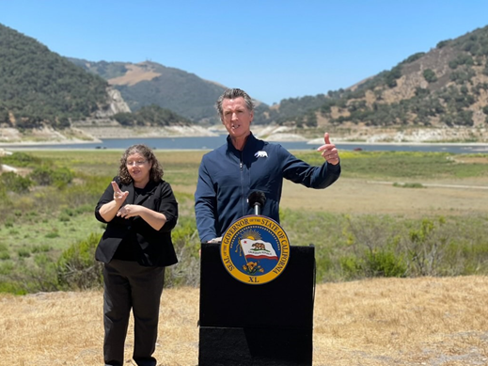
Summary of Executive Order N-10-21
What is Executive Order N-10-21?
Signed by Governor (July 8, 2021)
Seeks voluntary 15% reduction from 2020 water use levels
Applies to all sectors (residential, business, agriculture)
Promotes “commonsense measures”
Irrigate landscapes more efficiently
Run dishwashers/washing machines when full
Find/fix leaks
Install water-efficient showerheads
Take shorter showers
Use shut-off nozzle on hoses
Take cars to commercial car washes that use recycled water
State will track and report monthly progress
Source: DWR

Slide 5
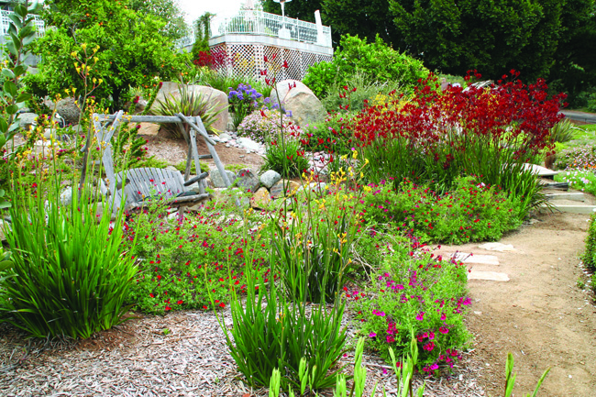
Is San Diego Prepared for Drought?
Water conservation is hard-wired in San Diego County
High-priority rights on the Colorado River are secure
Drought-resilient supplies include seawater desalination
Region’s water supplies are reliable even in multiple dry years

Slide 6
Started Preparing in Early 1990s

Slide 7
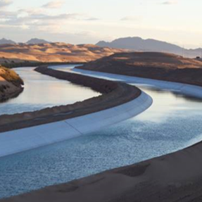
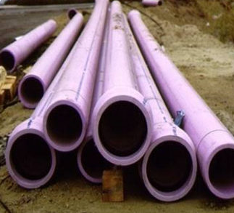
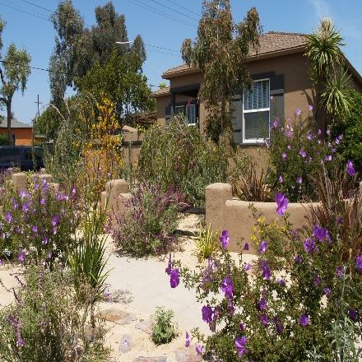
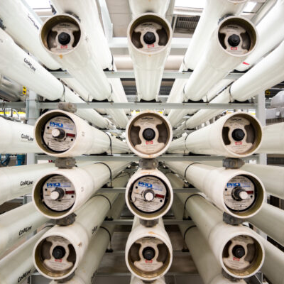
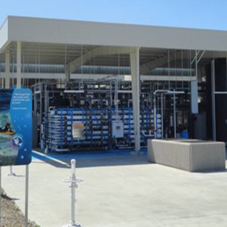
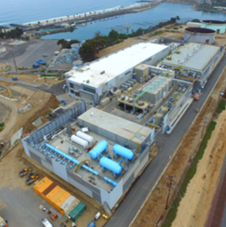
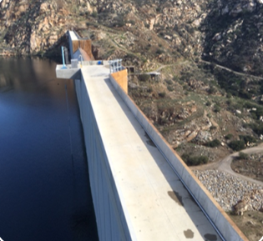
Canal Linings
Reclaimed Water
Conservation
Water Reliability Through Diversification
Groundwater
Potable Water Reuse
Carlsbad Desal Plant
Local Surface Water Storage

Slide 8
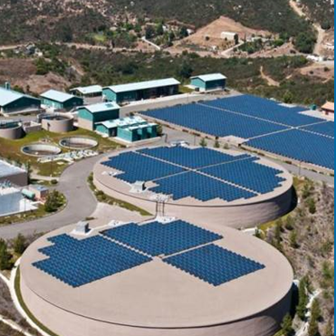
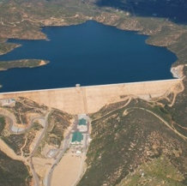
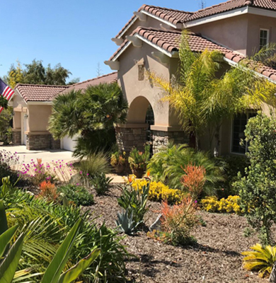
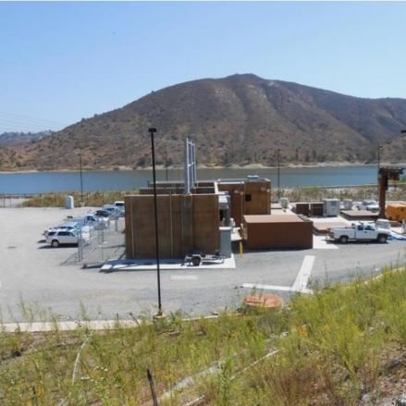
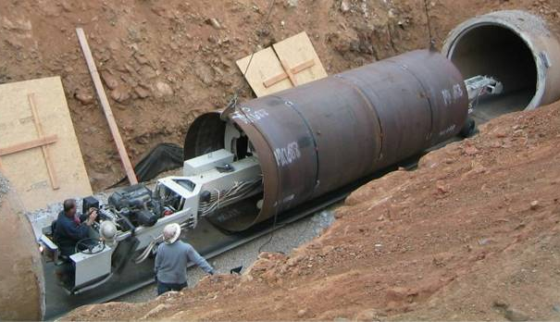
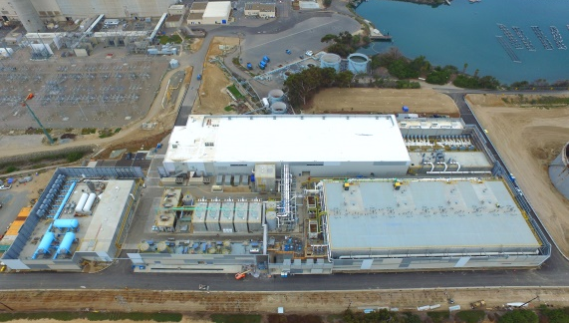
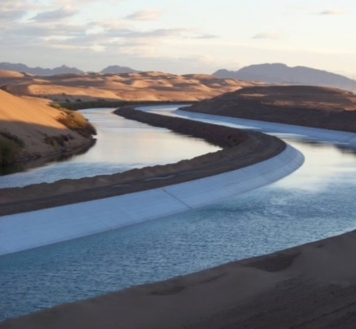
Innovative Investments in Supply Reliability
Twin Oaks Valley Water Treatment Plant
$179 million
Local Water Storage (San Vicente and Olivenhain Dams)
$1 billion
Decades of Water Use Efficiency Investments
Hundreds of Millions $
Lake Hodges Energy & Pumped Storage Projects
$208 million
Pipeline Relining $493 million
Carlsbad Seawater Desalination Projects $1 billion
All-American & Coachella Canal Lining Project $447 million ($190 million from Water Authority)

Slide 9
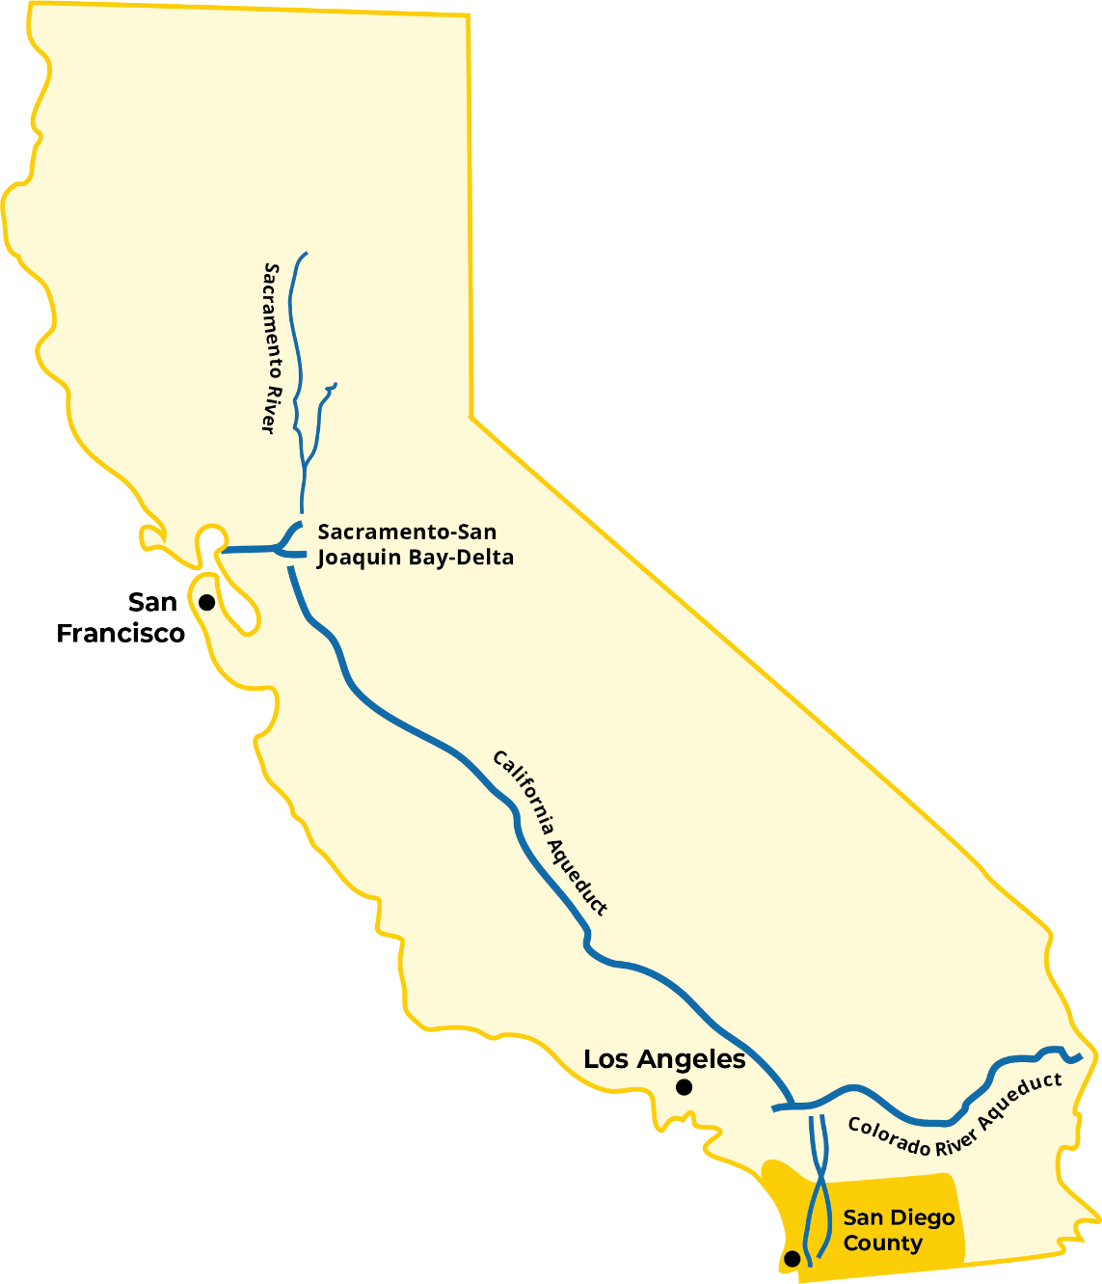
Results of Diversification
FY 2016 – 2020 Five-Year Average
State Water Project
10%
Colorado River
Local Supply
66%
24%

Slide 10
2020 Demand and Supply Mix
Continued supply reliability for the San Diego Region
2020
Water Supply Sources
Total = 463 TAF

Slide 11
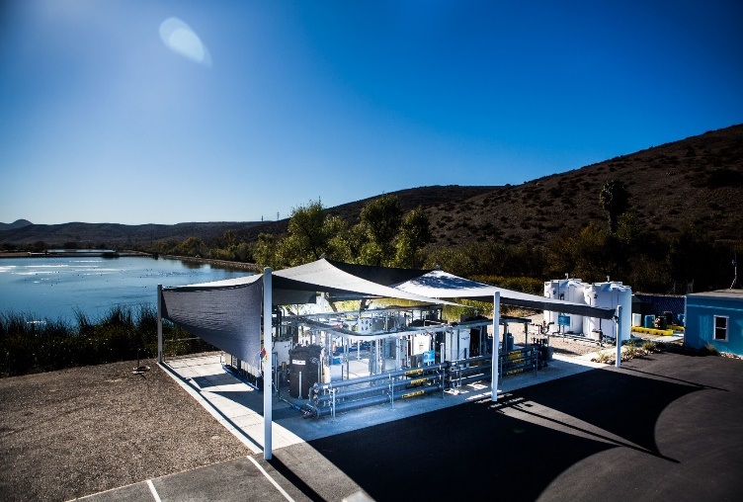
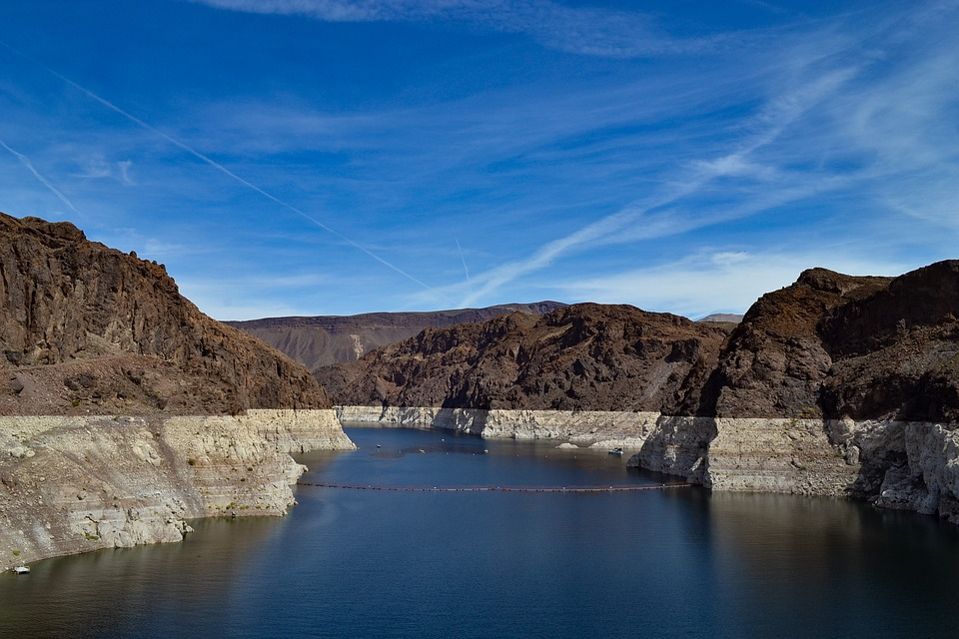
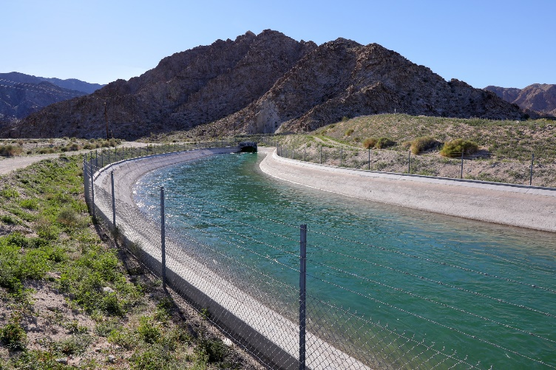
Planning for Tomorrow
Investment in potable reuse: Member agencies advance local projects (East County Advanced Water Purification; Pure Water San Diego; Pure Water Oceanside)
Raising water levels: Storing supplies in Lake Mead would increase elevation
Delivering QSA supplies: Potential Regional Conveyance System that could be a better deal for ratepayers

Slide 12
2045 Projected Water Resources Mix
Continued supply reliability for the San Diego Region
2045
Water Supply Sources
Total = 631 TAF

Slide 13
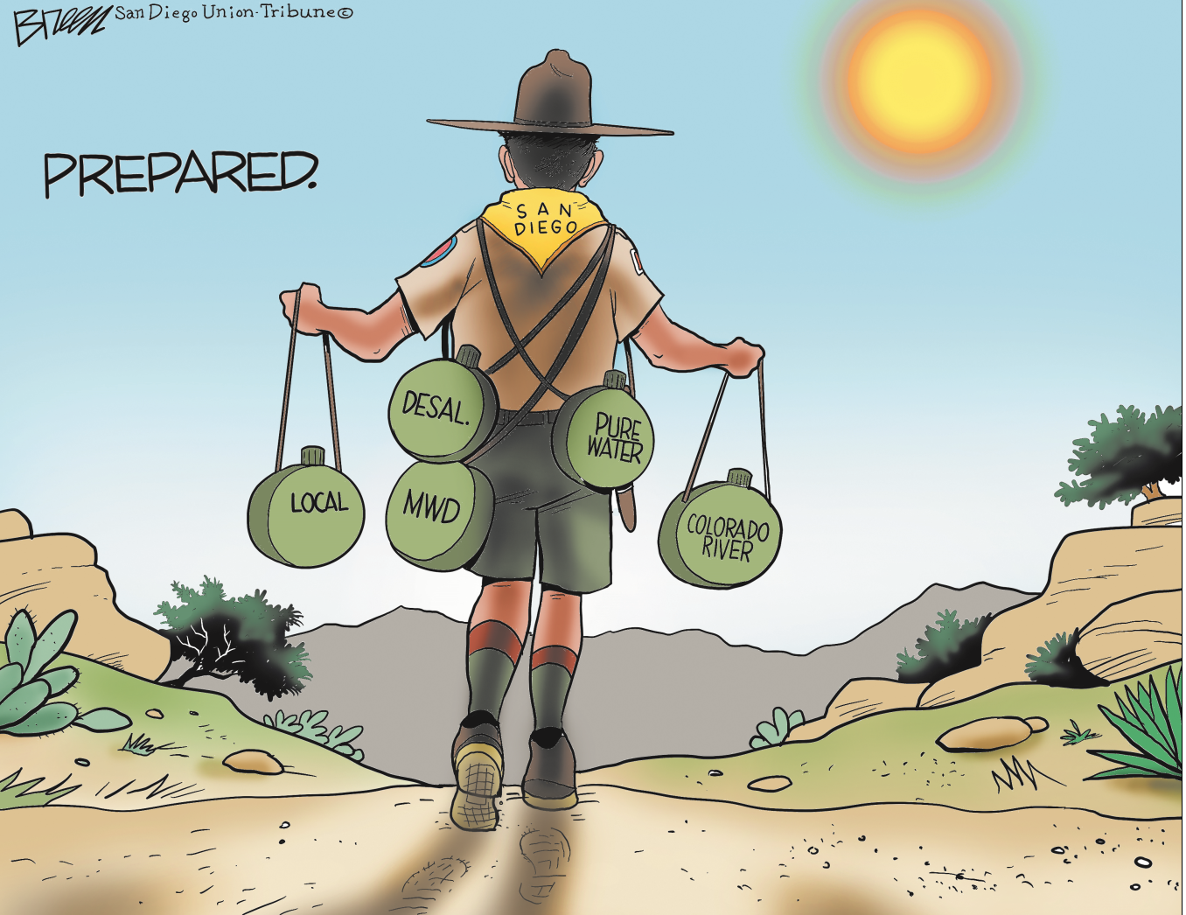
San Diego is Prepared

Slide 14
Outreach Efforts Support Voluntary Efforts
Continued social and digital media ads supporting voluntary conservation
Additional tip sheets
Water Year 2022 media event on Sept. 30
Planning for Water Shortage Contingency Plan - Level 1

