Slide 1
Urban Water Institute
Road to Achieving Cybersecurity for Water Agencies
September 8, 2021

Slide 2
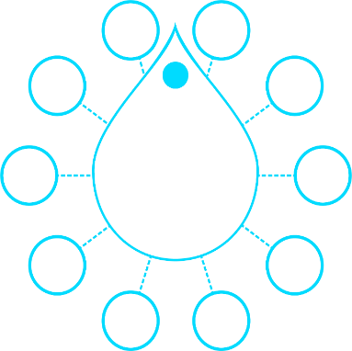
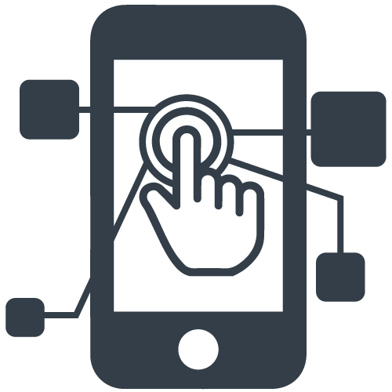
America’s Water Infrastructure Act of 2018 (AWIA)
Section 2013 mandates water systems serving >3,300:
Conduct Risk and Resilience Assessment (RRA) of the risks to, and resilience of, the water system
Update Emergency Response Plan (ERP) and incorporate RRA results
Review/Update RRA & ERP every five years
Utility Objectives:
Align with America’s Water Infrastructure Act (AWIA) of 2018
Manage risk and increase resilience
Knowledge transfer assuring ongoing compliance
Improve risk and resilience posture
Malevolent Acts
Pipes
Infrastructure
Natural Hazards
Monitoring
AWIA 2018 Targeted Risks
Cyber
Capital
Needs
Financial
Infrastructure
O&M
Chemicals
2

Slide 3
RRA Approach | Framework
AWWA J100-10: 7 Step Process
1) Asset Characterization
American Water Works Association (AWWA) J100-10 (R13) Standard: RAMCAP® Risk and Resilience Management of Water and Wastewater Systems
Following the AWWA J100-10 process:
Kickoff: Steps 1 and 2
Small group discussions: Steps 3, 4, and 5
RRA Verification Workshop: Steps 6 and 7
AWWA Cybersecurity Guidance and Assessment Tool
USEPA Guidance: Baseline Information on Malevolent Acts for Community Water Systems, 2019
Other USEPA and industry standard resources
2) Threat Characterization
3) Consequences Analysis
4) Vulnerability Analysis
5) Threat Likelihood Analysis
6) Risk/Resilience Analysis
7) Risk/Resilience Management
3

Slide 4
Objectives
Outline Risk and Resilience for Cybersecurity and Business Continuity
Define Mission Criteria and Critical Cyber Assets
Perform Cyber Risk Assessment
Likelihood (L): What is the likelihood (probability/frequency) of the threat occurring?
Vulnerability (V): How vulnerable is the asset to the loss (What is the likelihood that the threat will result in the estimated consequences)?
Consequence (C): What are the worst reasonable consequences resulting from a threat to a critical asset?
Mitigation: How can we lower risk and/or increase resilience?
Information Security Policy
Continuity of Operations Plan
4

Slide 5
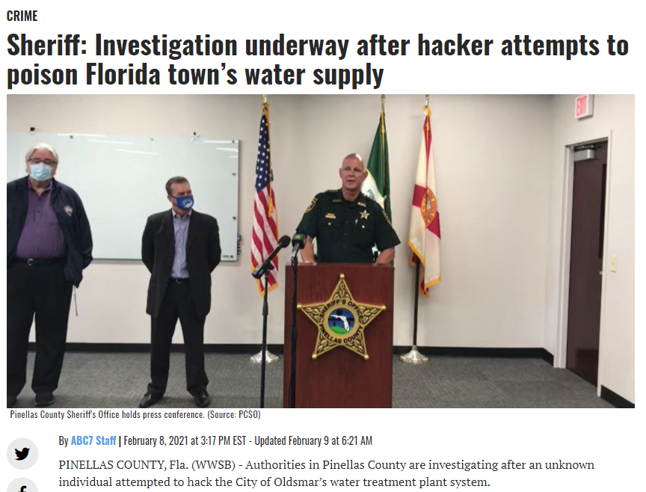
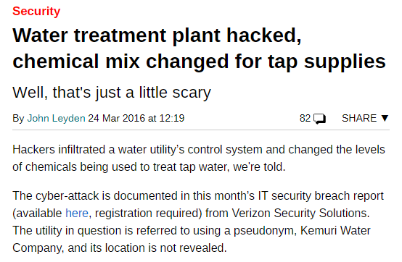
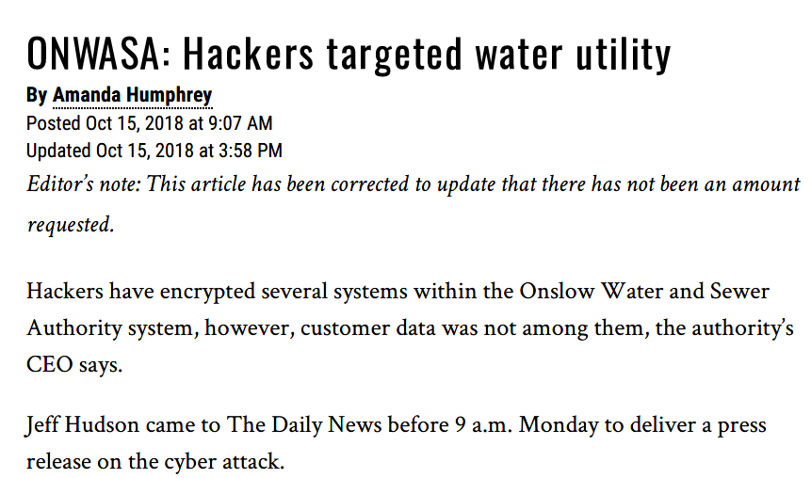
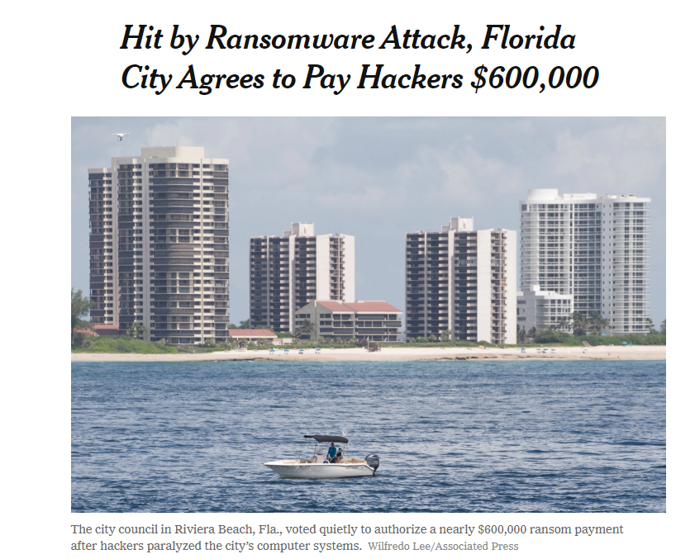
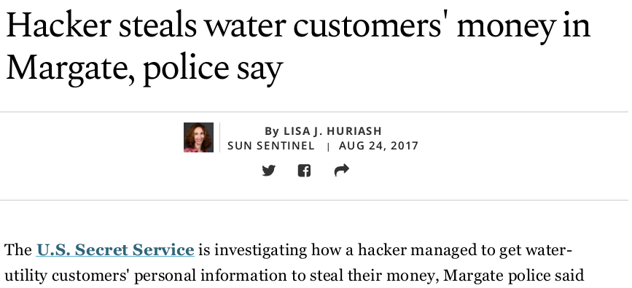
Threat Likelihood

Slide 6
Cyber Adversaries | Outsider
Foreign Intelligence Services
Infiltrate Critical Operations
Control Infrastructure
Domestic Terrorist
Compromise National Security
Damage Infrastructure
Extremist
Send a Message
Disrupt Infrastructure
Criminal:
Financial Gain
Ransomware
Vandal:
Curiosity
Challenges
Malware
6

Slide 7
Cyber Adversaries | Insider
Super-Insider
Negate Security
Operations Offline
Collusion
Compromise Security
Collude with Outsider
Revenge:
Amplify Message
Damage Operations
Disgruntled:
Send a Message
Disrupt Operations
Criminal:
Personal Gain
Resource Theft
7

Slide 8
USEPA Guidance on Cyber Attacks
Business Enterprise Systems (BES)
A cyber-attack on utility billing, communications, data management or other information systems, which may disable affected systems and result in the loss of information resources, including personal, financial and other sensitive data, and other economic consequences for the utility
Cyber-attacks on business enterprise systems occur frequently at water utilities (and elsewhere). Many successful cyber-attacks involving water utility business enterprise systems have been reported, often with significant economic consequences for the utility.
Water utilities experience an attempted cyber-attack on a business enterprise system once per year, and 30% of these incidents have the potential for significant economic consequences.

Slide 9
USEPA Guidance on Cyber Attacks
Process Control Systems (PCS)
A cyber-attack on utility process control systems, including monitoring, operations, and centralized control. The attack may disable or manipulate utility infrastructure, potentially resulting in loss of service, the contamination of finished water and damage to utility infrastructure
No successful cyber-attacks on U.S. water utility process control systems have been proven, though possible attacks have been reported.
Pilot-scale studies have demonstrated cyber capability to manipulate water utility valves and chemical dosing.
Water utilities use communications and control systems that are common across critical infrastructure sectors, and these systems have been penetrated by cyber-attacks in other sectors.
Available intelligence (public) indicates long-term cyber presence in U.S. critical infrastructure control systems by foreign state actors.
Water utilities experience an attempted cyber-attack on a process control system once per year, and 10% of these incidents may have significant public health or economic consequences.

Slide 10
USEPA Guidance on Cyber Attacks
Threat | SCADA | IT | Enterprise Systems | Financial Systems
Cyber Outsider | 0.01 | 0.03 | 0.03 | 0.03
Cyber Insider* | 0.01 | 0.03 | 0.03 | 0.03
Threat Likelihood Values
These values will represent the adjusted Threat Likelihoods.
*Contrary to the default USEPA Guidance, the likelihoods for Insider events has been decreased by 10% due to the population of adversaries that could be a threat.
How many possible intrusions are you seeing?
How many are credible threats?
Do any get through your security measures?
Can you track the target of intrusions?

Slide 11
AWWA Cybersecurity Tool
Step 1: Prioritize Recommendations
Priority 1
Minimum Level of Acceptable Security.
Implement Immediately.
Priority 2
Significant and Immediate Increase in security.
Priority 3
Priority 4
Security System Foundation
Implement as soon as budget allows.
Protection for more sophisticated but less common attacks
Step 2: Review Control Measures
Risk Accepted
Does not align with existing standards.
Planned
Future plans in place.
Partially Implemented
Fully Implemented
Standards partially align.
Measure is an established standard.
Not cost effective.
Identified for Mitigation
Progress towards implementing.
Reduce Risk through Organization, Procedures, and Technology.
Identify controls that support the implementation of cybersecurity best practices.
Reduce Risk through Organization, Procedures, and Technology.
Developed from and correlated to many industry standards.
Step 3: Assign Vulnerability Criteria
Deter
Prevent unauthorized access.
Detect
Identify unauthorized access.
Delay
Respond
Prevent unauthorized access from continuing further.
Recover from an event.

Slide 12
Consequence
Threat | SCADA | IT | Enterprise Systems | Financial Systems
Cyber Outsider | Isolated attack on the SCADA system to prevent DWP from accessing. Increased manual effort, possible damage to PLCs, valves, etc. | Ransomware on IT Infrastructure. Loss of productivity, inability to bill, potential theft of sensitive data. | Penetration of Enterprise Applications. Loss of productivity and potential loss of data. | Ransomware attack on financial systems. Inability to bill, theft of customer data, potential theft of rerouting of funds.
Cyber Insider | Attack on the SCADA system to cause damage to the system and send a message. | Destructive attack on IT Infrastructure for revenge. Loss of productivity and potential loss of data. | Destructive attack on Enterprise Systems for revenge. Loss of productivity and potential loss of data. | Non-destructive attack on the Financial system, likely to reroute or steal funds, or steal then sell customer data.
Scenario Planning
Past Events
Cost Estimates
Cyber Insurance
Recovery Times
Back Billing
Hardware Loss
System Damage
“Worst Reasonable Case Scenario”

Slide 13
Additional Resources
AWWA Alerts
AWWA Cybersecurity Risk and Responsibility in the Water Sector
AWWA Cybersecurity Guidance
WaterISAC
ICS-CERT

