Slide 1
Projections and Uncertainty in the Colorado River Basin
Urban Water Institute Conference
September 8, 2021
Rebecca Smith, PhD, Lower Colorado Basin Region

Slide 2
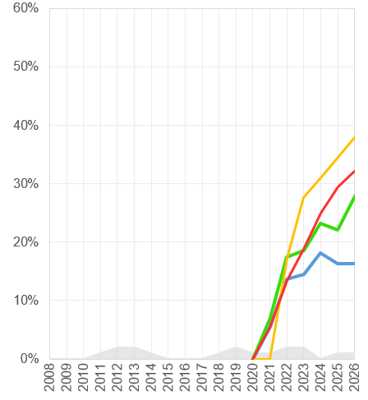
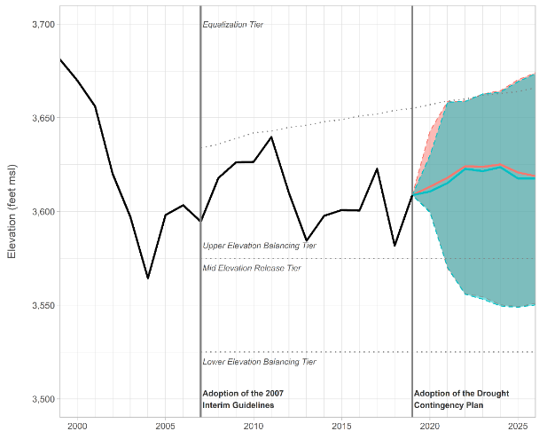
Process to Project System Conditions
2. Key sources of uncertainty
Hydrology
3. Run model
4. Project system conditions & compute risks
1. Initial conditions
Initial Reservoir Elevations
System Model
Demand
Policy
System conditions are most sensitive to assumptions about future hydrology
To account for the uncertainty in future hydrology, multiple, sometimes hundreds, of hydrologic traces are used
Models are run using each hydrologic trace, resulting in projections of system conditions (e.g. reservoir elevations, releases, etc.)
For probabilistic projections, statistics are computed to get risk

Slide 3
Models, Data, & Assumptions for Different Projection Horizons
Current Conditions
Hundreds of hydrology traces available based on historical data and climate projections
Stakeholder-provided Upper & Lower Basin demand projections
Current operating policies applied via rules through 2026, followed by assumptions
24 months
CRMMS-24MS Mode
3 hydrology traces based on CBRFC forecasts + historical data
Embedded Upper Basin water use, stakeholder-provided Lower Basin demands
Current operating policies applied via rules and operator expertise
2-5 years
CRMMS-ESP Mode
35 hydrology traces based on CBRFC forecasts + historical data
Embedded Upper Basin water use, stakeholder-provided Lower Basin demands
Current operating policies applied via rules
CRMMS = Colorado River Mid-Term Modeling System
CBRFC = Colorado Basin River Forecast Center
ESP = Ensemble Streamflow Prediction
CRSS = Colorado River Simulation System
Decades
CRSS

Slide 4
Purpose- & Data-Driven Projections
24-Month Study: least uncertainty
Decisional months capitalize on skillful forecasts and well characterized demands
Specific projections tied to policy
2- to 5-Year probabilistic projections: moderate to large uncertainty
Capitalize on moderate forecast skill in Year 1
Incorporate more information from historical hydrology to explore wider range of potential future system conditions
Understand possibilities considering current conditions and policies
Decades-long probabilistic projections: deep uncertainty
Incorporate full range of historical hydrology information, climate change-informed historical information, and climate change projections
Explore impacts of climate change and different demand and policy assumption for long-term planning

Slide 5
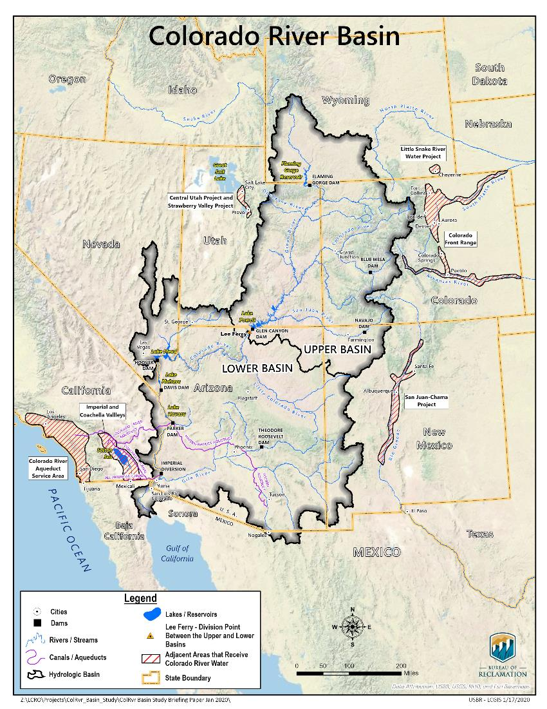
Upper Colorado River Basin Hydrology
Lees Ferry, AZ, stream gage
Near 1922 Compact point (Lee Ferry)
Divides Upper Basin and Lower Basin
Upper Basin accounts for approximately 90% of total CRB streamflow
Highly variable from year to year
Notes:
Points to make:
Basin is characterized by highly variable hydrology and we have constructed a large amount of storage to deal with that variability – 4x average annual inflow
Store water in the high flow years so that deliveries can be made in low flow years
As demand has increased over time, our margin has become tighter, particularly in the Lower Basin

Slide 6
Lees Ferry Observed Natural Flow Record (1906-2021)
Avg Annual Flow 1906-2019: 14.7 maf

Slide 7
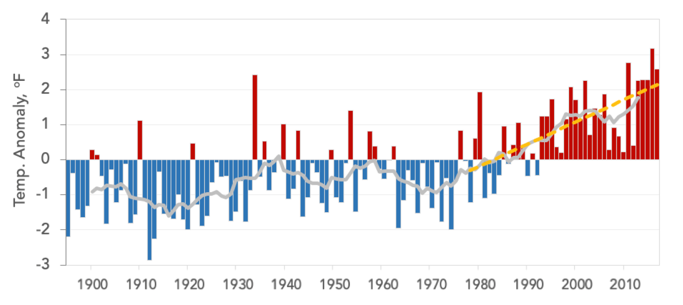
Increasing Temperature Trend
Annually-averaged temperature for the Colorado River Basin, 1895–2018, shown as departures from a 1970–1999 average. The gray line is a 10-year running average plotted on the 6th year. A 40-year linear trend (dashed yellow line) shows 2.4°F of warming from 1979–2018. Figure taken from forthcoming Colorado River Basin Climate and Hydrology—State of the Science Report: https://www.usbr.gov/lc/region/programs/research-reports-etc/Final_CRB_SoS_Project_Overview.pdf
Notes:
Figure 2.16 Annually-averaged temperature for the Colorado River Basin, 1895–2018, shown as
departures from a 1970–1999 average. The gray line is a 10-year running average plotted on the
6th year. A 40-year linear trend (dashed yellow line) shows 2.4°F of warming from 1979–2018.
It’s been getting hotter since the 80s and we know that hotter temps result in less streamflow for a given amount of precipitation. Let’s take the recently observed streamflow and leave off most of the observations from the cooler 20th century

Slide 8
Lees Ferry Observed Natural Flow Record (1906-2021)
Avg Annual Flow 1906-2019: 14.7 maf
Avg Annual Flow 1988-2019: 13.3 maf

Slide 9
Mid-Term Uncertainty and Shifting Risk*
*Projections not official; based on August 2020 CRSS modeling with Lake Powell initial elevation of 3,592’. Lake Powell’s current elevation is ~3,550’

Slide 10
Mid-Term Uncertainty and Shifting Risk*
*Projections not official; based on August 2020 CRSS modeling with Lake Powell initial elevation of 3,592’. Lake Powell’s current elevation is ~3,550’
** CMIP3 and CMIP5 ensembles span 3 different emissions futures and were downscaled using Bias Correction Spatial Downscaling (BCSD)

Slide 11
Long-term risk outlooks using different supply, demand, and policy assumptions*
*Projections not official; based on August 2020 CRSS modeling with Lake Powell initial elevation of 3,592’. Lake Powell’s current elevation is ~3,550’
** CMIP3 and CMIP5 ensembles span 3 different emissions futures and were downscaled using Bias Correction Spatial Downscaling (BCSD)

Slide 12
Long-term risk outlooks using different supply, demand, and policy assumptions*
*Projections not official; based on August 2020 CRSS modeling with Lake Powell initial elevation of 3,592’. Lake Powell’s current elevation is ~3,550’
** CMIP3 and CMIP5 ensembles span 3 different emissions futures and were downscaled using Bias Correction Spatial Downscaling (BCSD)
Notes:
Demands and policy are also uncertain
Note that risk has shifted dramatically since last year- powell is over 40 ft lower

Slide 13
Long-term risk outlooks using different supply, demand, and policy assumptions*
*Projections not official; based on August 2020 CRSS modeling with Lake Powell initial elevation of 3,592’. Lake Powell’s current elevation is ~3,550’
** CMIP3 and CMIP5 ensembles span 3 different emissions futures and were downscaled using Bias Correction Spatial Downscaling (BCSD)
Notes:
Demands and policy are also uncertain
Note that risk has shifted dramatically since last year- powell is over 40 ft lower

Slide 14
Long-Term Planning under Deep Uncertainty
Deep uncertainty occurs when probabilities of any given set of future conditions cannot be estimated with confidence
Translation: it is impossible to determine the most appropriate planning assumptions
Statistics-based analysis (e.g. “percent of traces”, “acceptable risk”) may be unreliable as the sole basis for understanding system or planning for future
Decision Making under Deep Uncertainty (DMDU) planning methods incorporate concepts and techniques that help address the challenges of planning under climate change
Seeking robust solutions that perform well enough in a wide range of future conditions
Characterize vulnerabilities based on observable conditions
Plan for adaptation as conditions evolve (and uncertainty decreases)

Slide 15
Thank You
Rebecca Smith: rebeccasmith@usbr.gov

