Slide 1
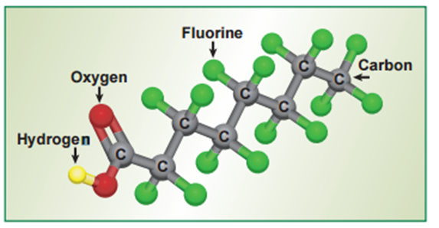
Nicole Blute, PhD, PE
Urban Water Institute
February 19, 2020
PFAS Treatment Options

Slide 2
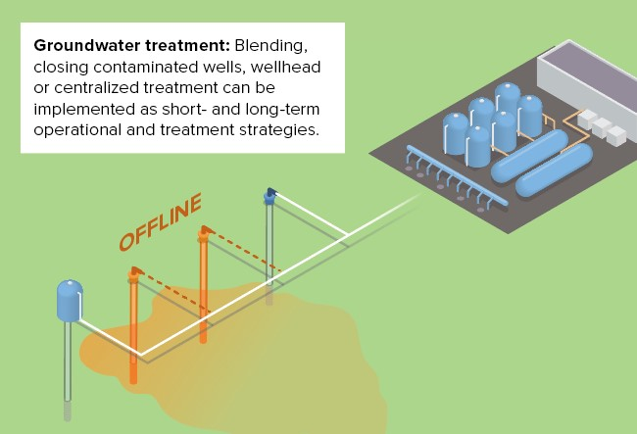
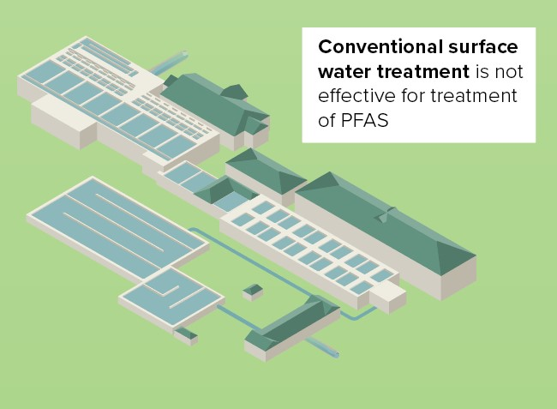
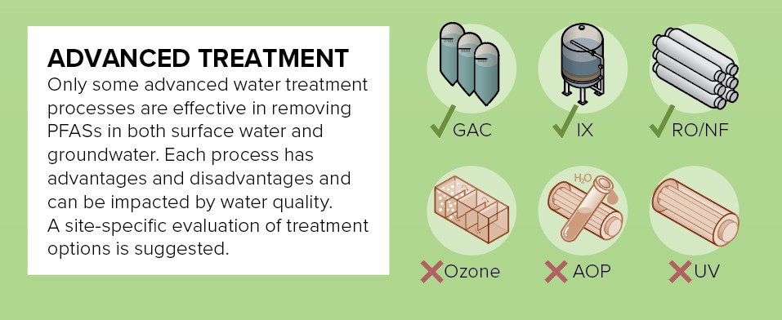
Treatment Options
Notes:
Groundwater treatment can range from blending to wellhead or centralized treatment of multiple wells.
Conventional surface water treatment is not effective for removal of PFAS.
More advanced water treatment option can be used to remove PFAS, including GAC, IX, and RO/NF. Advanced oxidation has not been shown to be effective. In general, selection of a treatment option depends on water quality, available footprint, and cost.

Slide 3
Treatment Options
Complicating Factors:
Often PFAS projects are associated with legal actions and uncertain regulatory future, including
  PFOA and PFOS treatment targets
  Additional PFAS compounds
  Short term vs. long term treatment
DDW requested that OEHHA provide a recommendation in developing notification levels for 7 compounds detected frequently in the state:
perfluorohexane sulfonic acid (PFHxS)
perfluorobutane sulfonic acid (PFBS)
perfluorohexanoic acid (PFHxA)
perfluoroheptanoic acid (PFHpA)
perfluorononanoic acid (PFNA)
perfluorodecanoic acid (PFDA)
4,8-dioxia-3H-perflourononanoic acid (ADONA)
Notes:
Often, PFAS related projects are associated with lawsuits, complicating the projects. In addition, an uncertain regulatory future calls into question PFOS and PFOA treatment targets, additional PFAS compounds, and the need to put in treatment quickly vs. considering the most cost effective treatment for the long term.

Slide 4
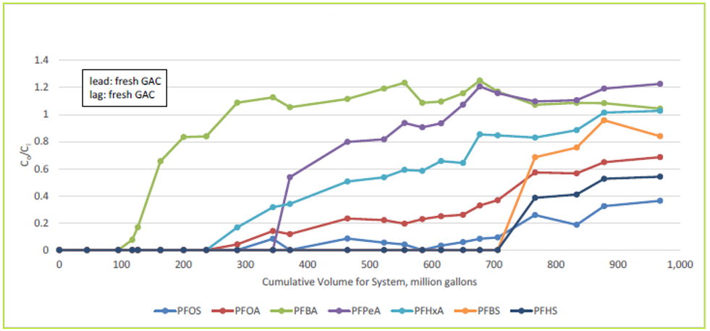
Chemical Structure Determines Treatment Duration of Media
Potential desorption after exhaustion
Notes:
Chemical structures dictate treatment duration. This figure shows example breakthrough curves on GAC for a number of different PFAS compounds.
Breakthrough occurs first for PFBA (Perfluorobutanoic acid, 4-chain carbon), followed by PFHxA (Perfluorohexanoic acid,6-chain carbon), PFPeA (perfluoropentanoic), PFOA (Perfluorooctanoic acid), PFOS (Perfluorooctane sulfonic acid), PFBS (Perfluorobutane sulfonate), and PFHS (perfluorohexanesulfonic acid).
A few things to note from these charts –
Breakthrough time varies significantly by compound structure.
The shape of the breakthrough curve varies, with some having much sharper curves than others.
Treated water concentrations have been shown to exceed the influent concentration after GAC exhaustion, indicating potential desorption to some degree.

Slide 5
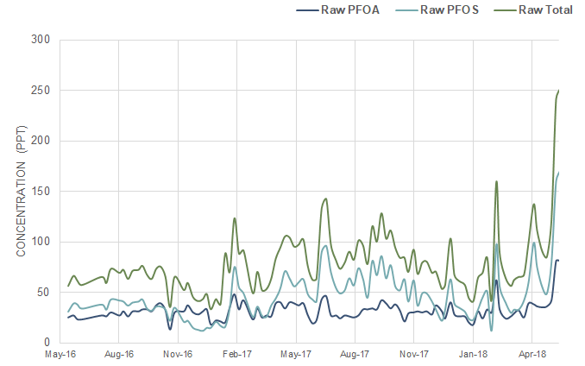
Example of Municipal PFAS Treatment
GAC in Surface Water
Gadsden, Alabama
Surface water system in Alabama
May 2016
EPA issues Health Advisory Level (HAL) for PFOA and PFOS
July 2017
Water system decides to act to provide additional treatment to maintain levels below HAL
Initially, PFOA/ PFOS levels below HAL
By summer 2017, concern that levels were exceeding the HAL
Notes:
We’ll walk through a couple of case studies of PFAS treatment. First – a large surface water installation of GAC for a system in Gadsden Alabama (outside of Birmingham).
The City had made significant capital investments to deal with Stage 2 DBP Rule compliance, as I’ll show on the next slide.
EPA’s issuance of the Health Advisory Level for PFOA and PFOS led the City to act to maintain levels below the HAL.

Slide 6




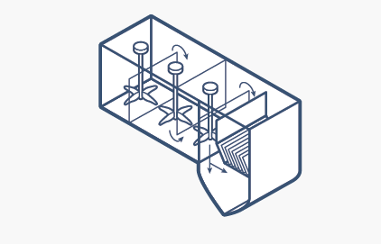


Advanced Treatment Already Implemented
MIEX for Stage 2 DBP Rule Compliance
Coagulation / Flocculation / Sedimentation
Free Chlorine Disinfection
River Source
Ion exchange (TOC removal)
Conventional Filtration
Distribution
Recently installed IX is not effective for PFOA/PFOS – another treatment process is needed
Notes:
The City had installed Miex for TOC removal in their conventional treatment system but found that it did not provide sufficient removal of PFAS compounds.

Slide 7
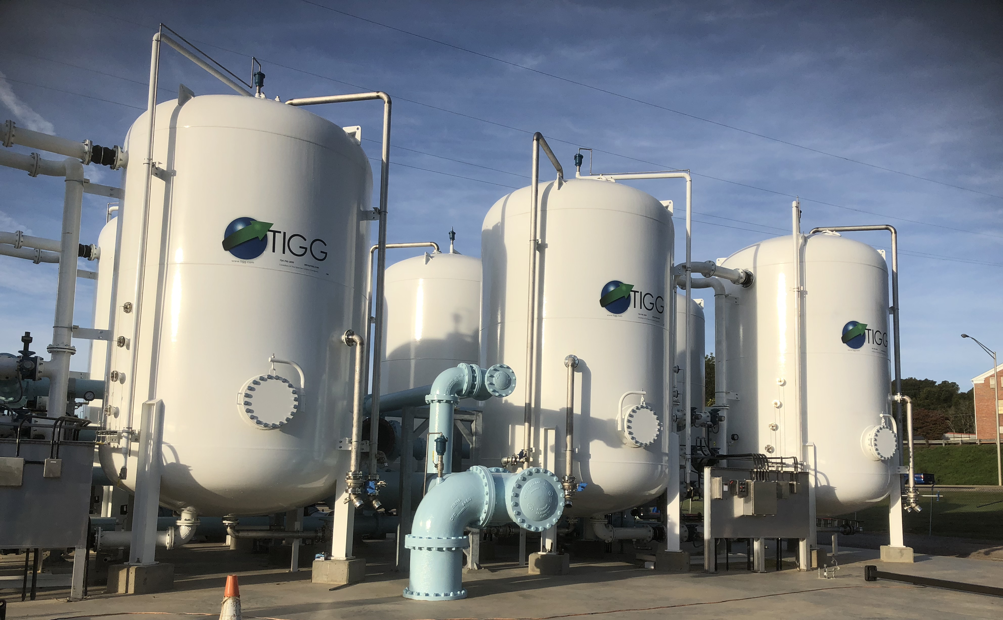
GAC Post-Filter Adsorbers Installed
Gadsden, Alabama
Fast track implementation of 6 MGD of treatment
Insufficient time to assess technologies through pilot testing
Initially, regulators urging RO but does not remove PFAS from environment (concentrate stream)
Selected GAC adsorption for PFAS removal in the near-term
Thermal regeneration of GAC shown to be effective for removing adsorbed PFASs
Notes:
The City chose to install 6 MGD of post-filter GAC contactors in a fast track project that involved 4 months of design and 8 months of construction. On this schedule, RSSCT testing was conducted but there was not time for pilot testing of the approaches.

Slide 8
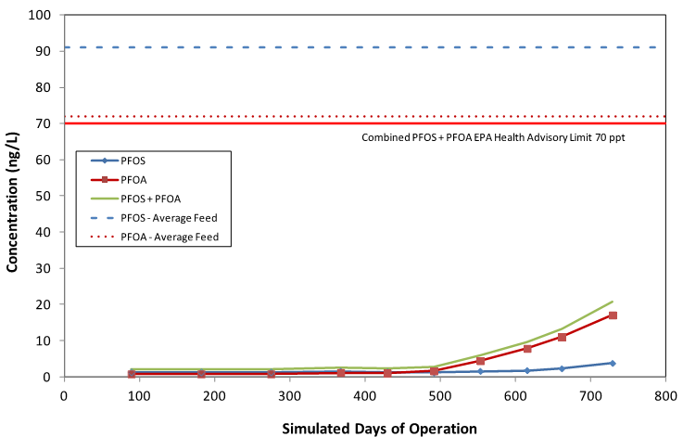
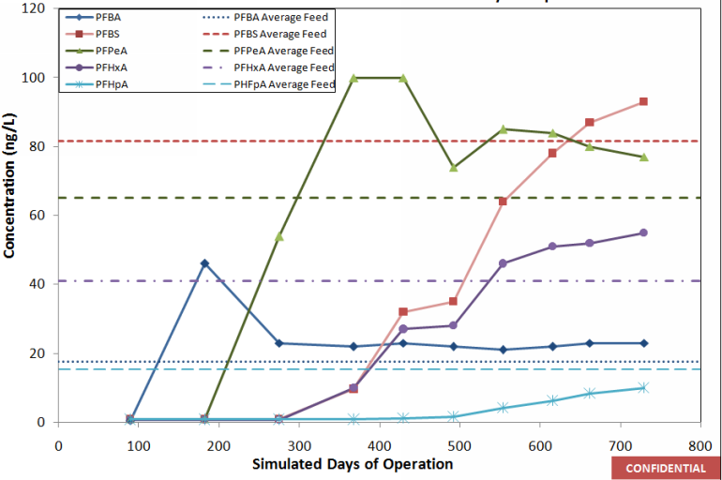
GAC Accelerated Column Testing
Evaluation of GAC effectiveness for other PFAS compounds
12.5 min EBCT – PFOA + PFOS
12.5 min EBCT – Short Chain PFAS
PFAS | Carbon Chain Length | Days to Initial Breakthrough
PFOS | 8 | 554
PFOA | 8 | 367
PFHpA | 7 | 430
PFHxA | 6 | 365
PFPeA | 5 | 270
PFBS | 4 | 365
PFBA | 3 | 90
Notes:
Accelerated column testing again demonstrated the number of days to breakthrough, which was largely tied to carbon chain length and functional groups like carboxylic acid and sulfonate.

Slide 9
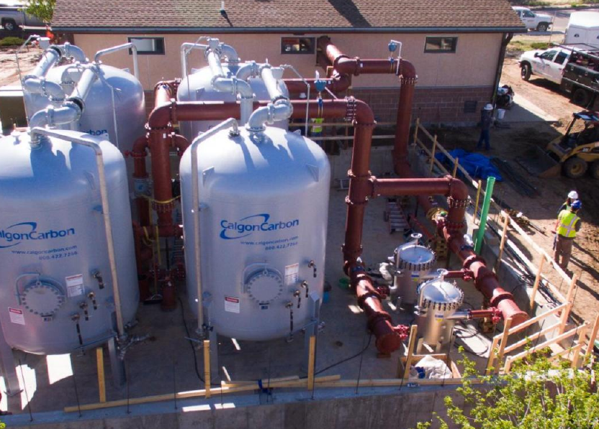
Example of Municipal Ion Exchange for PFAS
Widefield, Colorado
First IX facility in US for PFAS (2017)
Two resins chosen
  Dow CAL-RES 2109
  Dow PSR2+
Selected macroporous resin due to cross-linked backbone
  More chlorine tolerant
  Easier to return to service after shutdown
Had coliform hit after a new transmission main was constructed
  Due to IX selection, chlorine was successfully used to eliminate coliform hit
  Gel type resins less resistant to chlorine, resulting in more difficulty returning to service
Courtesy of Brandon Bernard, Water Department Manager, brandon@wwsdonline.com
Notes:
To provide another case study, I’ll refer to the first ion exchange installation in the US for PFAS. This facility, in Widefield, Colorado, uses macroporous resins for the explicit purpose of being able to chlorinate the raw water in case of bacterial hits.
The facility manager is very pleased with the application of IX, and it has been operating for more than 2 years without a changeout.

Slide 10
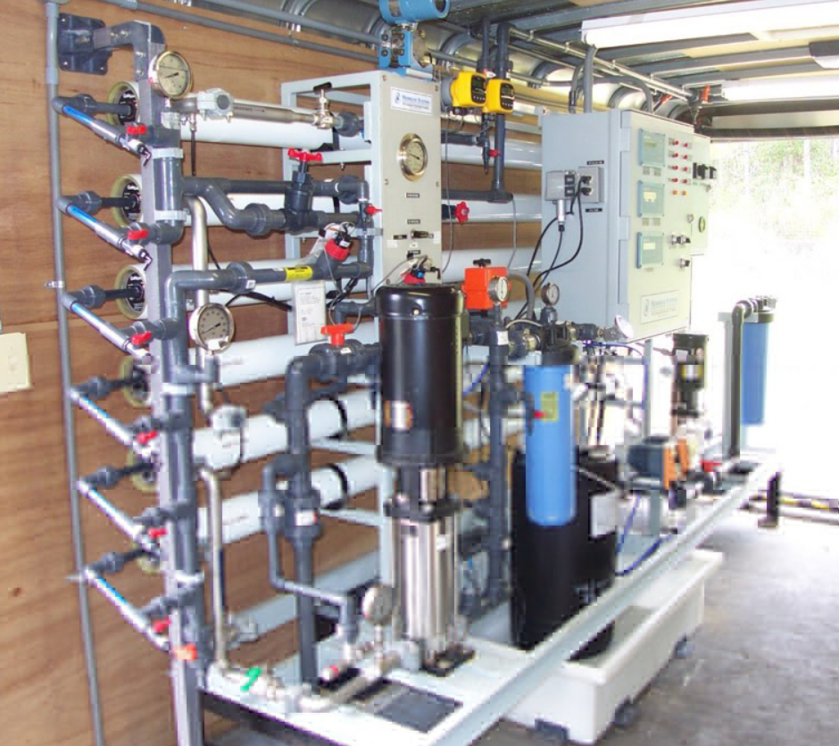
Reverse Osmosis – Surface Water
WRF 4913
Low Pressure Reverse Osmosis Pilot Data
(Results provided in-kind to WRF 4913)
Parameter | RO Influent (ng/L) | RO Effluent (ng/L)
PFOS +PFOA | 18 - 26 | ND
PFHxA | 19 - 20 | ND
PFPeA | 16 - 17 | ND
PFMOAA | 320 - 750 | ND – 11
PFO2HxA | 12 - 26 | ND
GenX | 7 - 12 | ND
Sum of 45 PFAS tested | 423 - 892 | ND - 11
RO concentrate levels 7 – 10x concentration of influent
Notes:
Finally, looking at Reverse Osmosis, a WRF study found that many of the PFAS compounds could be fully removed by RO.
However, RO concentrate had levels of 7 to 10 times the influent concentration, which can make it a challenge to dispose of.

Slide 11
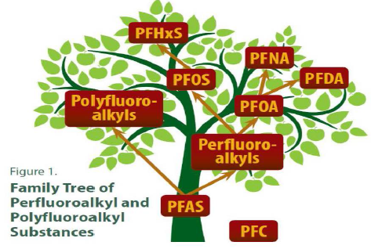
Development of Treatment Strategies with Consideration for Other Needs
Do other constituents need treatment?
Are IX resins “broad spectrum” enough for the PFAS chemicals present?
Does GAC breakthrough limit applicability?
Is a combination of technologies cost-effective?
Source: www.atsdr.cdc.gov
Notes:
So when you are considering which treatment to select, a number of factors should be considered.
Do other constituents require treatment, such as VOCs or iron?
If you are thinking of IX, understanding whether the selected resin covers all of the PFAS chemicals present.
Identification of GAC time to breakthrough, which affects cost and practicality of operation.
Would the system benefit from a combination of technologies, such as a roughing GAC filter followed by polishing IX?

Slide 12
Treatment Comparison Summary
 | PFOA/ PFOS Removal | Short-Chain PFAS Removal | VOC Removal | Perchlorate Removal | Fouling (Media, Membranes) | Waste Disposal Challenges
GAC |  |  |  |  | TOC
Ion Exchange |  |  |  |  | Fe/Mn
Reverse Osmosis |  |  |  |  | Fe/Mn, CaCO₃ | Brine with PFAS; Greater water loss
Notes:
Example Costs
GAC
$9M for 10 MGD
$1.3 M/year O&M
IX
$13M for 10 MGD
$0.8 M/year O&M

Slide 13
What Can Be Done Now?
Planning
Comparison of treatment options for specific installations
  Cost estimates
  Footprints
Testing
  Confirmation of technology performance or manufacturer performance guarantee
Communications
  Develop communications strategy early
  Provide factual information to media and customers
  Simplify highly technical information
  Public Statements, website updates, social media updates, talking points for customer service representatives, FAQ, and bill inserts

Slide 14

Ongoing Research
WaterRF 4913: Treatment Alternatives for Short-chain PFAS
Hazen Co-PI with NCSU, CSM, Ann Arbor, SNWA
Participating Utilities all over the country
Project Goals:
  Evaluating conventional and innovative sorbents
  Identifying essential membrane properties
  Assessing impact of background water matrix parameters
  Comparing pre-treatment options to enhance downstream adsorption
  Developing scale-up protocols to estimate full-scale sorbent use rates
  Generating data for residuals management
  Modeling quantitative structure-property relationships to predict removal by adsorption, anion exchange, and membrane processes
Notes:
Research on PFAS removal is underway in a lot of locations. One such study involves evaluation of treatment options for short-chain PFAS, which we discussed can be more challenging to treat.
Some of the goals of the project include:
Evaluating conventional and innovative sorbents (organoclays, cyclodextrins, polymers)
Identifying essential membrane properties
Assessing impact of background water matrix parameters
Comparing pre-treatment options to enhance downstream adsorption (e.g., TOC removal to enhance GAC effectiveness)
Developing scale-up protocols to estimate full-scale sorbent use rates
Generating data for residuals management
Modeling quantitative structure-property relationships to predict removal by adsorption, anion exchange, and membrane processes

Slide 15
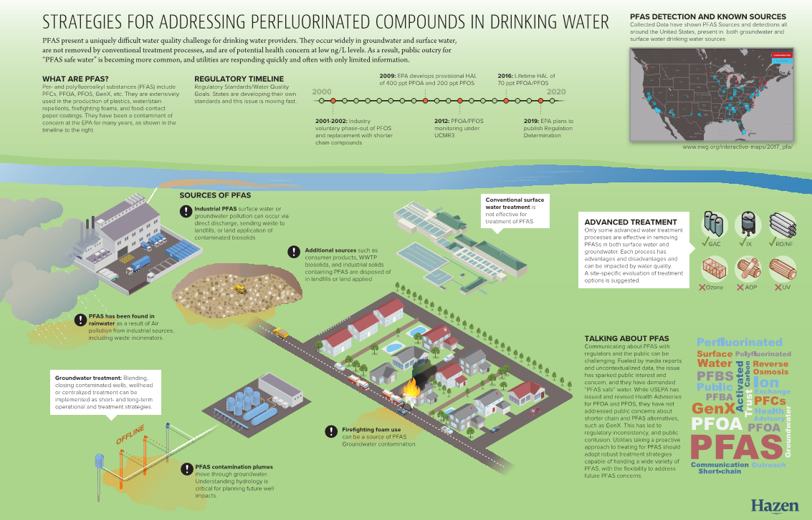
Thank you! Questions?
Notes:
Finally – a large component of our work has involved development of communications materials to share findings and plans with customers.

