Slide 1
Sites Reservoir

Slide 2
Key Presentation Take-Aways for UWI
Governance Innovations
(Jeff)
Realities of Affordability & Permits
(Jerry)
Multiple Benefits for all of California
(Jerry)

Slide 3
Our Strength is in Our
Broad Statewide Participation
Sacramento Valley
Carter Mutual Water Company
City of American Canyon
Colusa County
Colusa County Water Agency
Cortina Water District
Davis Water District
Dunnigan Water District
Glenn County
Glenn-Colusa Irrigation District
LaGrande Water District
Placer County Water Agency
Reclamation District 108
City of Roseville
Sacramento County Water Agency
City of Sacramento
Tehama-Colusa Canal Authority
Westside Water District
Western Canal Water District
Bay Area
Santa Clara Valley Water District
Zone 7 Water Agency
San Joaquin Valley
Wheeler Ridge-Maricopa Water Storage District
Rosedale-Rio Bravo Water Storage District
Southern California
Antelope Valley – East Kern Water Agency
Coachella Valley Water District
Desert Water Agency
Irvine Ranch Water District
Metropolitan Water District
San Bernardino Valley Municipal Water District
San Gorgonio Pass Water Agency
Santa Clarita Valley Water Agency

Slide 4

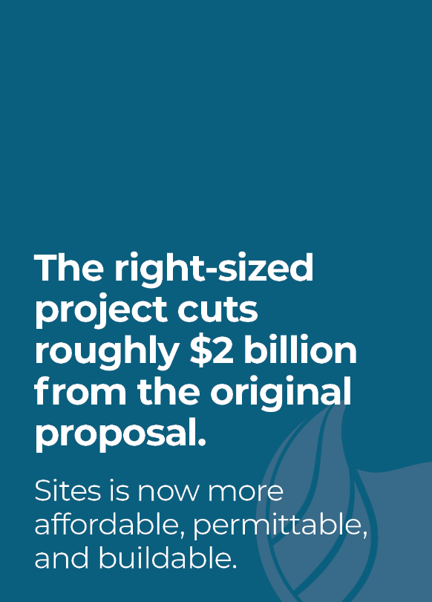
Affordable, Permittable, Buildable
Sites underwent a rigorous value planning effort that resulted in a “right-sized” project. The Sites Reservoir of today:
      Has a smaller footprint than the previous iteration
      Meets the water supply needs of current participants
      Comes at a lower cost
      Supports State’s environmental goals
      Creates flexibility for participants
      Performs under most challenging climate change scenarios

Slide 5
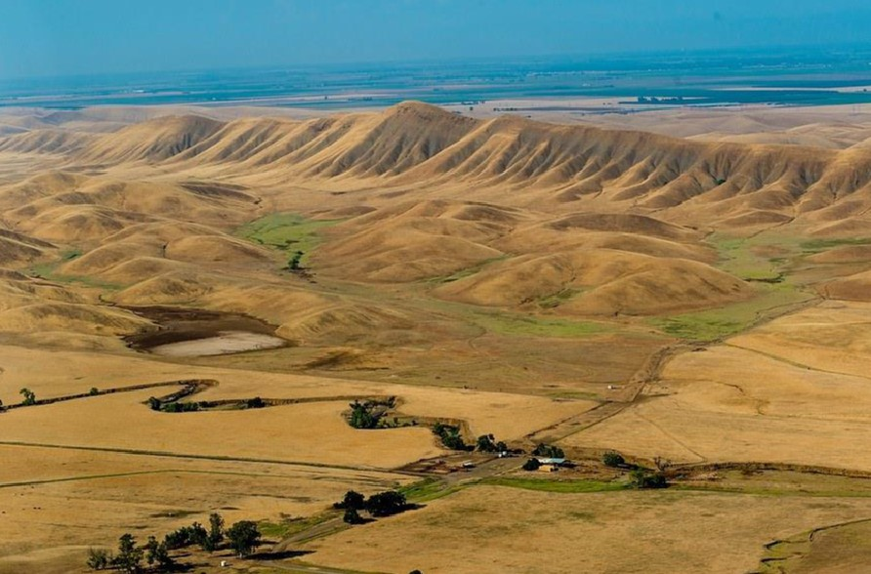
Rightsized to Meet Our Current and Future Water Supply Needs

Slide 6
The “rightsized” project optimize use of existing conveyance infrastructure
Notes:
JP has map

Slide 7
Provides Climate Change Resiliency
      Captures excess flows in the Sacramento River – rain instead of snowmelt
      Off-stream storage and state of the art fish screens protect the river system environment
      Adds 1.5 million acre-feet of storage space providing water mgmt. flexibility
      Provides new, affordable water for people, farms and environment during the more frequent dry spells California will experience
      Allows other reservoirs, like Shasta Oroville and Folsom, to optimize cold water during dry periods for environmental purposes
How does Sites Reservoir address these challenges?
Project performance is modeled to improve by approximately 5%-10% under anticipated climate change conditions

Slide 8
Provides a Resilient Supply of Water for all of California
SITES PROJECT NEW WATER SUPPLY
Year Type | Water Supply (thousand acre-feet)
Wet | 80-90
Above Normal | 92-292
Below Normal | 190-296
Dry | 398-429
Critically Dry | 308-348
Long-Term Average | 207-260
If we had Sites Reservoir in this 2021 drought year we estimate we would have nearly 1MAF of additional water for California’s farms, cities and the environment.

Slide 9
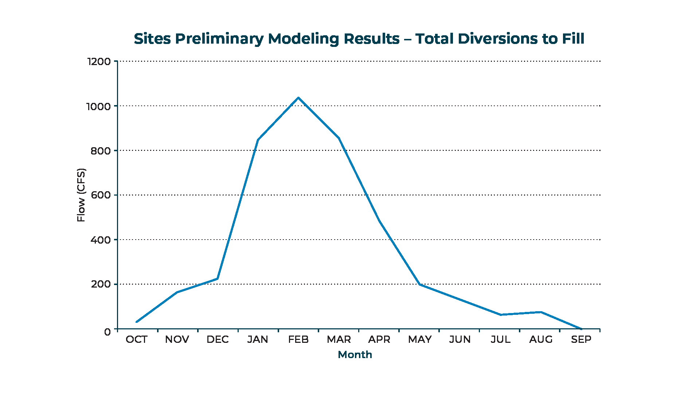
Sites is a Stormwater Capture Project

Slide 10
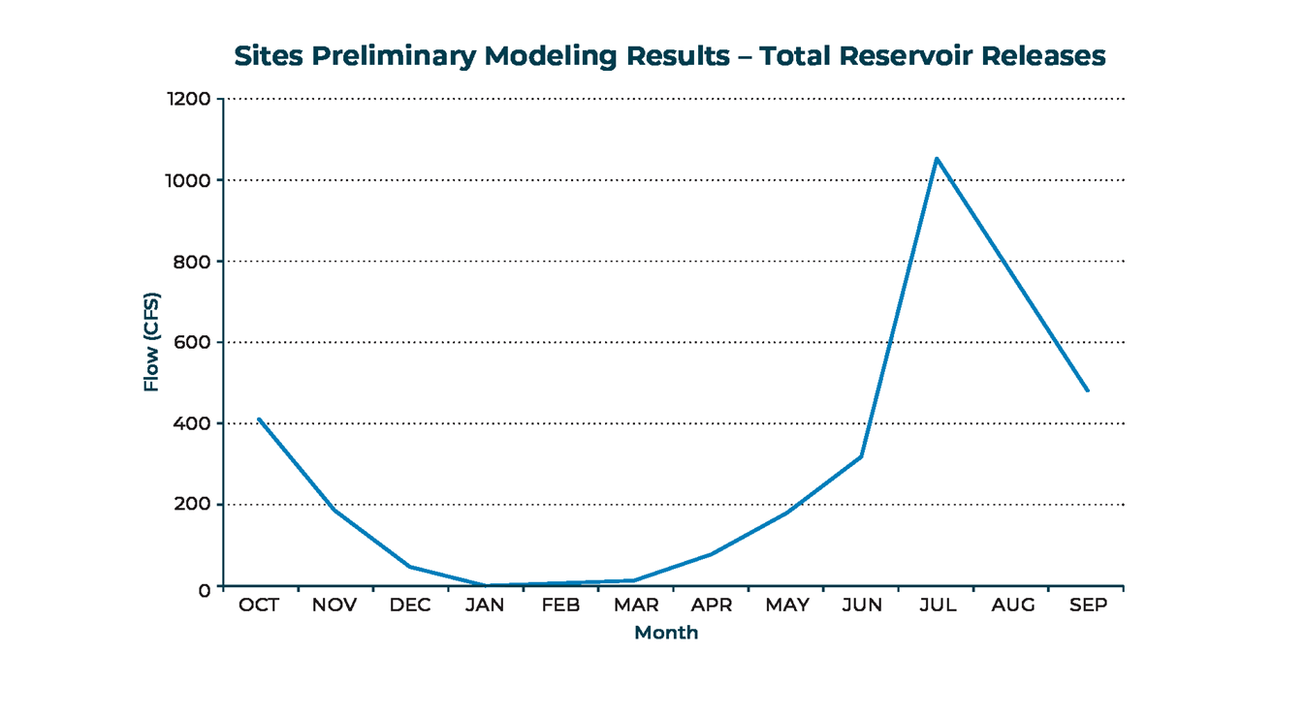
Sites Releases Are Similar to Snowpack Runoff

Slide 11
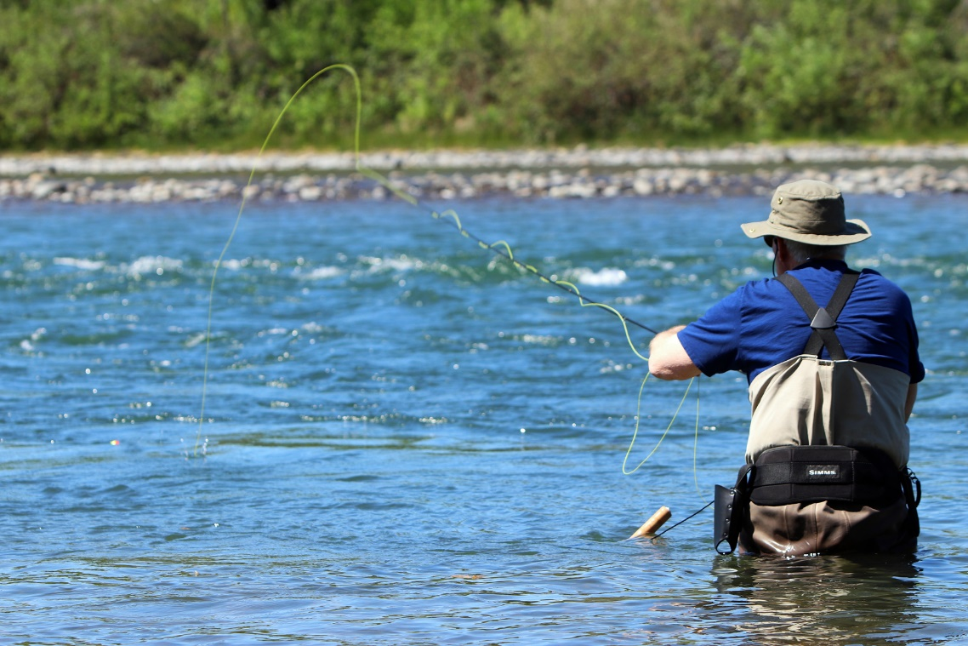
State Public Benefits in Sites funded by Prop 1
Total 2018 MCED: $816M (Rank 3)
Environmental (~67%)
  Refuge Supplies - Provide a reliable supply of refuge water to improve Pacific Flyway habitat for migratory birds and other native species
  Yolo Bypass - Provide water dedicated to help improve conditions for the Delta Smelt
  Other Possibilities (not currently included) -
    Preserve cold-water for use later in the summer months to support salmon development, spawning and rearing
    Environmental Water Manager concept to flexibly manage the State’s asset for optimal environmental results
Recreation (~23%)
Flood Control (~ 5%)

Slide 12
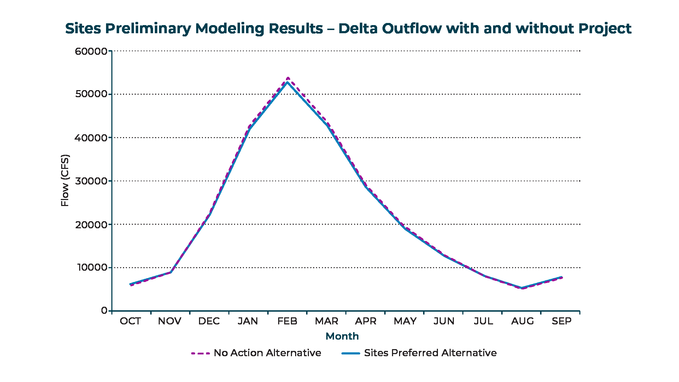
Sites Puts a Small Amount of Uncaptured Flow to its highest and best use

Slide 13
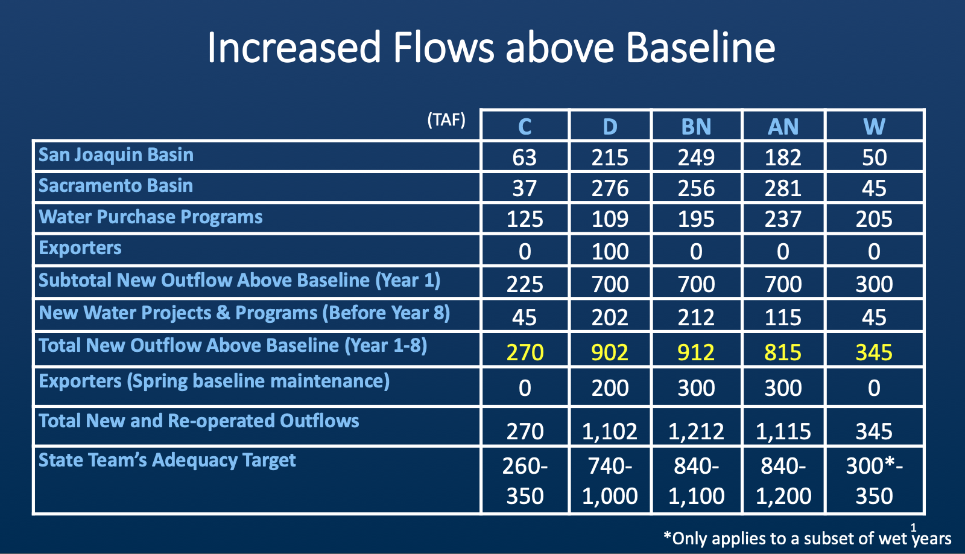
Sites can Assist with the Bay Delta Issues

Slide 14
Sites RDEIR/SDEIS Project Alternatives
Facilities / Operations | Alternative 1 | Alternative 2 | Alternative 3
Reservoir Size | 1.5 MAF | 1.3 MAF | 1.5 MAF
Hydropower | Incidental upon release | Same as Alt 1 | Same as Alt 1
Diversion Locations | Red Bluff Pumping Plant and Hamilton City | Same as Alt 1 | Same as Alt 1
Conveyance Release / Dunnigan Release | 1,000 cubic feet per second (cfs) into new Dunnigan Pipeline to Colusa Basin Drain | 1,000 cfs into new Dunnigan Pipeline to Sacramento River. Partial release into the Colusa Basin Drain | Same as Alt 1
Reclamation Involvement | Funding Partner Operational Exchanges Within Year Exchanges Real-time Exchanges | Operational Exchanges Within Year Exchanges Real-time Exchanges | Same as Alt 1, but up to 25% investment
DWR Involvement | Operational Exchanges with Oroville and use of SWP facilities South-of-Delta | Same as Alt 1 | Same as Alt 1
Route to West Side of Reservoir | Bridge across reservoir | Paved road around southern end of reservoir | Same as Alt 1
Notes:
Ali has slide to send.

Slide 15
Sites has to be Affordable, Permittable and Buildable
Reservoir Size (MAF) | Alternative 1 (1.5MAF)
Total Project Cost (2021$, billions) | ~$3.9B
Annualized AF/year release (AFY) | ~230,000
Estimated Unit Costs During Repayment Without WIFIA Loans (2021$, $/AF) | ~$800
Estimated Unit Costs During Repayment With WIFIA Loans (2021$, $/AF) | ~$700

Slide 16
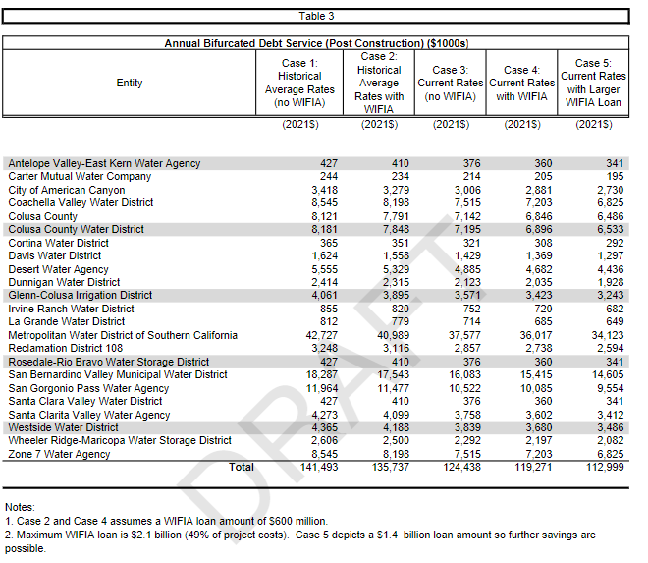
Cost of Financing Has Largest Impact on Annual Cost

Slide 17
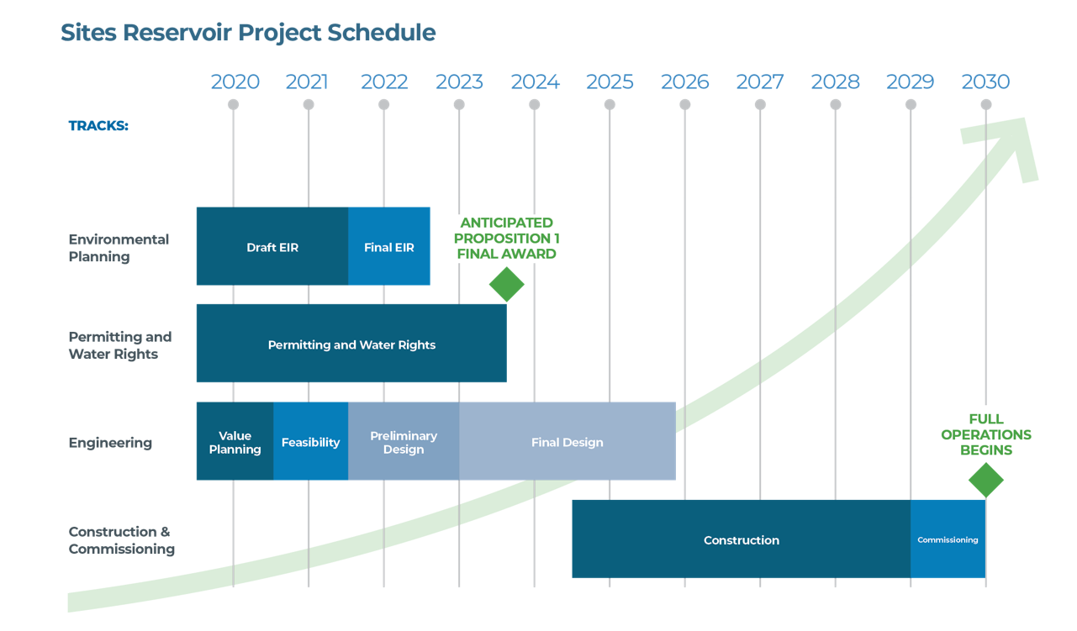
Looking Ahead

Slide 18
Priorities over the Next 6 Months
2021 Priorities
      Confirm 75% “non- public benefit” cost share commitment – answer 3 big questions i) what do “you” get? ii) how much does it cost? iii)how do “we” pay for it?
      Achieve state required feasibility determination and supporting analysis planned for Dec ‘21 CWC meeting – (federal feasibility was determined in Dec’20)
      Circulate the revised Draft Environmental Impact Report/Supplemental Draft Environmental Impact Statement for public review and comments
      Prepare and submit Sites Water Right Application
      Initiate critical project permit processes (ITP, BOs)
      Establish Preliminary Operating Terms with DWR, Bureau of Reclamation and local facility partners
      Continue to collaboratively engage with landowners, tribes, NGOs and local communities

Slide 19
Sites Project Authority & Participants
Sacramento Valley
Authority Board (11 agencies)
Colusa County 4.5%
Colusa County Water District 4.6%
Glenn County
Glenn-Colusa Irrigation District 2.3%
Placer County WA & City of Roseville
Reclamation District 108 1.8%
Sacramento Co WA & City of Sacramento
Tehama-Colusa Canal Authority
Westside Water District 2.4%
Associate Members (6 non-voting)
Western Canal Water District
Tehama-Colusa Four
Cortina Water District 0.2%
Davis Water District 0.8%
Dunnigan Water District 1.3%
LaGrande Water District 0.5%
Other (2 non-voting)
US Bureau of Reclamation (Cost-share) 6.6%
California Department of Water Resources 17.7%
(Ex Officio)
Sacramento Valley
Reservoir Committee
American Canyon, City of 1.8%
Carter MWC 0.1%
Beyond the Sacramento Valley
Reservoir Committee
Antelope Valley-East Kern WA 0.2%
Coachella Valley Water District 4.5%
Desert Water Agency 2.9%
Metropolitan Water District 22.6%
Irvine Ranch Water District 0.5%
Rosedale Rio Bravo WSD 0.2%
San Bernardino Valley Muni WD 9.7%
San Gorgonio Pass Water Agency 6.3%
Santa Clara Valley Water District 0.2%
Santa Clarita Valley Water Agency 2.3%
Wheeler Ridge-Maricopa WSD 1.4%
Zone 7 Water Agency 4.5%
Local Water Agencies:
Reservoir Comm members: 23
(Participants)
Working Draft dated 2019 Mar 31
Notes:
Dual governance
How many are participating at conference (e.g. UWI = 5)

Slide 20
Current Governance Structure
Sites Project Authority
Approach:
Sites Project Authority: Chartering Document and Bylaws
Reservoir Committee: Bylaws and compliance with terms and conditions of the Project Agreement
Voting: 1 member, 1 vote
Delegations of Authority
Material Change Categories:
Prop 1 eligibility
Changes in scope, schedule &/or cost
Changes in facility performance or reliability
Change in power or generation
Shifting of significant risk
Changes to water rights and/or annualized yield
Compliance with laws & regulations (e.g. dam safety)
Changes in environmental mitigation or compliance obligations.
Material Change Threshold
Material Change Threshold
Reservoir Committee
Voting: pro-rated by acre-ft.
2015 November
Page 20

Slide 21
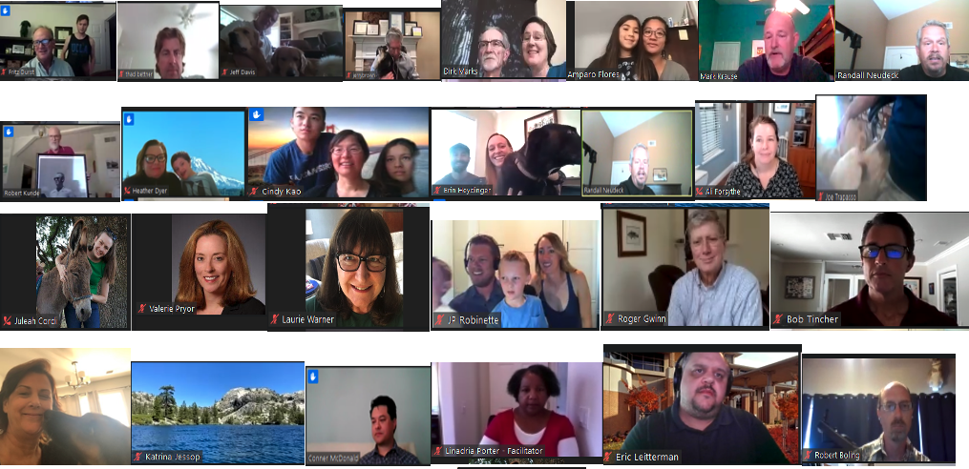
2020 Strategic Planning

Slide 22
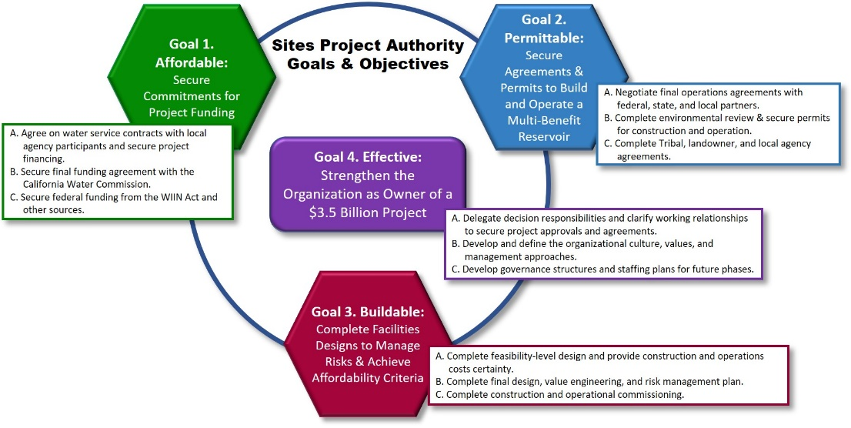
2020 Strategic Planning – Goals and Objectives

Slide 23

Framing – Oversight and Decision-making
Phase
3
Design & Financing
4
Construction
5
Operations
Design
Construction
Operations
Responsibilities & Obligations
Land acquisition
Lands management
Financial Commitments
Permit Compliance
Utility management
Assets &
Agreements
Water right & permits
Participation agreements
State & Federal funding
Bank financing agreements
Water right & permits
Lands
Financing agreements
State & Federal funding
Water right & permits
Lands
Facilities/Recreation
Contracts & agreements
Key Governance
Issues
Land acquisition
Design – cost/risks
Management & staffing
Construction/risk mgmt
Lands management
Contracts & agreements
Operations/risk mgmt
Water marketing

Slide 24
Governance Interests
  s
Local
Investor
Water right
- Who participates
- Remedies
Permit compliance
Project costs
- Design/construction
- Financing
Operations & use agreements
Land use & management
- Land acquisition
- Recreation access
- Downstream safety
Operations
- Costs
- Water right compliance
- Apportioning
- Water market
Environmental benefits
Local agreements
- Integration of local facilities
- Other local commitments
Mitigation
Risk management
Payments
- Obligations
- Remedies
Community relations
Shared

Slide 25
Summary Of Take-Aways for UWI
Governance & Innovation
Beneficiary Pays
Fed/State/Local Participation
Local Oversight
Benefit Contracts
Realities of Affordability & Permits
Competitive unit cost of water
Protective conditions for species
Net benefits for the environment
Use of existing facilities
Integrated Operations
Multiple Benefits for all of California
New Water Supply (Ag & Urban)
Ecosystem Priority Flexibility
Added Flood Control/Public Safety
New Recreation
JOBS!

Slide 26
Questions

