Slide 2
7:45 a.m. Registration Networking & Exhibits Please Join Us For Our Buffet Breakfast in the Horizon Ballroom Sponsored By Meyers Nave
Urban Water Institute Spring Water Conference:
February 19 - February 21, 2020

Slide 3
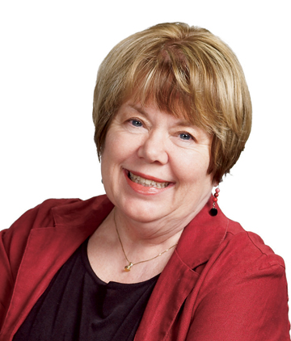
8:30 a.m. Opening Remarks
Ane Deister
Executive Director,
Urban Water Institute
Urban Water Institute Spring Water Conference:
February 19 - February 21, 2020

Slide 4
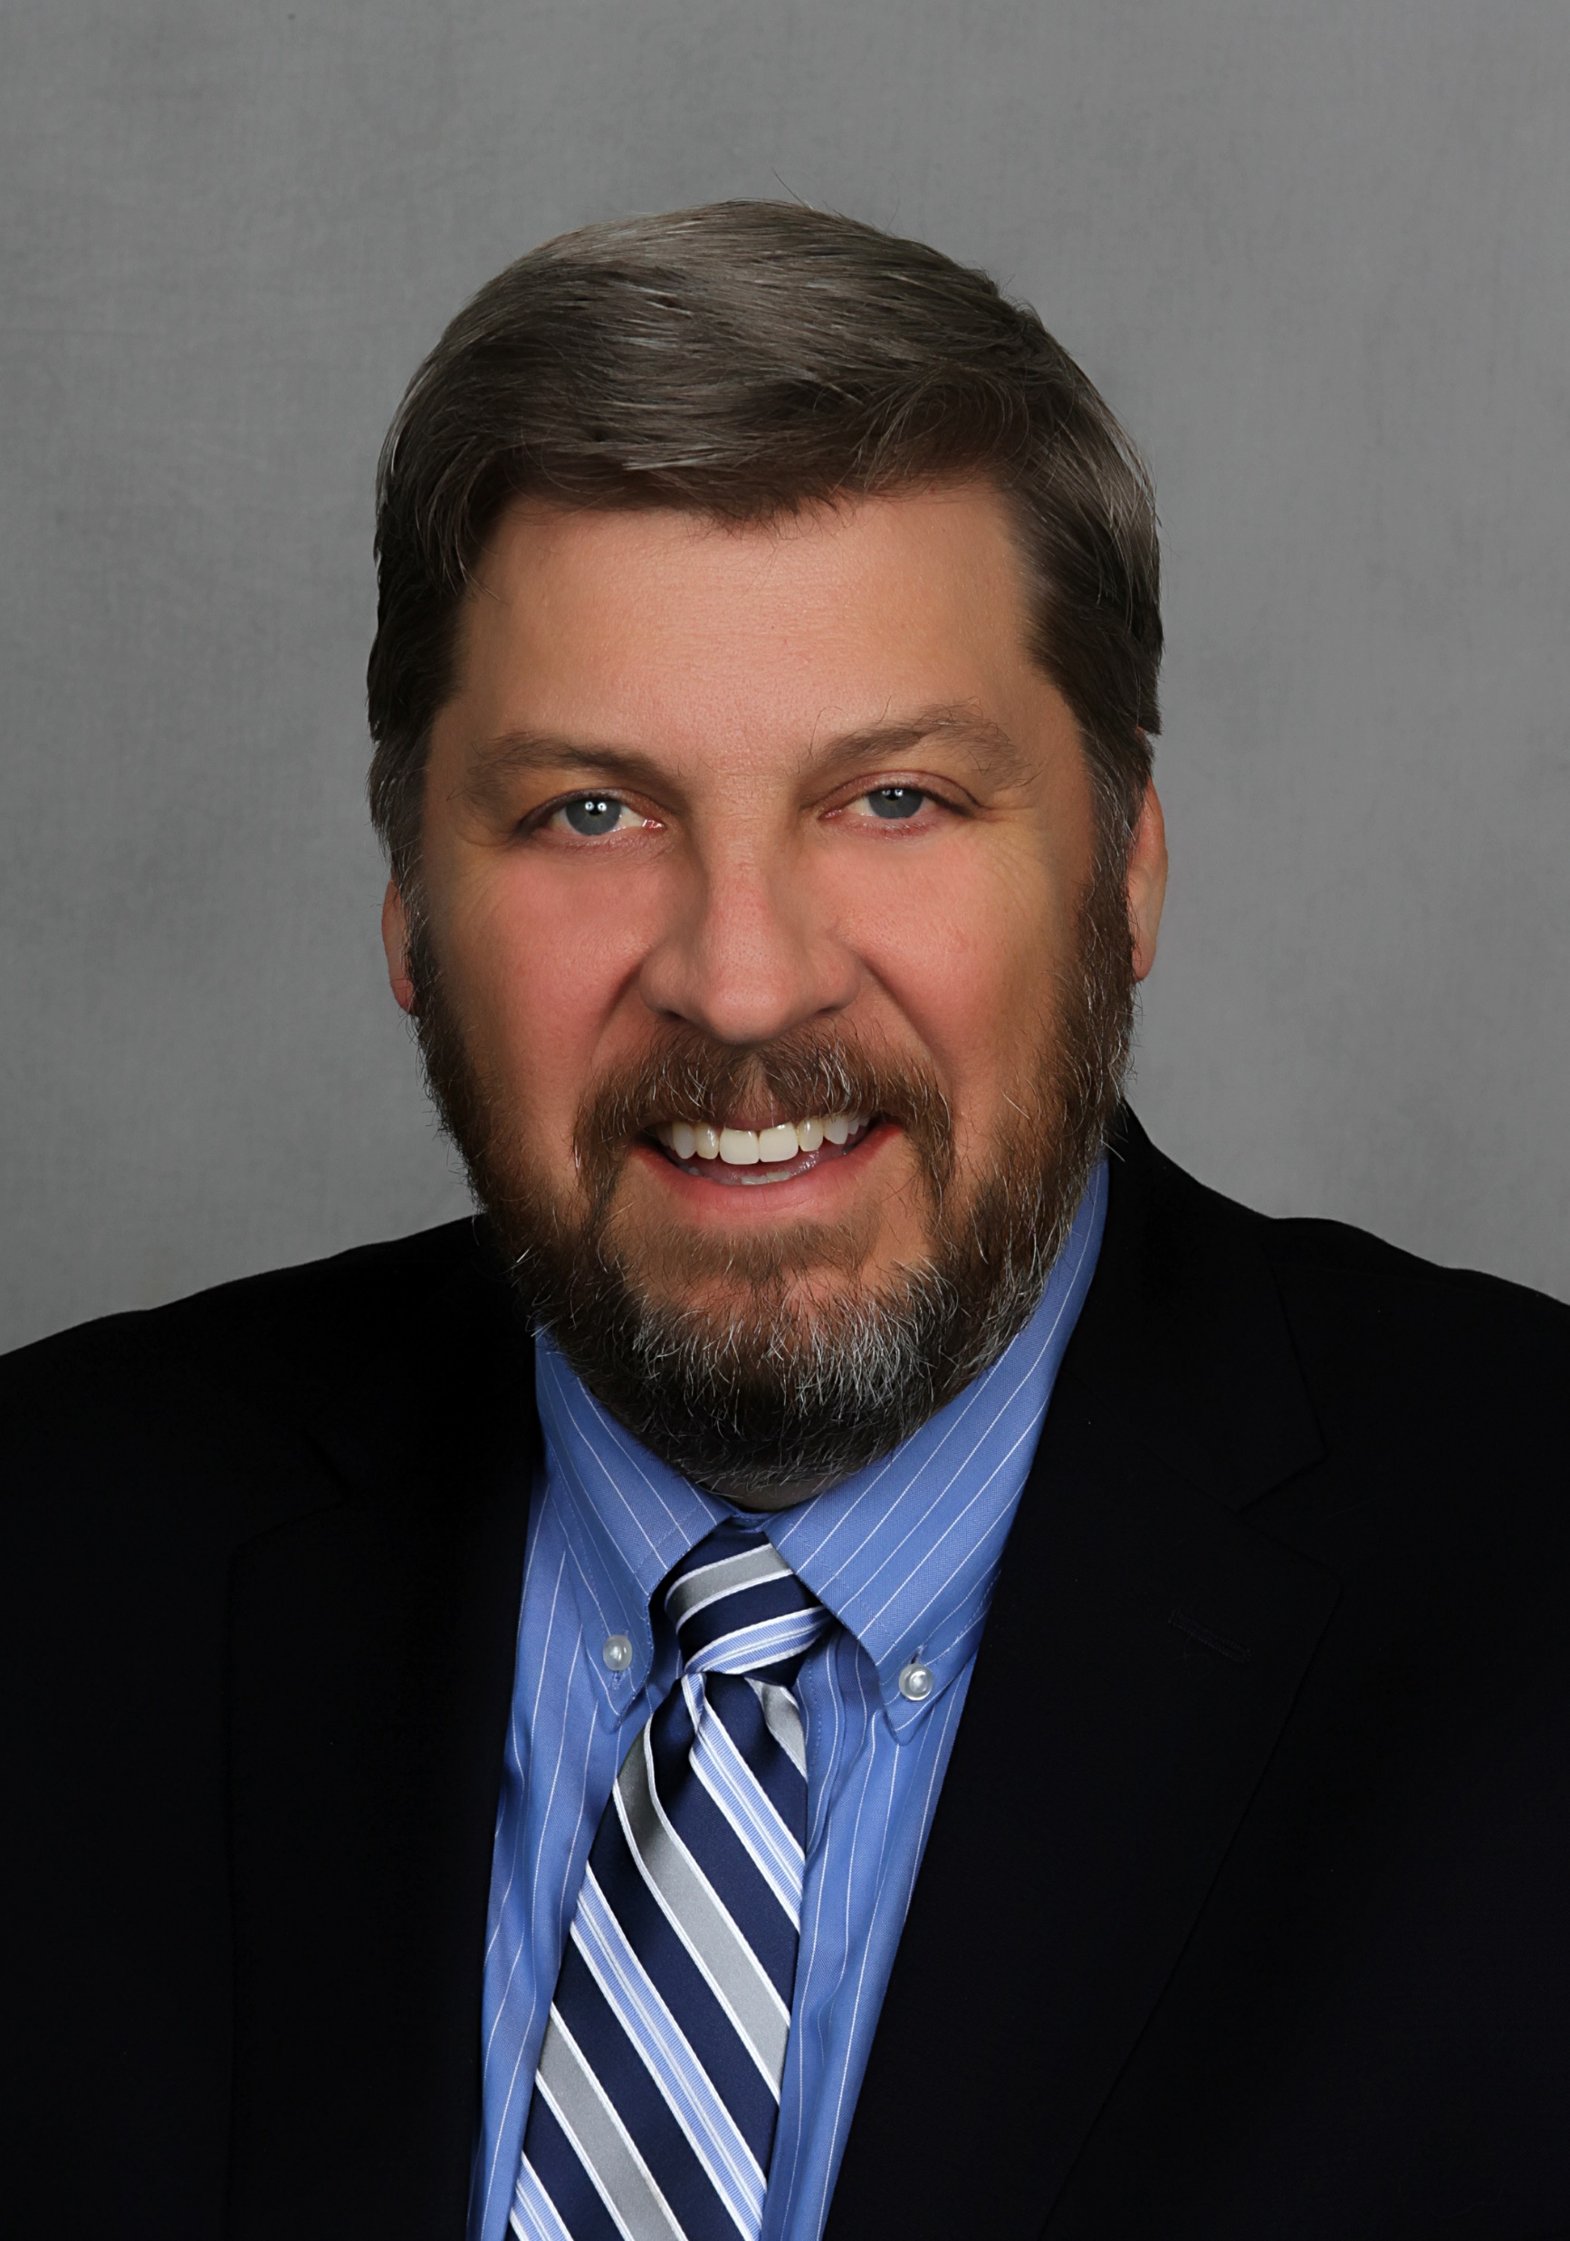
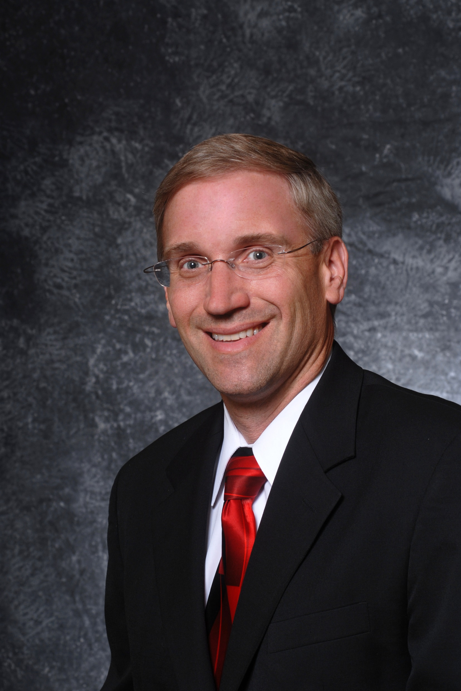
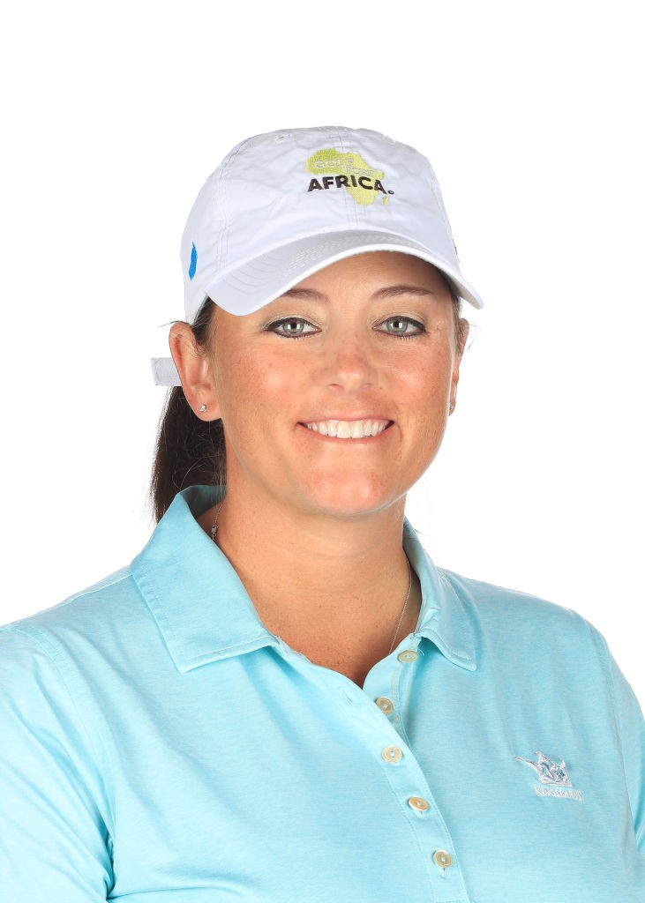
8:45 a.m. – Filling Buckets with Talents, Time and Treasure
Unsung heroes are helping people, communities and nations deliver clean, safe water where there is neither. Stories are inspirational and a tribute to those who give willingly to help others in need.
Moderator:
Matt Stone
General Manger,
Santa Clarita Valley Water Agency
Doug Headrick
Board Member,
Lifewater International
Kendall Dye
Board Member,
Golf Fore Africa,
LPGA
Urban Water Institute Spring Water Conference:
February 19 - February 21, 2020

Slide 5
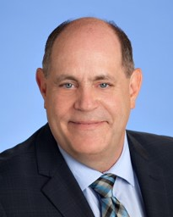
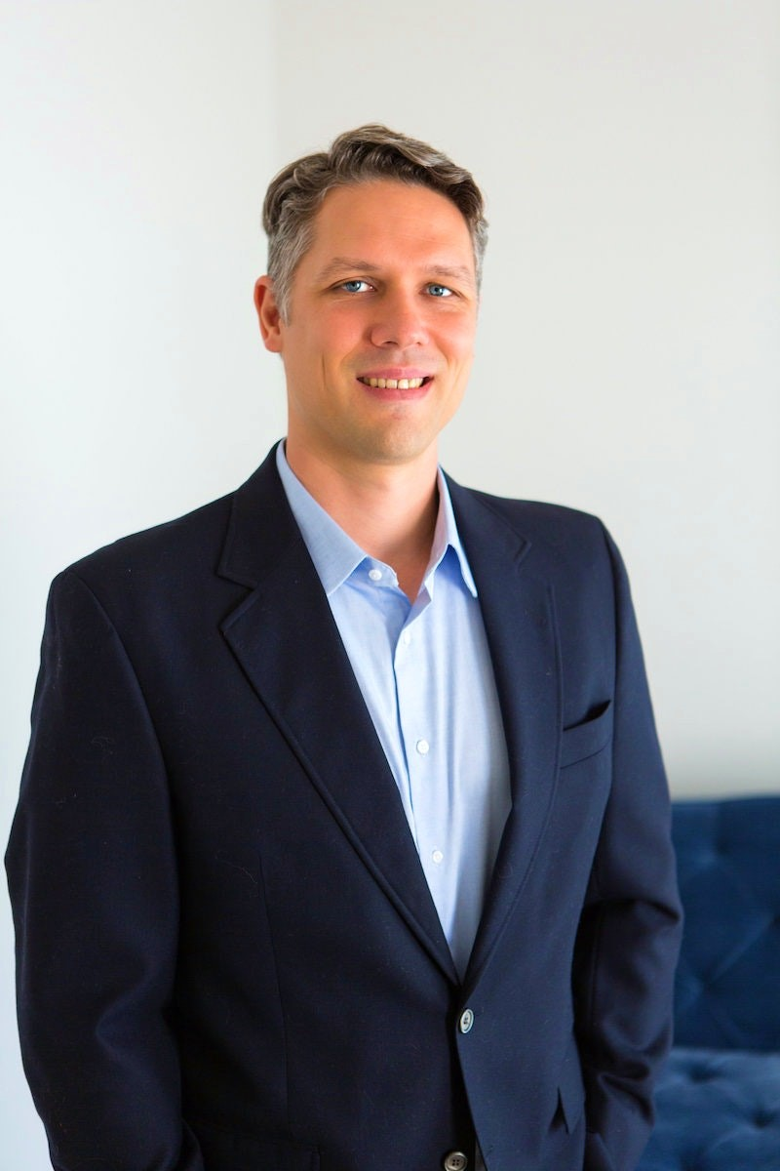
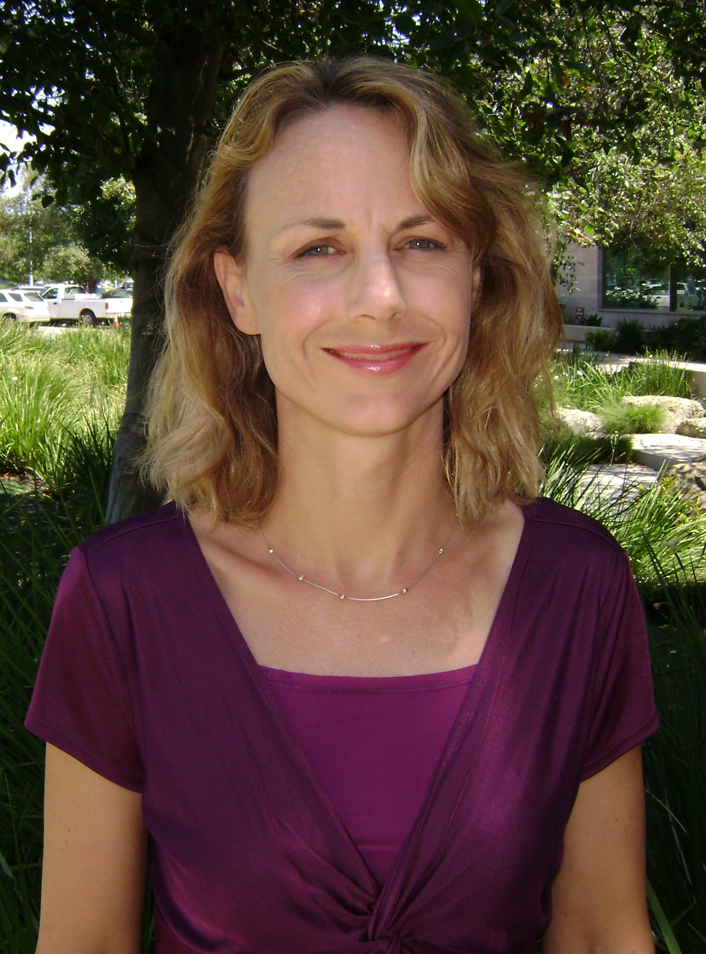
9:30 a.m. – The State of the State Programs Affecting the Water Utilities Business
The Delta Conveyance NOP on the street; Governor Newsom moving forward with sustainability. How do they affect utilities?
Moderator:
Rich Nagel
Vice President,
Jacobs
Erik Ekdahl
Water Rights Division,
State Water Resources Control Board
Fiona Sanchez
Director of Water Resources,
Irvine Ranch Water District
Urban Water Institute Spring Water Conference:
February 19 - February 21, 2020

Slide 6
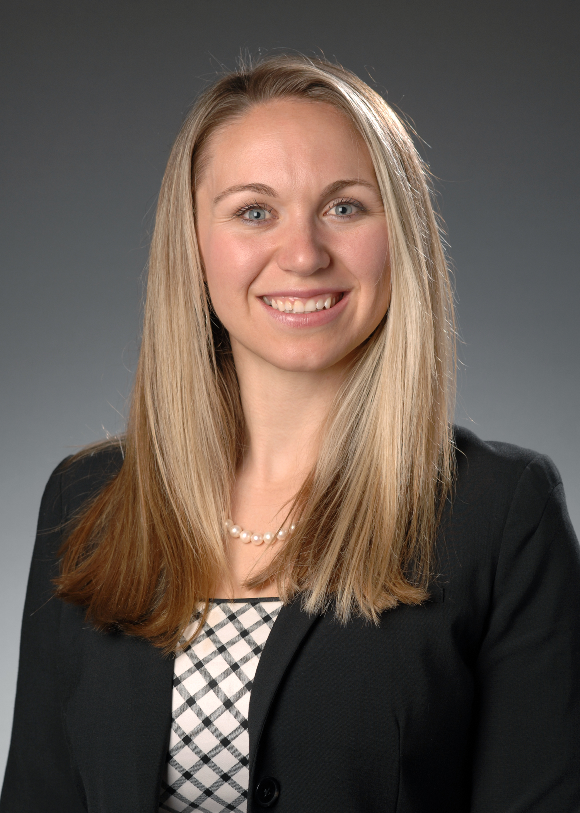
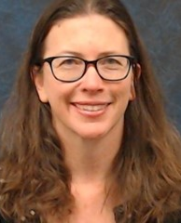
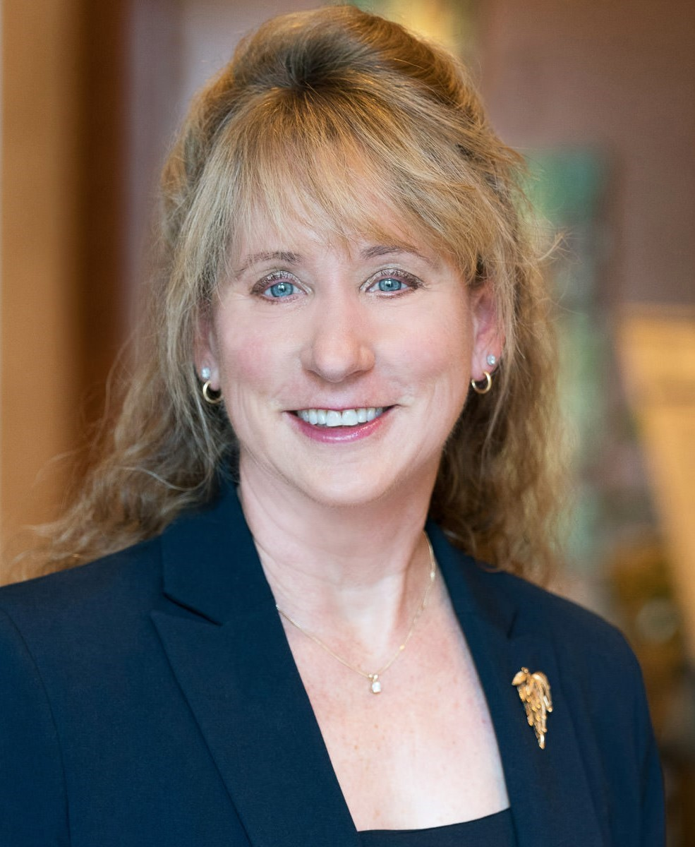
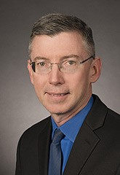
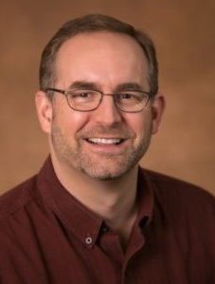
10:15 a.m. – Regional Reliability Through Partnerships and Collaborations
Meeting today’s water demands sometimes takes a village—several organizations working with a combined commitment and mutual goals. Some examples will be shared.
Moderator:
Andree Hunt-Johnson
Sr. Water Resources Engineer,
BAWSCA
Maureen Martin
Special Projects Manager,
Contra Costa Water District
Amy Holm
Executive Director,
The Climate Registry
Brad Coffey
Group Manager of Water Resource Management, Metropolitan Water District
Kirk Westphal
Water Resources Leader,
Brown & Caldwell
Urban Water Institute Spring Water Conference:
February 19 - February 21, 2020

Slide 7
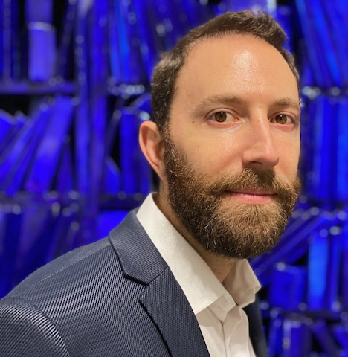
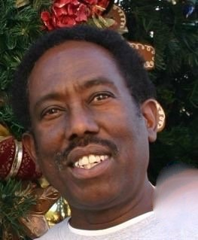
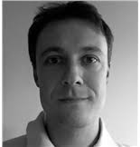
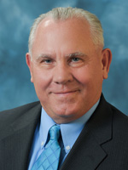
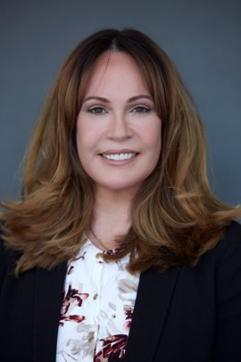
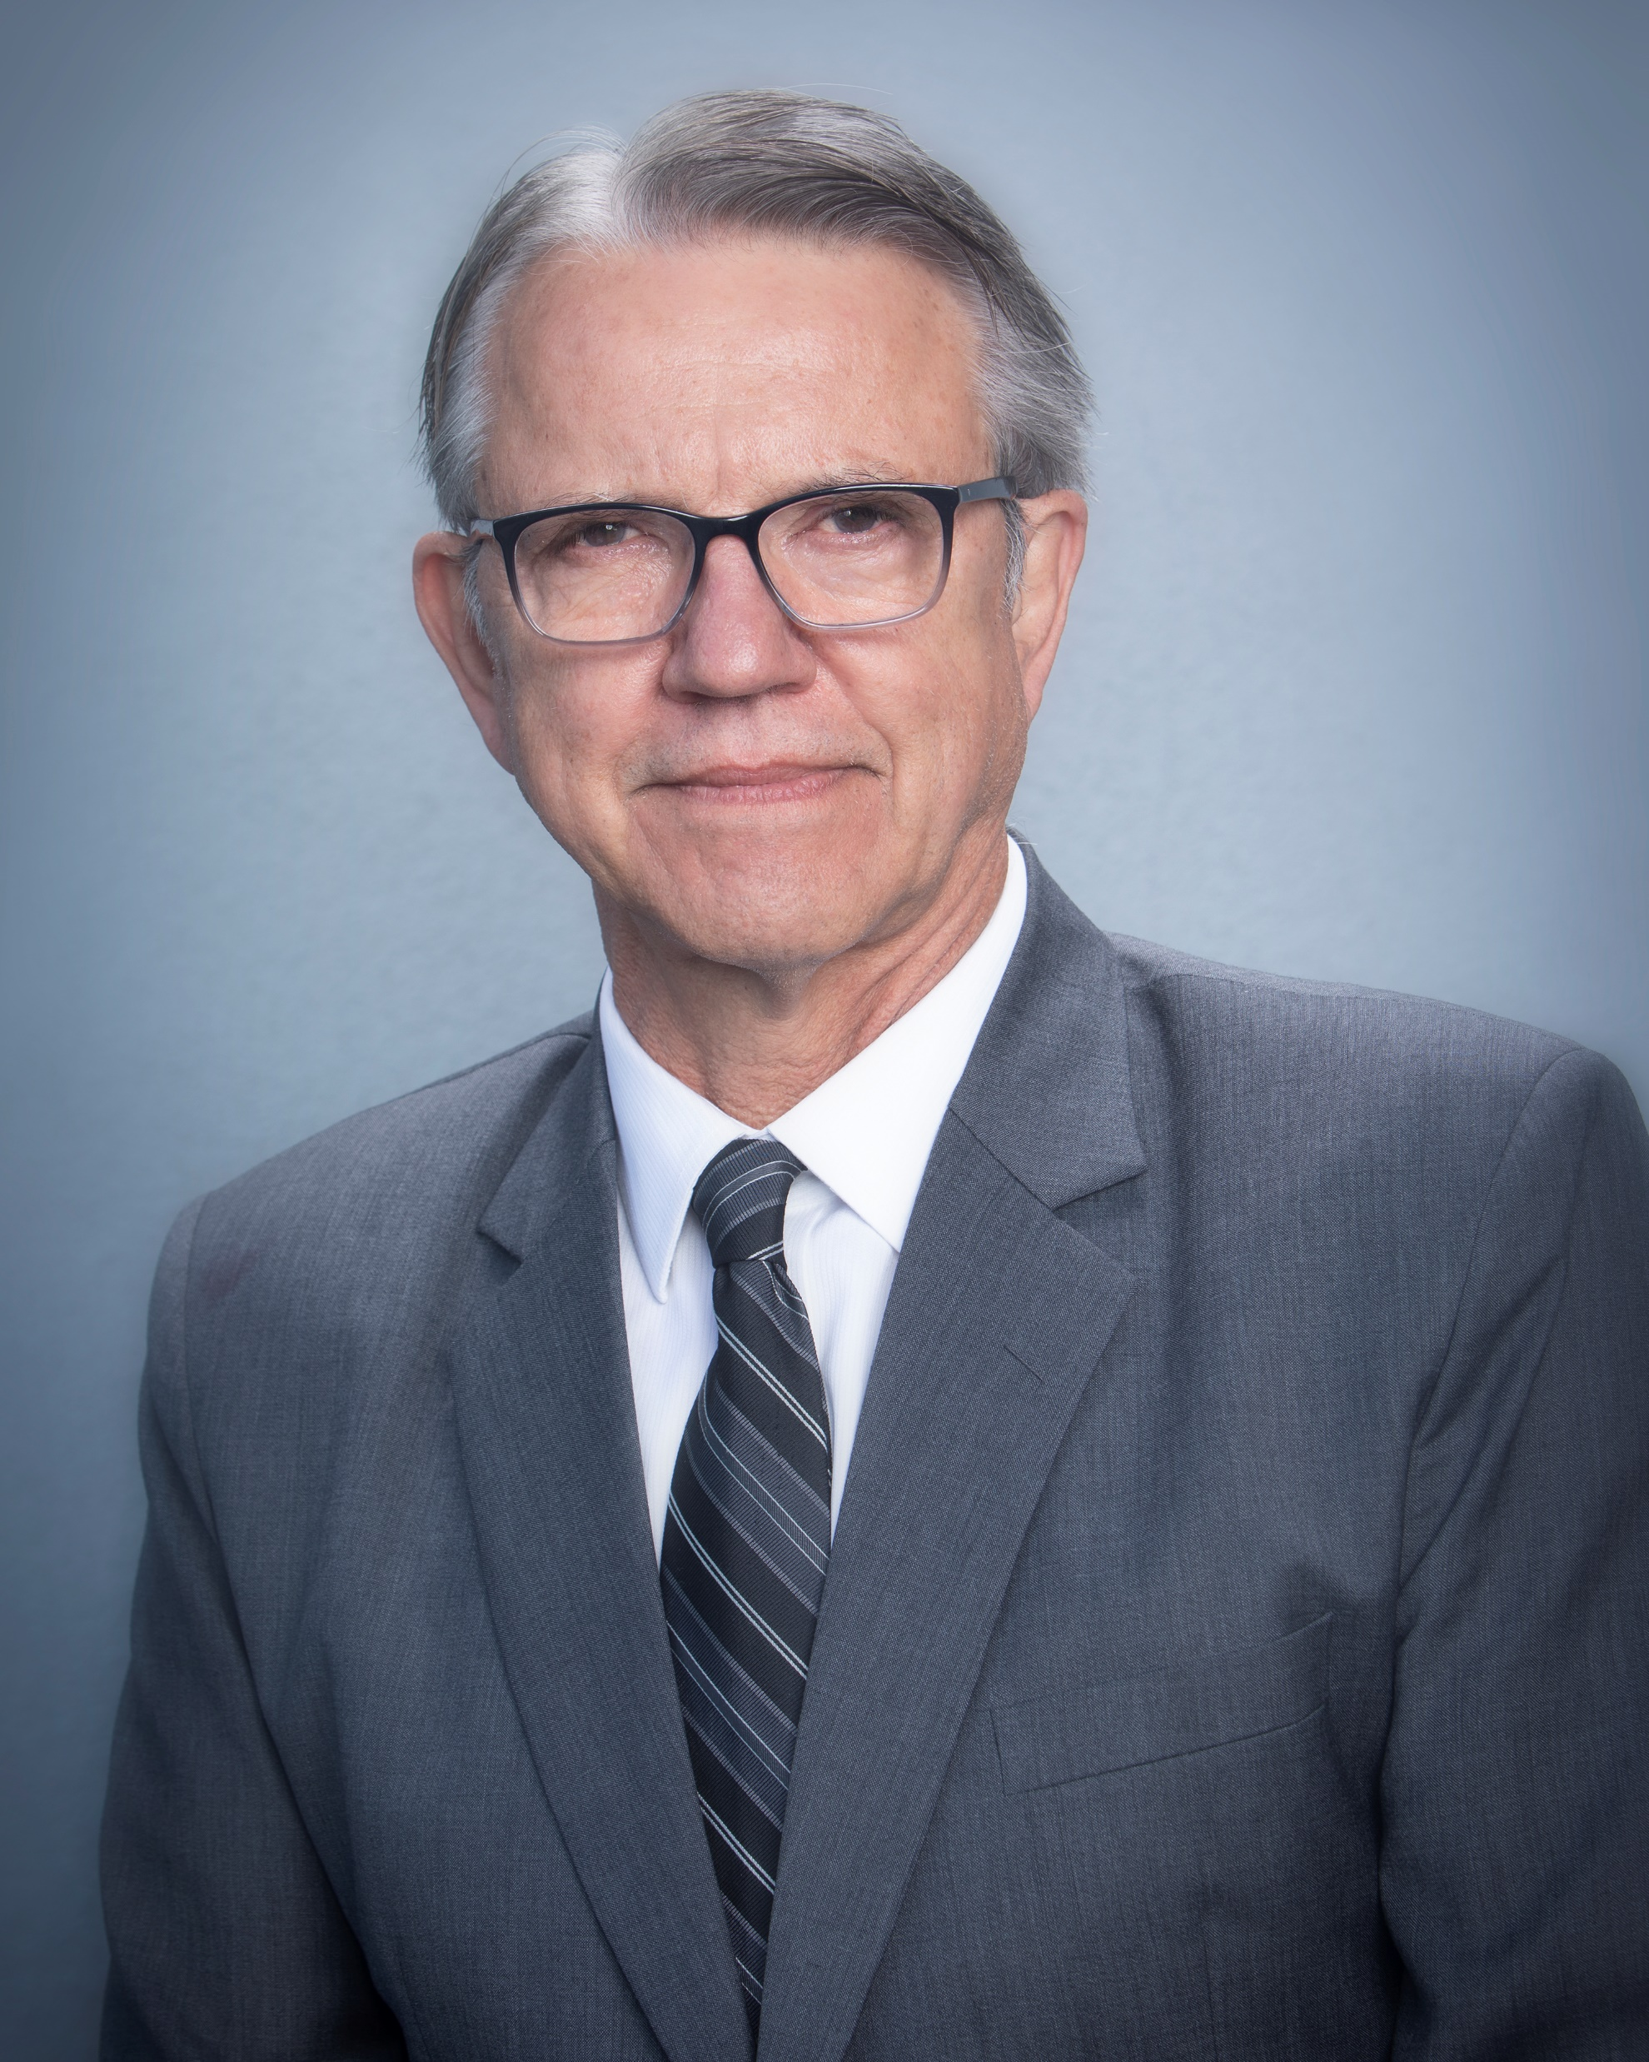
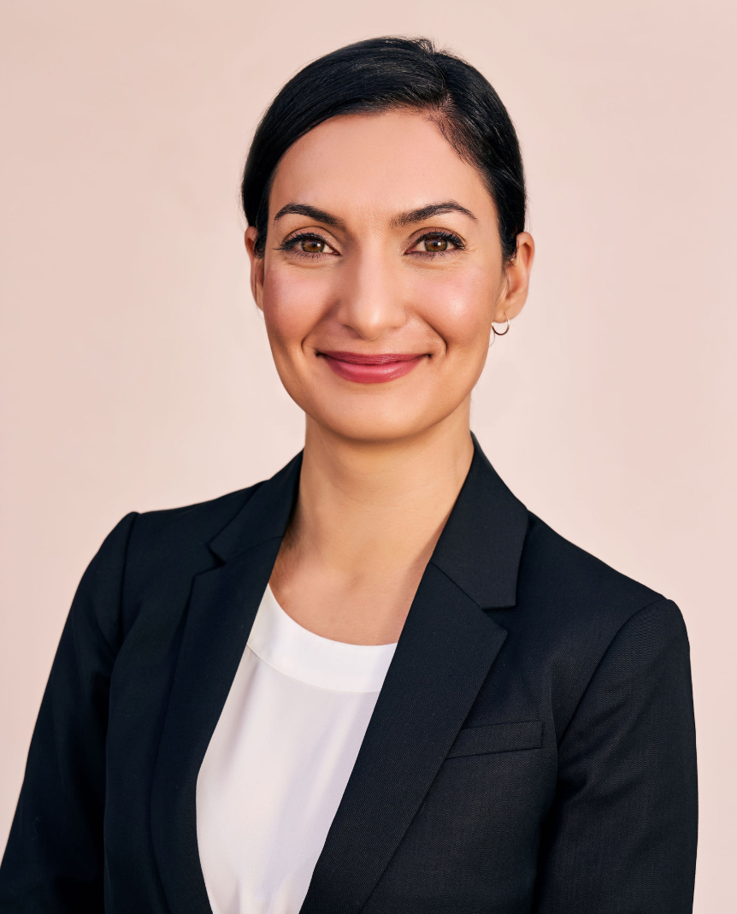
11:15 a.m. – Who’s Swimming with the Sharks? It's 2020, twenty years into the 21st century, and while we fiddle with our smart phones, we're still struggling with how to bring new technology into our water and wastewater systems. "We've always done it this way" is our battle cry. But there continue to be brave folks trying to make things better for us and our customers. Welcome three of these intrepid entrepreneurs pitching their ideas in front of a panel of wizened water warriors. Sit back and enjoy today's trip into the Shark Tank!
Presenters:
Adam Stein
CEO,
Advantageous Systems LLC
Charles Jennings
General Manager,
Jenfitch Inc.
Dan Angelescu
CEO,
Fluidion US Inc.
Moderator:
Greg Quist
Board of Directors,
Rincon del Diablo
Water District
Judges:
Lisa Ohlund
General Manager,
East Orange County Water District
Bob Siemak
Assistant General Manager,
Water Conservation District
Cristina Ahmadpour
President,
Isle Utilities

Slide 8
Chairman’s Raffle!
Series 5 Nike Apple Watch!!
Urban Water Institute Spring Water Conference:
February 19 - February 21, 2020

Slide 9
Conference Adjourns. Thank You For Joining Us!

