Slide 2
Thank You To Our Buffet Breakfast Sponsor Western Municipal Water District
8:00 a.m.

Slide 3
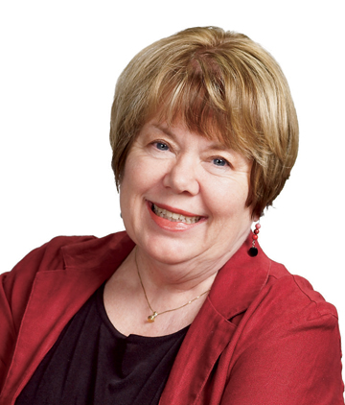
8:15 a.m. Opening Remarks Short conference report card, lessons learned, and introduction to the final day of conference.
Ane Deister
Executive Director,
Urban Water Institute

Slide 4
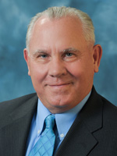
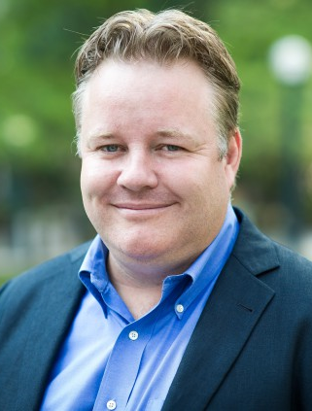
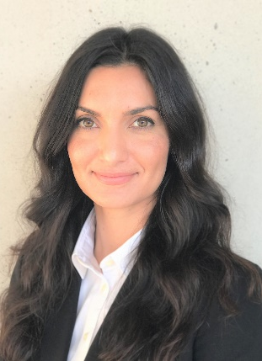
8:30 a.m. – Show Me the Money!
Who’s Investing in Water and Why
Private investors are staking out the water industry as a new gold mine for economic returns. Learn from the experts why they see this as a thriving new investment market, who’s in the game, and how they decide to
invest or not invest.
Moderator: Greg Quist
Board Member,
Rincon del Diablo Municipal Water District
David Henderson
Partner,
XPV Water Partners
Cristina Ahmadpour
President,
ISLE Utilities
Mark Lambert
Former President,
IDE Technologies America

Slide 5
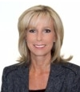
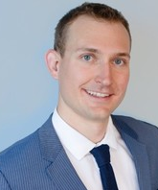
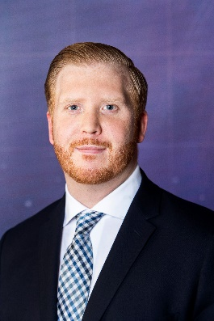
9:30 a.m. – Nasdaq Veles Calif: Water as a Commodity
California has a robust water transfer market that helps agencies accommodate changing demands, and address supply variability. However, unlike nearly every other segment of the United States economy, the water market has been largely ignored by the financial sector - until now. How can the introduction of a new exchange-traded financial product deliver value for water managers?
Moderator:
Shelley Sorsabal
Board President,
Antelope Valley - East Kern Water Agency
Matt Payne
Principal,
WestWater Research
Patrick Wolf
Senior Product
Development Specialist,
Nasdaq Global Indexes

Slide 6
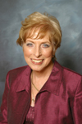
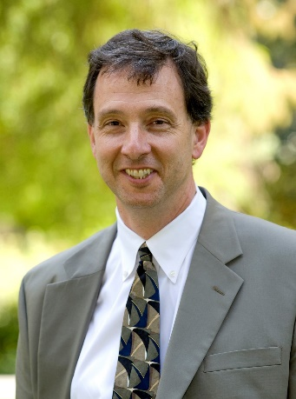
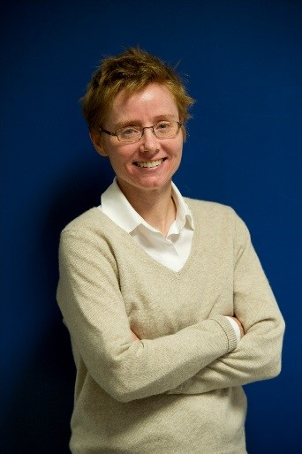
10:15 a.m. – Policy, Pivots, Planning, and Plumbing –
An Update on the Bay Delta
A new chapter has opened in the Bay Delta saga with the recent Newsom administration’s shift to a single tunnel concept for a Delta Conveyance Project. Our moderator and panelists will provide an update from the policy perspective as well as some pragmatic next steps for the necessary planning, permitting, preliminary design an environmental review for a Delta Conveyance Project.
Moderator:
Mary Aileen Matheis
Board Member,
Irvine Ranch Water District
Alf Brandt
Senior Counsel to the Speaker,
California State Assembly
Kathryn Mallon
Executive Director,
Delta Design and Construction Authority

Slide 7
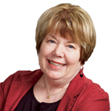
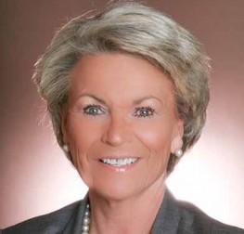
11:15 a.m. – Tell It Like It Is
The venerable Pat Mulroy will share her thoughts and insights in her own way – as she has been doing for more than 3 decades
Introduction: Ane Deister
Executive Director,
Urban Water Institute
Pat Mulroy
Former General Manager,
Southern Nevada
Water Authority

Slide 8
12:00 p.m. – Chairman’s Raffle!
Nike Apple Watch!!

Slide 9
Conference Adjourn. Thank You For Joining Us!

