Slide 1
WASHINGTON UPDATE
INFRASTRUCTURE, DROUGHT AND CLIMATE RESILIENCY
URBAN WATER INSTITUTE
28TH ANNUAL CONFERENCE
PRESENTED BY
ERIC SAPIRSTEIN
ENS RESOURCES, INC.
SEPTEMBER 9, 2021

Slide 2
THE ISSUES
Infrastructure Funding
Reconciliation
Fiscal Year 2022 Appropriations
Impose New Focus on Federal Assistance
Disadvantaged and Underserved Communities
Buy America(n)

Slide 3
Mike Luckovich Editorial Cartoon used with permission of Mike Luckovich and Creators Syndicate. All rights reserved.

Slide 4
INFRASTRUCTURE
BUILDING FOR A RESILIENT FUTURE
Senate H.R. 3684 Creates Five Year Funding Stream for Water Programs
House Vote End of September
Key Program Funding Commitments
Core Wastewater and Drinking Water SRF
Western Water and Drought
Disadvantaged Communities
Flood Protection and Resilience
Key Program Authorizations

Slide 5
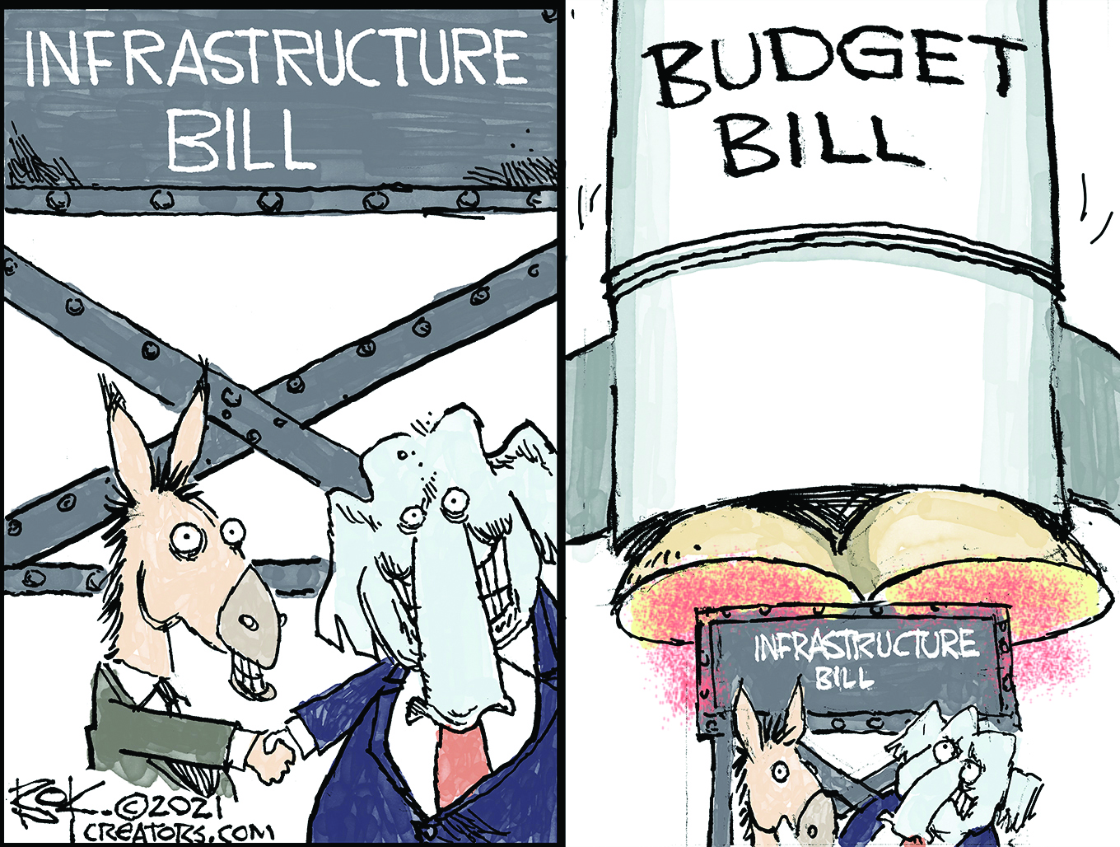
Chip Bok Editorial Cartoon used with permission of Chip Bok and Creators Syndicate. All rights reserved.

Slide 6
RECONCILIATION
Filling in the Blanks
$3.5 Trillion Soft Infrastructure
September 15 Deadline for Committees Recommendations
House and Senate Vote on Final Reconciliation Measure
Outlook for Reconciliation
Progressives vs. Centrists
“President” Manchin Rules Senate
Democrat Only
Lisa Benson Editorial Cartoon used with permission of Lisa Benson,
the Washington Post Writers Group and the Cartoonist Group.
All rights reserved.
Notes:
Water. Total: $3.575 billion
Indian Water Rights Settlement
Extension $2,000,000,000
Emergency Drought Relief $650,000,000
Salton Sea Restoration $250,000,000
4
Water Resources Research Institutes $75,000,000
Federal Priority Stream gauges $150,000,000
Snow Water Supply Forecasting $50,000,000
Water Technology Investment $50,000,000
Aquatic Ecosystem Restoration $250,000,000
Large Scale water Recycling and Reuse $100,000,000d

Slide 7
Steve Kelley Editorial Cartoon used with permission of Steve Kelley and Creators Syndicate. All rights reserved.

Slide 8
FISCAL YEAR 2022 APPROPRIATIONS
And There’s More Than Just The Infrastructure Bill
House and Senate Water Programs Robust Funding
Earmarks Process Worked
Key Take Aways
Strong Support for Core Water Infrastructure
Funding for Drought Emergency and Wildfires
Focus on Disadvantaged/Underserved Communities
Climate Resiliency Programs
Continuing Resolution….Like Death and Taxes…Inevitable

Slide 9
OTHER MATTERS
Wildfire Risk Mitigation
$5.5 Billion of which
$3.4 B for thinning, prescribed burns and collaborative projects
$2.1 B for good neighbor projects
Categorical exclusion for permits (water infrastructure pipelines)
Debt Ceiling Increase
Funding Projects: Next Steps
Notes:
$5.5 billion over five years for wildfire risk mitigation.
$3.4 billion would be directed to the U.S. Forest Service and the U.S. Department of the Interior to reduce the threat of wildfire on federal lands through mechanical thinning, timber harvests, prescribed burns, community wildfire protection grants and collaborative led projects.
$2.1 billion for ecosystem restoration through Good Neighbor Agreements, invasive species eradication, cross-boundary management projects and stewardship contracts.
New categorical exclusion for forest management activities to establish fuel breaks to protect critical infrastructure from wildfire, including roads, water infrastructure, pipelines and transmission lines.
Energy Supply Resiliency
$5 billion for the USDOE to establish a grant program to support activities that reduce the likelihood and consequence of impacts to the electric grid due to extreme weather, wildfire, and natural disaster.

Slide 10
WASHINGTON UPDATE
INFRASTRUCTURE, DROUGHT AND CLIMATE RESILIENCY
URBAN WATER INSTITUTE
28TH ANNUAL CONFERENCE
PRESENTED BY
ERIC SAPIRSTEIN
ENS RESOURCES, INC.
SEPTEMBER 9, 2021

