Slide 1
Urban Water Institute
State Legislative Update
September 9, 2021

Slide 2
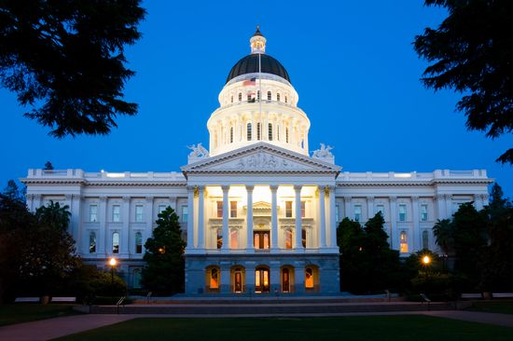
Legislative Calendar
Appropriations Committee deadline: August 27
Legislative Session ends September 10
Floor Session only: August 30 to September 10
Governor has until October 10 to sign or veto legislation

Slide 3
2021-2022 State Budget Update
Total Budget expenditures set at $262.6 billion
Includes $76 billion of surplus + $27 billion in federal aid
Additional State Budget Details
Over $25 billion in reserve accounts, higher than any level in history
Over $8 billion in economic stimulus payments for low-income individuals
Additional $1.5 billion in small-business assistance grants
$12 billion in new funding for homelessness programs over two-years

Slide 4
2021-2022 State Budget Update
One-Time Investments: Resources
Drought Package: Provides approximately $3 billion to address and get ahead of the emerging drought
Wildfire Package: Provides approximately $1 billion over multiple years for various wildfire prevention and response efforts to wildfires
Climate Resiliency Package: Provides approximately $3.7 billion over three years to make needed climate resiliency investments. This is $2.4 billion more than what was proposed in the Governor’s May Revision

Slide 5
2021-2022 State Budget Update
Drought Package: AB/SB 170
Total of $855 million appropriated in 2021-2022 (Total Water Resilience Package estimated at $4.6 billion)
$120 million for continued SGMA implementation
Increases to overall funding amounts from the adopted Budget
$30 million to the State Board for PFAS support
$115 million for groundwater cleanup and recycling

Slide 6
2021-2022 State Budget Update
Natural Resources: AB/SB 155
CEQA exemptions for native fish and wildlife habitat protection projects
Extends the provisions preventing the discontinuing of water service to customers due to nonpayment to December 31, 2021
Establishes specific reporting requirements for water extractions and diversions

Slide 7
2021-2022 State Budget Update
Climate Resiliency: AB/SB 155 & AB/SB 170
Makes $500 million available for the protection and restoration of coastal and ocean resources – Sea level rise/climate change
Extreme heat and community resilience center funding
Multi-benefit nature-based solutions funding

Slide 8
2021-2022 State Budget Update
Wildfire: AB/SB 155 & AB/SB 170
Appropriates roughly $1 billion in total for 2021-2022
$282 million for wildfire fuel breaks
$541 million for Healthy and Resilient Forests and Landscapes
$120 million to CalFire for fire prevention grants.

Slide 9
Natural Resources Trailer Bill (AB/SB 148)
Water and Wastewater Arrearage Payment Program (CWWAPP)
Includes $985 million in funding for a drinking water and wastewater arrearage program
State Water Board is currently conducting a review of the statewide need and establishing guidelines for applications
Water agencies will have 60 days to apply for the funding
Funding to be distributed on a proportional basis: Water > Wastewater
Water agencies are required to allocate payments directly to customer accounts within 60 days of receiving funds
Timeline for disbursement of funds is from November 1, 2021 to January 31, 2022

Slide 10
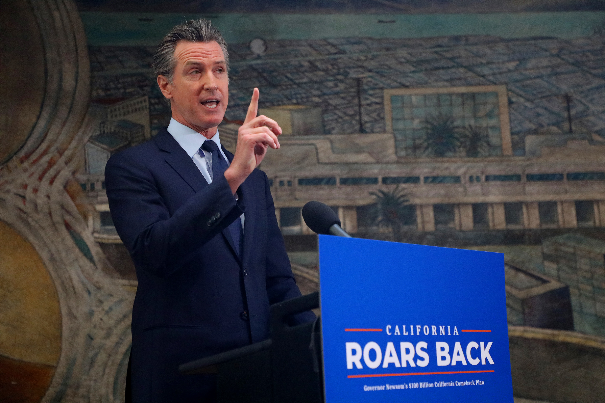
Additional State Updates
Recall election set for September 14, 2021
Eviction moratorium extended until September 30, 2021
Cal/OSHA guidelines for workplace regulations relaxed
In July, some counties began to issue stricter guidance

Slide 11
AB 361 (Rivas) – Open Meetings/Teleconferences
Details
Allows local agencies to use teleconferencing for public meetings without complying with specific Brown Act restrictions in certain state and local emergencies
Status
Currently on the Senate Floor
Local agencies would be required to declare at a public meeting that in-person meetings would present imminent risks to the health or safety of attendees
Includes significant protections for public access and public comment during virtual meetings

Slide 12
Potential for Vaccine Mandate Bill
Details
Language released less than two weeks before the legislative session ended
Requires employees to submit proof of COVID-19 vaccination or weekly COVID-19 tests
Would apply to government employees, including local public agencies
Status
Could be introduced next year
Includes medical exemptions for those unable or ineligible to receive the vaccine

Slide 13
Questions?
Thank You
Cori Takkinen
Vice President
CTakkinen@townsendpa.com www.townsendpa.com
Eric O’Donnell
Senior Associate
EODonnell@townsendpa.com www.townsendpa.com

