Slide 1
Drought Response
Urban Water Institute
September 8, 2021

Slide 2
Overview
Marin Water Overview
Current Water Supply
Approach to Drought
Marin Water Overview
2

Slide 3
Marin Water Overview
California’s oldest municipal water district (Chartered in 1912)
Marin County’s largest drinking water provider, serving more than 191,000 people in central and southern Marin
Protecting and preserving 22,000 acres of watershed land on Mt. Tamalpais
3

Slide 4
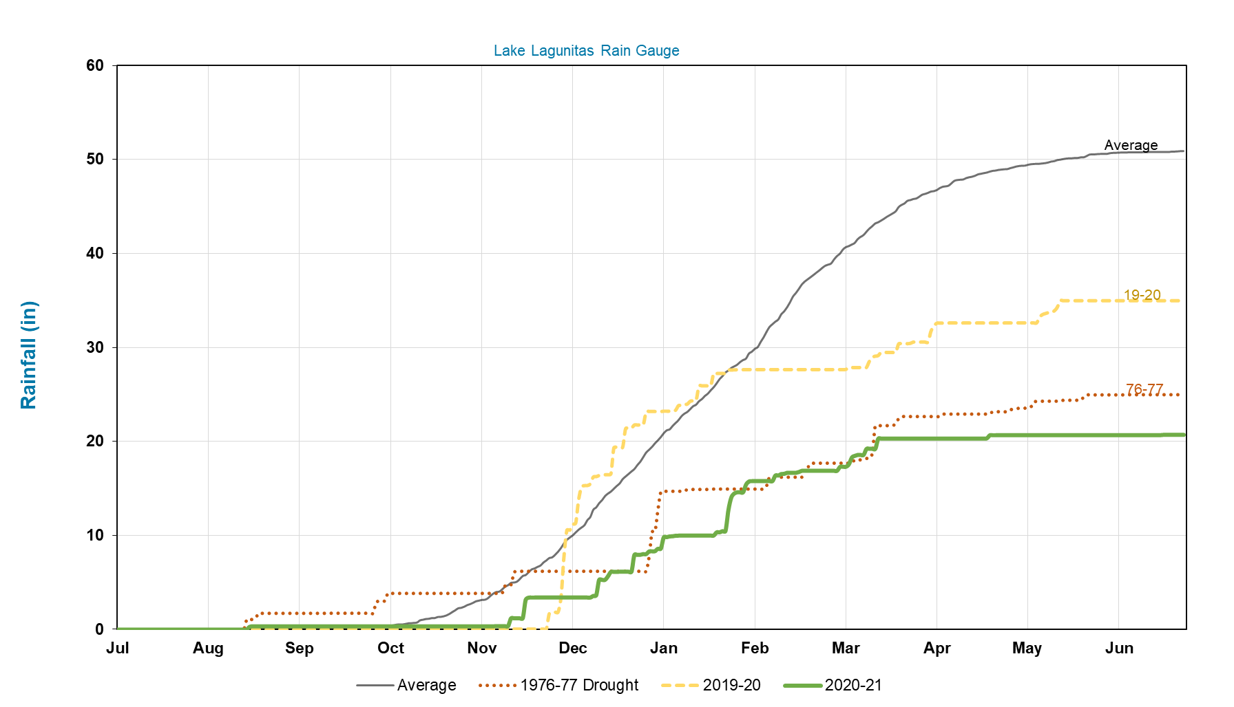
Current Water Supply
Cumulative Rainfall
Two consecutive dry years: 2020 was the second-driest year in 90 years
Historic drought: The last 18 months of rainfall is among the lowest on record in more than 140 years
4

Slide 5
Historical Total Reservoir Storage
September 2021
Notes:
August 3 – 32,300 ac-ft (< 41% of total capacity)

Slide 6
Projected Reservoir Storage
40% conservation savings
Notes:
Local Historical rainfall runoff patterns
Criticality of conservation to save considerable water given uncertainty surrounding rainfall patterns
-noting that at historic average rainfall-runoff amounts, reservoir storage is projected to be in the vicinity of 50,000 acre-feet at the end of next spring, so it will take considerable rainfall to fill the reservoirs and move the district back into a position
Projected Reservoir Storage: Next, moving into projected reservoir storage levels over the next 18 months. Going into the summer and fall months, no rainfall is considered until early October or so. At the same time, irrigation picks up and we expect the next summer months to be a critical opportunity to decrease outdoor water use and save that water. As shown here in the dashed blue line, without conservation, we project around 25,000 ac-ft if we receive 50% of normal rainfall in the early fall winter months. With conservation, significant impact can be on storage levels be seen here on the solid blue line, up around 30,000 ac-ft, and that is really contigent on IF WE ARE ABLE TO REACH OUR TARGET.
n we’ve seen in past years with more consistent rainfall

Slide 7
Actual vs. Targeted Water Use
27% weekly reduction in water use
21% conservation since May 1st
Notes:
August 3 – 32,300 ac-ft (< 41% of total capacity)

Slide 8
Approach to Current Drought
Customer outreach, education, and support
Water waste restrictions and outdoor irrigation limitations
Continue and enhance voluntary indoor water usage savings, moving to allotments/penalties
Pursue opportunities to augment water supply

Slide 9
Residential Targets for Indoor Use
Most Efficient
Opportunity to Conserve
On Track
0
35 gpcd
55 gpcd
*gpcd = gallons per capita per day

Slide 10
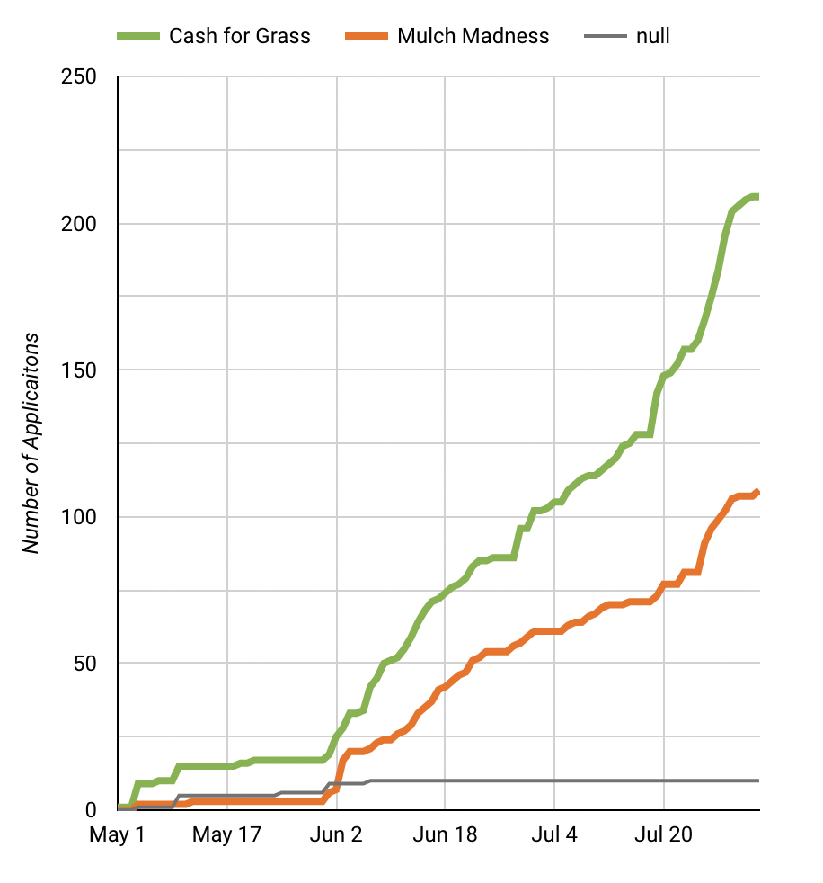
Marin Water’s Conservation Programs & Incentives
Rebates/Incentives
Direct Metering Flume
Rain Barrel/Cistern
High Efficiency Clothes Washer
Graywater
Hot Water Recirculating System
Pool and Spa Cover
Turf Replacement
Focus Groups/High Water Users
Landscape professional training

Slide 11
Emergency Drought Project Planning
Scenario based on:
Actual runoff from 2020-2021
20% Conservation
40% Conservation
Uncertainty
Unusable

Slide 12
Emergency Drought Projects
Desalination – 3.6 TAF (3.6MGD)
Water Transfers – 15 TAF (13.5 MGD)
Project Component | Cost Range
Operational Cost | $5M - $7M
Capital Improvements | $25M - $30M
Total | $30M - $37M
Project Component | Cost Range
Water Purchase and Wheeling | $10M - $18M
Capital Improvements | $50M - $70M
Total | $60M - $88M
Project delivery 12 months
Capacity limited
No desalination facilities have been constructed in SF Bay
Costly, temporary
Project delivery 12 months
Capacity adequate
Costly, long-term resilience

Slide 13
33 days
29 days
62 days
74 days
8 days
2021
Jun
Aug
Oct
Dec
Feb
Apr
Jun
2022
Assess options
Negotiate terms
Approve agreements
Water Transfer
Option payment
Regulatory processes: SWRQCB, CEQA, NEPA, USBR (any or all)
Call date
First water
Pipeline
Planning
Verify feasibility
CEQA
Today
Jun 1 - Jul 15
Jul 9 - Jul 20
Authorize design phase
Jul 20 - Aug 27
Advertise for material purchases (pipe, valves, pumps, etc)
Award purchase contract(s)
Aug 20 - Nov 15
Fabrication of materials
Pipeline Design & Construct
Design
Jun 1 - Sep 12
Advertise for construction bid(s)
Award construction contract(s)
Construct
indicates Board decision required
13

Slide 14
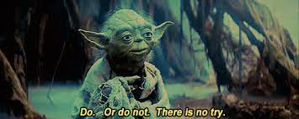
Summary
Taking an “all the above” approach
Regional Collaboration
“Hope for the best,
Plan for the worst”

