Slide 1
“Is the Bay Area Ready for Potable Reuse?1”
Tony Estremera, Director
Urban Water Institute's 25th Annual Water Conference
San Diego, CA
August 24, 2018
Notes:
Talking Points
Santa Clara Valley Water District is at the forefront of water reuse in Northern California.
Our goal is to have 10% of water supply from recycled water.
We are planning an initial phase of potable reuse including 24,000 AFY by 2025.
Non-potable reuse will continue to grow, with a goal of 30,000 AFY.
Combined, that means almost 55,000 AFY of reuse.
Recycled water is extremely important to us because it provides a drought-resistant, locally-controlled water supply.
The four wastewater treatment plants in Santa Clara County process thousands of acre-feet per year of water that could be reused.
The District is working with San Jose, Sunnyvale, Palo Alto and SCRWA.

Slide 2
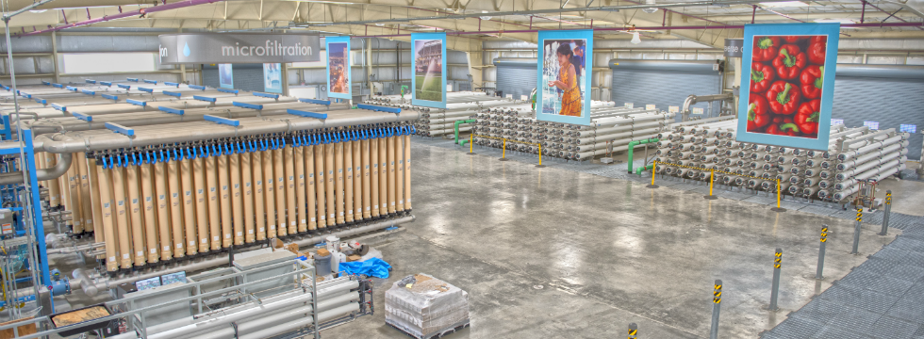
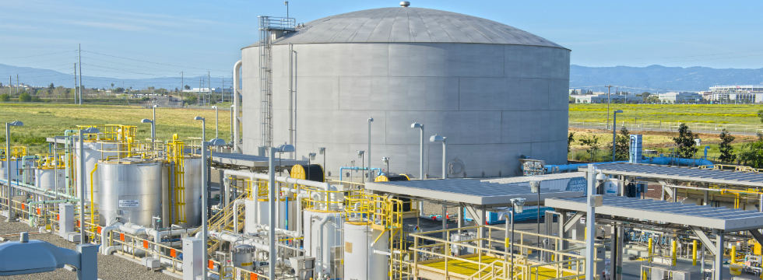
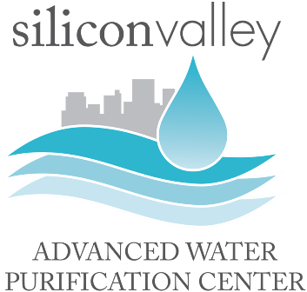
Advanced Treatment Technology
MF-RO-UV-AOP Demonstration at SVAWPC
Wastewater can be cleaned and reused as a sustainable and drought-resistant water supply.
Notes:
Talking Points
The District has institutional arrangements with each producer.
For example, we have partnered with San Jose to build the largest purification facility in Northern California.
The Silicon Valley Advanced Water Purification Center can produce 8 MGD of purified water.
It uses state-of-the-art Microfiltration, Reverse Osmosis, and Ultraviolet Light.
For some smaller communities, 8 MGD would be almost their entire water supply.
For Santa Clara County, our needs are almost 300,000 AFY. So, we consider this a demonstration for even bigger projects in the future.
SVAWPC has been in operation since 2014.
We host many visitors, including international guests.
The facility is tour friendly, and can accommodate visitors to see processes up close.
Our outreach program is accessible to the general public and technical audiences.
We offer taste tests of purified water, which enhances public acceptance.
Being able to see and feel the water reduces the “yuck factor” of recycled water.

Slide 3
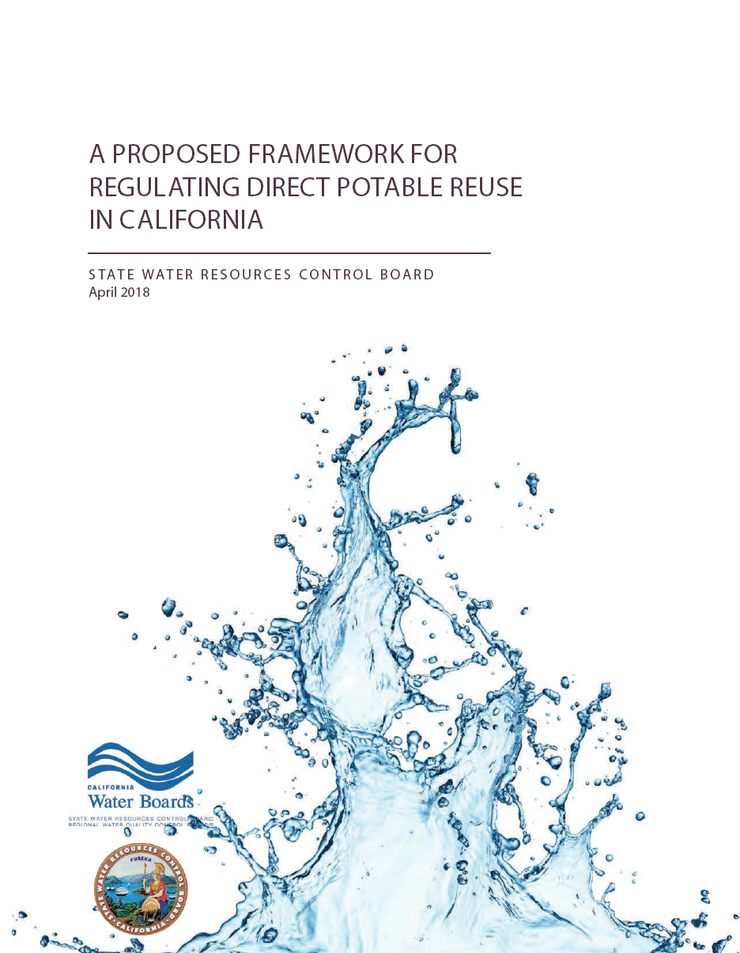
Implementation Framework
Technical, Managerial, and Financial Capacity to Implement Potable Reuse
Regulations exist for Indirect Potable Reuse and are under development for Direct Potable Reuse.
Notes:
Talking Points
There are different types of potable reuse—i.e. Direct and Indirect.
An example of IPR is OCWD Groundwater Recharge System
Many types of DPR are possible. For example, purified water could augment an existing drinking water treatment plant.
DPR could also be “flange-to-flange,” where purified water adds to a treated water distribution system.
The District is investigating many alternatives, and preparing numerous studies for future projects.

Slide 4
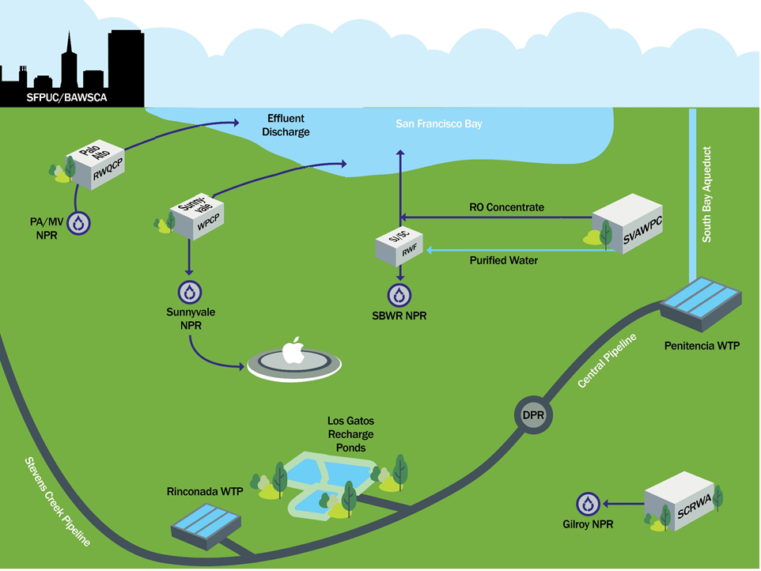
Integrating Existing Systems
Notes:
Talking Points
Future work includes integration of recycled water systems in Santa Clara County.
*CLICK TO SHOW POTENTIAL INTERTIES*

Slide 5
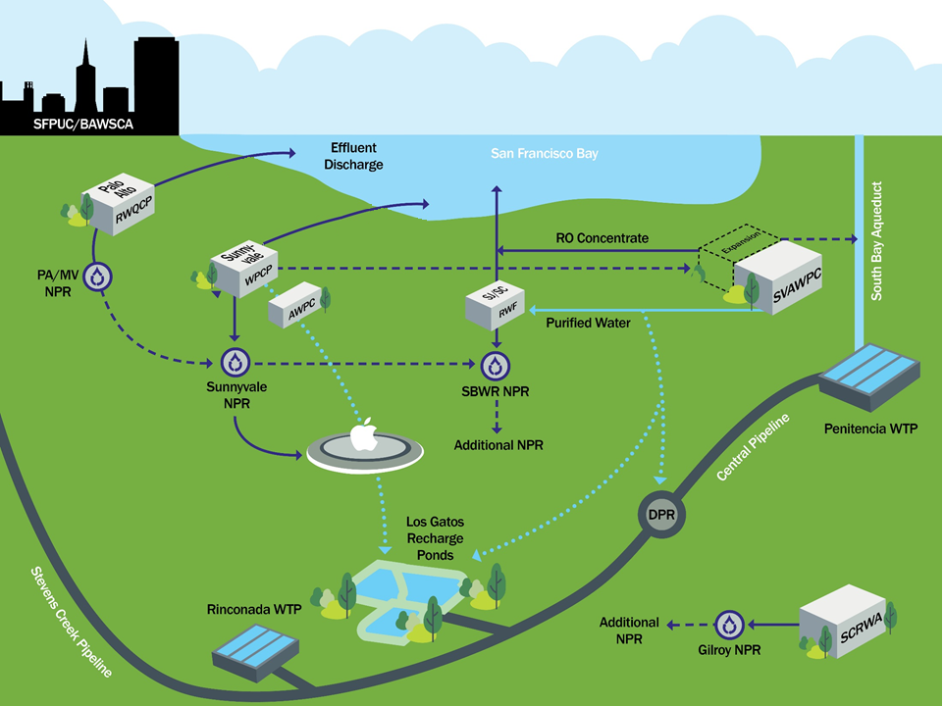
Reuse can be integrated into our water supply infrastructure
Notes:
Talking Points
Potable and non-potable reuse infrastructure can be optimized for efficiency.
District is preparing a Countywide Water Reuse Master Plan to guide investment over the next 20 years.
Preliminary findings will be ready by the end of this year.

Slide 6
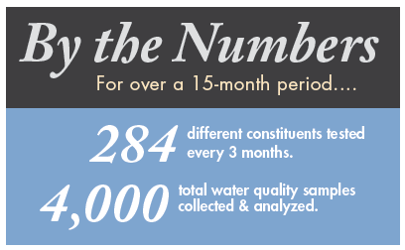
Water Quality Monitoring
Potable Reuse Demonstration Test Plan at SVAWPC, September 2016
Testing at SVAWPC in San Jose demonstrates that purified water exceeds federal and state standards.
Notes:
Talking Points
SVAWPC is also a research test bed. We collaborate on projects internally with District engineers and externally with WateReuse Foundation and universities such as Stanford and UC Berkeley.
A Potable Reuse Demonstration Test Plan encompassed 4,000 samples collected in a 15 month period.
The data generated at SVAWPC is getting us ready to work with regulators for future potable reuse.
We work closely with NWRI through an Independent Advisory Panel that provides input on our program.
The District will be ready for permitting when the time comes.

