Slide 1


Is the Bay Area Ready for Potable Reuse?
Urban Water Institute • August 24, 2018
Paul A. Sciuto, Monterey One Water General Manager

Slide 2

Agenda
What is Pure Water Monterey?
Why was Pure Water Monterey needed?
How did we get here?
What's Happening Today?

Slide 3
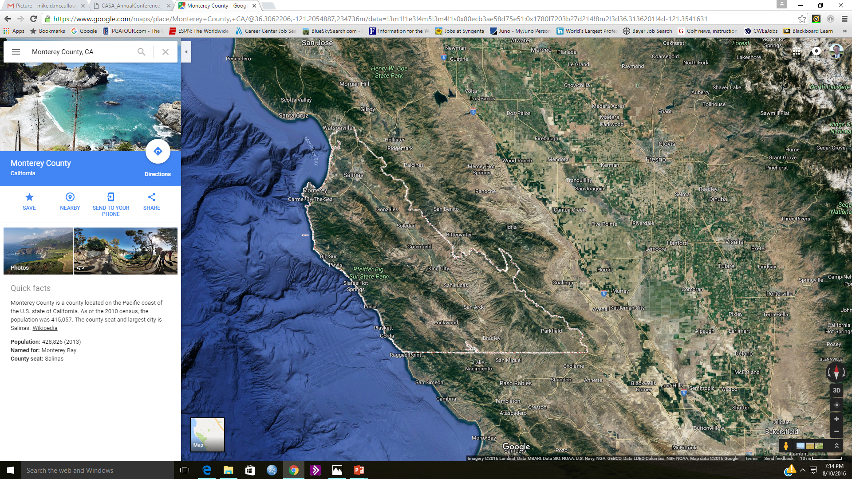
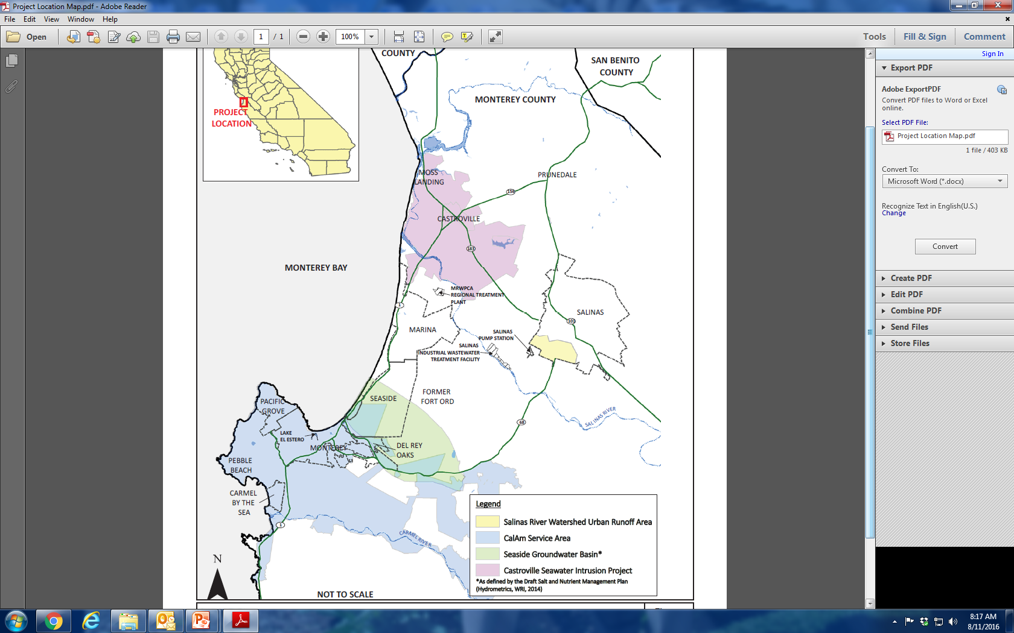
Where We Are

Slide 4
Pure Water Monterey
Advanced purified recycled water project to address water supply needs
Provide 3,500 acre feet/year (AFY) of advanced purified recycled water for injection into the Seaside Groundwater Basin
Utilize unused water for beneficial use (agriculture & urban)

Slide 5
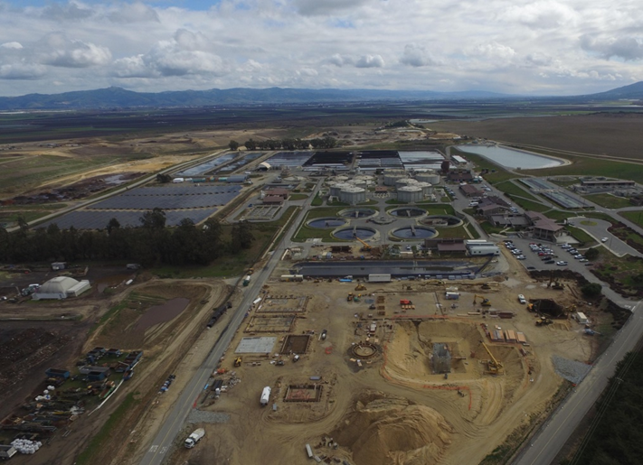
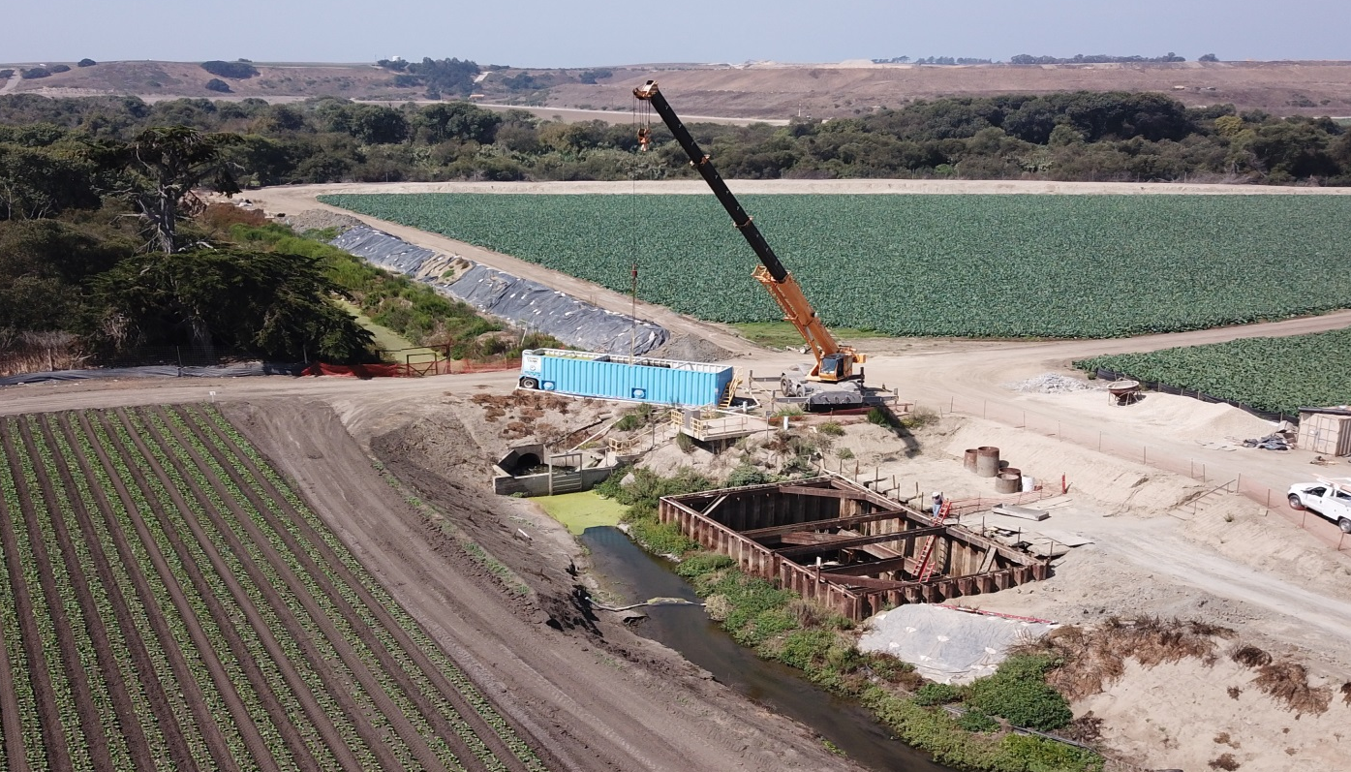
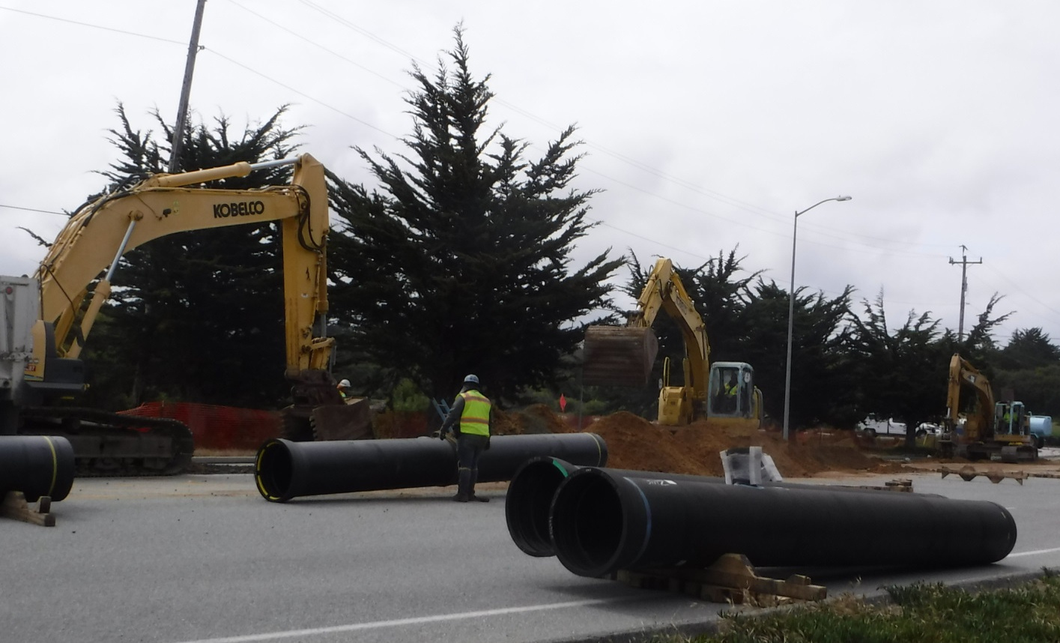
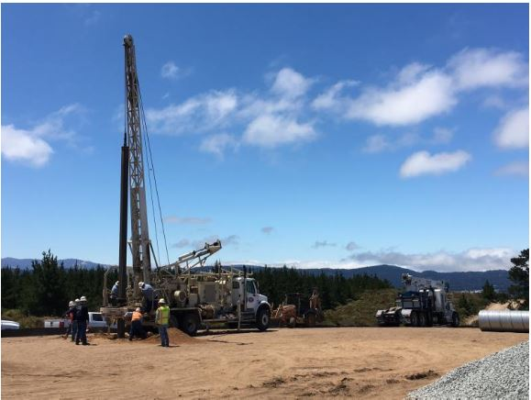
4 Components to PWM
Advanced Water Purification Facility
Source Water Diversion Structures
Conveyance Pipeline
Injection Wells & Appurtenances

Slide 6
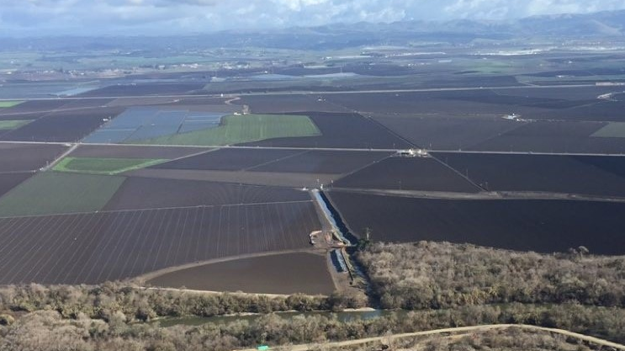
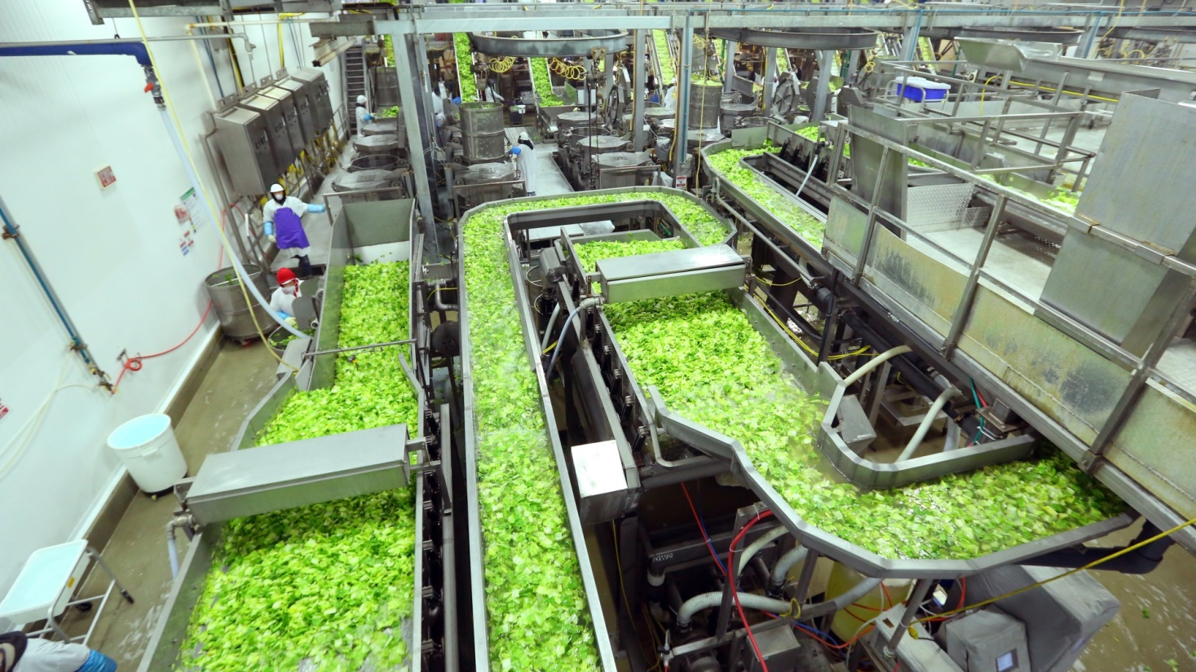
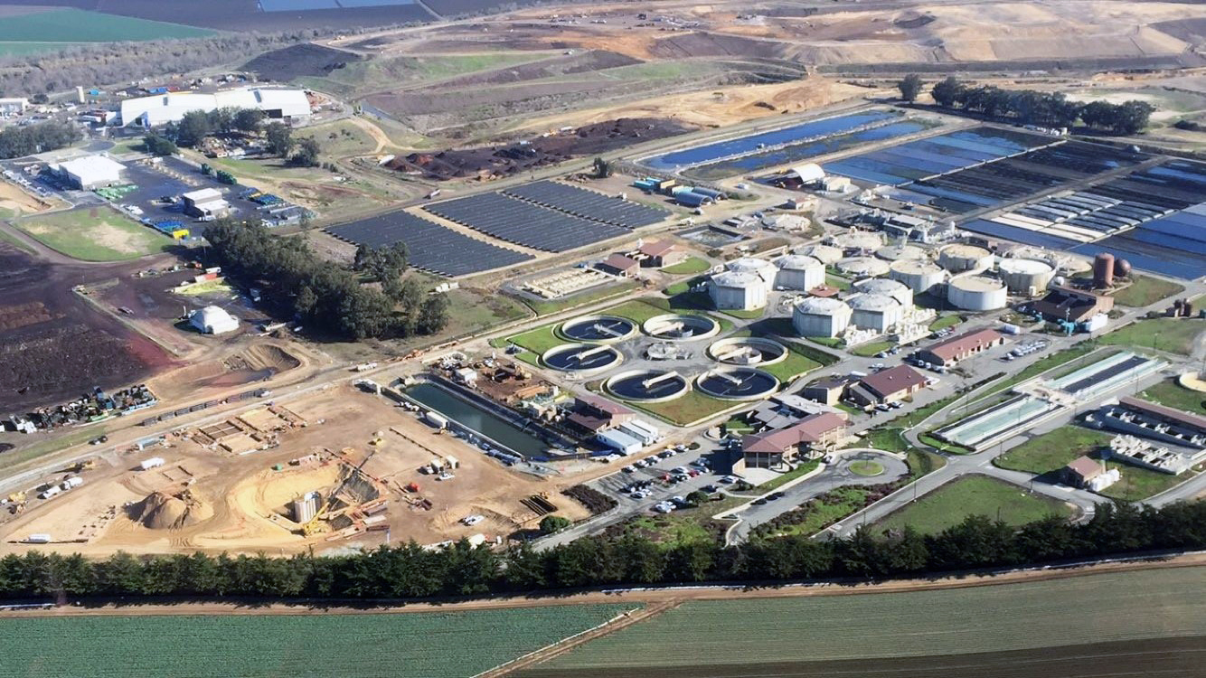
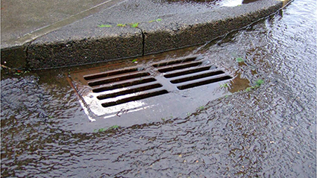
PWM Source Waters
Agricultural Drainage Water
Agricultural Wash Water
Secondary Treated Wastewater
Urban Storm Water Runoff

Slide 7
PWM Source Waters
Proposed Daily Source Water Percentages
  Wastewater – 67%
  Ag Wash Water – 17% *
  Blanco Drain – 12.5% *
  Rec Ditch – 4% *
  * As Needed

Slide 8
Blending of Sources then Primary & Secondary Treatment
Salinas
Industrial Waste
Water
Urban
Storm/Runoff
Primary Treatment
Ag.
Drainage
Screening
Primary Sedimentation
Biological Trickling Filters
Bio-
flocculation
Secondary Clarification
M1W Wastewater
Secondary Effluent
To existing
tertiary treatment
To Advanced Water Purification Facility (AWPF)
Unused water to Ocean Outfall

Slide 9
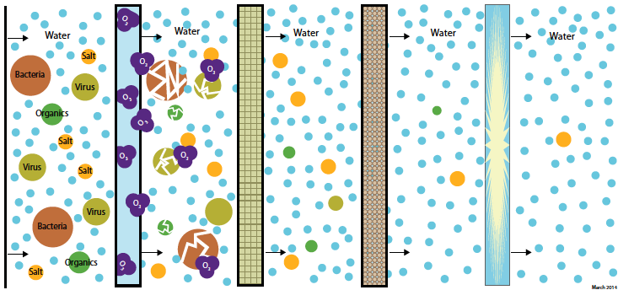
Advanced Purification Treatment Processes
Treated Source Waters
UV Disinfection and Hydrogen Peroxide
Ozone Treatment
Membrane Filtration
Reverse Osmosis

Slide 10
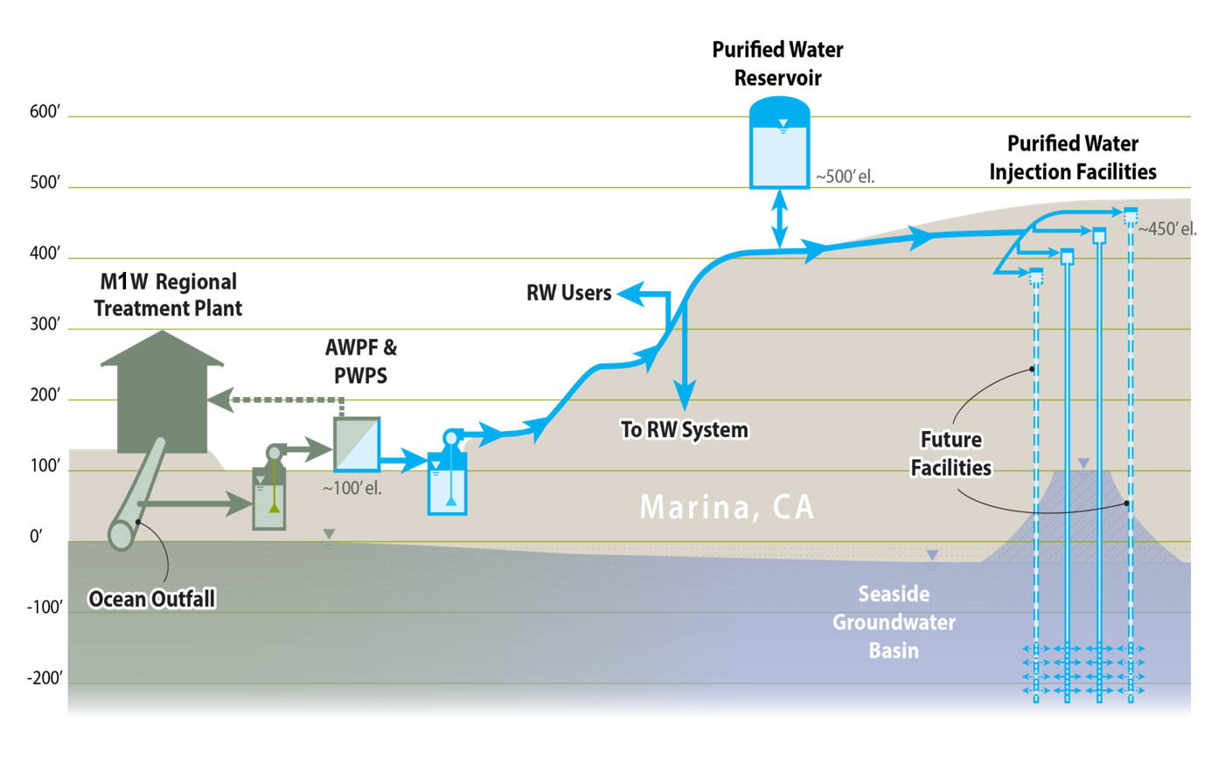
Injection into the Seaside Basin

Slide 11
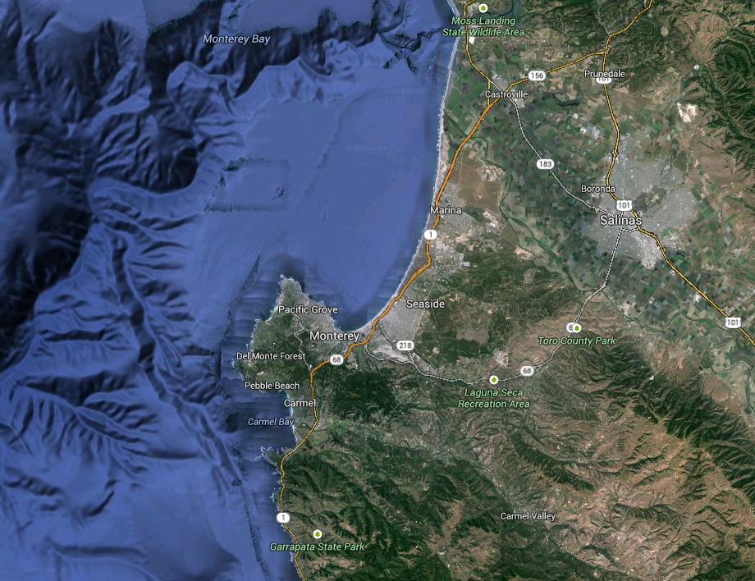
Why was Pure Water Monterey needed?
Monterey Bay National Marine Sanctuary
Board Goal: No Wastewater Discharge
Salinas River Basin
Seawater Intrusion
Area of Special Biological Significance
No State or Federal Water Available
Seaside Groundwater Basin
Adjudicated
Carmel River SWRCB Order 95-10 and CDO
Notes:
SWRCB CDO and Seaside Basin Adjudication mandate reductions in diversions

Slide 12
Demand in 2013-14
Demand in 2014-15
Carmel River Supply
New Revised CDO
Seaside Basin Supply
per Adjudication

Slide 13
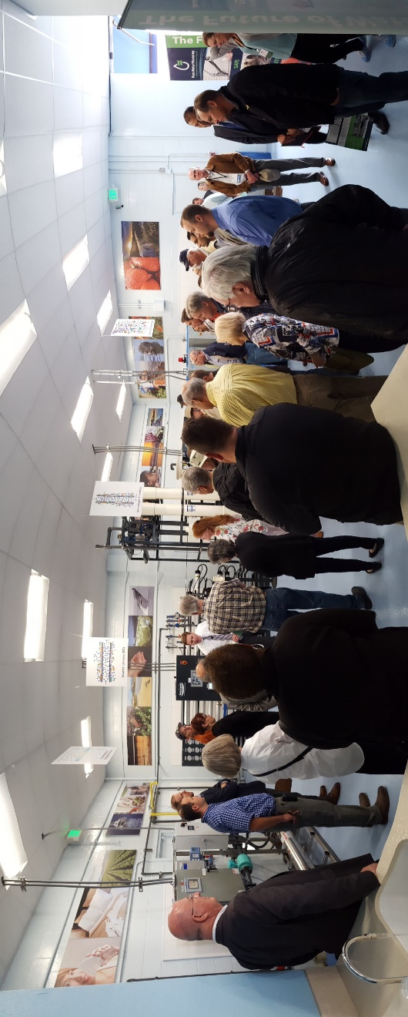
Community Buy-In
Taking Community leaders down to Orange County to see GWRS – Seeing is believing or better yet drinking is believing
Community Engagement = Demonstration Facility

Slide 14
How Did We Get Here?
APRIL 2012
Cal Am submits Application to CPUC for a Water Supply Project
  Pure Water Monterey listed as a Project Variant
  CPUC to PWM - Need to Complete 9 Criteria in order to be deemed a viable project
Criterion 1: Final EIR
Criterion 2: Permits
Criterion 3: Source Waters
Criterion 4: Water Quality and Regulatory Approvals
Criterion 5: PWM Project Schedule Compared to Desalination Schedule
Criterion 6: Status of PWM Project Engineering
Criterion 7: PWM Project Funding
Criterion 8: Reasonableness of WPA Terms
Criterion 9: Reasonableness of the PWM Project Revenue Requirement

Slide 15
How Did We Get Here?
MAY 2013
Pure Water Monterey Notice of Preparation for Environmental Impact Report (EIR)
OCTOBER 2015
Certified EIR
SEPTEMBER 2016
Water Purchase Agreement with Cal Am and MPWMD
NOVEMBER 2016
Division of Drinking Water Approved Engineering Report
MARCH 2017
Secure a loan with State Revolving Fund
(1% for 30 years plus $15M in grant)
OCTOBER 2017
Started project construction

Slide 16
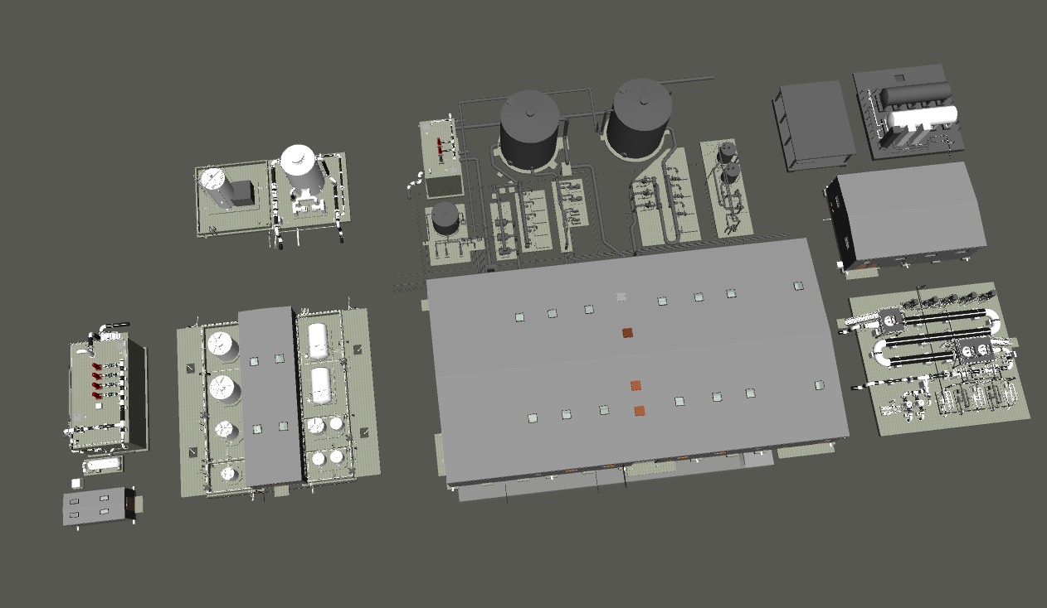

What's Happening Today!

Slide 17
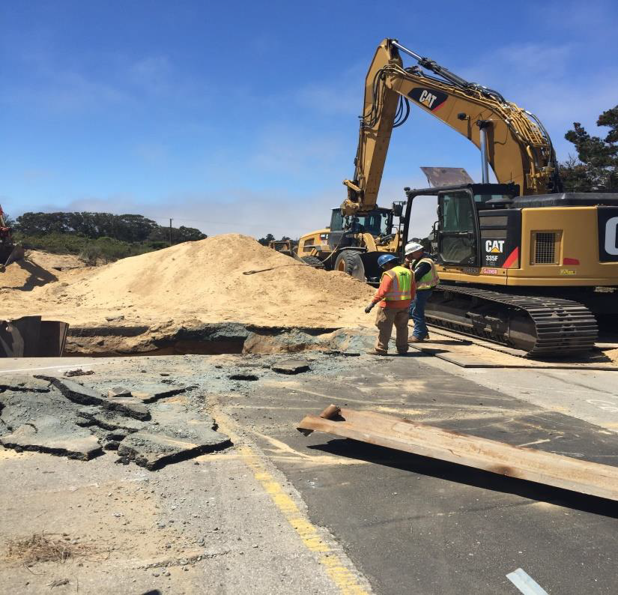
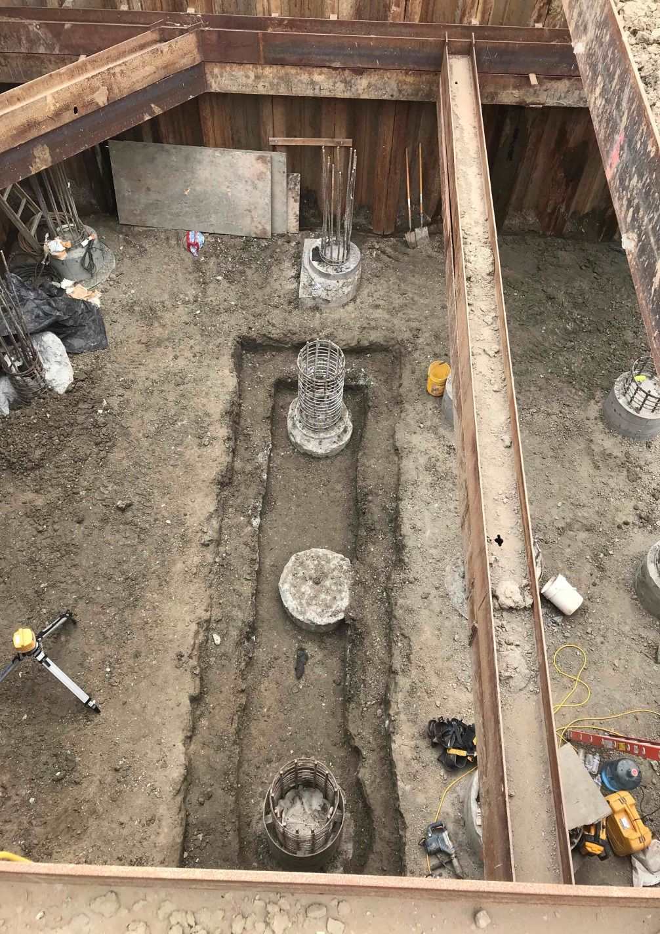
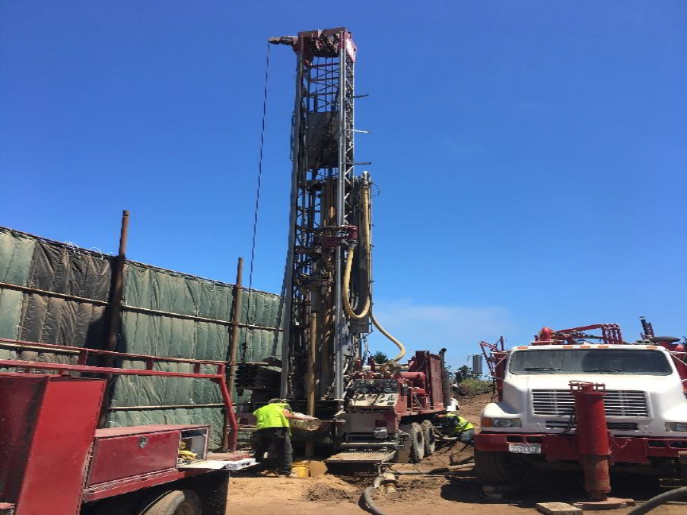
Construction Progress
Conveyance Pipeline
MCWD lead
Blanco Drain
Pump Station
Seaside Groundwater Basin
Injection Wells

Slide 18
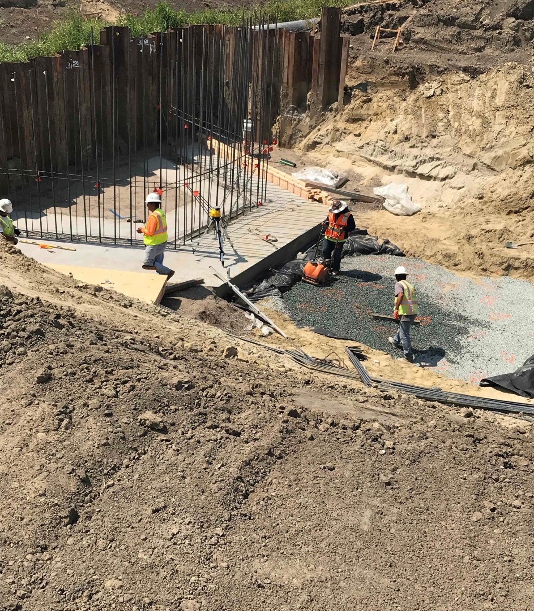
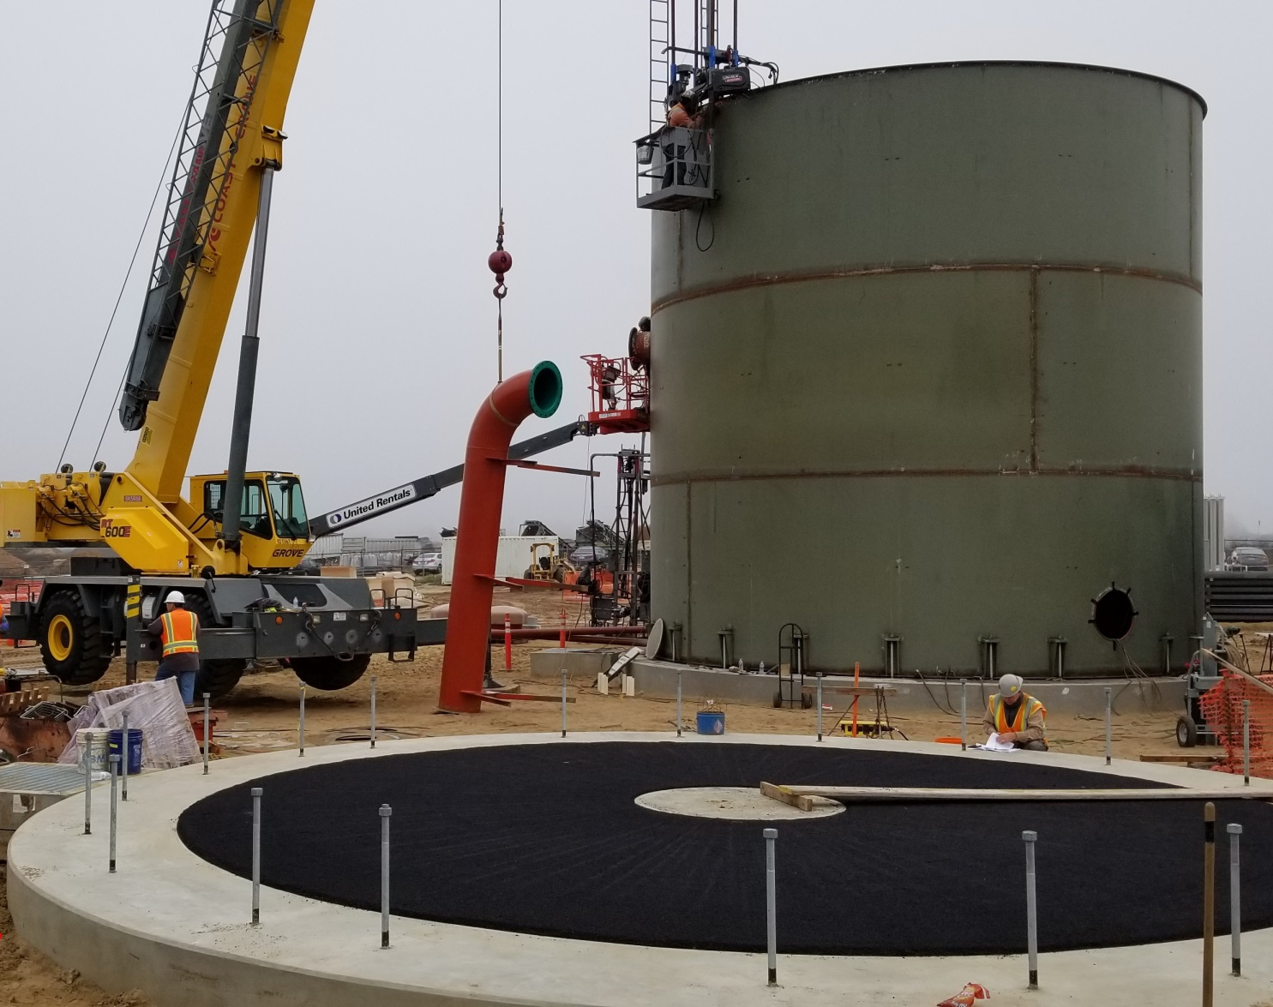
Construction Progress
Reclamation Ditch
Pump Station
Advanced Water
Purification Facility

Slide 19
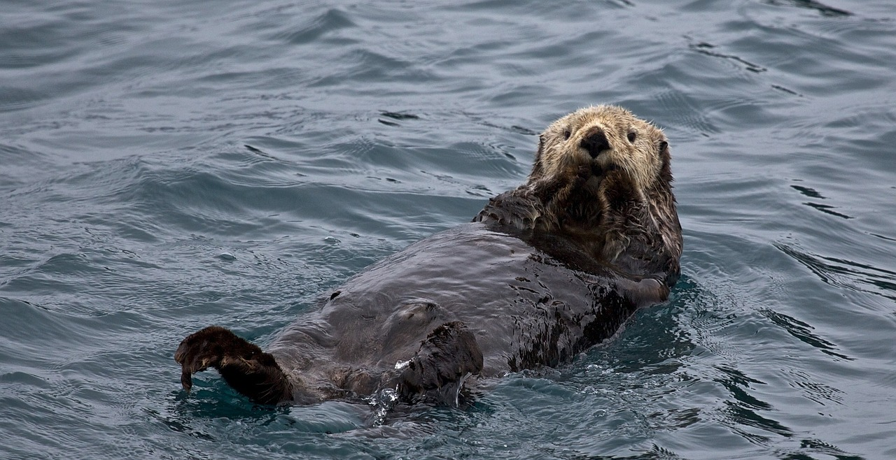
Questions

