Slide 1
West Basin
Municipal Water District
Urban Water Institute
August 23, 2018
Shivaji Deshmukh, P.E.
Executive Manager
of Engineering & Operations

Slide 2
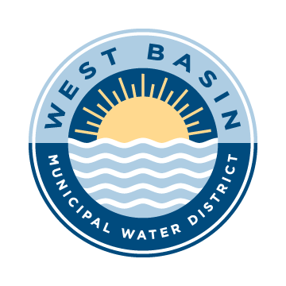


Mission
Provide a safe and reliable supply of
high-quality water to the communities we serve.
Celebrating 70 Years!
1947-2017
2
www.westbasin.org
Notes:
Public wholesale water agency that,
Provides imported drinking water to nearly 1 million people in 17 cities.
West Basin Municipal Water District was formed by a vote of the people in 1947 to reduce groundwater over-pumping and to make local water supplies more reliable through new sources of water.
A member agency of Metropolitan Water District of Southern California, which provides imported water from Northern California’s State Water Project and the Colorado River.
West Basin is an innovative public agency and a recognized leader in:
Producing recycled water
Implementing effective water conservation programs
Exploring ocean water desalination, and
Providing community education
We are committed to:
Water Reliability
Water Quality
Sound Financial and Resource Management
Customer Service
Environmental Stewardship

Slide 3
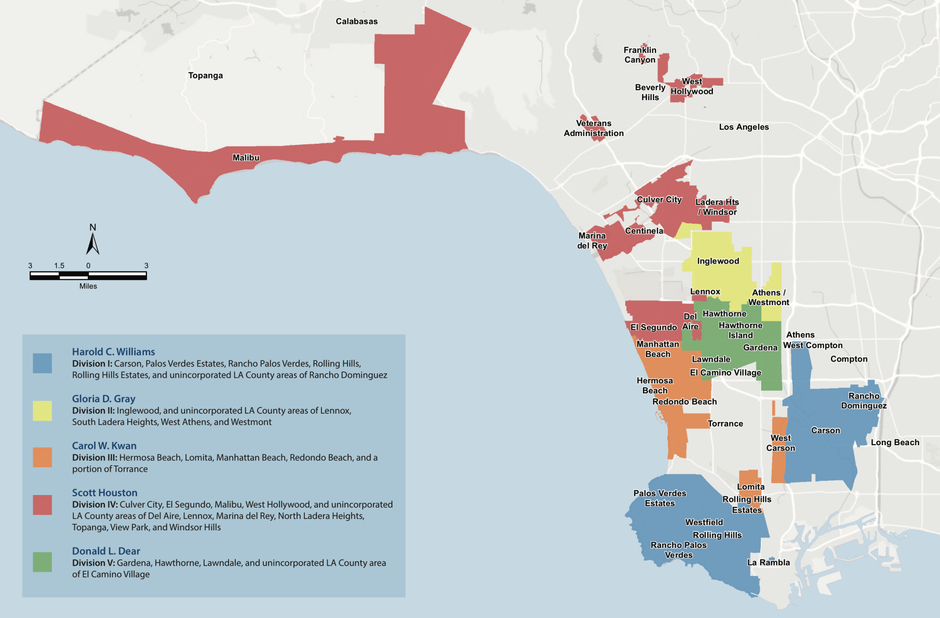
Service Area
3
www.westbasin.org

Slide 4
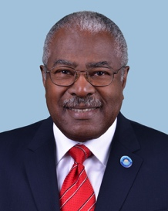
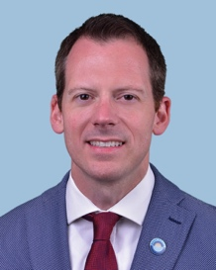
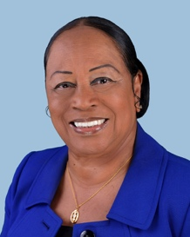
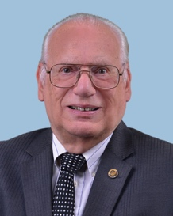
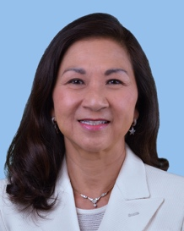
West Basin Board of Directors
Division I
Harold C. Williams
Secretary
Division II
Gloria D. Gray
Treasurer
Division III
Carol W. Kwan
Member
Division IV
Scott Houston
Vice President
Division V
Donald L. Dear
President
4
www.westbasin.org

Slide 5
WATER RELIABILITY THROUGH SUPPLY DIVERSIFICATION
Water Reliability Through Supply Diversification
2015 Water Supply Portfolio
Percentages rounded and based on 2015 Urban Water Management Plan data
5
www.westbasin.org
Notes:
West Basin’s approach to securing water reliability: diversification.
In 1947, the district was formed to make local water supplies more reliable through reduced groundwater pumping and new water sources (at that time: imported water from Metropolitan)
Today, West Basin’s Water Reliability Program entails reducing dependence on imported water, increasing conservation and developing locally controlled, drought-proof supplies of water.

Slide 6
Water reliability Through supply diversification
Water Reliability Through Supply Diversification
Projected Water Supply 2025
Percentages rounded and based on 2015 Urban Water Management Plan data.
6
www.westbasin.org
Notes:
West Basin’s approach to securing water reliability: diversification
As mentioned, formed in 1947 to make local water supplies more reliable through new water sources (at that time, imported water from Metropolitan) and reduced groundwater pumping
Today, West Basin’s Water Reliability Program entails reducing dependence on imported water, increasing conservation and developing locally controlled, drought-proof supplies of water.

Slide 7
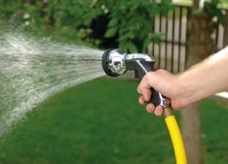
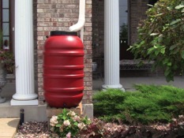
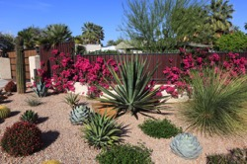
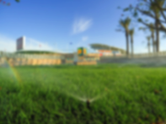
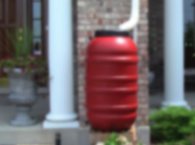
Conservation Programs
Distributed over 300,000 water-saving devices
Receive 300% return on investments for our customers
Conserved more than 167 billion gallons of potable water
7
www.westbasin.org
Notes:
Cash for Kitchens (C4K) - West Basin provides restaurants and other food service facilities with free water-use inspection visits to assess their current water usage. These assessments include strategies on how to conserve water, free conservation devices, a water-use report, and information about current commercial device rebates offered by Metropolitan Water District.
New in 2017! To conduct surveys of kitchen devices and appliances at 225 institutional facilities, such as schools, community centers and hospitals
Landscape Irrigation Efficiency Program (LIEP) - provides outdoor water evaluations, which identify leaks, broken sprinklers & pipes, unnecessary runoff, sprinkler controller issues, and other water wasting problems in large landscapes. The program includes sprinkler nozzle retrofits and an outdoor water-use report, complete with recommendations on more efficient outdoor watering habits for residents and businesses.
Ocean Friendly Landscape Program -This project, funded by the Department of Water Resources and in partnership with the Surfrider Foundation, is comprised of 4 major components. 16 gardens upon completion.
Construction of Ocean Friendly Demonstration Gardens at public sites
Free “Hands-on-Workshops” for customers
Installation of smart sprinkler controllers for large landscapes
Distribution of smart sprinkler controllers (WBICs) for residents through free exchange events and through increased rebates.
Ocean Safe Car Washes - Ocean Safe Car Washes clean and recirculate their water to use 50-85% less water than the average home car wash and help prevent runoff & pollution from entering the ocean. These car washes in West Basin's service area provide discount coupons to customers.
Rain Barrels - Catch the rain and reduce your potable water use with a free rain barrel! West Basin provides its customers with free Rain Barrels during our Rain Barrel Distribution Events.
Rainwater/Greywater Workshops - Rainwater/Greywater Workshops to educate residents about the benefits of using rainwater and greywater and how to create a simple Laundry-to-Landscape (L2L) Greywater System!
Rebate Programs - West Basin partners with cities, local agencies, and water wholesalers to provide a variety of rebates available to its residential and commercial customers.
Turf Removal – West Basin no longer providing rebates, as this program has concluded. However, West Basin’s $300,000 turf removal grant from the United States Bureau of Reclamation resulted in:
1.3 Million square feet (or 30 acres) of water wasting turf being removed
168 acre feet of water saved each year, or 1,684 over a 10 year period

Slide 8
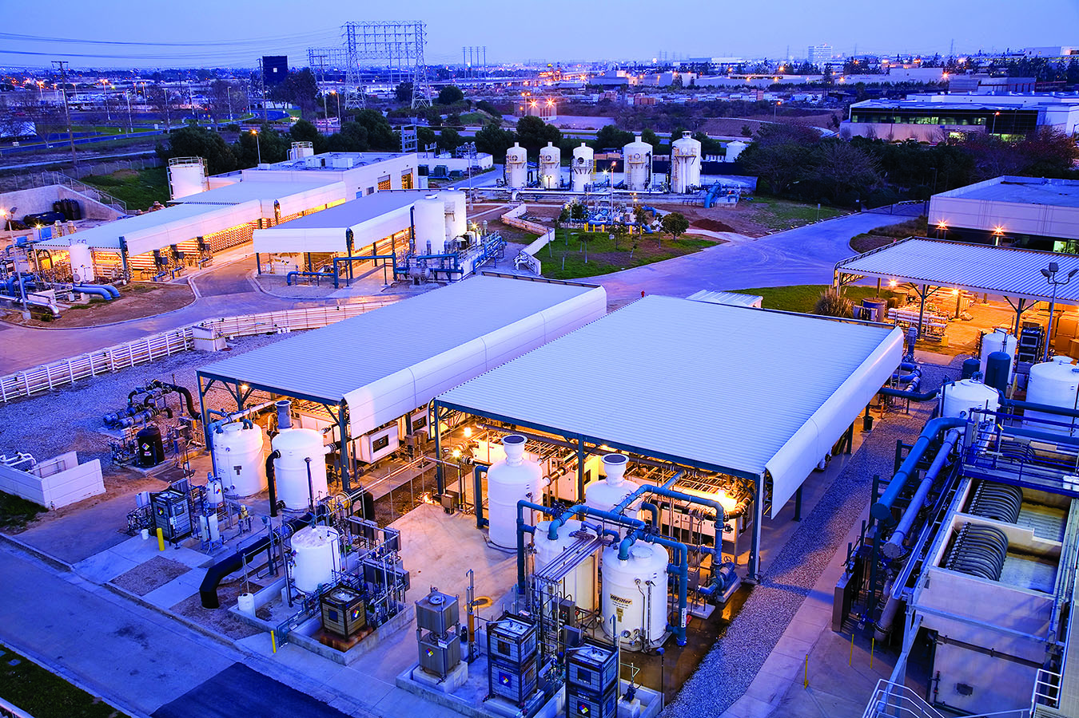
Water Recycling
More than 175 billion gallons of water produced
Over 13,000 visitors annually
Five “designer” waters
Edward C. Little Water Recycling Facility
El Segundo, Calif.
8
www.westbasin.org
Notes:
In addition to conservation by all, West Basin continues its legacy of recycling water.
In 1992, West Basin received state and federal funding to design and build a world-class, state-of-the-art water recycling treatment facility in El Segundo (commissioned in 1995).
The facility currently produces up to / approximately 40 million gallons of recycled water every day:
Preventing this wastewater from the Hyperion Treatment Plant from entering the Santa Monica Bay.
This also conserves drinking water, enough to meet the needs of approx. 80,000 households for a year.
While we welcome the public to schedule public tours of the facility, please note that major construction is taking place on the facility premises and throughout the system in order to enhance our recycled water program
Depending on the construction schedule, different areas of the facility will have limited our no tour access.
West Basin also has plans to renovate the visitor center in 2018 so it can continue to remain a key destination for school groups, water professionals and the general public

Slide 9
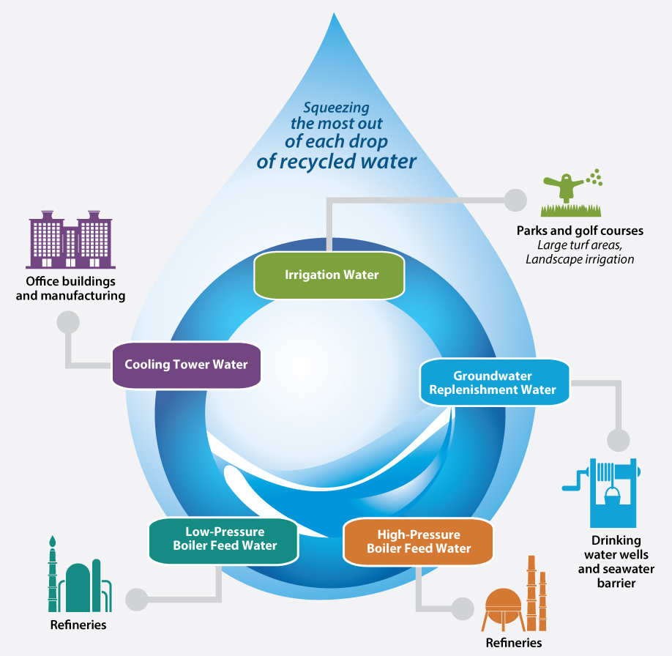
5 Designer Recycled Waters
9
www.westbasin.org
Notes:
West Basin is the only water agency in the world that makes 5 types of fit-for-purpose or “designer” water out of wastewater (from LA City Sanitation, Hyperion Treatment Plant).
The 5 types of designer waters are:
Tertiary Water (Title 22) for a wide variety of industrial and irrigation uses
Nitrified Water for industrial cooling towers
Pure Reverse Osmosis Water for refinery low-pressure boiler feed water
Ultra-Pure Reverse Osmosis Water for refinery high-pressure boiler feed water
Softened Reverse Osmosis Water: Secondary treated wastewater purified by micro-filtration (MF), followed by reverse osmosis (RO), and disinfection for groundwater recharge
Through one of our projects, the Carson Tesoro Expansion Project, we are looking to produce a 6th designer water using a custom engineered microfiltration system.

Slide 10
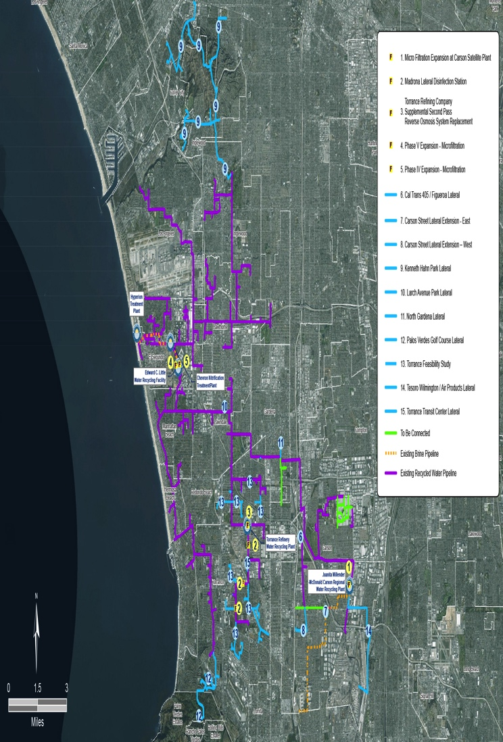
Recycled Water Distribution System
10
www.westbasin.org
Notes:
1 recycling facility (ECL) and 3 satellite plants (Chevron Nitrification Treatment Plant, Torrance Refinery Water Recycling Plant, Carson Regional Water Recycling Treatment Facility)
Approx. 120 miles of recycled water pipeline
Approx. 300 recycled water connections

Slide 11

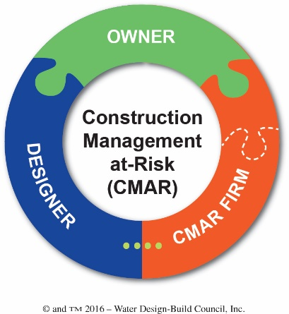
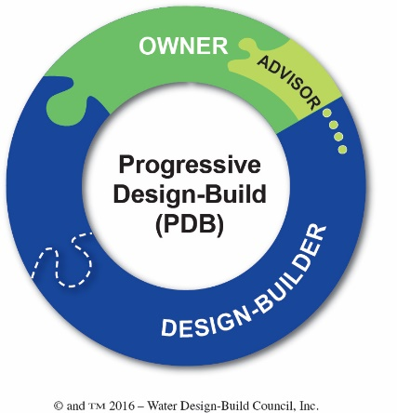
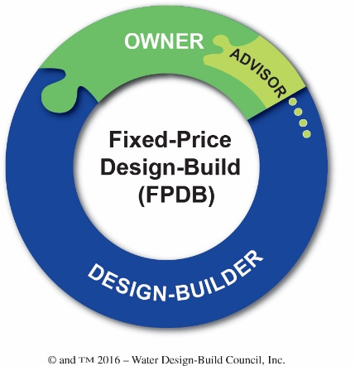
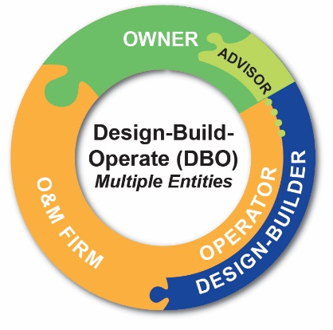

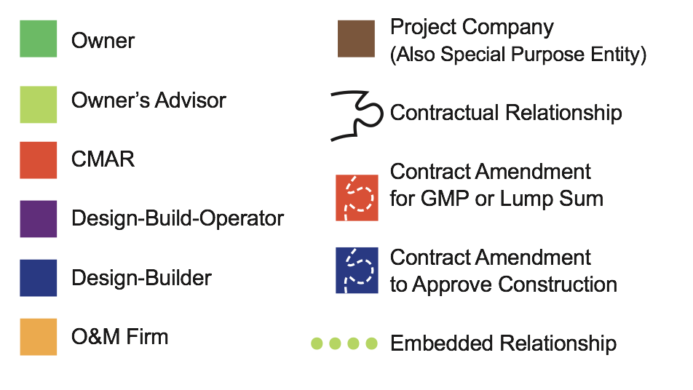

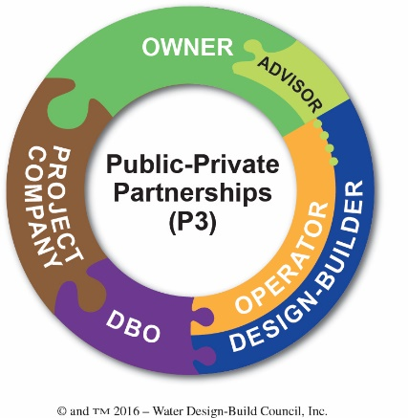
Spectrum of Collaborative Project Delivery Options
Traditional Delivery
Design-Build Collaborative Delivery
11

Slide 12
Previous Design Build Projects
Chevron Refinery Nitrification Plant – 1995
Exxon/Mobil Refinery Nitrification Plant – 1995
ECLWRF Phase II – 1997
Carson Regional Water Recycling Plant – 1999
ECLWRF Phase III – 2001
ECLWRF Phase IV – 2007
ECLWRF Phase V – 2013
12

Slide 13
Project Delivery Considerations
Schedule Constraints - Benefits to Revenue?
Project Complexity
Potential for Innovation - Cost /Quality Benefits
Quality Enhancement - Single Point of Responsibility?
District PM & Support Staff Availability
Risk Management
Best Value vs. Low Bid
13

Slide 14
Constraints/Challenges
24 / 7 Operations
Limited Site Area
Plant Operations
Tie-ins and Utility Condition
New Facility Integration
Permitting
Site Tours and Public Events
14

Slide 15
West Basin Priorities
DB Team Selection
Approach / Understanding
Full Accountability
Throughout Project Duration
Team Integration
Clearly Defined Roles, Responsibilities, and Objectives
Impacts to Operations
Committed Team Members
Foresight to Build Flexibility into Operations
Comprehensive Design Considerations
Project Participation from Start to Finish
Thorough Operational Knowledge Early On
Develop Strong Professional Relationship with Team Members
Vendor Responsibility and Liability
15

Slide 16
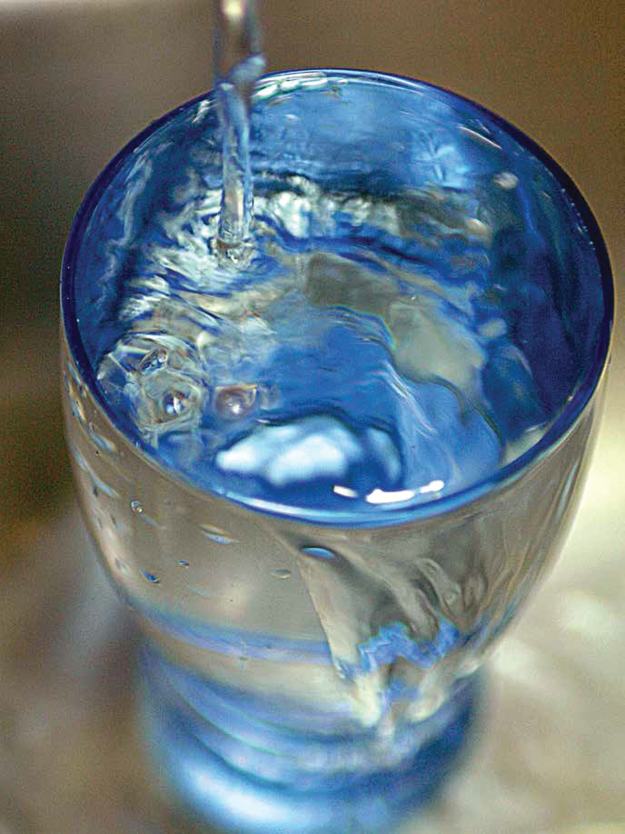
Ocean Water Desalination
Drought-proof, regulated supply of drinking water
Could provide +/- 10% of our future potable water supply
Responsible research since 2000
Governor Brown’s California Water Action Plan
74% support in public opinion poll
Environmental Impact Report process
16
www.westbasin.org
Notes:
Since 2000, West Basin has been conducting a responsible Ocean Water Desalination Program
Our responsible approach to ocean water desalination means we protect marine life, maximize energy efficiency and minimize cost
A potential 20 million gallon per day (MGD) facility in El Segundo could meet the needs of roughly 40,000 average households or approximately 175,000 people in a year.
West Basin is currently conducting an Environmental Impact Report process to evaluate the impacts of a proposed ocean water desalination facility
Once the report is released, we will broadly announce it and inform the public how they can learn more. We also offer briefings.
By exploring ocean desalination, we are addressing our water supply challenges, and acting on:
Governor Brown’s California Water Action Plan for increased regional self-reliance and investment in new technologies that include desalination;
Metropolitan Water District of Southern California’s Water Tomorrow, Integrated Water Resources Plan, which incorporates seawater desalination projects in its local resources incentive program for development of additional local supplies.

Slide 17
Weighted Ranking of Key Issues…
Achieving project consensus and approval
Defining project scope and configuration
Getting the “best price”
Getting the “best value”
Establishing accountability for performance
Optimizing internal West Basin culture and organization
Accommodating external stakeholders
Minimizing environmental and social impacts
Considering alternative risk transfer approaches
17
www.westbasin.org

Slide 18






www.westbasin.org
Connect with us
www.westbasin.org

