Slide 1
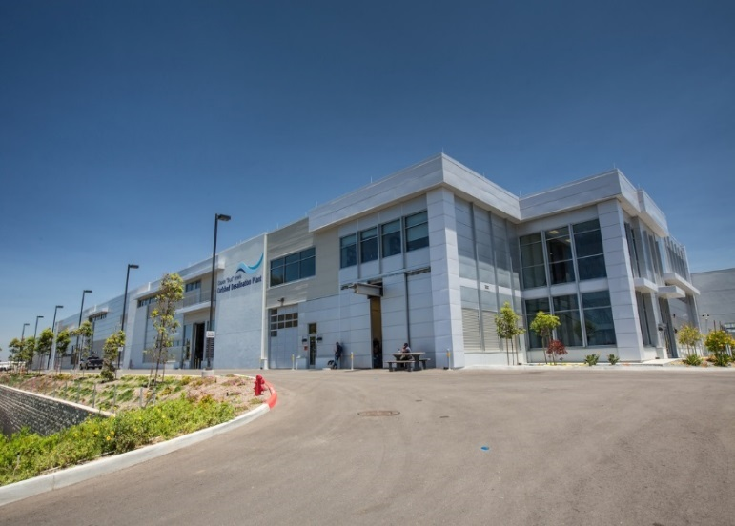

Claude “Bud” Lewis Desalination Plant
Carlsbad Desalination Plant DBFOM
Neil V. Callahan
Urban Water Institute
August 23, 2018

Slide 2
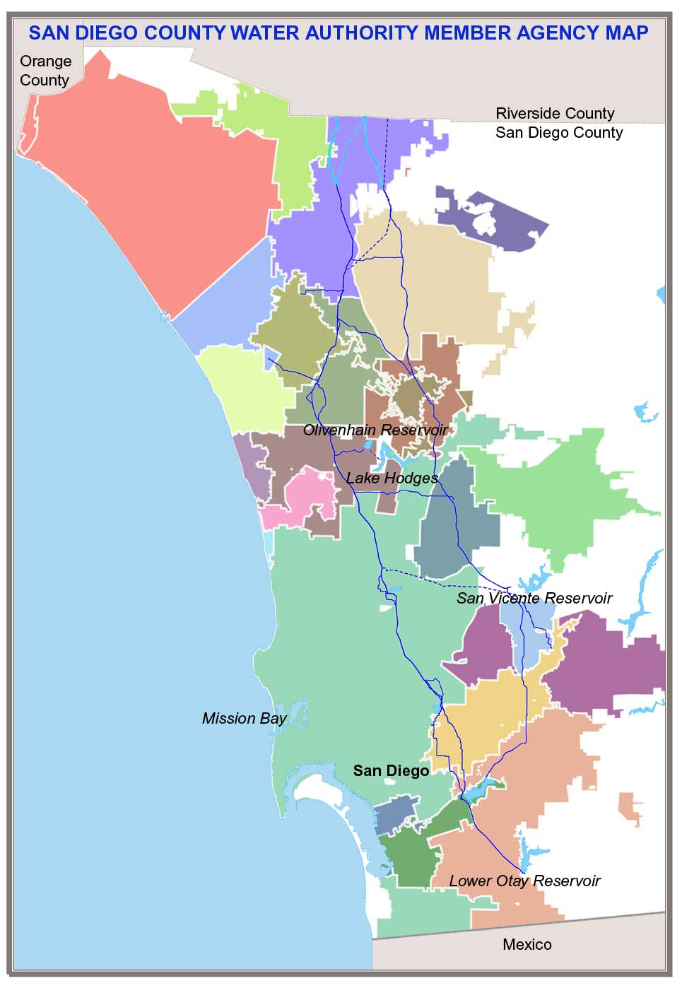
San Diego County Water Authority
Wholesale water agency created by state Legislature in 1944
  Serves 3.3 million people and region’s $220 billion economy
  24 member agencies (retailers)
Provides 80-90% of water used in San Diego County
  Builds, owns, operates and maintains large-scale regional water infrastructure
  Largest ag-to-urban water conservation & transfer in U.S.
  Invested more than $2 billion in facilities (desalination, pipelines, treatment and reservoirs) in the past 15 years
Notes:
2

Slide 3
Increasing San Diego County's Water Supply Reliability through Supply Diversification
1991
2020*
28 TAF 5%
80 TAF 15%
16 TAF 3%
43 TAF 8%
56 TAF 10%
190 TAF 35%
550 TAF 95%
33 TAF 6%
59 TAF 11%
Total = 578 TAF
52 TAF 10%
2017
8 TAF 2%
2035*
Total = 537 TAF
57 TAF 9%
78 TAF 17%
24 TAF 5%
16 TAF 2%
72 TAF 11%
100 TAF 21%
40 TAF 9%
80 TAF 13%
36 TAF 6%
16 TAF 3%
51 TAF 8%
193 TAF 40%
26 TAF 5%
200 TAF 32%
110 TAF 17%
10 TAF 2%
Total = 477 TAF
Total = 632 TAF
Metropolitan Water District
San Luis Rey Water Transfer
Groundwater
Imperial Irrigation District Transfer
Recycled Water
Local Surface Water
All American & Coachella Canal Lining
Seawater Desalination
Potable Reuse
* Based on Interim Demand Forecast Reset and includes verifiable and additional planned local supply projects from 2015 UWMP
(TAF=Thousand Acre-Feet)
Notes:
Total Demands
1991 – 578 TAF (actual)
2017 – 477 TAF (actual)
2020 – 537 TAF (projection)
2035 – 632 TAF (projection)

Slide 4
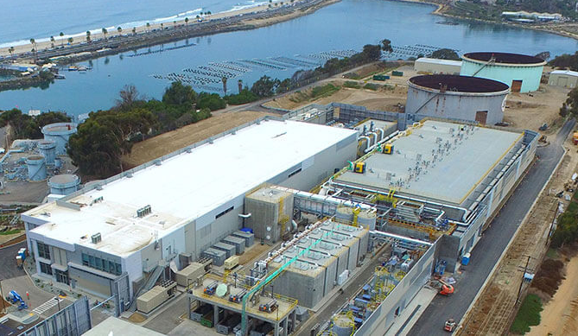
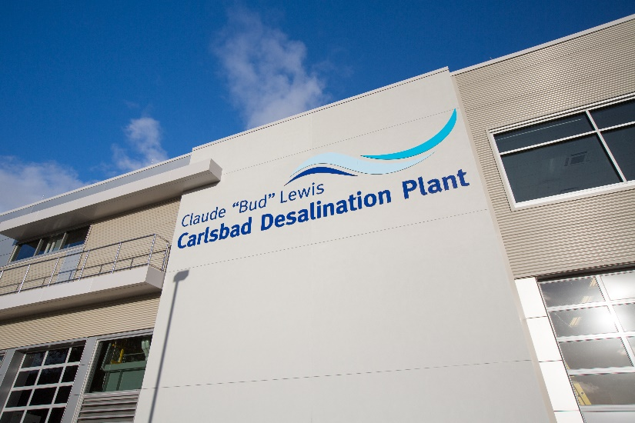
Lewis Carlsbad Desalination Plant
  Owned and operated by Poseidon Water
  30 year contract
  $1 billion investment
  48,000-56,000 acre-feet/year of drought-proof supplies
  Largest, most advanced seawater desalination facility in North America
  On-line in December 2015

Slide 5
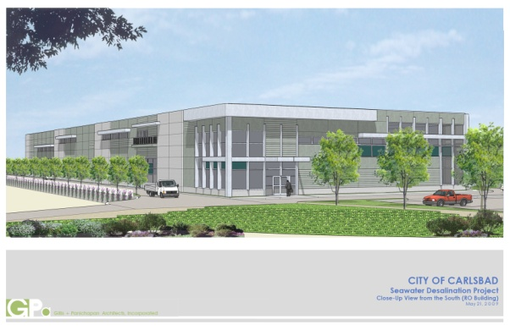
Landmark Water Purchase Agreement between the Water Authority and Poseidon
Water Authority Board approved WPA on Nov 29, 2012
Outlines commercial and financial terms for production and delivery of water from the Carlsbad Plant
Transfers risk to private developer
  Permitting
  Design liability
  Cost overruns
  Operations
  Must meet water quality requirements

Slide 6
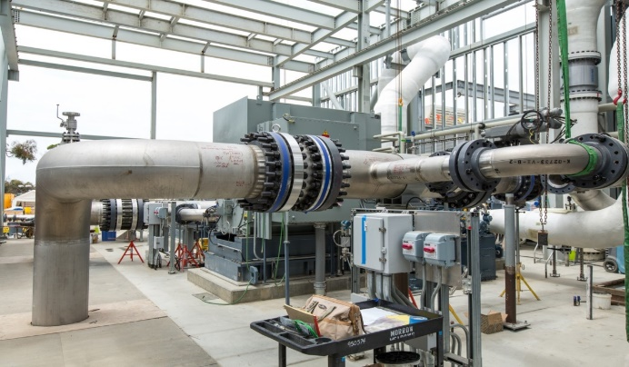
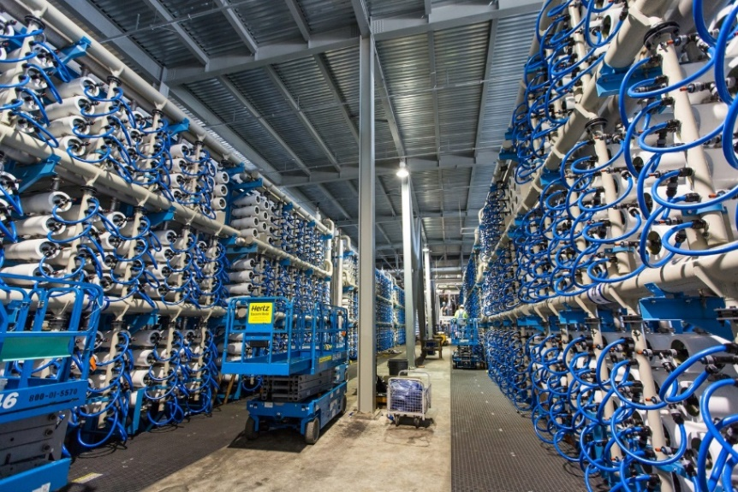
Project Structure – Desalination Plant
Water Purchaser
  Water Authority is sole off-taker
  Water Purchase Agreement
Developer/Owner
  Poseidon Water
Construction/Operation of the Plant
  WPA between Water Authority and Poseidon
  Contractor – Kiewit/Shea Desalination
  IDE Technologies provided process technology
  Plant Operations and Maintenance also provided by IDE

Slide 7
Total Project Costs
Total Capital Cost
2017/18 water purchase price* (includes pipeline)
*Current estimate based on highest electricity rate applicable
Total desalination plant | $537 million
Total conveyance pipeline | $159 million
Financing costs | $227 million
Water Authority improvements and oversight | $80 million
Total Capital Costs | $1.003 billion
56,000 acre-feet per year | 48,000 acre-feet per year
$2,274/AF | $2,524/AF

Slide 8

The Carlsbad Project:
A Successful Public Private Partnership (P3)
Risk Transfer to Poseidon/Contractor team
Price certainty throughout Water Purchase Agreement term
Buy-out provisions after 10 years of operation
Transfer to public ownership at the end of the 30 year agreement

Slide 9
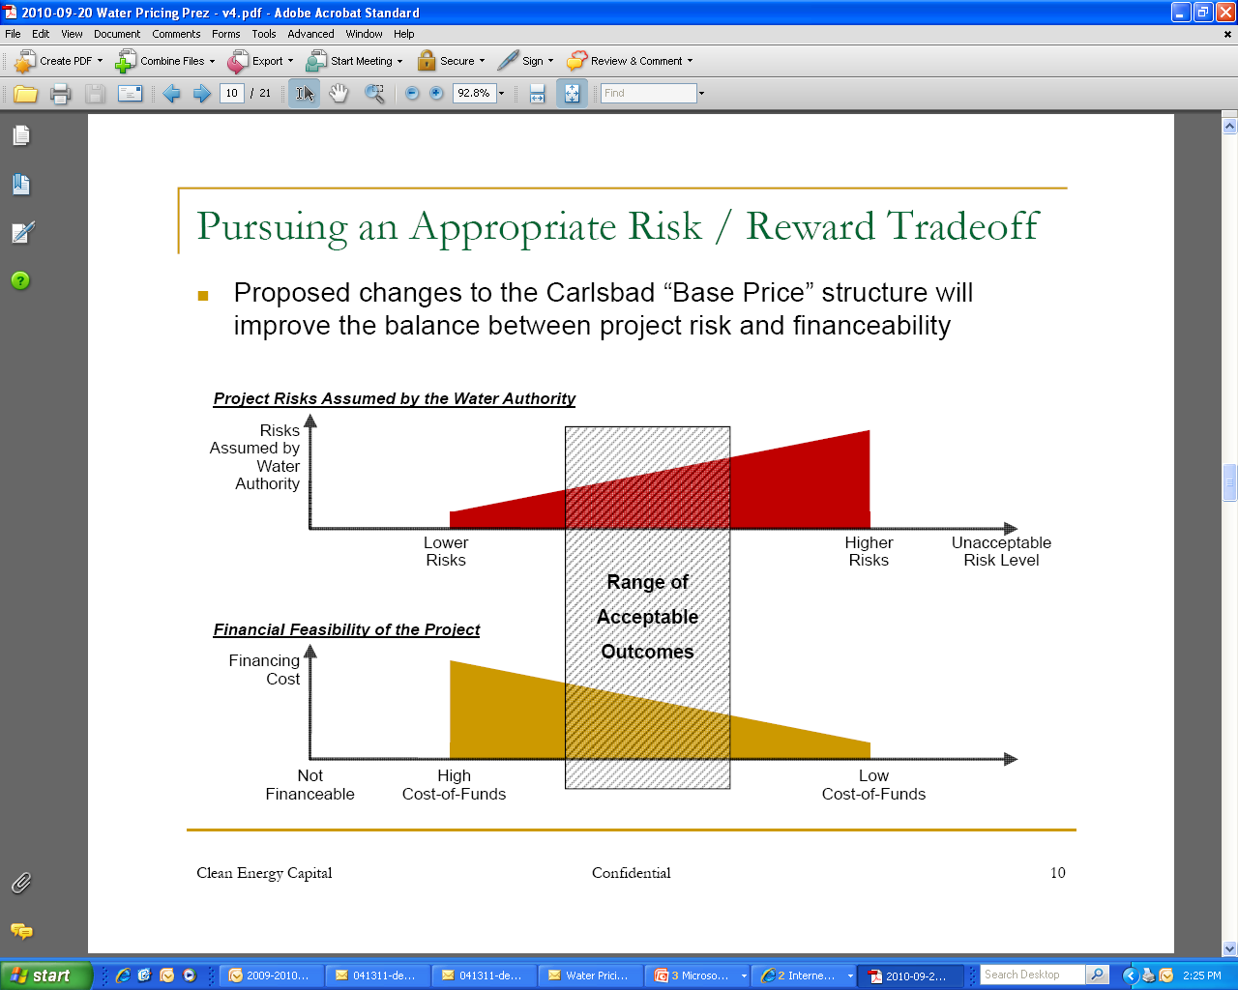
Key Objective of WPA
Balancing Price and Risk
SDCWA had never constructed or operated a seawater desalination facility
Assign appropriate risks to private developer at minimum cost to ratepayers

Slide 10


Carlsbad | Project Risk Allocation
Risk Description | Poseidon | SDCWA
Permitting
Financing
Interest Rate
Construction
Technology
Operating Performance
Pipeline Operating Risk
Electricity | Consumption | Pricing
Water Demand
Regulation

Slide 11
P3 Delivery Pros and Cons
Pros:
  Risk transfer to the private sector
  Speed (design and construction can proceed concurrently)
  A commodity purchase with defined terms and conditions
  Performance guarantees
  Approval rights over acceptance/performance testing
  Debt is kept off the public agency balance sheet
Cons:
  Take or Pay contract
  Higher cost of capital
  Greater overall transactional complexity
  Limited public agency input regarding design, construction and operations
  Public agency does not have a direct relationship with contractors

Slide 12
Carlsbad | 18 Months of Operating Experience
Delivered over 90,000 AF
Supplied 9% of regional water demand
Largest source of local water
Insulated region from water use restrictions
Met or exceeded all drinking water standards
Project is financially sound, compliant with debt obligations, and reserves are fully funded.

Slide 13
Questions?

