Slide 1
San Diego County Water Authority: Our WaterFix Journey
Urban Water Institute
August 22, 2018
Glenn Farrel
Government Relations Manager

Slide 2
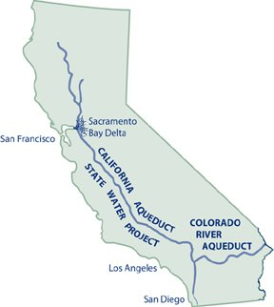
Bay-Delta’s Relevance to Water Authority
Sources of San Diego County’s Water Supply (2013-2017 five-year average)
13%
State Water Project (MWD supplies)
72%
Colorado River (Long-Term Transfers and MWD supplies)
15%
Local Supply
Notes:
You’ve likely heard this “end of the pipe” phrase before to describe San Diego’s geographic location in the state relative to water supplies sources that are available for consumptive uses.
As you can see, about 85% of our region’s water supply is imported to San Diego County. Most of the region’s water supply originates in the Colorado River basin:
-Through the Water Authority’s transfer with the Imperial Irrigation District
-Through agreements related to lining of the All-American and Coachella canals
-And through water purchases from MWD
Only about 13% of the region’s water supply – which is less than we produce on our own locally – originates from the Bay-Delta source.
The 15% in local water supply development is characterized by recycled water, desalination, some limited groundwater, and local surface water runoff

Slide 3
Reduced Reliance on the Bay-Delta
2009 Delta Reform Act (Water Code §85021):
  “Reduce reliance on the Delta”
  “Invest in improved regional supplies”
  “Improve regional self-reliance”
  “Invest in conservation, and water use efficiency”
  “Invest in advanced water technologies”
Notes:
The Delta Reform Act of 2009 made reducing dependence on the Delta while improving regional self-sufficiency an imperative. The words on the screen are right out of the Act:
“reduce reliance on the Delta”
“invest in improved regional supplies”
“improve regional self-reliance”
“invest in conservation, and water use efficiency”
“invest in advanced water technologies”
The Water Authority began implementing these actions many, many years before this state law required us to do so. The proof point? Between 1990 and the end of this decade, the Water Authority will have reduced its water purchases from MWD – our source of Bay Delta water – by 81 percent – and by nearly 90% by 2035.

Slide 4

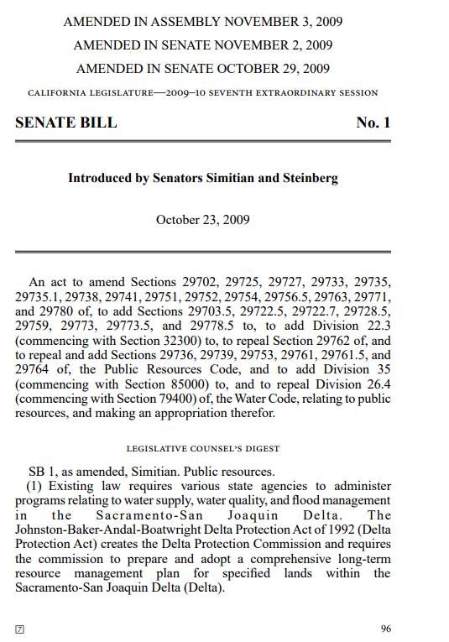
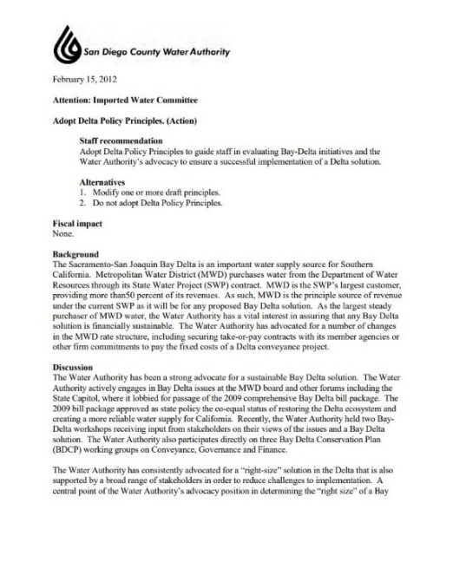
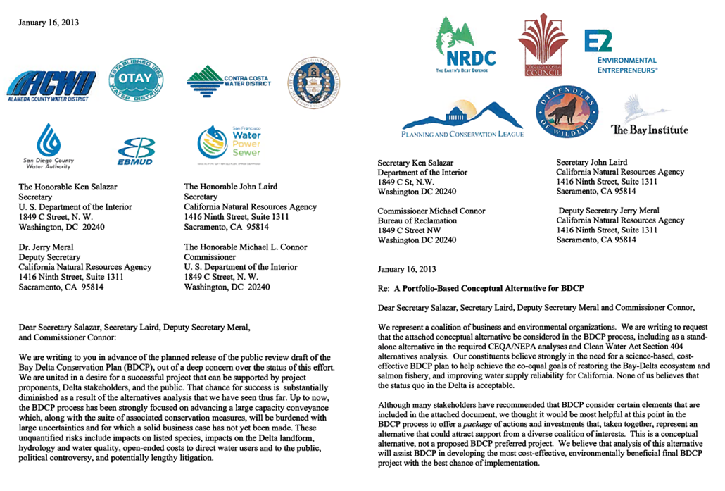
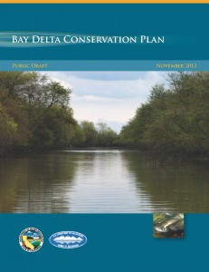
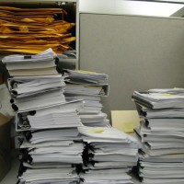

Water Authority’s Investment in Finding a Delta Solution
Water Authority
multi-disciplinary Team Review of BDCP 2013-2014
Delta Reform Act 2009
Bay-Delta Policy
2012
‘Portfolio Approach’
2013
BDCP November 2013
California WaterFix and Eco Restore 2015
EIR/S Documents
Notes:
For several years, the Water Authority embarked on what we like to refer to as a “journey of discovery” – seriously, it was a very rigorous evaluation and analysis of proposed solutions to address the co-equal goals of water supply reliability and protection of the environment – a standard that so famously emerged from the significant negotiations during 2009 on the Delta Reform package of legislation.
The WA was actively engaged and involved in the 2009 Delta Reform package of legislation and later became a signatory to a coalition letter in 2013 urging the state to consider a “portfolio approach” to a Delta fix. Rather than just move full steam ahead with a conveyance-only program, the “portfolio approach” envisioned conveyance improvements coupled with local water resources development and new storage opportunities.
When the BDCP emerged, the WA engaged a multi-disciplinary internal team to tackle review of volumes of documents, prepared dozens of staff reports on various components of the BDCP, and invited stakeholders from throughout the state – representing widely varying opinions and perspectives on the BDCP – to our Board room for dialogue and discussion.
Similarly with the WaterFix program that was unveiled in 2015 – the WA has continued to engage an extremely active review, analysis, and evaluation of the program and proposals

Slide 5
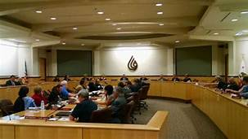
Water Authority’s WaterFix Policy Principles
August 9, 2018 Water Authority Board action to adopt “Bay Delta & WaterFix Project Policy Principles”
Key excerpt from policy principles:
The Water Authority Board of Directors supports the WaterFix project, as currently proposed, conditioned upon Metropolitan Water District (MWD) properly allocating the costs of the project as conservation, or supply charges, as similar facilities historically have been defined in MWD’s SWP contract with DWR.
Notes:
This multi-year evaluation and debate over the twin tunnels, BDCP, and WaterFix project culminated on August 9 of this year with the WA Board of Directors adopting new Bay Delta and WaterFix Project policy principles that communicate the WA’s conditional support for the WaterFix project. The condition being that MWD properly allocates the costs of the project as conservation, or supply charges, as similar facilities historically have been defined in MWD’s State Water Projedt contract with DWR.

Slide 6
“Conditional Support”?
Staff implementation of the Board’s policy direction is focused on ensuring:
  There is a clear delineation of cost allocation to MWD member agencies
  The costs are allocated in a manner that reflects the imposition of those costs as conservation, or supply, charges
  Advancement of the project does not get out in front of cost allocation determinations
  Implementation of this policy direction is substantially similar to advocacy of a “Support if Amended” position on legislation
Notes:
In terms of the staff’s implementation and execution of the WA Board’s policy principles, we view conditional support to be much like a Support if Amended position on legislation. When our Board adopts a S/A position, that means if we get amendments we are requesting, then we will support the bill.
Similarly, our conditional support means something very similar – if our conditions are satisfied, we will be fully supporting the WaterFix project.
The key, of course, is in what are the conditions?

Slide 7
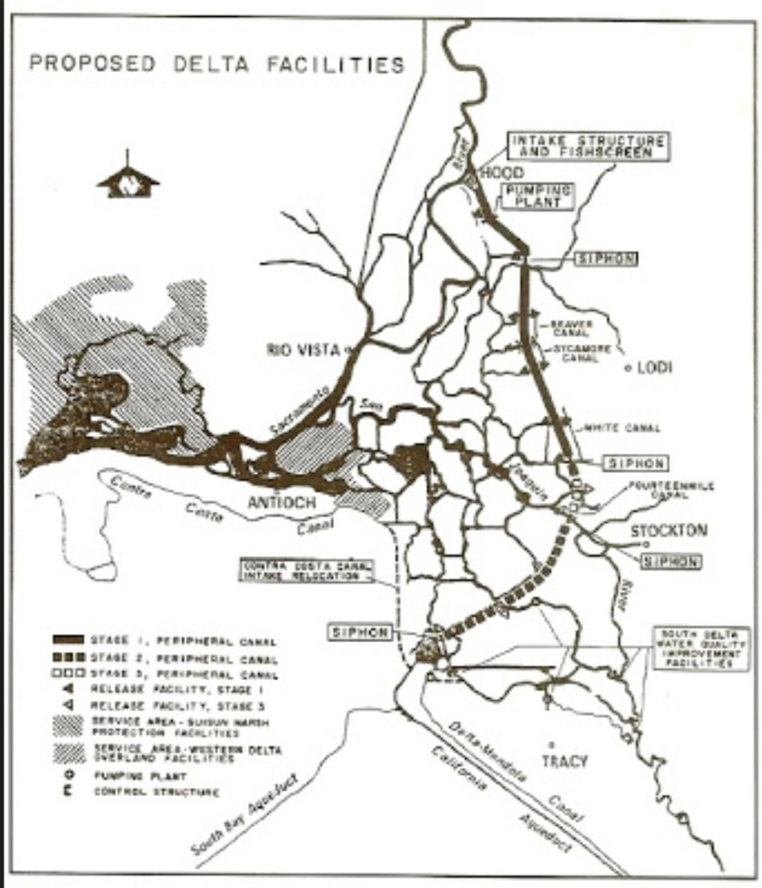
Treatment of WaterFix Costs
MWD-SWP contract (executed 11/4/1960)
“Project conservation facilities” (supply)
“Project transportation facilities” (transportation)
DWR Bulletin 132
First issued: 1964
Peripheral canal referenced: 1963 (“solving Delta problems”)
Peripheral canal costs incorporated in cost estimates: 1965
Notes:
Without getting too far into the weeds, it is important to understand the historical context for conveyance project costs. In MWD’s state water project contract executed in 1960, there was a clear delineation between two types of charges:
Project conservation facilities – supply charges
Project transportation facilities – transportation charges
In DWR’s Bulletin 132, which was first issued in 1964, the peripheral canal was identified as a project conservation facility – for “solving Delta problems”

Slide 8
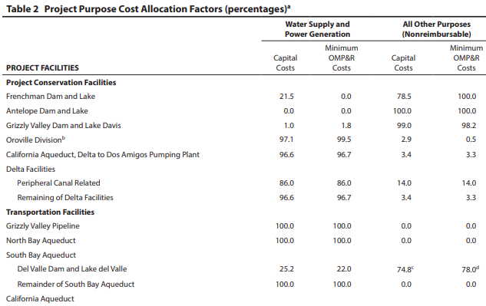
DWR Bulletin 132
In recent years, Appendix B to Bulletin 132
  Data and computations used to determine water charges
  Table 2: “Project Purpose Cost Allocation Factors”
    Peripheral canal related costs are treated as “Project Conservation Facilities” (i.e., Supply)
DWR Bulletin 132-17 Appendix B Table 2
Notes:
And even in to recent years, DWR’s Bulletin 132 has continued to treat peripheral canal related costs as Project Conservation Facilities – supply costs. Based on this historical context, there seems to be no real sound rationale to veer from that characterization of costs. This current WaterFix project is intended to address many of the same benefits as the earlier peripheral canal project, and that project was intended by DWR to be charged as Project Conservation Facilities – on supply charges.

Slide 9
WaterFix impacts on Water Authority’s Ratepayers
Range of impacts to Water Authority if MWD allocates WaterFix costs to Transportation, but recovers one-half through the Readiness-to-Serve (RTS) charge
MWD assigns WaterFix Costs to | Increase in household monthly bills*
Supply | $0.55-$0.80
Transportation | $13.27-$21.07
Transportation, but 50% recovered by RTS | $7.99-$12.69
* Based on demand forecast reset; nominal $ based on MWD’s projected share of $10.8B (assumes no cost overruns), interest rates of 4% and 8%, single family household using 0.4 AF of Water Authority’s water annually
Notes:
This characterization of costs is important to the WA, and there is a very important reason why the WA Board has conditioned its support of the WaterFix on this very narrow issue of cost characterization.
If MWD assigns the WaterFix costs to supply – as Project Conservation Facilities, then the WA staff projects the increase in household monthly bills to be fairly nominal…
If MWD assigns the WaterFix costs to transportation – you can see the significant different range of potential costs to San Diegans – this is because the WA relies on MWD to transport San Diego’s independent Colorado Rivery water supplies – there would be a clearly unique and material financial impact on San Diego ratepayers if the charges were characterized in this manner.
If MWD utilizes a hybrid approach and charges a portion to transportation and a portion to its Readiness to Serve charge (as it has indicated previously), there would still be a material affect on San Diego water rates.
This is not a simple issue – it is a bit down in the weeds and requires a doctorate in economics and math to truly understand, but there is definitely ongoing dialogue between the WA, MWD, and the state to better understand these calculations, the cost allocation of WaterFix project costs, and the characterization of those costs.

Slide 10
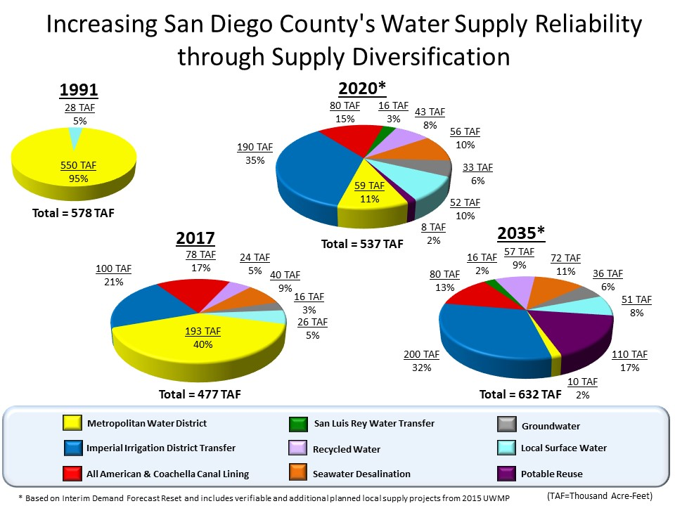
Local Projects Remain Essential to Drought Resiliency
Notes:
However WaterFix proceeds – and we surely acknowledge the importance of those SWP supplies for southern California and even SD County, a lot of the important discussion within the statewide water community needs to continue to be focused on local water supply development and demand management. I know that a lot of the remainder of your conference agenda focuses on these important sources of water, and the value that they bring to a water supply portfolio from a number of important perspectives, including:
Improving regional self sufficiency
Reducing reliance on the Delta
Drought-proofing communities
Improving resiliency to hydrologic cycles and swings
Even as the WaterFix project continues to proceed and develop, it’s important to ensure that our communities continue to provide appropriate signals and opportunities for locally-controlled and drought-resilient local water supply development.

