Slide 1

California’s Water Resilience Portfolio
Erik Ekdahl
Division of Water Rights
State Water Resources Control Board

Slide 2

Overview
Color Palette:
Use Eyedropper function
Water
Certainty
The Resilience
Portfolio Executive Order
Value-Based Management & Collaboration
Notes:
Value based management options: value in terms of cost, but also in terms of ethical, moral, and cultural values that reflect the local community and watershed. But because no watershed is an island, those ethical, moral, and cultural values also must reflect the people of the state – because those are the laws under which all resource management decisions must ultimately be measured against. Still, there’s immense flexibility in how local watersheds can manage their local resources.

Slide 3
California
population
20
Oroville Dam Completed
Population (millions)
MILLION
since 1968
2016
Source: California Department of Finance estimates
Notes:
Source: California Population Estimates, with Components of Change and Crude Rates, July 1, 1900-2016
Population

Slide 4


California Housing & Water Use
Population = 50 million by 2050 (+10 million)
4 million new housing units just to keep up
Current Water Use: About 2 houses per acre-foot
2 million ac-ft/year of new water for population growth

Slide 5
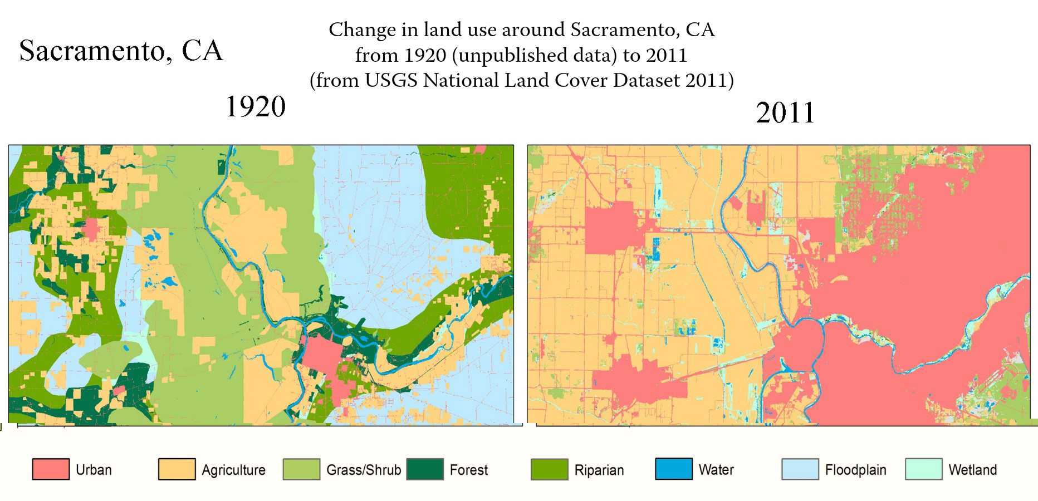
2011
1920
Sacramento
LAND USE
Source: The Grinnell Resurvey Project, Museum of Vertebrate Zoology, UC Berkeley
Notes:
Source Link: http://mvz.berkeley.edu/Grinnell/centralvalley/

Slide 6
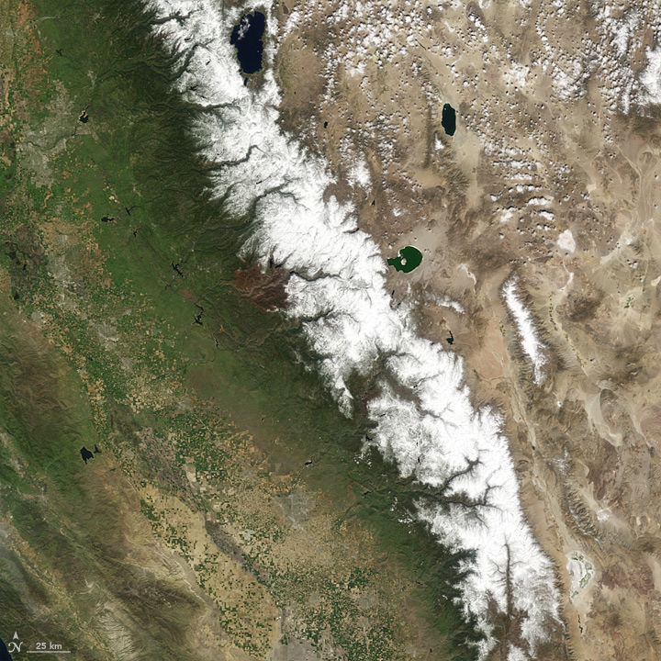
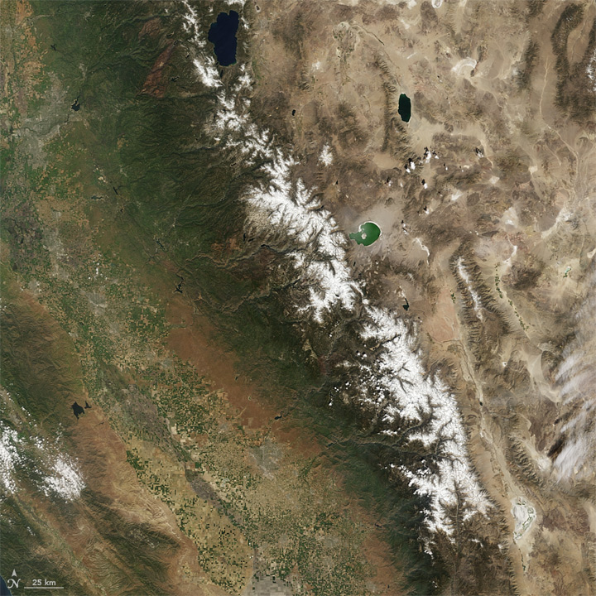
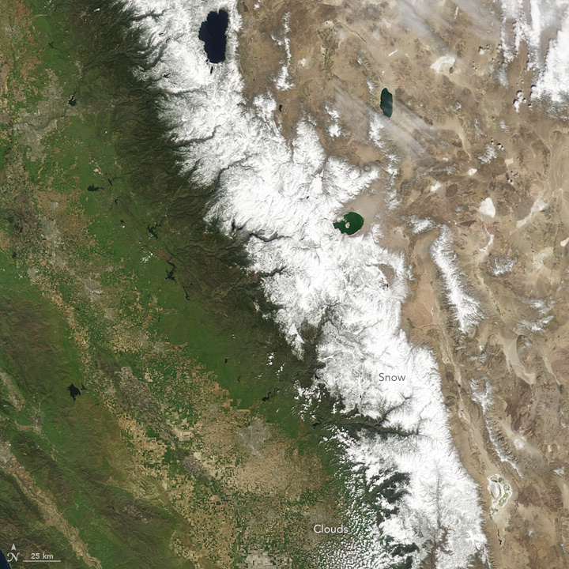
Sierra Nevada Snow Pack
Spring 2010
Average year
Spring 2014
34% of average
Climate
Spring 2015
5% of average
Source:
NASA Earth Observatory
Notes:
http://earthobservatory.nasa.gov/Features/WorldOfChange/sierra_nevada.php

Slide 7
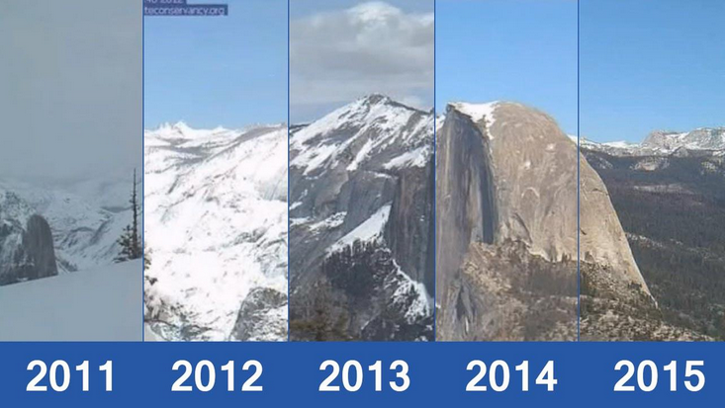
Notes:
These are images taken by the Yosemite Conservancy of Half Dome and the sierras taken in the third week of March over the last 5 years

Slide 8
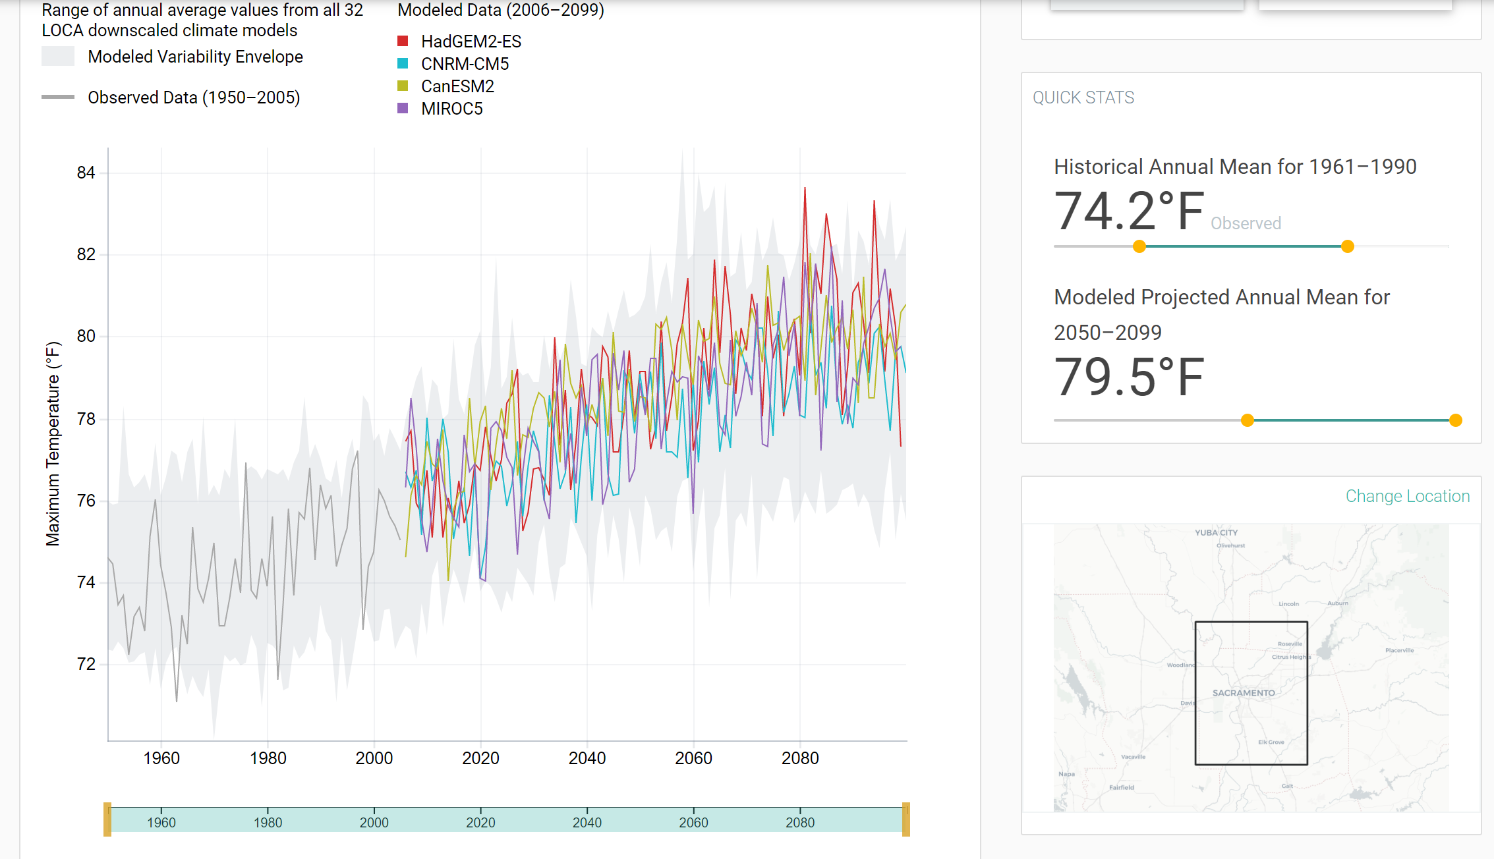
CalAdapt projections predict a 5 degree average temperature increase over historical average
https://cal-adapt.org/tools/annual-averages/#climatevar=tasmax&scenario=rcp45&lat=38.59375&lng=-121.46875&boundary=locagrid&units=fahrenheit

Slide 9
California’s
history of drought
Long Term
Average
PDSI
Drought
Threshold
Source: NOAA
Notes:
Source link: https://www.ncdc.noaa.gov/cag/time-series/us
PDSI recording of 0 reflects normal conditions, while -1 is considered to be the official drought threshold. Any recording of -4 and below signifies extreme drought.
Palmer Drought Severity Index
This is a graph of the Palmer Drought Severity Index for California from 1895 to 2016. O, which is highlighted by the blue line is considered normal conditions and -1, the red line, is considered the drought threshold. So, anything below -1 is a drought. As presented on the graph, droughts are not unusual in California, and when you add in the impacts of climate change, we are likely to experience a greater number of droughts and a higher severity of droughts into the future, which makes planning and managing water supplies, extremely important. So, now we come back to the Sustainable Groundwater Management Act.

Slide 10

PLANNING FOR 2050
Color Palette:
Use Eyedropper function
50 million Californians (+10 Million)
5 degrees warmer on average from 2050-2100
Water
Supply
Certainty
Notes:
Why the resilience portfolio, why now? Opportune time to evaluate our current status, and where we think we’ll need to be in 2050…

Slide 11
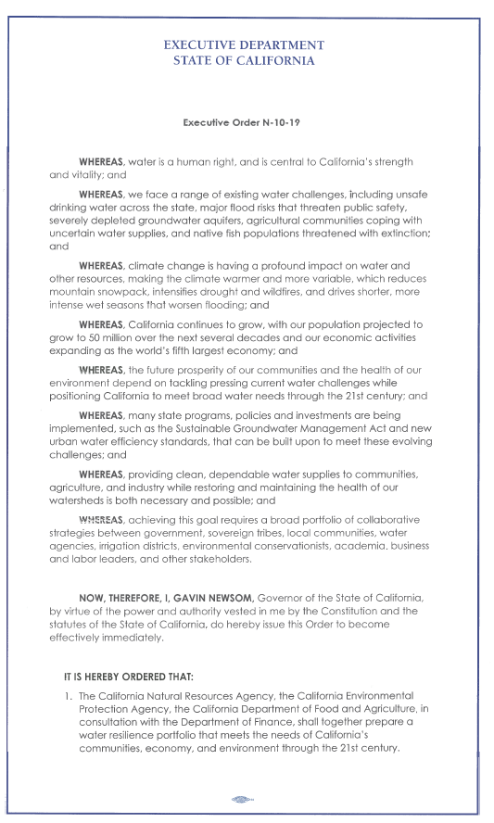
Signed April 29, 2019
Directs California Natural Resources Agency (CNRA), California Environmental Protection Agency (CalEPA), and California Department of Food and Agriculture (CDFA) to:
Prepare a water resilience portfolio that meets the needs of California’s communities, economy, and environment
Expand and/or reassess the priorities in the California Water Action Plan

Slide 12
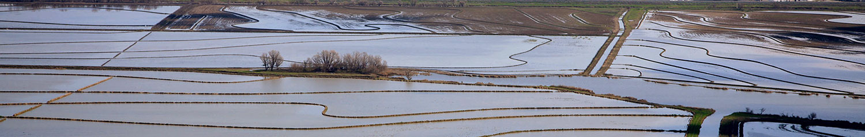
PORTFOLIO PRIORITIES
Multi-benefit approaches
Natural infrastructure (forest headwaters, floodplains, aquifers)
Innovation and new technologies
Regional approaches
Integration across state government
Partnerships across governments and organizations
Notes:
Nancy-
The Governor directed that the Portfolio recommendations should emphasize projects that
-- meet multiple needs at once
Take full advantage of the wetlands, aquifers, and other green infrastructure
Embrace innovation and new technologies
Take a regional approach
Consider successful approaches from outside California
Strengthen partnerships across local, tribal, state, and federal governments, and stakeholders
He also asked that we recommend ways to better integrate our efforts and coordinate our actions across state government.

Slide 13
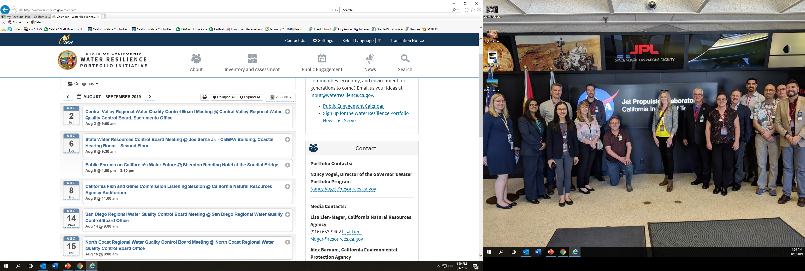


HOW TO PROVIDE FEEDBACK
Email us at input@waterresilience.ca.gov
Calendar of outreach events throughout the state at http://waterresilience.ca.gov/
Notes:
Nancy-
Outreach includes providing updates at existing agency meetings and conducting additional workshops at locations throughout the state requested by industry groups, local public agencies, and NGOs on specific aspects of the Portfolio.

Slide 14





?
Solutions
Project Funding
Land Use
“New” water -
Efficiency, Reuse, Stormwater,
Desal, Imports, etc.
Better Data, Science
Collaborations
All of these solutions are based on local, state,
and federal collaboration and participation

Slide 15
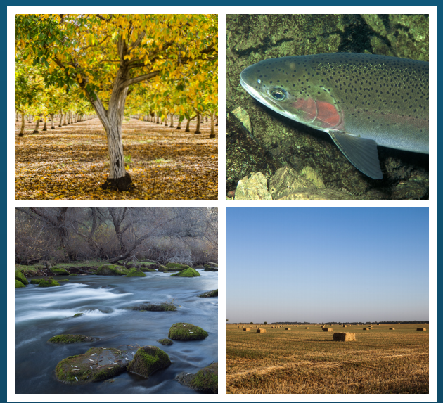
Value-Based
management & collaboration
Notes:
Cost of resilience… vs. cost of inaction
Value

Slide 16
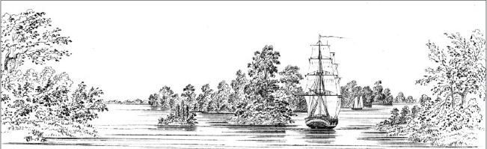
Sacramento Delta, circa 1850

