Slide 1
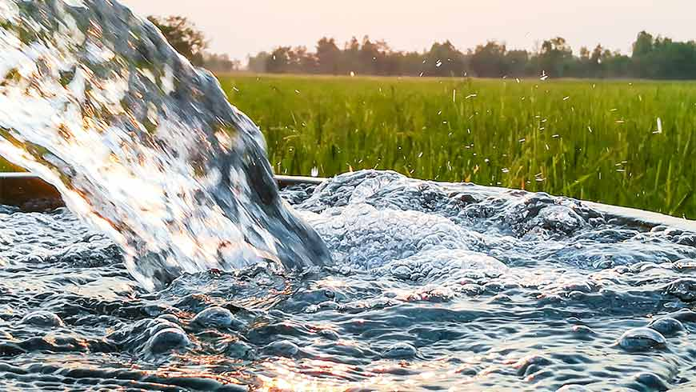
Urban Water Institute Snapshot
Leadership, ongoing activities, plans for the
future
Greg Quist, Chairman UWI
Board Rincon del Diablo

Slide 2
Greg Quist, Chair
Rich Nagel, Vice Chair
John Thornton, Treasurer / Secretary
Ane Deister, Executive Director
Stacy Davis, Administration Director

Slide 3
Ongoing Activities
Palm Springs Feb conference
San Diego August conference
Wayne Clark scholarship
Water Education Water Leaders

Slide 4
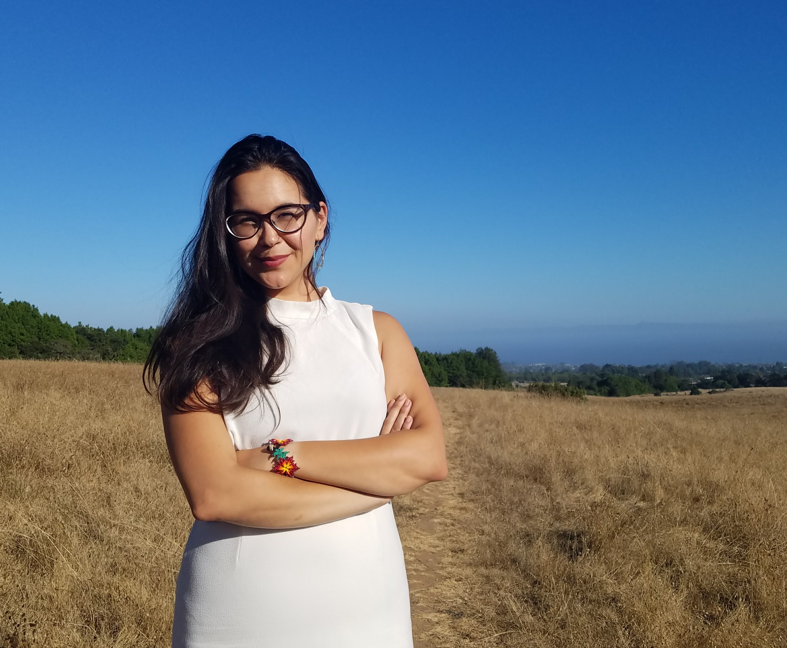
Wayne Clark Young Professionals Water Education Scholarship Fund
Our 2019 Recipient is: Adriana Renteria
Adriana is Regional Water Management Coordinator at the Community Water Center. Through participating in Sustainable Groundwater Management Act (SGMA) implementation efforts, Adriana works to support transparent and inclusive regional groundwater planning efforts that protect drinking water needs. Adriana also coordinates the Community Water Leaders Network (CWLN), a leadership network that supports local elected water decision makers to increase access to safe and affordable drinking water in their communities through information sharing, trainings, and roundtable discussions.
Adriana received a Bachelor of Arts in Environmental Studies and Economics from UC Santa Cruz. Before joining CWC, Adriana worked at UC Santa Cruz’s American Indian Resource Center as the Coordinator for People of Color Sustainability Collective, hosting programming around environmental justice topics and highlighting the many diverse ways that communities of color have practiced sustainability. Born and raised in Merced, Adriana is grateful to be back in the San Joaquin

Slide 5
New Activities: Strategic Plan
Mission
Strategic Goals

Slide 6
Mission: Provide timely, compelling, and diverse discussion of water policy, economics and resource management
Strategic Goals:
1: To facilitate an exchange of ideas to influence Western Water Policy
2: Provide timely, provocative and sometimes controversial programs
3: Foster enduring relationships to inspire an engaged water community
4: Create a venue to exchange ideas with water policy makers
5: Welcome new voices, perspectives and ideas to the water policy dialogue

