Slide 1
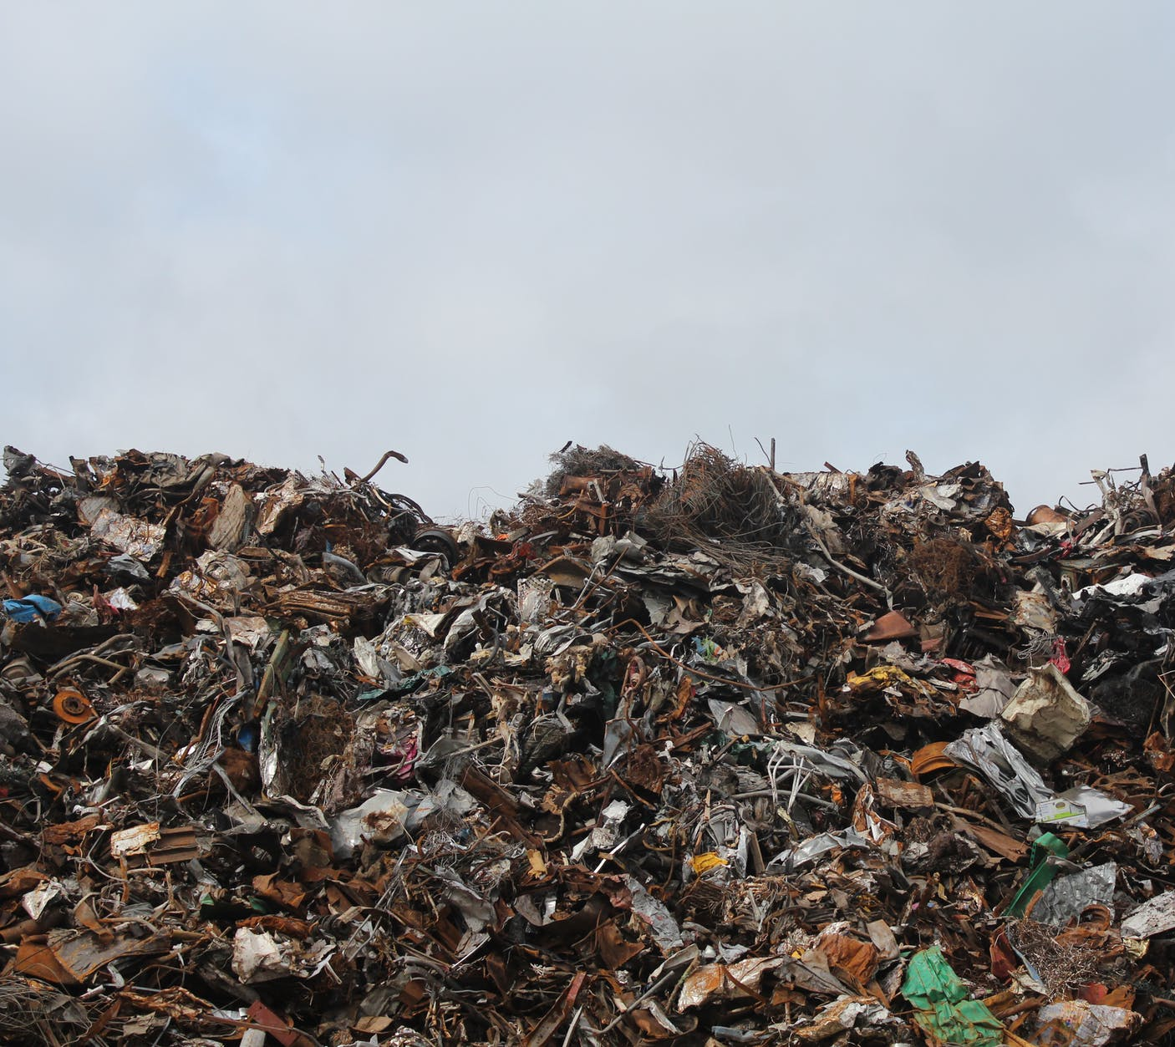
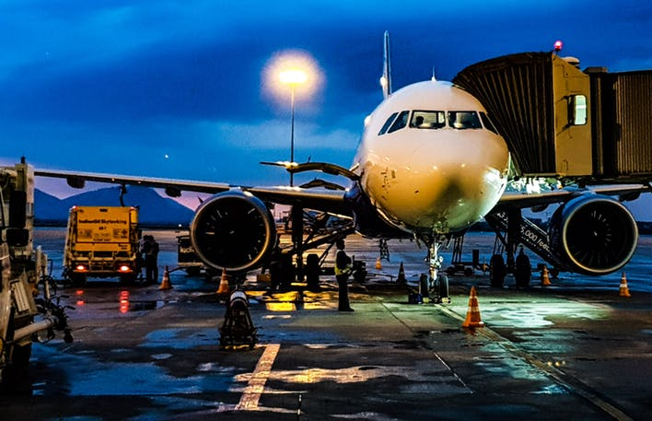
California Water Boards
PFAS Efforts
Annalisa Kihara, PE
Supervising Water Resource Control Engineer
Division of Water Quality

Slide 2
Outline
Phased Investigation Approach
Phase I: Investigative Orders
Laboratory Accreditation
Upcoming Efforts
Department of Defense Coordination

Slide 3
US EPA’s PFAS Action Plan
Drinking Water – Consider MCLs & Evaluate if broader PFAS regulation necessary
Monitoring – Nationwide PFAS drinking water monitoring in next UCMR cycle
Cleanup – Consider designating PFOS & PFOA as hazardous substance & developing interim groundwater cleanup recommendations

Slide 4
State Water Resources Control Board
Division of Drinking Water (DDW)
Health & Safety Code
Drinking Water
Division of Water Quality (DWQ)
Water Code
Groundwater
Surface Water
WQOs
NLs, RLs, MCLs
WQO = Water Quality Objectives
Narrative & Numeric to protect beneficial uses
NL = Notification Level
Concentration does not pose health risk
RL = Response Level
Concentration where DDW recommends source removal
MCL = Max Contaminant Level
Regulatory Concentration Limit
Notification Levels:
13 ppt PFOS, 14 ppt PFOA
Response Levels:
70 ppt combined (PFOA & PFOS)
Notes:
Health and Safety Code defines a Notification level (NL) as the concentration of a contaminant in drinking water that does not pose a significant health risk but warrants notification
Notification levels are issued under the authority of the Deputy Director of the Division of Drinking Water (DDW).
The Response Level (RL) is the concentration of a chemical at which DDW recommends removing the source from service or treatment.
NL’s and RL’s are based strictly on health impacts

Slide 5
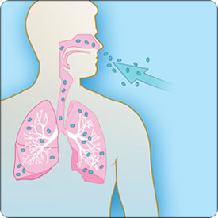
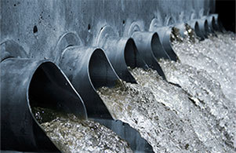
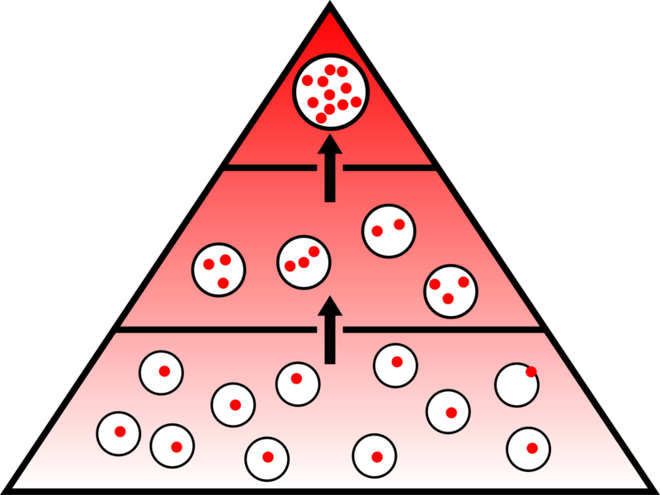
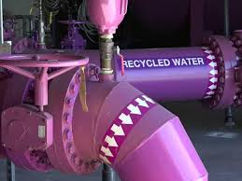
Exposure to PFAS
Ingestion
(food packaging)
Consumer and Industrial products
Dermal
Inhalation
Disposal
Manufacturing
Drinking water
Biosolids
Landfills
Fire-fighting
Wastewater
Food (Bioaccumulation)
Leach
Direct discharge
Effluent Discharge
Recycled Water
Groundwater and surface water

Slide 6
PFAS Phased Investigation approach: Phase I (Started March 2019)
California Water Code §13267 Orders (DWQ)
30 Commercial airports w/training or fire response sites
196 Municipal Solid Waste landfills
Labs must be compliant with Table B-15 of DoD QSM version 5.1 (or later)
23 required analytes, 15 optional
Notes:
WQ 2019-005-DWQ and WQ 2019-006-DWQ

Slide 7
PFAS Phased Investigation approach: Phase I (March – June 2019)
Health and Safety Code §116400 (DDW)
192 public water systems (approx. 612 public water supply wells)
Wells adjacent to airports, landfills, UCMR 3 detections
EPA Method 537 rev 1.1 (14 analytes) or 537.1 (18 analytes)
Notes:
WQ 2019-005-DWQ and WQ 2019-006-DWQ

Slide 8
Public water system well investigation: March and April 2019
2-mile radius
1-mile radius
1-mile radius
(UCMR 3 detection)
Public water system wells received 116400 orders

Slide 9
Targeted Detection Methods
CA ELAP Accreditation Available
Method: | EPA Method 537 (Rev 1.1) | EPA Method 537.1 | PFAS by LC-MS/MS compliant w/Table B-15 of QSM5.1+ | ASTM D7968-17a | EPA Method 8327 | EPA Method 8328
Release Year: | 2009 | 2018 | 2017 | 2017 | 2019 | Unreleased
Matrices: | DW | DW | SOL, WW, GW | S | GW, SW, WW | SW, GW, WW, SOL
PFAS Analytes | 14 | 18 | 23-38 (varies by lab) | 21 | 24 | 25
Labs accredited per method | 10 | 3 | 16 | 0 | 0 | -
Matrices
DW = Drinking Water SOL = Solids
WW = Wastewater SW = Surface water
GW = Groundwater
Notes:
Sampling & Analysis Challenges:
PFAS in almost everything
DDW & DWQ Sampling Guidance

Slide 10
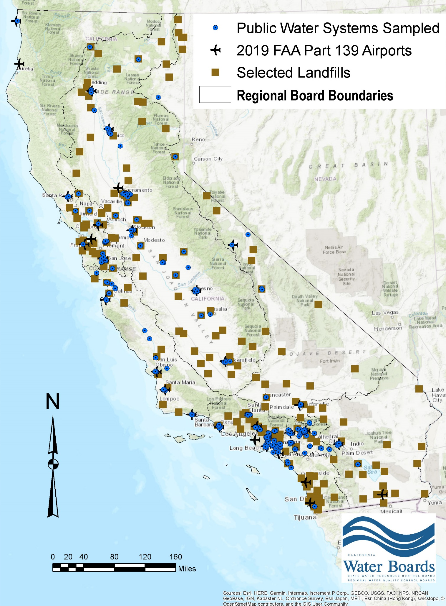
Investigation Results
Data collected will:
Identify impacted drinking water wells
Inform additional areas where watershed specific source identification efforts are needed
Inform additional monitoring (if needed)
Inform future investigations
Inform consideration of Public Health Goals (PHGs) and eventually potential MCLs

Slide 11
PFAS Phased Investigation approach: Upcoming Efforts
Potential sources & nearby drinking water wells:
Industrial manufacturing facilities (metal plating, chrome plating, etc.)
Wastewater Treatment Plants & Pre-treatment plants
New laboratory analysis methods:
EPA Method 8327: Validated June 2019. ELAP accreditation coming soon
EPA Method 8328: Target Fall 2019 (draft method)
“Total” PFAS method: (TOP, TOF): EPA currently evaluating.
Notes:
EPA 8328 based on existing SOP that meets DoD Quality Systems Manual 5.1 Table B-15 requirements.
Build in flexibility ‒
Columns ‒
Elution schemes
Two lab internal validation started, ten lab external validation study planned but…
‒ Process is too slow. Exploring collaborative effort with DoD to jump start external laboratory validation.
Target Fall 2019 for draft method.
Target Quantitation Limits: 10 nanogram/L

Slide 12
PFAS Phased Investigation approach: Upcoming Efforts
Implementation of Assembly Bill 756:
Water Board can order a public water system to
Monitor for PFAS
Report PFAS detections to customers
Remove a water source when a detection exceeds the response level

Slide 13
Department of Defense collaboration
Collaborate with all U.S. military branches:
identify past and current efforts
obtain data collected at all bases with known or suspected PFAS impacted groundwater
Ensure PFAS sources beyond AFFF use areas are assessed:
e.g. chrome plating, landfills, waste water treatment facilities
Identify drinking water wells sampled by U.S. military branches
domestic and public supply

Slide 14
For More Information:
Email: PFAS@waterboards.ca.gov
Website: waterboards.ca.gov/pfas/
LIST SERVE – BACKGROUND – GUIDES - FAQS - PRESENTATIONS
Annalisa Kihara, PE
Annalisa.Kihara@waterboards.ca.gov
Thank You

