Slide 1
Drought contingency planning: USGS perspectives
Urban Water Institute Annual Conference, San Diego, August 22, 2018
Eric Reichard, Director, USGS California Water Science Center

Slide 2
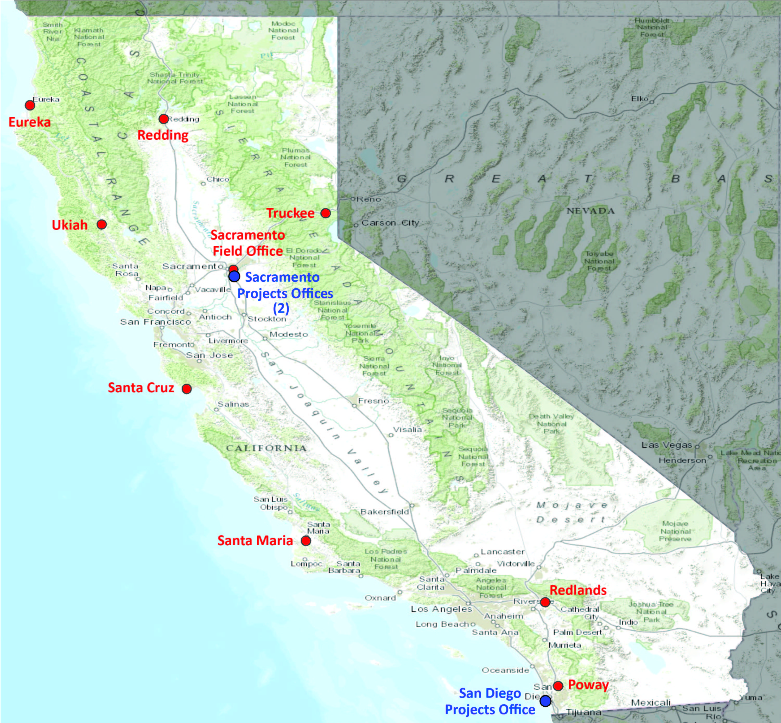
USGS Water Science Centers
28 Centers nationwide
Provide foundational data and scientific analyses to address the water issues facing the state(s) and nation.
Partner with state, regional, local, tribal, and federal entities.

Slide 3
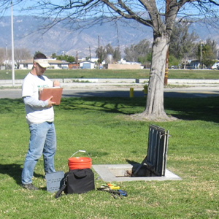
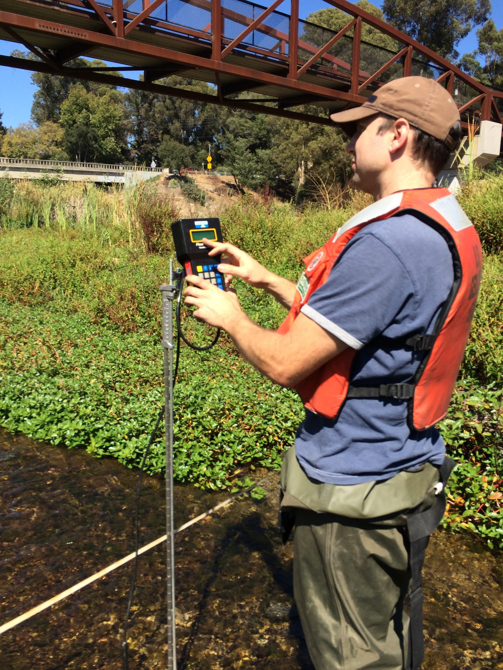
Responding to drought requires monitoring to characterize hydrologic trends and variability

Slide 4
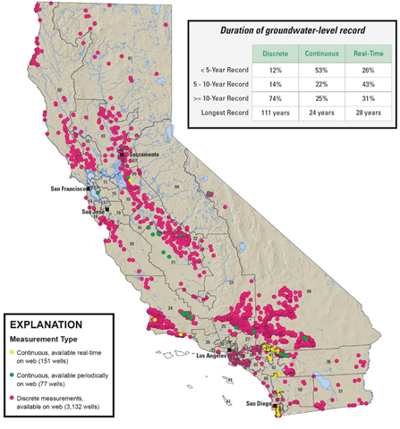
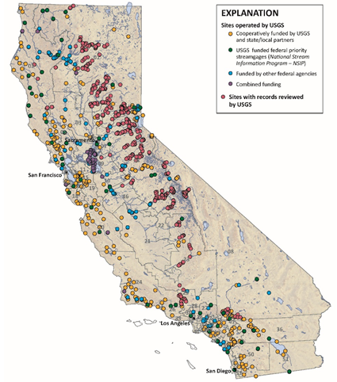
Groundwater Monitoring
~3000 discrete stations
~230 continuous stations
Surface Water Monitoring
~500 USGS gaging stations
~550 furnished records (FERC)
Notes:
24 gages in San Diego County
USGS 10255810 BORREGO PALM C NR BORREGO SPRINGS CA
USGS 11012500 CAMPO C NR CAMPO CA
USGS 11014000 JAMUL C NR JAMUL CA
USGS 11015000 SWEETWATER R NR DESCANSO CA
USGS 11016200 SWEETWATER R A DEHESA CA
USGS 11022200 LOS COCHES C NR LAKESIDE CA
USGS 11022480 SAN DIEGO R A MAST RD NR SANTEE CA
USGS 11023000 SAN DIEGO R A FASHION VALLEY AT SAN DIEGO CA
USGS 11023340 LOS PENASQUITOS C NR POWAY CA
USGS 11025500 SANTA YSABEL C NR RAMONA CA
USGS 11027000 GUEJITO C NR SAN PASQUAL CA
USGS 11028500 SANTA MARIA C NR RAMONA CA
USGS 11042000 SAN LUIS REY R A OCEANSIDE CA
USGS 11044250 RAINBOW C NR FALLBROOK CA
USGS 11044300 SANTA MARGARITA R A FPUD SUMP NR FALLBROOK CA
USGS 11044350 SANDIA C NR FALLBROOK CA
USGS 11044800 DE LUZ C NR DE LUZ CA
USGS 11045300 FALLBROOK C NR FALLBROOK CA
USGS 11045600 ONEILL LAKE OUTLET CH NR FALLBROOK CA
USGS 11045700 ONEILL LK SPILL CH NR FALLBROOK CA
USGS 11046000 SANTA MARGARITA R A YSIDORA CA
USGS 11046100 LAS FLORES C NR OCEANSIDE CA
USGS 11046300 SAN MATEO C NR SAN CLEMENTE CA
USGS 11046360 CRISTIANITOS C AB SAN MATEO C NR SAN CLEMENTE CA

Slide 5
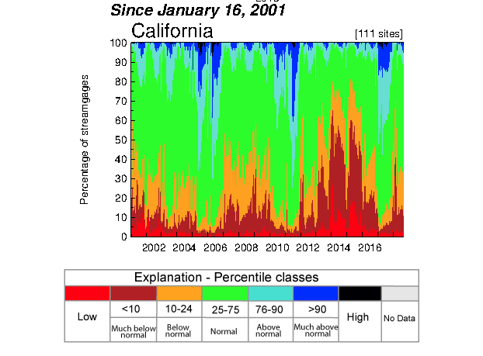
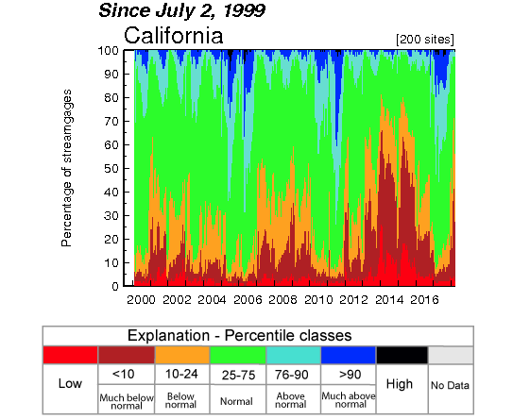
Streamflow variability
Notes:
Through Aug 19, 2018
Stations with >= 30 years record
https://waterwatch.usgs.gov/index.php?id=pa01d&sid=w__plot_sum&r=ca

Slide 6
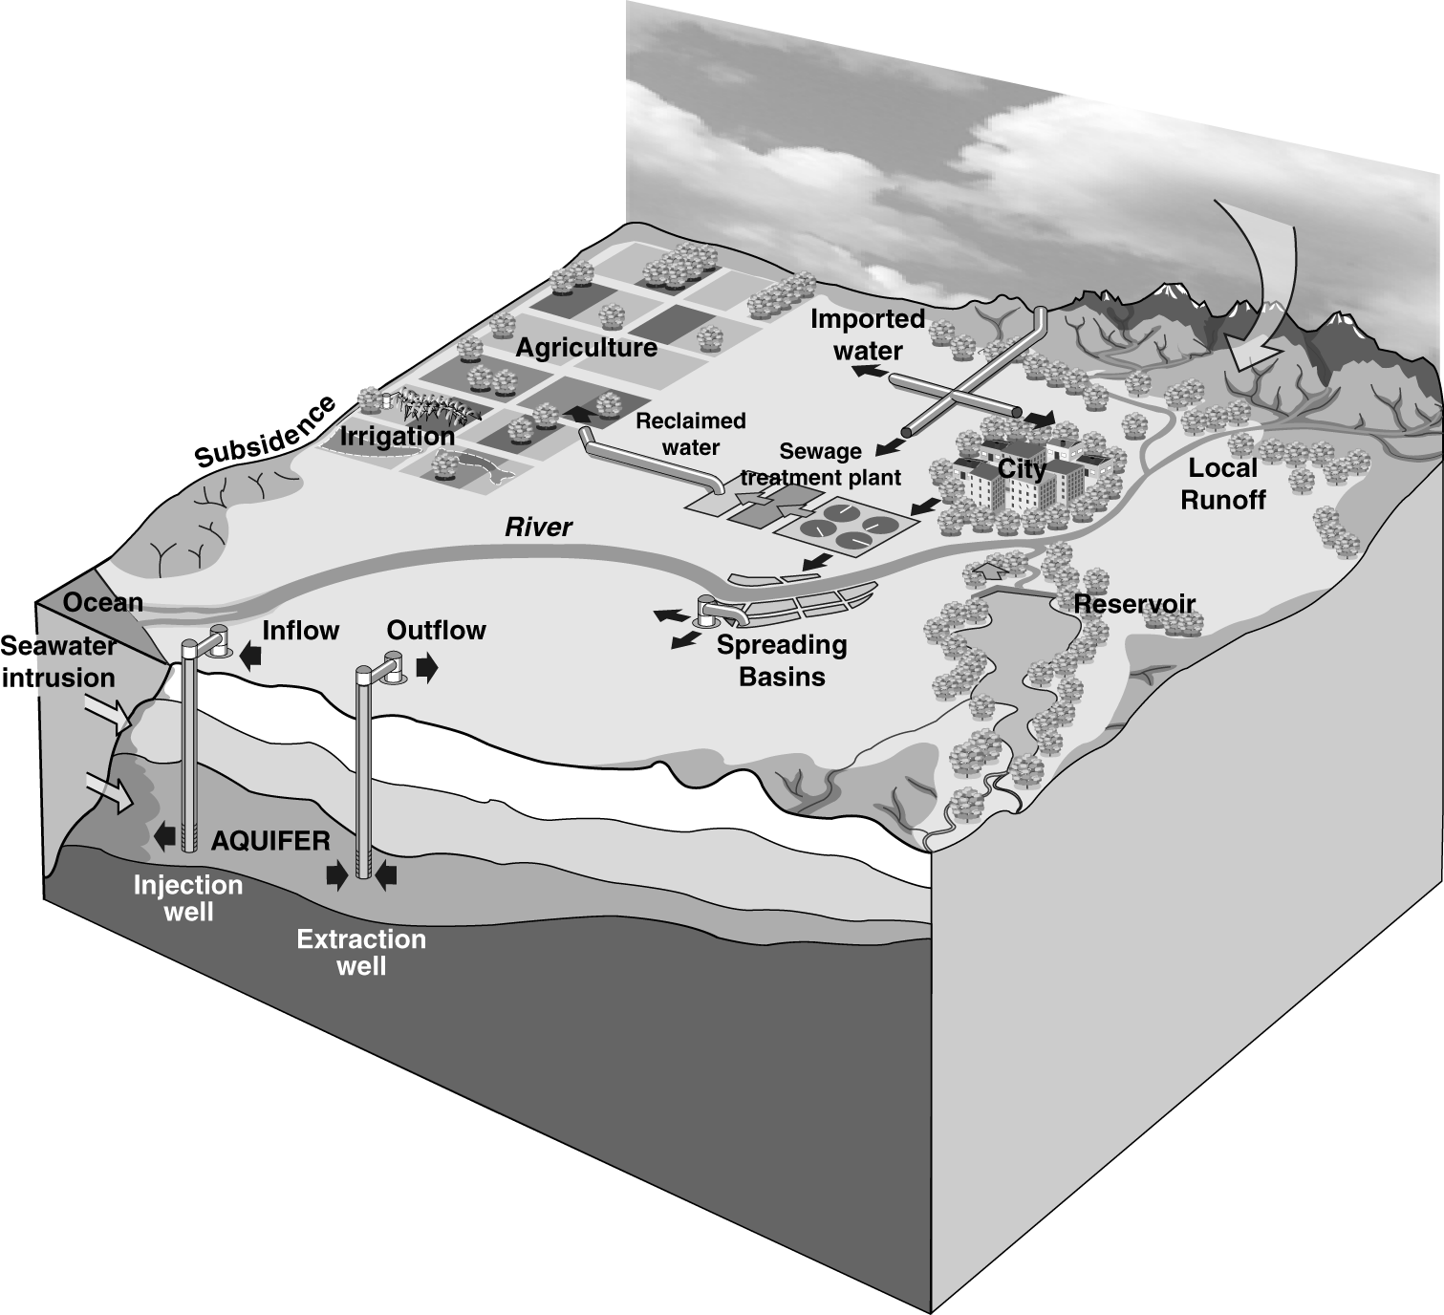
Responding to drought requires conjunctive surface water-groundwater management
Groundwater pumpage effects on surface water resources
Surface water availability effects on groundwater demand
Opportunities for managed aquifer recharge
Sustainable Groundwater Management Act (SGMA)

Slide 8
USGS national drought priorities
Evaluate the complex interactions that determine drought and drought effects;
Understand how drought affects fish and wildlife species;
Advance efforts in coordinate drought monitoring systems; and deliver decision-support science to help Federal, regional, State, Tribal, and local stakeholders.
Develop an integrated drought modeling and prediction capability to predict drought risk and vulnerability for planning and mitigation.
USGS California Drought site: ca.water.usgs.gov/california-drought

