Slide 1




TAPPING THE WORLD OF POSSIBILITIES
Urban Water Institute
Spring Water Conference
Palm Springs Hilton
February 28, 2019

Slide 2
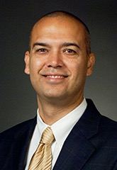
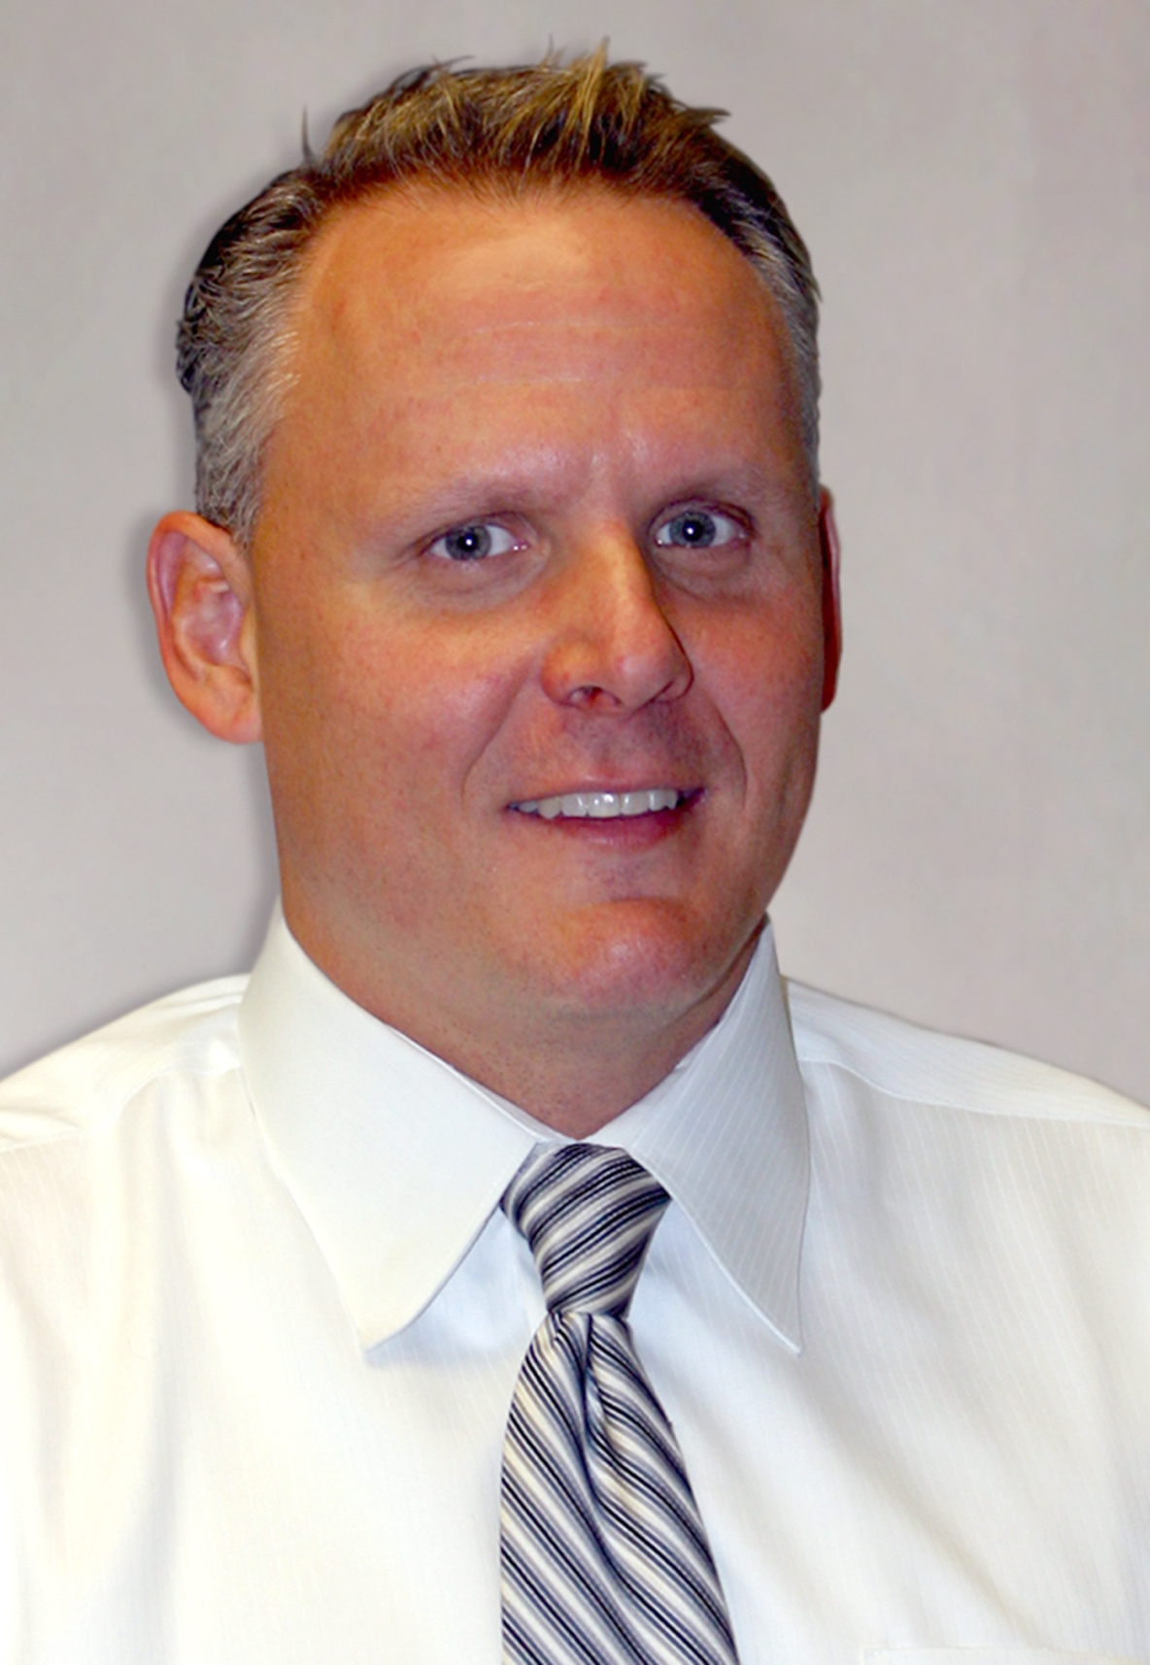
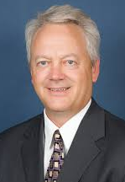
PANELISTS
Deven Upadhyay
Ray Tremblay
Tom
Love
AGM and Chief Operating Officer
Facilities Planning Department Head
General Manager
Metropolitan Water District of Southern California
Sanitation Districts of Los Angeles County
Upper San Gabriel Valley Municipal Water District

Slide 3
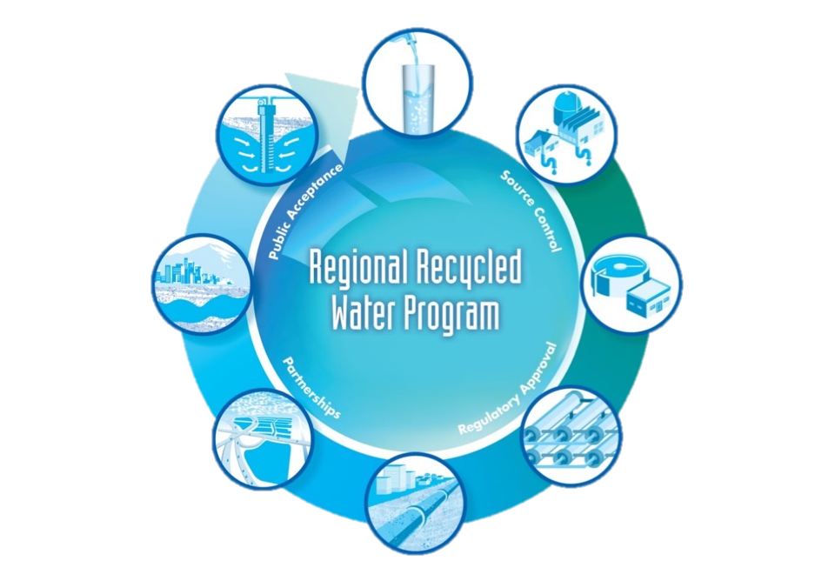
OVERVIEW
Potable Uses
Homes and Businesses
Extraction Wells
Joint Water Pollution Control Plant
Groundwater Basins
Spreading Grounds or Injection Wells
Advanced Water Treatment Plant
Conveyance System

Slide 4
IMPLEMENTATION
Three Perspectives
Tom Love
Ray Tremblay
Upper San Gabriel Valley Municipal Water District
Los Angeles County Sanitation Districts
Deven Upadhyay
Metropolitan Water District of Southern California

Slide 5
Program overview
Deven Upadhyay – Metropolitan Water District
5

Slide 6
PROGRAM CONCEPT
Collaboration between Metropolitan and the Sanitation Districts of Los Angeles County
Development of a new regional water source
Up to 150 mgd (168,000 AFY)
Deliveries to Member Agencies
Recharge and store in groundwater basins
Increase regional storage reserves and reliability

Slide 7
METROPOLITAN & LACSD
Decade of discussions on water recycling
  2010-12 Pilot studies on treatability of effluent
  2015 Discussions on a potential partnership
November 2015 – Board authorized
  Agreement with LA County Sanitation District No. 2 for development of potential regional recycled water program
  Recycled water demonstration project
  Feasibility and financing studies

Slide 8
METROPOLITAN & LACSD
November 2016 – Feasibility Study Report
  RRWP at 150 mgd is technically feasible
  Identified challenges and uncertainties
  Recommended additional conceptual planning studies
  Total Capital Costs: $2.7 Billion (2016 dollars)
  Unit Cost of Yield: $1,610 per acre-foot (2016 dollars)

Slide 9
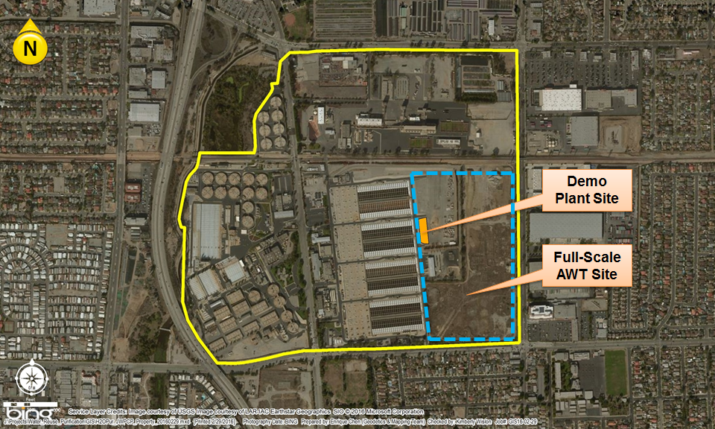
AWT LOCATION AT JWPCP

Slide 10
CONCEPTUAL PLANNING STUDIES
10

Slide 11
MAJOR CONCLUSIONS
Phased implementation is recommended
  Initial AWT capacity of 100 mgd
  First phase backbone conveyance system
  Flexibility for future DPR
Cost-effective approach
  Keeps unit costs of yield competitive with full-scale program
  Reduces initial capital and O&M costs of the program

Slide 12
BENEFITS OF PHASING
Annual yield at 100 mgd closely matches demands
Initial production of 100 mgd increases certainty of wastewater flow availability
Future DPR opportunities include Weymouth WTP
Regulatory complexity reduced
Unit production costs are competitive with full-scale implementation
Impact on overall MWD costs reduced from full-scale implementation

Slide 13
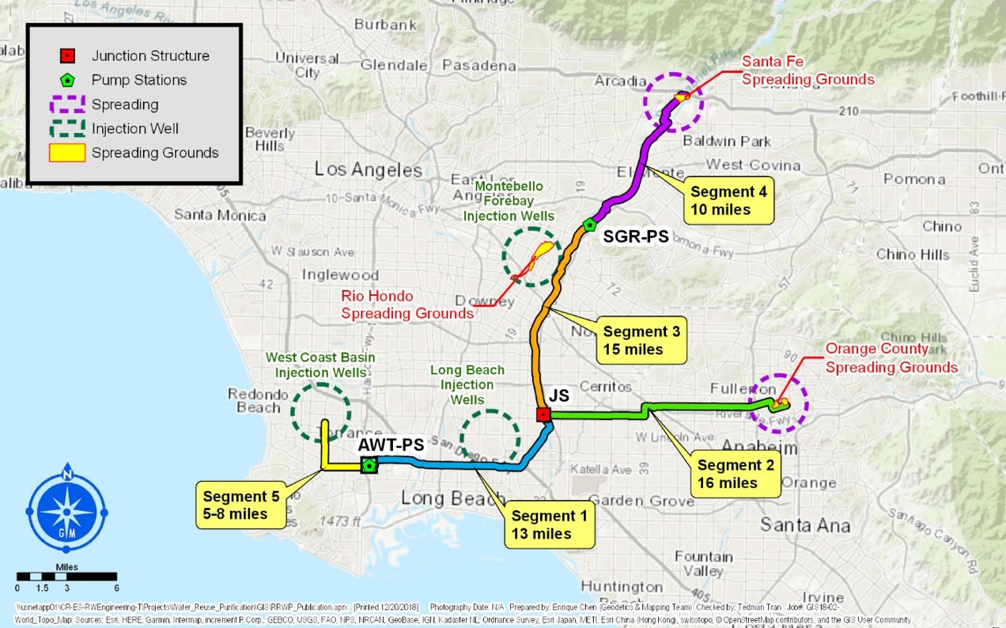
CONVEYANCE OVERVIEW

Slide 14
PROPOSED PROGRAM
MGD | 100 | 50 | 150
Phase | Phase 1 | Phase 2 | Total
Capital Cost ($M)* | $2,615
Unit Cost ($/AF) | $1,813
Santa Fe Spreading
Grounds
*Does not include any grants or other outside funding
Montebello Forebay Injection Wells
Pump Station
Rio Hondo Spreading
Grounds
Up to
150-mgd Pipeline
Harbor Industrial Users
Long Beach
Injection Wells
JWPCP
100-mgd AWT & Pump Station
Backbone System
PHASE 1 BACKBONE

Slide 15
PROPOSED PROGRAM
MGD | 100 | 50 | 150
Phase | Phase 1 | Phase 2 | Total
Capital Cost ($M)* | $2,615 | $782 | $3,397
Unit Cost ($/AF) | $1,813 | $1,853 | $1,826
Pump Station(s)
Santa Fe Spreading
Grounds
*Does not include any grants or other outside funding
Montebello Forebay Injection Wells
Pump Station
Rio Hondo Spreading
Grounds
Up to
150-mgd Pipeline
Harbor Industrial Users
Long Beach
Injection Wells
West Coast Basin
Injection Wells
Junction Structure
60-mgd Pipeline
Orange County Spreading
Grounds
JWPCP
150-mgd AWT & Pump Station
Backbone System
Additional Basin Options
ADDITIONAL RECHARGE

Slide 16
PROPOSED PROGRAM
Pump Station(s)
Weymouth WTP
Santa Fe Spreading
Grounds
Montebello Forebay Injection Wells
MWD
Yorba Linda Feeder
Pump Station
Rio Hondo Spreading
Grounds
Up to
150-mgd Pipeline
Long Beach
Injection Wells
Diemer WTP
Harbor Industrial Users
West Coast Basin
Injection Wells
Junction Structure
MWD EOCF#1
Orange County Spreading
Grounds
JWPCP
150-mgd AWT & Pump Station
Backbone System
Additional Basin Options
Future DPR Options

Slide 17
ADDITIONAL COMMENTS
Further refinement of DPR options will continue during environmental planning
Full range of options to be included in a Programmatic Environmental Impact Report (PEIR) and a Programmatic Environmental Impact Statement (PEIS)
Preliminary cost estimates have been updated from 2016 to 2018 dollars

Slide 18
PROGRAM COSTS
Recommended Program
 | Phase 1 Backbone (2018 Dollars) | Full Program^{1,2} (2018 Dollars)
Production Capacity (mgd) | 100 | 150
Capital Program Cost³ | $2.6 billion | $3.4 billion
Program Unit Cost of Yield ($/AF) | $1,813 | $1,826
¹Adds Orange County and West Basin deliveries to Initial Backbone system
²Does not include costs for DPR to Weymouth or Diemer WTPs
³Costs include 25% for engineering services and 35% overall program contingency

Slide 19
NEXT STEPS
Post Final Conceptual Planning Studies Report (Mid-February 2019)
Presentation to E&O Committee (March 2019 Meeting)
Hold Board Workshops (Spring-Summer 2019)
Request Board consideration to proceed with environmental process and engineering support (Fall 2019)
Continue Demonstration Plant testing for regulatory approval and AWT optimization
Draft Report Under Development

Slide 20
TAPPING THE WORLD OF POSSIBILITIES
Urban Water Institute
Spring Water Conference
Palm Springs Hilton
February 28, 2019

Slide 21
Wastewater perspective
Ray Tremblay – Sanitation Districts of Los Angeles County

Slide 22
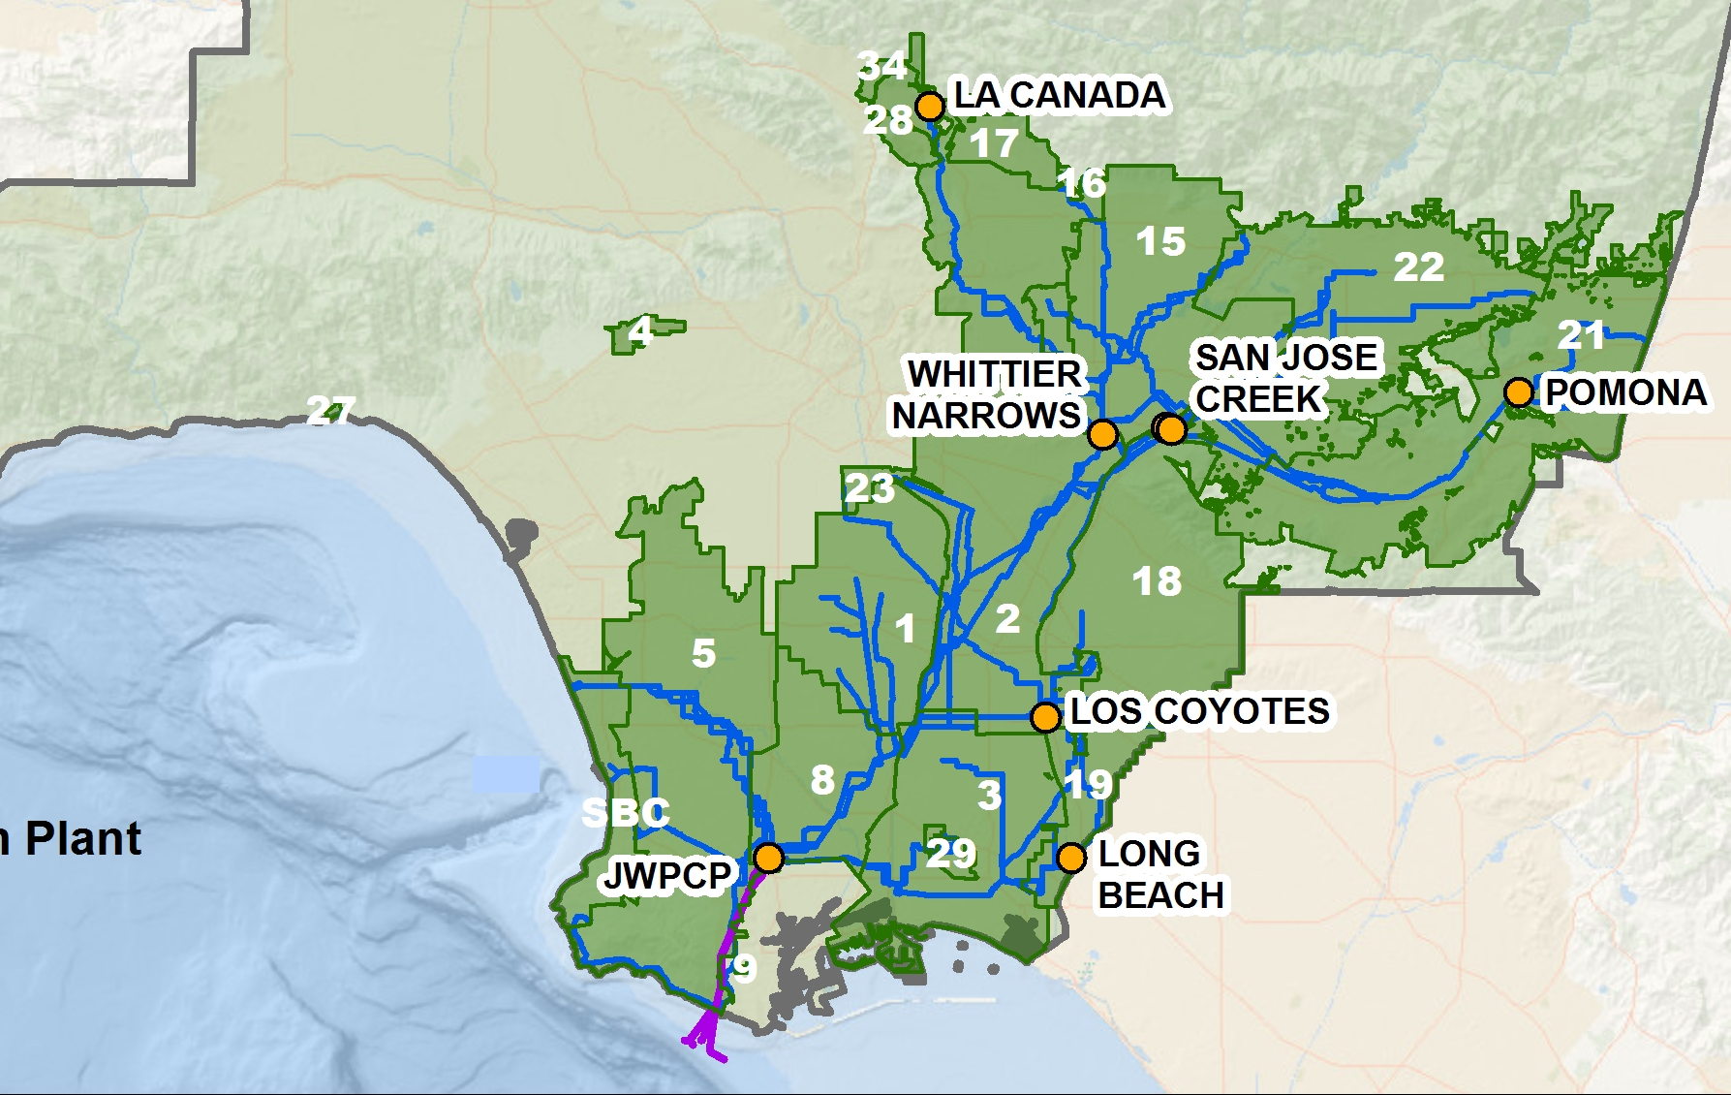
JOINT OUTFALL SYSTEM
Collect and treat sewage from 5.6 million people
GOVERNANCE
24 special districts with one staff
SERVICE AREA
78 cities & unincorporated county
824 square miles
INFRASTRUCTURE
1,400 miles of sewers
11 wastewater treatment plants
Ocean outfall system
Notes:
We’re a regional agency that collects and treats sewage (wastewater) from over 5.6 million people, over half the County’s population.
In terms of governance, we’re actually 24 separate special districts that share the same staff under a joint powers agreement. The mayors of 78 cities and the Chair of the County Board of Supervisors sit on our board.
We have 11 treatment plants, 7 are part of our JOS, we built upstream near where reuse can occur.
We produce about 400 mgd, reuse about 100 mgd.
Flows for upstream WRPs is mostly contracted
Largest facility, and only ocean discharge plant is JWPCP producing about 260 MGD.
Largest and only untapped source of water
Sewage from cities flow into our large trunk sewers (shown in blue) and then directed to one of 7 wastewater treatment plants (shown in orange).
Two separate systems – segregate higher quality domestic from industrial sources
The upstream (inland) plants are purposely located so that the treated water can be recycled where the demand is the highest.
Also, the sewage not handled by the upstream plants flows down to the Carson plant. Industry was sited in LA county in part knowing it would go to JWPCP.

Slide 23
PRODUCTION/REUSE

Slide 24
A CHANGING FOCUS
New Site Plan For JWPCP
Effluent Performance Specification
Nitrogen Management
  Water Quality Goals
  Cost and Feasibility
  Integration With Existing Operations
Acceptance of Brine Discharges
Source Control
  Boron, Nitrosamines, 1,4-Dioxane
Notes:
During demo plant testing we will be looking not only at impact of waste residual, (waste streams from the treatment processes), brine as well as the removal of some compounds.
Providing Construction Support, Preparing for Demo plant testing, Exploring Opportunities to Enhance the Source Water Quality (Nitrogen Management &Source Control)
Collect data that will:
Help assess the impact of residual waste streams on JWPCP operation
Provide information for the Sanitation Districts’ Source Control Program
Help assess regulatory compliance with JWPCP NPDES permit and Ocean Plan requirements as related to chemistry, microbiology and toxicity
Collect data to assess the impact of residual waste streams on JWPCP operation
Collect data for the Sanitation Districts’ Source Control Program
Coordinate with MWD to ensure data needs are met to assess regulatory compliance with Groundwater Recharge requirements and Basin Plan objectives
Collect data to assess regulatory compliance with NPDES and Ocean Plan requirements
Approach
Identify Potential Source(s)
Residential, industrial or POTW source
Review existing data, collect data
Initiate IW Source Control Efforts as Warranted
Approach varies based on source and compound
Could involve outreach and/or treatment evaluations
Objective: Identify optimal nitrogen management practice based on:
Ability to Meet Water Quality Goal
Operational Complexity
Operational Reliability and Redundancy
Technology Maturity
Cost
Environmental Impact
Constructability

Slide 25
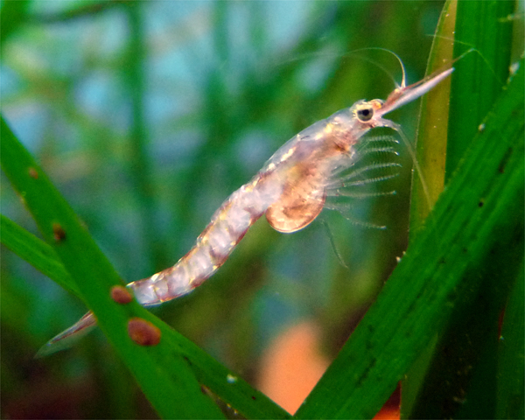
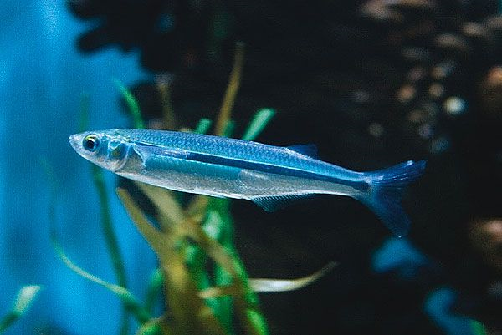
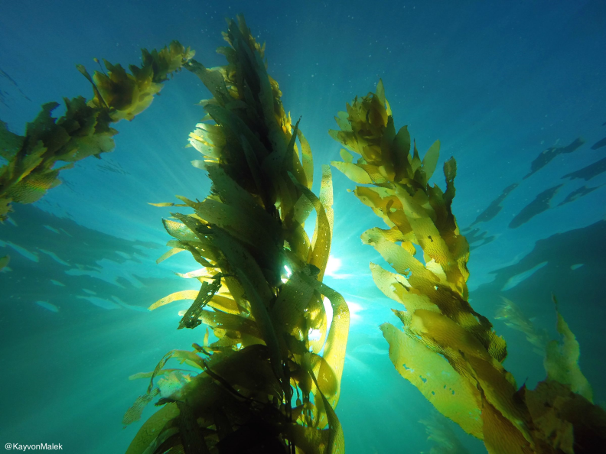
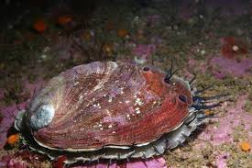
OCEAN DISPOSAL OF BRINE

Slide 26
TAPPING THE WORLD OF POSSIBILITIES
Urban Water Institute
Spring Water Conference
Palm Springs Hilton
February 28, 2019

Slide 27
Replenishment NEEDS
Tom Love – Upper San Gabriel Valley MWD

Slide 28
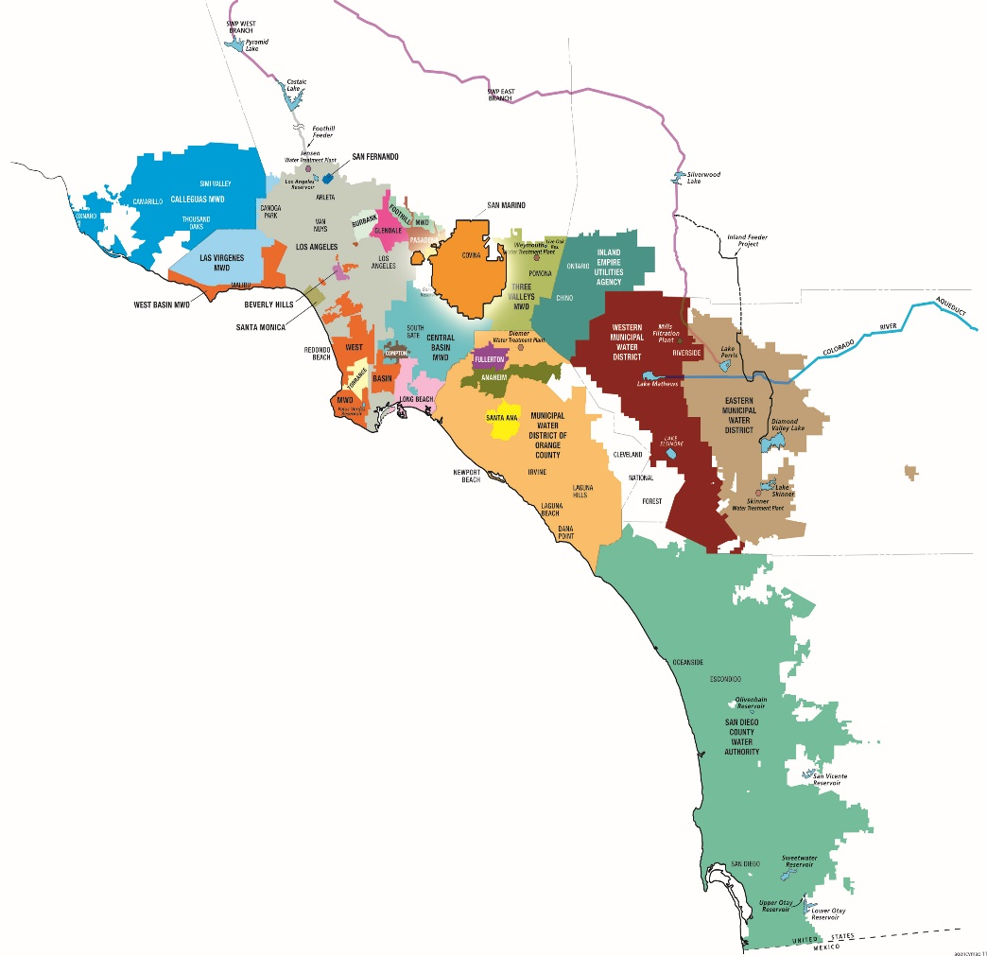
UPPER SAN GABRIEL VALLEY MWD
A special district formed in 1960
144 square mile service area
Population served: 900,000
Provides supplemental water to San Gabriel Valley communities
Metropolitan Water District member agency
Total water demand is about 200,000 acre feet of water annually
75% Local/25% Imported Water Supply
www.upperdistrict.org

Slide 29
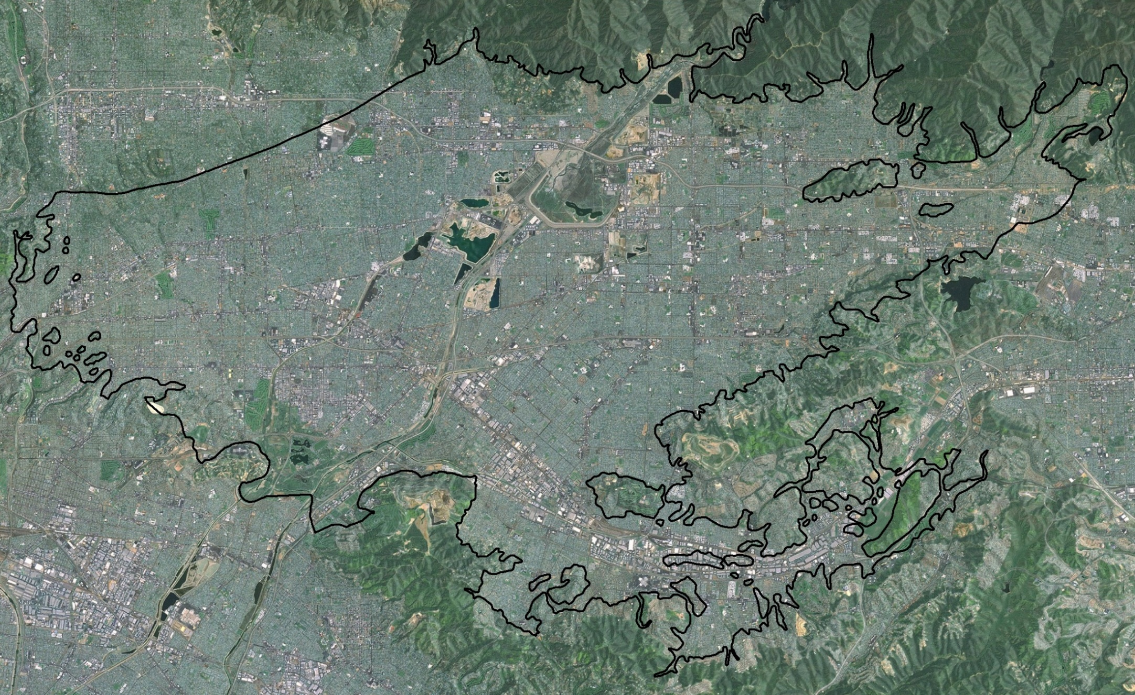
ARIAL OF SAN GABRIEL BASIN

Slide 30
KEY WELL
Current Elevation: 179.1 ft. (as of Jan. 25, 2019)
Notes:
530,000 AF storage used during drought.
Space for over 560,000 AF – no losses
154,000 AF in Cyclic Accounts – Average annual imported Basin wide 60,000 AFY – UD 2/3rds

Slide 31
RECYCLED WATER
Notes:
Direct 3,000 AFY. 25 year effort on indirect potable (10,000 AFY)
LACSD flows down 40% since 2000 – RW Demands have increased, 1211 permitting barriers.

Slide 32
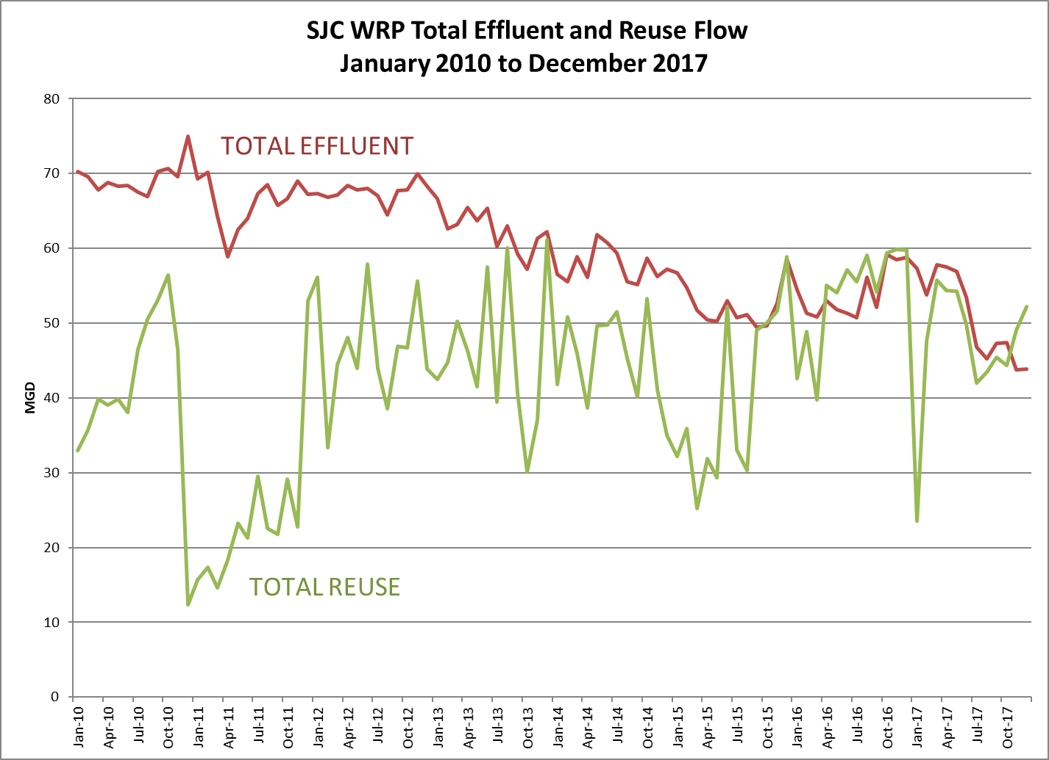
  Effective Water Conservation and Increasing Recycled Water Utilization – Upstream Plants Fully Utilized
Notes:
Nearly all rainfall is captured in all but the wettest of years

Slide 33

33

