Slide 1
The City of Los Angeles and The Los Angeles River
Urban Water Institute Spring Water Conference
February 28, 2019
Evelyn Cortez-Davis, P.E., BCEE
Assistant Director of Water Resources

Slide 2
History of the Los Angeles River
Source: The Los Angeles River Revitalization Master Plan
Notes:
EARLY HISTORY OF THE LA RIVER
The Los Angeles River has since evolved into many looks/incarnations
The River is the original source of life for the City of Los Angeles. Once plentiful with wetlands and marshes, filled with willows, alder, sycamore, steelhead trout, and grizzly bears, it was home to the Tongva people for thousands of years.
In the 19th and 20th centuries, the River powered the City’s industry and served as an important transportation corridor, creating economic value and growth.
A series of devastating floods caused the River to be channelized beginning in the 1930s-1940s
Flood events
1914: $165 million in property damage;
1934: $75 million in damage and 49 deaths;
1938: $900 million in damage and 87 deaths
The picture on the right shows the current state of the River, with most of the 51-miles channelized.

Slide 3
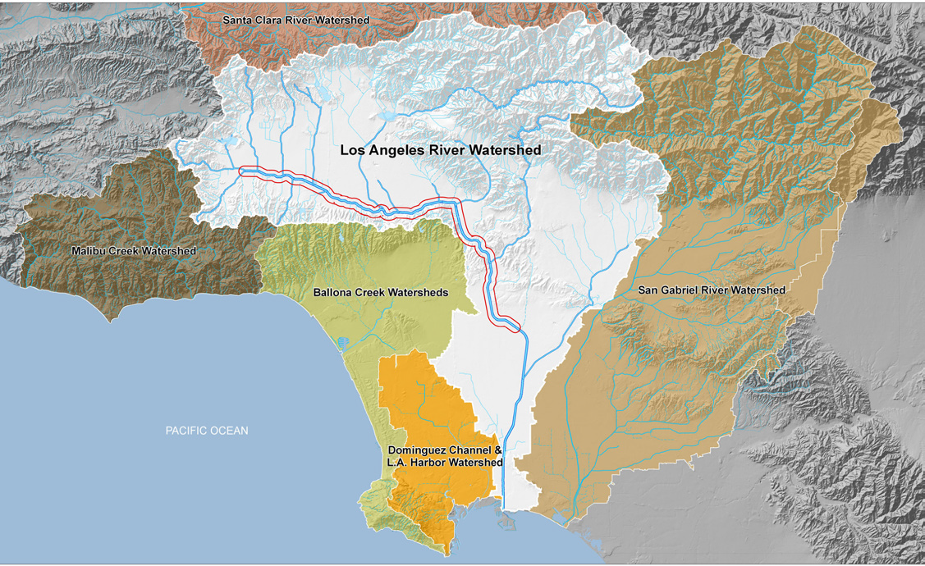
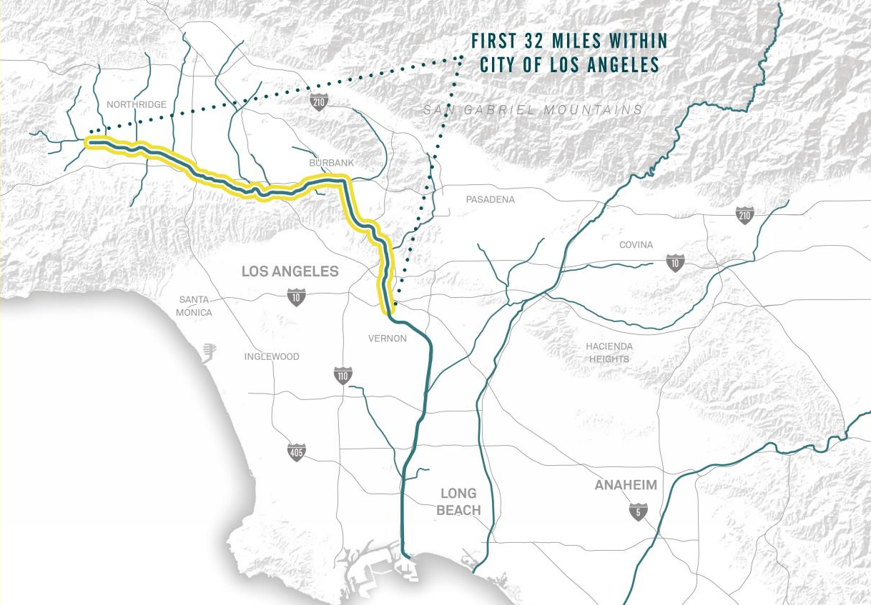
The Los Angeles River Watershed
32-mile reach of the LA River within the City of Los Angeles
Source: The Los Angeles River Revitalization Master Plan
Notes:
LAR Watershed ~ 830 mi^2
The Los Angeles River begins in the west San Fernando Valley (Simi Hills), and ends at the Pacific Ocean
15 cities in the River Corridor
900,000+ people within 1 mile buffer of River
400,000 of which live within the City of LA
32 miles of the 51-mile river are located with the City’s boundaries.

Slide 4
Los Angeles River Water Sources
Tillman WRP
Burbank WRP
LA -Glendale WRP
The City’s Water Reclamation Plants (WRP) are operated by LASAN

Slide 5
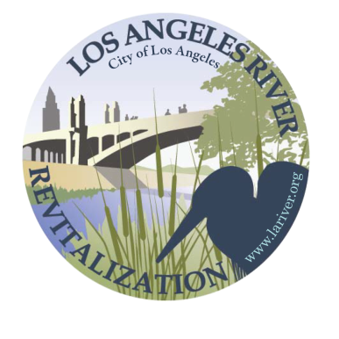
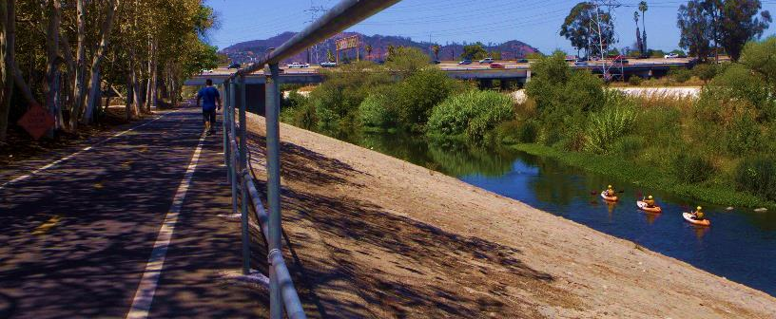
Diverse Interests for the Los Angeles River
Water supply
Recycled water projects
1211 petitions
Stormwater runoff reductions
Water rights allocations
Beneficial uses
Habitat restoration
Recreational activities
Community engagement
www.larivermasterplan.org
lariver.org

Slide 6
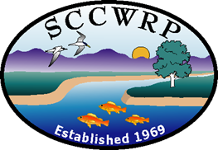
SWRCB Los Angeles River Flow Study
River Beneficial Uses
Local Water Supply
Southern California Coastal Water Research Project

Slide 7
Los Angeles River Flow Study Project Goals
Technical tools
Relationship between flows and aquatic/non-aquatic beneficial uses
Flow management scenarios
Consensus on appropriate flow needs and optimal flow management scenarios
Source: Establishing Environmental Flow for the Los Angeles River presentation by SCCWRP, SWRCB, Colorado School of Mines and Council for Watershed Health
Notes:
Develop technical tools that quantify the relationship between various alternative flow regimes and the extent to which aquatic life and non-aquatic life beneficial uses are achieved.
Evaluate various flow management scenarios in terms of their effect on uses in the LA River.
Engage multiple affected parties to reach consensus about appropriate flow needs and optimal allocation of flow reduction allowances from multiple WRPs in consideration of other proposed flow management actions.

Slide 8
Los Angeles River Flow Study Project Tasks
Stakeholder Coordination
Non-aquatic Life Use Assessment
Aquatic Life Beneficial Use Assessment
Apply Environmental Flows/Evaluate Scenarios
Monitoring and Adaptive Management Plan
Source: Establishing Environmental Flow for the Los Angeles River presentation by SCCWRP, SWRCB, Colorado School of Mines and Council for Watershed Health
Notes:
Activity 1 Goal - Coordinate with stakeholders on technical approach and desired outcomes
Activity 2 Goal – Identify key non-aquatic life uses and determine hydrologic needs for those uses
Minimum depths and flow needs for fishing, bird watching, recreation, etc.
Activity 3 Goal – Develop flow-ecology relationships for key aquatic species or habitats in the LA River
Task 3A – Assess hydrologic baseline
Task 3B – Identify and categorize ecological endpoints of management concern
Task 3C – Determine flow-ecology relationships for stream endpoint
Task 3D – Determine flow-ecology relationships for marsh and estuary habitats
Activity 4 Goal – Evaluate effect of flow management/alteration on both aquatic life and non-aquatic life uses in the LA River
Task 4A – Determine appropriate hydrologic tools and update modeling analysis
Task 4B – Analyze tolerances of system to flow modification
Task 4C – Analyze water use scenarios
Task 4D – Evaluate stormwater capture scenarios
Task 4E – Evaluate groundwater interactions
Task 4F – Evaluate habitat management offsets for flow reductions
Task 4G – Evaluate effects of flow alteration on tidal portions of the river
Task 4H – Establish recommended flow targets w/stakeholder coordination
Activity 5 Goal – Develop a recommended monitoring strategy with potential triggers for adaptive management
Permanent flow monitoring stations and monitor biological responses to flow changes

Slide 9
Los Angeles River Flow Study Schedule and Cost
Schedule: completed by December 2020
Total Cost $2.86M
State/Regional Boards’ contribution - $1.7M
Funding partners - $1.16M
For technical elements of study
City of Los Angeles, LACDPW and LACSD

Slide 10
Los Angeles River Case Study Benefits
Develop tools and approaches for assessing effects and optimizing water use management scenarios
Support decision making under water code section 1211 –wastewater change petitions
Prototype for consideration of establishing environmental flows in urban (effluent dominated) systems
Case study for implementation of Tier 2 of statewide environmental flows framework
Source: Establishing Environmental Flow for the Los Angeles River presentation by SCCWRP, SWRCB, Colorado School of Mines and Council for Watershed Health
Notes:
California Environmental Flows Framework
In 2016, a group of experts self-organized to pool knowledge and data, evaluate methods, and ultimately develop a statewide framework for determining environmental flow criteria for California. The strategy is organized into a two-tiered approach that varies in scale and detail.
The two-tiered framework will provide a set of functional flow criteria for all streams in California (Tier 1) and a technical guidance document for estimating refined flow criteria at regional to site-specific scales (Tier 2).
Tier 1: Use the California natural stream classes and the functional flows method to set flow criteria statewide
Statewide applicable approach to set flow criteria protective of river-dependent ecosystems
Tier 2: Provide guidelines for estimating refined flow criteria depending on the regional, local or site-specific context
A tailored approach that incorporates specific environmental and water management factors and priorities

Slide 11
Thank You
Questions?
Evelyn Cortez-Davis, P.E., BCEE
Assistant Director, Water Resources Division
Los Angeles Department of Water and Power
evelyn.cortez-davis@ladwp.com

