Slide 1
How Sanitation Water Should Be Allocated: Ecosystems V. Recycling
Aaron A. Ferguson
Urban Water Institute Conference
February 28, 2019
Palm Springs, CA

Slide 2
THE 1211
PROCESS

Slide 3
Water Code Section 1210
Establishes treatment plant owner’s exclusive right vs. suppliers rights to reclaimed water system, unless agreement to contrary
Sections 1210-1212 do not alter obligations to any “legal user of the discharged treated wastewater”
Sections 1210-1212 do not affect water quality permitting or regulatory enforcement

Slide 4
Water Code Section 1211
Requires SWRCB approval for “change in point of discharge, place of use or purpose of use” of recycled water if the change will result in a reduction in streamflow in any part of a watercourse
Proposed changes reviewed pursuant to
Water Code § 1700 et seq.
Only required finding is no injury to any “legal users of the water involved” (Wat. Code §1702)

Slide 5
Water Code Section 1212
Allows for dedication of all or portion of discharges for fish and wildlife enhancement, and other instream uses, and water is then not available for use or appropriation by other users
Potential utilization as a mitigation measure for recycled water projects

Slide 6
NO INJURY
ANALYSIS

Slide 7
No Injury Analysis
“Whether or not injury will occur depends on whether the other legal users of the water have water rights sufficient to require [the waste water treatment plant owner] to release the treated waste water for the legal users’ benefit.” (Order WR 95-9 [Reconsideration of WW Order 20].)

Slide 8
Ownership Analysis
Analytical Framework for Recycled Water Rights Issues
  Source of Supply / Rights of Downstream Users
  Amount of Water
  Place of Use
  Means of Conveyance
  Instream Flow Considerations

Slide 9

Ownership Analysis
Source of the recycled water
  Natural Flow
  Imported Water
  Foreign Water
  Water delivered under contract
  Groundwater

Slide 10
“No Injury” Analysis
Downstream water right holders are protected from injury to the extent the source of the water is native water/natural flow
No injury rule does not protect downstream water right holders when the source of the water is “foreign water.”
Foreign water is water that would not be present in a given water body under natural conditions.
  Imported Water (from outside watershed)
  Foreign in time (stored water)
  Non-tributary groundwater

Slide 11
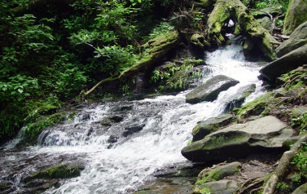
Rights of Downstream Users
Riparian Rightholders
  Most senior
  Attach to natural flow
  Do not attach to:
    Water foreign to the water course
    Previously stored water
    Non-tributary groundwater

Slide 12
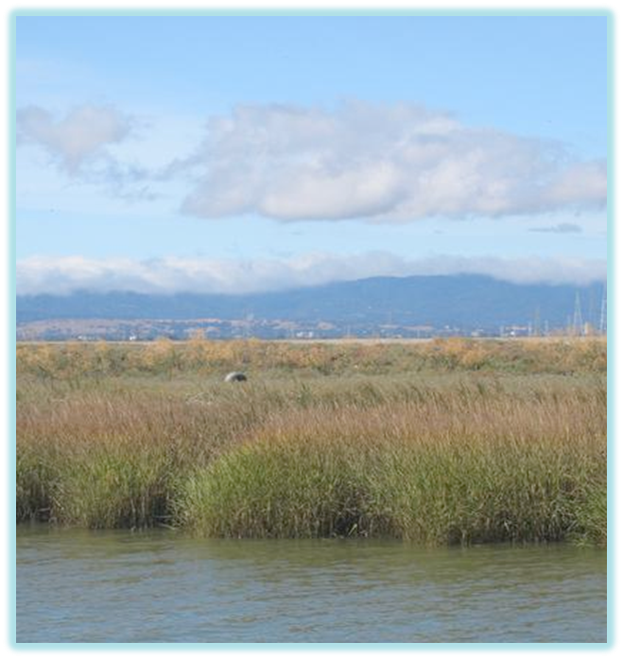
Rights of Downstream Users
Appropriative Rights
  Rights attach to any water flowing in the stream, subject to terms and conditions (Wat. Code, §1201.)
  Seniority depends on date of application or date appropriation commenced
  Appropriative rights initiated since 1914 can only be acquired by obtaining permit from SWRCB (People v. Shirokow (1980) 26 Cal.3d 301.)

Slide 13
Relative Rights
Source: Natural Flow
  Subject to appropriation
  Subject to right to recapture and reuse in place of use of upstream right holder
Source: Abandoned Foreign Water
  Subject to appropriation (Bloss v. Rahilly (1940) 16 Cal.2d 70.)
  Subject to right of importer to recapture at any time
    Stevens v. Oakdale ID (1939) 13 Cal.2d 343, 348-49
  Those appropriating abandoned foreign water are junior to the importer

Slide 14
SWRCB Standard Permit Term 25
Title: Nonnatural Water
When Used: If some or all of the water applied for is return flow, imported water, or waste water
Term: To the extent that water available for use under this permit is return flow, imported water or wastewater, this permit shall not be construed as giving any assurance that such supply will continue

Slide 15
Natural Flows/Return Flows
“When waters are diverted from surface flows or pumped from the ground and put to some use, such as for irrigation or household purposes, there is typically an unconsumed portion, and if the unconsumed portion drains back to the stream, it is known as “return flow.” (Hutchins, The Law of California Water Rights (1956), p.392.)
Unappropriated water” includes “[w]ater which having been appropriated or used flows back into a stream, lake or other body of water.” (Wat. Code, §1202(d); see Ahaheim Union Water Co. v. Fuller (1907) 150 Cal. 327, 330.)

Slide 16
Treated Waste Water and Return Flow Doctrine
Scott v. Fruit Grower’s Supply Co. (1927) 202 Cal. 47
  See WR 95-9, p. 18 “[w]here natural flow has been returned to its stream after use, the downstream right holders using the return flows have been able to prevent the discharger from reclaiming the water.”
Notably, Scott had nothing to do with return flows
  It concerned diversion of spring flow to another watershed
  The waters diverted and exported were not first put to use, as return flows would have been
  Discussion of use for irrigation prior to diversion had nothing to do with the case
Notes:
-Scott is routinely relied on to support the right of downstream water users to treated/discharged municipal waste water.
-Governor’s Commission to Review California Water Rights Law- Final Report (Dec.1978), p.64.
-WR 2008-024, p. 5;

Slide 17
“Native Water” Theory
“But for the interruption in recharge created by the treatment plant, the wastewater would have been available for use under natural conditions.”
  Water was diverted or pumped and completely consumed
  Resulting byproduct of use is a waste that cannot be reused without treatment
  Cannot ignore laws that preclude use or discharge without treatment (See Wat. Code, 13510-13556.)
  “Recycled Water” is “water which, as a result of treatment of waste, is suitable for a direct beneficial use … that would not otherwise occur and is therefore considered a valuable resource.” (13050(n).)
Notes:
-Slater, 1 Cal. Water Law and Policy (2008), Sec. 7.07 at pp. 7-15.
-Laws precluding use or discharge without treatment - Wat Code 13523, 13524

Slide 18
Recycled Water as Foreign, Developed or Stored Water
Foreign Water: brought from a different watershed resulting in a new supply
Developed Water: water “added” to a water course after some human action or intervention (could have originated in watershed)
Stored Water: diverted water held back by artificial means; water later released is foreign water subject to recapture (could also be considered “salvaged” water, such as floodwaters)
The California Supreme Court has held that parties that have introduced foreign, developed, or stored water into a watercourse have primacy rights to that water
SRCSD has advanced these arguments in responding to protests
Notes:
Foreign Water: (See Stevens v. Oakdale Irrigation District (1939) 13 Cal.2d 343, 352; City of Los Angeles v. City of Glendale (1943) 23 Cal.2d 68, 77-78; see also State Board Order No.2008-0034, p. 6.)
Developed Water: Mayberry v. Alhambra (1898) 125 Cal. 444,449, 452; Churchill v. Rose (1902) 136 Cal. 576, 578-579
Stored Water: Water stored and released into an otherwise “native” watercourse is still considered “foreign” water and susceptible to recapture (Lindblom v. Round Valley Water Co. (1918) 178 Cal. 450, 457; see also SWRCB Cases 136 Cal.App.4th at p. 674; Riverside Order at p. 6.); see also City of Santa Maria v. Adam (2012) 211 Cal.App.4th 266, 304-305 [Salvaged water may [*305] be native to the extent it would naturally flow within the stream to which it is released but it is “foreign in time. (Citations Omitted.) It would not find its way into the Basin absent a reclamation project to divert [***72] it, store it, and release it on a schedule to augment natural recharge. It is rescued water; the rescuer has the prior right to it.]
Primacy Rights: E Clemens Horst Co. v. New Blue Point Mining Co. (1918) 177 Cal. 631, 634-640; Churchill v. Rose (1902) 136 Cal. 576, 578-579

Slide 19
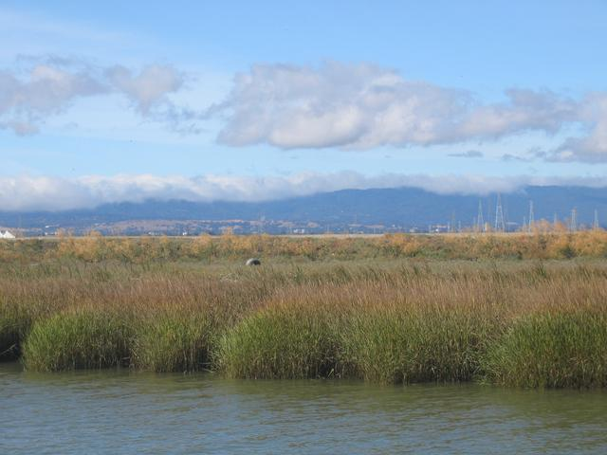
Rights of Downstream Users
Water derived from contractual rights (return flow provisions in contract)
This would afford potential rights only to the contracting party, not other downstream users

Slide 20
Current SRCSD Petition – USBR Arguments
USBR has asserted reduction in flow could injure its use of water in connection with the CVP
Asserted a right to use of seepage and return flows entering the District’s facilities and to the recycled water as well
Water Code 1210
  Assumes legal right to water
  Wastewater treatment plant holds right against supplier, even those using water under contract, unless agreement exists;
  Water suppliers contract with USBR, are not District customers; District not a party to CVP contracts
Notes:
1210: nothing shall affect the treatment plant owner’s obligations to any legal user of the discharged treated wastewater; but, this merely incorporates the no injury rule

Slide 21
Underlying Rights of Downstream Users
Rights to water from groundwater extraction
  Treated as foreign water if it does not reach surface water under natural conditions (i.e., gaining stream vs. losing stream)
  See SWRCB Order 95-9,p. 22.

Slide 22

Amount of Water
Compare reuse project amount to amounts of the source supplies
Compare reuse amount to expected “growth flows” of wastewater discharges
Notes:
SRCSD proposes to reduce discharge by 50,000 af/yr
First Bullet
For example, for SRCSD, annual discharge of treated effluent between 2011 and 2015 was approximately 136,743 af/yr
Estimated that 40-50% of the effluent entering the District’s facilities originates as groundwater, while the remaining originates from surface supplies
Thus, the groundwater component, since it is “foreign” to the stream, is more than enough to account for the reduced discharge of up to 50,000 af/yr under the Program
Second Bullet
“Growth flows” are not subject to WC 1211 process, if never discharged to the stream

Slide 23
Place of Use
If reuse is within place of use or service area, and prior to discharge, absolute right to reuse
If reuse is within place of use / service area, but natural stream used, then analyze rights of particular downstream users
Notes:
If treatment plant owner intercepts before discharge, consider treated waste water as abandoned personalty, and thus absolute ownership
Lewis v. Scazighini (1933) 130 Cal.App. 722
Heyneman v. Blake (1862) 19 Cal. 579
Stanislaus Water Co. v. Bachman (1908) 152 Cal. 716

Slide 24
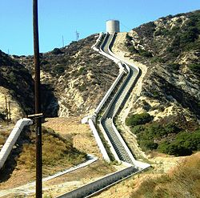
Means of Conveyance
Implicates certain procedural considerations
Water Code § 1211 petition vs. water rights application (or both)
Use of natural stream course to convey to existing POU may implicate downstream rights
WC 7075
Photo of the Los Angeles Aqueduct Cascades
Notes:
Water Code § 7075
Water which has been appropriated may be turned into the channel of another stream, mingled with its water, and then reclaimed; but in reclaiming it the water already appropriated by another shall not be diminished.

Slide 25
EFFECTS ON FISH AND WILDLIFE

Slide 26
Environmental Effects of Project
Basis for Considering
  Public Trust – SWRCB obligation to consider and mitigate where feasible
  Art. X, Sec. 2 – whether a particular use is reasonable depends on the circumstances (See WR 95-9)
  Water Code 1211/1702- proposed change will not injure any legal user of water involved
    No case law on question of whether legal user includes fish and wildlife, but “[s]uch an interpretation, however, would be consistent with existing case law that interprets the Water Code to provide standing for protection of the public trust.” (WR 95-9, p. 29, fn. 10, p. 33; see WR 2008-0024])
    Does not limit SWRCB authority to balance
Notes:
Water Code 1243 – use of water for fish and wildlife for preservation of fish and wildlife is beneficial use
“Fish and wildlife uses … are specifically given legal status by section 1243.” (See WR 95-9)
1243.5: SWRCB to consider amount of water to remain in source

Slide 27
DFW’s Right to Protest
Fish and Game Code, Sec. 711.7
Water Code sections 1701.2: petition must include fish and wildlife information from CDFW
Water Code sections 1703 et seq.: petitioner shall notify CDFW of proposed change; any interested person may file a protest in the form required by the regulations
Title 23, Secs. 745: allegations in a protest must be supported by facts
Notes:
F&G 711.1-fish and wildlife resources are held in trust for the people of the state through the department
Water Code 1330: Authority to protest water right application

Slide 28
Response to Other CDFW Protest Provisions
CESA
CDFW’s Lake and Streambed Alteration Program (LSA Program)
Requirements would apply in absence of condition in the approval of the District’s change petition
No reason to condition approval on compliance with CESA and LSA Program
Notes:
Regional San’s experience-resolved protest with CDFW by including conditions:
-change does not authorize act which results in take of listed species
-petitioner will obtain all necessary federal, state, and local agency permits
-groundwater monitoring to assess potential project effects on groundwater elevations and associated benefits to riparian forests

Slide 29
PUBLIC INTEREST CONSIDERATIONS

Slide 30

Public Interest Considerations
Cal. Constitution, art. X, sec. 2; Water Code § 100
  “the general welfare requires that the water resources of the State be put to beneficial use to the fullest extent of which they are capable”
Water Code § 275
“Department and board shall take all appropriate proceedings or actions … to prevent waste, unreasonable use, unreasonable method of use, or unreasonable method of diversion of water”

Slide 31
Public Interest Considerations
Water Code § 461: conservation of water requires maximum use of reclaimed water
Water Code §§ 13510-13512: people have an interest in development of facilities to recycle water; future water requirements may be met by beneficial use of recycled water; state should take all possible steps to encourage development of water recycling facilities
Water Code § 13550: use of potable domestic water for nonpotable uses … is a waste or an unreasonable use of the water … if recycled water is available that meets various conditions

Slide 32
Public Interest Considerations
The Legislature hereby makes the following findings and declarations:
. . . .
(c) There is a need for a reliable source of water for uses not related to the supply of potable water to protect investments in agriculture, greenbelts, and recreation and to replenish groundwater basins, and protect and enhance fisheries, wildlife habitat, and riparian areas.
. . . .
(f) The use of recycled water is a cost-effective, reliable method of helping to meet California’s water supply needs.
(g) The development of the infrastructure to distribute recycled water will provide jobs and enhance the economy of the state. (Wat. Code § 13576.)

Slide 33
CEQA-Consideration of Environmental Effects
SWRCB is Responsible Agency (14 CCR 15096)
SWRCB must consider the environmental effects of the project as shown in the EIR or negative declaration. (sub. (f))
Responsibility for mitigating or avoiding only the direct or indirect environmental effects of those parts of the project which it decides to carry out. (sub. (g)(1))
Cannot approve where feasible mitigation measures exist (sub. (g)(2))]
Must make findings under 14 CCR 15091, 15093
Notes:
15091-
15093-

Slide 34
Building the Record
Petition
  State Water Board order subject to challenge
  Petition for reconsideration before State Water Board if issued under delegated authority
  Judicial review 30 days after final action
  Code of Civil Procedure 1094.5 controls
    Order supported by findings; findings supported by evidence
CEQA
  State Water Board is responsible agency (14 CCR 15096)
  CEQA determinations subject to challenge

Slide 35
Contact Information
Aaron Ferguson
Somach Simmons & Dunn
aferguson@somachlaw.com
(916)-446-7979

