Slide 1
Tribal Water Rights & Groundwater Recharge
Heather Welles, O’Melveny & Myers LLP

Slide 2
Winters Doctrine
Tribe and U.S. claiming reserved right to groundwater in the Coachella Valley
Winters doctrine: Federal government reserves a right to use water to fulfill the primary purpose of the reservation

Slide 3
Agua Caliente v. CVWD Case Background
“Phase 1” litigated existence of right to groundwater under the Winters doctrine and aboriginal rights
Now in “Phase 2”
Jurisdiction
Quantification standard
Ownership of groundwater storage space
Water quality claim

Slide 4
Questions Raised by Agua Caliente v. CVWD
How should reserved rights be allocated in a managed groundwater system?
How could different ownership regimes for aquifer storage space impact recharge programs?
Should federal property claims impose unique water quality standards on recharge activities?

Slide 5
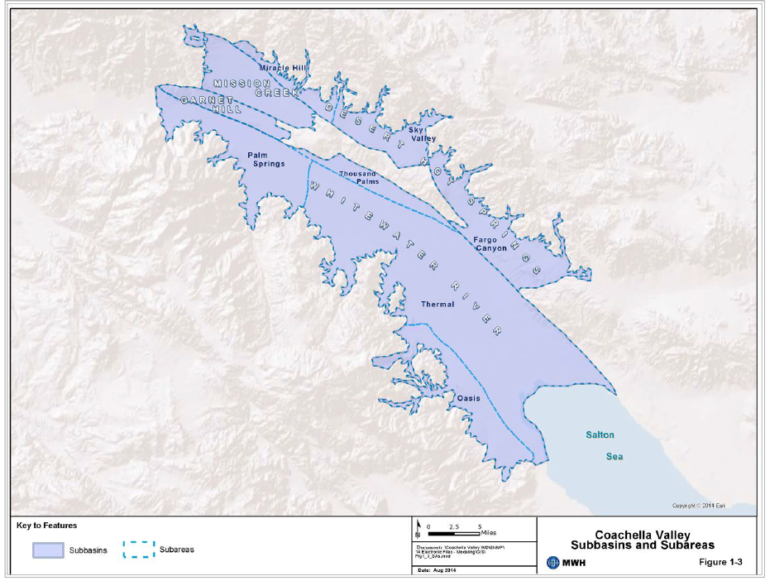
Coachella Valley Groundwater Basin

Slide 6
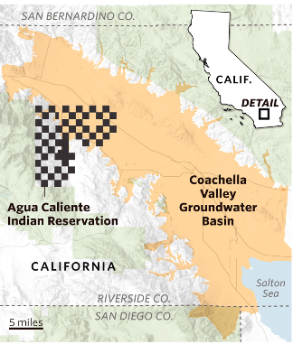
Reservation Land
Source: Wall Street Journal

Slide 7
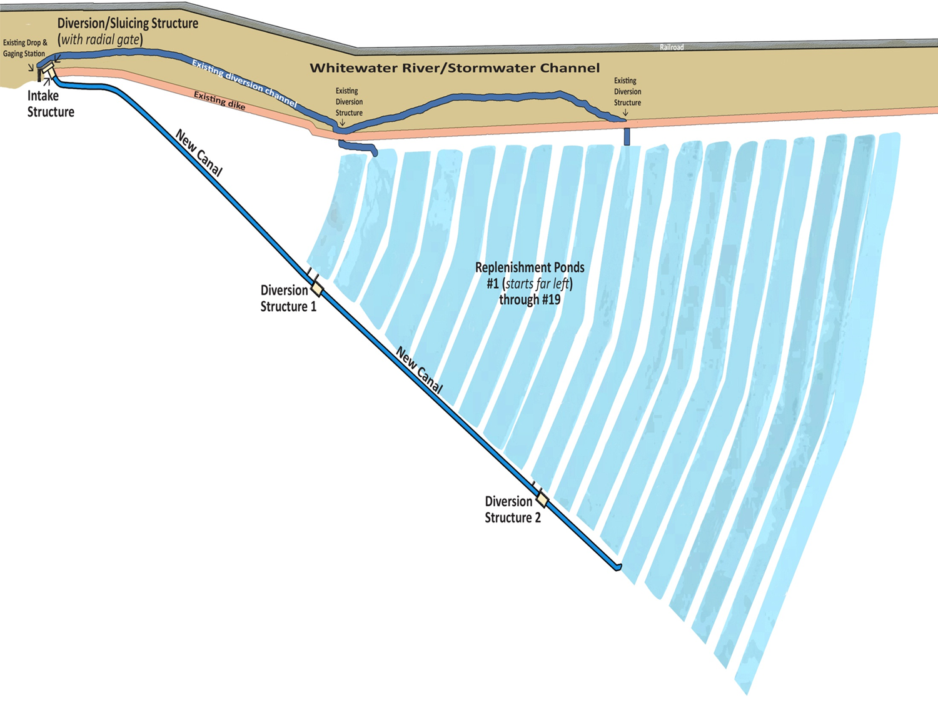
Whitewater River Replenishment Facility

Slide 8
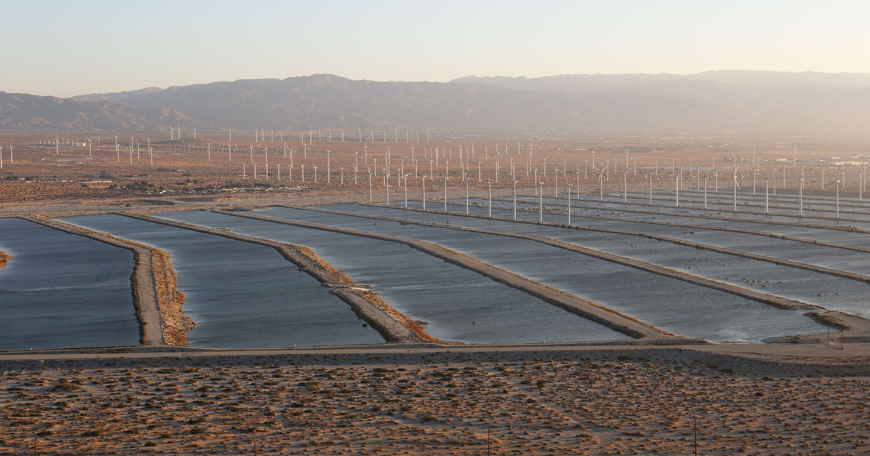

Slide 9
Questions Raised by Agua Caliente v. CVWD
How should reserved rights be allocated in a managed groundwater system?

Slide 10
Questions Raised by Agua Caliente v. CVWD
How could different ownership regimes for aquifer storage space impact recharge programs?

Slide 11
Questions Raised by Agua Caliente v. CVWD
3. Should federal property claims impose unique water quality standards on recharge activities?

Slide 12
Regimes Governing Imported Water Quality
Groundwater
Surface Water
Federal Law:
Safe Drinking Water Act
State Law:
Porter-Cologne
Antidegradation policy
Groundwater substitution transfers require monitoring for quality impacts
Federal Law:
Clean Water Act: “Water transfers rule”
Water quality standards & TMDLs protect beneficial uses
State Law:
Porter-Cologne
Public trust doctrine
SWP/CVP Water Supply Contracts

Slide 13
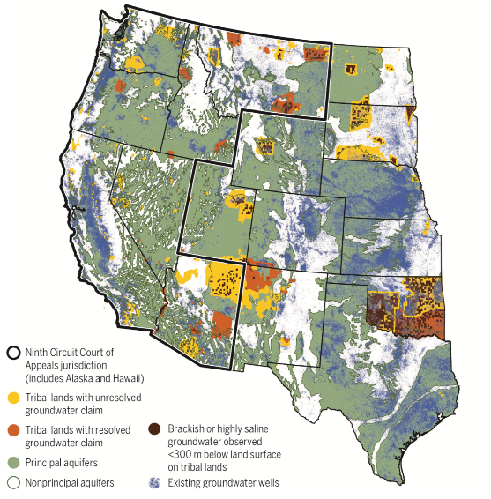
Potential Tribal Groundwater Claims
Source: Stanford University

Slide 14
Potential Federal Groundwater Claims
About 640 million acres (28% of U.S. land area)
Agencies include BLM, Forest Service, Fish and Wildlife Service, National Park Service, and Department of Defense
Source: USGS

Slide 15
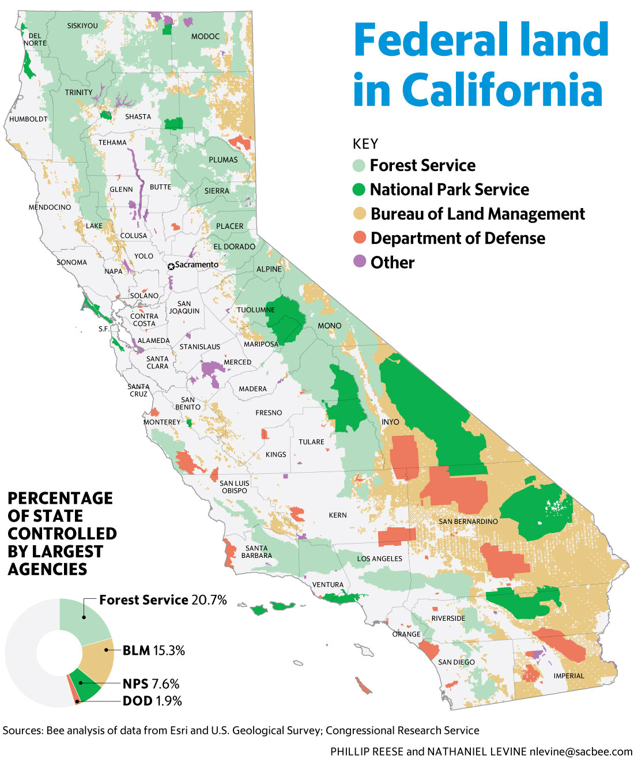

Slide 16
Discussion
Heather Welles
hwelles@omm.com
(213) 430-7613

