Slide 1

Agua Caliente v. CVWD
Catherine Ferretti Munson
Kilpatrick Townsend
Urban Water Institute, February 28, 2019

Slide 2
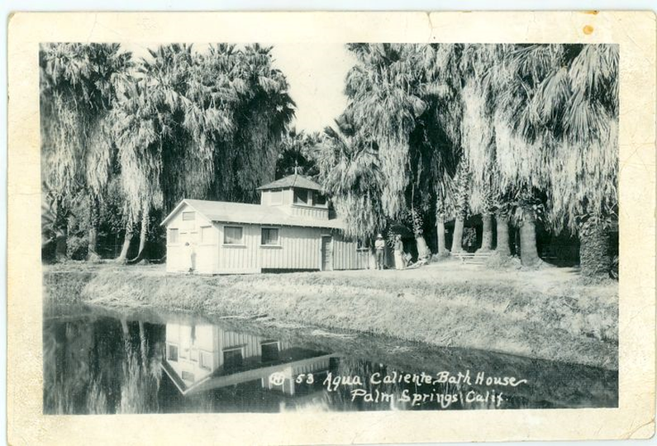
Background
From time immemorial to today: Cahuilla people inhabit the Coachella Valley, relying on surface and groundwater resources to survive.
The Agua Caliente Cahuilla’s geographic, cultural and spiritual center was and is located at Sec he, now known as the Palm Springs Hot Springs.

Slide 3
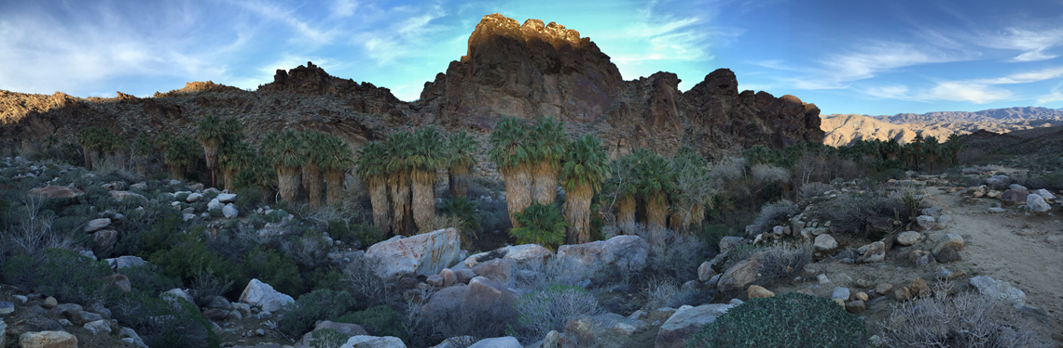
SURFACE WATER AVAILABILITY
Surface water supplies consist of small streams emerging from San Jacinto Mountains on the west side of the reservation which do not flow most of the year.

Slide 4
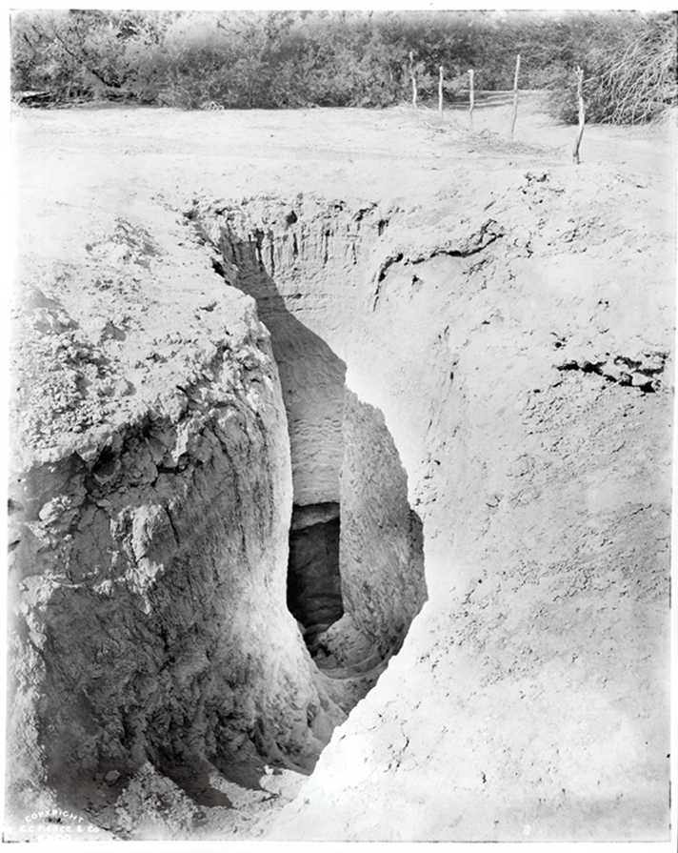
GROUNDWATER AVAILABILITY
Ancestral Cahuilla dug walk-in wells in the Coachella Valley long before Euro-American contact.
These wells were some distance from the mountain canyons/streams.

Slide 5
Reservation History
In 1876, President Grant issued the first Executive Order setting aside lands for Agua Caliente.
After Indian Agents determined that the initial Reservation was insufficient to serve as a permanent homeland, President Hayes issued an Executive Order substantially expanding the Reservation in 1877.
Historical records show that water was a major consideration when the United States set aside the Reservation.

Slide 6
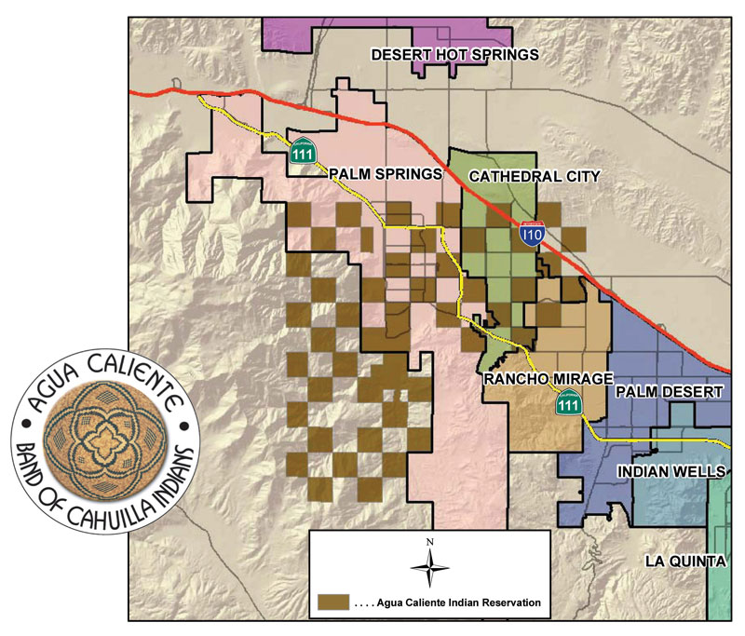
Agua Caliente Reservation

Slide 7
Exchange of SWP Water for Colorado River Water
In 1973, CVWD and DWA began using imported water from the Colorado River, in exchange for their rights to SWP water in a bucket-for-buck exchange, to "recharge" the aquifer in an effort to offset the ongoing overdraft.
The introduction of Colorado River water, which has much higher rates of total dissolved solids (TDS) and other impurities than the native groundwater, has diminished the quality of the existing groundwater.
The recharge facility is near and directly up gradient from the Agua Caliente Reservation, so these effects are particularly relevant to the Tribe.

Slide 8
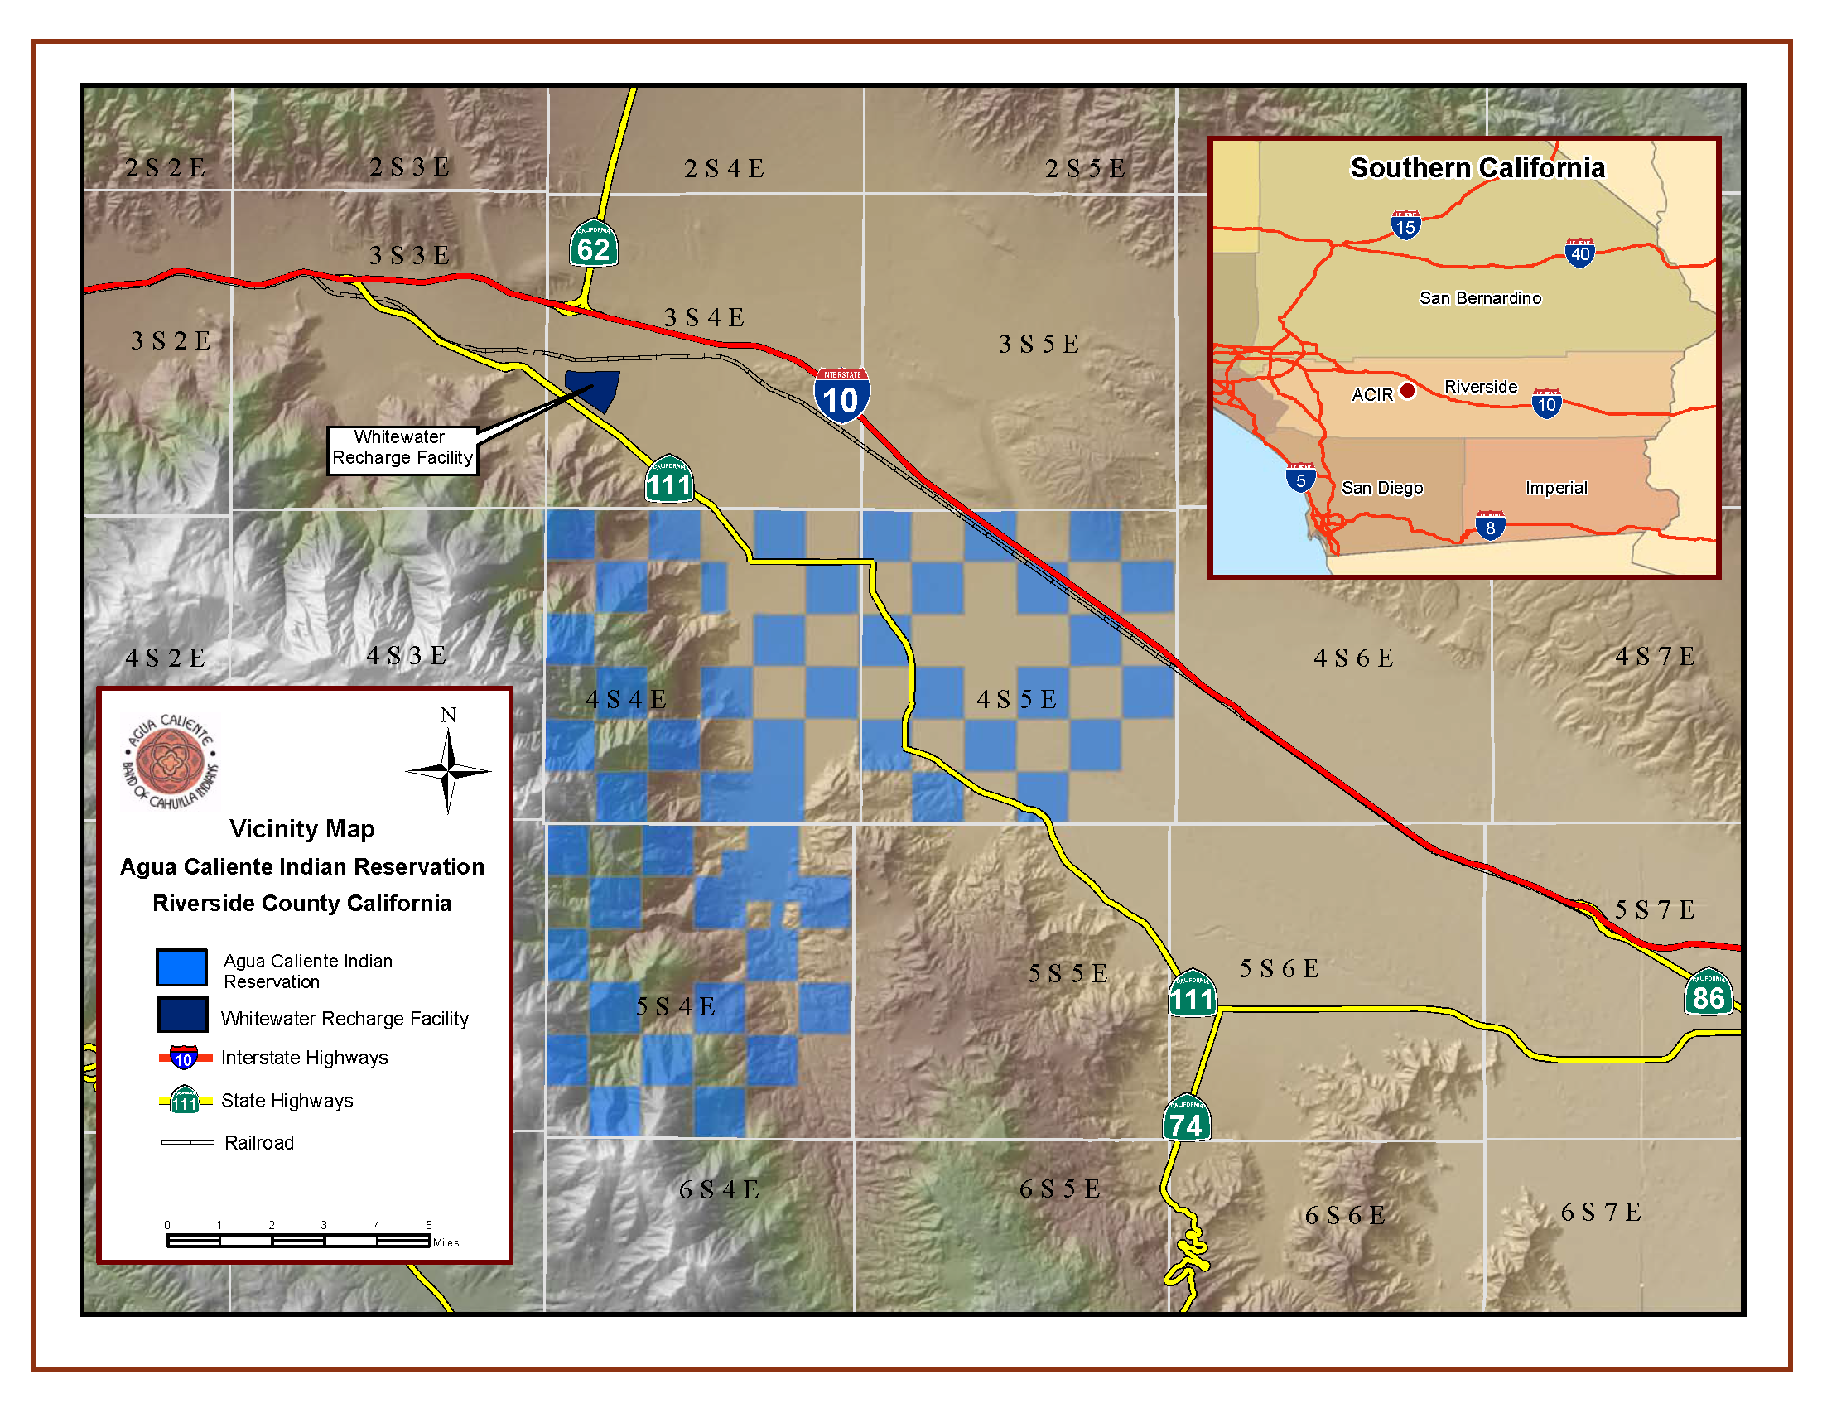
Recharge Facility

Slide 9
Impacts on Water Quality
1978 USGS study predicted that the Colorado River recharge would result in a plume of water with elevated levels of TDS levels reaching the Reservation by 2000.
The 1992 USGS study confirmed this result and identified a DWA/USGS Well under the Reservation as one of many that were influenced.
Studies show that TDS in this well has exceeded 500 mg/L. To meet its salinity standards, MWD mixes Colorado River water with lower TDS water supplies prior to delivery.

Slide 10
Rising TDS levels

Slide 11
DWA and CVWD Expert

Slide 12
CVWD 2010 SPEIR

Slide 13
Overdraft of the Aquifer
Agua Caliente has raised concerns about the management of the Coachella Valley Basin aquifer for more than two decades.
  As of 2010, CVWD estimated the cumulative overdraft of the aquifer as more than 5.5 million acre-feet.
Agua Caliente v. CVWD, (9th Cir. 2017)
Districts’ expert estimates 80,000 AF over drafted under the Reservation
Water levels have declined up to 90 feet.
(Source: Krieger & Stewart, 2014 )

Slide 14
Overdraft
District plans assume 50% reliability of SWP water when the past 12 years, average reliability has been under 45%.
MWD currently owed 385,000 AF in pre-delivery water
No plans to remedy cumulative overdraft, just to stop additional overdraft based on a 1990 baseline.

Slide 15
Overdraft

Slide 16
Overdraft predicted to continue
“The Coachella Valley Groundwater Basin (and its subbasins) is in an overdraft condition and will most likely remain so, even with the importation and exchange of available SWP water, until a higher proportion of the maximum SWP Table A allocations becomes available. With maximum Table A allocations, recharge in the WWR and MC Management Areas would offset the current annual overdraft, although overdraft in future years is virtually unpredictable, due to the difficulty of projecting long-term growth and reliability of SWP supplies.”
DWA, Engineer’s Report 2018.

Slide 17
Agua Caliente’s Lawsuit
Agua Caliente reached out to the districts before filing suit.
Response: “there is little to discuss.”
Filed May 2013 – Complaint seeks a declaration and quantification of Agua Caliente’s federally reserved rights to groundwater.
Injunctive relief to stop overdraft and degradation water quality.
Declaration of Agua Caliente’s ownership in the pore space.
The United States intervened in support of Agua Caliente in June 2014.

Slide 18
Winter’s Doctrine
Basis of Indian water rights is the Federal reserved water rights doctrine established in United States v. Winters in 1908
establishment of a reservation impliedly reserves the amount of water necessary to accomplish the purposes of the reservation
past, present, and future uses included
rights are not lost by non-use
governed by Federal and not state law
held in trust by the Federal Government
No balance of the equities

Slide 19
Agreement to Phase the Case
Agua Caliente and the Water Districts agreed to divide the case into multiple phases, with the core legal issues to be decided before litigating more fact-intensive aspects of the case:
Phase 1 – Existence of reserved rights to groundwater
Phase 2 – Quantification standard, water quality, pore space, equitable defenses
Phase 3 – Quantification and other defenses, such as Rule 19.

Slide 20
Rulings in favor of Agua Caliente
Agua Caliente has a federally reserved right to groundwater.
Equitable Defenses raised by Districts (laches, balance of the equities, unclean hands) are barred.
Phase 2 Issues briefed and currently pending before the Court and standing

Slide 21
How should groundwater be allocated?
FOUR DIFFERENT STANDARDS
Agua Caliente – Practical Irrigable Acreage (PIA)
Coachella Valley Water District – Hybrid PIA and modern homeland
Desert Water Agency – Homeland, with extensive limitations
USA – Broad and Flexible Homeland Standard, includes PIA

Slide 22
Practicable Irrigable Acreage
Five tribes in Arizona v. California were decreed 905,496 AFY. Tribes had 135,636 practically irrigable acres, even though in the early 1960s, these tribes were actually irrigating less than 36,000 acres.
Approximately over 12% percent of the total dependable water supply of the Lower Colorado River (and over 25% of Arizona’s total Colorado River allocation established in the case) to these five tribes.

Slide 23
Settlement of Tribal Water Rights
“The overall result where settlements have been concluded has been to significantly increase water supplies to tribes, generally without diminishing (and indeed sometimes increasing) water available for non-Indian tribal uses.”
Reid Chambers, ASU Law Journal, ASU Law Journal (2014)
Western States Water Council – “the policy of encouraging negotiated settlements of disputed Indian water rights claims as the best solution to a critical problem that affects almost all of the Western States.”

Slide 24
Benefits of Settlements
Department of the Interior (DOI) has completed 36 Indian water rights settlements since 1978
Wet Water
  Provide “wet water” to tribes; litigation provides “paper water”
Win-Win
  Provide water to tribes while protecting existing non-Indian water users
Local Solutions
  Allow parties to develop and implement creative solutions to water use problems based on local knowledge and values

Slide 25
Benefits of Settlements (cont’d)
Certainty and Economic Development
    Provide certainty to tribes and neighboring communities, support economic development for tribes, and replace historic tension with cooperation
Trust Responsibility
    Consistent with the Federal trust responsibility and Federal policy of promoting Indian self-determination and economic self-sufficiency

Slide 26
Indian Water Rights Settlements with Federal Legislation, by State (Pam Williams)

Slide 27
Federal Costs of Settlements
Federal funding required by Indian water
settlements has significantly increased over time
Roughly a billion dollars expended between
mid 1980s and 2002 but more than $2 billion authorized between 2009-2016

Slide 28
Number of Indian Water Rights
Settlements by Year of Federal Legislation (Pam Williams)

Slide 29
Storage space and water quality
How could different ownership regimes for aquifer storage space impact recharge programs?
Should federal property claims impose unique water quality standards on recharge activities?

