Slide 1

Update on AZ LBDCP Implementation Process
Chuck Cullom
February 27, 2019

Slide 2
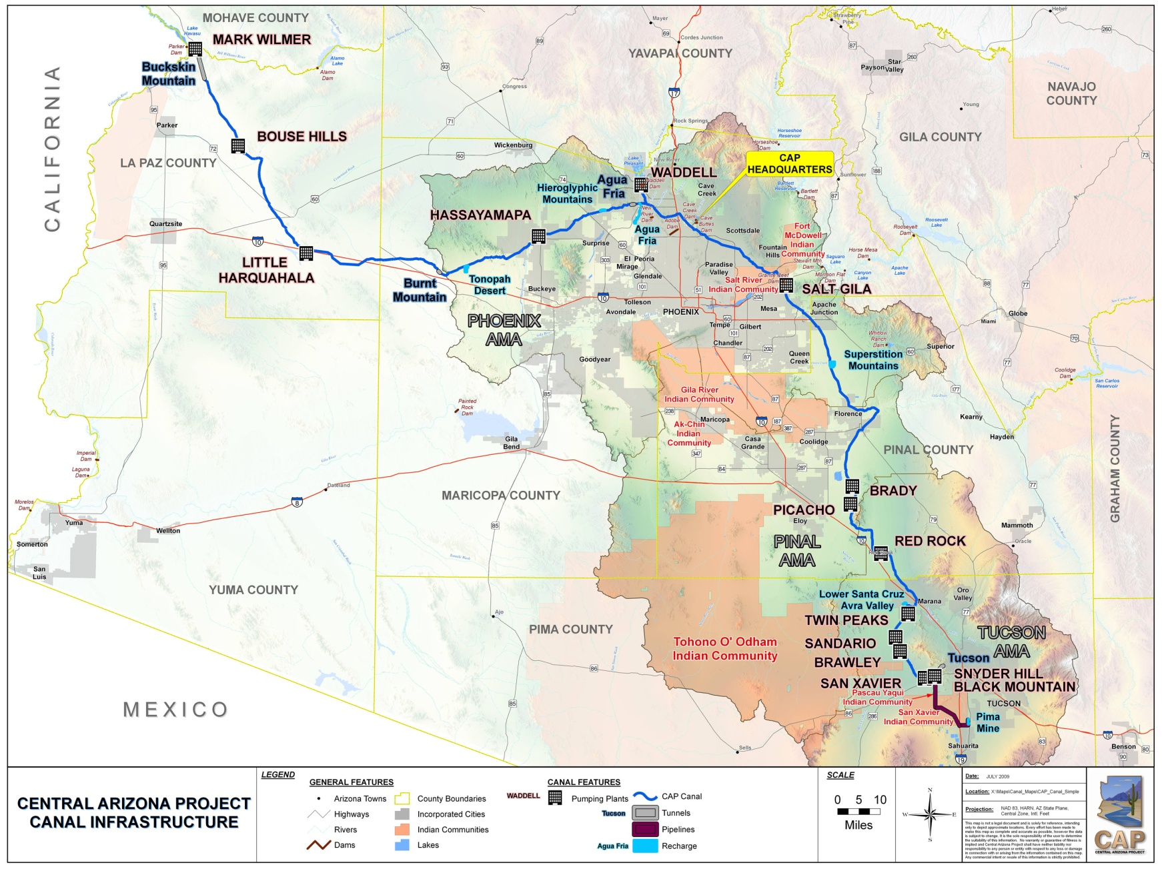
Central Arizona Project
336-mile aqueduct
14 pumping plants lift water nearly 3,000 feet
Delivers ~ 1.6 MAF/yr
Diverse customers: Tribes, Irrigation districts, Cities, Mines
80% AZ pop. reside in CAP Service Area
50% of AZ’s economy related to CAP deliveries
Junior Priority, vulnerable to shortages
Notes:
CAP is largest source of renewable water for AZ
1.6 million AF/year (521 billion gallons)
Serves 3 counties containing 80% of Arizona’s population
CAP has 80 regular customers and each year has specific contracts for excess water
History of CAP
1968 Federal Authorization through Colorado River Basin Projects Act
1973 Construction begins on CAP system
Declared Substantially Complete in 1993
Compromises along the way
CAP has junior priority
NGS built instead of additional hydroelectric dams

Slide 3
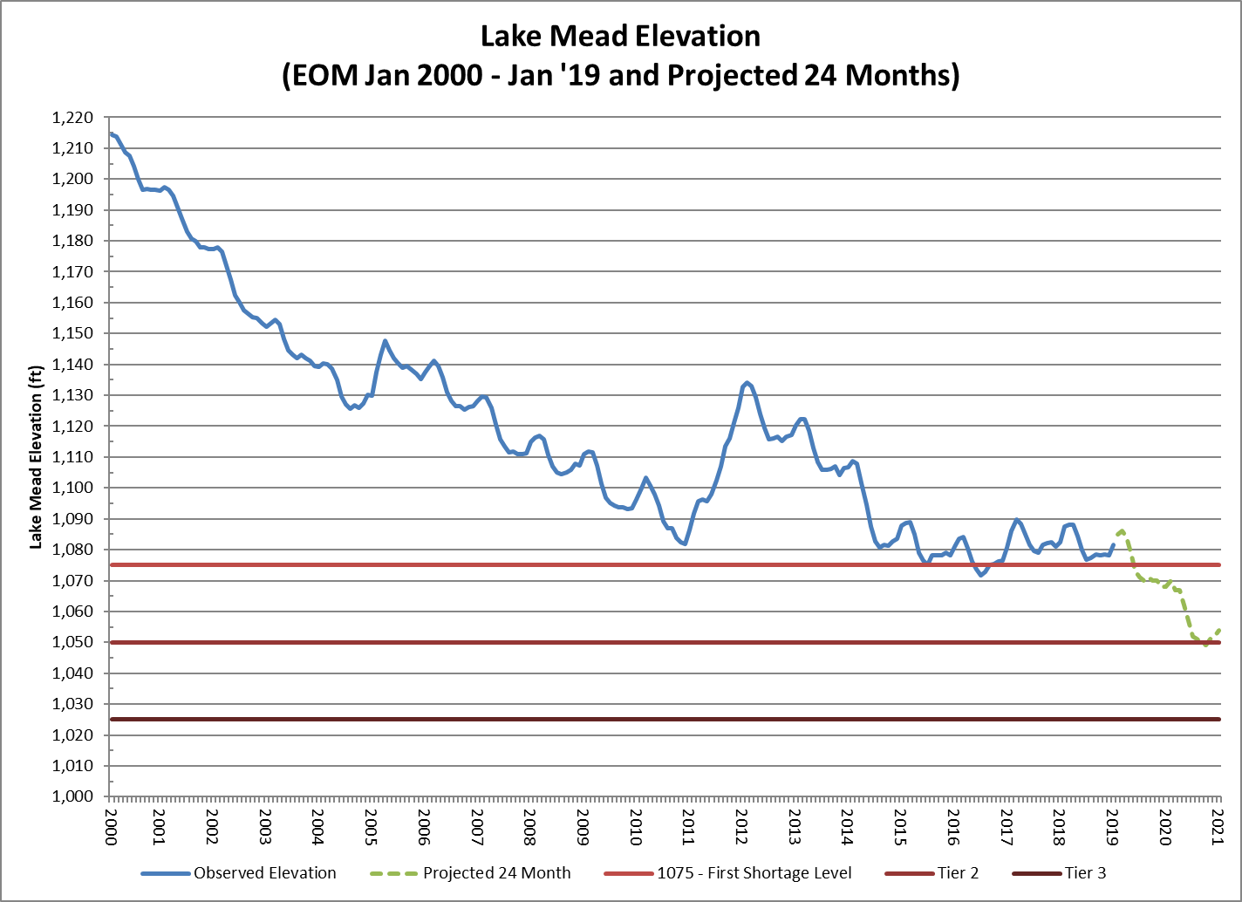
Origins of DCP
CA QSA
Minute 319
Minute 323
‘07 Guidelines
PSCP & MOU
LB & UB DCP

Slide 4
Risk of Lake Mead < 1,020’
5.7 maf
1,020’
22%
2007 Projections
(1906-2005 hydrology)
2007 Projections
(1906-2005 hydrology)
No DCP
(April 2018 Projections)
No DCP
(April 2018 Projections)
With DCP
(April 2018 Projections with Upper & Lower Basin DCPs & Binational WSCP)
With DCP
(April 2018 Projections with Upper & Lower Basin DCPs & Binational WSCP)
Notes:
Full Hydrology 1906-2015 (Average 14.83 MAF / year inflow into Lake Powell)
Stress Test Hydrology 1988-2015 (Average 13.26 MAF / year inflow into Lake Powell) a reduction of 10.6%
Many scientists project that the Stress Test hydrology is closer to our future. As prudent water managers and planners, we need to plan for that drier future.
[Point out teacup diagram]
[Discuss projection for how quickly we can fall to Deadpool]

Slide 5
Arizona’s DCP Process
ADWR and CAWCD jointly convened an Arizona Steering Committee composed of over 40 representatives, including:
  ADWR
  CAWCD
  Arizona Legislative Leaders
  CAP municipal, industrial, and agricultural customers
  CAP tribal customers
  On-river municipal and agricultural users
  On-river tribal users
  BOR
Process began on June 26th 2018, ending on February 19th 2019
  9 Steering Committee Meetings and
  Multiple Work Group (3 WGs) and small group meetings,
Notes:
CAP is largest source of renewable water for AZ
1.6 million AF/year (521 billion gallons)
Serves 3 counties containing 80% of Arizona’s population
CAP has 80 regular customers and each year has specific contracts for excess water
History of CAP
1968 Federal Authorization through Colorado River Basin Projects Act
1973 Construction begins on CAP system
Declared Substantially Complete in 1993
Compromises along the way
CAP has junior priority
NGS built instead of additional hydroelectric dams

Slide 6
2007 Interim Guidelines Shortage Reductions
and Incremental DCP Contributions
Lake Mead Elevation | AZ 2007 | AZ DCP | AZ TOTAL | NV 2007 | NV DCP | NV TOTAL | CA 2007 | CA DCP | CA TOTAL | BOR DCP | MX Min 323 | MX BWSCP | MX Total | TOTAL
≤1090 >1075 | 0 | 192K | 192K | 0 | 8K | 8K | 0 | 0 | 0 | 100k | 0 | 41k | 41k | 341k
≤1075>1050 | 320K | 192K | 512K | 13K | 8K | 21K | 0 | 0 | 0 | 100k | 50k | 30k | 80k | 713k
≤1050>1045 | 400K | 192K | 592K | 17K | 8K | 25K | 0 | 0 | 0 | 100k | 70k | 34k | 104k | 821k
≤1045>1040 | 400K | 240K | 640K | 17K | 10K | 27K | 0 | 200K | 200K | 100k | 70k | 76k | 146k | 1,113k
≤1040>1035 | 400K | 240K | 640K | 17K | 10K | 27K | 0 | 250K | 250K | 100k | 70k | 84k | 154k | 1,171k
≤1035>1030 | 400K | 240K | 640K | 17K | 10K | 27K | 0 | 300K | 300K | 100k | 70k | 92k | 162k | 1,229k
≤1030>1025 | 400K | 240K | 640K | 17K | 10K | 27K | 0 | 350K | 350K | 100k | 70k | 101k | 171k | 1,288k
≤1025 | 480K | 240K | 720K | 20K | 10K | 30K | 0 | 350K | 350K | 100k | 125k | 150k | 275k | 1,475k

Slide 7
AZ & CAP Priority Pools
On-River users P1 – P3, largely Ag Users in Yuma, and Tribes
CAP P4 – junior to P1 – P3
On-River P4 – shares priority with CAP, located in Havasu, Parker, Mohave Co
CAP absorbs more than 95% of reductions in Arizona
CAP Priorities: 1 = P3 in CAP, 2 = Tribal + M&I, 3 = NIA Pool, 4 = Ag Pool, Recharge/Replenishment
Notes:
CAP is largest source of renewable water for AZ
1.6 million AF/year (521 billion gallons)
Serves 3 counties containing 80% of Arizona’s population
CAP has 80 regular customers and each year has specific contracts for excess water
History of CAP
1968 Federal Authorization through Colorado River Basin Projects Act
1973 Construction begins on CAP system
Declared Substantially Complete in 1993
Compromises along the way
CAP has junior priority
NGS built instead of additional hydroelectric dams

Slide 8
CAP Priority Pools (current use, estimated available)
Excess
Tribes
Cities & Industry
Long-Term
Contracts
Notes:
This is an illustration that should be familiar to most of you. This is one chart you want to be at the bottom of—that’s where the higher priorities are. This is showing current levels of usage, but _prior_ to current voluntary system conservation activities.
[click]
Also keep in mind that the names of the priorities don’t perfectly align with who is using the supplies, including through leases and assignments

Slide 9
CAP Priority Pools – ‘07 Guidelines
2007 Guideline Reductions to AZ
320,000 (Tier 1)
400,000 (Tier 2)
480,000 (Tier 3)
Notes:
This is how the reductions under the 2007 Guidelines fall, assuming usage patterns during shortage are similar to current use.

Slide 10
CAP Priority Pools – LBDCP
‘07 Guidelines + LBDCP
Contributions by AZ
192,000
512,000 (T1 + 192k)
592,000 (T2 + 192k)
640,000 (T2 + 240k)
720,000 (T3 + 240k)
Notes:
…And here is how the additional reductions under DCP fall

Slide 11
Steering Committee Mission
Discuss and recommend how to adopt and implement the LBDCP in a way that is acceptable to Arizona water users

Slide 12
Steering Committee Objectives
Seek broad commitment and support for the implementation of LBDCP in Arizona
Recommend appropriate and sustainable processes and tools to implement LBDCP in AZ
Obtain approval by the Arizona Legislature of a joint resolution authorizing the Director of ADWR to agree to the LBDCP

Slide 13
Proposed Sideboards
Focus on the adoption and implementation of LBDCP in Arizona.
Operate within and respect existing legal authorities, contracts and priorities.
Seek solutions that acknowledge that the impacts of a reduced supply differs among water users.
Please respect the Steering Committee process and each other.
While CAP and ADWR are jointly leading the process, the input, ideas, questions, and dialogue from the delegates and public is vital and welcome.
Agreement of appropriate documentation of proceedings

Slide 14
LBDCP Implementation Plan – 2 Components
Mitigation Component
  Wet water CAP deliveries for mitigation
  Payment for reductions (compensated mitigation) when wet water mitigation is insufficient
  Money for new groundwater infrastructure for CAP Ag
Offset Component
  System conservation and ICS creation to replace CAP ICS that is used for mitigation
  Pre-firming concept to address NIA firming obligations from Indian water settlements
Notes:
Tom
Listen to stakeholder comments and position statements:
Maximize “Yes” and address “No”
Address Mitigation for the LBDCP Term 2020 – 2026
Provide additional protection for Lake Mead through
“offset” programs

Slide 15
Mitigation Component- Key Terms
  2020 – 2022
    100% mitigation for NIA Pool (annual determination of vol.)
    Fixed volume for CAP AG, dependent on annual tier determination
  2023 – 2025
    No CAP Ag Mitigation (except USF to GSF and groundwater infrastructure)
    M&I and Indian priority fully mitigated first
    NIA volume based on actual orders/operating conditions
    NIA 75% under T1 and T2a (until no supplies)
    NIA 50% under T2b (until no supplies)
  2026
    Zero mitigation
  No mitigation for any water user in T3 or 2026, whichever occurs first
Notes:
Ted

Slide 16
Offset Component– Key Terms
Conserve 400 kaf to offset use of CAP ICS
Offsets provided through:
  100 kaf US-GRIC ICS
    Pre-firming for US Tribal firming obligation
  50 kaf AWBA-GRIC ICS
    Pre-firming for Arizona’s AWSA firming obligation
  150 kaf System Conservation
  50 kaf Additional Tribal ICS
  50 kaf - CAP-SRP Exchange payback
Notes:
Tom -
-

Slide 17
Participants (~24) in Funding & Water
CAWCD: Funding and Water – 480 kaf & $65M
SRP: Water in exchange - 50 kaf
CAP M&I Users (9): Water in USF-GSF – 100 kaf
GRIC: Water for ICS – 200 kaf
CAP AG (7): Investment in GW infrastructure & taxes - $5M + $8M
State of Arizona: Funding System Con. & GW - $39M
AWBA: LTSC for USF-GSF, Firming - $12M
US: Funding GW Infrastructure, Firming – BOR $24M, USDA tbd
NGOs: Funding - $8M
CRIT: Water for System Conservation – 150 kaf
Notes:
Tom

Slide 18
Arizona DCP Legislative Recap 01/31/19
SJR1001/HJR2002 Colorado River Drought Contingency Plan
Resolution to authorize* the ADWR Director to sign the Interstate DCP Agreements on behalf of the State of Arizona if:
  Federal legislation passes directing the secretary of the interior to execute and implement the DCP agreements;
  All parties other than the United States and the State of Arizona have authorized the execution of DCP agreements.
*A.R.S. § 45-106 states: “An agreement entered into between the [ADWR] director and the United States or a state or government involving a sovereign right or claim of this state is not effective unless approved by the legislature by concurrent resolution.”
Notes:
Tom

Slide 19
Arizona DCP Legislative Recap
SB1227/HB2545 Colorado River Drought Contingency Plan Amendments
Authorization for the AWBA to exchange existing LTSCs between AMAs; LTSC transfer fee waiver
Increase accrual of LTSCs for existing effluent managed recharge facilities from 50% to 95%, allowing those credits to be applied to assured water supply determinations, and extending ability to accrue LTSCs beyond 2025 for storage of effluent and water imported into an AMA or groundwater basin.
Limited repeal of “WaterBUD” in the Pinal AMA from 2020 through 2026
Groundwater & Irrigation Efficiency Projects Fund
  GF appropriation of $7 million; $2M from ADWR DCP funds; repurposing Pinal withdrawal fee for groundwater infrastructure in Pinal AMA; intent clause.
Notes:
Tom

Slide 20
Arizona DCP Legislative Recap
SB1227/HB2545 Colorado River Drought Contingency Plan Amendments
Arizona System Conservation Fund
  GF appropriation of $30 million; ADWR authority to act as the fiscal agent for NGO contributions
$2M from ADWR DCP funds to the Augmentation and Conservation Assistance Fund at ADWR for conservation grants in AMAs for conservation of groundwater
ADWR report to Legislature on DCP agreements
Notes:
Tom

Slide 21

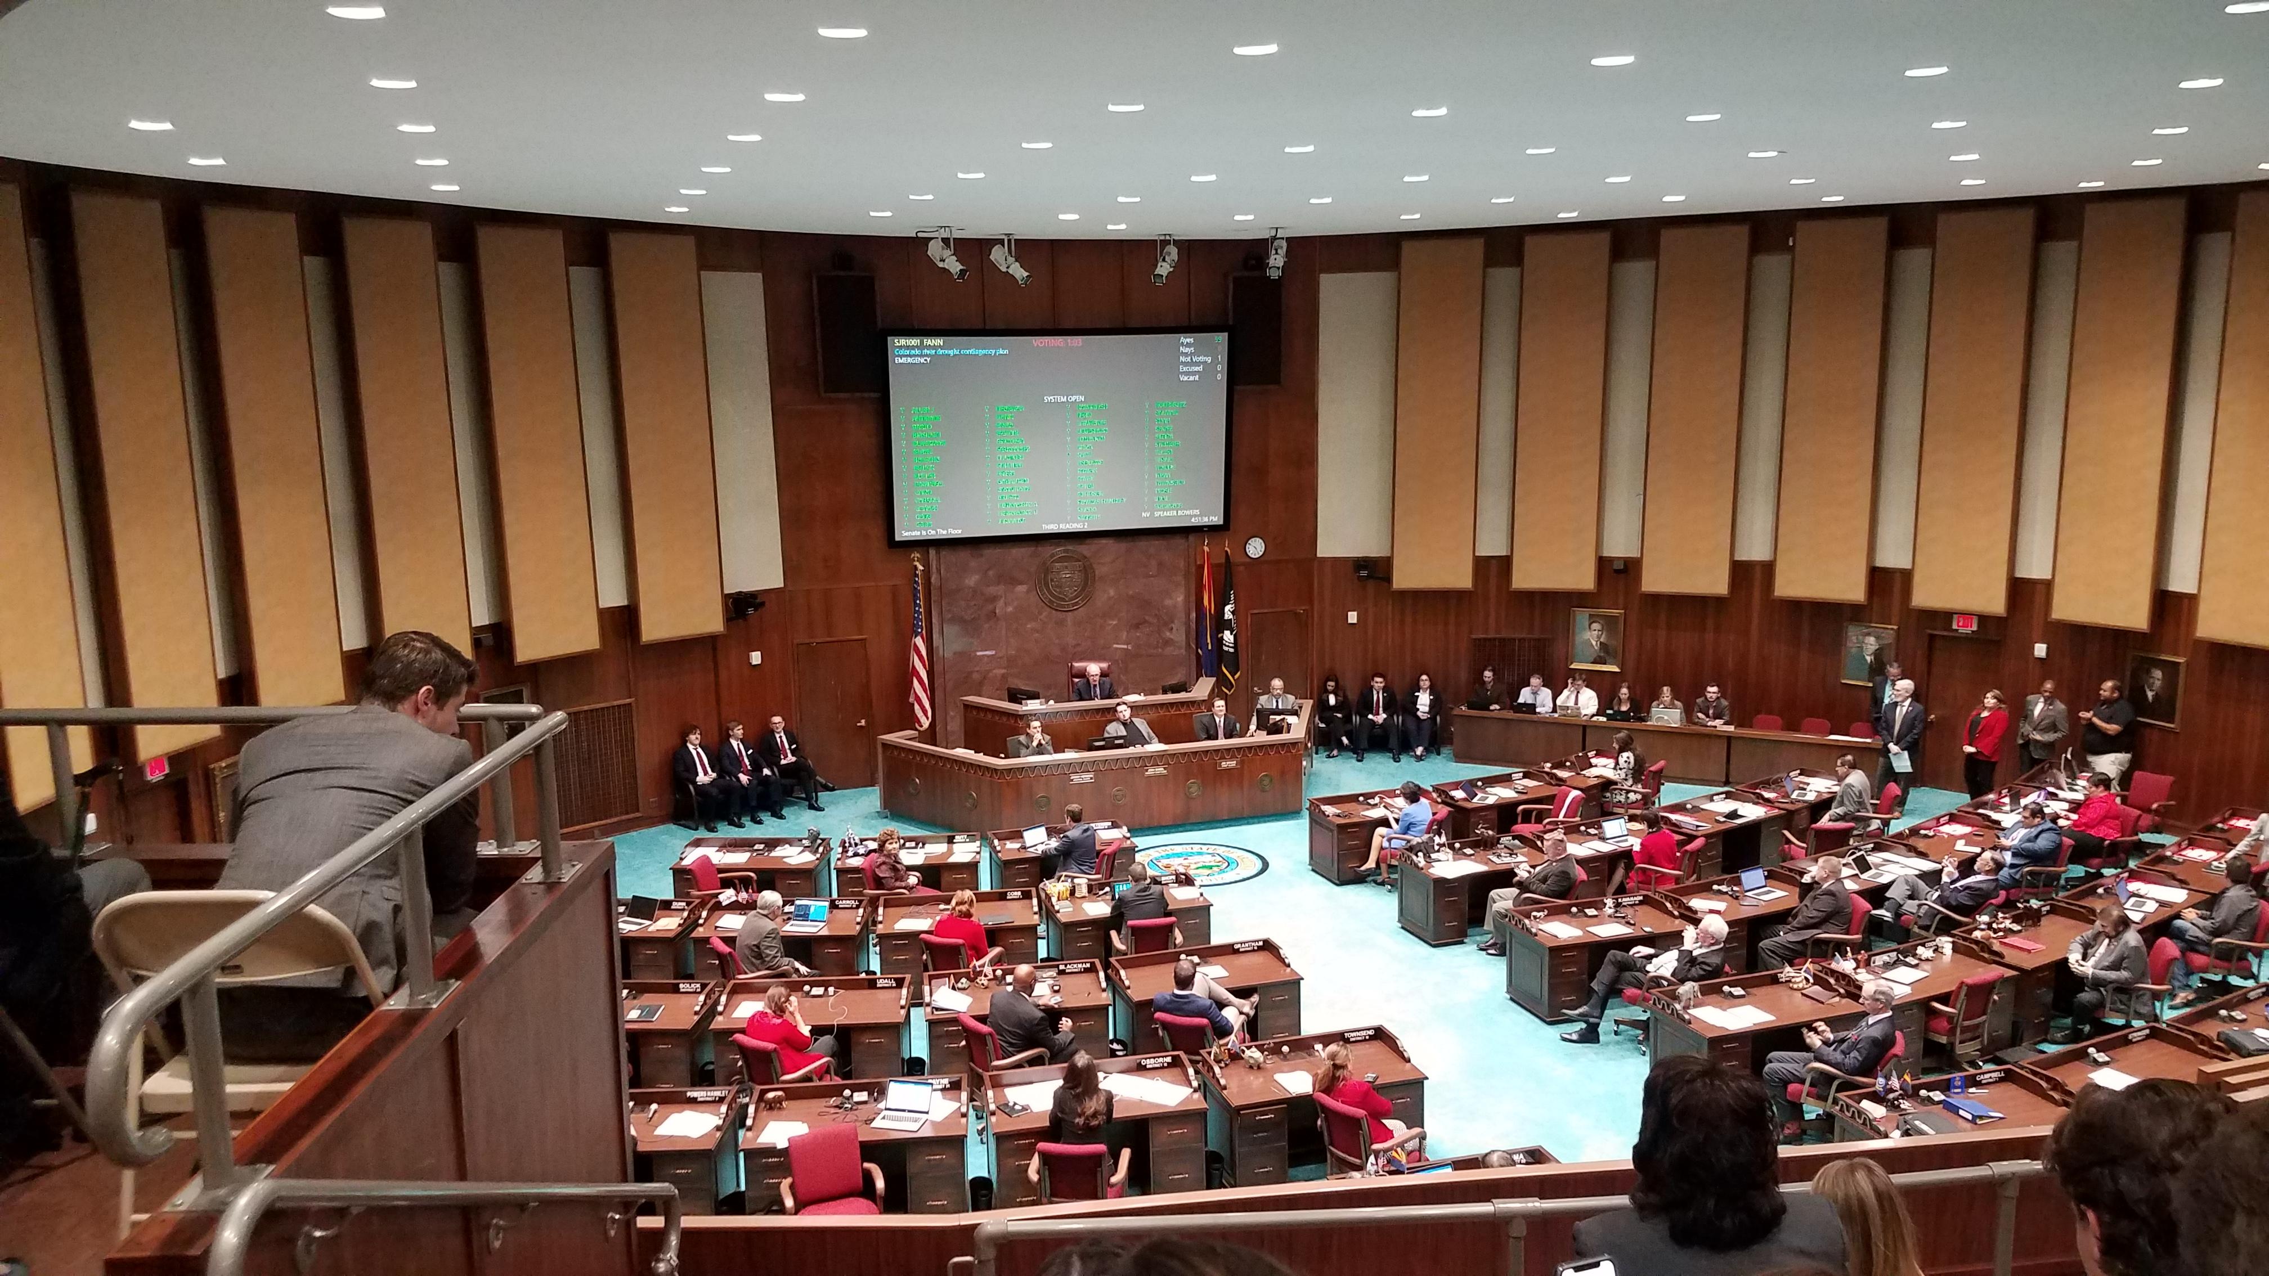
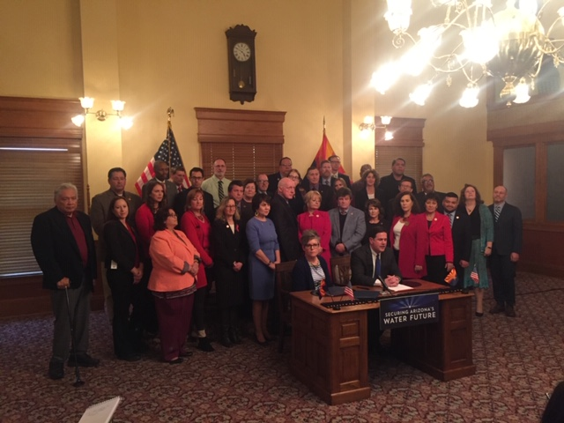
AZ LBDCP Vote & Signing Ceremony

Slide 22
Intra-Arizona Implementation Status
# | Agreement Name | Status | Actions Taken to Date | Parties
1 | Arizona Implementation | Draft concept |  | ADWR, CAWCD, others TBD
2 | CAP Ag Mitigation | Draft terms |  | CAWCD, CAP Ag Distr.
3 | CAP NIA Mitigation | Draft terms |  | CAWCD, CAP NIA customers
4 | CAWCD – SRP Exchange | Draft Agreement | Approved by CAWCD Board 02/21/19 | CAWCD, SRP
5 | Arizona ICS Framework & New AZ Exhibits | Draft Agreement & draft Exhibits | CAWCD consideration 03/07/19 | ADWR, BOR, CAWCD (Exhibits - interstate approval)
6 | CRIT System Conservation | Draft concept |  | ADWR, BOR, CAWCD, CRIT, others
7 * | US – CAWCD LBDCP Obligations | Final form of Agreement | Approved by CAWCD Board on 1/31/19 | US, CAWCD
8 ** | CAWCD – ADWR Exchange of Letters | Final Letters | Executed by CAWCD and ADWR on 1/30/19 | ADWR, CAWCD
* Orange means approved by CAWCD Board, awaiting execution by the U.S. and CAWCD
** Green means fully executed and final
Notes:
Ted

Slide 23
Intra-Arizona Implementation Status
# | Agreement Name | Status | Actions Taken to Date | Parties
9 | GSF – GSF Agreement | Concept |  | EPCOR, CAP Ag Distr.
10 | USF – GSF Agreements | Draft agreements |  | Some M&I users, CAP AG Distr., AWBA
11 | AWBA Recovery Agreements | Concept |  | AWBA, Recovery partners (TBD)
12 | US – GRIC ICS for US Firming | Draft concept |  | US, GRIC
13 | AWBA – GRIC “Pre-Firming” | Draft concept |  | AWBA, GRIC
14 | Interstate ICS Borrowing Capacity | Concept (volumes determined) |  | ADWR, SNWA, MWD
15 | Interstate Aggregate ICS Capacity | Concept (volumes determined) |  | ADWR, SNWA, CRCN, MWD
16 * | GRIC-CAGRD Water Supply Acquisition Agreements | Final Agreements | Executed by CAWCD, GRIC and GRWS on 1/31/19 | GRIC, GRWS, and CAWCD and the United States
* Orange means fully executed by CAWCD, GRIC and GRWS, awaiting execution by the U.S.
Notes:
Ted

Slide 24

Questions

