Slide 1
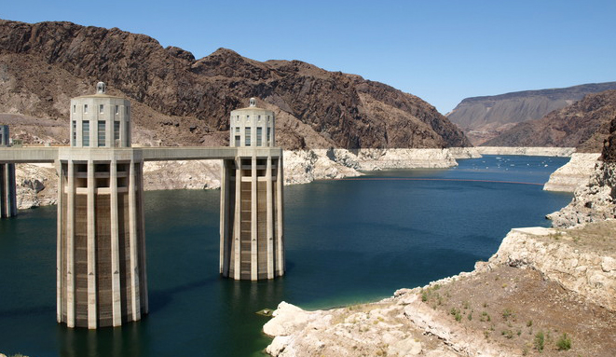

Status of Lower Basin
Drought Contingency Planning Efforts

Slide 2
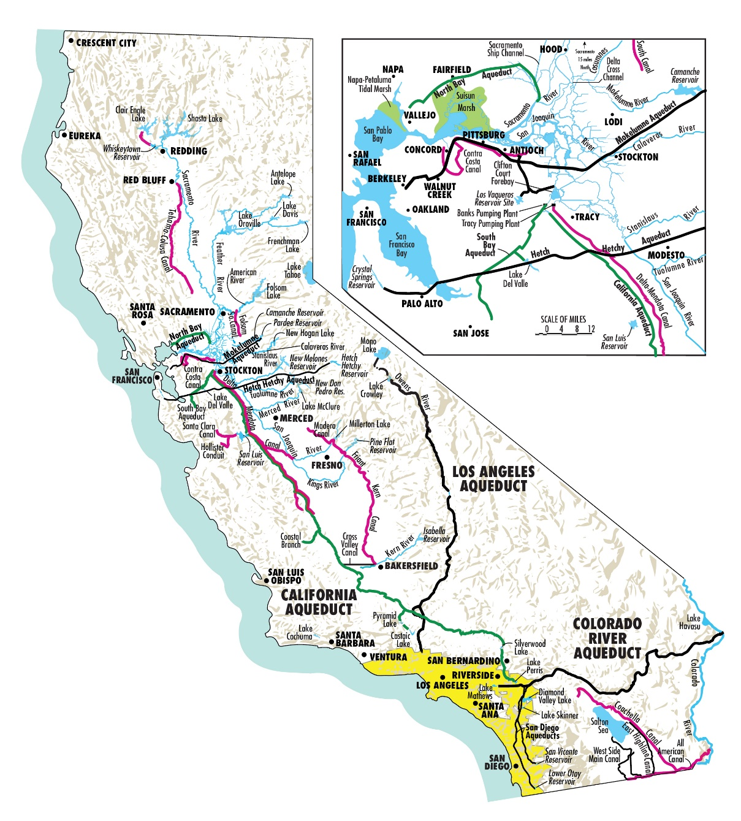
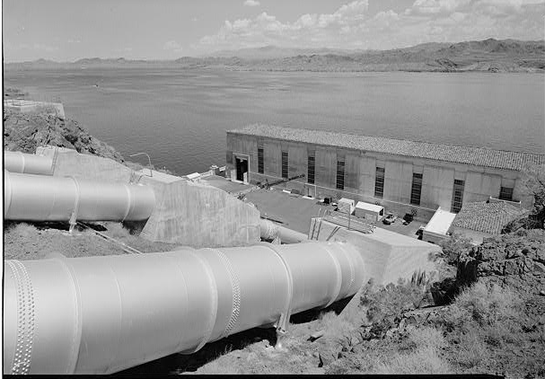
California
Water Delivery Infrastructure

Slide 3
Colorado River at Lees Ferry, AZ – Natural Flow
Notes:
3
Key Points:
This chart displays the natural flow at Lees Ferry, equivalent to the total inflow in the Upper Basin, approximately 90% of the total inflow in the basin.
The chart includes annual inflow (blue bars), a 10-year running average (grey line), and a moving long-term average (black line).
Inflows are highly variable from year-to-year
Natural flow is the flows that we would see without the influence of humans – no upstream reservoir regulation and no diversions.
Some statistics:
111-year (1906-2016) historical average is approximately 14.8 maf
2012-2013 was the 4th driest 2-year period (2002-2003 was the driest)
Period from 2000-2009 was the lowest 10-year average inflow—there were two years with above average inflow during the period
Period from 1953-1964 was the lowest 12-year average inflow, but note there were a couple of good years in the period
Period from 2000-2015 is the lowest 16-year average inflow (at 12.4 maf, or 83% of the long-term average of 14.8 maf)

Slide 4
2000-2007
1999-2000—Beginning of drought conditions in Colorado River Basin
  In 1999, the combined storage at Powell/Mead is at 95% capacity
January 2001—Adoption of Interim Surplus Guidelines
  Intended to create a “soft-landing” for California as it reduced uses from 5.2 MAF to 4.4 MAF annually
October 2003—Implementation of Quantification Settlement Agreement
  Nation’s largest ag-to-urban transfers; water conservation programs; and environmental mitigation for Salton Sea and Lower Colorado River
2004—Combined storage at Powell/Mead was 48% capacity
2004-2007-Public process to develop and initiate implementation of a set of guidelines to meet the operational challenges during low-reservoir conditions
  2007 Interim Guidelines for Lower Basin Shortages and the Coordinated Operations for Lakes Powell & Mead

Slide 5
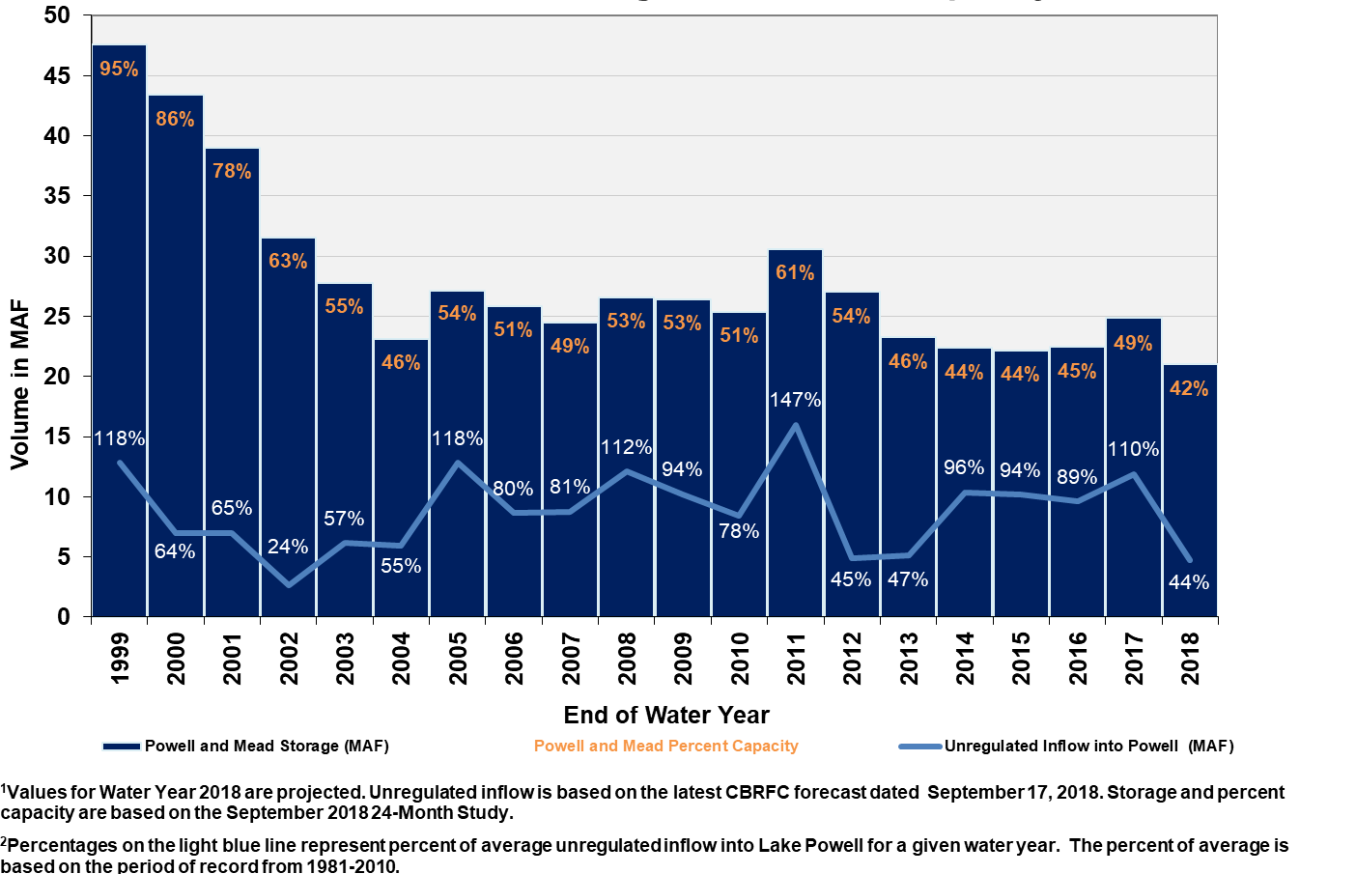
Lake Powell & Mead Storage and Percent Capacity & Unregulated Inflow into Lake Powell
This period contains the 2nd, 3rd, 4th, and 5th lowest years on record; with only 5 years above average!

Slide 6
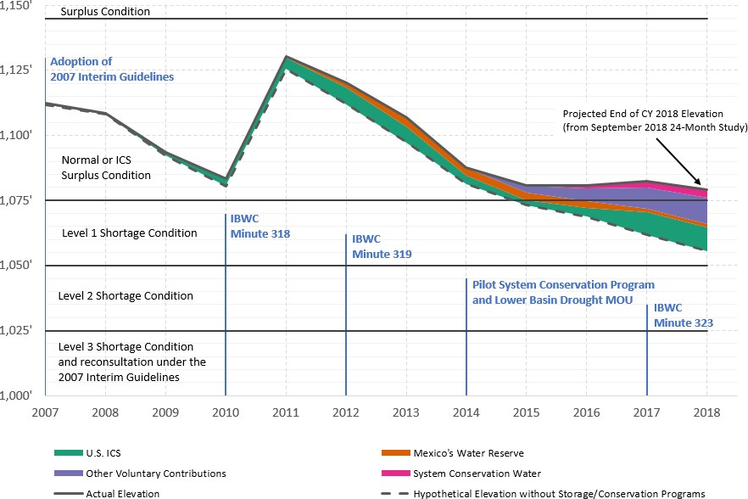
Lake Mead End-of-Calendar Year Elevation
Powell WY Release (maf)
8.23 8.98 8.24
8.24
12.52
9.47
8.23
7.48
9.0
9.0
9.0
9.0
End of calendar year 2018 balances of U.S. ICS and Mexico’s Water Reserve, system conservation water, and other voluntary contributions to Lake Mead are provisional and subject to change.

Slide 9
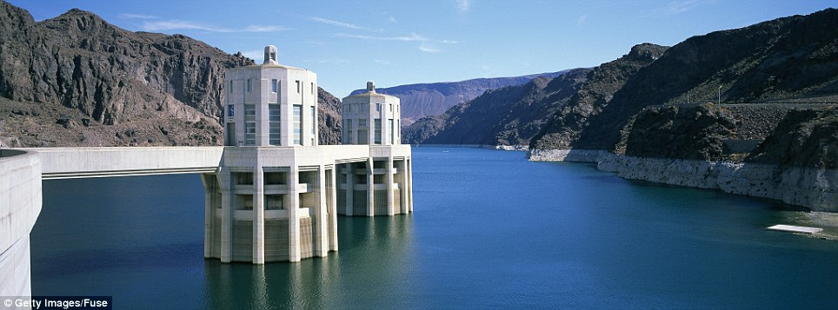
LB DCP Elements
Parties include DOI, AZ, CA and NV and Boulder Canyon Project Act Section 5 contractors;
The term is through the remaining period of the 2007 Interim Guidelines and concludes on December 31, 2025;
DCP contributions are required based upon specified Lake Mead elevations;
DOI to create 100 KAF “System Water” annually;
Establishes a process for making DCP contributions and ICS capacity-sharing among LB states;
Establishes conditions for the delivery, borrowing and repayment of DCP ICS; and
Increases cumulative ICS storage limits for each state by 200 KAF, and extends interstate banking provisions from Mead elevation 1,075’ down to elevation 1,045’.

Slide 10
Benefits of the LB DCP
Reduces the risk of Mead falling below 1,020’ to 6-7%, or about the same risk as when the ‘07 Guidelines were adopted;
Provide increased flexibility for the storage and recovery of ICS supplies;
Provides additional certainty for Mead operations during interim period;
Provides consultative process among the states and DOI associated with basinwide operations; and
Provides for activation of Section IV of Minute No. 323—Binational Water Scarcity Contingency Plan

Slide 11
Total Contemplated Lower Basin Volumes (in KAF) 2007 Interim Guidelines, Minute 323, Lower Basin Drought Contingency Plan & Binational Water Scarcity Contingency Plan
Lake Mead Elevation (ft msl) | 2007 Interim Guidelines Shortages |  | Minute 323 Delivery Reductions | Total Combined Reductions | DCP Contributions |  |  | Binational Water Scarcity Contingency Plan Savings | Combined Volumes by Country US: (2007 Interim Guidelines Shortages + DCP Contributions) Mexico: (Minute 323 Delivery Reductions + Binational Water Scarcity Contingency Plan Savings) |  |  |  |  | Total Combined Volumes
 | AZ | NV | Mexico | Lower Basin States + Mexico | AZ | NV | CA | Mexico | AZ Total | NV Total | CA Total | Lower Basin States Total | Mexico Total | Lower Basin States + Mexico
1,090 - >1,075 | 0 | 0 | 0 | 0 | 192 | 8 | 0 | 41 | 192 | 8 | 0 | 200 | 41 | 241
1,075 - >1050 | 320 | 13 | 50 | 383 | 192 | 8 | 0 | 30 | 512 | 21 | 0 | 533 | 80 | 613
1,050 - >1,045 | 400 | 17 | 70 | 487 | 192 | 8 | 0 | 34 | 592 | 25 | 0 | 617 | 104 | 721
1,045 - >1,040 | 400 | 17 | 70 | 487 | 240 | 10 | 200 | 76 | 640 | 27 | 200 | 867 | 146 | 1,013
1,040 - >1,035 | 400 | 17 | 70 | 487 | 240 | 10 | 250 | 84 | 640 | 27 | 250 | 917 | 154 | 1,071
1,035 - >1,030 | 400 | 17 | 70 | 487 | 240 | 10 | 300 | 92 | 640 | 27 | 300 | 967 | 162 | 1,129
1,030 – 1,025 | 400 | 17 | 70 | 487 | 240 | 10 | 350 | 101 | 640 | 27 | 350 | 1,017 | 171 | 1,188
<1,025 | 480 | 20 | 125 | 625 | 240 | 10 | 350 | 150 | 720 | 30 | 350 | 1,100 | 275 | 1,375
The US will work to create or conserve 100,000 af or more of Colorado River system water on an annual basis to contribute to conservation of water supplies in Lake Mead and other Colorado River reservoirs. All actions taken by the United States shall be subject to applicable federal law, including availability of appropriations.

Slide 12
DCP Implementation Schedule
Schedule—
  Conclude major negotiations/agreements by early-March;
  Submit seven states letter with proposed federal legislation and interstate DCP package to Congress ASAP;
  If DCP not completed by March 19th, Interior has requested “specific recommendations” from the seven states regarding actions to be taken to “reduce the risks the Colorado River Basin is facing…”;
  Notification provided to Mexico of completion of LB DCP to activate Section IV of Minute No. 323; and
  LB DCP becomes fully effective on January 1, 2020.

Slide 14


