Slide 1
South County Ag Program
A Model Multi-Benefit
Recycled Water, Groundwater Storage, and Conjunctive Use Project

Slide 2
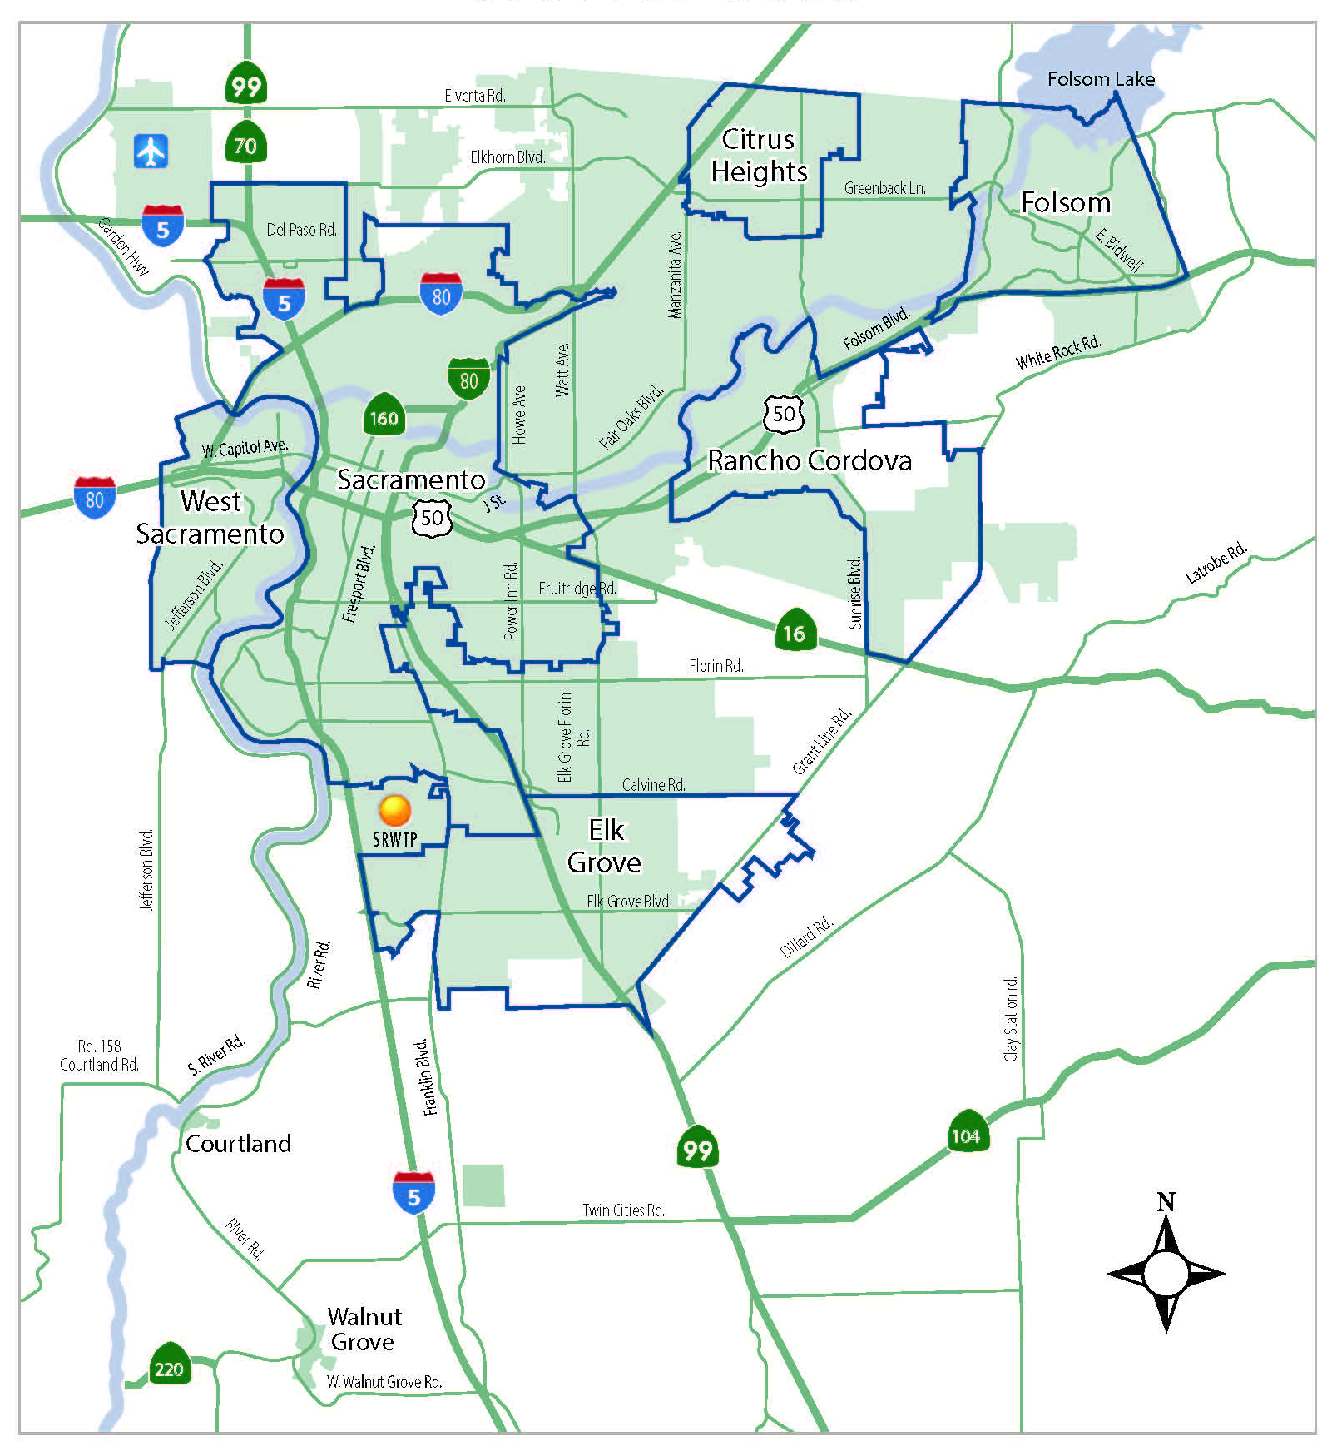
Service Area
Unincorporated Sacramento County
Cities of Citrus Heights, Elk Grove, Folsom, Rancho Cordova, Sacramento, and West Sacramento
Communities of Courtland and Walnut Grove
Approximately 400 square miles
1.4 million people

Slide 3
Water Storage Investment Program Overview
2014 Water Bond – Prop. 1 provided $2.7 billion for ground and surface water storage projects
WSIP can fund only the Public Benefits of a water storage project (ecosystem, water quality, recreation, flood control, and emergency response)
Projects must also benefit Delta ecosystem or its tributaries
Funding available - Up to 50% of the public benefits (however, ecosystem benefits must be 50% public benefits)
Conjunctive use projects can receive up to 100% of the Public benefits
Notes:
Requires contracts with DFW, SWRCB and DWR regarding public benefits
Requires all draft supplemental environmental documents complete by Jan 1, 2022
Requires major environmental permits to be secured
CEQA review needed to support environmental permits
CWC funding agreement cannot go forward until these steps are complete

Slide 4
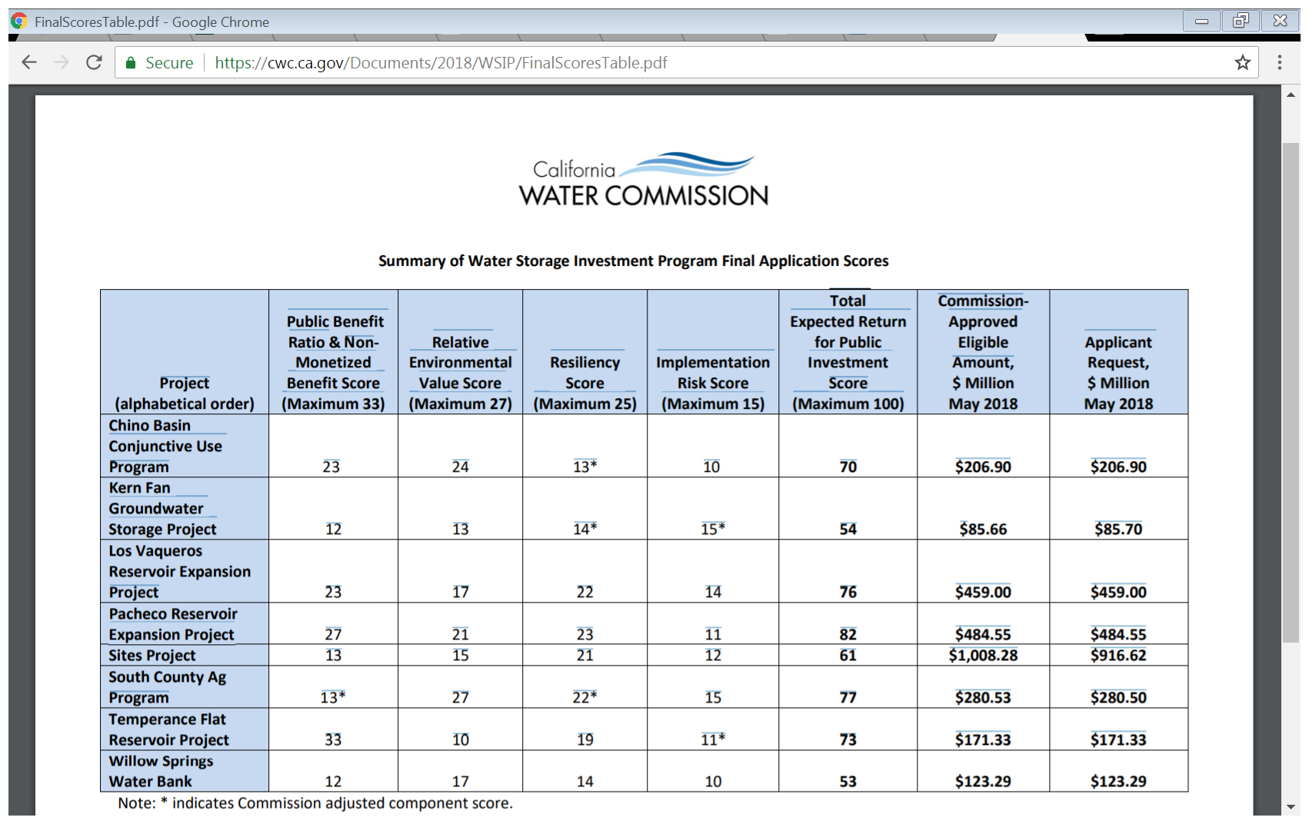
Summary of WSIP Applicant Scores and Eligible Funding

Slide 5
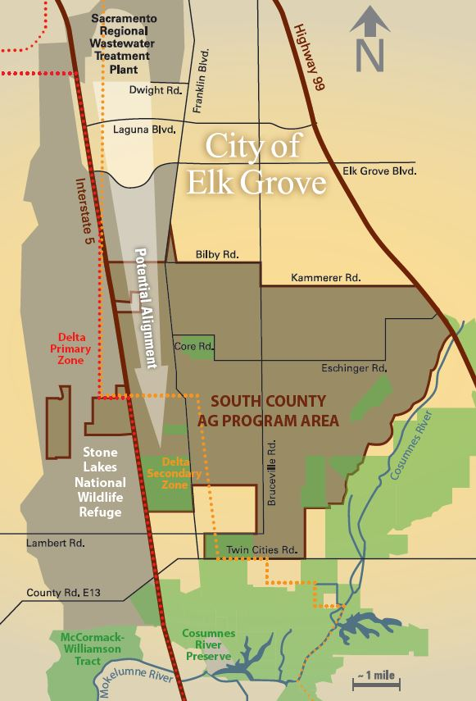
Developing An Opportunity –
South County Ag Program
Project Overview
Deliver up to 50,000 AFY of recycled water (includes in-lieu recharge and wintertime irrigation)
Irrigate up to 16,000 acres of ag and habitat lands
Produce Public Benefits
Groundwater Restoration
  Ecosystem
  Water Quality
  Potential recreation and fire response benefits
Notes:
Exciting opportunity.
Background on Regional San – and EchoWater
Once completed, EchoWater – Will produce Title 22 tertiary treated recycled water that can be used for other beneficial uses, such as providing recycled water for unrestricted use for irrigation.
Which leads me to the focus of our presentation today on the South County Ag Program.
We believe that his project exemplifies the concept of 1 Water and Utility of the Future Principles by:
embracing innovative approaches focusing on water reuse,
establishing non-traditional partnerships,
fostering environmental stewardship and
promoting regional sustainability.
One of largest WR projects in the state. – 160,000 AFY and cost-effective
Costs: $140 - $250 million – Avg of $250 AF

Slide 6
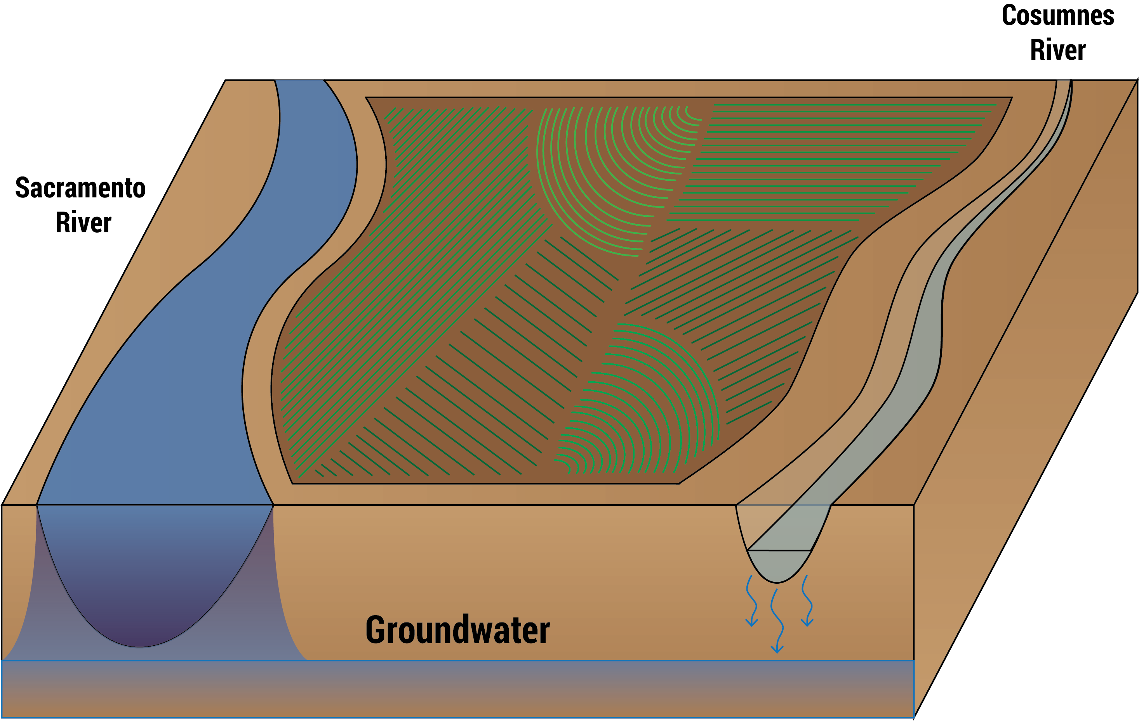
Summary of South County Ag Program’s
Multiple Benefits
Before
Notes:
Long-term pumping of groundwater has resulted in groundwater levels dropping as much as 60 feet or more
Riparian habitats, those on the floodplains of our rivers and streams, are some of the most diverse habitats in California. However, they are also some of the most threatened.

Slide 7
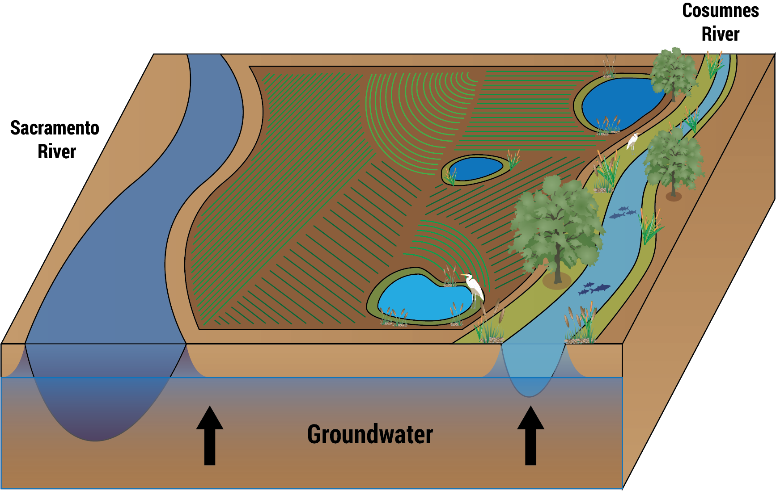
Summary of South County Ag Program’s
Multiple Benefits
After
Notes:
We believe the South County Ag Program is one of the most cost-effective and important ecological sustainability projects in the State.
As we have demonstrated today – With a $300 million dollar public investment we have generated over $1 billion in benefits.
Integrated conjunctive use water storage project
Provides agricultural, environmental and urban benefits
Efficient investment of public dollars
Increases flows in the Cosumnes River, which in turn flows to the Delta
Restores depleted groundwater and enhances groundwater & surface water connectivity
Enhances smart irrigation practices through the use of recycled water
There are significant investment in conservation enhancements that could be lost with out this program.
Project demonstrates how new groundwater approaches can help to protect groundwater dependent ecosystems.

Slide 8

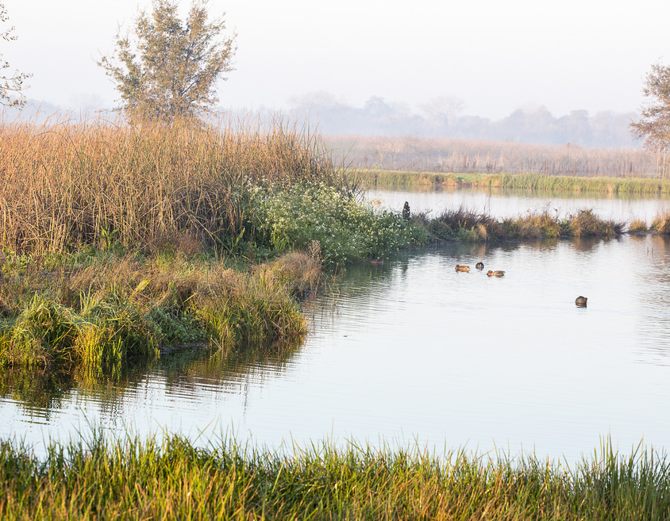
Groundwater Restoration Benefits
Restores groundwater levels up to 35 feet within 15 years
Improves stream flows in the Cosumnes River
Increases groundwater storage by ~ 245,000 AF in 10 years
Provides ~30,000 AFY for conjunctive use during droughts
          Provides Multiple Public Benefits through Conjunctive Use
Notes:
One of the amazing benefits of the South County Ag Program is the increases it provides to groundwater elevations in the area.
Groundwater Storage & Conjunctive use
Impressive Results
Regional and Statewide sustainability’

Slide 9
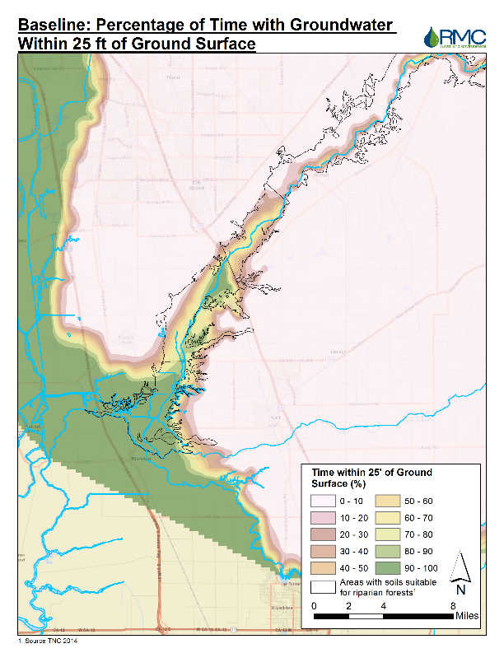
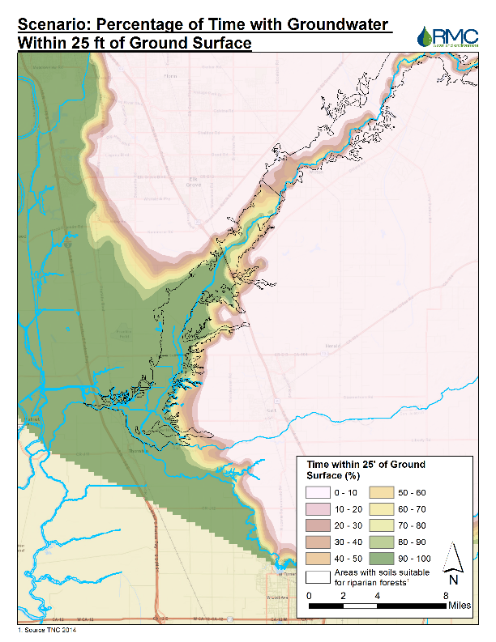
Percentage of Time with Groundwater
Elevations within 25' of the Surface
Baseline
Project
Notes:
The Green area represents where GW elevations are within 25 feet of the surface 90%-100% of the time.
These graphics illustrate that the Project can increase GW levels and provide significant benefit to riparian habitats and in-stream flows along the Cosumnes river corridor, especially below Highway 99
Increases in-stream flows on Cosumnes River and improves fall run chinook passage – increases the number of days that support fall-run chinook salmon by 34%.
Significant localized benefits in the Cosumnes Basin where it matters – for salmon and riparian habitat – as demonstrated by the stakeholder support.

Slide 10
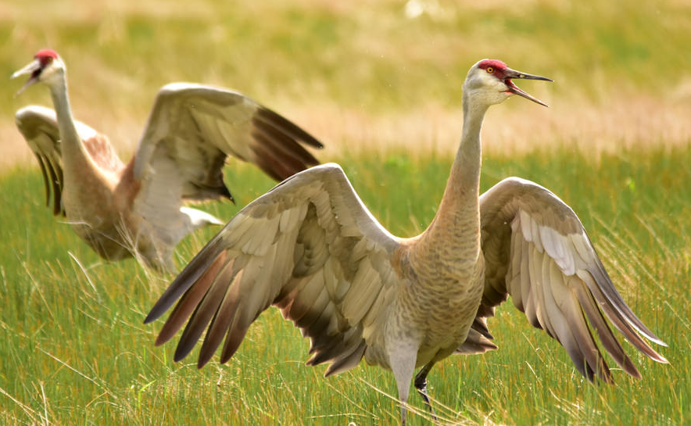
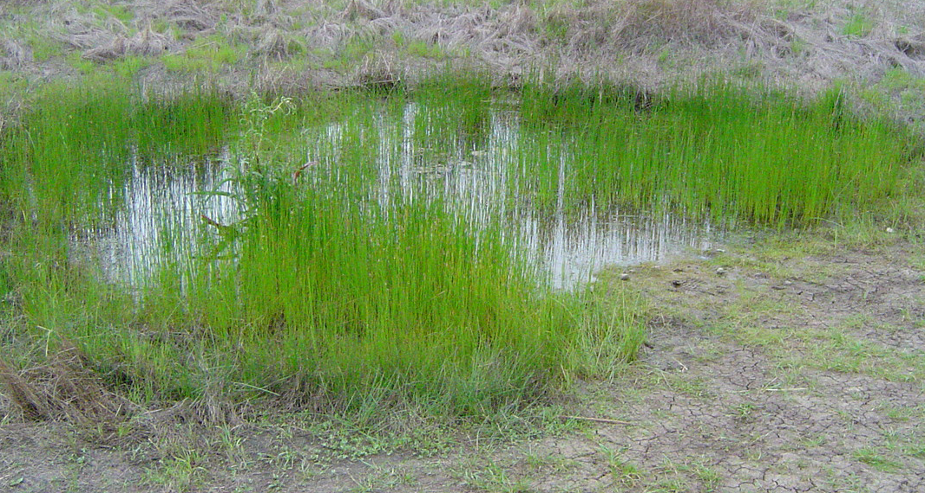
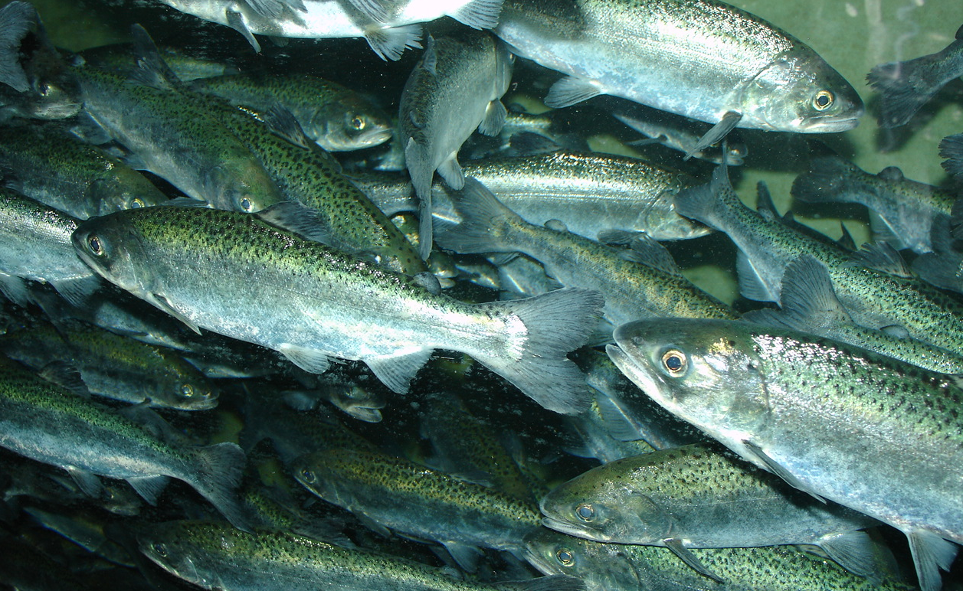
Ecosystem Benefits – In the Delta!
$246.30 Million
Additional 3,500 acres of sandhill crane habitat, which could support up to 700 additional individuals
Additional 500 acres of vernal pool habitat, which supports many listed species
Longer migration window for fall-run Chinook salmon as a result of increased flow volume in the Cosumnes River
Improved groundwater conditions and strategic water delivery can improve up to approximately 5,000 acres of wetlands and riparian forests by 2030

Slide 11
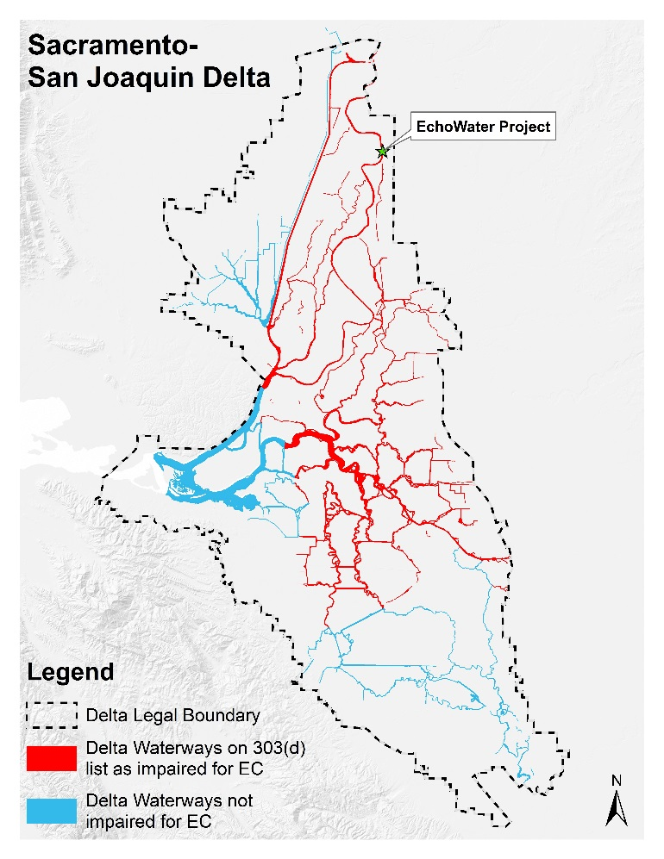
Water Quality Benefits
$47.7 Million
Reduce salt loading to Sacramento River by 95 tons per day
Four of eight Delta Waterways are included on State’s 303(d) list for electrical conductivity
Equivalent benefit would require costly reverse osmosis treatment for salt removal
Notes:
Briefly describe water quality benefits:
Reduce salt loads by 95 tons per day on average
Four of eight Delta Waterways (red waterbodies on figure) are impaired for electrical conductivity (blue waterbodies not impaired for EC); a measure of salinity
Equivalent benefit to project would be RO at very high costs
How address question of the transfer of these salts to ag lands …are there crop impacts or GW impacts from the salts in RW? – NO, Salts are not a GW concern in this basin. Some salts are beneficially used in the plants (e.g., nitrates).
The Delta is impaired for salt and the GW basin is not.
The GW basin has more assimilative capacity. RW is applied at agronomic rates and it is spread over a larger ground surface area that is then filtered through the soils. There would only be a small incremental change in the salt concentration I the GW.
Salt and Nutrient management plans would be developed. There are no anticipated impacts to crops, as this was a key issue we addressed working with our ag stakeholders.
The Delta is at 700EC, here as the GW basin is at 300EC, it is being spread out over a larger ground surface area.

Slide 12
Other Non-Monetized Public Benefits
Improves Climate Change Resiliency
Improves Habitat Connectivity –
Preserves Working Farmlands
Improves Groundwater Dependent Ecosystem Science
Aids in Emergency Fire Response
Increases Recreation
Helps accomplish objectives of Prop. 1 and SGMA

Slide 13
Projected Design & Capital and O&M Costs
(in 2015 dollars)
Total Planning and Design Costs - $75,306,630
Ecological Planning - $29,045,000
Facilities & GW Banking - $46,261,630
Total Construction Costs - $207,886,000
Facilities Cost - $173,500,000
GW Monitoring Wells - $150,000
Ecological Program - $34,236,000
Total Design & Capital Costs - $283,192,630
Total WSIP Funding - $280,500,000

Slide 14
How Will Public Benefits Be Achieved?
Design & Construct Conveyance and Distribution Facilities
  Including on-site facilities for end users
Develop & Implement Ecosystem Improvements
Develop & Implement Conjunctive Use Program
Develop & Implement Groundwater Accounting Program & Integrate with SGMA
  70% to GW recharge & 30% for extraction during critically dry years
Establish Monitoring & Reporting Program and Manage Adaptively
Notes:
How will Benefits be Achieved
Groundwater basin recovers over time and provides ecosystem benefits (riparian and in-stream flows)
Benefits enhanced by ecological restoration and land use management changes
Conjunctive Use and Groundwater Banking
70% of groundwater recharge will be left for ecosystem benefits and overall basin sustainability.
Remaining 30% available for extraction during drought conditions through water banking operations.
Another way of thinking about the overall project is the 70% of recharge goes to growing a “savings account”, while the 30% goes to a “checking account” that fluctuates up and down with payments and deposits (extraction and recharge)

Slide 15
WSIP Application Process
Aggressive timeline and rigorous process to prepare application (6 months)
Required public benefits to be quantified and monetized
Had to “re-do” groundwater & surface water modeling to incorporate 2030 and 2070 climate change and operational scenarios
Relationships….Relationships!!!
  Numerous agency meetings (CWC, DFW, SWRCB, DWR)
  Numerous meetings to gain & maintain stakeholder support and advocacy throughout process

Slide 16
Key Next Steps
On-going stakeholder collaboration
Secure Petition for Change
Develop Agreements/Contracts with CWC, DWR, SWRCB & DFW
Finalize Ecological Plan (identify high “eco-value” areas)
Develop & Secure Agreements with landowners/farmers/water suppliers
Establish Pricing of Recycled Water
Design & Construction (conveyance and distribution, including farmers and urban water suppliers)
Supplemental CEQA Documents

Slide 17


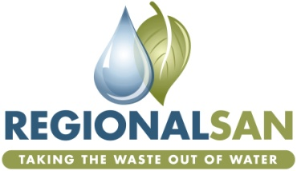



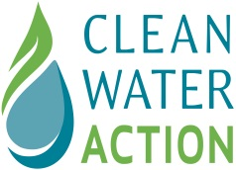






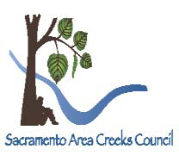


Facilitating Collaboration &
Building Partnerships
Notes:
The South County Ag Program has broad stakeholder support. I would like to spend a few minutes expanding on just who those stakeholders are and the process we went through to gain their support.
Regional San takes its mission very seriously to protect the environment to work responsibly with our community. With that in mind, we started early in the process (back in 2009 – Coalition, Charter, Mission, Principles)) working with a variety of stakeholders with the goal of facilitating collaboration and building partnerships. Their input was and continues to be critical in shaping the Program to achieve both the GW storage and Ecosystem benefits.
As the slide depicts, we worked with…Ag, NGOs, EJ, SCGA, Water Supply
The end result, -- we have support from this diverse stakeholder base, as evidenced in the letters of support provided with our Application. Our efforts working with the various stakeholders will continue, as their input is critical to shape the Program

Slide 18
Contact:
Terrie Mitchell – mitchellt@sacsewer.com
Website: http://www.regionalsan.com/south-county-ag-program
Questions?
Notes:
I would like to state at the outset, as with any project there is a team of individuals that bring their expertise to the project.
A diverse group engineers, scientists, communications, environmental professionals and legal counsel.
We have some of those people here today in the audience, so if cannot answer your questions, some of them may be able to.

Slide 19
BACK-UP SLIDES

Slide 20
WSIP Timeline & Process
To Receive Funding
Requires contracts with DFW, SWRCB and DWR regarding public benefits
Requires all draft supplemental environmental documents complete by Jan 1, 2022
Requires major environmental permits to be secured
  CEQA review needed to support environmental permits
CWC funding agreement cannot go forward until these steps are complete

Slide 21
Projected Annual O&M Costs and
Total Program Costs
In 2015 dollars
Total Annual O&M Cost (over 100 years) - $4,273,000
Pipeline & Pump Station - $2,600,000
Ecological Monitoring - $1,473,000
GW Banking - $200,000
GW Monitoring - $74,000
Total Replacement Costs for 100 years - $20,000,000
TOTAL CAPITAL AND O&M PROGRAM COSTS - $730,492,630

